Slide 1
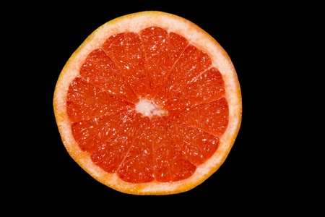
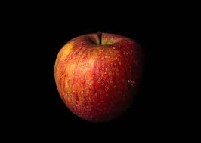
“Resistance is fruitile”
By MDJH students Alpita Patro and Adhira Ganesh
HR: 7-4 HR: 8-3

Slide 2
Introduction
Have you ever went shopping and bought a bag of fruit, but within a few days, you see that most of the fruit had rotted? This real-life scenario inspired us to test a theory by finding both the mass and electric resistance of fruits to determine the lifespan of them.
In this project, we used four apples and four grapefruits to test this idea. Scientists have used plasma shockwaves to check the ripeness of fruit, but we wanted to find a new and more efficient way of doing this.

Slide 3
Introduction (continued)
Resistance is the opposition to electricity flow. So, if an object has high conductivity, the resistance would be low. This project is based on the fact that fruits contain a large amount of pure water. Since pure water has low conductivity, the resistance is believed to be excessive. Throughout the experiment, we will be testing if the fruit's resistance can tell what stage of ripening the fruit is attending.

Slide 4
Purpose:
To determine the shelf-life of fruits based on it’s resistance and mass.

Slide 5
Question:
Is there a way to determine what stage of ripening the fruit is at by finding the resistance and mass?

Slide 6
Hypothesis:
The resistance and mass of the fruit will decrease in time.
Fruits have a certain resistance before it ripens. When fruits lose water during the ripening process, the resistance will decrease. The mass will reduce because water will evaporate due to the heat in the area. An amount of water content diminishes, which is why we see the fruit shrivel.
Support

Slide 7
Independent Variable: The time span
Dependant Variable: The resistance and mass of the fruits
Controlled Variables: the temperature, measurement tool, location, type of storage bag, same surface
Variables

Slide 8
The Experiment

Slide 9
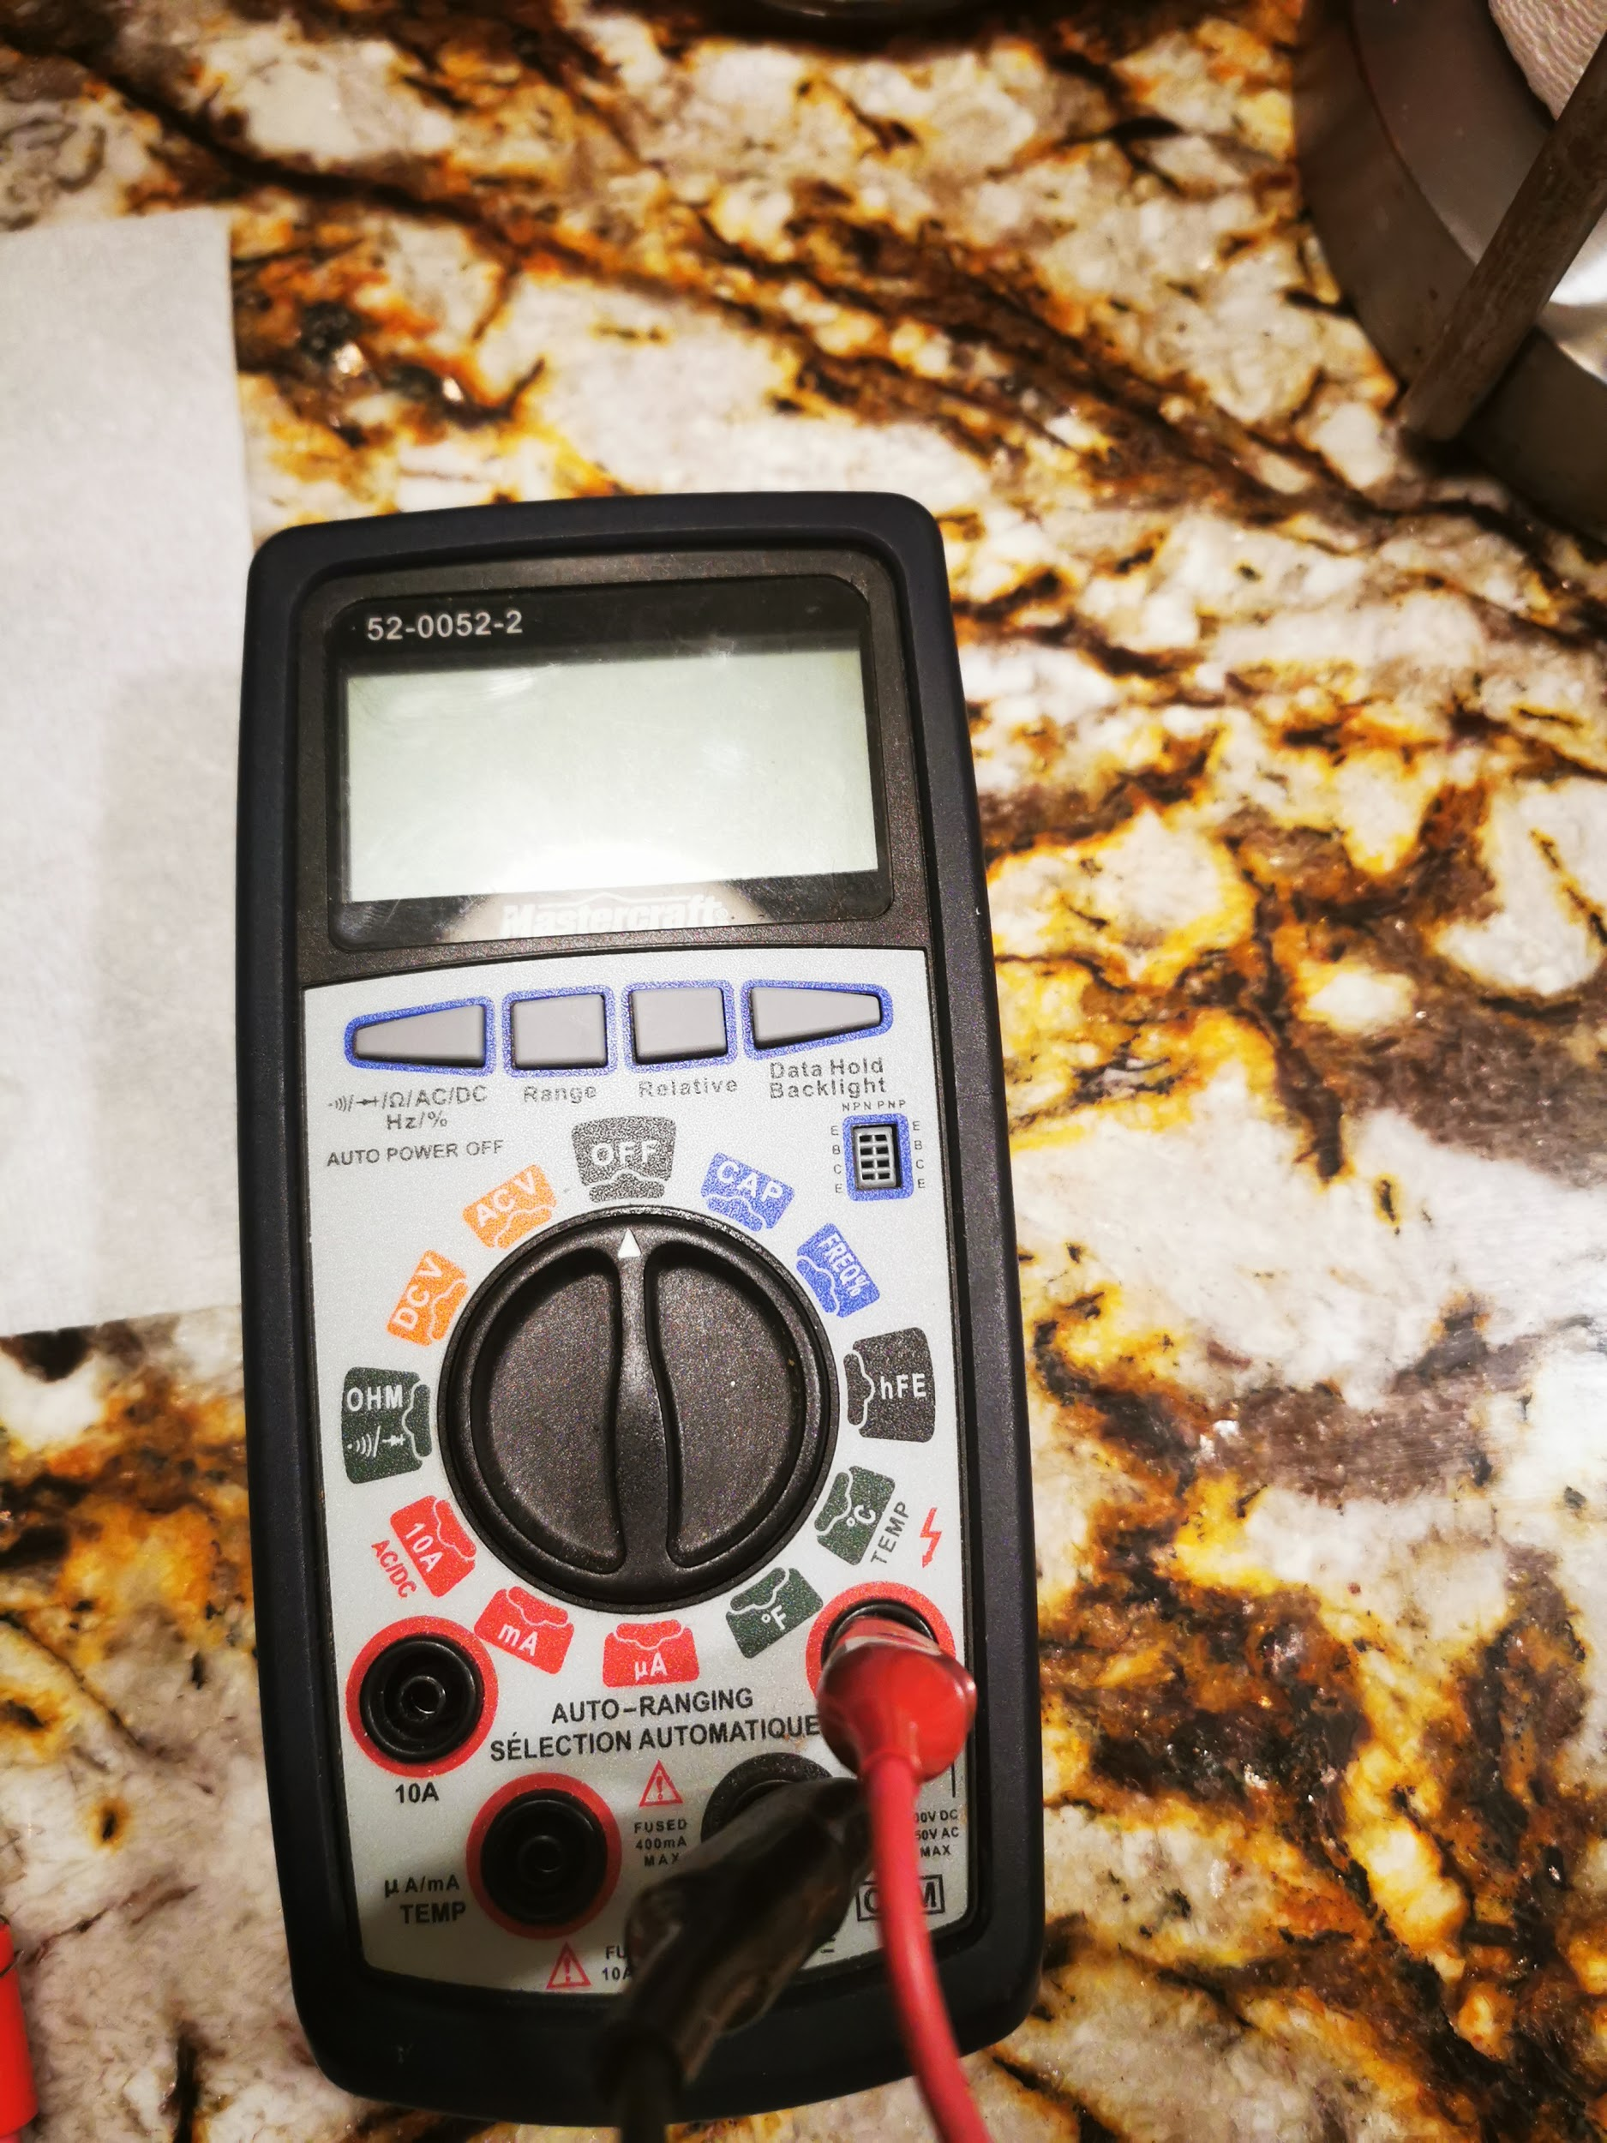
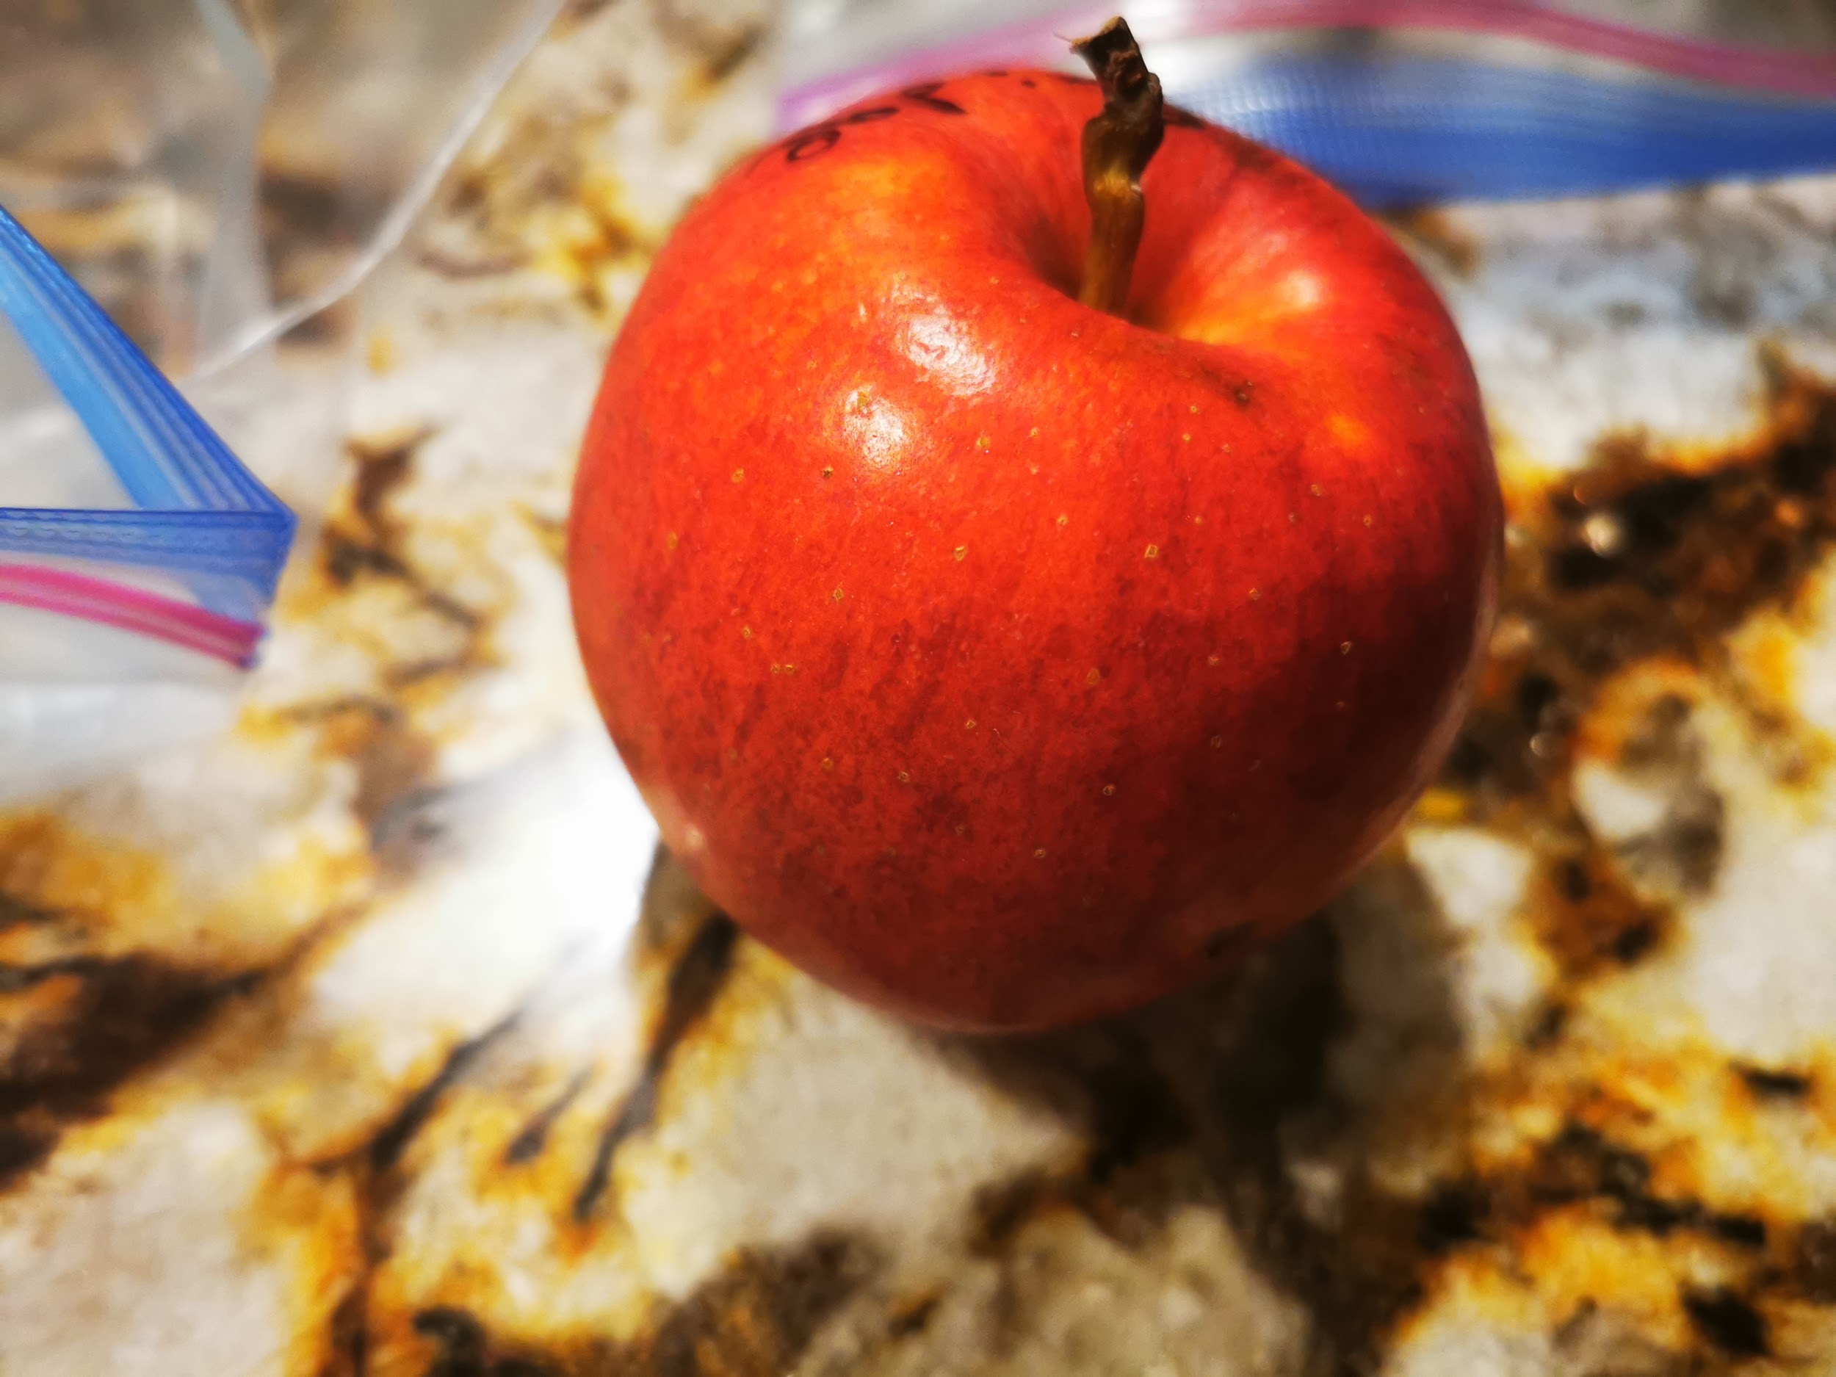
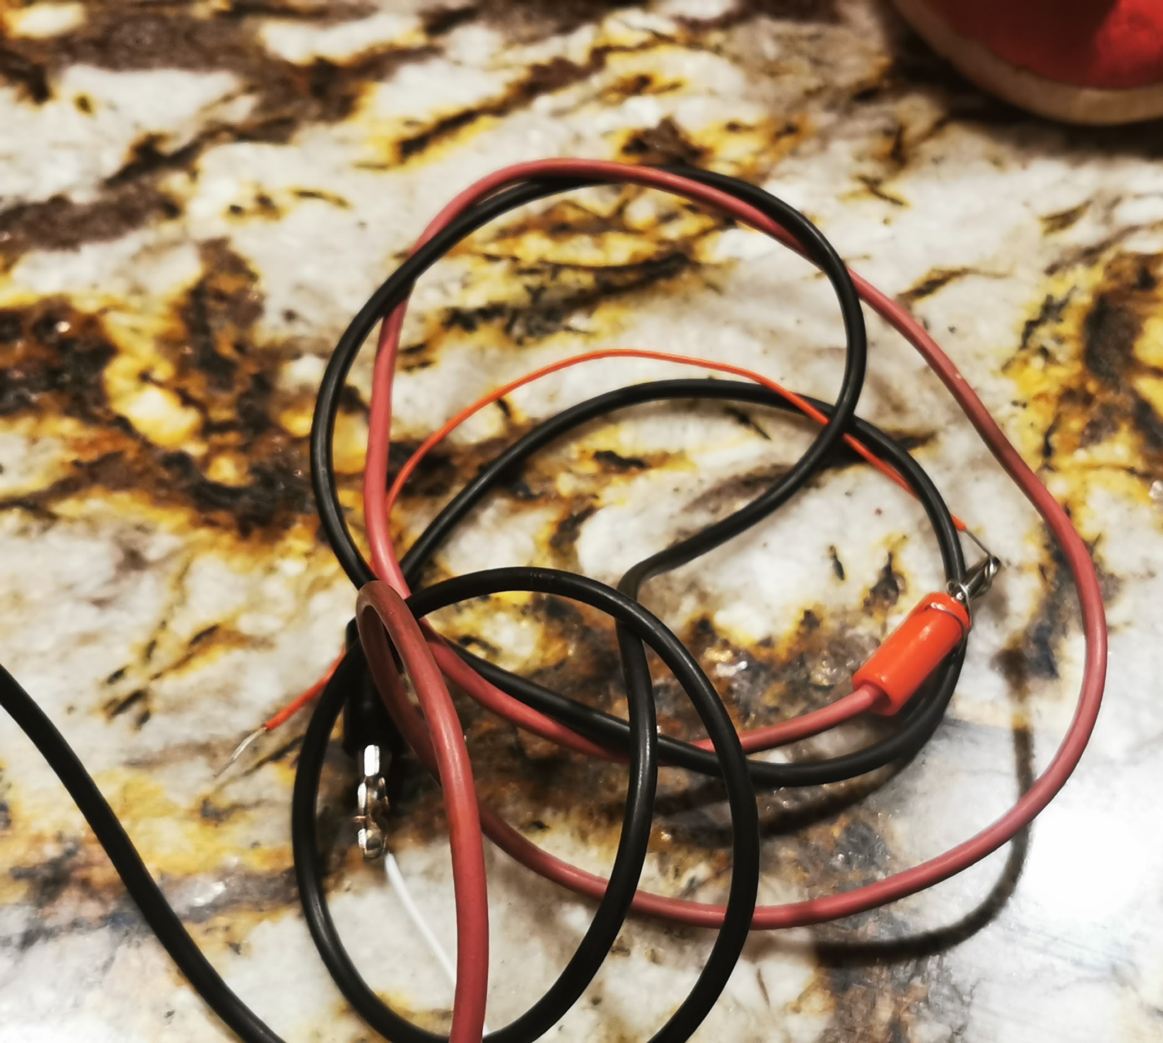
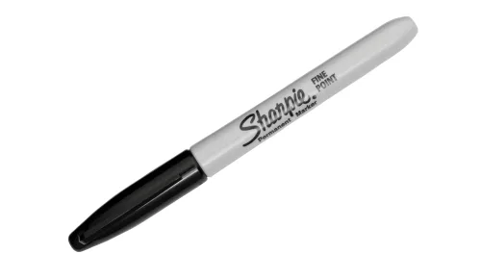
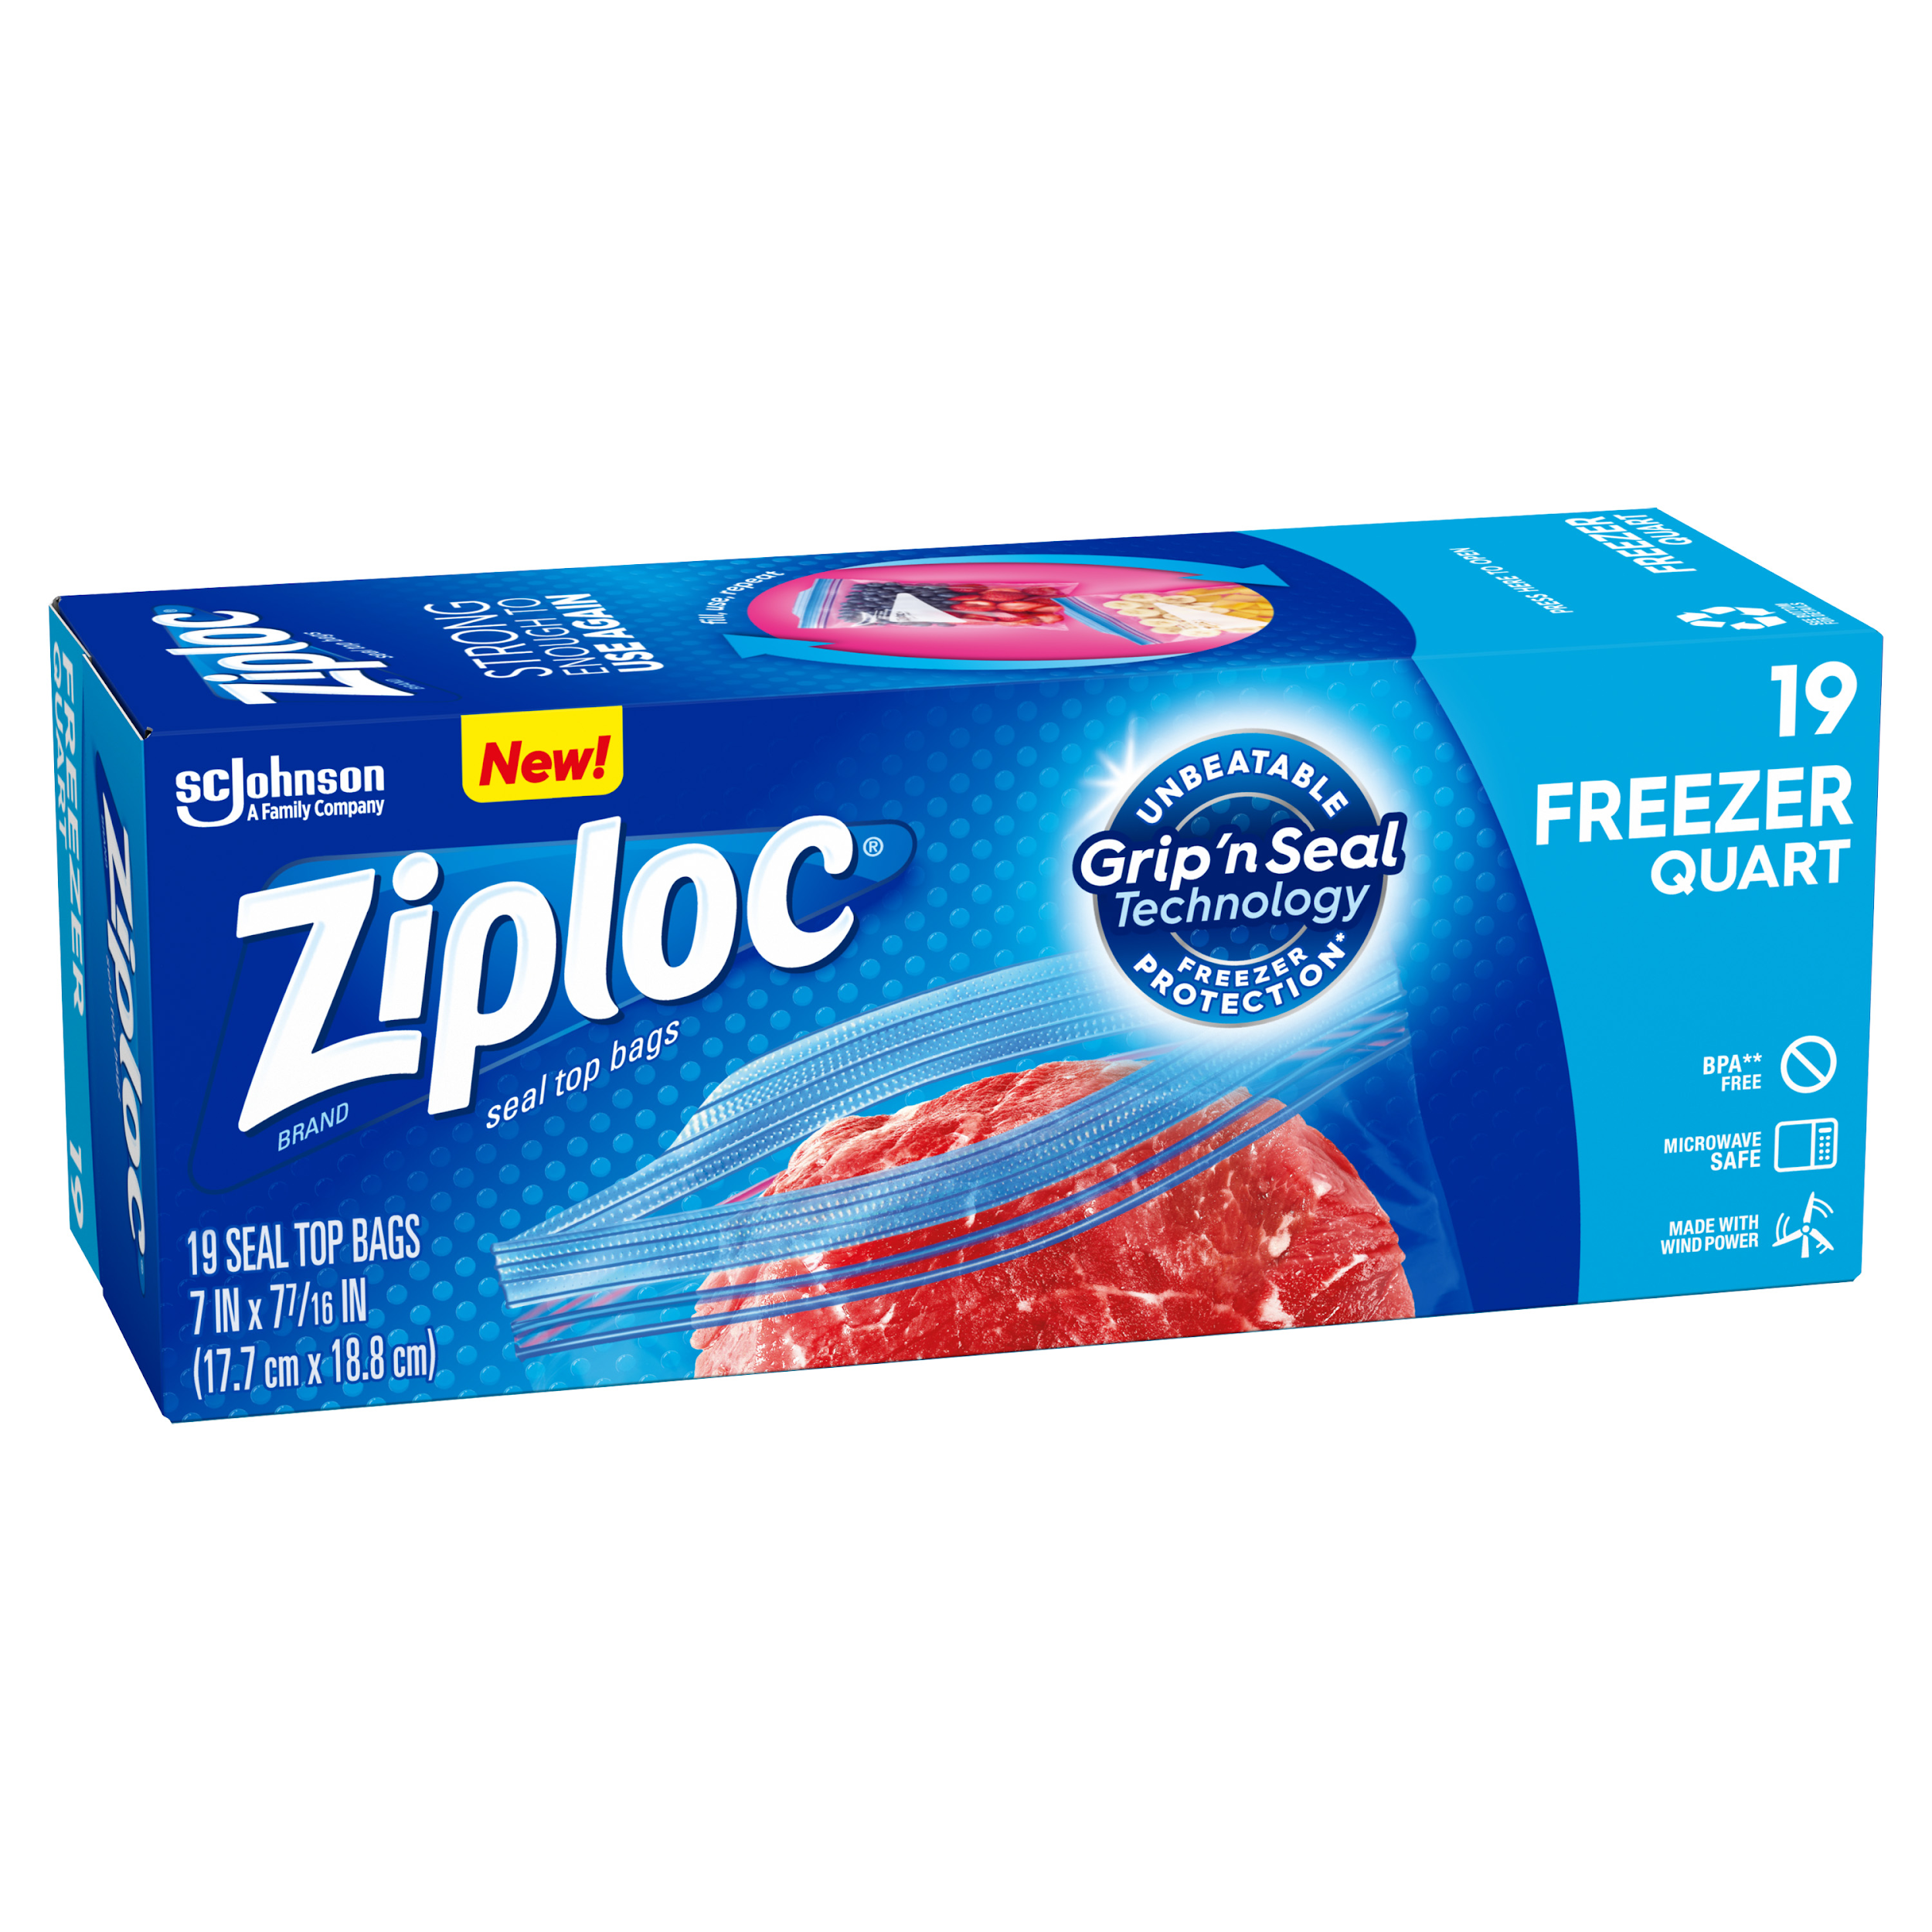
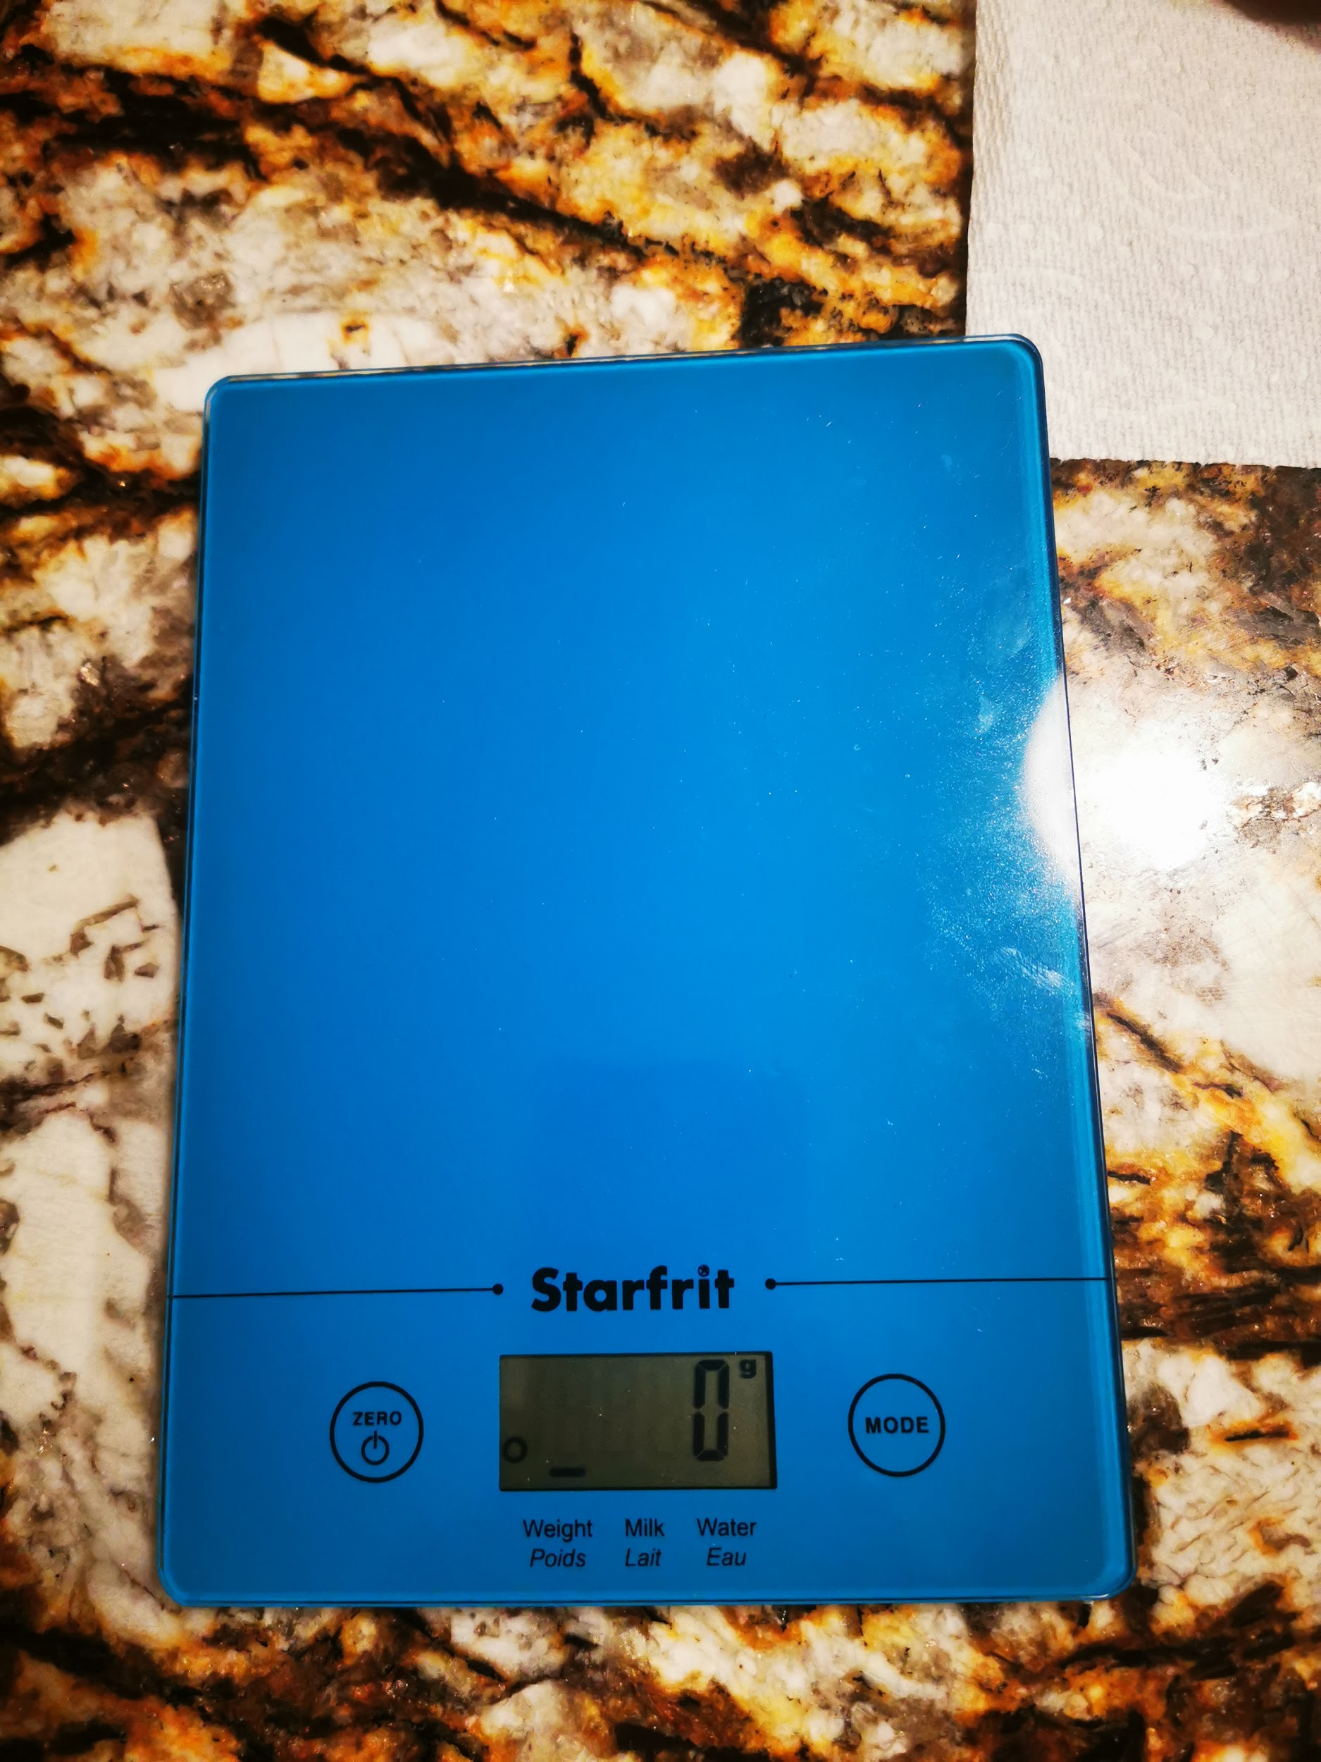
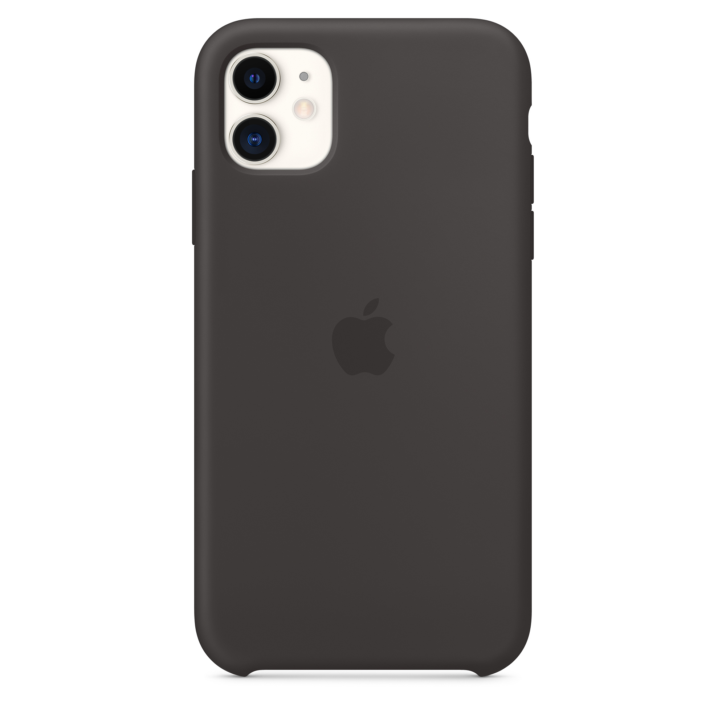
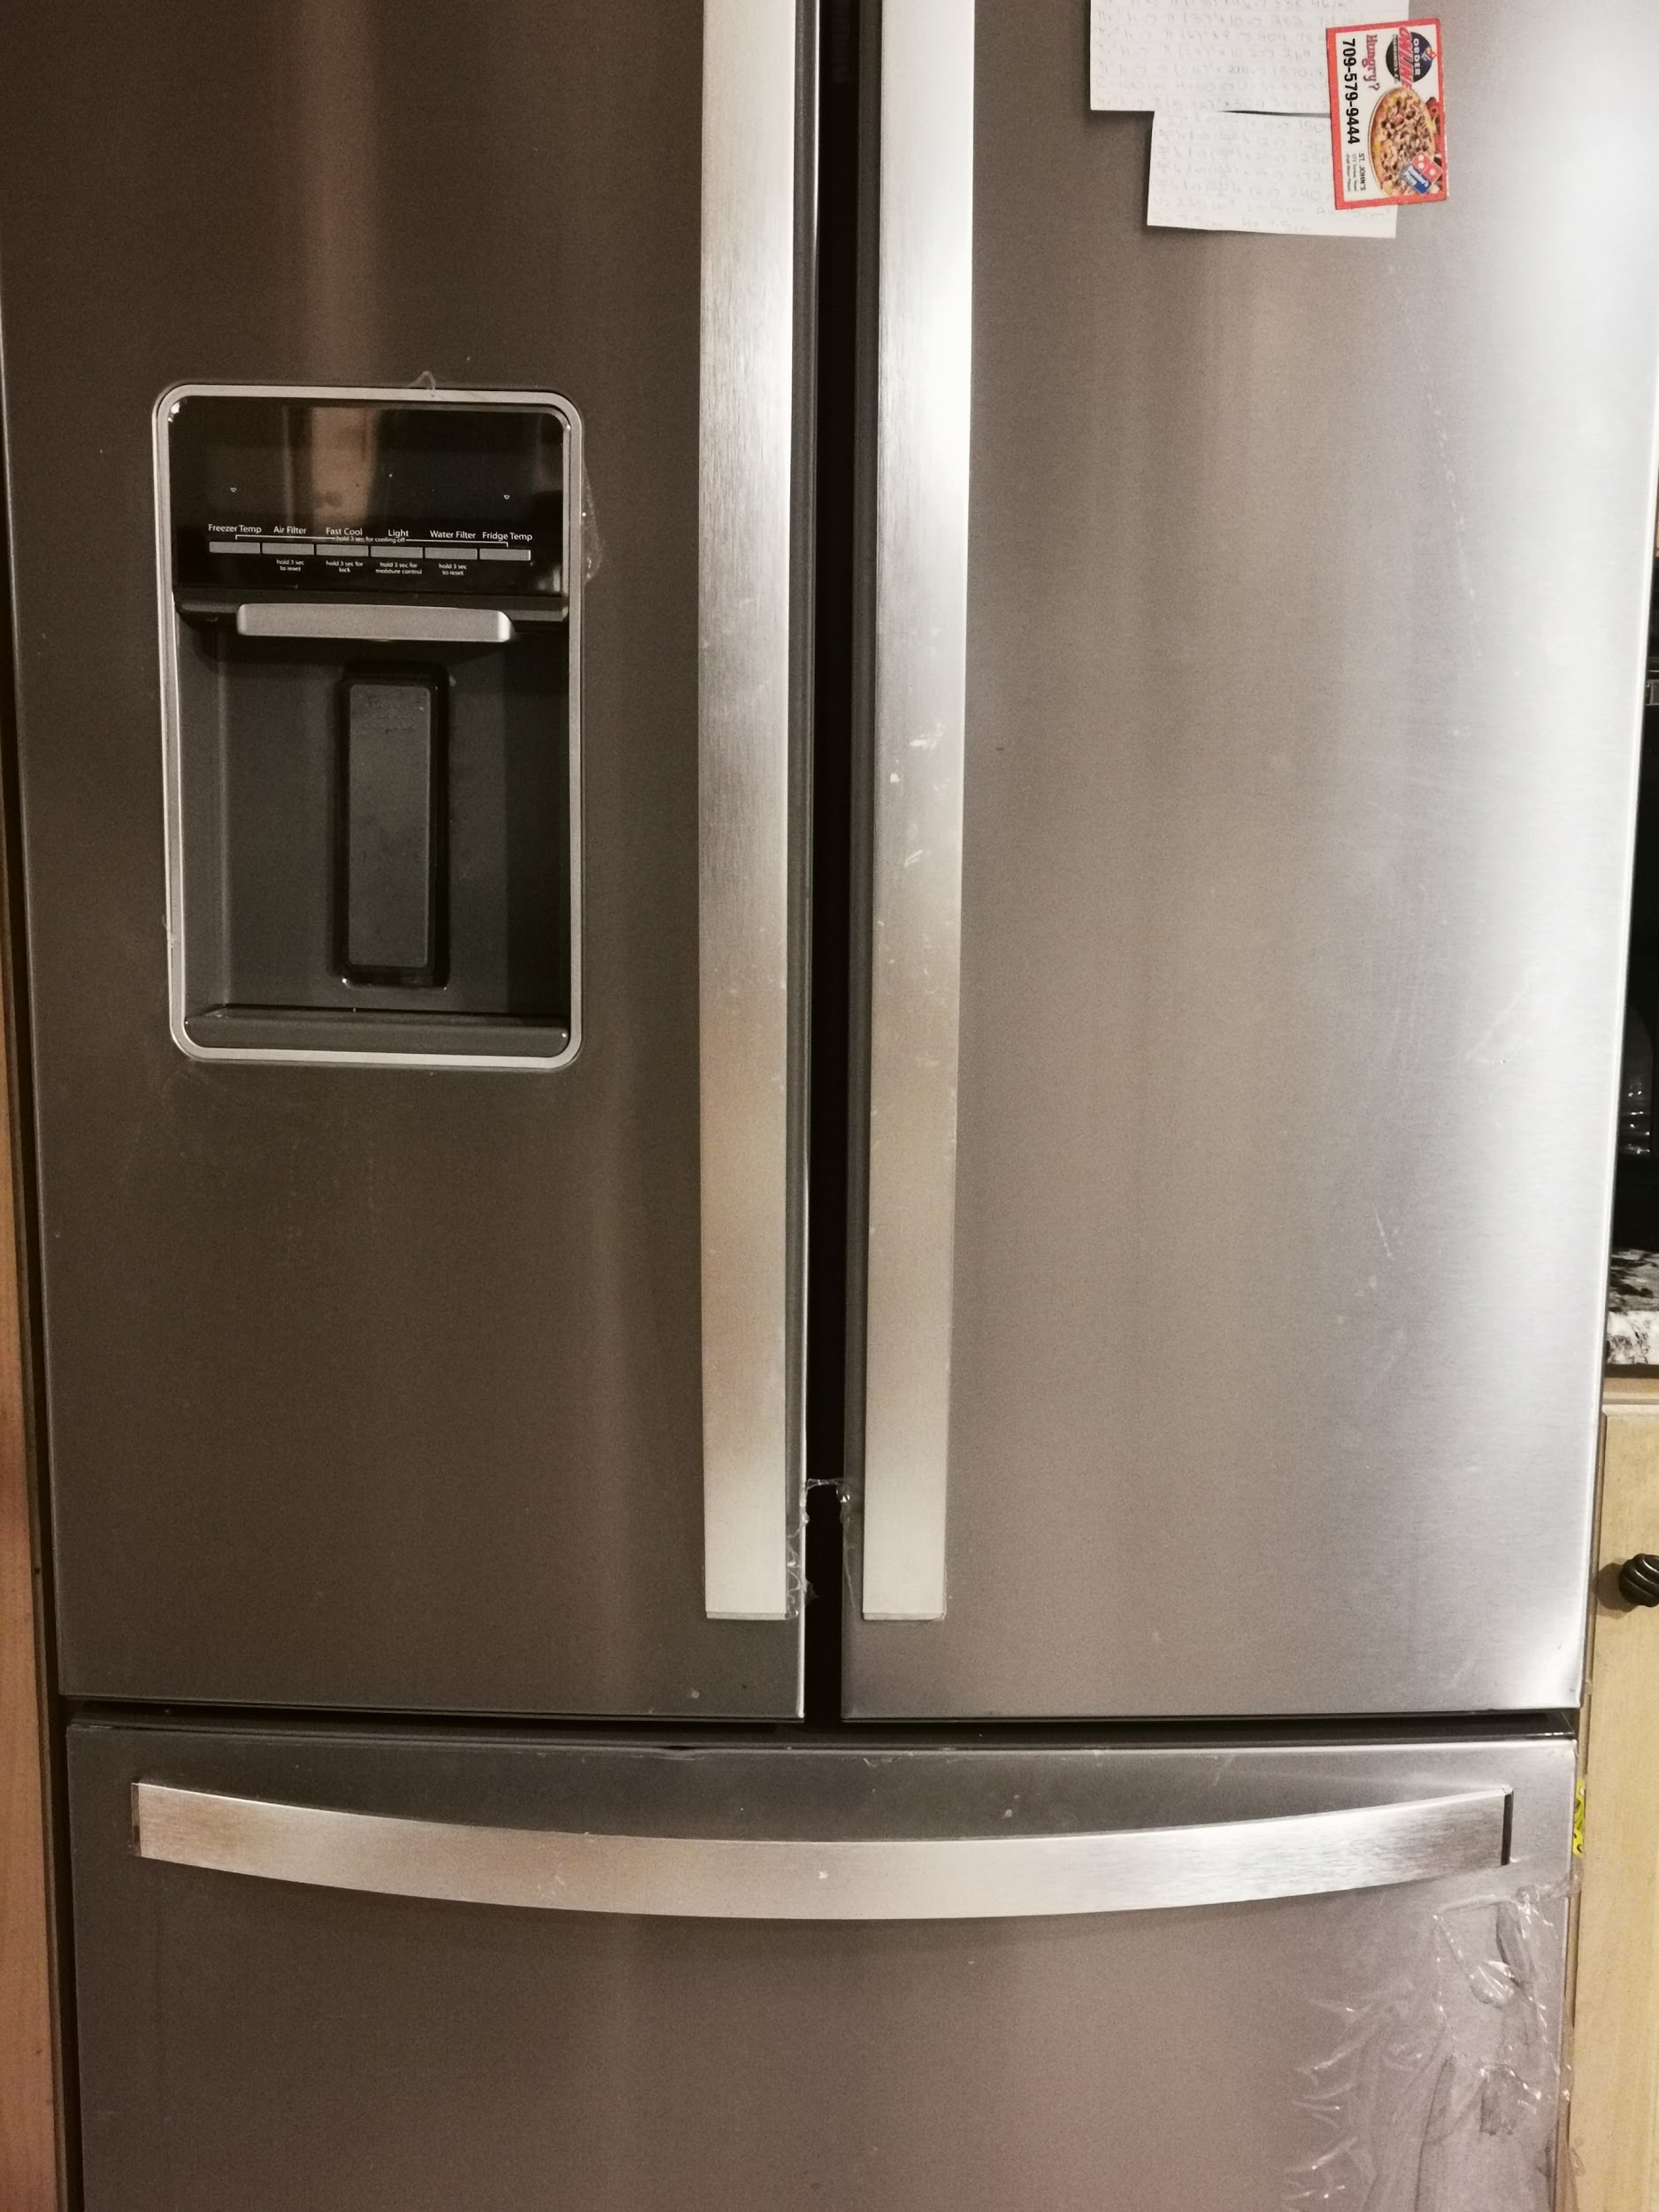
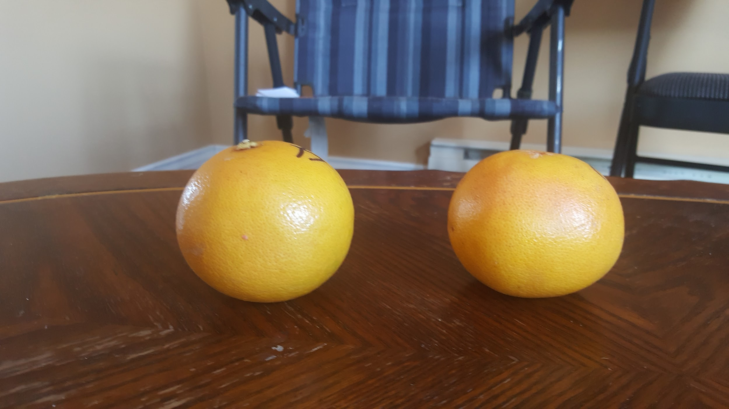
Materials
Multimeter and probes
Fruits: 4 Apples and 4 grapefruits
A Black Marker
Ziploc bags (for storage)
A refrigerator
Digital kitchen scale
A phone (for taking pictures)

Slide 10
Take two fruits that are the same kind(2 apples, 2 grapefruits). Make sure they are not damaged in any way.
Take one fruit and measure the mass of it. Record the mass and do the same for the other fruit.
Take a black marker and make two markings each side of the fruits. (Make sure the markings are parallel to each other)
Use a sharp object to puncture the fruit where the marks have been placed. Make sure the holes reach to the core.
Take the probes attached to the multimeter and gently place the tip inside the hole. Leave the probes in the fruit for approximately five minutes then record the number shown on the multimeter.
Procedure

Slide 11
6. Place the fruits in two separate bags. Make sure only ONE bag has the word “fridge” written.
7. Place the bag that has “Fridge” written on it inside the fridge. Place the other bag in at room temperature (20 degrees celsius)
8. Monitor the resistance and the mass daily for fifteen days.Write down the data and take pictures to document your work.
9. Repeat steps 1-8 with another pair of fruit.
10. Repeat the whole process as many times as you deem necessary.
Procedure(Continued)

Slide 12
Project Log
The documentation for this project is a table of the 15 consecutive days that were spent monitoring the resistance and mass of the fruits that were chosen. The following slides shows a table of the mass and the resistance of the fruits throughout the 15 day period. The log is under the names given to the fruits, Apple A, Apple, B, Grapefruit A, and Grapefruit B. There is also another log for test 2 of a new set of fruits marked Apple C, Apple D, Grapefruit C, and Grapefruit D.

Slide 13
Apple A (Room Temp.) Apple B (Fridge Temp.)
Day 1: M- 169g R- 162.9 kΩ
Day 2: M- 171g R- 183.3 kΩ
Day 3: M-170g R- 160.5 kΩ
Day 4: M-169g R- 186.7 kΩ
Day 5: M-169g R-212.5 kΩ
Day 6: M-169g R-228 kΩ
Day 7: M-167g R-180.3 kΩ
Day 8: M- 168g R-112 kΩ
Day 9: M-168g R- 190 kΩ
Day 10: M-168g R- 166.6 kΩ
Day 11: M-168g R- 177 kΩ
Day 12: M-168g R- 233.9 kΩ
Day 13: M-168g R-109.8 kΩ
Day 14: M-167g R- 158.7 kΩ
Day 15: M-167g R-164.6 kΩ
Day 1: M- 178g R-158.8 kΩ
Day 2: M- 177g R- 494 kΩ
Day 3: M- 177g R- 264.7 kΩ
Day 4: M- 177g R- 358.5 kΩ
Day 5: M- 177 g R-345.2 kΩ
Day 6: M- 177g R- 236.6 kΩ
Day 7: M- 177g R- 201.2 kΩ
Day 8: M- 176g R- 197.1 kΩ
Day 9: M- 176g R- 122.9 kΩ
Day 10: M- 177g R- 203 kΩ
Day 11: M- 176g R- 251.8 kΩ
Day 12: M- 177g R- 137.5 kΩ
Day 13: M- 176g R-127.1 kΩ
Day 14: M- 176g R- 121.4 kΩ
Day 15: M- 176g R-197 kΩ

Slide 14
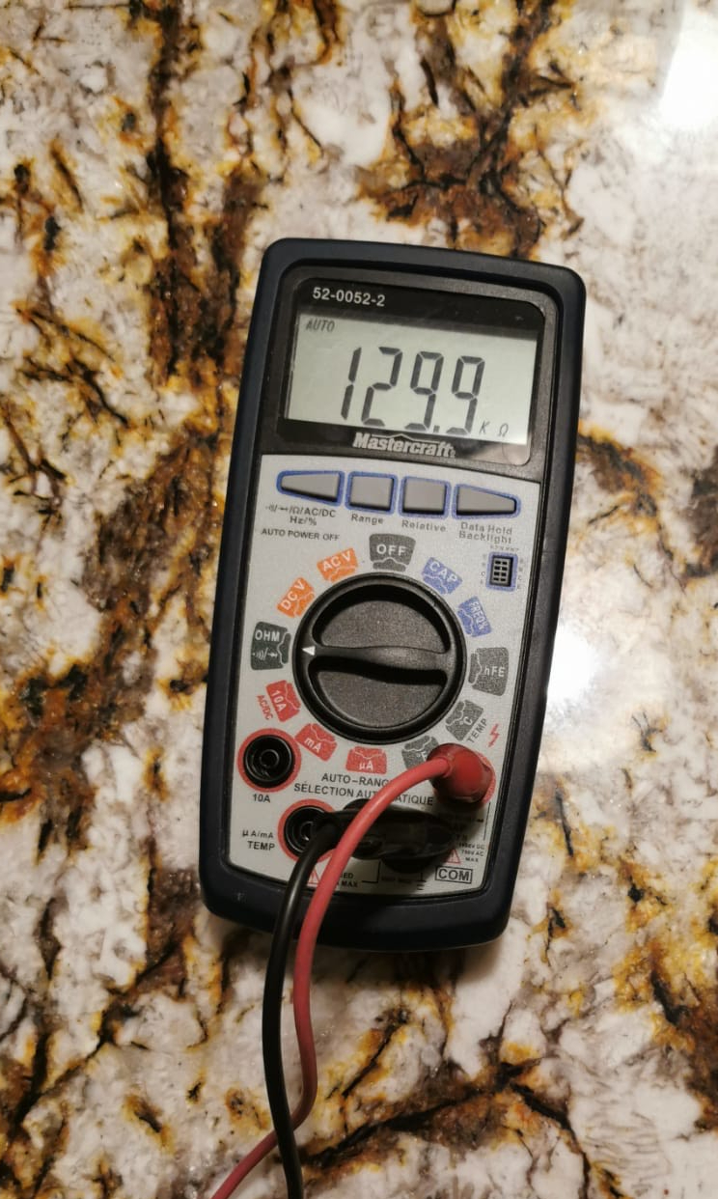
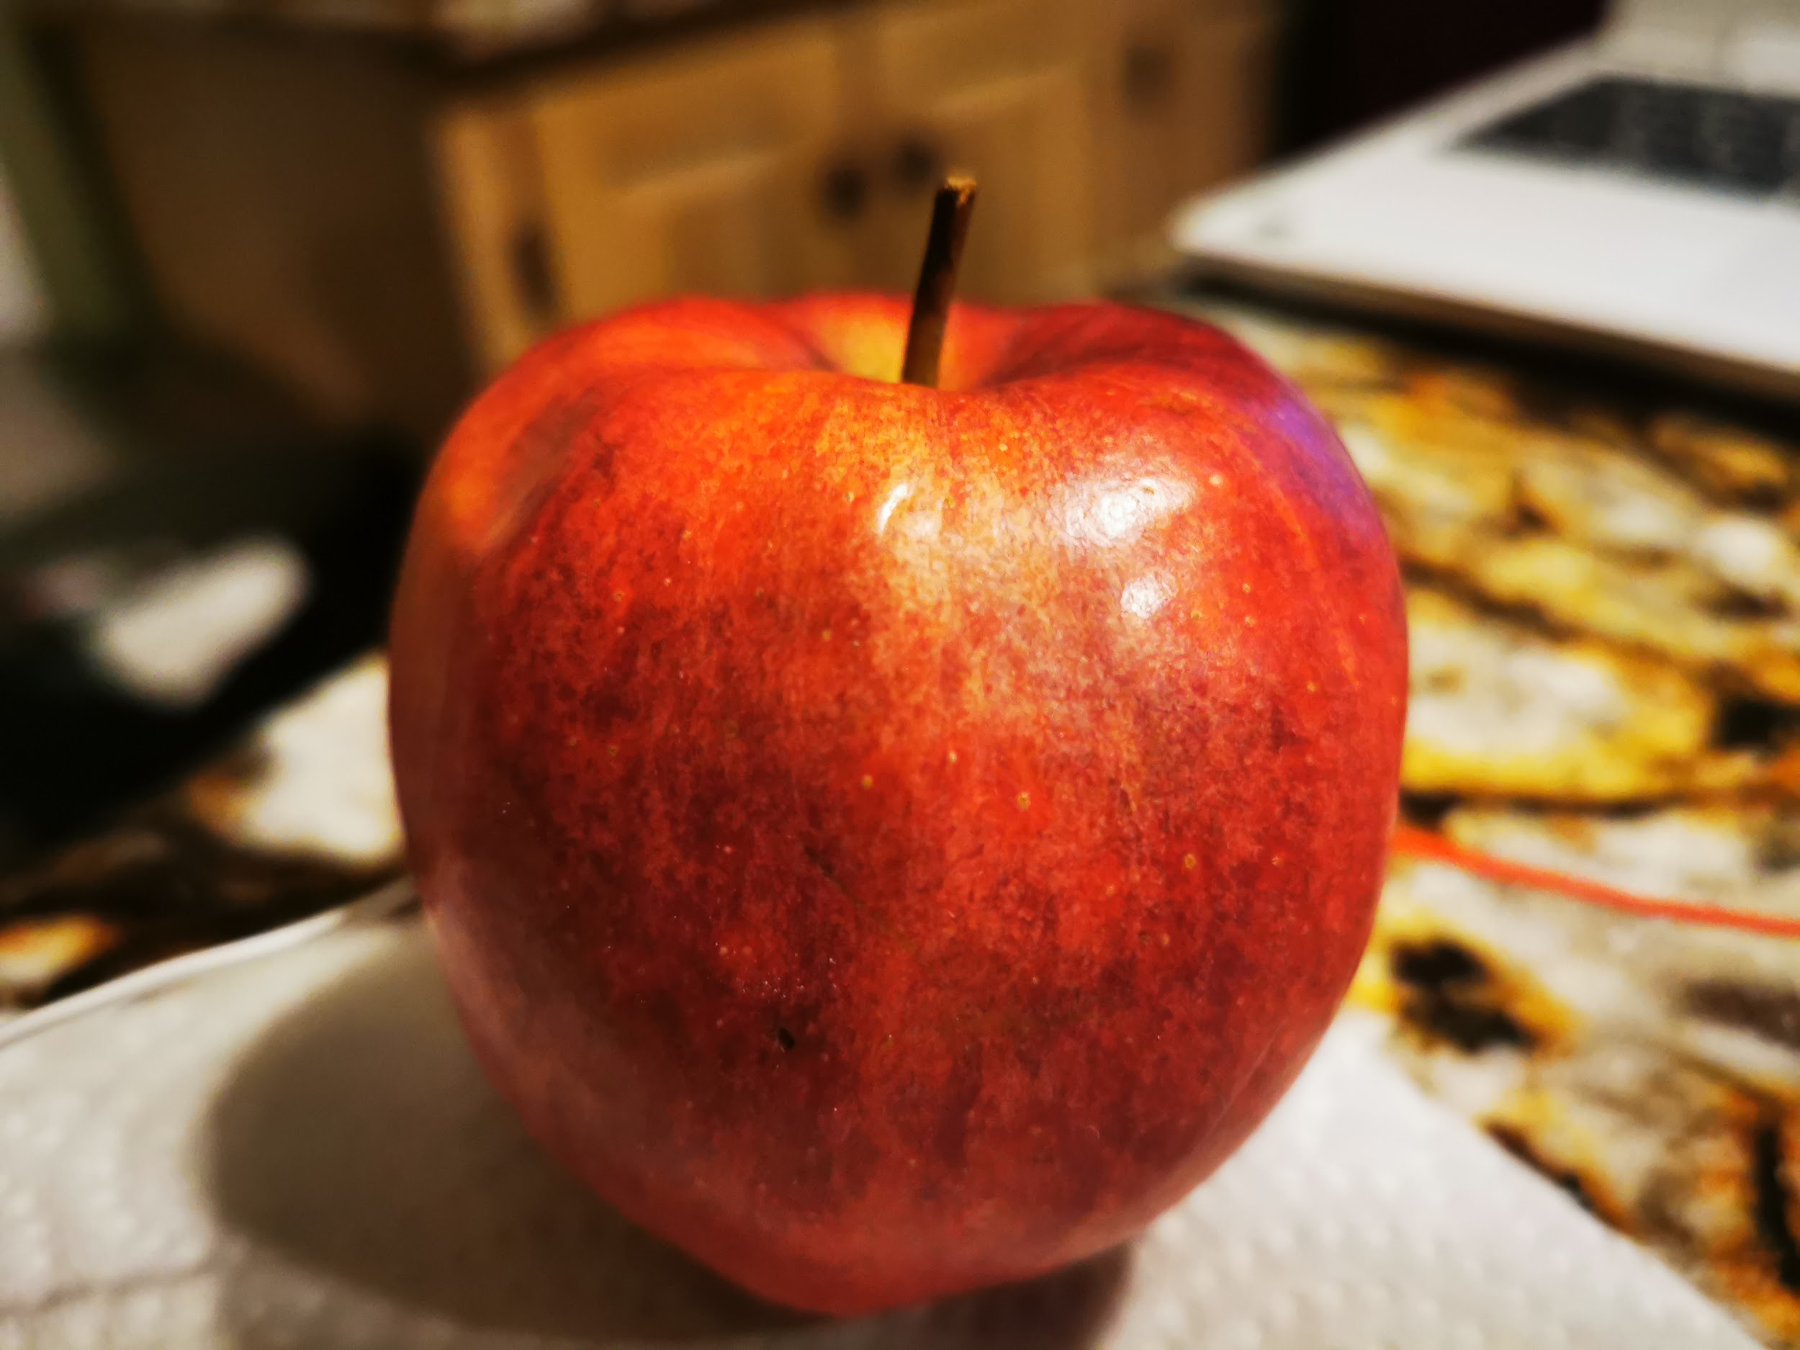
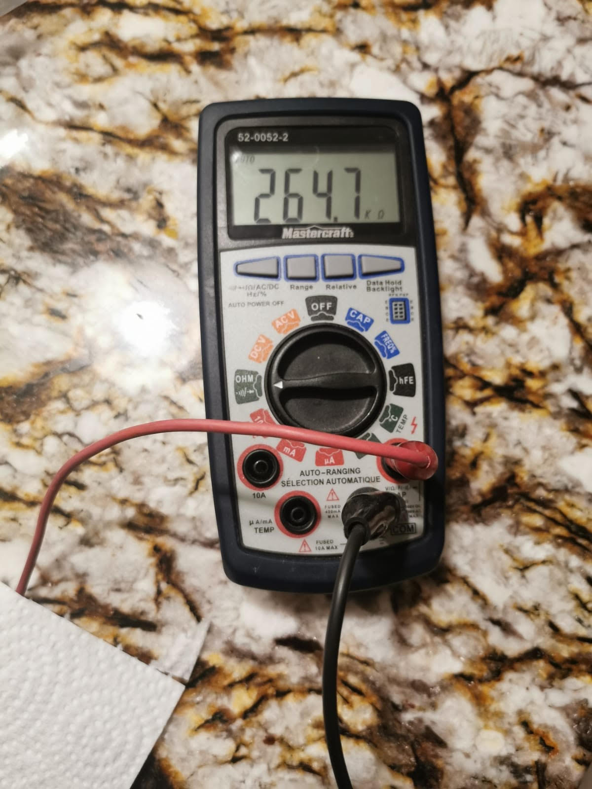
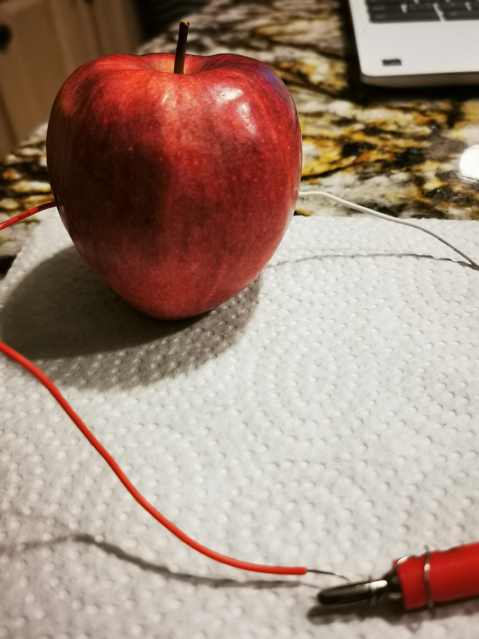
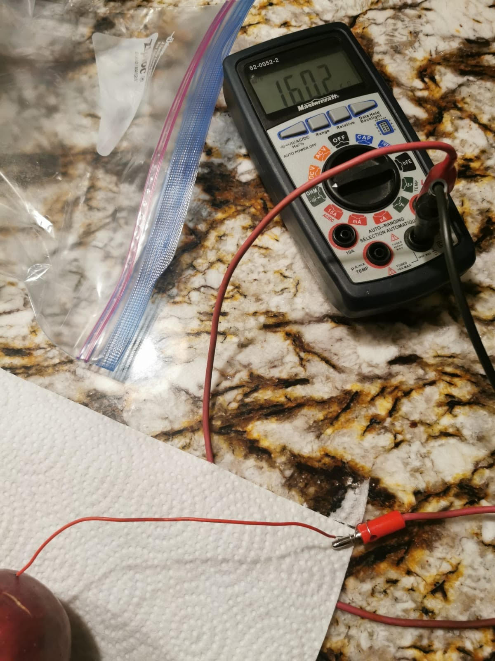
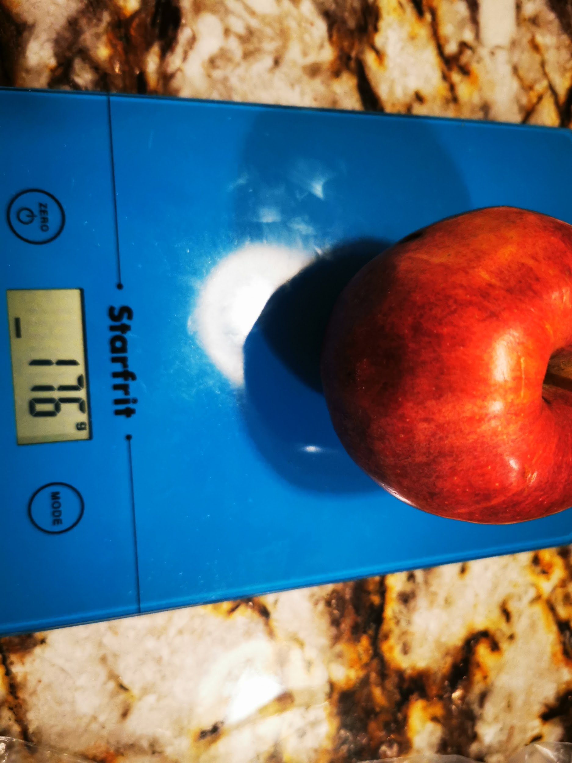
Day 1
Photos
Day 15
Day 11
Day 3
Day 3
Day 14

Slide 15
Apple C (Room Temp.) Apple D (Fridge Temp.)
New set of Apples
Day 1: M- 197g R-166.8 kΩ
Day 2: M- 197 g R-174.1 kΩ
Day 3: M- 197g R- 152.6 kΩ
Day 4: M- 197g R-215.3 kΩ
Day 5: M- 197g R-216 kΩ
Day 6: M- 196g R-178.4 kΩ
Day 7: M- 196g R-167 kΩ
Day 8: M- 196g R-219.4 kΩ
Day 9: M- 195g R- 136.9 kΩ
Day 10: M- 195g R-147.1 kΩ
Day 11: M- 195g R-150.1 kΩ
Day 12: M- 195g R-149.3 kΩ
Day 13: M- 194g R-216 kΩ
Day 14: M- 193g R-129.3 kΩ
Day 15: M- 191g R-152 kΩ
Day 1: M- 198g R-131.6 kΩ
Day 2: M- 198g R- 221 kΩ
Day 3: M- 198g R-151.1 kΩ
Day 4: M- 198g R- 276.6 kΩ
Day 5: M- 198g R-275 kΩ
Day 6: M- 198g R-167.4 kΩ
Day 7: M- 197g R-244.7 kΩ
Day 8: M- 197g R-290.4 kΩ
Day 9: M- 196g R-306.6 kΩ
Day 10: M- 197g R-246 kΩ
Day 11: M- 197g R-321 kΩ
Day 12: M- 197g R-189.3 kΩ
Day 13: M- 197g R- 119.6 kΩ
Day 14: M- 196g R-106.4 kΩ
Day 15: M- 196g R-177.2 kΩ

Slide 16
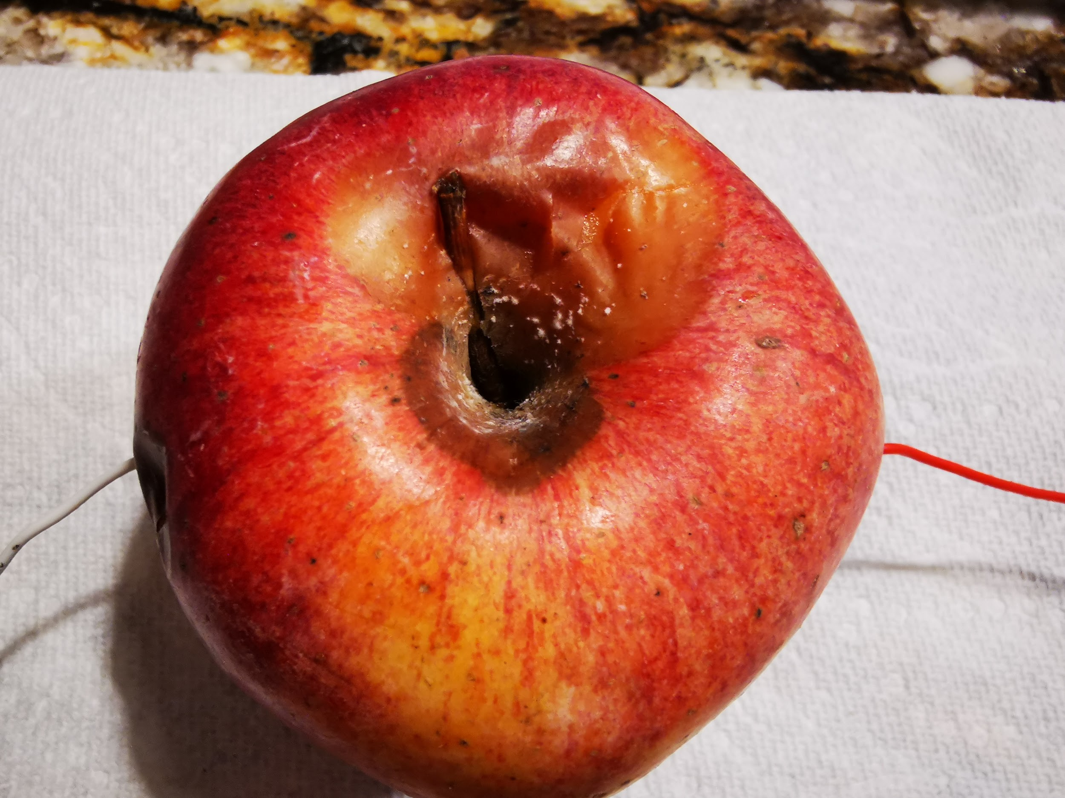
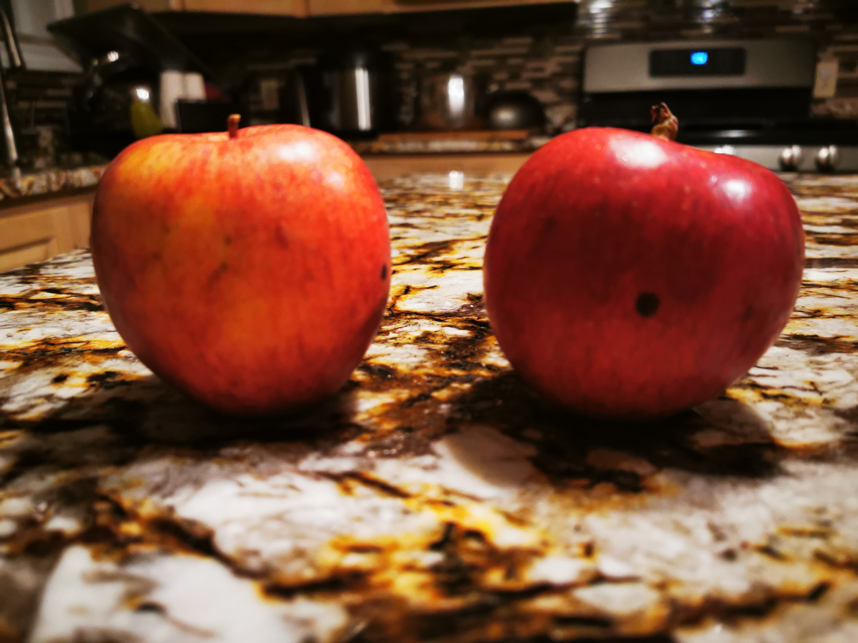
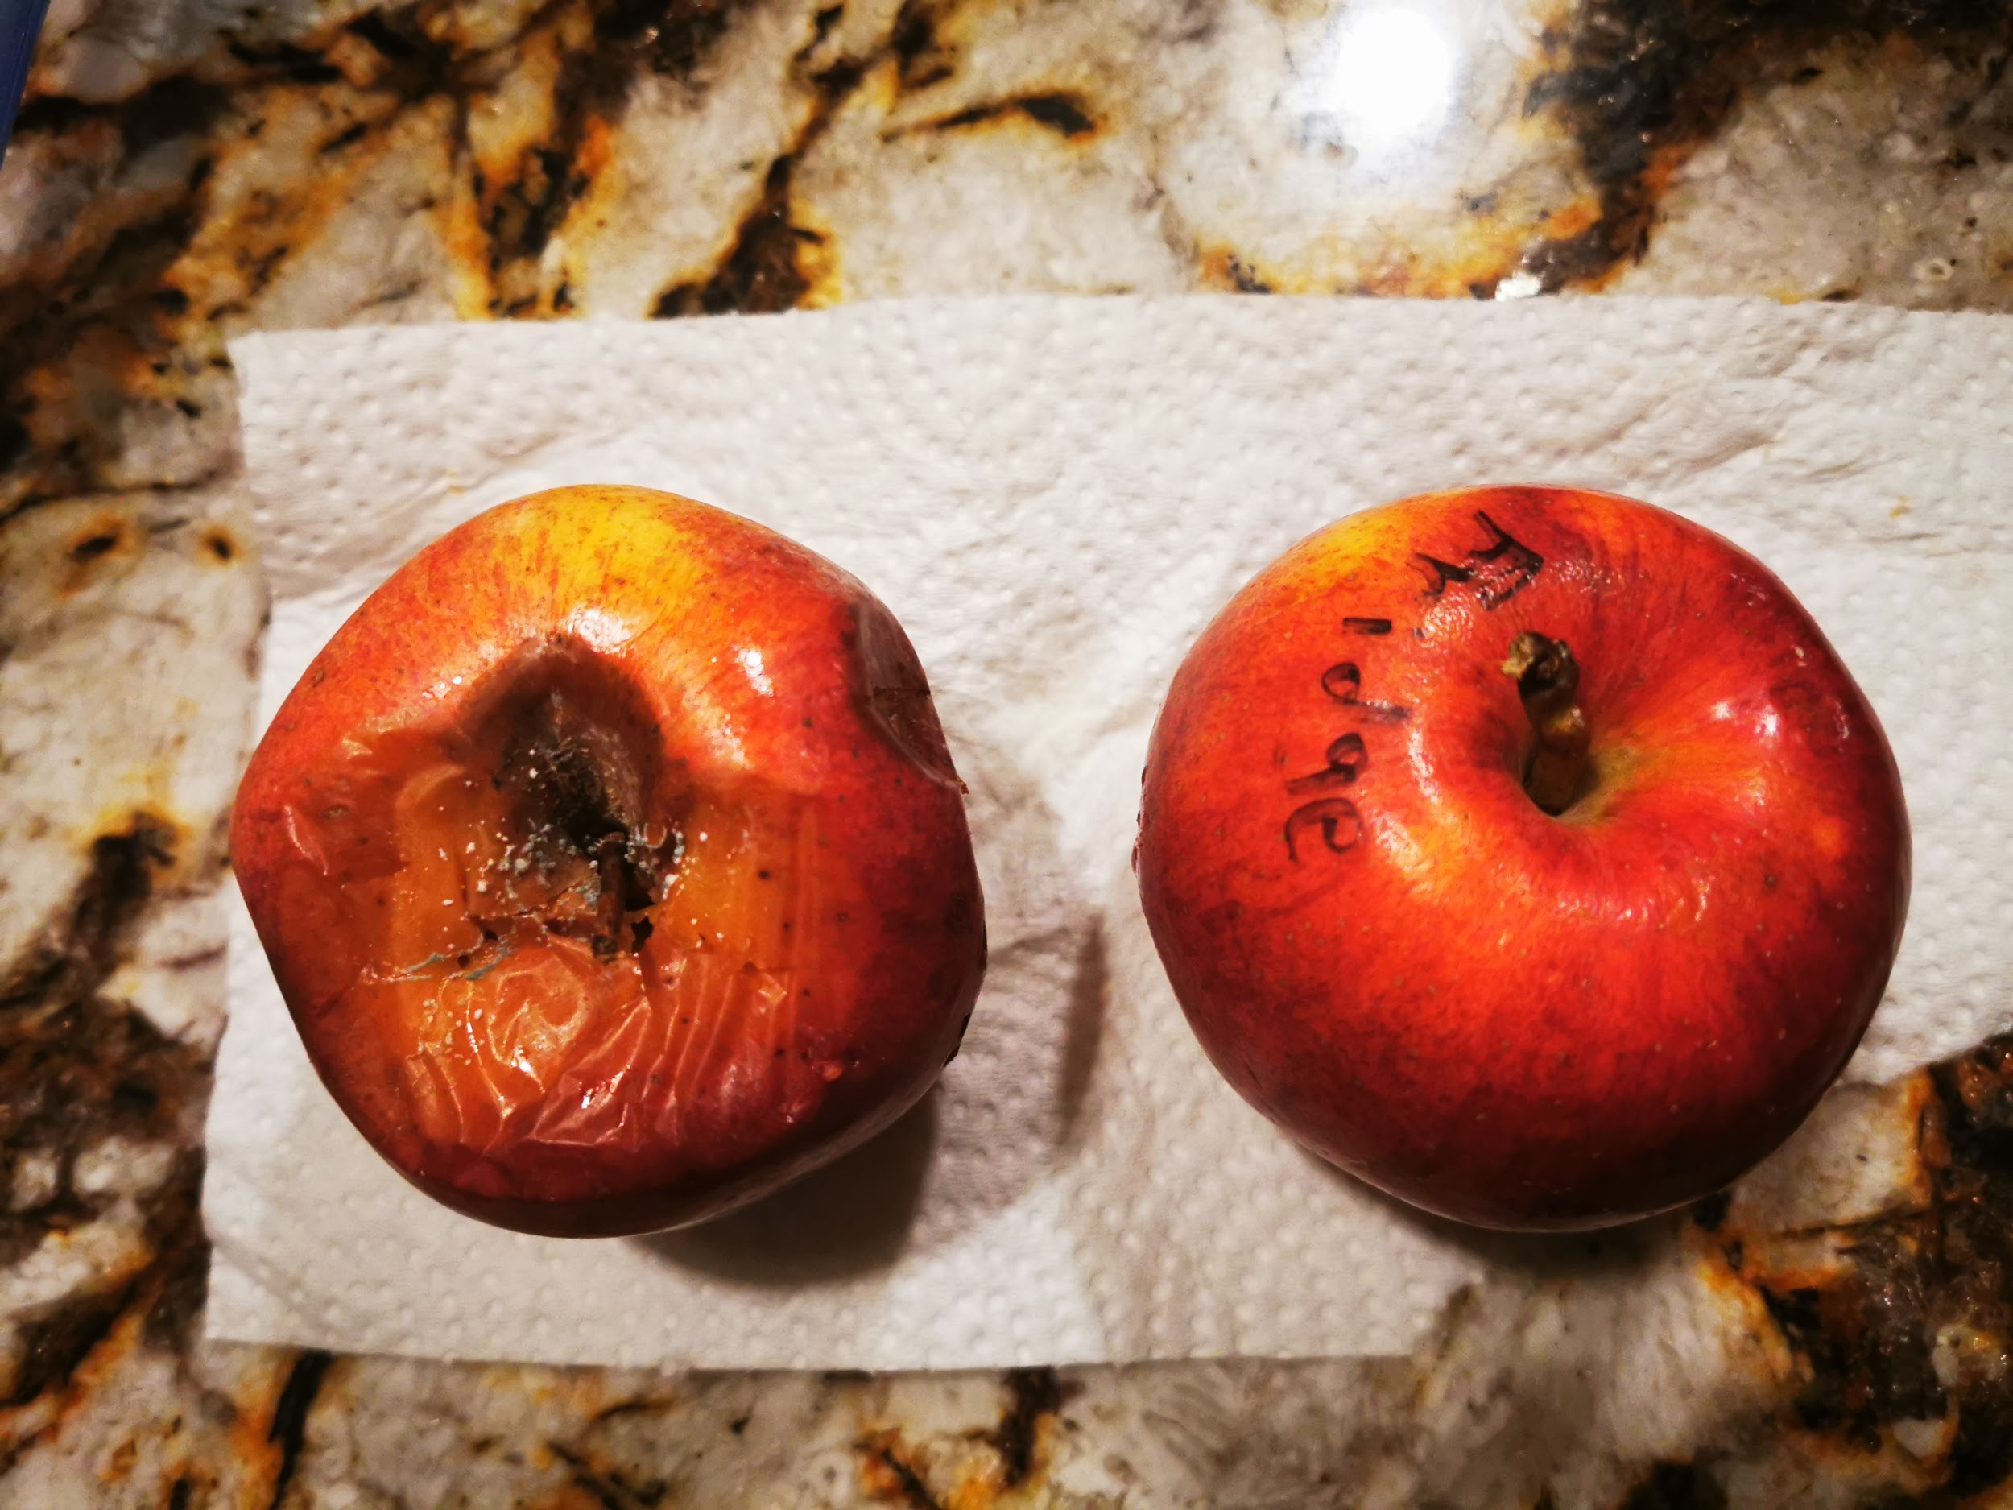
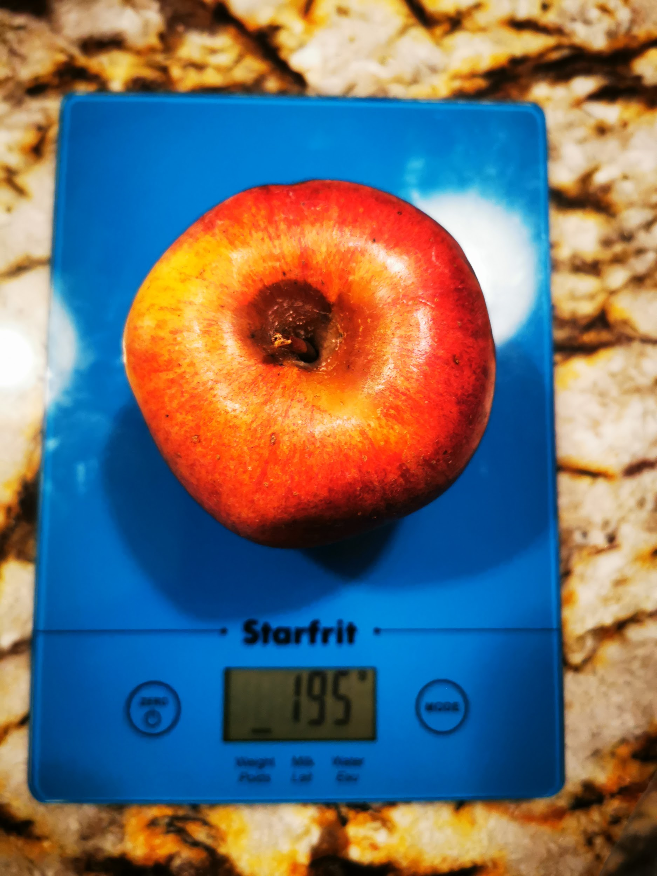
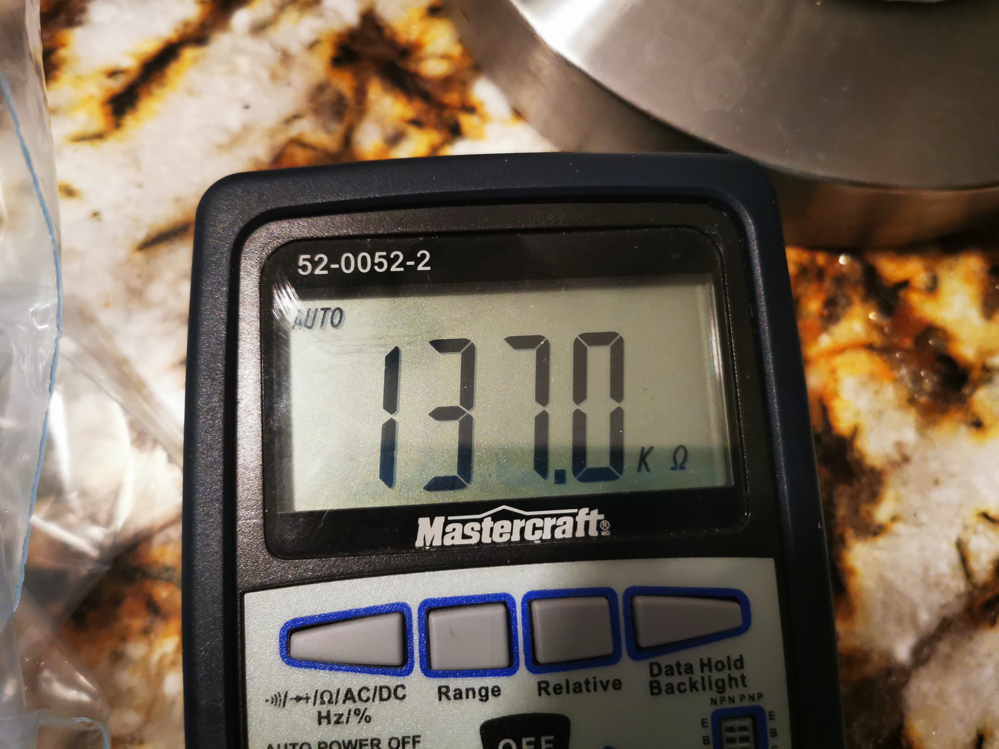
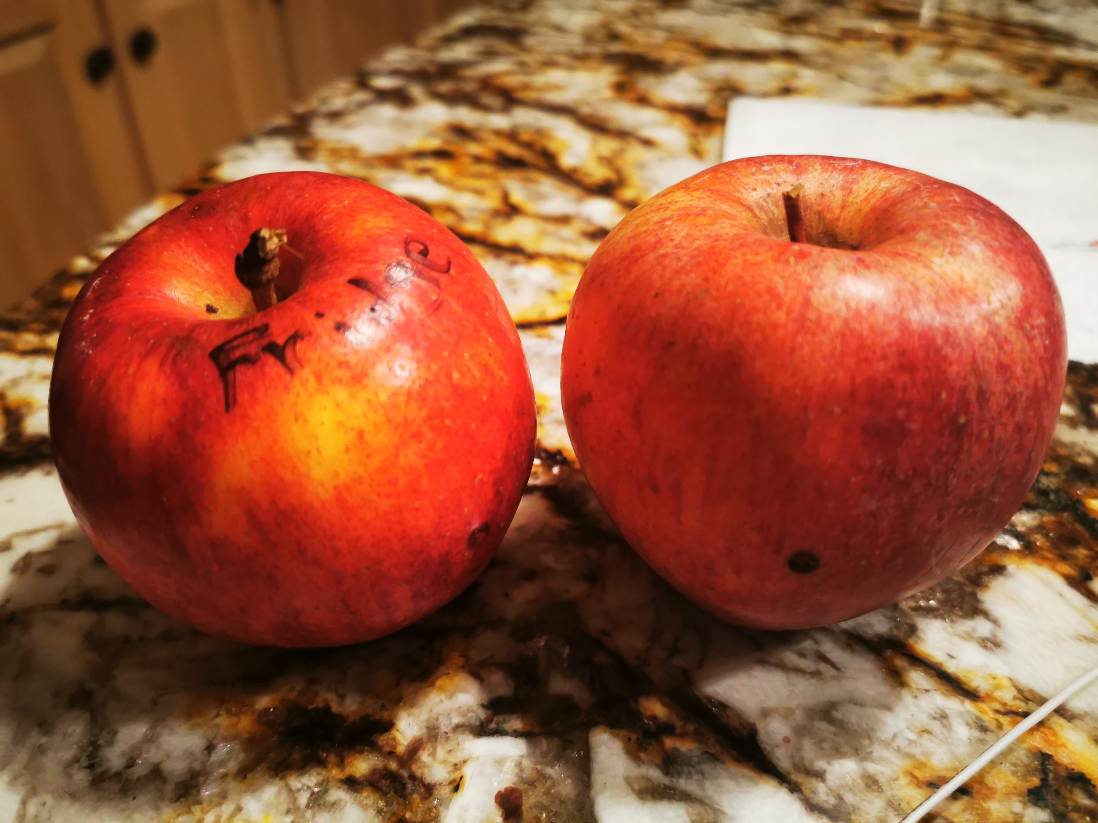
Day 15
Photos New Set
Day 12
Day 1
Day 11
Day 9
Day 4

Slide 17
Grapefruit A (Room Temp.) Grapefruit B (Fridge Temp.)
Day 1: M- 227g R- 152.2 kΩ
Day 2: M- 227g R- 143.6 kΩ
Day 3: M- 228g R- 54.02 kΩ
Day 4: M- 226g R- 120.8 kΩ
Day 5: M- 228g R- 55.29 kΩ
Day 6: M- 227g R- 49.69 kΩ
Day 7: M- 228g R- 61.83 kΩ
Day 8: M- 227g R- 150.6 kΩ
Day 9: M- 226g R- 137.2 kΩ
Day 10: M- 226g R- 62.25 kΩ
Day 11: M- 226g R- 133.2 kΩ
Day 12: M- 225g R- 138.7 kΩ
Day 13: M- 225g R- 135.5 kΩ
Day 14: M- 225g R- 177.4 kΩ
Day 15: M- 225g R- 175.6 kΩ
Day 1: M- 237g R- 254.5 kΩ
Day 2: M- 237g R- 170.1 kΩ
Day 3: M- 237g R- 157.3 kΩ
Day 4: M- 236g R- 138 kΩ
Day 5: M- 236g R- 140.9 kΩ
Day 6: M- 237g R- 143.9 kΩ
Day 7: M- 237g R- 152.6 kΩ
Day 8: M- 236g R- 160.2 kΩ
Day 9: M- 235g R- 179.3 kΩ
Day 10: M- 236g R- 182.9 kΩ
Day 11: M- 236g R- 194 kΩ
Day 12: M- 236g R- 161.8 kΩ
Day 13: M- 235g R- 136.6 kΩ
Day 14: M- 235g R- 107.6 kΩ
Day 15: M- 235g R- 166.2 kΩ

Slide 18
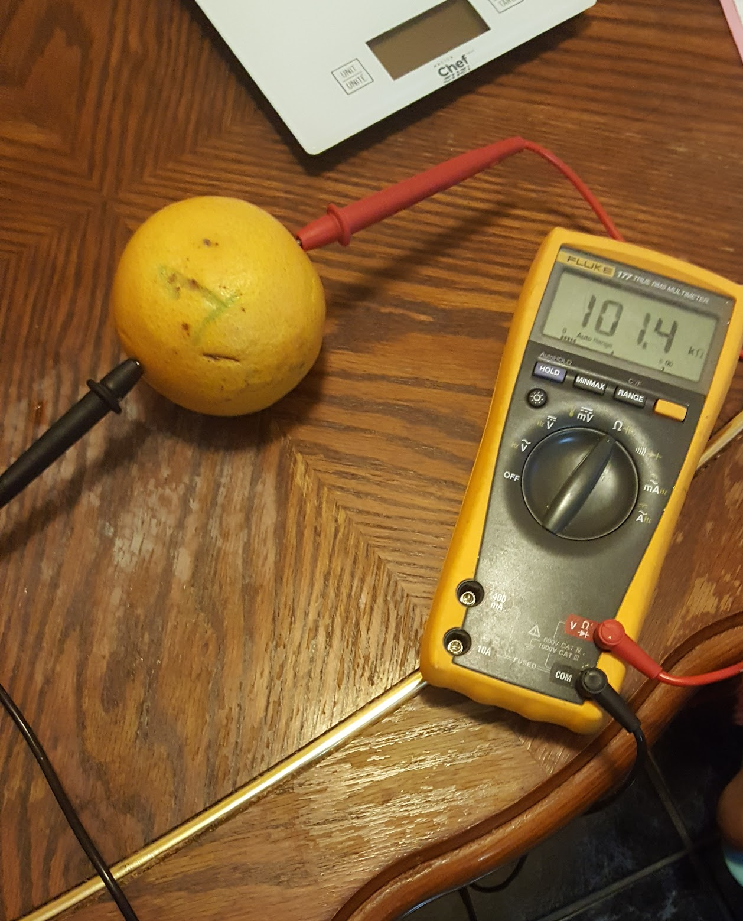
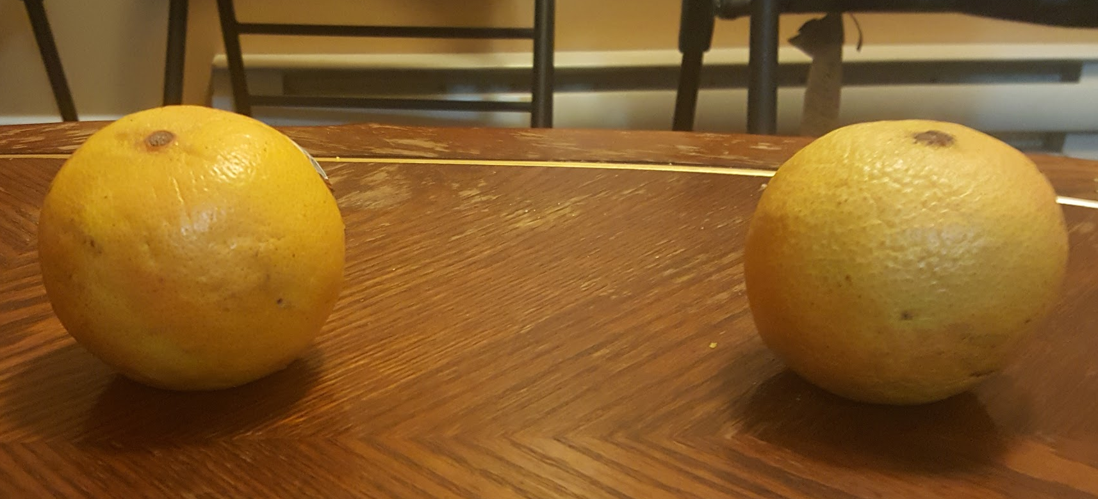
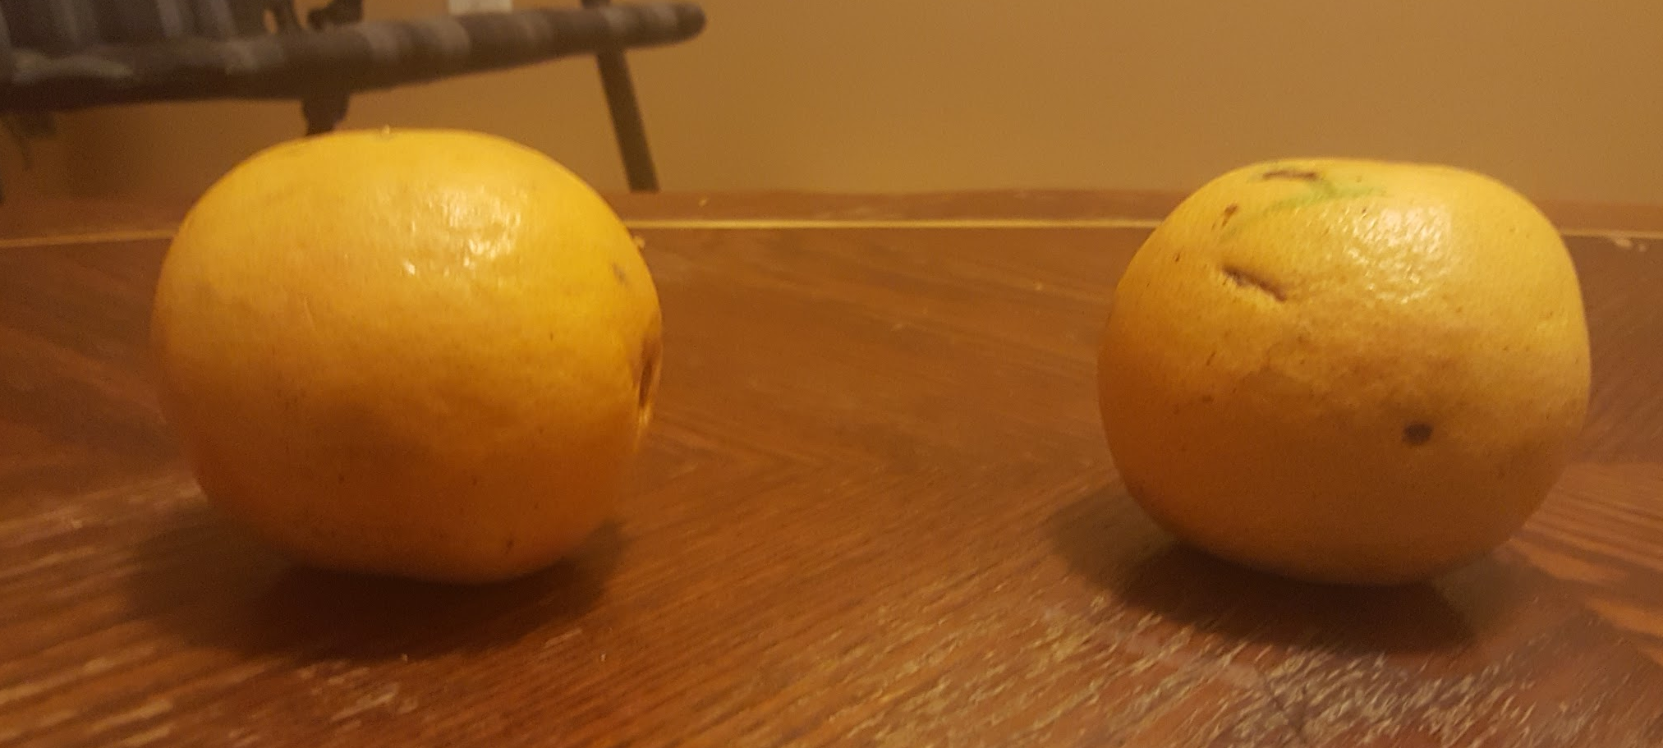
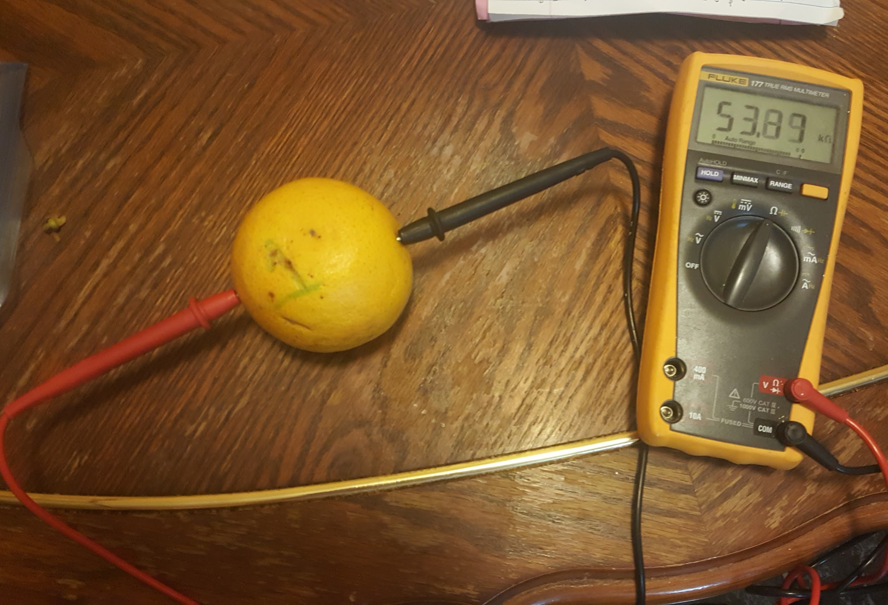
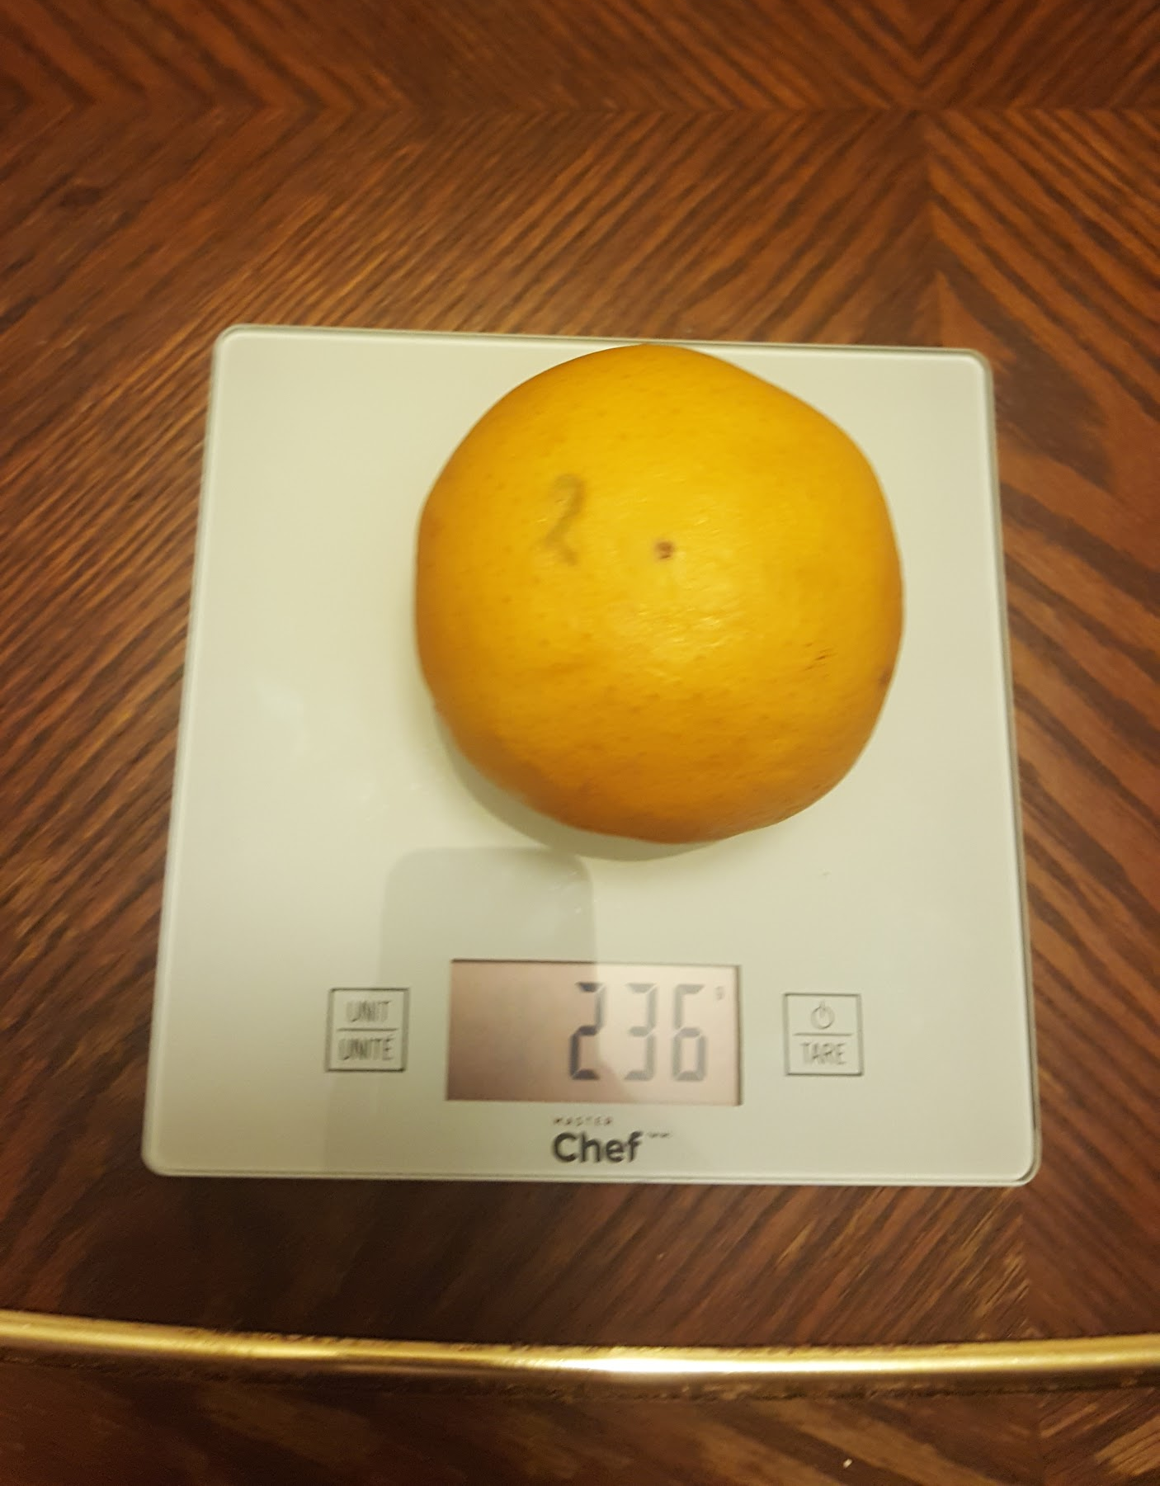
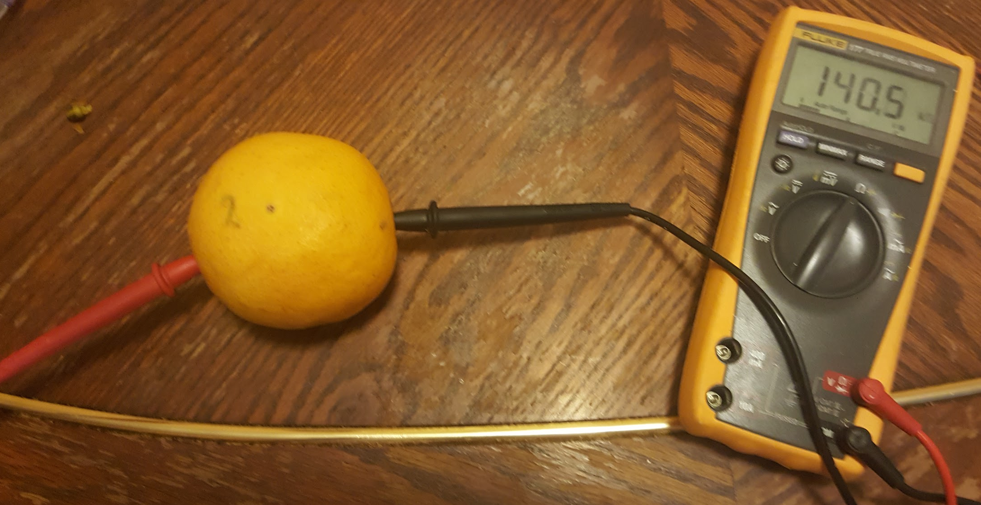
Day 8
Day 1
Photos
Day 15
Day 10
Day 9
Day 9

Slide 19
Grapefruit C (Room Temp.) Grapefruit D (Fridge Temp.)
New set of Grapefruits
Day 1: M- 253g R- 285.6 kΩ
Day 2: M- 253g R- 56.53 kΩ
Day 3: M- 254g R- 114.3 kΩ
Day 4: M- 254g R- 62.58 kΩ
Day 5: M- 253g R- 156.1 kΩ
Day 6: M- 252g R- 123.1 kΩ
Day 7: M- 252g R- 299.7 kΩ
Day 8: M- 252g R- 131.3 kΩ
Day 9: M- 252g R- 140.4 kΩ
Day 10: M- 252g R- 117.2 kΩ
Day 11: M- 252g R- 214.6 kΩ
Day 12: M- 251g R- 308.8 kΩ
Day 13: M- 251g R- 184.6 kΩ
Day 14: M- 251g R- 131.5 kΩ
Day 15: M- 251g R- 169.4 kΩ
Day 1: M- 263g R- 208.2 kΩ
Day 2: M- 263g R- 165.4 kΩ
Day 3: M- 263g R- 122.9 kΩ
Day 4: M- 262g R- 112.2 kΩ
Day 5: M- 263g R- 144.5 kΩ
Day 6: M- 263g R- 192.9 kΩ
Day 7: M- 263g R- 167.2 kΩ
Day 8: M- 263g R- 185.5 kΩ
Day 9: M- 263g R- 187.5 kΩ
Day 10: M- 262g R- 175.7 kΩ
Day 11: M- 263g R- 164.9 kΩ
Day 12: M- 262g R- 125 kΩ
Day 13: M- 262g R- 163.7 kΩ
Day 14: M- 261g R- 195.9 kΩ
Day 15: M- 261g R- 148 kΩ

Slide 20
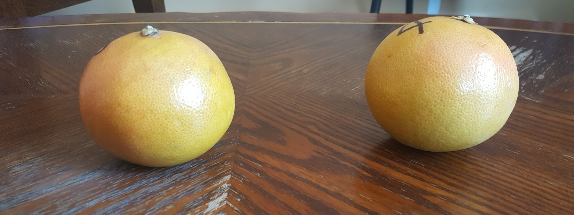
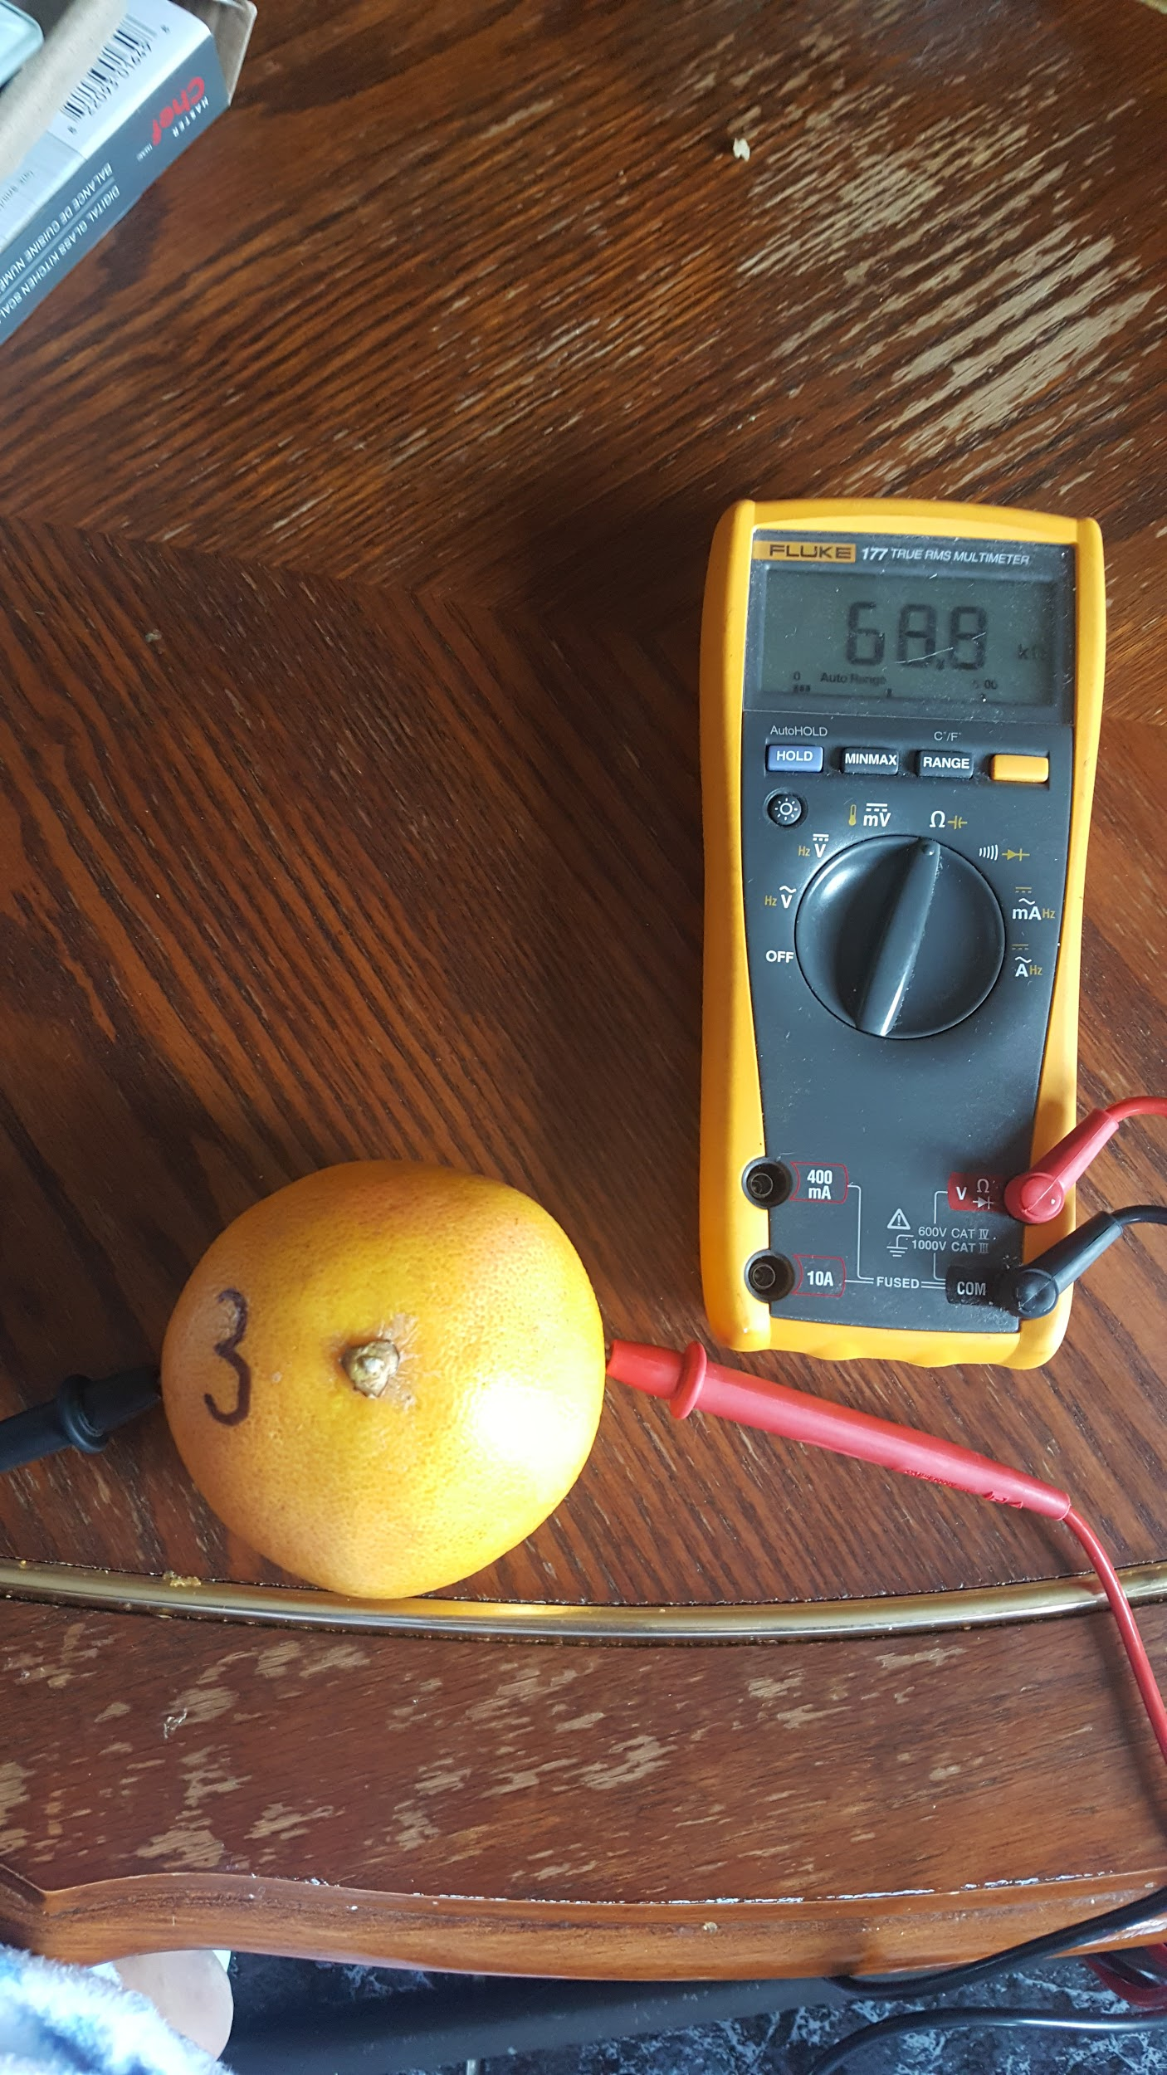
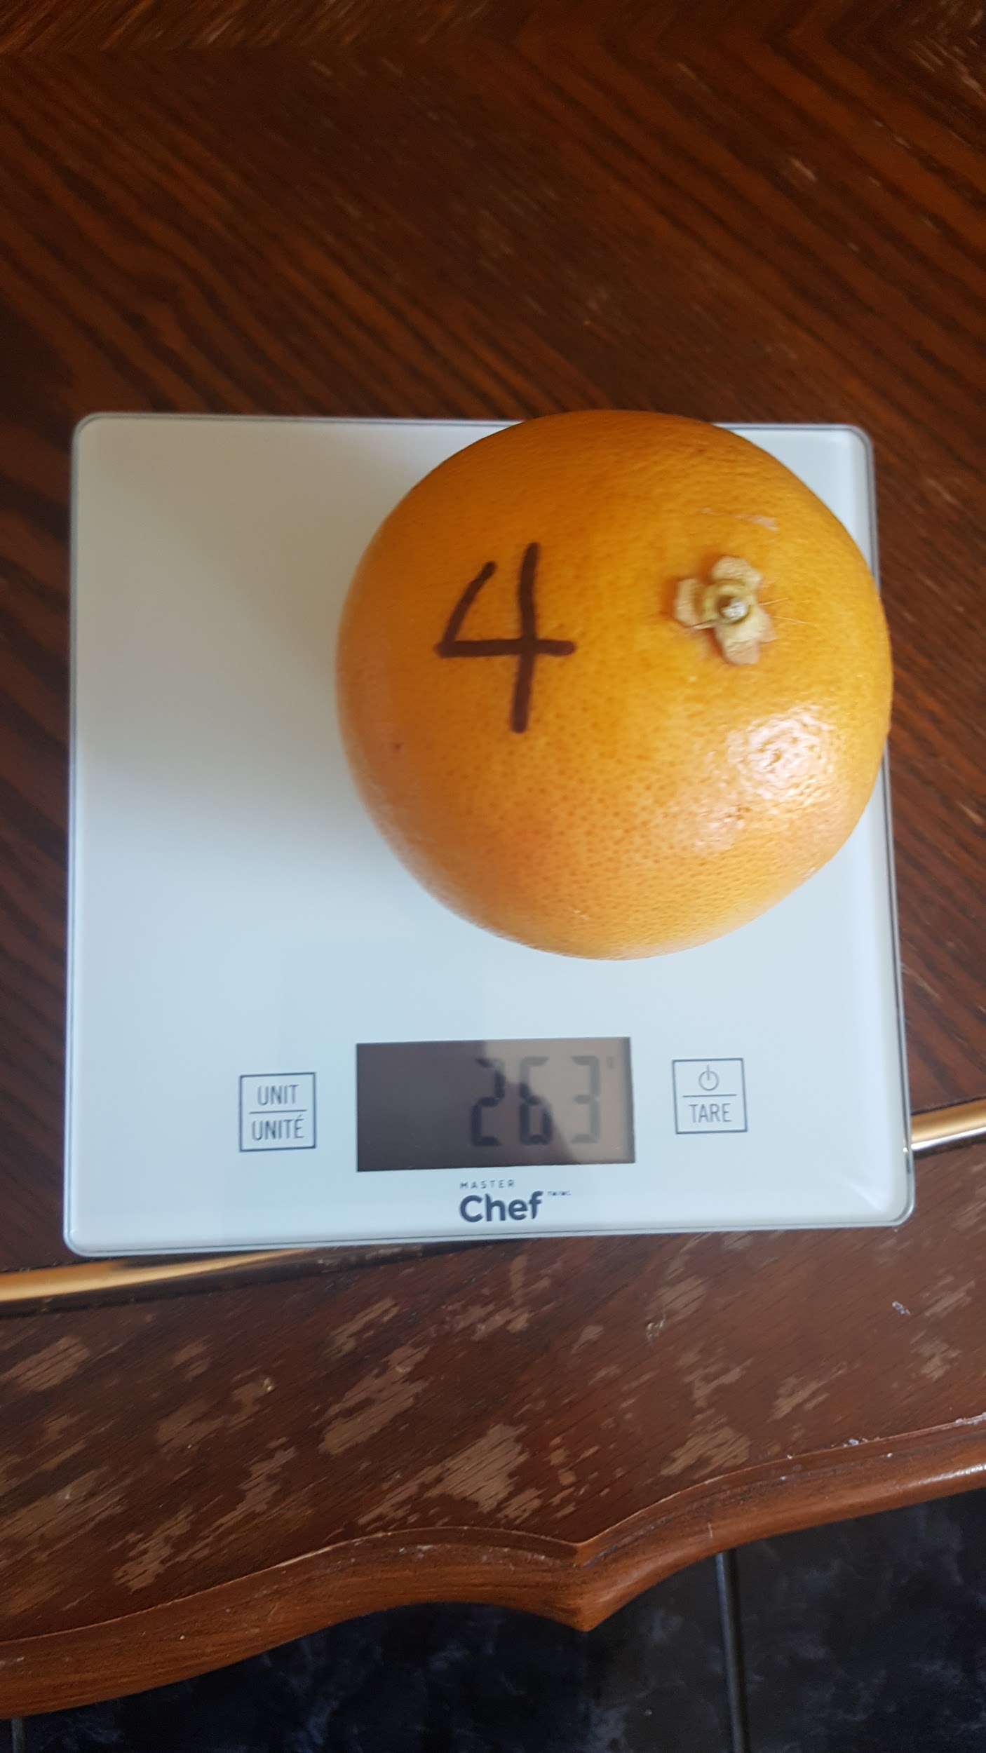
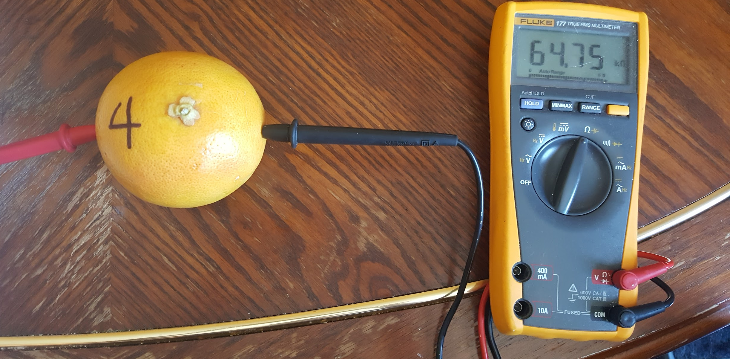
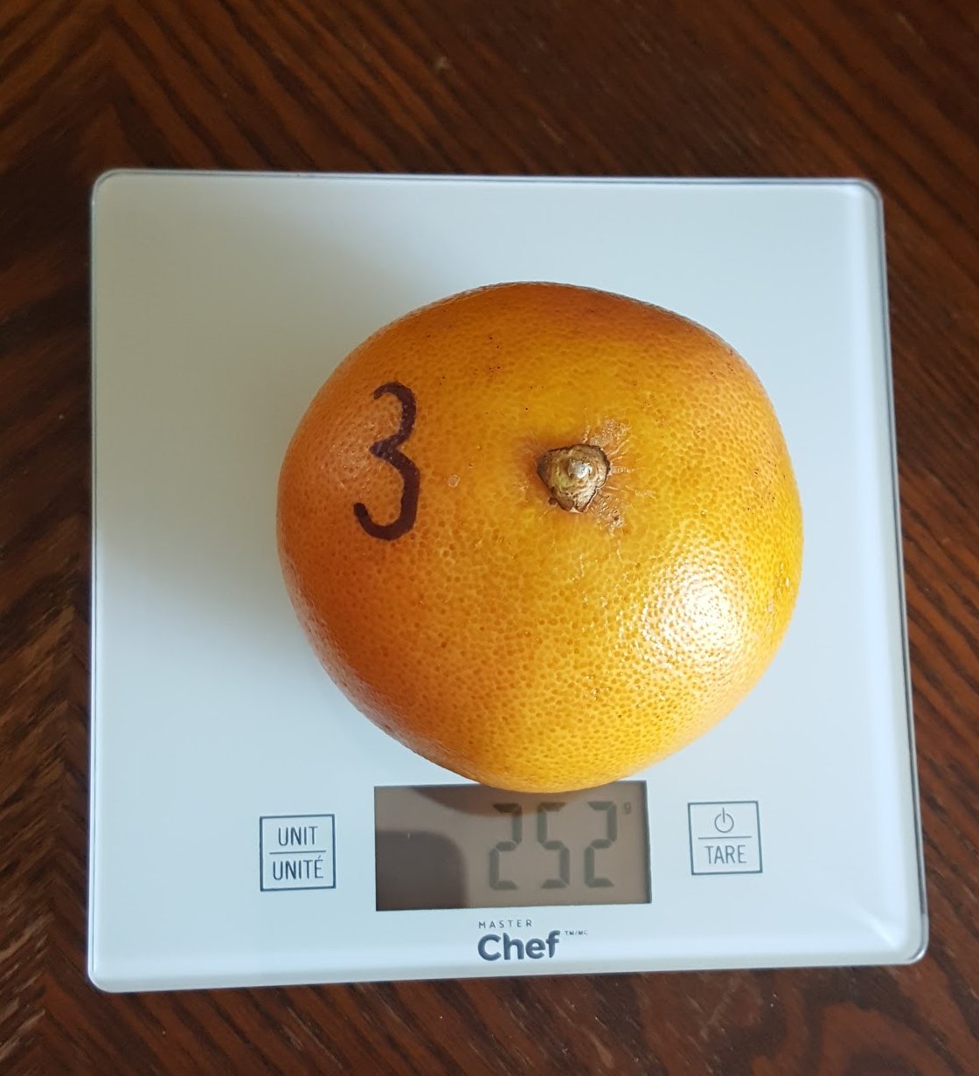
Day 1
Photos New Set
Day 10
3 4
Day 15
Day 1
4 3
Day 9
Day 2

Slide 21
The Results

Slide 22
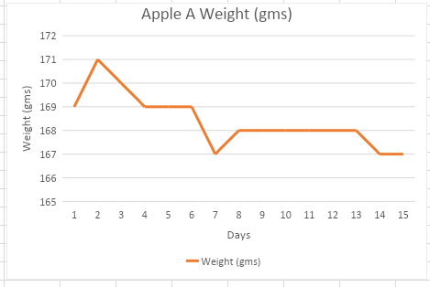
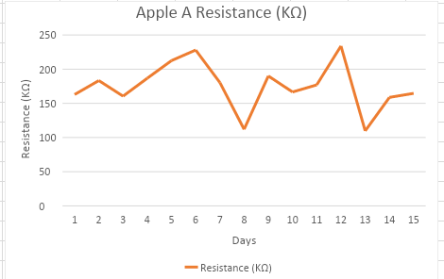
Apple A’s Mass (gms)
Graphs-Apple A
Apple A Mass (gms): It is clear to see that the graph line reaches a peak then dips down and plateaux. A trend is shown were the mass does decrease.
Apple A resistance (KΩ): The graph line goes up and down and doesn’t plateau at any point. There is no pattern that is visible either.
Mass (gms)

Slide 23
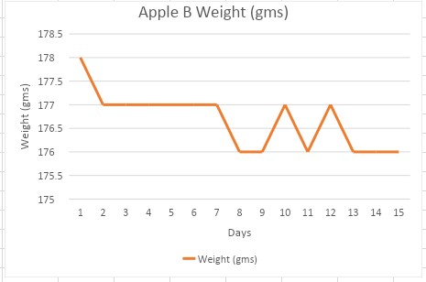
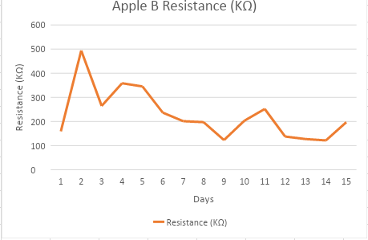
Mass (gms)
Apple B’s Mass (gms)
Graphs(Continued)-Apple B
Apple B Mass (gms): As shown, the graph line drops and then plateaux. It then goes up and down and plateaux again at the end. Again, there is a trend.
Apple B Resistance (KΩ): It is clear pretty to see that the graph line does not plateau at any point and there is no recognizable pattern that the resistance follows. However, their is a visible trend.

Slide 24
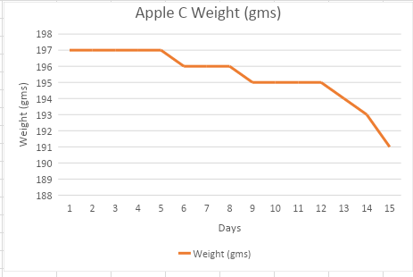
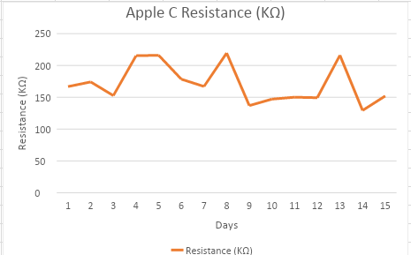
Mass (gms)
Apple C’s Mass (gms)
Graphs(Continued)-Apple C
Apple C Mass (gms): It is clear to see that the graph line reaches a total of three plateaus before falling.
Apple C Resistance (KΩ): It is clear to see that the graph line reaches many different peaks and doesn’t show any sort of pattern.

Slide 25
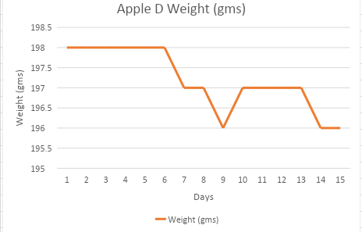
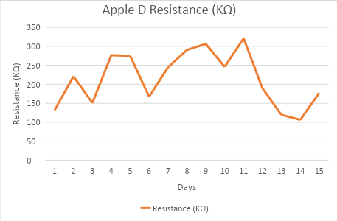
Mass (gms)
Apple D’s Mass (gms)
Graphs(Continued)-Apple D
Apple D Mass (gms): It is clear to see that the graph line plateaus and drops quite a bit.
Apple D Resistance (KΩ): It is clear to see that the graph line does not remain constant at any time throughout the 15 days.

Slide 26
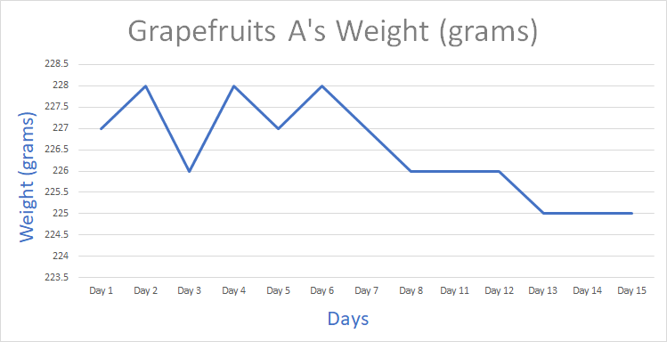
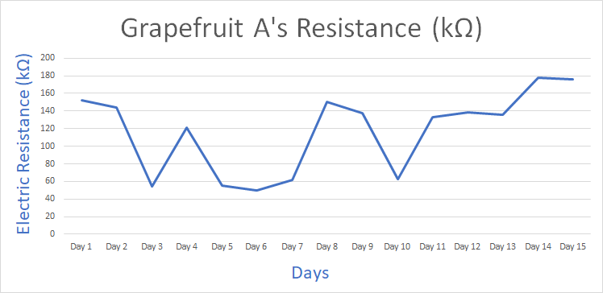
Graphs(Continued)-Grapefruit A
Mass
Grapefruit A’s Mass (gms): As shown, the mass of grapefruit A changes a fair bit during the first few days. Later, the mass continues to endure before falling.
Resistance (KΩ): It is clear that the resistance of Grapefruit A shows no distinct correlation between the resistance and the ripening period.
Mass (grams)

Slide 27
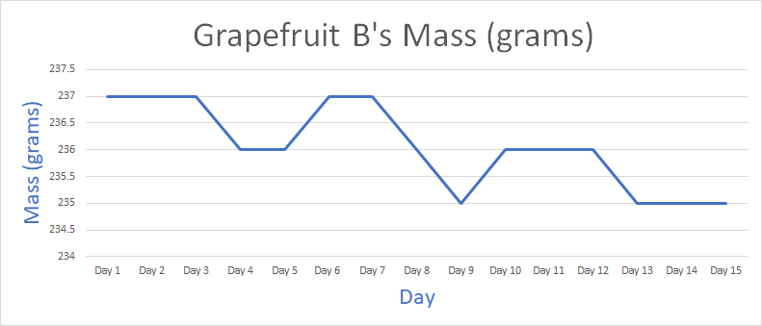
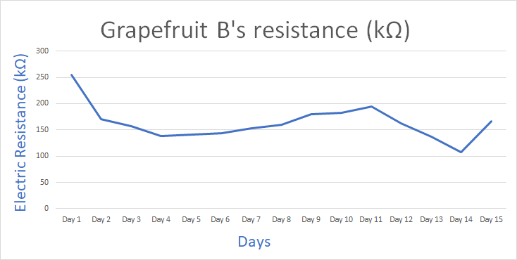
Graphs(Continued)-Grapefruit B
Grapefruit B Mass (gms): It is clear that mass of Grapefruit B, reaches several plateaux during the ripening stage. The weight has steadily reduced.
Grapefruit B Resistance (KΩ): It is clear that Grapefruit B's resistance decreased from day 1 to 4 then slightly rose before it dropped from day 11 to day 14. A trend is shown as the resistance decreases.

Slide 28
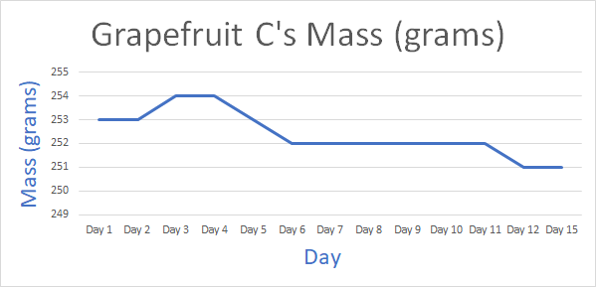
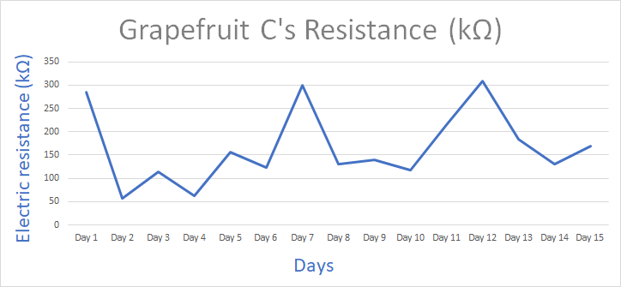
Graphs(Continued)-Grapefruit C
Grapefruit C Mass (gms): As shown in the graph, the mass of grapefruit C varies during the first few days then remains constant before dropping again.
Grapefruit C Resistance (KΩ): It is clear that the resistance of Grapefruit C fluctuates repetitively. There is no define relation between the ripening stage and resistance.

Slide 29
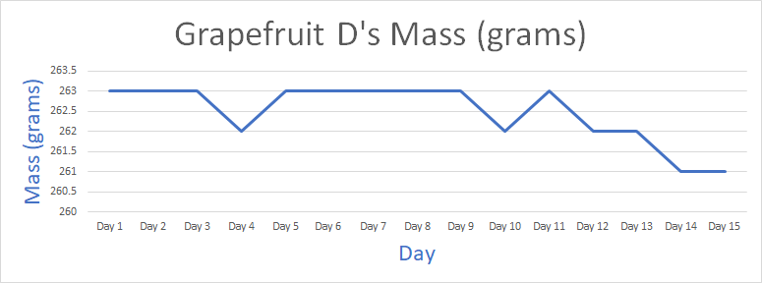
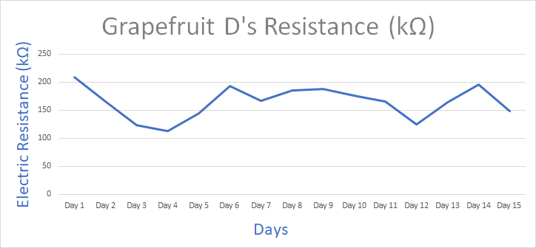
Graphs(Continued)-Grapefruit D
Graphs(Continued)-Grapefruit D
Grapefruit D Mass (gms): It is clear to see that the mass of Grapefruit D remains the same before dropping towards the end of the 15 day measurement.
Grapefruit D Resistance (KΩ): It is clear that resistance of Grapefruit D varied greatly. Once again, there is no detected pattern.

Slide 30
Discussion/Analysis Sources of Error
After Apple C showed signs of rotting, the probe holes had to be moved slightly towards the left side of the original hole. This was due to the fact that there was no reading when the probes were placed in the original hole. This may have altered the resistance numbers slightly.
The probes might have jiggled around in the hole if we were not careful and this could have had an impression on the resistance.
Anything that came in contact with the probe before recording the resistance might have had an influence on the numbers that were shown on the multimeter.
After a long look at the results, we have found no visible correlation between the resistance and ripening stage of the fruit. We believe that this is because the 15-day limit set was too short to detect a discernible pattern in the apples' and grapefruits' resistance. The time limit would have to be extended by an undetermined amount to see any change to the results. Though the experiment did not go the way we thought it would, the mass decreased in the 15 days. There is a list of errors that could have affected the results.

Slide 31
Sources of Error (Continued)
The temperature around the fruits did vary a couple of times and had to be reset. This might or might not have caused a change in the resistance and mass.
The resistance continues to increase or decrease in numbers even after five minutes. It was tough to record the numbers, so we partly relied on continuity as well.
Even a slip of the finger set the resistance and mass off a small bit. Because of this, the outcome of the mass and resistance changed.
Overtime, the piercings within the fruits expanded causing the probes to fall out of place.

Slide 32


Summary
After 15 Days
To summarize, our hypothesis is wrong. There wasn’t a correlation between the resistance and ripening stage of fruits. It could take more than 15 days to see an increase or decrease in the resistance of the fruit. Before the 15 day limit arrives, a pattern was supposed to be detected in the resistance of the fruit. Unfortunately, there wasn’t. However, the mass did decrease over time. The knowledge that has been acquired through this project is that resistance can be a factor in determining if a fruit is ripe or not but 15 days is not enough time to get results. Also, mass does decrease and can determine if a fruit is ripe enough. However, the initial mass should be known.

Slide 33
Acknowledgements
We have to give credit to our parents and our science teachers for helping us through this project. Without them we wouldn't have been able to get the materials or get through the finer details of the project. Thank you so much for the time you spent helping us!
Science Teachers: Phillip Smith, Jennifer Riggs
Parents: Ranjan Patro, Subhadra Patra, Jai Anand Ganesh, Saradha Venkatraman

Slide 34
Picture Links
Ziploc bag: https://www.google.com/search?q=ziploc+bags&rlz=1CAJCUZ_enCA926&sxsrf=ALeKk03jLSioovlTpB7H-b46NYPXstAcEQ:1616623293613&source=lnms&tbm=isch&sa=X&ved=2ahUKEwjiyZqJ98nvAhVNmlkKHSuEBFIQ_AUoAXoECAEQAw&biw=1366&bih=697#imgrc=IYX84oOU3O-DHM
Iphone:
https://www.google.com/search?q=iphone+11+black+case&tbm=isch&ved=2ahUKEwjwi4O898nvAhVPPd8KHSwNATYQ2-cCegQIABAA&oq=iphone+11+black+case&gs_lcp=CgNpbWcQAzICCAAyAggAMgIIADICCAAyBggAEAUQHjIGCAAQBRAeMgYIABAFEB4yBggAEAUQHjIGCAAQCBAeMgYIABAIEB46BwgjEOoCECc6BQgAELEDOgQIIxAnOgQIABBDOgcIABCxAxBDU
Sharpie Marker:
https://www.google.com/search?q=black+sharpie&tbm=isch&ved=2ahUKEwjGoO3J98nvAhUFON8KHfj6A9QQ2-cCegQIABAA&oq=black+sharpie&gs_lcp=CgNpbWcQAzICCAAyAggAMgIIADICCAAyAggAMgIIADICCAAyAggAMgIIADICCAA6BAgjECc6BggAEAUQHjoGCAAQCBAeOgcIIxDqAhAnOgQIABBDOgcIABCxAxBDOgUIABCxA1Cu-QdY7KUIYNanCGgBcAB4AoABlgOIAc0lkgEKMC4yNC40LjEuM
Apple:
https://www.google.com/search?q=apple+black+background&rlz=1CAJCUZ_enCA926&sxsrf=ALeKk00MLIVicNWAqlNVrdUeMSHxAmFq5Q:1617044779853&source=lnms&tbm=isch&sa=X&ved=
Grapefruit:
https://www.google.com/search?q=grapefruit+black+background&tbm=isch&ved=2ahUKEwjR5cOemdbvAhUhoOAKHdX9BKYQ2-cCegQIABAA&oq=grapefruit+black+background&gs_lcp=CgNpbWcQAzIGCAAQBxAeOgcIABCxAxBDOgQIABBDO

Slide 35
Reference List
BIODYNAMICS : Resistance. (n.d.). BIODYNAMICS. Retrieved February 7, 2021, https://www.biodyncorp.com/product/450/resistance_450.html#:%7E:text=Because%20of%20its%20electrolyte%20
Moirangthem, K and Tucker, G (2018, April 20). How Do Fruits Ripen? Frontiers for Young Minds. Retrieved February 7, 2021, https://kids.frontiersin.org/article/10.3389/frym.2018.00016
Carpenter, M. E. (2019, March 2). How to Use a Multimeter to Test the Electrical Charge in Fruits & Vegetables. Sciencing. Retrieved February 7, 2021, https://sciencing.com/use-electrical-charge-fruits-vegetables-8102592.html
Frenkel, C. (n.d.). Decrease in fruit moisture content heralds and might launch the onset of ripening processes. PubMed. Retrieved February 7, 2021, from https://pubmed.ncbi.nlm.nih.gov/23061891/
Conductivity (Electrical Conductance) and Water. (n.d.). Conductivity (Electrical Conductance) and Water. Retrieved March 29, 2021, from https://www.usgs.gov/special-topic/water-science-school/science/conductivity-electrical-conductance-and-water?qt-science_center_objects=0#qt-science_center_objects
Scribbr. (2021, March 29). APA Citation Generator (Free) | References & In-text Citations. https://www.scribbr.com/apa-citation-generator/

