Slide 1
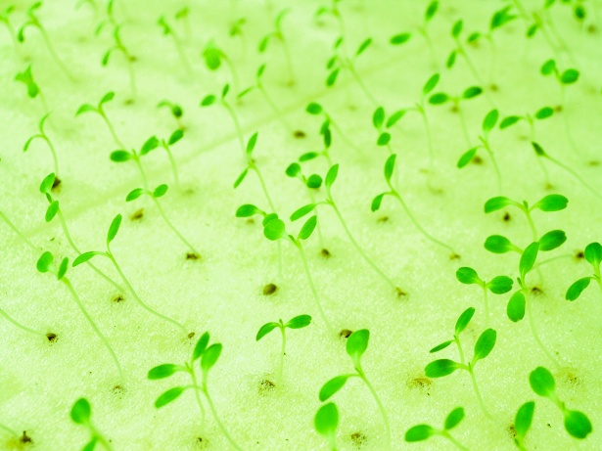
Growing Plants through Hydroponics
By: Claire French

Slide 2
What Is Hydroponics?
Hydroponics is a way to skip using soil and substitute it for another material, in this case coconut coir. Coconut coir is a material that contains no nutrients, allowing me to compare the growth of plants through nutrient rich water and through regular purified water. Hydroponics relies purely on the nutrient-rich water to help the plants grow. Hydroponics is very beneficial because it allows you to grow plants anywhere and at anytime during the year. This is very good, especially for places like Newfoundland, as our soil is not as nutrient-rich and our climate does not allow for plants to be grown during winter, late fall or even early spring. This is why hydroponics is a great alternative.

Slide 3
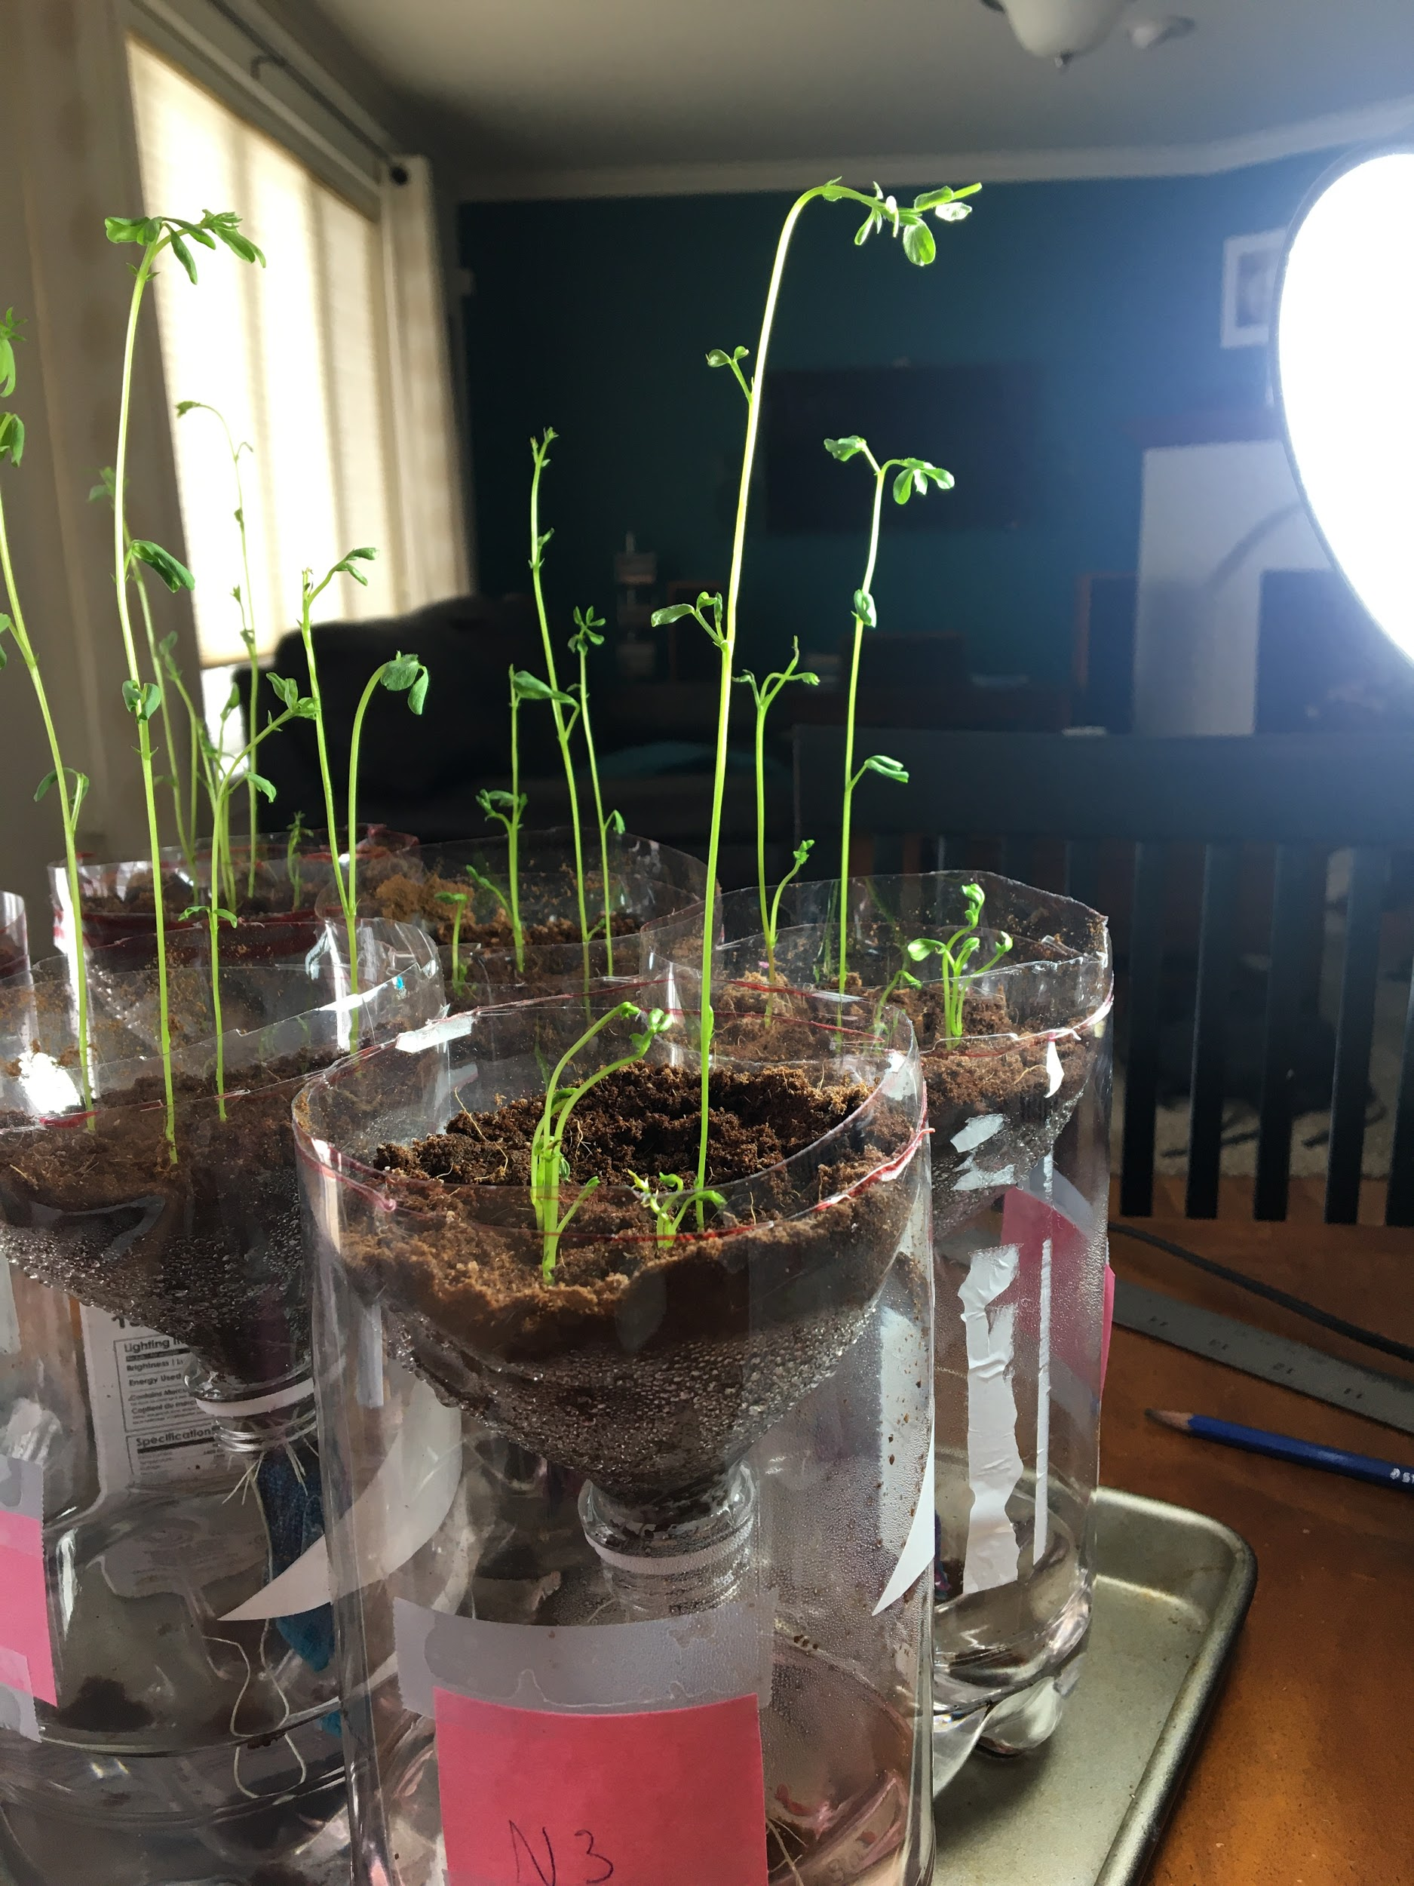
Purpose
The purpose of this project is compare hydroponically grown plants with nutrient-rich water versus hydroponically grown plants with regular purified water containing no added nutrients.

Slide 4
Variables
Independent variable - The independent variable will be the amount of nutrients used on the lentils
Dependant Variable - The dependent variable will be the growth of the green lentils.
Control - The control will be the green lentils and the coconut coir as they do not change throughout the project.

Slide 5
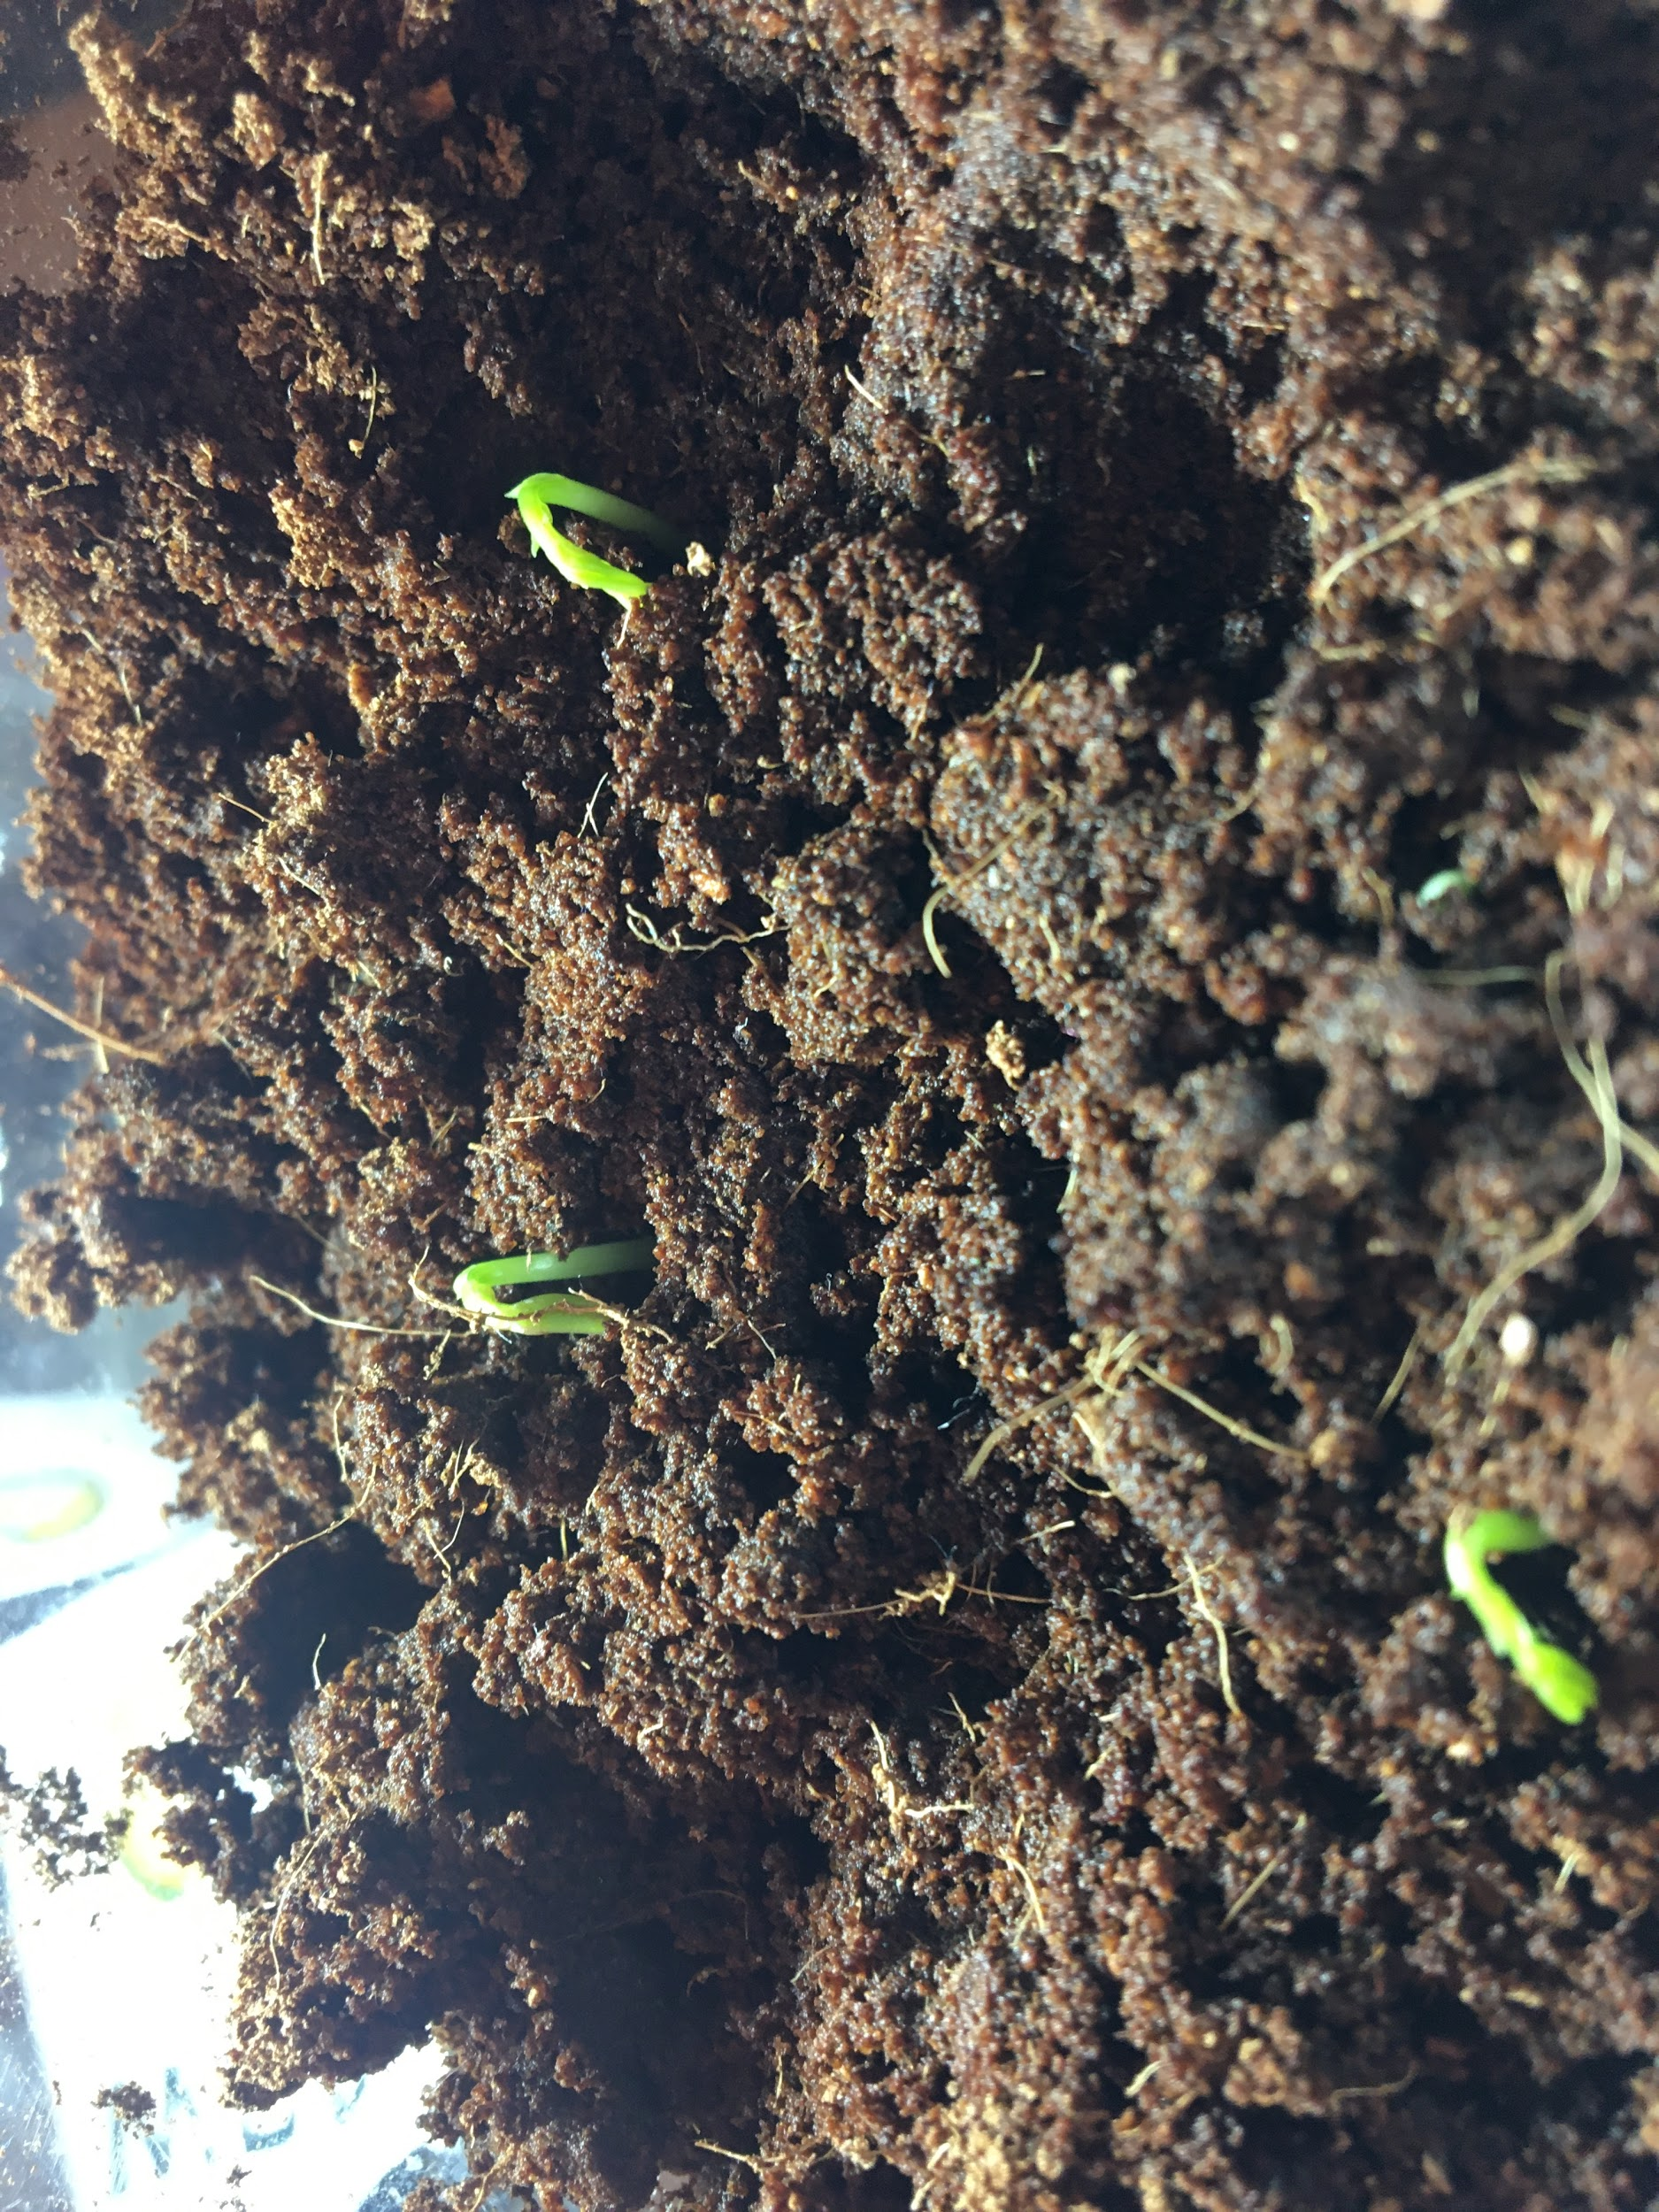
Hypothesis
The Hypothesis is that the hydroponically grown plants with nutrient rich water will grow bigger and faster than the plants grown with regular purified water.

Slide 6
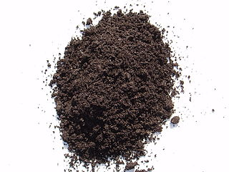
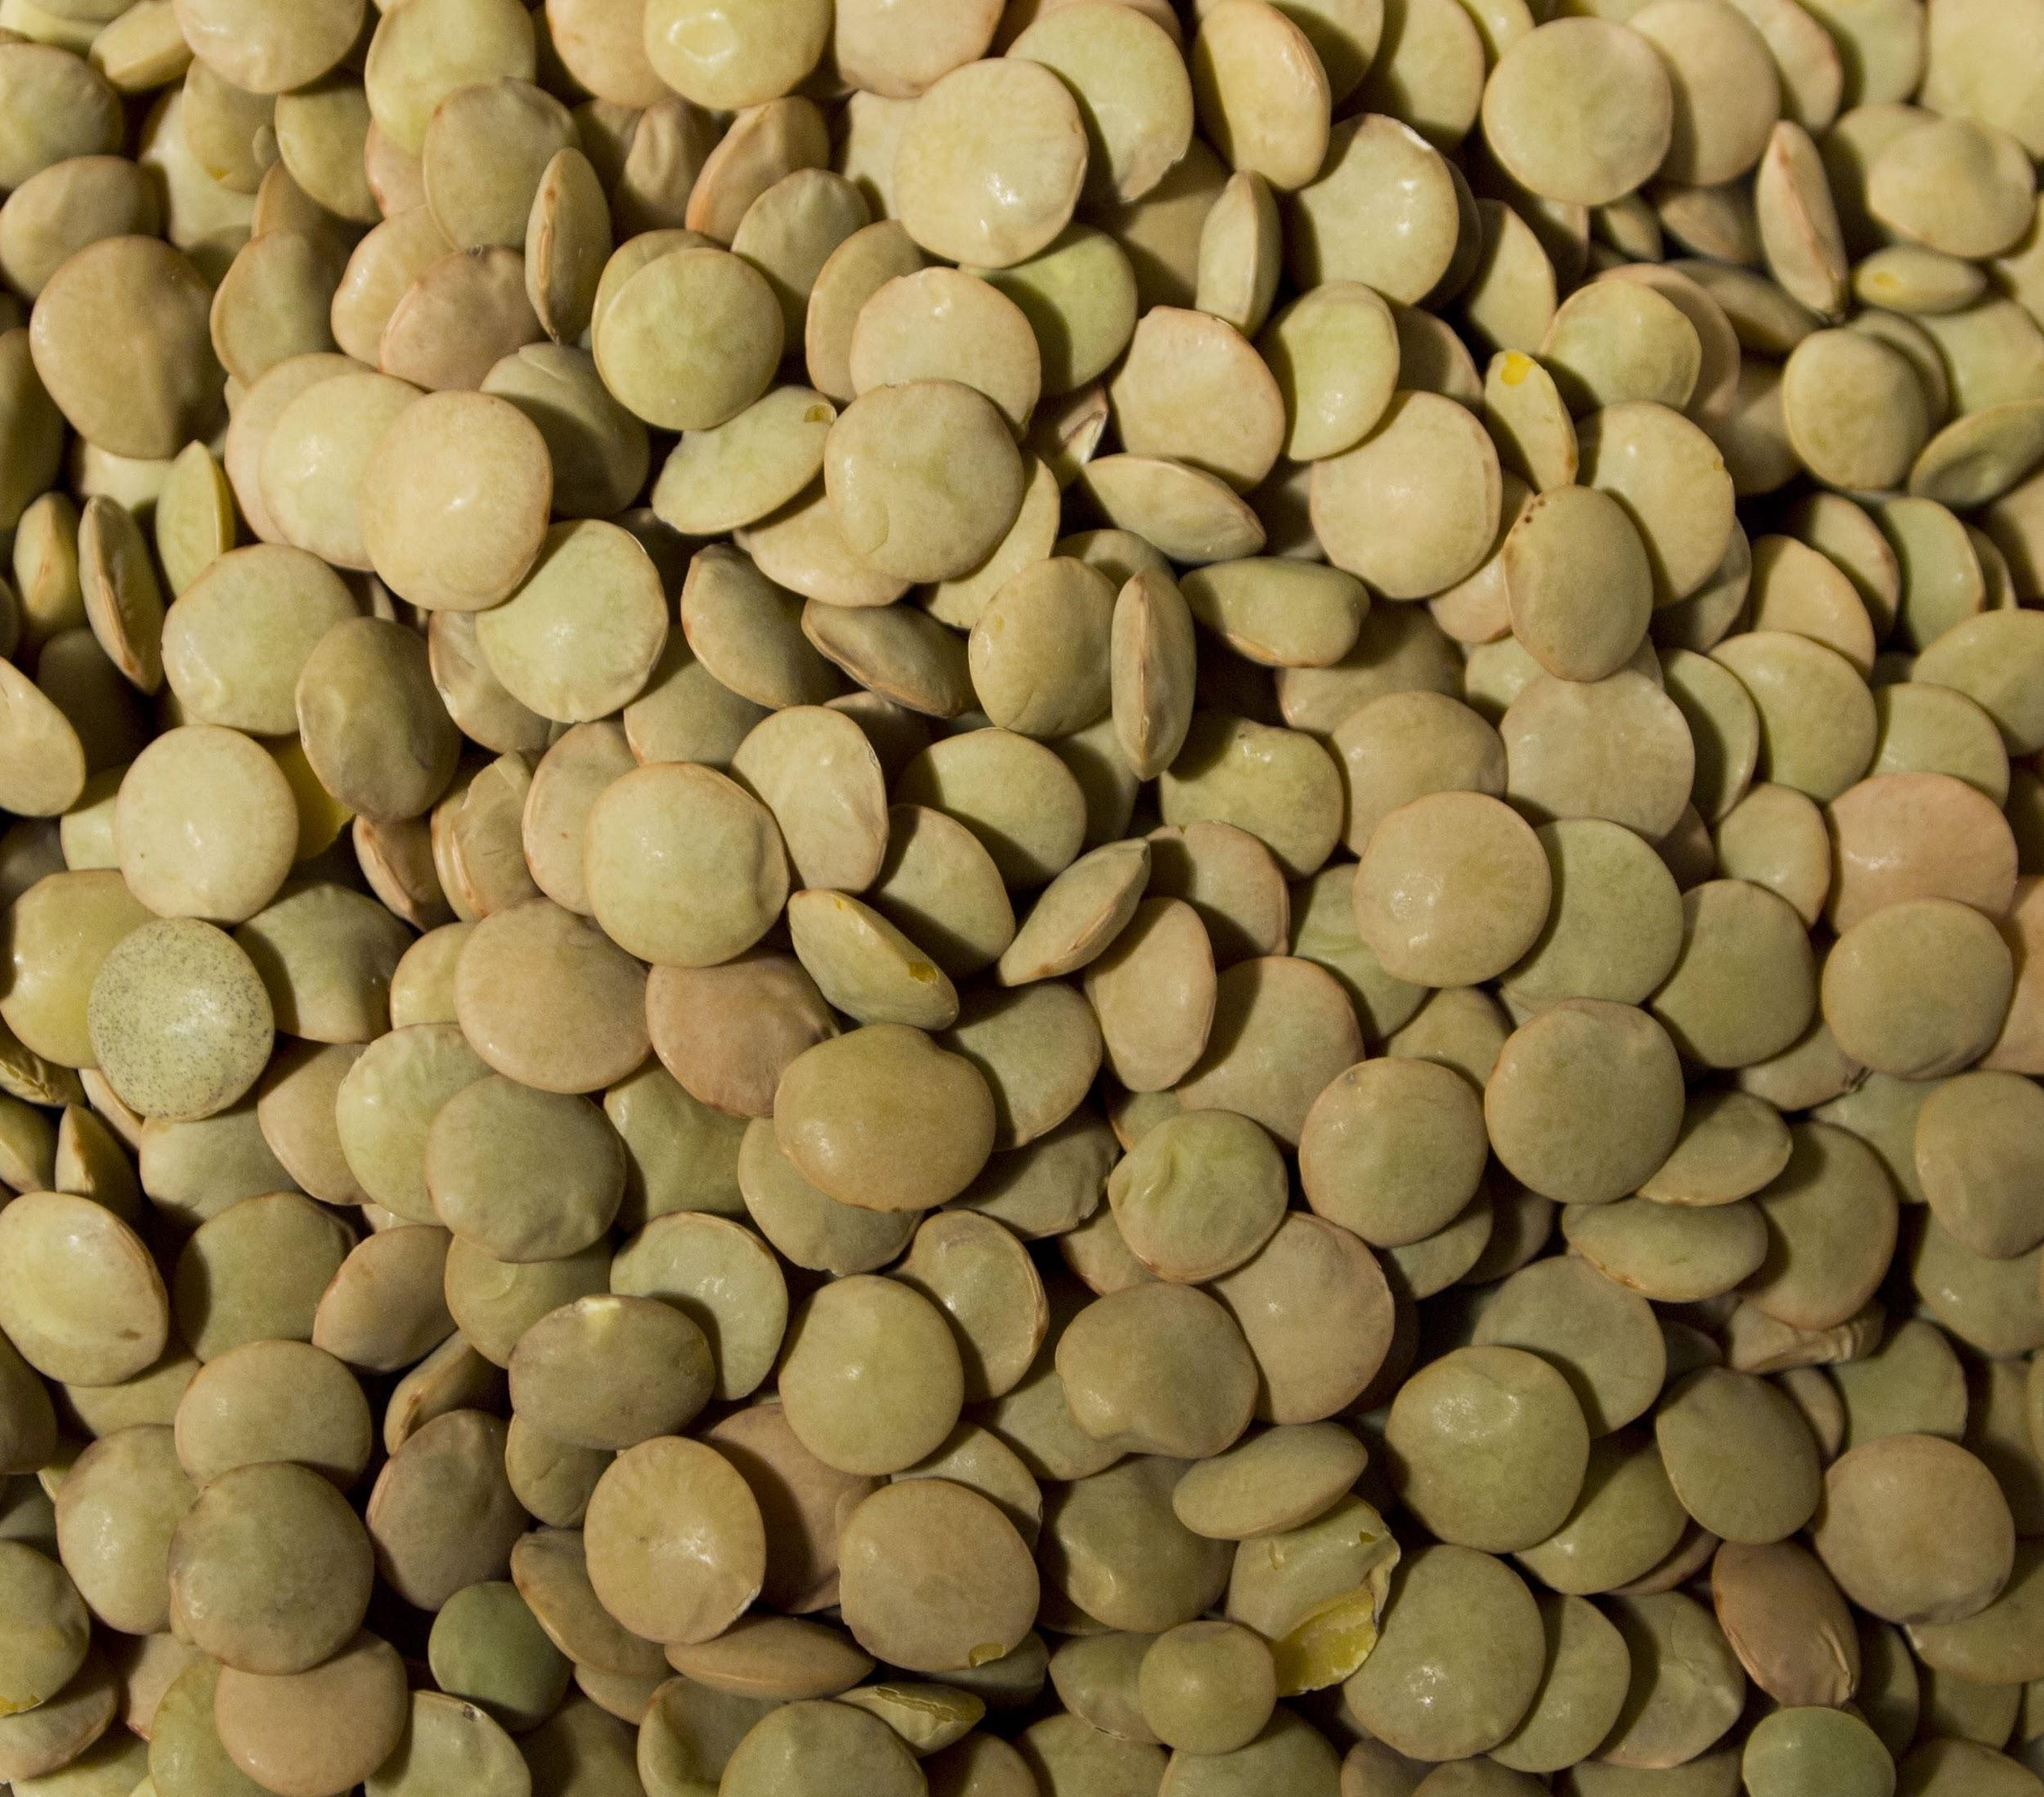

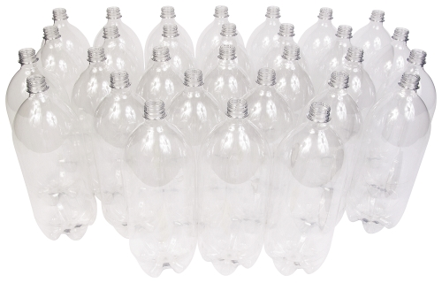
Materials
6 2L soda bottles
String Of Towel
Coconut Coir
Green Lentils
Gh Flora Grow
Digital scale

Slide 7
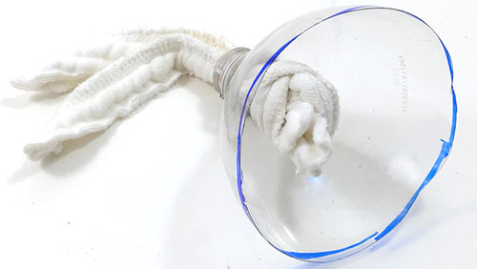
Procedure
Assemble all materials needed
Cut 2L soda bottle where the cylinder starts to curve towards the cap.
Flip the top part so the cap faces into the bottle.
Place the wick (piece of towel) in the top of the bottle. This will carry the water up to your plant.

Slide 8
Procedure
5. Fill the top part with coconut coir. This will be what your seeds will be grown in instead of soil. Coconut coir contains not nutrients.
6. Plant your seeds (I planted 4 in each container,
but you may plant more or less)
7. Water 3/6 containers with regular purified water and the 3/6
with nutrient-rich water.
8. Make sure to fill the bottom of the 2L bottle with nutrient-rich water or regular purified water so the wick can carry the water up to the seeds.
9. When you see sprouts record you data and the date.
10. Make sure to refill the water at the bottom if it is running low.
11. Monitor the plants and keep notes on measuring the height and length of the plant each day to record the differences in the height and in the length of the leaves.

Slide 9
Procedure
12. Once you have recorded your growth data gently uproot your plants and weigh the largest plant from each container.
13. Compare the weight between the nutrient-rich plants and the regular purified water plants.
14. Notice if there is differences in color of the roots, how much roots there are, and any other differences.

Slide 10
Results
Seeding Date: January 29th Seed type: Green Lentils Sprout date: February 3rd **NOTE** Height of the largest plant was taken every day and the length of the largest leaf was taken every two days. Nutrient-Rich Water Purified Regular Water Container N1 N2 N3 W1 W2 W3
Seedlings Appear - All Nutrient Rich water and Regular Purified water sprouted on February 3rd
Length Of Largest Leaf: 9mm 9mm 8mm 7mm 8mm 9mm Height of largest plant: 2.7cm 2.6cm 3.2cm 3.1cm 4.1cm 3.7cm Date: February 4th
Height of largest plant: 6.1cm 5.5cm 6.6cm 4.7cm 5.8cm 5.4cm Date: February 5th
Length of largest leaf: 1.3cm 1.5cm 1cm 9mm 9mm 1.4cm Height of largest plant: 6.1cm 5.5cm 6.6cm 4.7cm 5.8cm 5.4cm Date: February 6th
Height Of Largest Plant: 11.1cm 10.8cm 10.6cm 8.5cm 9.4cm 9.0cm Date: February 7th

Slide 11
Seeding Date: January 29th Seed type: Green Lentils Sprout date: February 3rd Nutrient-Rich Water Purified Regular Water Container N1 N2 N3 W1 W2 W3
Seedlings Appear - All Nutrient Rich water and Regular Purified water sprouted on February 3rd
Length Of Largest Leaf: 2cm 1.7cm 1.3cm 1.3cm 1.7cm 1.6cm Height of largest plant: 14cm 12.9cm 14.3cm 11.5cm 11.5cm 12 cm Date: February 8th
Height of largest plant: 16.0cm 15.5cm 16.2cm 14.6cm 14.0cm 14.3cm Date: February 9th
Length of largest leaf: 2.4cm 2.0cm 2.0cm 2.0cm 2.0cm 1.8cm Height of largest plant: 18.1cm 17.5cm 18.7cm 16.1cm 14.8cm 15.7cm Date: February 10th
Height Of Largest Plant: 11.1cm 10.8cm 10.6cm 8.5cm 9.4cm 9.0cm Date: February 11th

Slide 12
Seeding Date: January 29th Seed type: Green Lentils Sprout date: February 3rd Nutrient-Rich Water Purified Regular Water Container N1 N2 N3 W1 W2 W3
Seedlings Appear - All Nutrient Rich water and Regular Purified water sprouted on February 3rd
Length Of Largest Leaf: 2.5cm 2.1cm 2.2cm 2.1cm 2.1cm 1.9cm Height of largest plant: 20.9cm 21.7cm 22cm 19.5cm 15.5cm 18.2 cm ******************* Date: February 12th
Height of largest plant: 22cm 23.2cm 23.3cm 19.5cm 16cm 20cm Date: February 13th
Length of largest leaf: 2.7cm 2.7cm 2.6cm 2.6cm 2.5cm 2cm Height of largest plant: 23.5cm 24.2cm 24.1cm 22.5cm 16cm 20cm ************* Date: February 14th
Height Of Largest Plant: 24cm 25cm 25.1cm 23.1cm 16.5cm 21.1cm Date: February 15th

Slide 13
Seeding Date: January 29th Seed type: Green Lentils Sprout date: February 3rd Nutrient-Rich Water Purified Regular Water Container N1 N2 N3 W1 W2 W3
Seedlings Appear - All Nutrient Rich water and Regular Purified water sprouted on February 3rd
Length Of Largest Leaf: 2.8cm 2.7cm 2.6cm 2.7cm 2.6cm 2.7cm Height of largest plant: 24.6cm 25.5cm 26.4cm 23cm 17cm 22cm Date: February 16th
Height of largest plant: 25.7cm 25.5cm 26.4cm 23.6m 17.1cm 23.2cm Date: February 17th

Slide 14
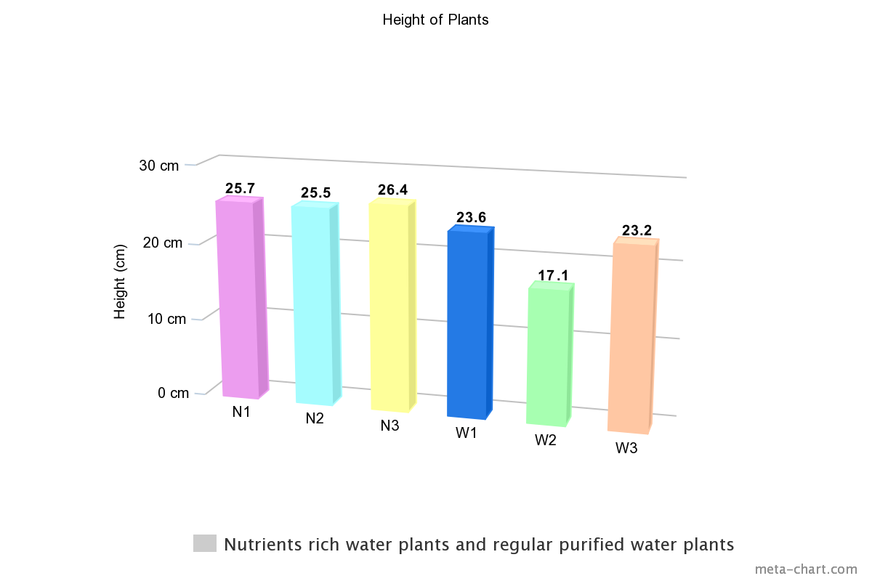
Bar graph end results.

Slide 15
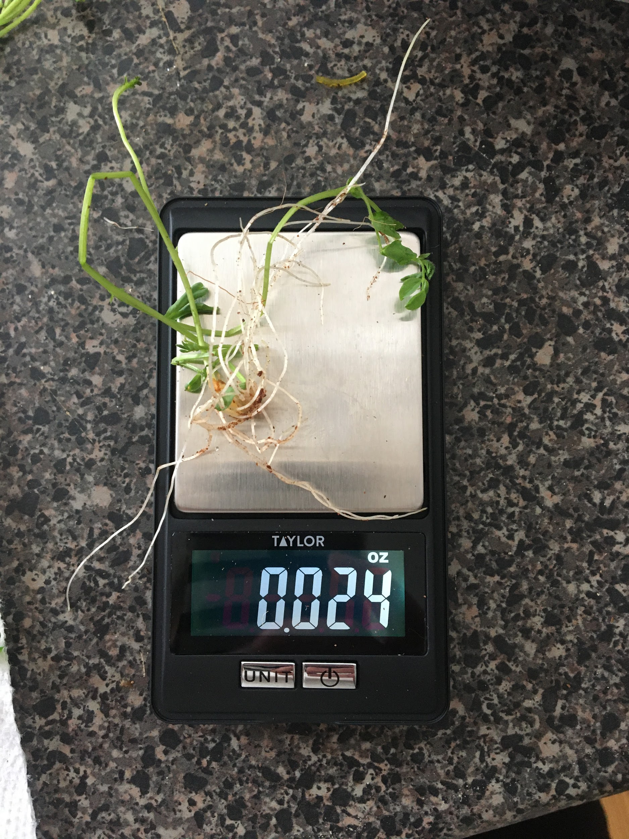
Results - Weight of the roots and notes
N1 - 0.030 oz
N2 - 0.027 oz
N3 - 0.022 oz - Very little roots
W1 - 0.019 oz
W2 - 0.024 oz
W3 - 0.018 oz - Very little roots

Slide 16
Observations
While doing this project there were several things noted. As predicted in the hypothesis, the nutrient-rich water plants did grow a fair bit bigger than the plants with regular purified water. However at the start of the project both sprouted on the same day. The plants with Regular Purified water were starting to take off faster than the nutrient-rich water and had 0.9cm in the difference between the largest Nutrient-rich water plant and Regular purified water plant on the first day they sprouted. Another observation is that when the plants were uprooted some of the Regular Purified water had a tint of orange on the roots and the Nutrient-Rich water did not. Another thing observed is when the plants were uprooted to weigh them, some of the roots got tangled into the towel rooter plug. In some areas they went through the towel. When recorded the weight of the roots the nutrient-rich plants had shorter roots but longer stalks and the regular purified water plants had longer roots but shorter stalks. Another thing noticed is that when the plants were uprooted the seed that was once a green lentil had now turned a tint of orange.

Slide 17
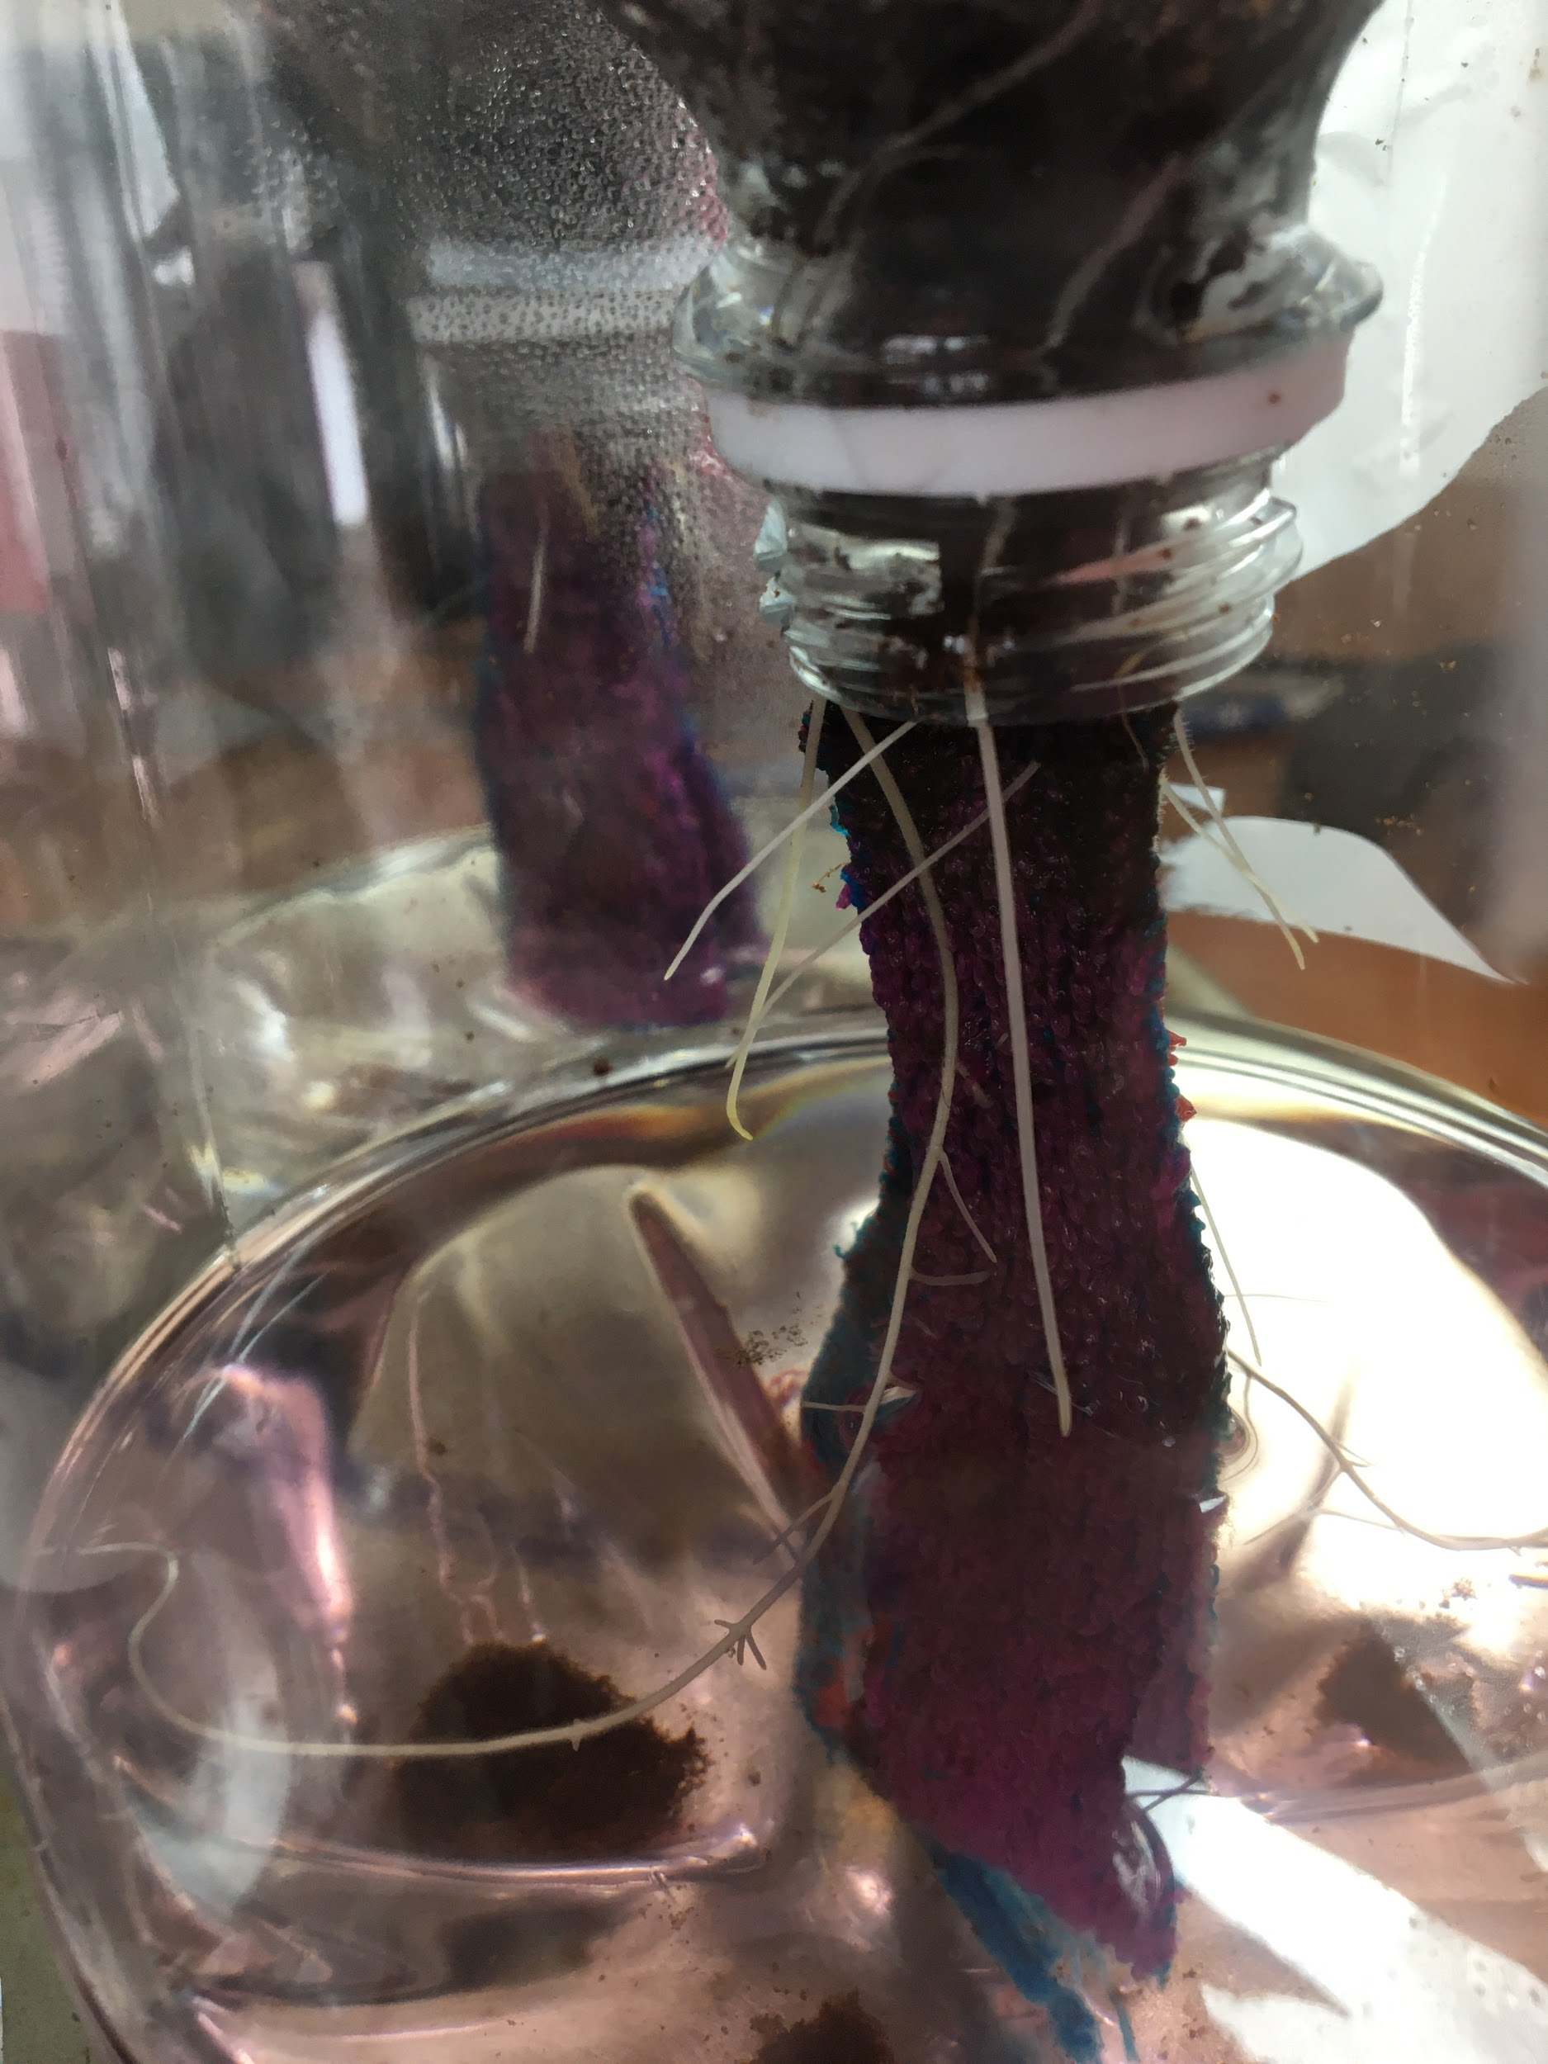
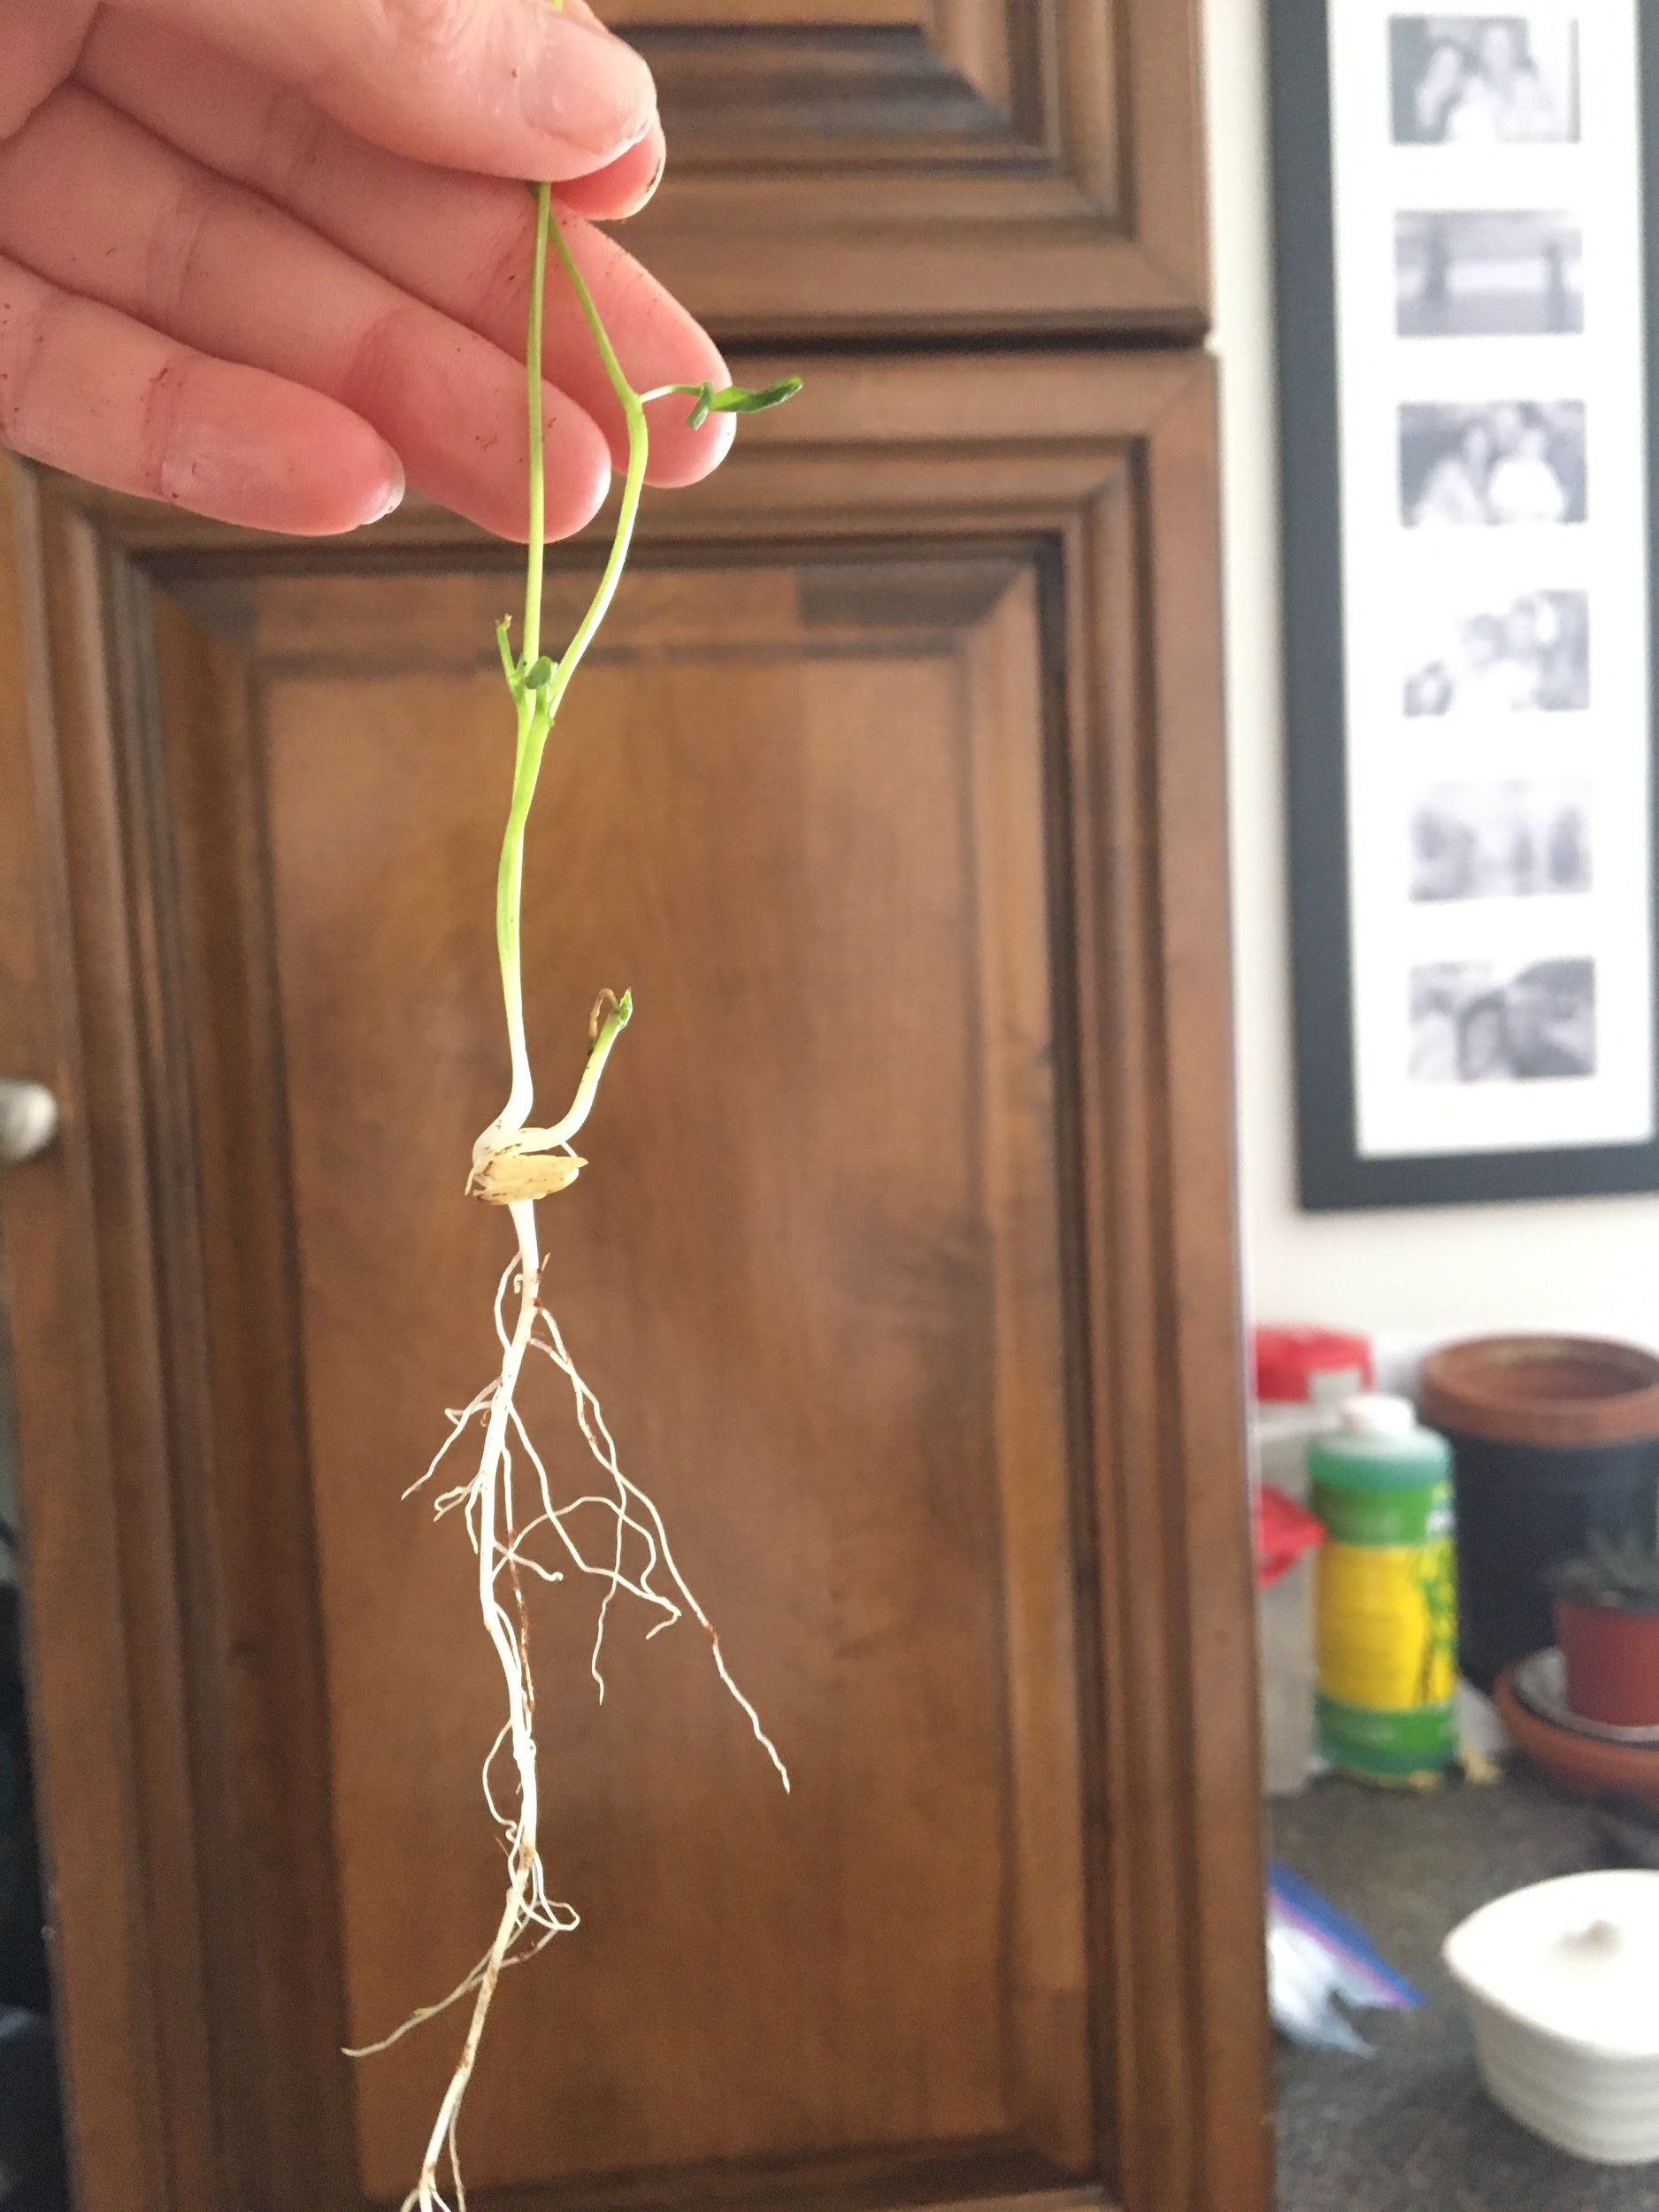

Slide 18
Discussion
Some different types of human error in this project could have been when the plants were measured. For example the measurements of the plants could have been a few millimeters off when measuring the height of the plant as well as the length of the leaves. Another example is one week the nutrients could have not been mixed thoroughly throughout the water allowing some plants to get more nutrients than others. When looking at the results some things that were very noticeable are that my nutrient rich plants did better in the end of the project than the regular purified water. However in the beginning of the project the regular purified water started to grow better. This could be caused due to the nutrients being added and how it may have caused a delay in there growing in the beginning when they were just seeds but once they sprout the nutrients help the plants to grow faster and bigger. However the nutrient rich plants may also have started to grow and take off a bit later then the regular purified plants due to being waterlogged and overwatered which is the number one reason for stunt of growth.

Slide 19
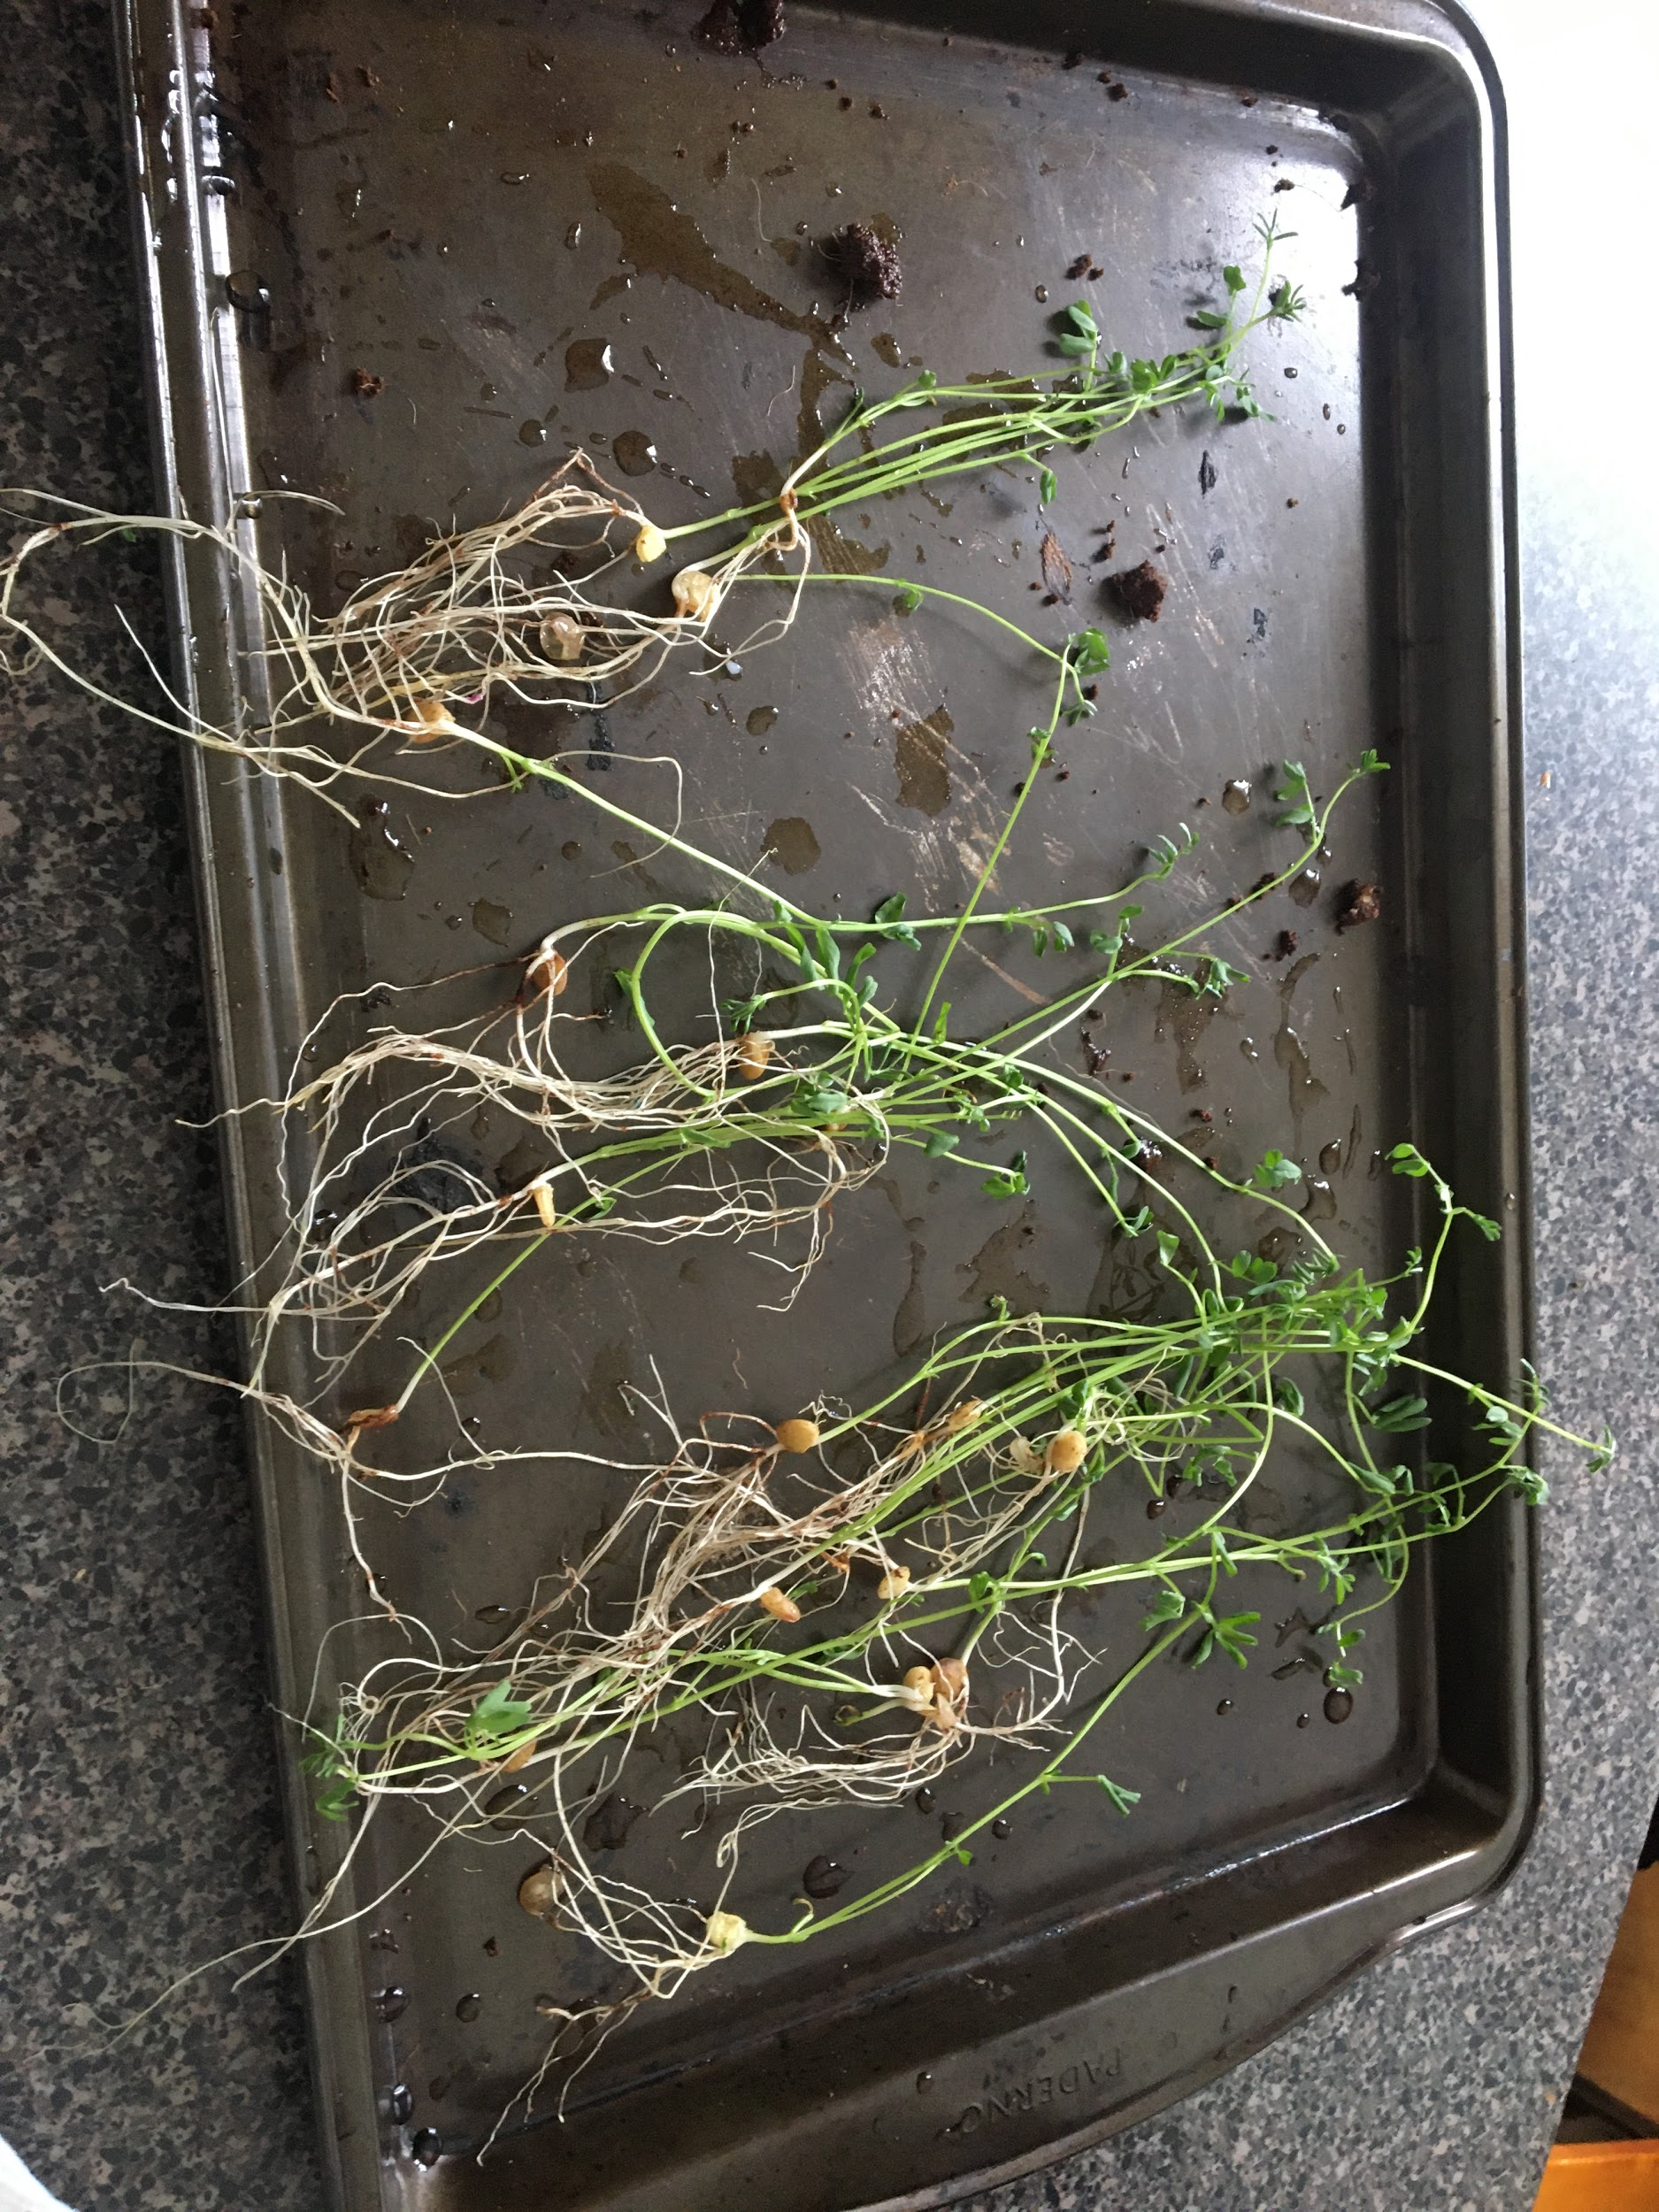
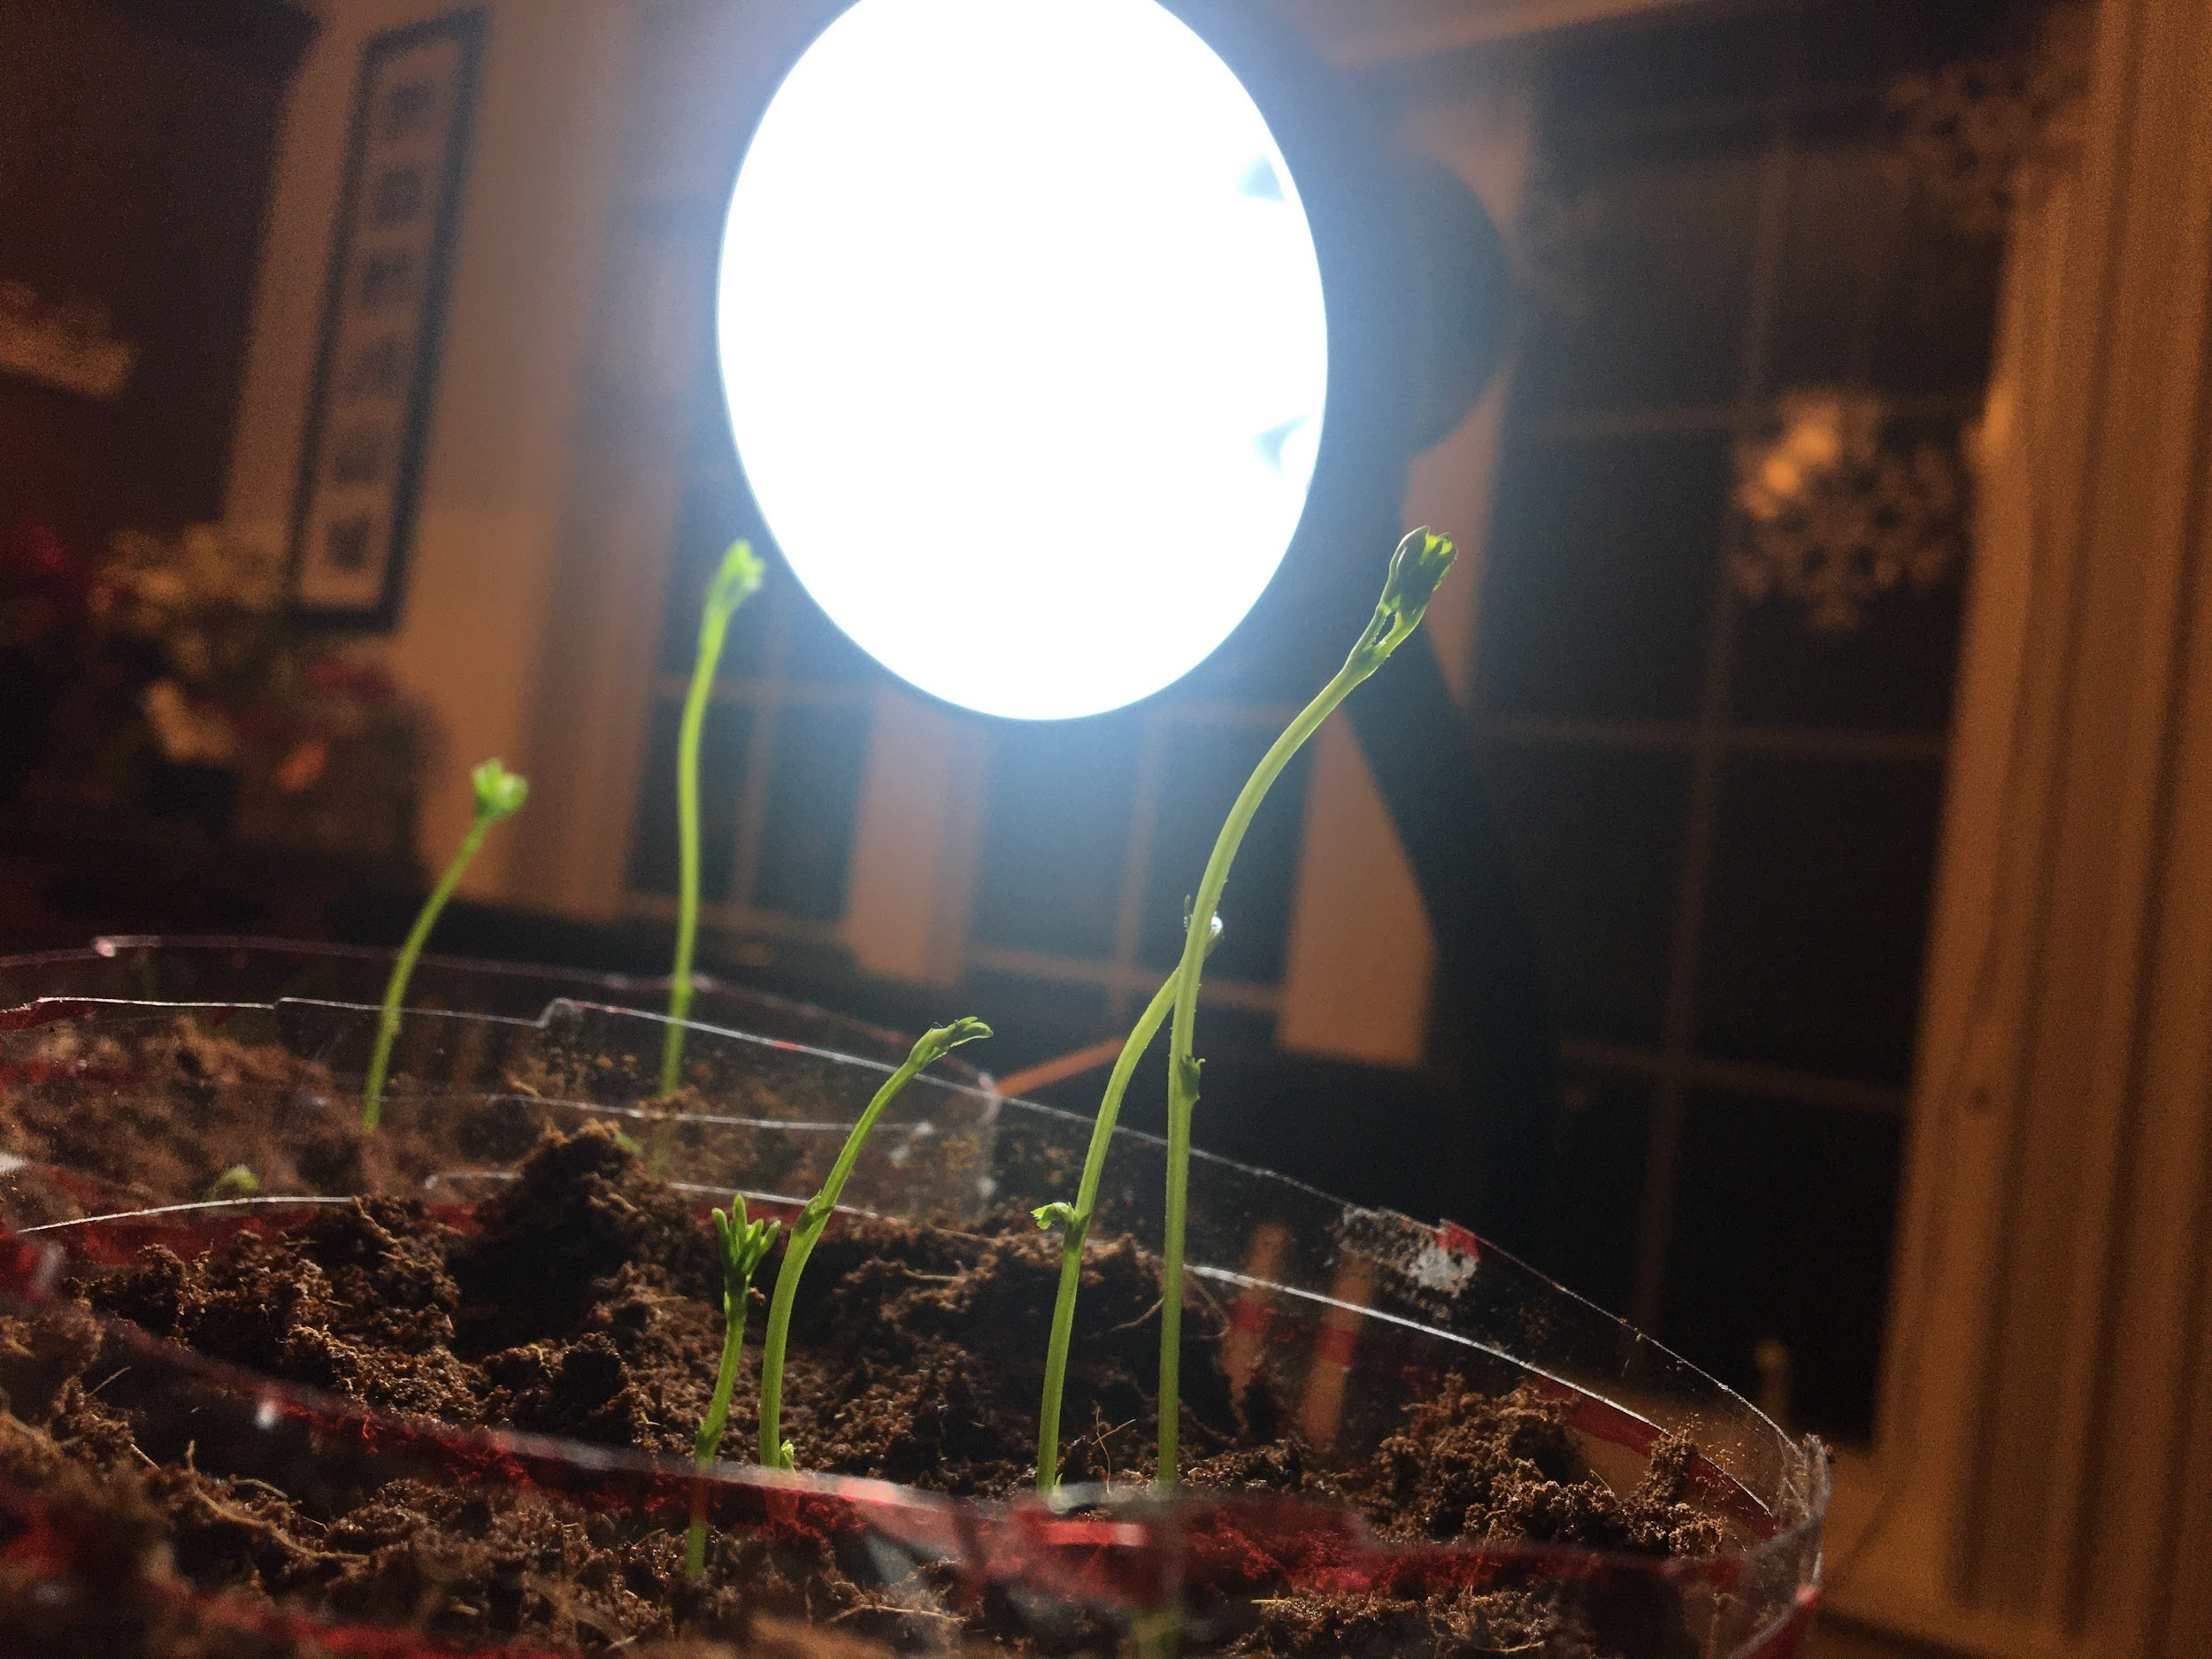
Conclusion
In conclusion the hypothesis was correct. It was predicted that the plants with nutrient rich water with grow better than the plants with regular purified water. This proves that hydroponics is a great alternative in Newfoundland as it can be grown year round in any season.

Slide 20
Bibliography
https://www.sciencebuddies.org/science-fair-projects/project-ideas/PlantBio_p045/plant-biology/hydroponics-gardening-without-soil#materials
https://www.verticalroots.com/the-what-and-why-of-hydroponic-farming/

