Slide 1

Can We Truly Trust Our Senses?
By: Vaishnavi Devarapalli and Sheza Chowdhury

Slide 2



Welcome!
Welcome to our project called “Can We Truly Trust Our Senses?” Our project is about the logic and theory behind if our hearing deteriorates as we age, and if so, then how? We will explain our experiment that we have conducted and our conclusion/theory. And afterwards, we will answer some questions!

Slide 3

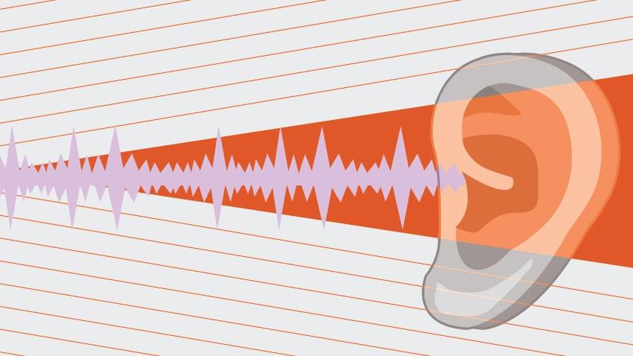
The Purpose
The purpose of this experiment is to see whether age affects our hearing, what causes it to affect our hearing, what we can do about it, and finally see if we can prevent the effect from happening in the beginning.

Slide 4


The Procedure
Get an auditory illusion (Yanny or Laurel)
Play it to people of various age groups (1-10, 10-20, 20-30...etc.)
Note what they hear (Yanny or Laurel, or Both)
Compare their results to other age groups (This many people heard Yanny in 1-10, but this many people heard Yanny in 20-30)

Slide 5

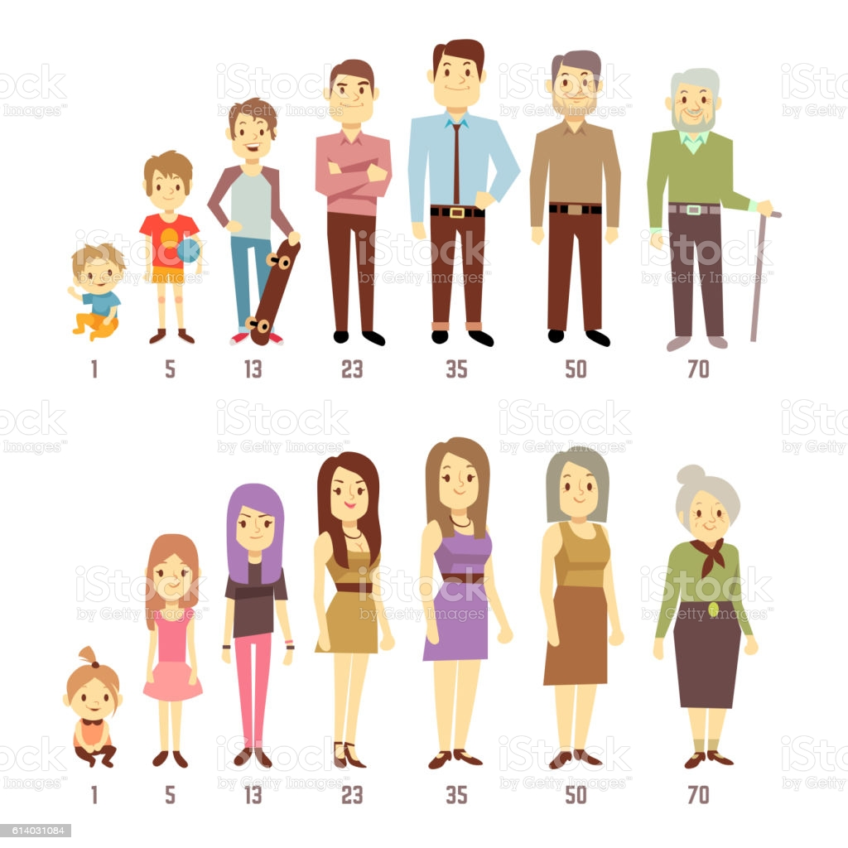
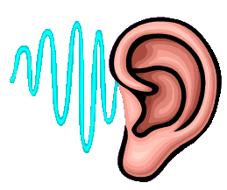
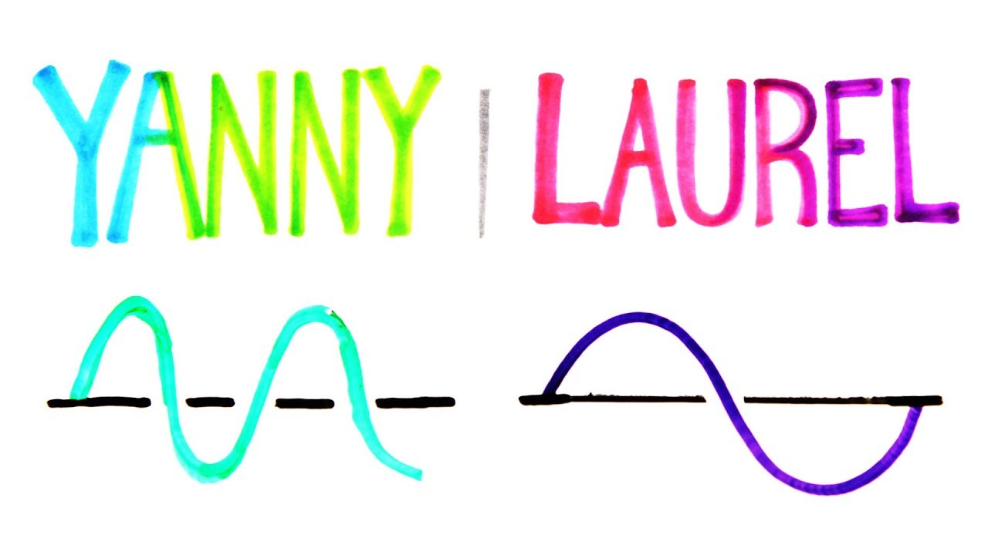
The Variables
There are two controlled variables in this experiment, the first being the audio illusion because no matter what, we are not changing the audio illusion, and the second being the place we are playing the illusion from, because if we were to switch devices then the outcome may not be as accurate. The independent variable in this experiment is the age, because we are changing the age group each time. And lastly the dependant variable of this experiment is what the person hears because that is what we are measuring/trying to find out.

Slide 6


Yanny or Laurel?
Here is the auditory illusion we will be using:
https://youtu.be/uuM6iAADU8U

Slide 7
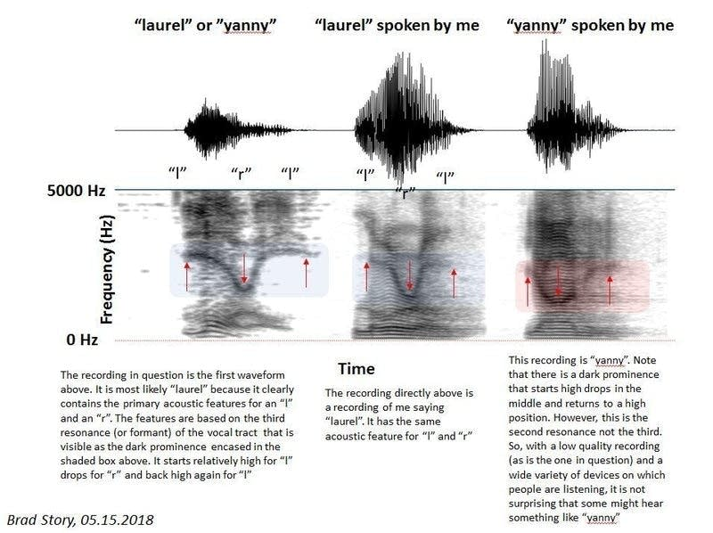

Slide 8



Our Hypothesis~!
Our hypothesis is that different age groups will hear different things because as we see in our daily lives as we get older, our hearing, along with our other senses are sharper the younger we are. And also sometimes there are things that we can hear, that our parents/elders can’t. So we predict that the older age groups will hear a majority of Laurel because we know that as we age our ability to hear higher frequencies, (Yanny) weakens because of Sensory Presbycusis. Presbycusis is an age related hearing loss, but Sensory Presbycusis is age related hearing loss that deprives us from hearing higher frequencies as we age.

Slide 9

Results~!

Slide 10
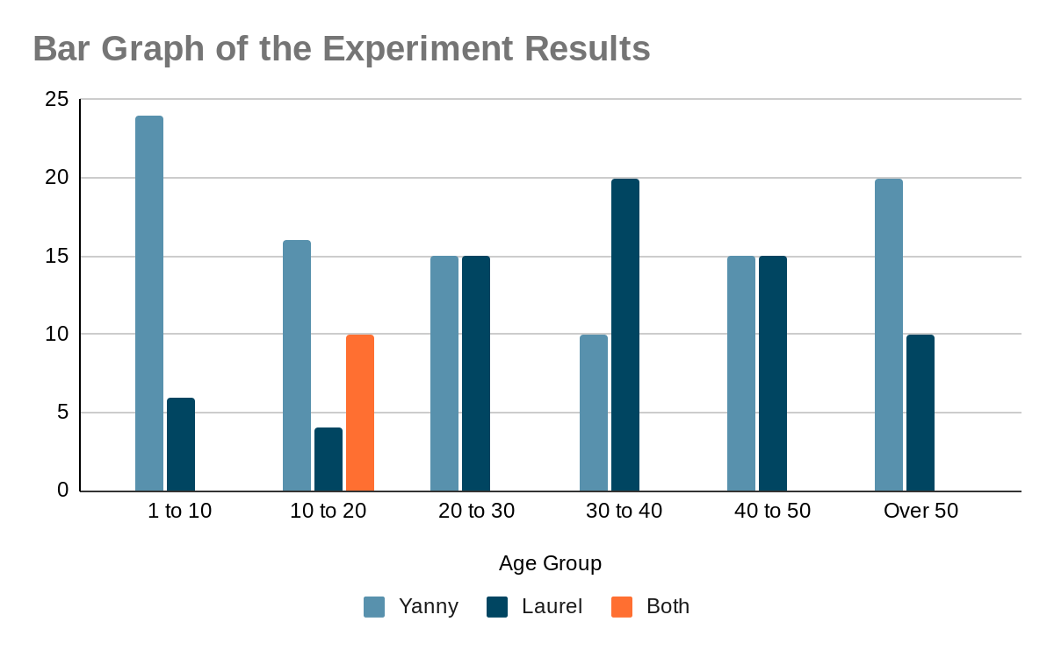

Slide 11

Analyzing The Results
We found that the age group 1-10 heard a majority of Yanny, because when you are younger you can hear higher frequencies better. For 10-20 the majority was still Yanny BUT some heard both Yanny AND Laurel at the same time which is not unusual because your ability to hear higher and lower frequencies always changes around the ages of 10-20. Once it came to 20-30, we see that they both balance out because Sensory Presbycusis can start as early as ages 18-20. But that does not mean that your hearing has COMPLETELY changed, so it balances out. In 30-40 you can see that now the majority is Laurel because now the ability to hear higher frequencies is deteriorating.

Slide 12


Something Unexpected…
When we got to 40-50 we saw that there was another balance, so we concluded that there could be other factors that could affect a person’s hearing. And finally over 50, there was a majority of Yanny, so we came to the conclusion that there ARE other factors that affect a person’s hearing, and not everyone is equally affected by Sensory Presbycusis as we thought.

Slide 13


Conclusion
Our conclusion is that “Can we truly trust our senses?....No. We cannot trust our senses because our senses/hearing is ever changing each day, we can count on them to keep us alive (hopefully) but as we age, essentials in daily life will become slightly more difficult, BUT~! There are things we can do to prevent/combat Sensory Presbycusis. Presbycusis, along with all the other types of it, is caused when neurological pathways in the inner ear weaken as we age. The damage caused varys from different factors such as genetic mutations, early noise exposure, and those times when you crank up the volume in your headphones to jam to a good song (you know what I’m talking about).

Slide 14


Preventing/Combating Presbycusis
Here are some easy-to-follow things we can do to prevent/combat Presbycusis:
Make sure you keep your headphones at a safe volume
Avoid loud noises such as motorbikes, snow mobiles, jet skis, and loud music at parties (That one’s mainly for the young ones ;))
Use earplugs when you are in places with a lot of noise
Ask people to speak up if they cannot be heard
Avoid places with too much noise pollution
Don’t stand too close to speakers at concerts

Slide 15

Starring
(Our “Test Subjects”)
Sheza’s Parents - Shuhana Shahnaz, and Rafiqul Chowdhury
Vaishnavi’s Parent- Rajasekhar Devarapalli Ramani Devarapalli
Our Teachers
Mr. West, Mrs. Penney, and Mme. Parsons
Our Classmates
Julianna Keay, Faith Ryall, Zein Sakkar, Spencer Malloy, and Kaelen Piercey
Other People
Lauren, Victor, Daisy, Daisy’s Sister, Zein’s Mom, Yafi, Tashfia, Tashfia’s Parents, Adrian, Adrian’s Parents, Alishba, Janita, Arika, Sadia, Marufa, Niha, Vaishnavi’s Sister, Sheza’s Aunt, Uncle, and Grandma, Raiyan, and Shaior.

Slide 16

Credits
Our Parents:
Sheza’s- Shuhana Shahnaz and Rafiqul Chowdhury
Vaishnavi's- Rajasekhar Devarapalli and Ramani Devarapalli
Our Teacher: Mr.West (Chesley West-chesleywest@nlesd.ca)
Websites/Organizations:
WestWeb: https://www.cheswest.com/sciences-7.html
MedlinePlus: https://medlineplus.gov/ency/article/004013.htm

Slide 17

Thank You~!
We hope you found our presentation interesting~!

