Slide 1
Surface Tension on Floating Objects and Cheerios Effect
Orpa Hawlader
Grade 8
Macdonald Drive Junior High
Notes:
Hi, I'm Orpa, I'm from Macdonald drive junior high. And my project is on something called the Cheerios effect.

Slide 2

Background
Cheerios
Plastic Balls
Notes:
Have you ever noticed how the cereal in your bowl of milk sticks to each other or the side of the bowl? This is because the milk or water’s surface curves when it touches objects which cause things to attract to each other I thought this was interesting so I decided to test what sort of things affect the force that pulls them together.

Slide 3
Question & Purpose
Purpose:
Examine why small floating objects, such as cheerios, are attracted to each other
Question:
What makes floating objects come closer together?
How shape of air-water interface near the floating object affects attraction?

Slide 4
Variables
Independent
Five different objects (float differently)
Cheerios
Small black beads
Medium blue beads
Big white beads
Light plastic balls
Dependent
How far attraction between two objects exists
Velocity of object due to attraction
Notes:
My two variables are size which was the independent variable and dependent variable being the time that it took for the two objects to attach to each other.

Slide 5
Materials
Clear plastic tubs/sink
Cheerios
Plastic balls
Beads
Grid paper
Water
Stopwatch
Magnifying glass
Cell phone to take pictures and videos
Notes:
To do the experiment we used….

Slide 6
Procedure
Fill plastic tub (or sink) with water
Place a piece of grid paper underneath the tub
Place objects gently onto water at a certain distance
Start video and stopwatch to get measurements
Restart if they were not connecting
Notes:
First thing we did was fill our tub with water, when we wanted to test with some bigger objects we used the sink. Then if we were using the tub we placed some grid paper underneath to measure the distance between the objects. When the objects were placed we started the stopwatch as well as started to film it. There was a certain distance at which the objects wouldn't attract to each other so if it that happened we would just place them a little a little closer together. This way we found the max distance but also got a video so we could find how the speed of the object would change.

Slide 7
Hypothesis
I predict that with increasing distance there will be a decrease in effect of the surface tension between two objects. This may be due to the curve of the air-water interface becoming more shallow/flatten out as we move away from the walls or other objects. The shape of the object can also have an effect the curve of the surrounding water which may not necessarily cause an attraction.

Slide 8
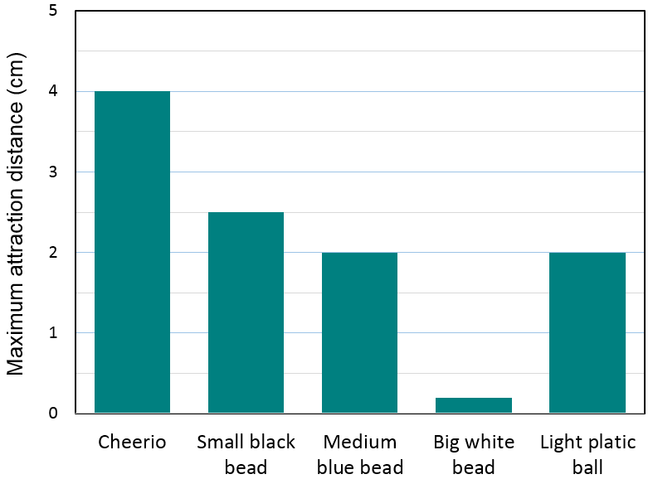


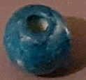
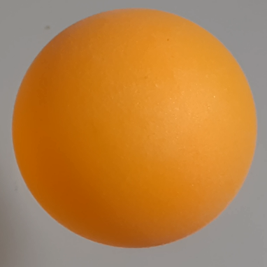
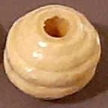
Maximum Distance Objects Can Attract

Slide 9
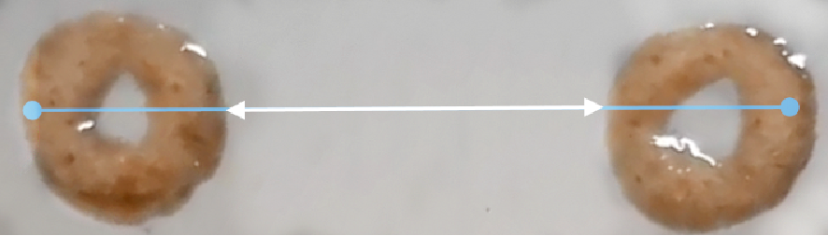
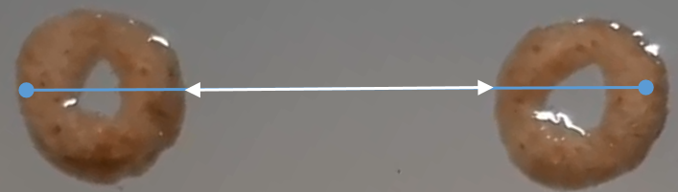
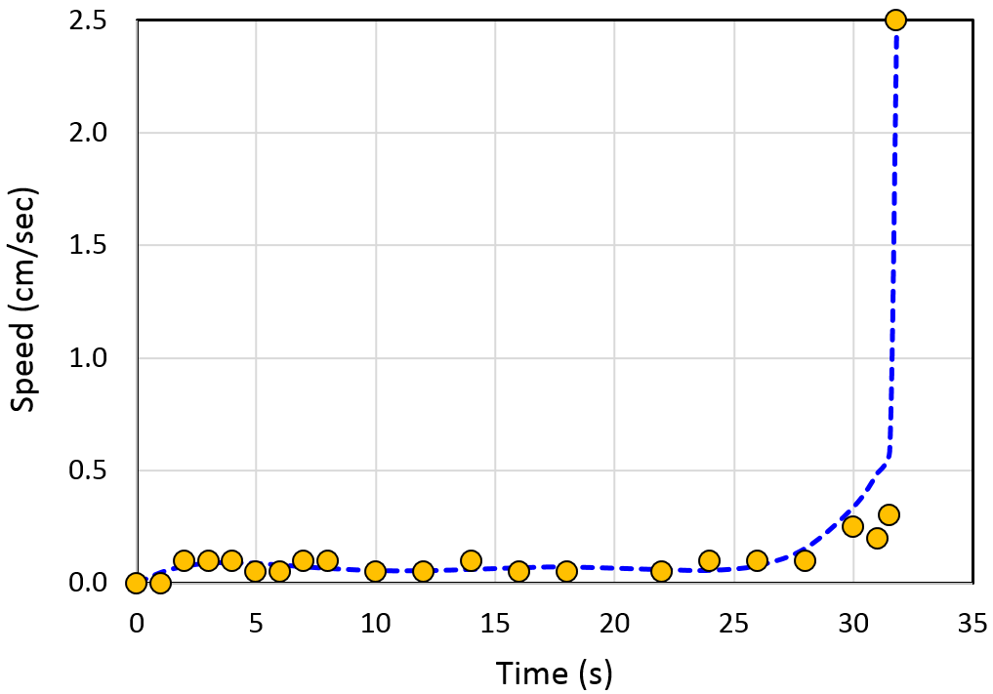
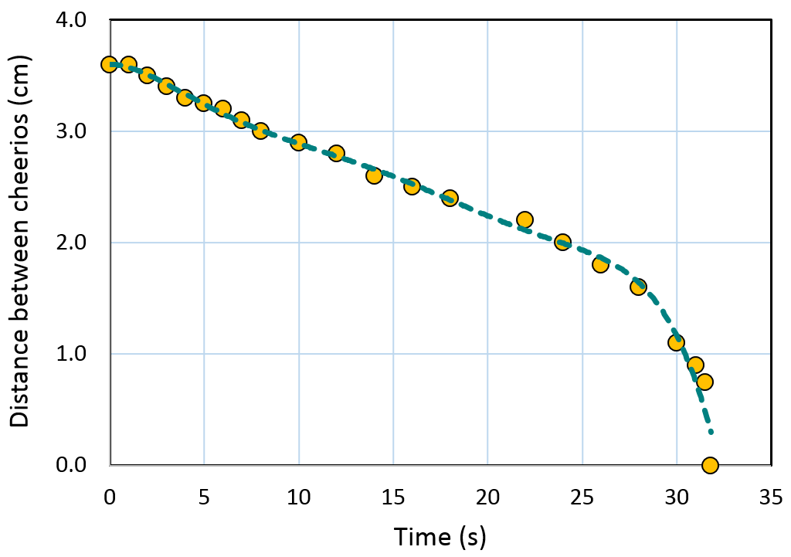
Results
Change in distance with time
Speed of cheerios

Slide 10
Discussion
Notes:
These objects connect because the water's surface curves up when it touches the object's surface. When there are to objects that are curving the water's surface in the same direction they will be attracted to each other. When a cheerio is placed in the water the water around it curves upward and they attach to each other.

Slide 11
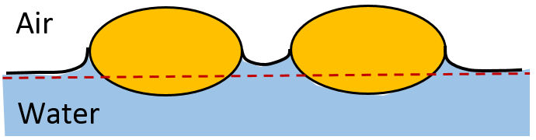
Why Objects Attract?
-Water surface curves up when it touches cheerios
-Cheerios seek highest point
So cheerios moves towards each other
Notes:
These objects connect because the water's surface curves up when it touches the object's surface. When there are to objects that are curving the water's surface in the same direction they will be attracted to each other. When a cheerio is placed in the water the water around it curves upward and they attach to each other.

Slide 12
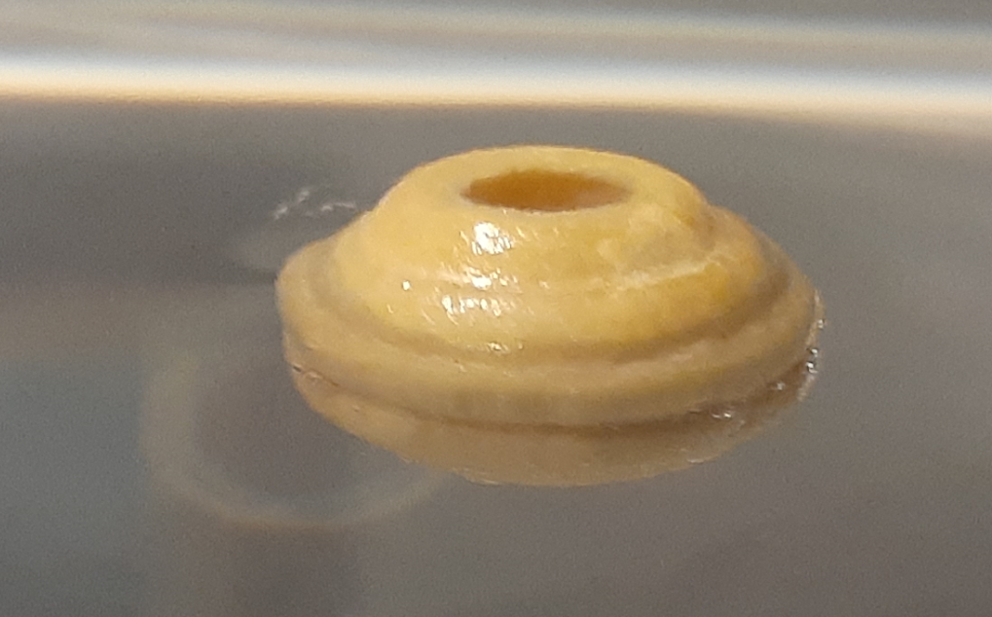
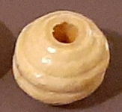
What Happens if Water Shape is Different?
Large white beads:
Because of the shape and how much it was submerged, unlike with the cheerios there was no curved shape of water
So, very little attraction occurred

Slide 13
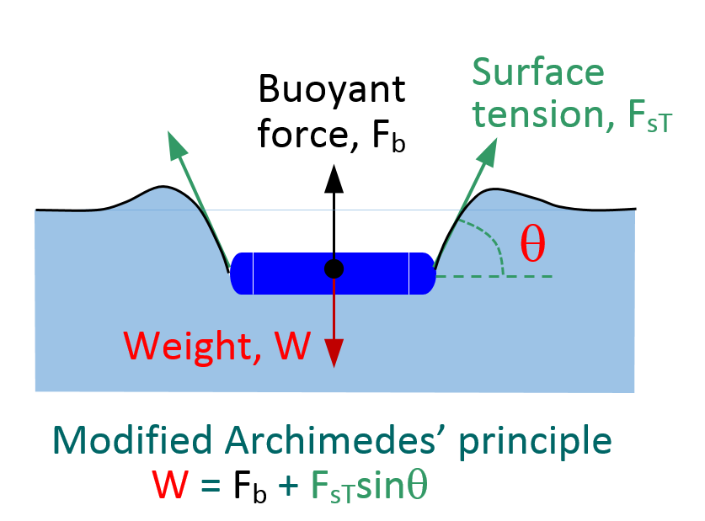
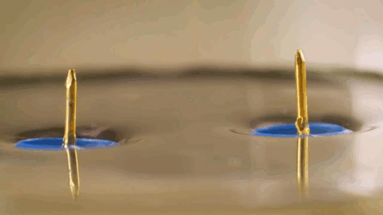
Heavier objects
-Paper clips usually would sink but waters meniscus can hold it up
-Water surface is curved downward
-If two paper clips are put in the water, they float toward each other
Notes:
On the other hand there are paper clips which are denser than water and usually it would sink but the waters meniscus is so strong that it can hold up the paper clip because of its surface area. It curves the water's surface downward and when two paper clips are put in the water they float toward each other as well. Another cool thing about this is the fact that if you place a paper clip and a cheerio near each other and they repel each other since the water's surface is moving in opposite. Archimedes' principle does not consider the surface tension (capillarity) acting on the body

Slide 14
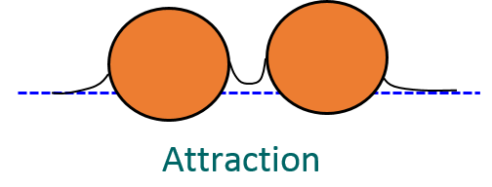
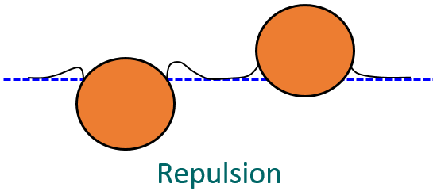
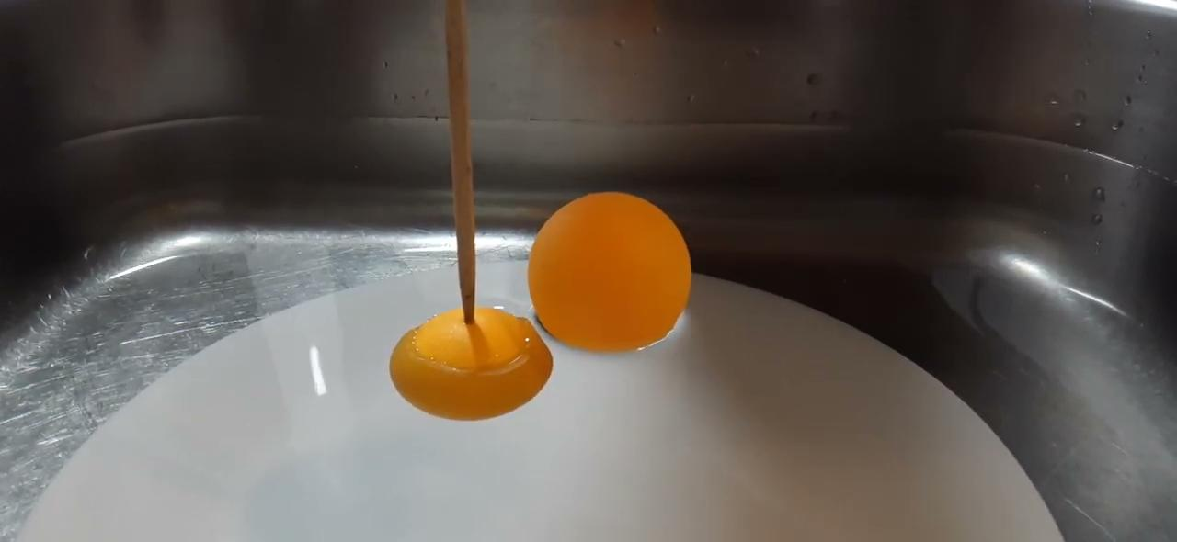
Different Water Surface Shape

Slide 15
Sources of Errors
- Could not measure exact maximum distance of attraction between objects accurately (many trials required)
-Shape of air-water interface was very difficult to measure
-Edge of plastic tub/sink might have some effects
-People walked around, even some breathing during experiment, caused some disturbance
Notes:
Since this was done at home there were a few things that could have gone wrong. We didn't have very good technology do the measurement probably weren't perfect but they were as accurate as we sould get them. We also coils have messed up the experiment by breathing on it or moving things in the area around it.

Slide 16
Conclusions
Shape of the air-water interface near the floating objects causes attraction or repulsion between them
Attraction depends on object type and the amount it submerged
Joining speed increases when they come closer

Slide 17
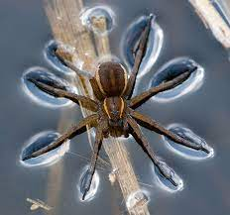
Possible Applications
Water-spiders use surface tension to get out of water
Other applications:
How to use the power of cheerios effect (Brown University)
Blood clot to heal injuries

Slide 18
References
Keller, J.B. (1998). Surface tension force on a partly submerged body. Physics of Fluids 10, 3009
Vella, D. & Mahadevan, L. (2005). The “cheerios effect.” American Journal of Physics 73, 817.
Vella, D. (2007). The fluid mechanics of floating and sinking.
Ooi C. H., Plackowski, C., Nguyen, A.V. Vadivelu R. K., St. John, J.A., Dao, D.V. & Nguyen, N. T. (2016). Floating mechanism of a small liquid marble. Scientific Reports, 6:21777.
Goodall, R. (2020) Harnessing the power of the ‘Cheerios effect.’ Brown University. https://theboar.org/2020/01/harnessing-the-power-of-the-cheerios-effect/

Slide 19
Acknowledgements
I would like to thank my mom, dad and sister who helped me to understand some concepts and doing experiments. Thanks to my science teacher who is always inspiring and supporting to explore some new things.

