Slide 1
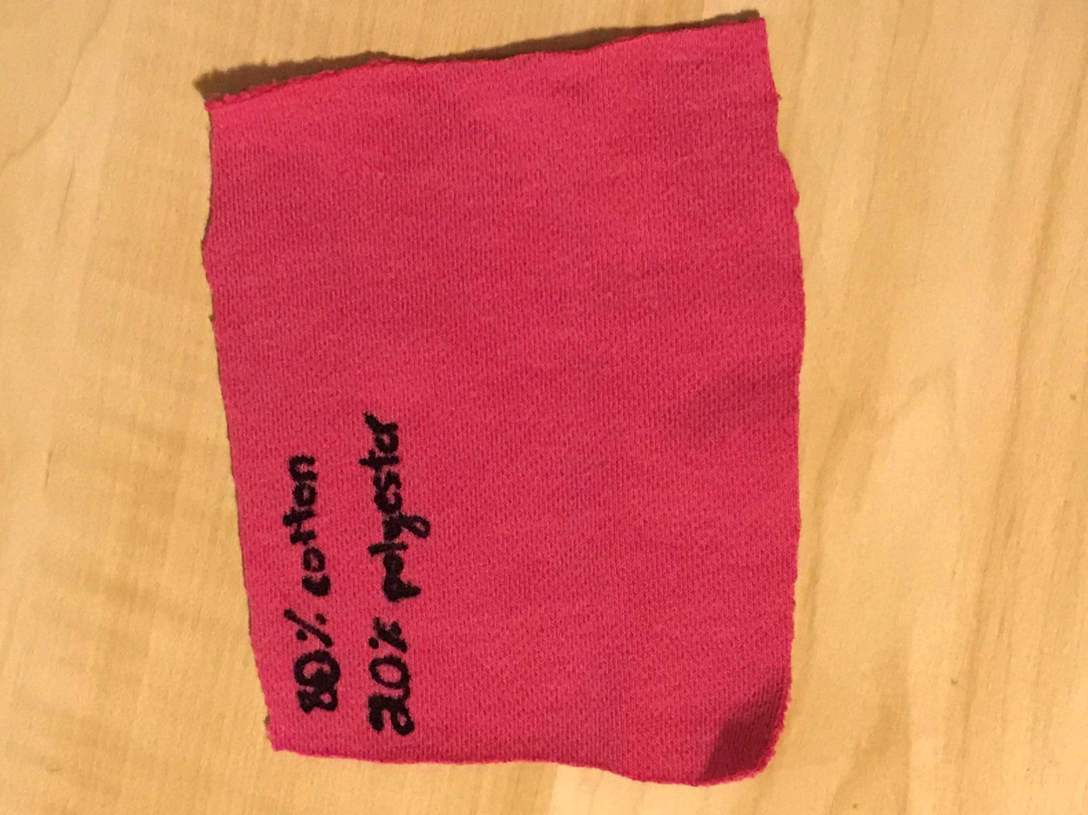
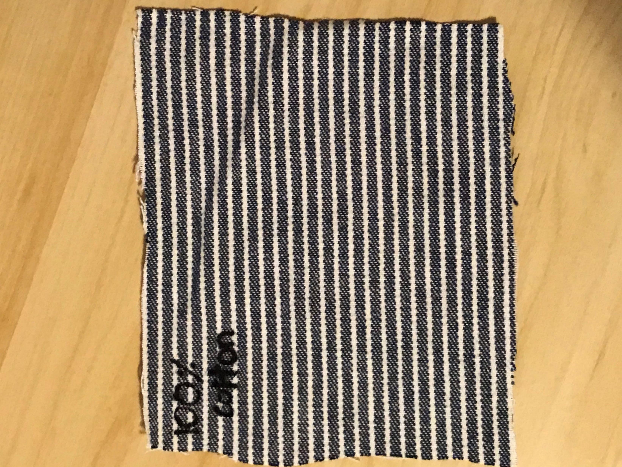
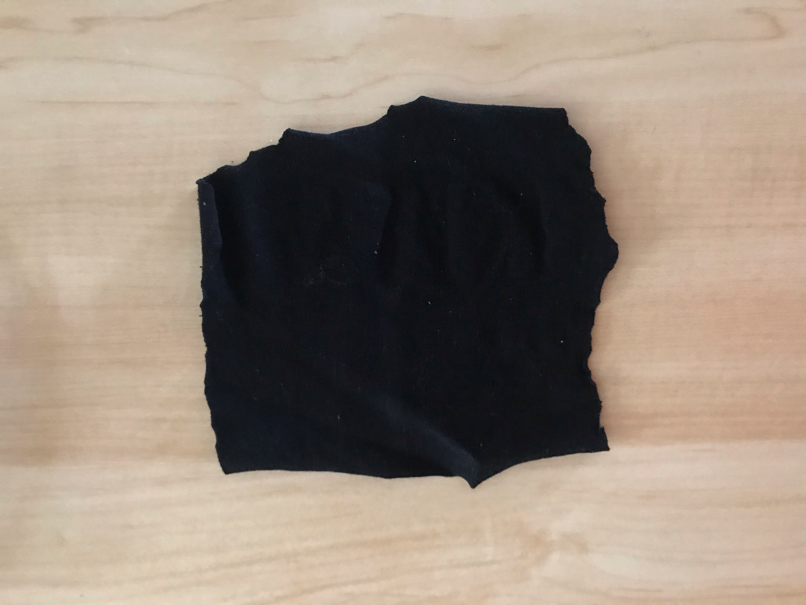
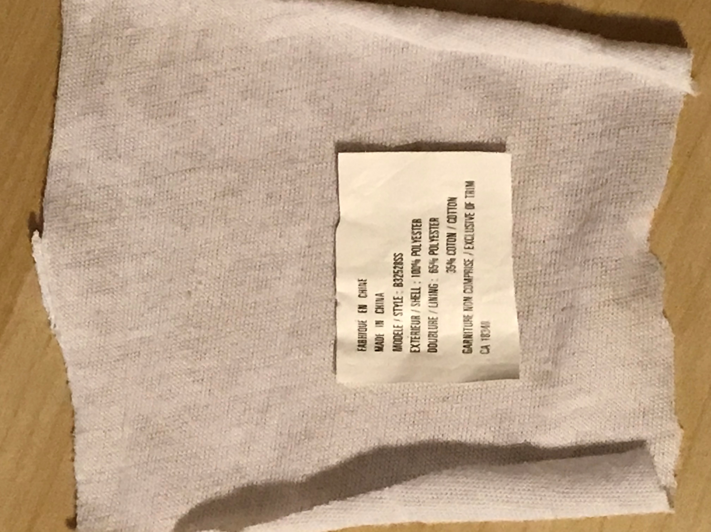
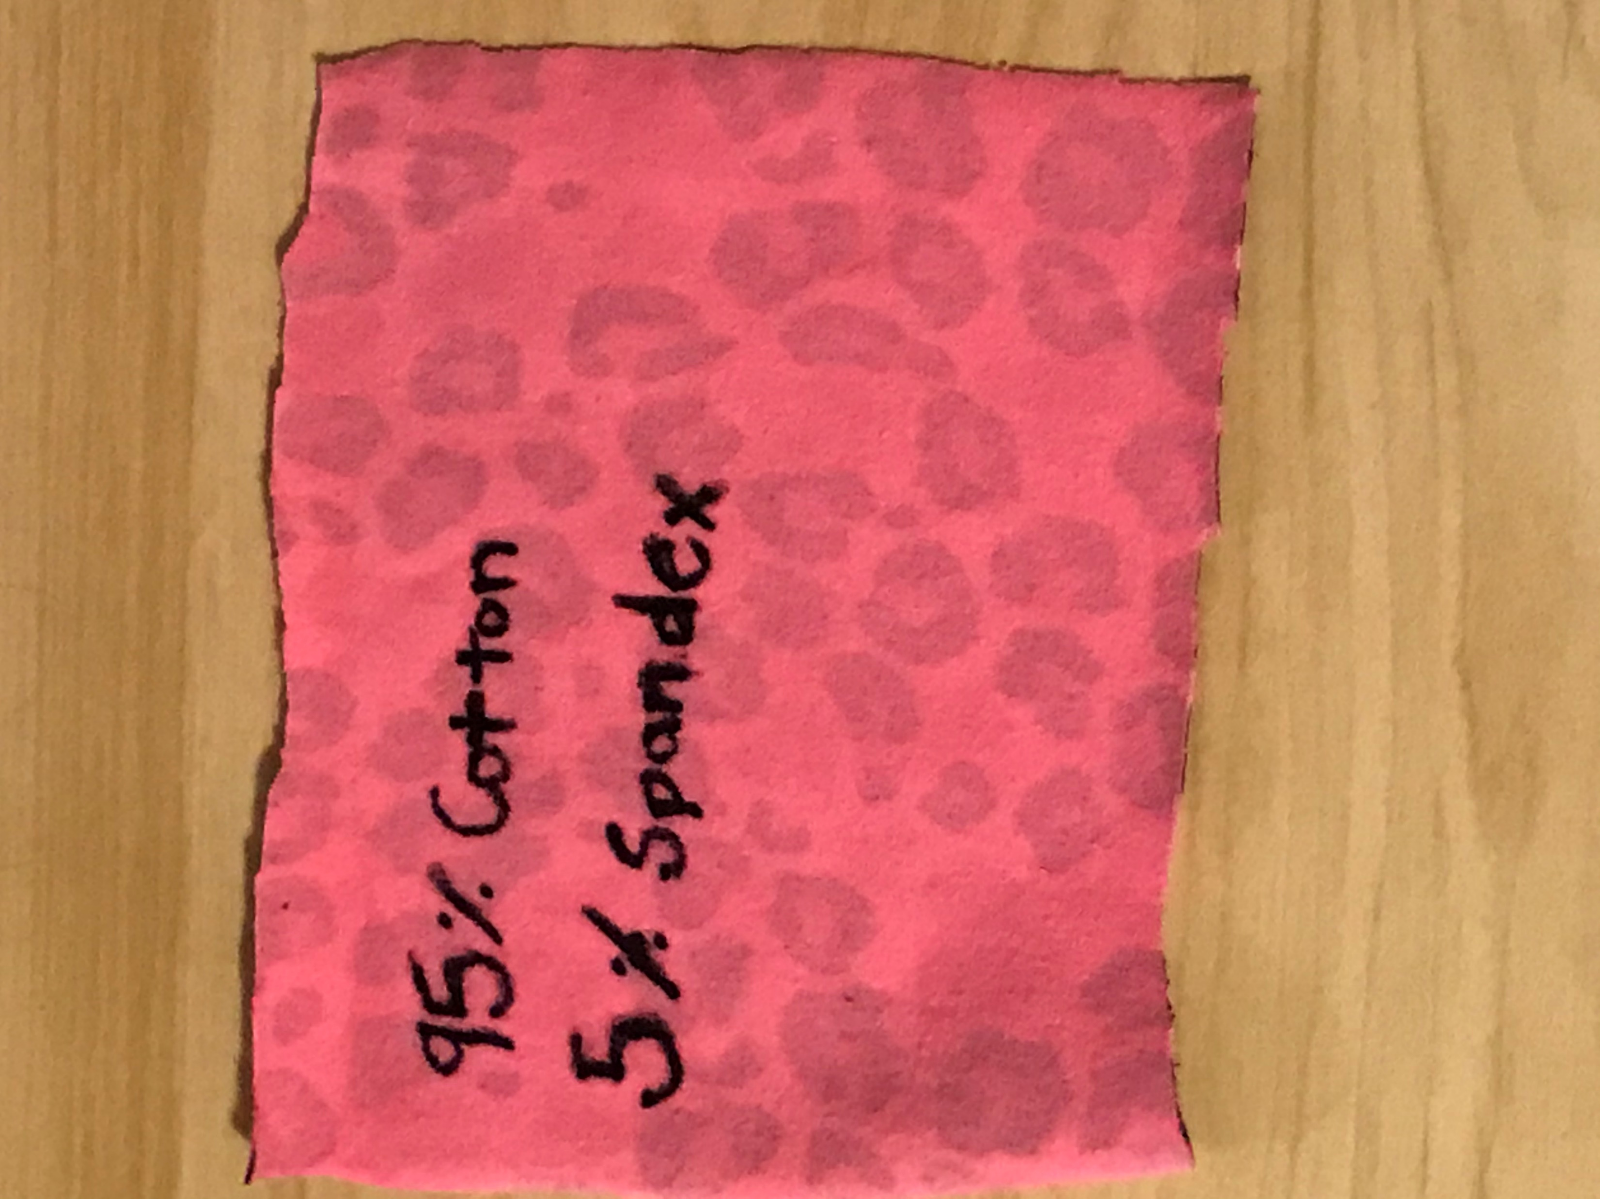
What Material for Masks Works the Best?

Slide 2
Introduction
What is the coronavirus?
How can we protect ourselves from this virus?
  Well, one way is to wear a mask!
Myth or Fact? You could die from wearing a mask for too long

Slide 3
Purpose
To study what materials for masks are the best at filtering various size particles

Slide 4
Hypothesis
If the material/fabric is thicker, then it is a better material for a mask
Thicker materials will do better than thinner materials

Slide 5
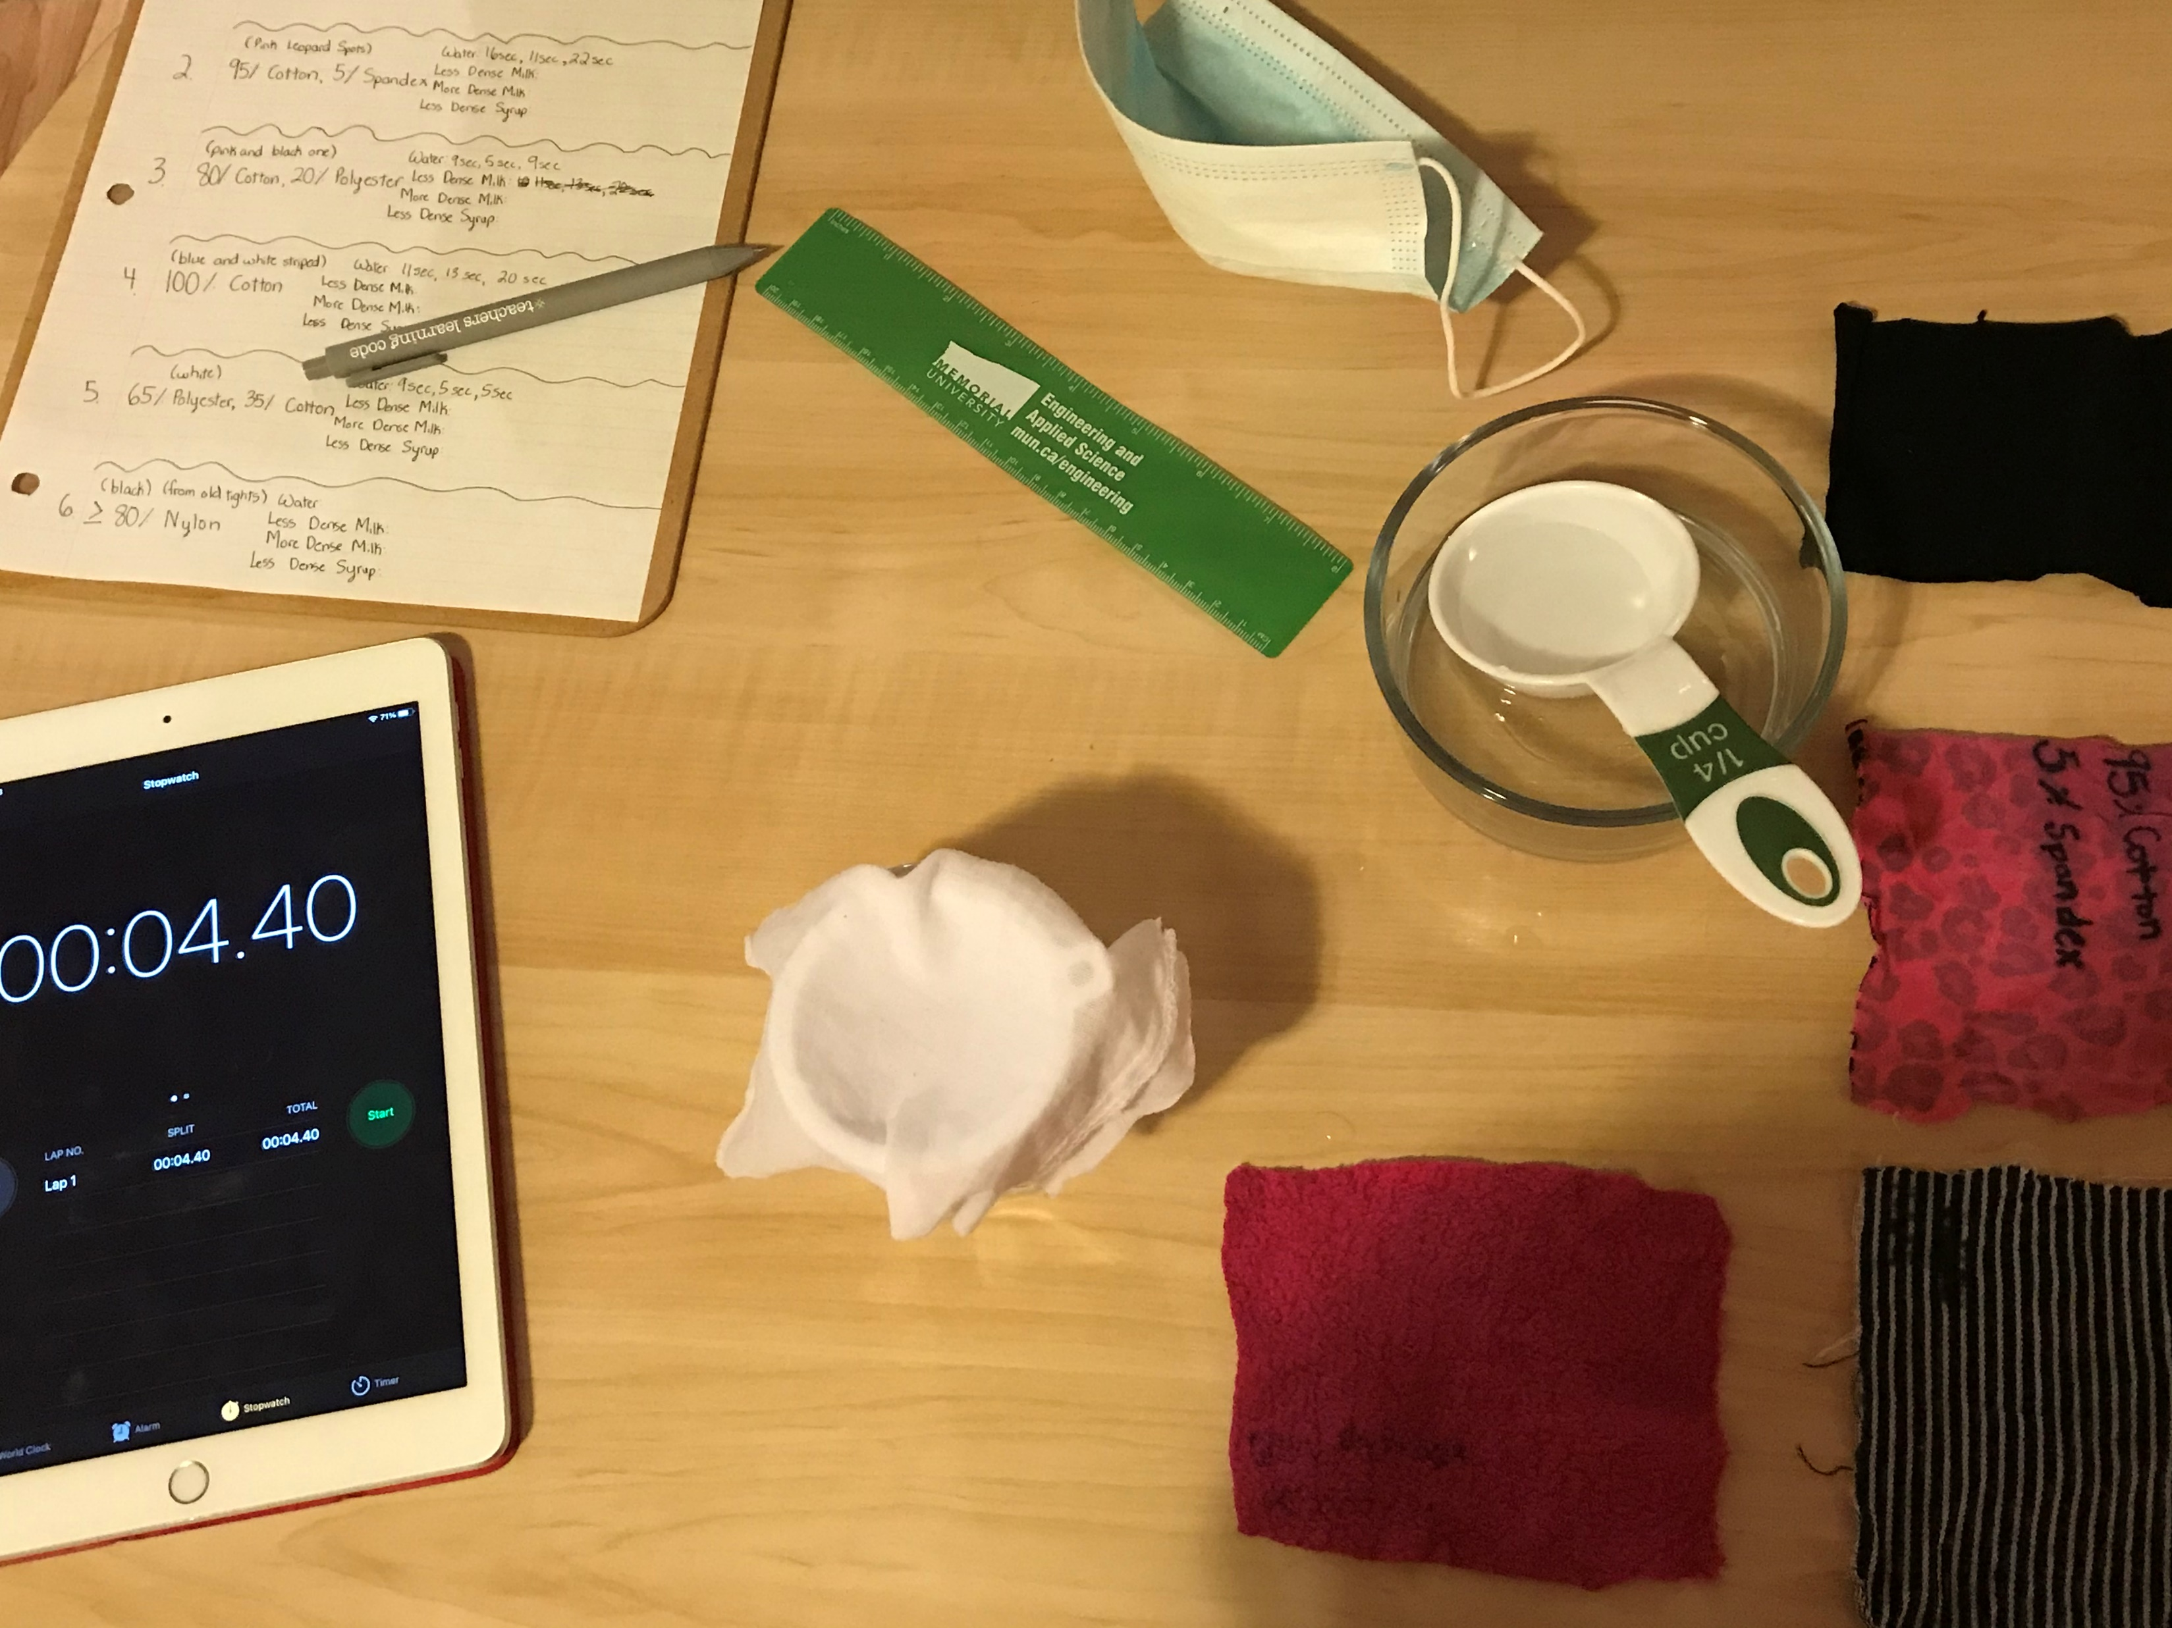
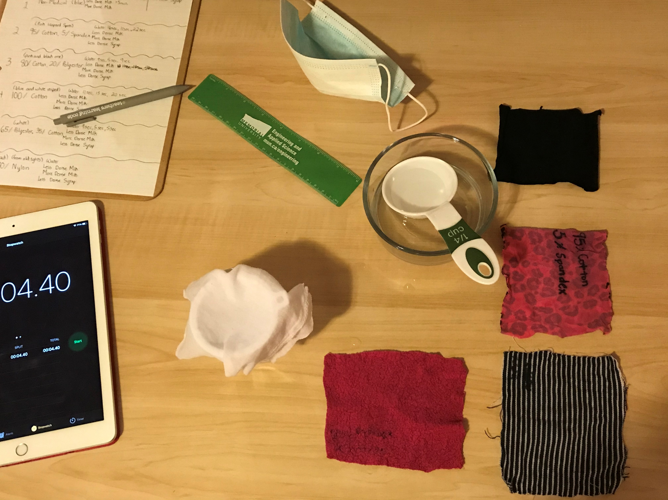
Materials
Water, milk, maple syrup
Non-medical mask, cotton cloths, nylon cloths, other types of fabric
Timer, funnel, and container

Slide 6
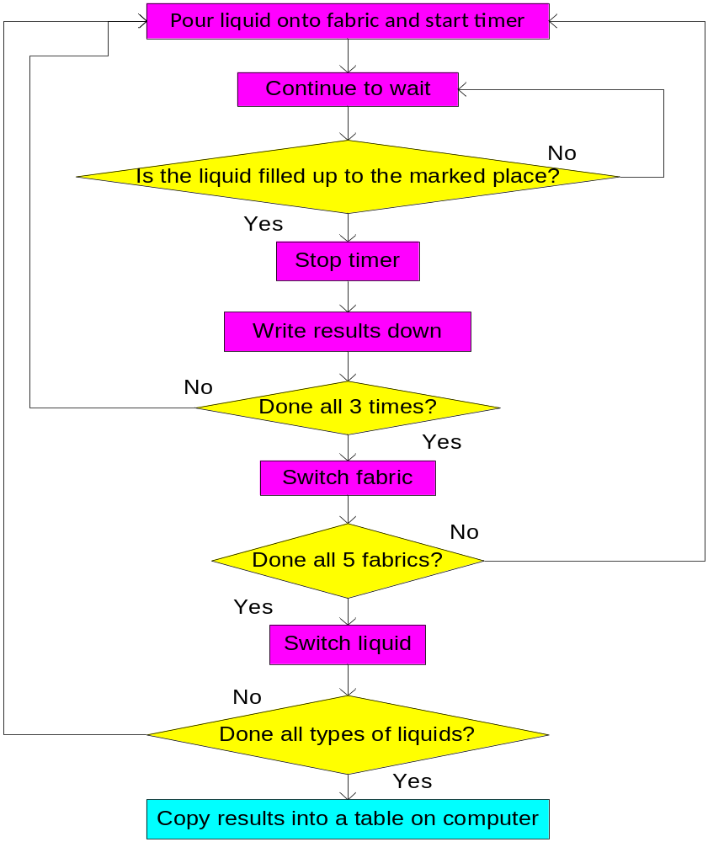
Procedure
Find all the materials
Mark a place on the container, which a liquid will fill up to
Place a funnel on top of the container
Place a piece of fabric over the funnel
Pour the liquid onto the fabric and immediately start the timer
When the liquid fills up the container to the marked spot, stop the timer
Record the results and continue three trials for each liquid

Slide 7
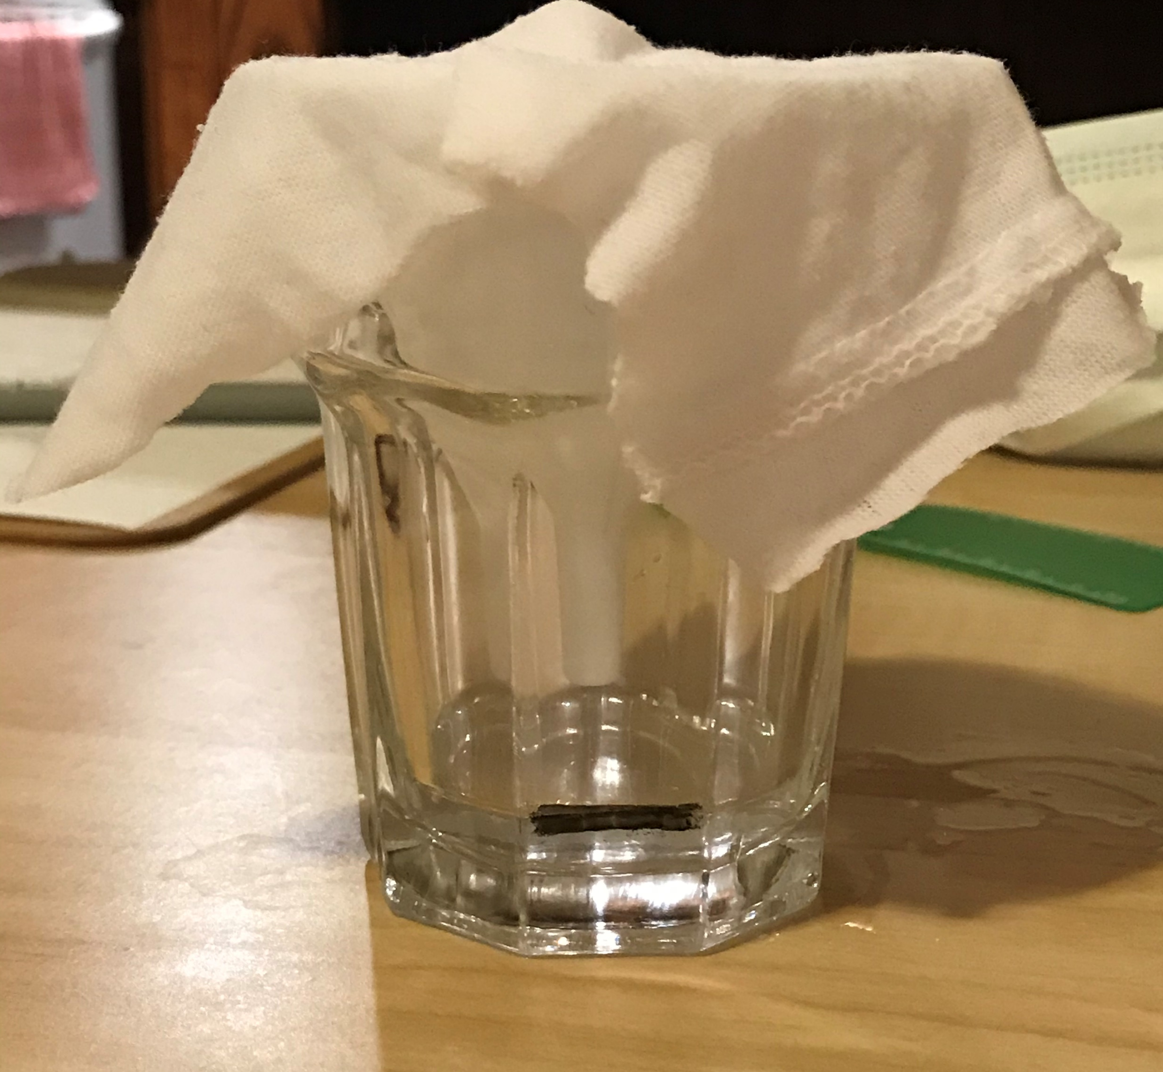
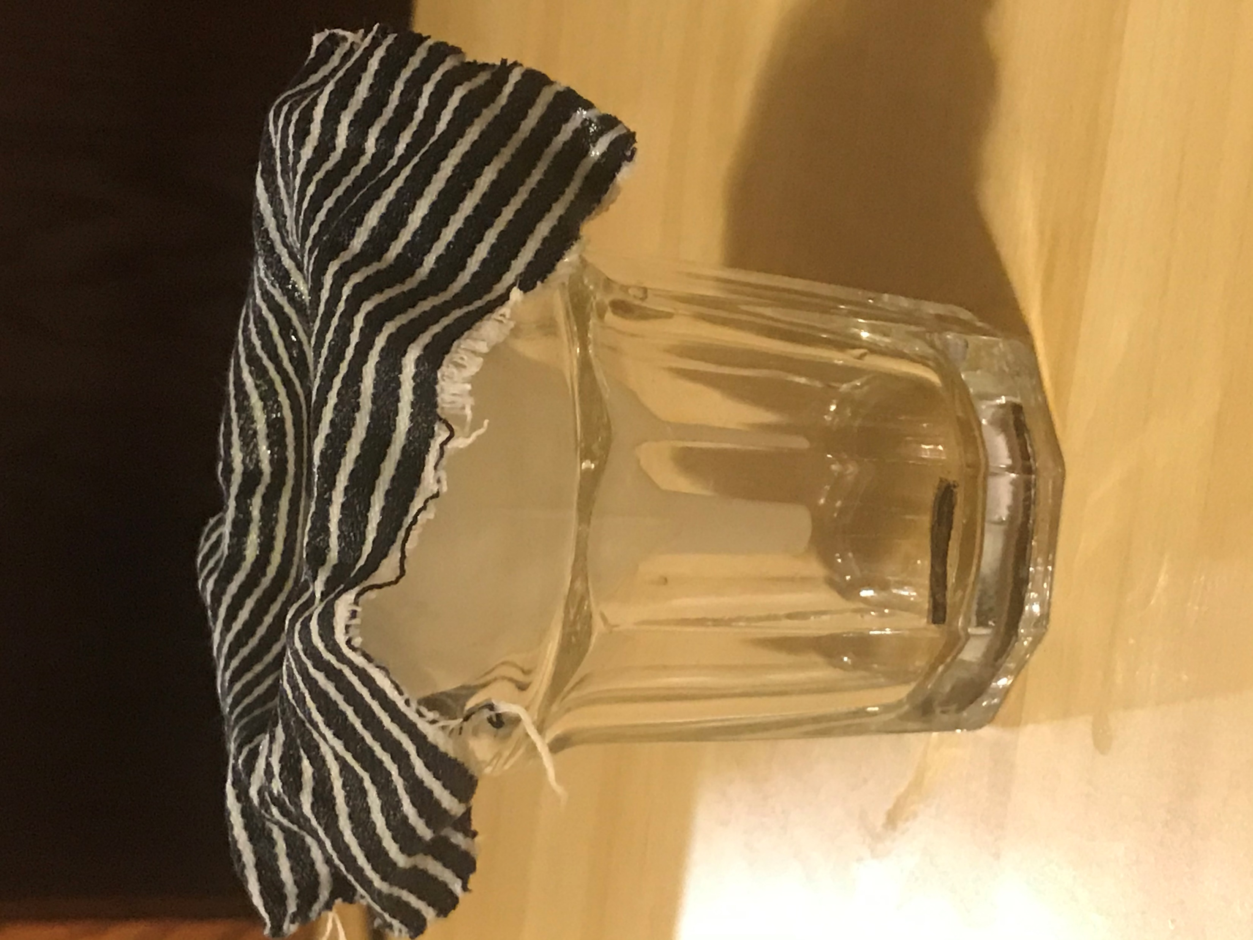
Procedure

Slide 8
Procedure
What are the independent and dependent variables?
2 independent variables
  Type of fabric
  Type of liquid
1 dependent variable
  The time of a liquid filling up a certain portion of the container
What do the elements of this experiment represent?
  Piece of fabric — a mask
  Liquid — particles in the air

Slide 9
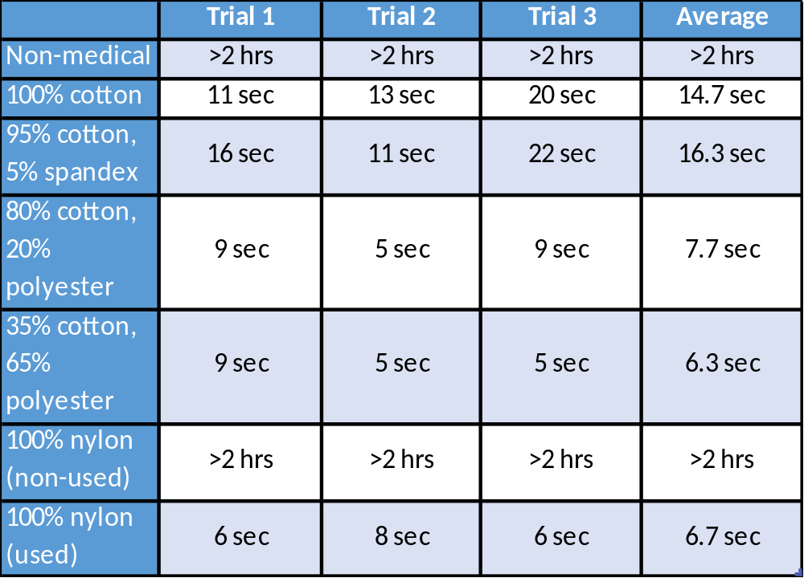
Experimental Results for Water

Slide 10
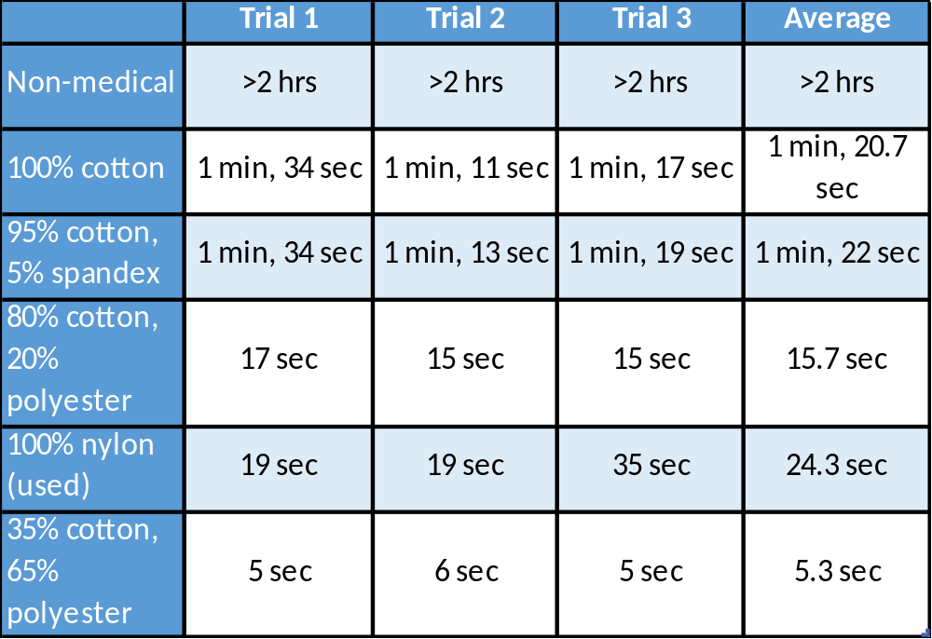
Experimental Results for Less Dense Milk

Slide 11
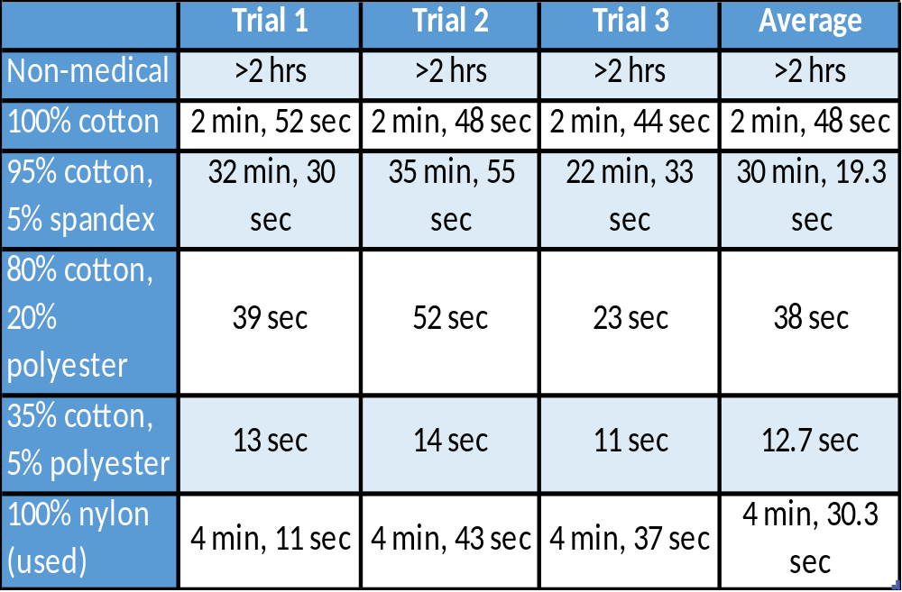
Experimental Results for More Dense Milk

Slide 12
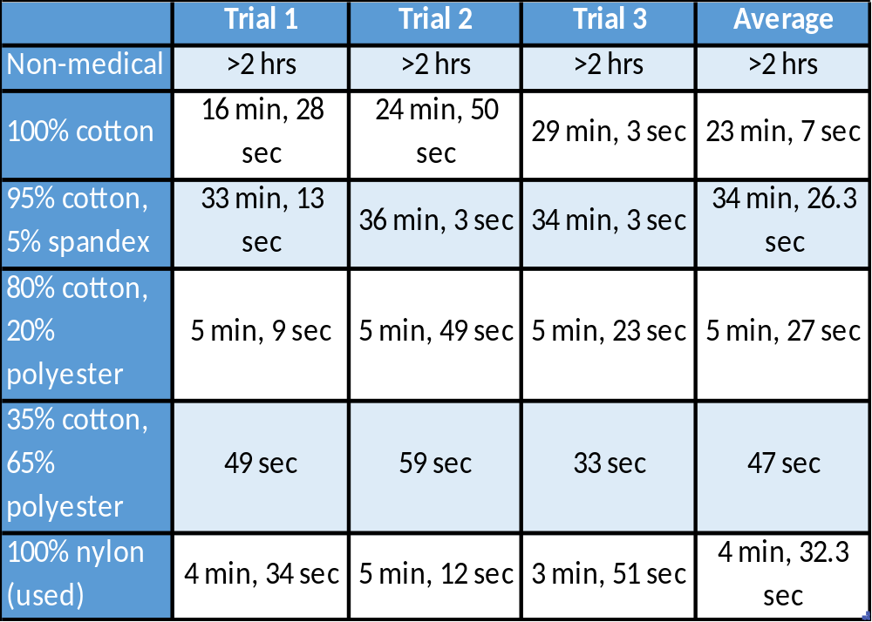
Experimental Results for Less Dense Syrup

Slide 14
Discussion
Why was water added to the used liquids?
What happened to the results as the liquids became denser?
Source of error?
  What happened to the fabric when it was used many times?
What is the tread count?
How do we achieve the best protection from mask wearing?
  Mathematical analysis (two people vs three people)

Slide 15
Conclusion
The hypothesis proved to be almost correct
Most thicker materials did perform better than thinner materials
Materials with higher thread count would perform better
Masks are a great way to keep everyone safe from the coronavirus!

