Slide 1

The Effect of Lowering Huntingtin Protein Levels in Hippocampal Neurons on Cell Apoptosis.
By: Caleb Tibbs
Grade 10
Holy Spirit High School
C.B.S NL

Slide 2

Introduction
Huntington's disease is neurological disease caused by a mutation in the huntingtin gene. The huntington gene produces huntington's protein (HTT). HD can cause many symptoms such as movement issues, loss of memory and trouble regulating emotions.
There are many treatments being developed for huntington's disease that could cause HTT levels to lower. For my project I grew 4 neural cultures to analyze the effects of lowering huntingtin protein levels on cell death, to see if these types treatments could be used for patients with HD. If Lowering HTT levels in cells has no significant effects on cell death, these types of treatments could be used by patients with HD.

Slide 3

Purpose: The purpose of this project is to help determine the effects of lowering HTT levels on apoptosis (cell death), to determine if treatments for Huntington's disease that could cause lower HTT levels could be used by patients with HD.
Question: What are the effects of lowering HTT levels in neurons on cell death and could treatments for HD that could cause huntingtin protein levels to lower be used by patient with HD?
Hypothesis: I predict that cells that have lowered HTT levels, will have an increased rate of apoptosis as compared to the control.

Slide 4

Variables
Independent variable: The HTT level in neurons.
Dependent variable: The amount of cell death in neurons.
Controlled variables: The culture media, the number of times the media was replaced, the incubator, the brain region used to collect the cells, the slides the cultures were placed on and the microscope settings used during imaging.

Slide 5
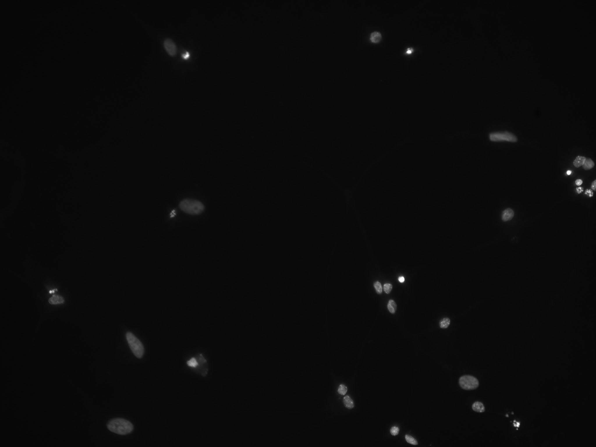
Materials
Brain tissue from the hippocampus of newborn rats
Scalpel
Papain (proteolytic enzyme – breaks down protein)
Pipets of various sizes
Glass coverslips
24 well plate
Poly D lysine (allows for attachment of cells to glass coverslips)
Widefield microscope
Incubator
Feeding media: Neurobasal Media, B 27, Penicillin/streptomycin (PS), Glutamax and hepes
DAPI mounting media
Microscope slides

Slide 6

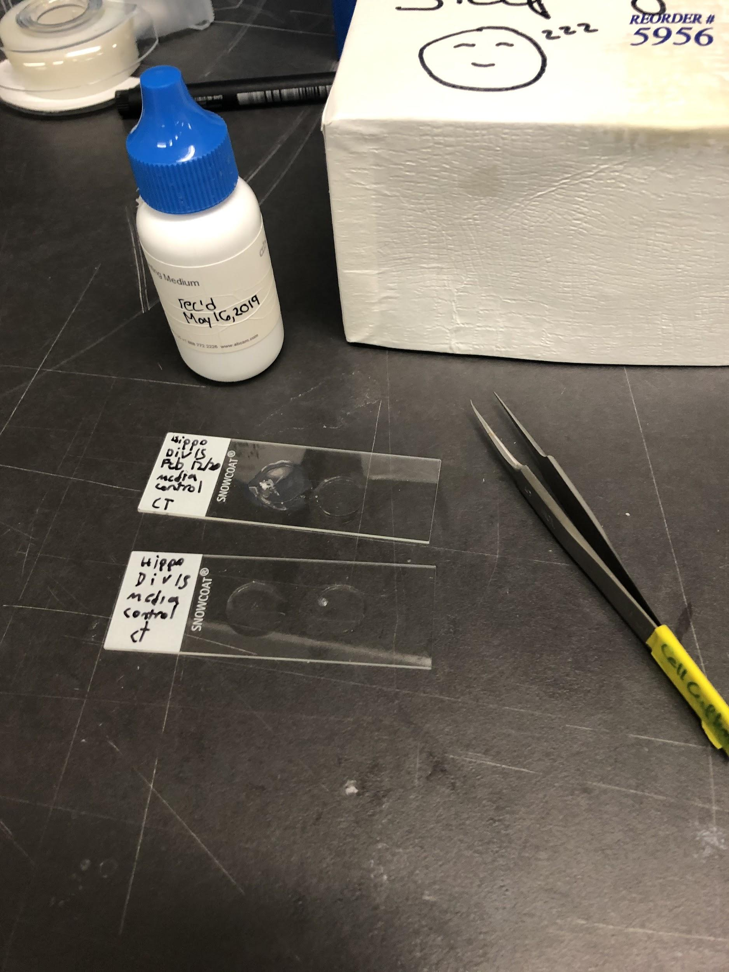
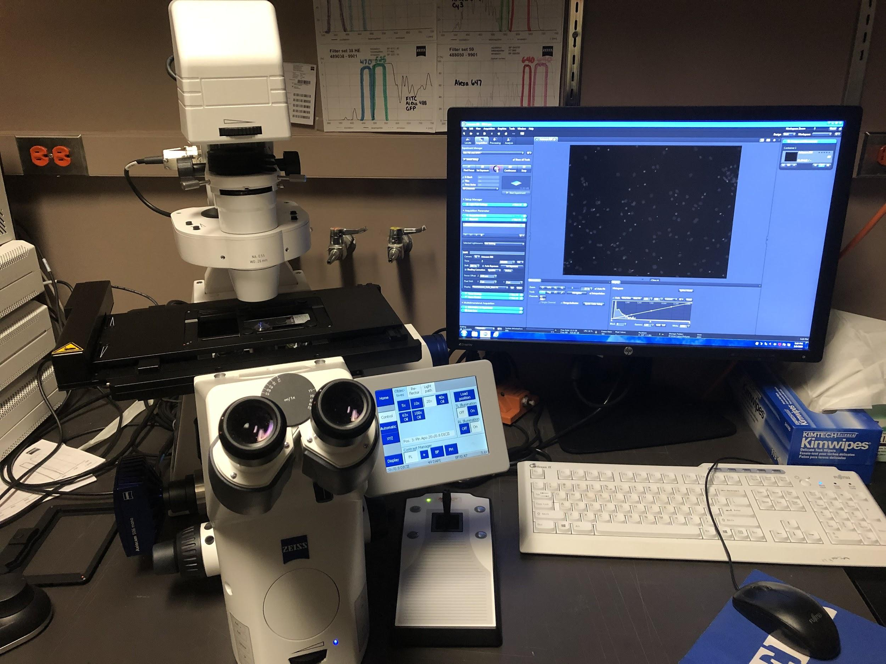

Slide 7

Procedure: starting the cultures
Dissection: Firstly, neuronal tissue from the hippocampus of young rats was dissected for culturing, using a dissecting microscope
Dissociation: Next, the samples are broken down into cellular components in a process known as dissociation. The dissected brain tissue is first minced into small pieces using a scalpel. Then, a proteolytic enzyme is added to break down excess proteins that bind the cells together, so that the cells are separated from each other. Then, the tissue is passed through a pipet multiple times and the cells are freed into a single cell layer.

Slide 8
Plating: These cells are then plated onto Poly D Lysine coated coverslips in well plates and a culture media is added to help the cells grow.
Genetic manipulation: A chemical is then added to the variable culture that causes the HTT levels of the cells to lower.
Maintenance: The cells are placed into an incubator and once a week, the culture media is suctioned out and a new one is added.

Slide 9
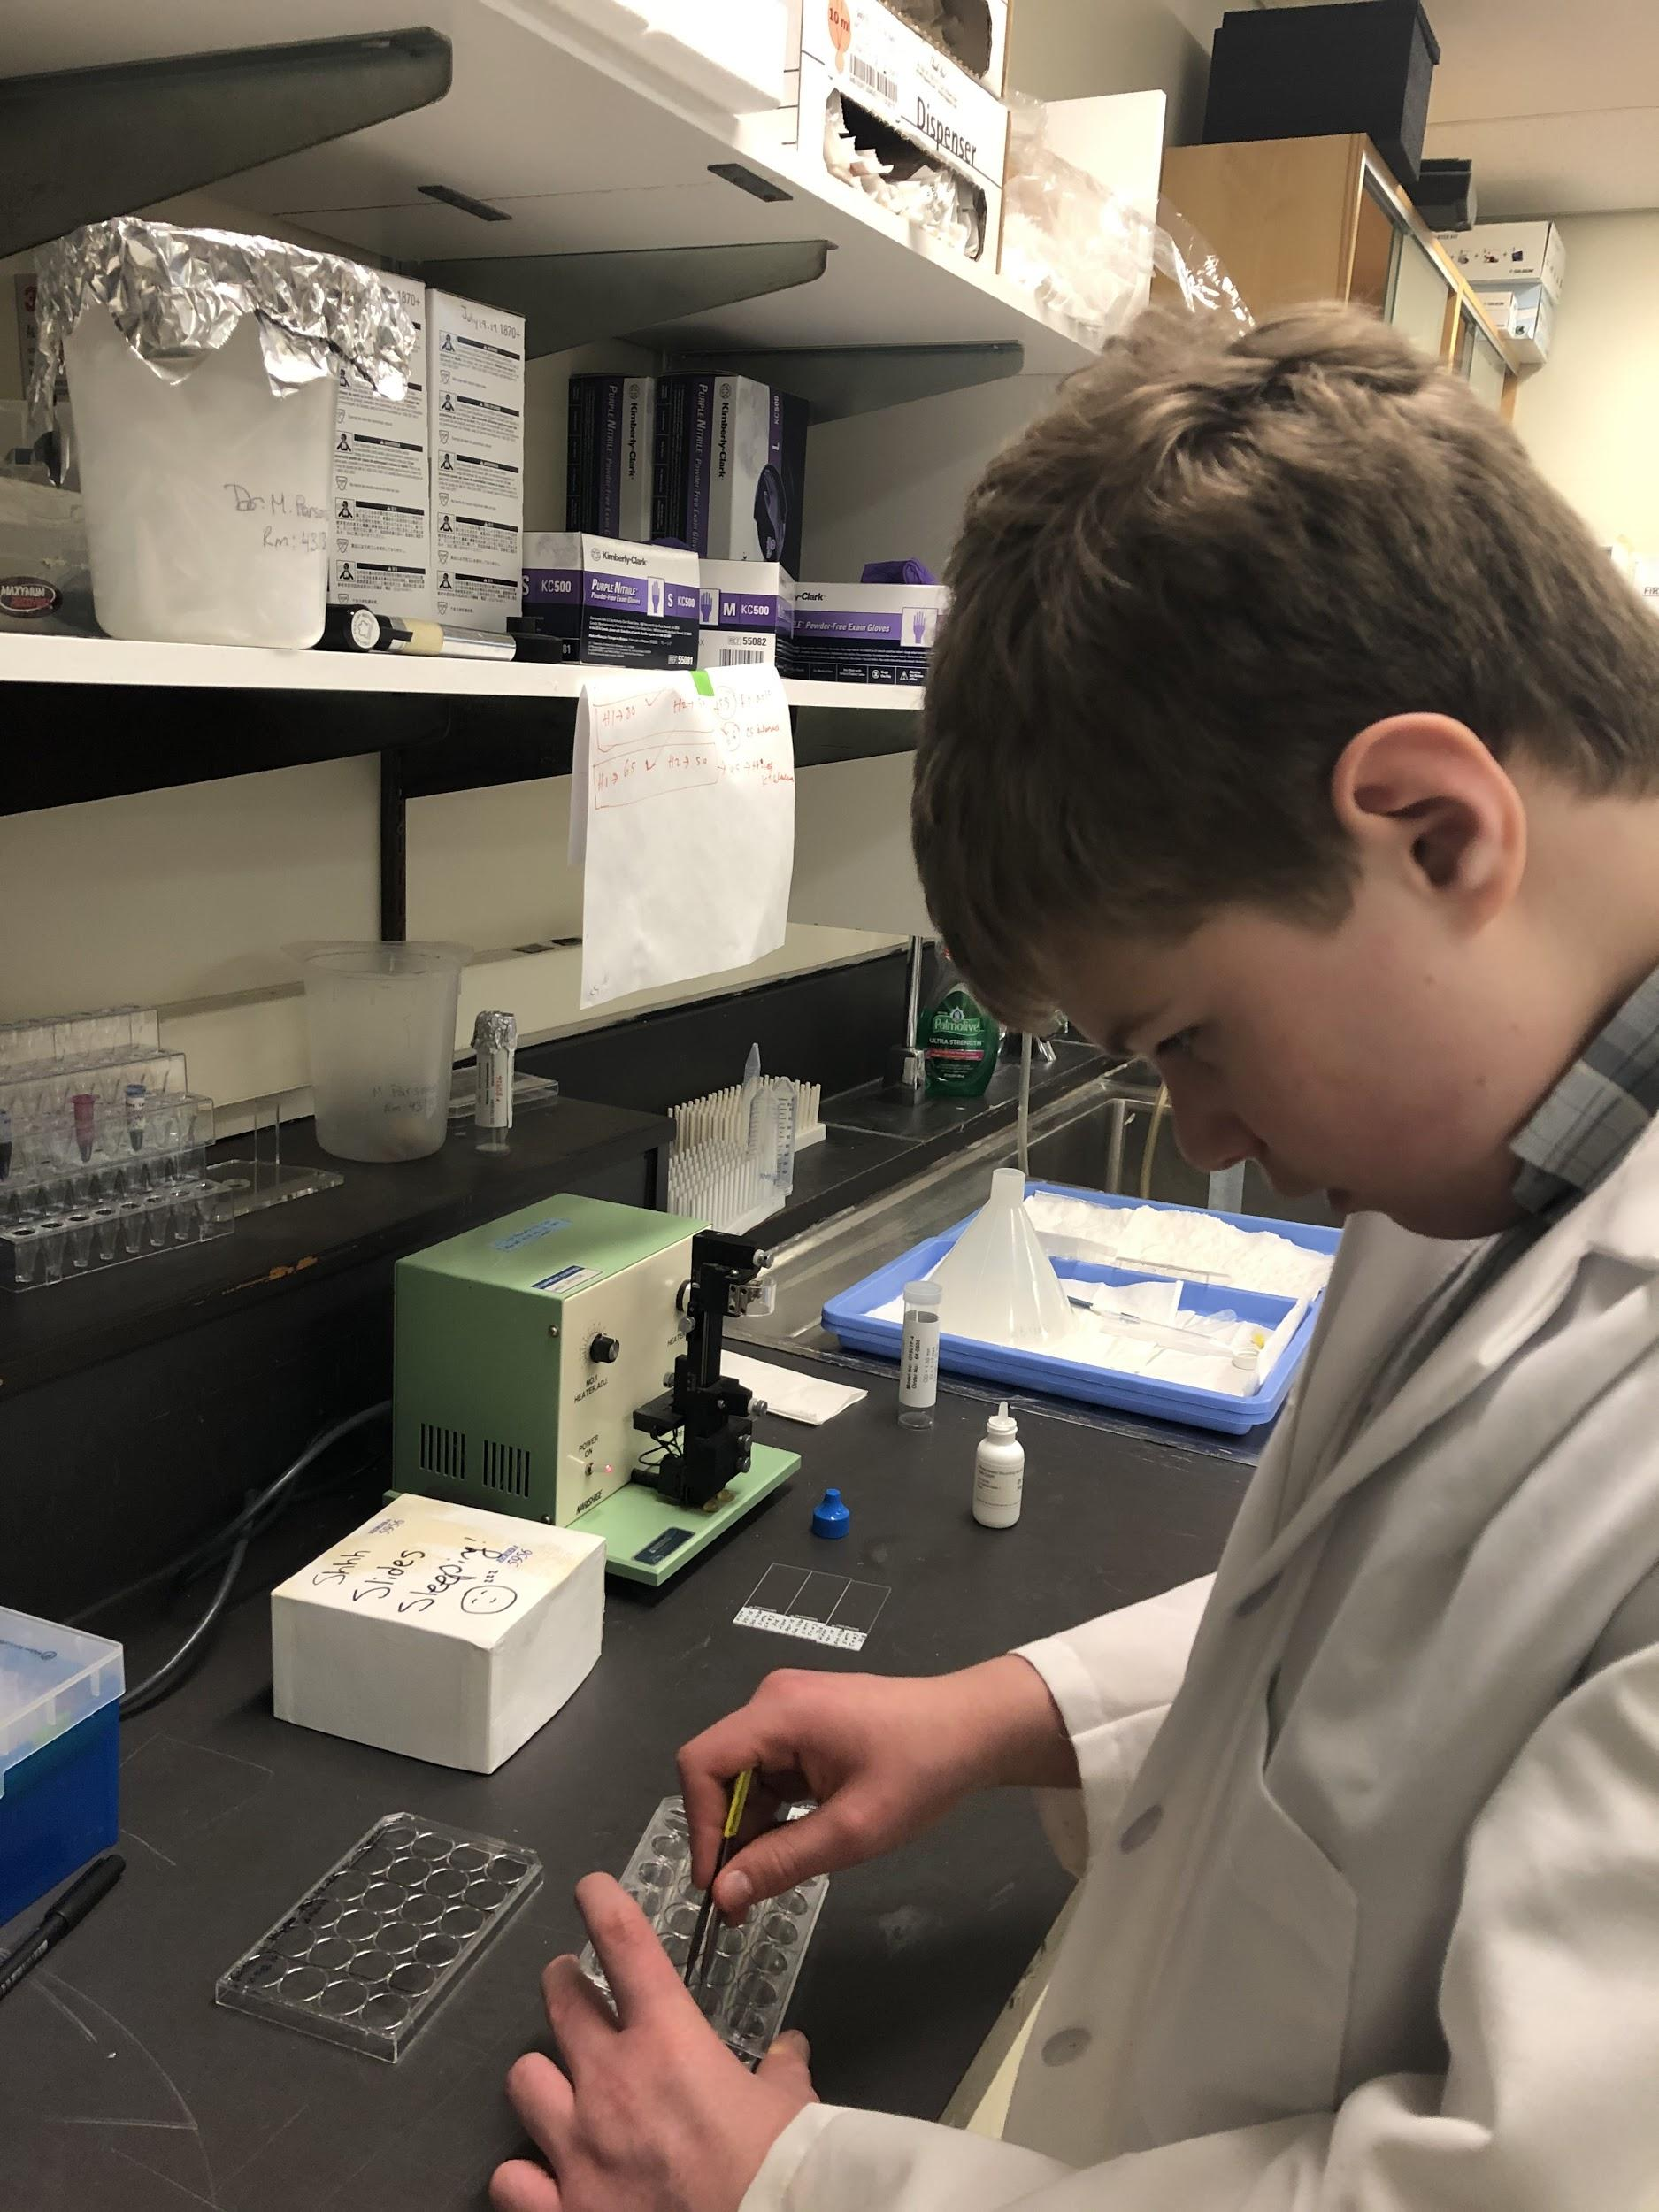
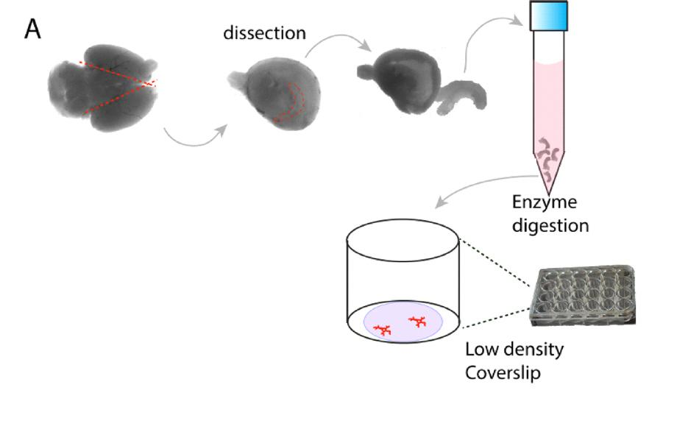

Slide 10
Procedure: analyzing the cultures
Imaging: I placed the cultures on microscope slides and chemical called DAPI is added to make the cells glow. Then I put the cultures under a widefield microscope and took 4 pictures of each culture.
Analyzing: To analyze the data I used a program called “imagej”. First, I opened up the program and set the scale. Then, I inserted one of my photos into the program and used the zoom function to zoom in on a nucleus. Then, I used the freehand selections tool to make a trace of the nucleus and added it to the ROI manager. Then, I used the measure function to determine the size of the nucleus in μm² and added the data to a table. I did this 3 times per photo until I analyzed all of the photos. After I collected all of my data I put the results through a t test to determine if it was statistically significant.

Slide 11
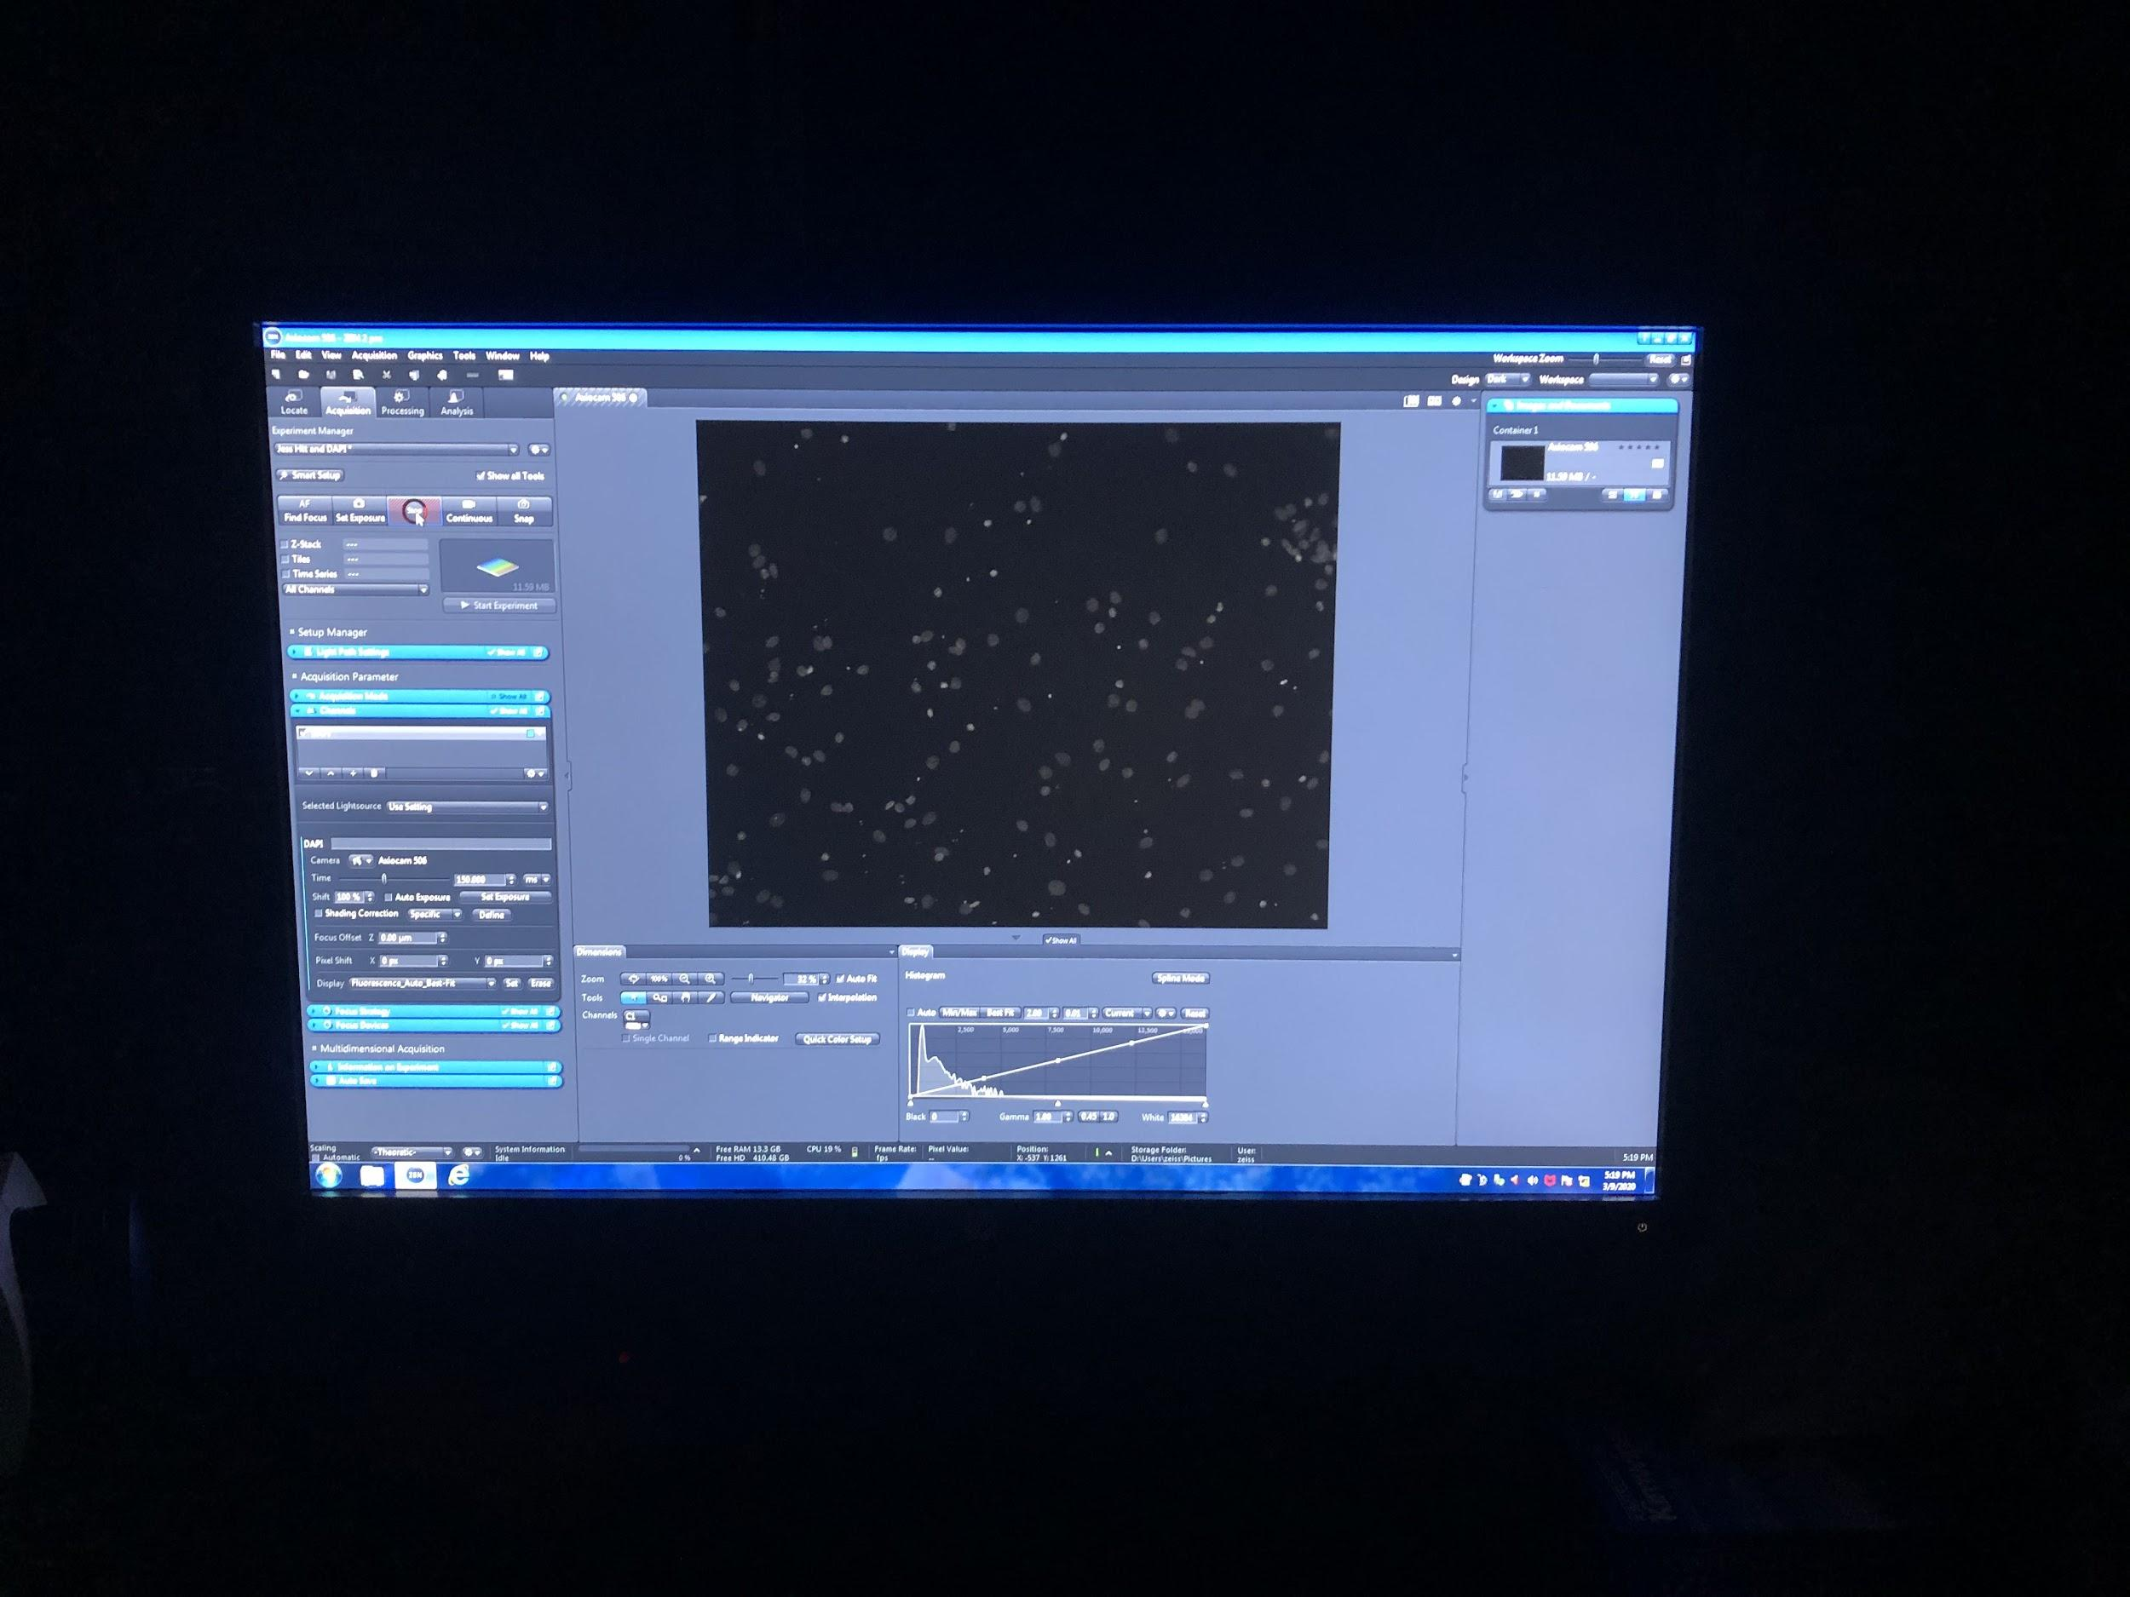

Slide 12
Results
The Size Of The Nuclei (μm²)
Nucleus #12
63.792
53.95
54.105
71.212
 | Nucleus #1 | Nucleus #2 | Nucleus #3 | Nucleus #4 | Nucleus #5 | Nucleus #6 | Nucleus #7 | Nucleus #8 | Nucleus #9 | Nucleus #10 | Nucleus #11
Control culture 1 | 42.769 | 116.024 | 78.993 | 65.647 | 60.855 | 45.912 | 52.765 | 56.527 | 52.971 | 122.174 | 92.699
Control culture 2 | 69.615 | 80.333 | 101.82 | 152.009 | 76.829 | 61.216 | 79.56 | 231.568 | 85.073 | 62.195 | 92.751
HTT lowered culture 1 | 133.355 | 88.01 | 79.044 | 89.196 | 58.691 | 62.246 | 65.905 | 45.087 | 67.612 | 77.808 | 54.259
HTT lowered culture 2 | 174.578 | 68.378 | 102.644 | 62.143 | 87.959 | 61.422 | 92.493 | 62.401 | 101.305 | 51.168 | 78.323
Avg
75.094
95.577
72.943
84.502

Slide 13
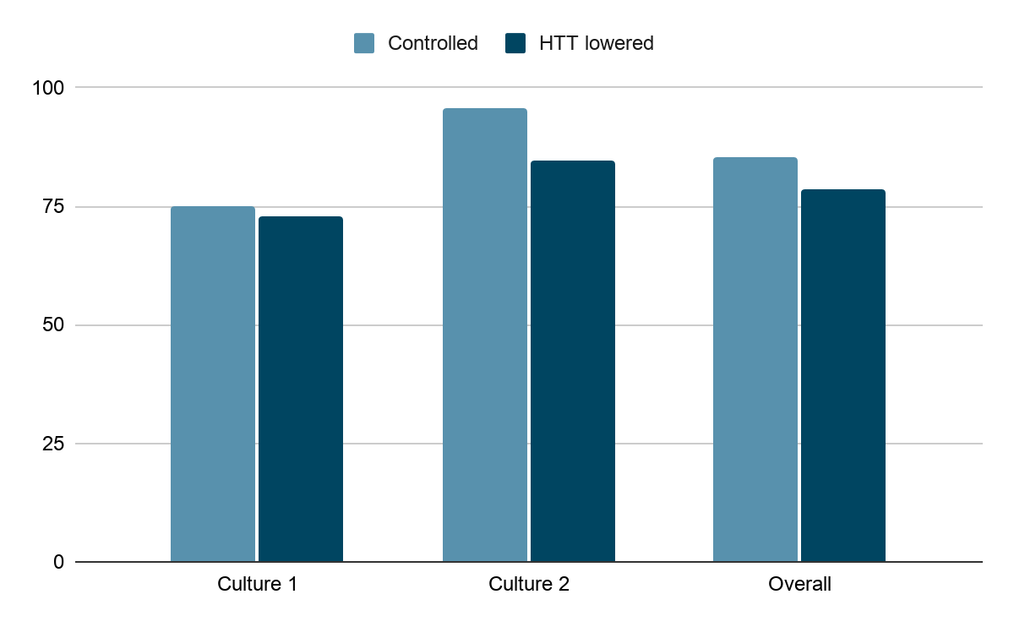
The Average Size of the Nuclei (μm²)

Slide 14
Discussion
After analyzing the nuclei I determined that the average size of the control nuclei was 85.34μm²and the average size of the nuclei with lowered HTT levels was 78.72μm². After putting my result through a T-test it was determined that my results had a p-value of 0.5394 and therefore were not statistically significant. This means that in this study lowering HTT levels in cells did not have any significant effects on cell death.

Slide 15
Control:
HTT Lowered:

Slide 16
Sources of error
One source of error that I discovered while doing my project was tracing around the nuclei to measure their area. This was a source of error because I couldn’t trace around the nuclei perfectly, so the results that I got for the area of the nuclei could be slightly bigger or smaller than their actual size.

Slide 17
Conclusion
In conclusion, my hypothesis was incorrect and there were no significant effects of lowering HTT levels on cell death. This means that treatments for HD that could cause HTT levels to lower could be used by patients with huntington's disease and I recommend that these types of treatments should be studied further by researchers.

Slide 18
Acknowledgements
I would like to thank Jessica Barron, Firoozeh Nafar and Matthew Parsons who made this project possible, for taking the time to teach me how to grow and analyze the cells.

Slide 19
Sources
Yokota, T., Sugawara, K., Ito, K., Takahashi, R., Ariga, H., & Mizusawa, H. (2003). Down regulation of DJ-1 enhances cell death by oxidative stress, ER stress, and proteasome inhibition. Biochemical and Biophysical Research Communications, 312(4), 1342-1348.
Yu, S.-W., Wang, H., Poitras, M.F., Coombs, C., Bowers, W.J., Federoff, H.J., . . . Dawson, V.L. (2002). Mediation of poty(ADP-ribose) polymerase-1 - Dependent cell death by apoptosis-inducing factor. Science, 297(5579), 259-263.
JoVE Science Education Database. Neuroscience. Primary Neuronal Cultures. JoVE, Cambridge, MA, (2020).
Lu, Z., Piechowicz, M., Qiu, S. A Simplified Method for Ultra-Low Density, Long-Term Primary Hippocampal Neuron Culture. J. Vis. Exp. (109), e53797, doi:10.3791/53797 (2016).

