Slide 1
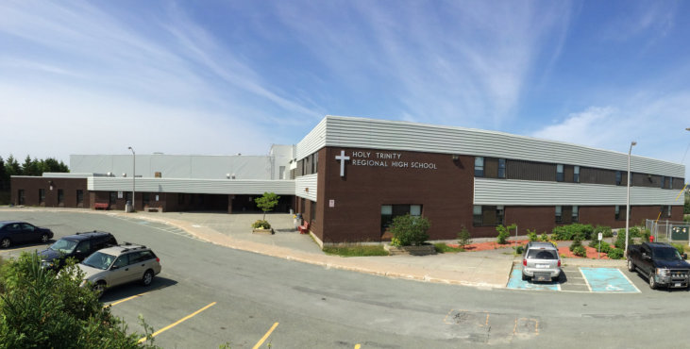

Bacterial Growth in HTH
Erin Reddy and Meredith Jones
Holy Trinity High School
Torbay, NL

Slide 2

Purpose
-To find out which surface in the school has the most bacteria growing.
Question(s):
-Which area will have the most bacteria growth?
Hypothesis:
-The most touched surface will have the most bacterial growth, but with Covid-19, everything is being cleaned more often so there will not be as much growth.

Slide 3

Independent variable:
-The surface that is swabbed
Dependent variable:
-The amount of bacteria that grows
Controlled variables:
Same procedure for swabbing
Same cotton swabs
Same agar plate
Same place stored
Length of storage for agar plate
Same solution of agar
Same technique for estimation amount of bacteria growth

Slide 4
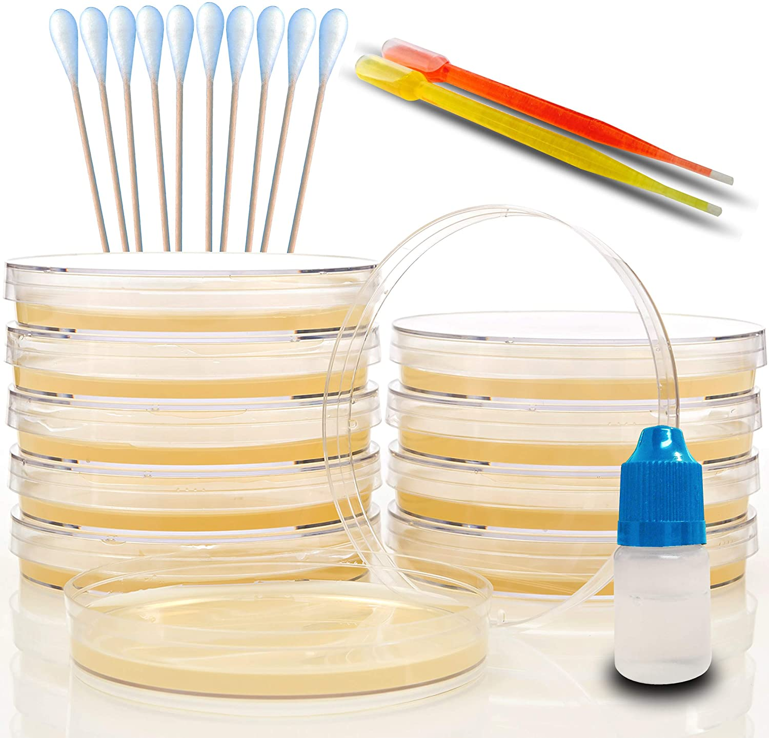
Materials:
-Petri dish kit from amazon
-cotton swabs
-petri dishes
-nutrient solution
-Graphing paper to estimate bacteria growth

Slide 5
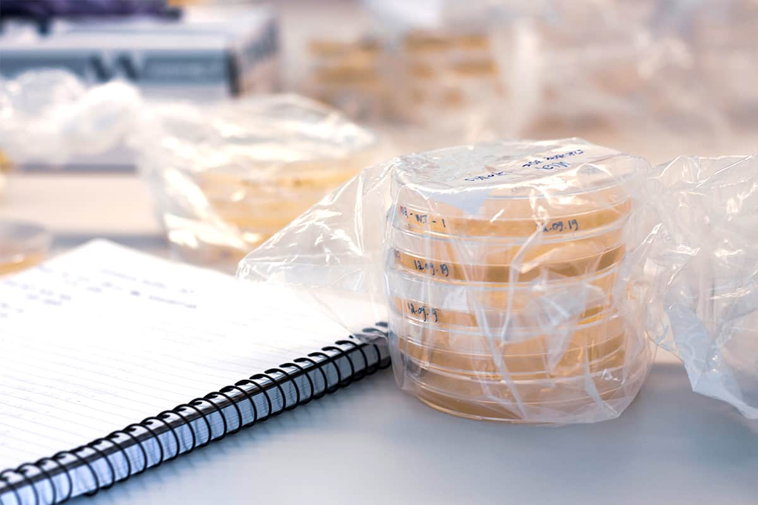

Procedure:
Create solution of agar
Swab the surface with cotton pad
Rub cotton pad on solution in container
Place all containers in same atmosphere
Graph amount of bacteria grown

Slide 6
Procedure continued:

Slide 7
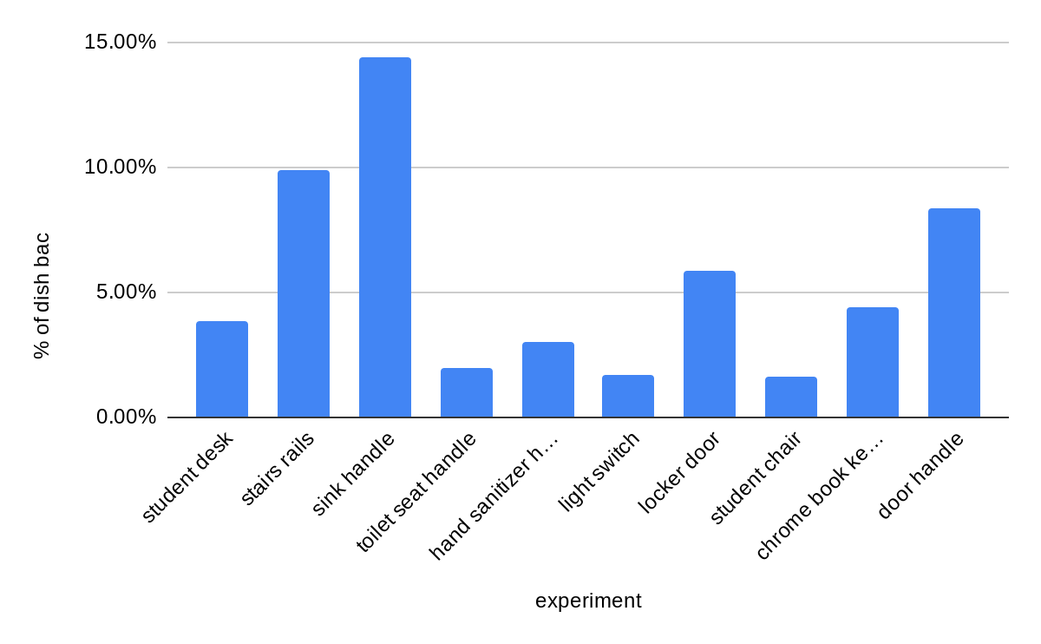
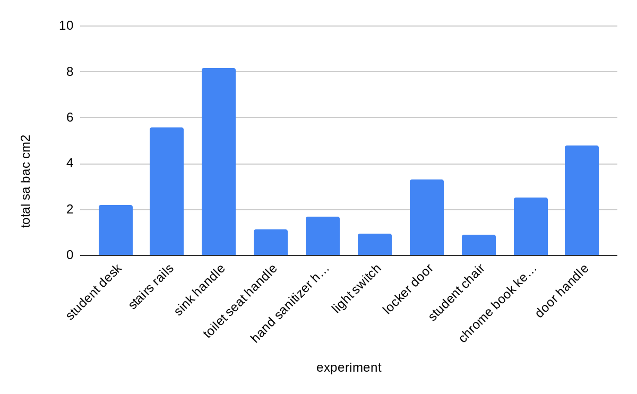
Results:
Figure 2: Total surface area of bacteria in cm2
Figure 1: Percent of the dish covered with bacteria

Slide 8
Results (continued):Table 1: Total surface area
Experiment | Total surface area of bacteria (cm2) |  | Range: | Average: | Median: | Mode: | Standard Deviation:
student desk | 2.2 |  | 7.27 | 3.1293 | 2.35 | #N/A | 2.38907244
stairs rails | 5.6
sink handle | 8.19
toilet seat handle | 1.13
hand sanitizer handle | 1.7
light switch | 0.96
locker door | 3.31
student chair | 0.92
chrome book keyboard | 2.5
door handle | 4.783

Slide 9
Table 2: Percent% of dish covered
experiment | % of dish bac |  | Range: | Average: | Median: | Mode: | Standard Deviation:
student desk | 3.88% |  | 12.82% | 5.51% | 4.15% | #N/A | 0.04205210525
stairs rails | 9.87%
sink handle | 14.44%
toilet seat handle | 1.99%
hand sanitizer handle | 3.00%
light switch | 1.69%
locker door | 5.84%
student chair | 1.62%
chrome book keyboard | 4.41%
door handle | 8.34%

Slide 10
Discussion:
throughout the studies, it was discovered that the place with the most bacteria was the sink.
the second most bacterial surface was the railing in the stairwell.
the least bacterial surface was the student chair.
it was interesting doing this study to be able to see how well the school has been cleaned.
it was also interesting to see the things that were sanitized the most, and the things that were sanitized the least, especially during the COVID-19 pandemic.

Slide 11

Sources of error
Random errors
change in temperature of the atmosphere around the bacteria.
- the duration in which the bacteria was growing
systematic errors
how the agar mixture was prepared

Slide 12

Conclusion
Related to our hypothesis the stair railing is a commonly touched surface which would show why it has a higher bacteria growth than most of the others that were tested.

Slide 13

Acknowledgments:
-We would like to thank Ms. Kavanagh for helping us with this project.
-We would also like to thank Ms. Edstrom for letting us use her classroom to swab different surfaces.

Slide 14
References
(Finding Germs At School PHEOCs Procedure PHEOCS Investigation )
https://www.stevespanglerscience.com/lab/experiments/growing-bacteria/

Slide 15
Project log

Slide 16


Thank you!

