Slide 1
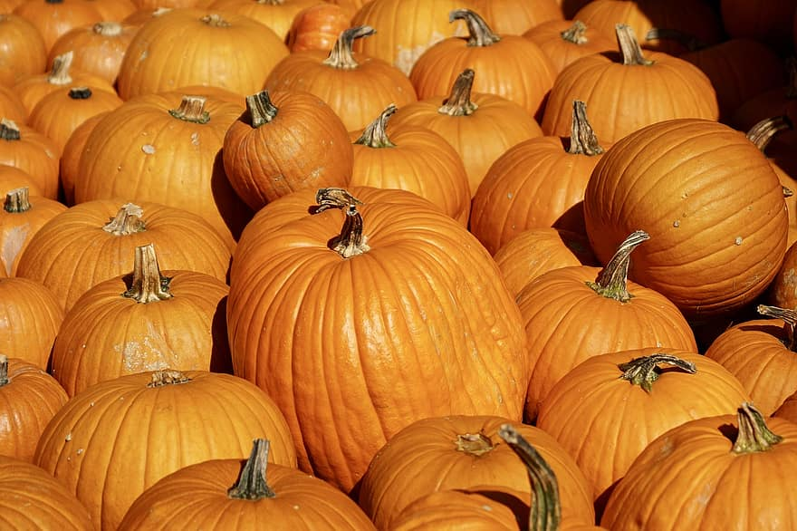
Does Chicken poop effect the growth of pumpkins?
Natalie Newell & Emily Gladney Grade 10
Holy Trinity High School
Torbay

Slide 2
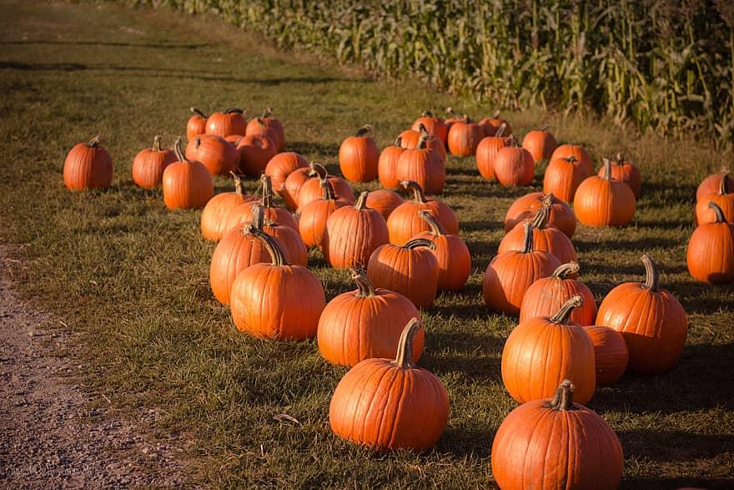
Purpose: To find out if chicken poop fertilizer is good for the growth of pumpkins.
Question: Does chicken poop effect the growth of pumpkins?
Hypothesis: The pumpkin watered with the chicken poop fertilizer will grow the largest and most rapid.

Slide 3
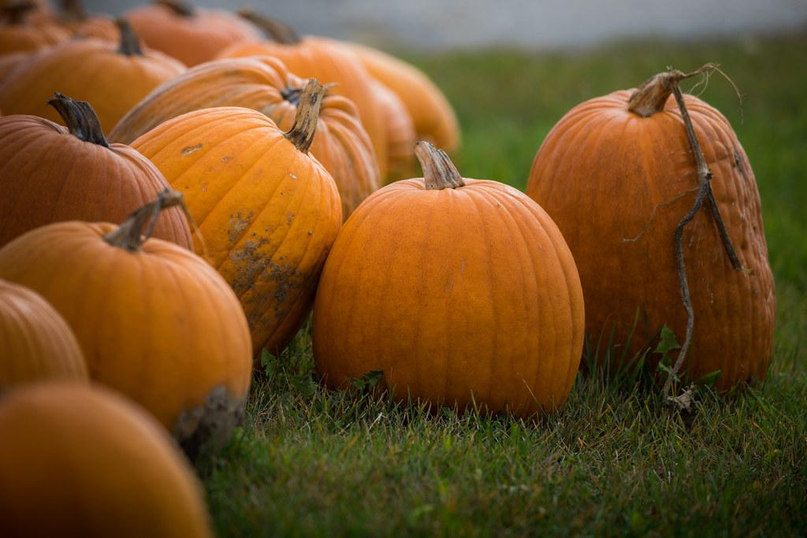
Independent variable:
Amount of fertilizer added to the pumpkin
Dependent variable:
How tall the plant grows
How fast the plant grows
Amount of flowers that bloom
Controlled variables:
How moist the soil is
The humidity level of the soil
The amount of chicken poop added to the plant
How often the plant is watered
What type of soil the plant is grown in
How humid the room is that the plants are grown in

Slide 4
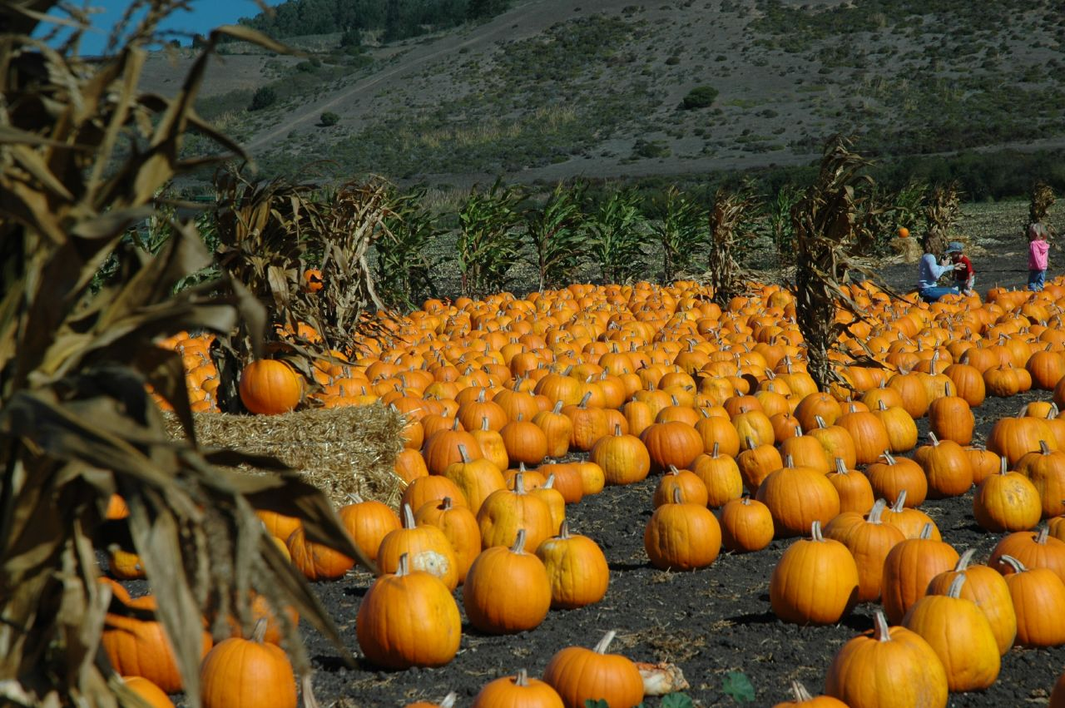
Materials:
Pumpkin seeds
Damp paper towel
Ziploc bag
Expanding soil pod
Water
Chicken poop (around ⅓ cup per watering)
Large gatorade bottle (355 ML bottle) to hold the fertilizer water
Different sized pots for transplanting your seedlings (small to large)
2, 5 gallon buckets of soil
Trellises
Measuring tape
Scale

Slide 5
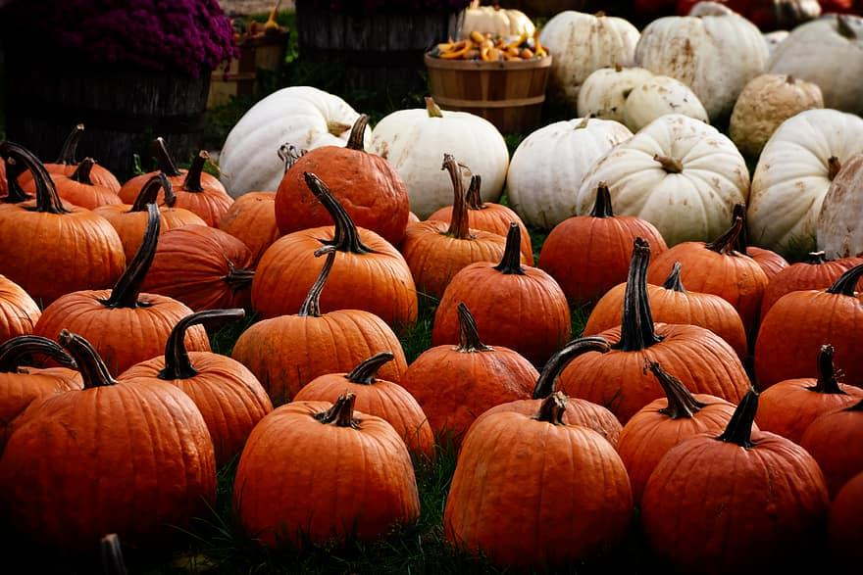
Procedure 1/2:
Gut a pumpkin and find the seeds
Germinate the seeds in a damp paper towel In a plastic bag inside the fridge
Place the seedlings in damp soil in a one inch expanding seed soil pots
Keep moist until growth is big enough to be moved out of the seed pouch
Once the sprout grows big enough to be transplanted move it to a slightly bigger pot. (This process will happen a few times until it makes its way up to a five gallon bucket, just transplant when the plant looks like its getting too big for its pot)

Slide 6
Procedure 2/2:
Once a week days after repotting the pumpkins into the biggest bucket Mix up ⅓ chicken poop in the bottle full of water and pour the whole thing into one plant and give the other one the same amount of water
Guide the plant to grow up the trellises
Once the plants start to bloom, use a q-tip to share the pollen from each flowers with each other to start the growth of the pumpkin itself
Once the pumpkin starts to grow, take weekly measurements (the circumference) and write down the measurements
Pluck the pumpkins from the vine once turned orange (usually around 100 days)
Weigh and measure the pumpkins then conclude your experiment
NOTE: Steps may vary Depending on the factors such as humidity, moisture, light, ect.
NOTE: The top inch of the soil should be kept moist so water roughly twice weekly depending on conditions.
6.
7.
8.
9.
10.
11.

Slide 7
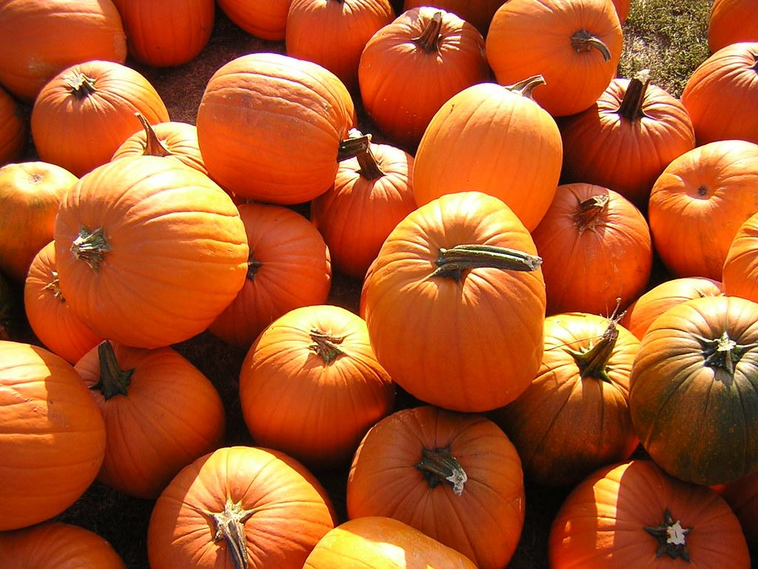
Results:
The chicken poop didn’t have any positive nor negative effects on the growth of the pumpkin plants
This shows that the hypothesis was not correct when saying plant A (with Chicken poop) would grow bigger and faster
Note that this experiment is only on pumpkins which are known for not thriving high levels of nitrogen which is included in the fertilizer
Plant A (CP) Plant B (No CP)
Average growth: 9.6cm 10.4cm
Mode: 8cm N/A
Standard deviation: 1.6cm 4.34cm
variation: 2.64cm 18.4cm
Median: 9cm 12cm

Slide 8
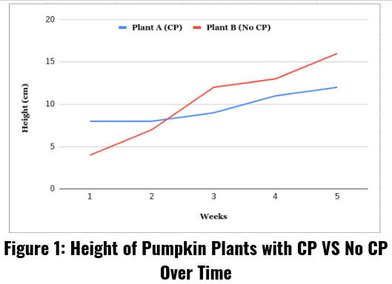
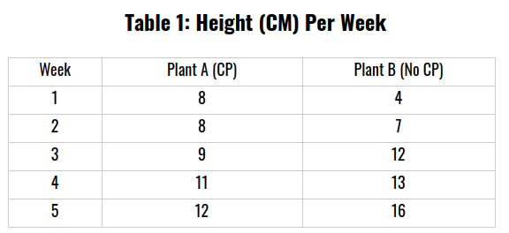
Results:
This Table (Table 1) and Graph (Figure 1) shows how
on a weekly basis that the plant with the CP started
off taller but was overtaken during week two then
continued to remain taller.

Slide 9
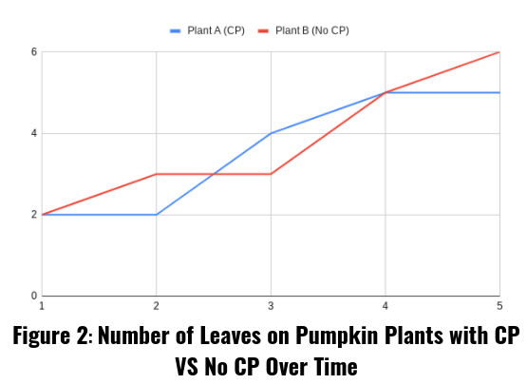
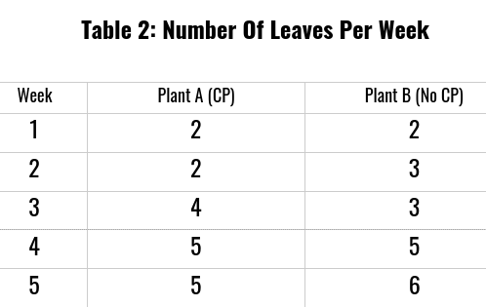
Results:
This Table (Table 2) and Graph (Figure 2) shows
the number of leaves on pumpkin plants with CP
and without CP are both up and down and neither
has a drastic difference.

Slide 10
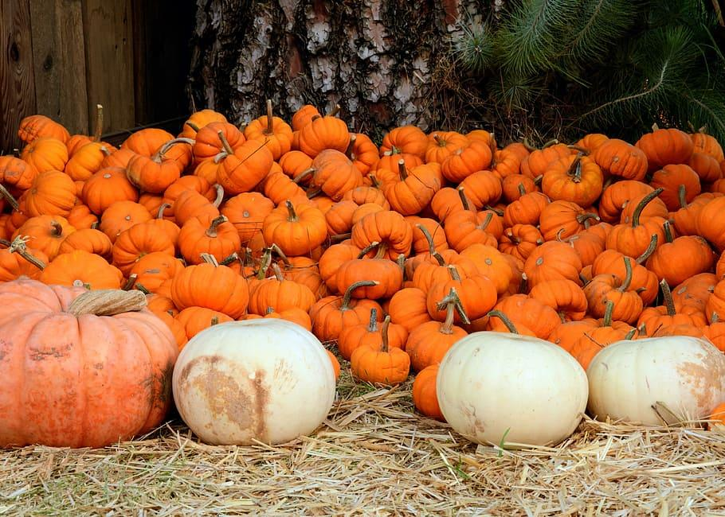
Discussion:
The hypothesis was not correct when saying that the pumpkin watered with the chicken fertilizer will grow the biggest and fastest.
The first set of data shows A starting off taller, then being passed by B, then A caught up again, this was not expected to happen.
The second set of data shows plant A and B taking turns rising about equally, this shows that the chicken poop didn’t have any effect on the amount of leaves the plant produced

Slide 11
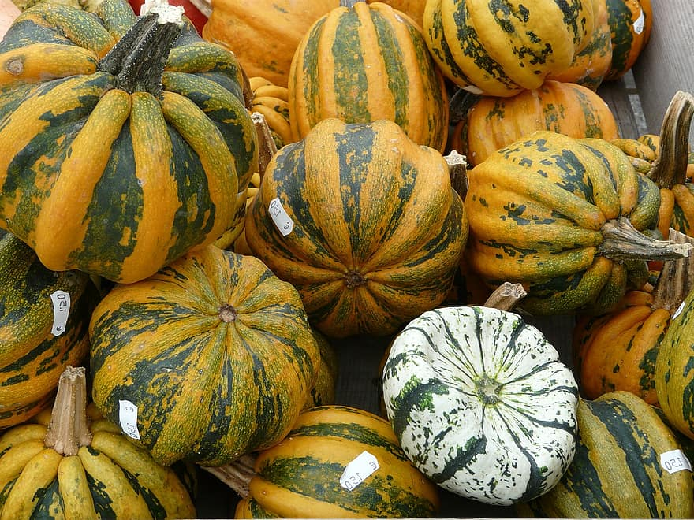
Sources Of Error:
Systematic Error - If this experiment had to of taken place during the summer the outcome could of possible been different due to the winter days being shorter, this caused the plants to get less sunlight. If this experiment was redone a grow lamp should be used to maximize the amount of light time the plant gets.
Random Error - Pumpkin plants like to be kept in a warmer climate, they were kept in a window so the cld could of possibly stunted their growth. If this experiment was redone a grow lamp (also gives off heat not only light) should be used to keep the plants warm.
Systematic Error - The soil used was regular potting soil, when starting seeds its beneficial to use seed starting soil so the sprouts get the proper nutrients. This could have caused the seeds to not grow to their full potential. If the experiment was redone seed starting soil should be used.

Slide 12
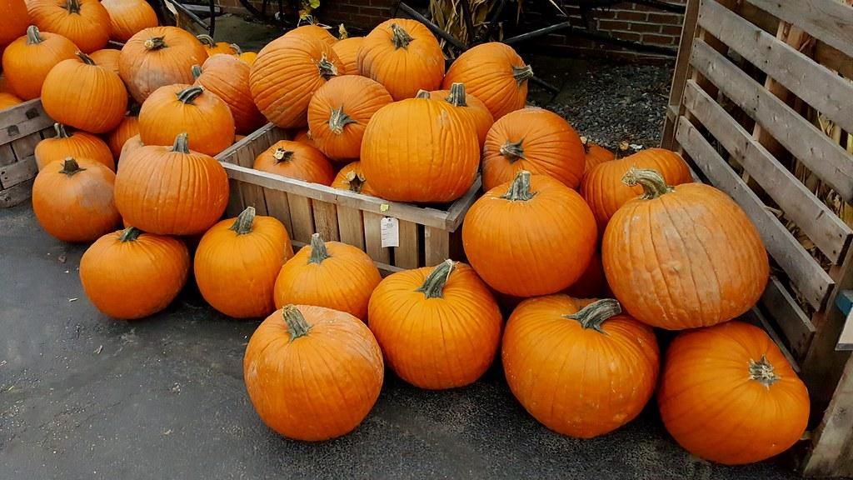
Conclusion:
Based on the experiment, the Chicken Poop did not have any benefits or negative effects on the pumpkin plants and the hypothesis was incorrect.

Slide 13
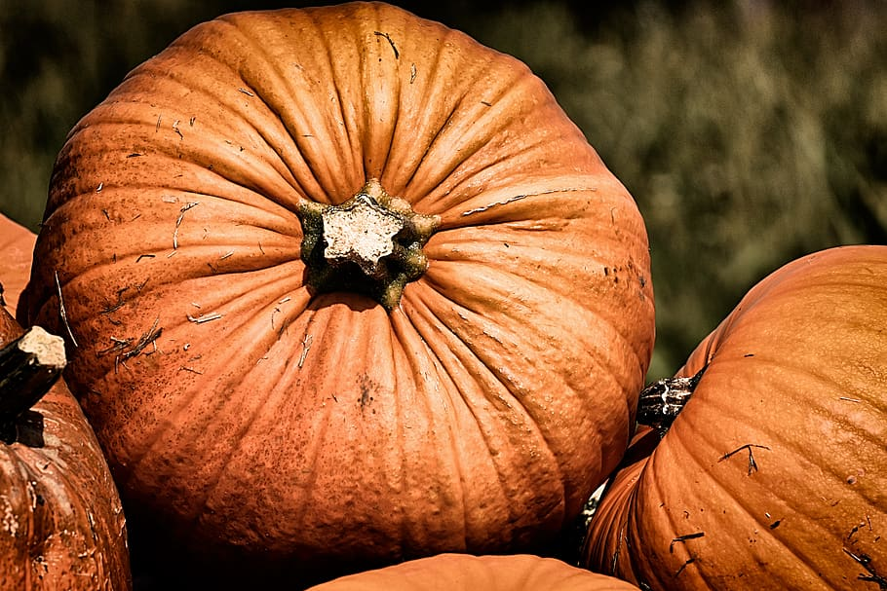
Acknowledgments:
Natalie- I would like to acknowledge my mom joanne, my dad Darryl, my stepdad Stephen, and my late nan for all having green thumbs and showing me how to grow and take care of all different kinds of plants throughout my life
Emily- I would like to acknowledge my nan for teaching me how to garden and my mom for teaching me the other specifics. My nan would take me out to her garden and show me her pumpkin patch and how she composts.

Slide 14
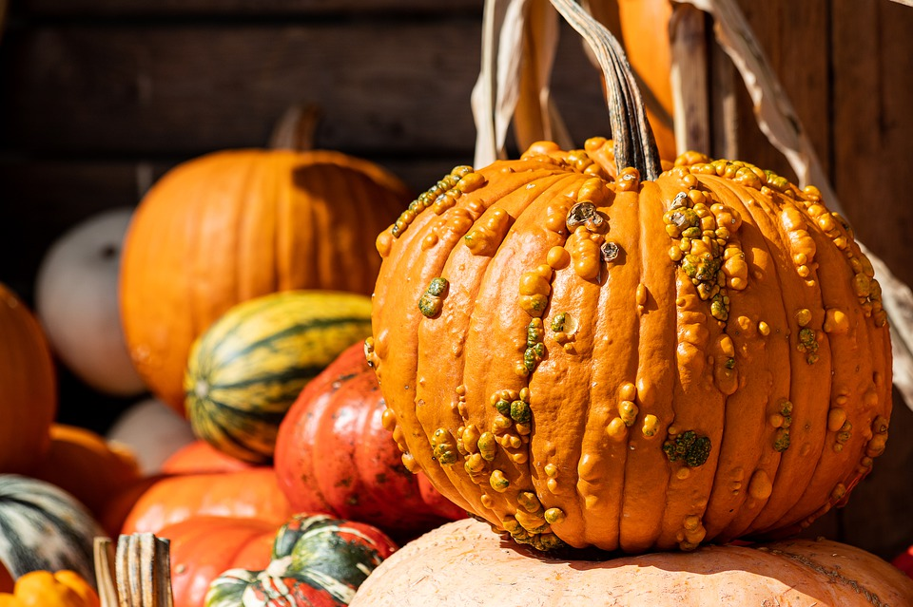
References:
LLou, G (2014/03)
How To Brew Chicken Manure Tea For Your Garden. Retrieved from:https://www.fresheggsdaily.blog/2014/03/how-to-brew-chicken-poop-or-horse.html#:~:text=Dilute%20your%20tea%2C%201%20part,beets%2C%20carrots%2C%20etc.
Grist, D (2017/Dec/17) How To Grow Pumpkins
Retrieved From:
https://www.gardeners.com/how-to/growing-pumpkins/8585.html

