Slide 1
How Pollution Affects the pH Levels of Water in Newfoundland
Rylee Murrin, Abby Gruchy
Holy Trinity High school
Grade 10

Slide 2
Purpose:
Question(s):
Hypothesis:
The purpose is to study how pollution affects the water quality in Newfoundland compared to more polluted areas around the world.
What are the PH levels of lakes and ponds around Newfoundland compared to lakes and ponds in more polluted areas?
The water near the cities and more polluted areas will have a pH level lower than 7 meaning the water will be more acidic, the pH levels of water in the province of Newfoundland wil be less acidic compared to the water in bigger cities like Toronto, Vancouver and New York.

Slide 3
Independent Variables:
Dependant Variables:
Controlled Variables:
The pollution of the area around the water sources.
The pH levels of water
Use the same pH meter each time while measuring
Have the same people record the data each time .
Measure the pH level of each body of water on the same day.

Slide 4
Materials:
pH meter
Pencil and paper to record the results with
Water from lakes or ponds

Slide 5
Procedure:
Procedure:
Collect water from a more polluted and urban area.
Dip pH meter into the water, wait for the results.
When the results are shown, record onto a sheet of paper using a pencil.
Collect Water from a less polluted rural area.
Dip the pH meter into the water, wait for the results.
When the results are shown, record onto a sheet of paper using a pencil.
When both experiments are complete, compare the results to determine the effect pollution has on the pH level of water.
Once this is completed, research the pH levels of water in bigger cities (i.e. Toronto, Vancouver, New York)
Then compare the pH levels of Newfoundland to these bigger and more urban cities.

Slide 6
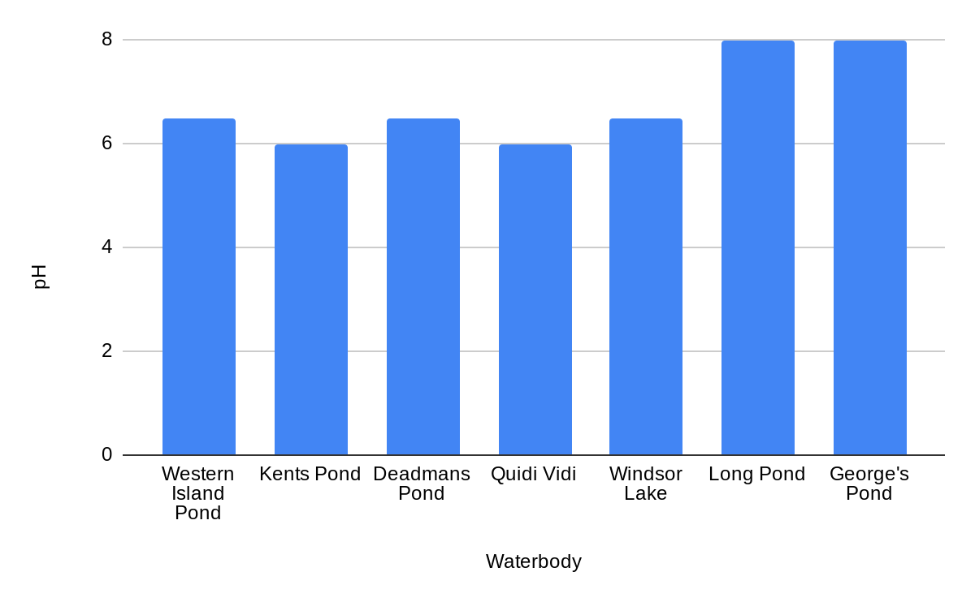
Results:
 |  |  | Average: | Median: | Mode: | Standard Deviation:
Waterbody | pH | Range: | 6.785714286 | 6.5 | 6.5 | 0.859124693
Western Island Pond | 6.5 | 6-8
Kent's Pond | 6
Deadman's Pond | 6.5
Quidi Vidi | 6
Windsor Lake | 6.5
Long Pond | 8
George's Pond | 8
Figure 1: Different Bodies of Water and Their pH levels
Table 1: Different Bodies of Water and their pH Levels.

Slide 7
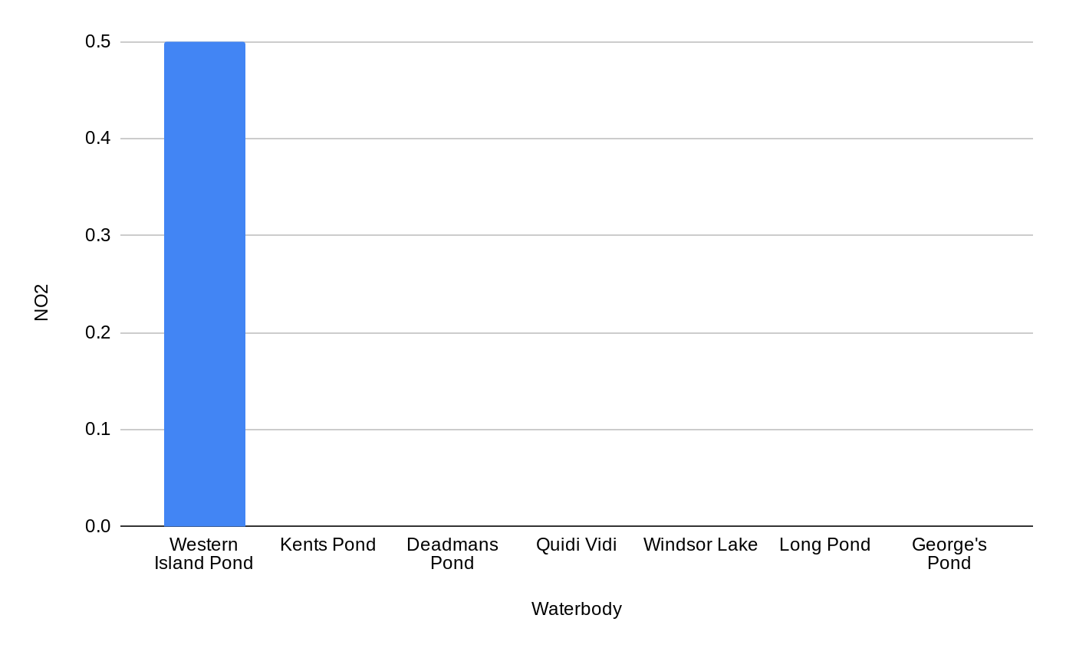
Figure 2: Different Bodies of Water and Their Nitrite Level.
Results continued:
Waterbody | NO₂ | Range: | Average: | Median: | Mode: | Standard Deviation:
Western Island Pond | 0.5 | 0-0.5 | 0.07142857143 | 0 | 0 | 0.1889822365
Kent's Pond | 0
Deadman's Pond | 0
Quidi Vidi | 0
Windsor Lake | 0
Long Pond | 0
George's Pond | 0
Table 2: Different Bodies of Water and Ther Nitrite Levels.

Slide 8
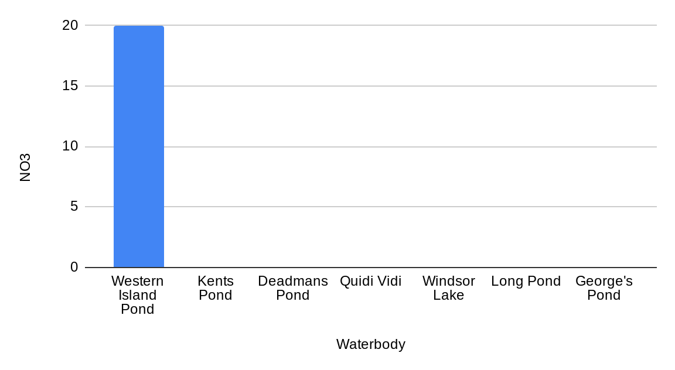
Figure 3: Different Bodies of Water and Nitrate Level
Results continued:
Waterbody | NO₃ | Range: | Average: | Median: | Mode: | Standard Deviation:
Western Island Pond | 20 | 0-60 | 2.857142857 | 0 | 0 | 7.55928946
Kent's Pond | 0
Deadman's Pond | 0
Quidi Vidi | 0
Windsor Lake | 0
Long Pond | 0
George's Pond | 0
Table 3: Different Bodies of Water and Their Nitrate Levels.

Slide 9
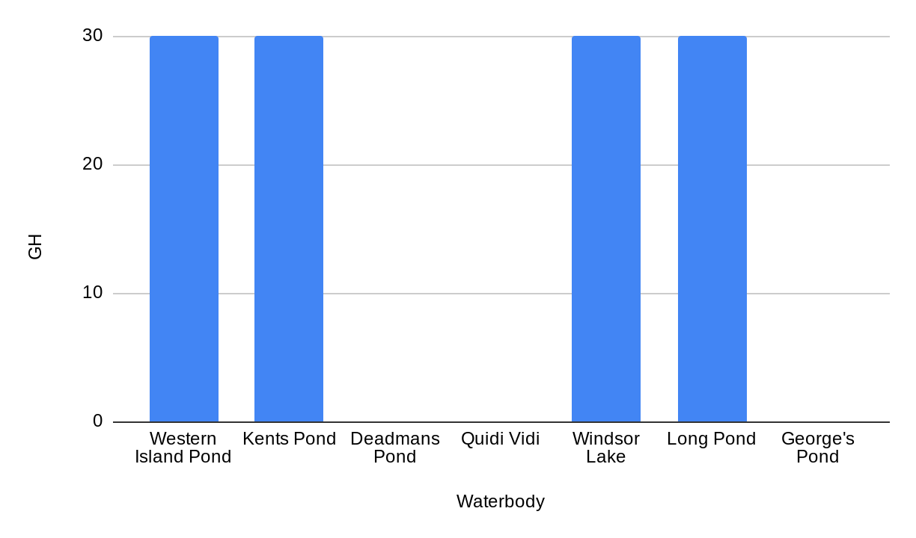
Figure 4: Different Bodies of Water and Their General Hardness.
Results continued:
Waterbody | GH | Range: | Average: | Median: | Mode: | Standard Deviation:
Western Island Pond | 30 | 0-30 | 17.14285714 | 30 | 30 | 16.03567451
Kent's Pond | 30
Deadman's Pond | 0
Quidi Vidi | 0
Windsor Lake | 30
Long Pond | 30
George's Pond | 0
Table 4: Different Bodies of Water and Their General Hardness.

Slide 10
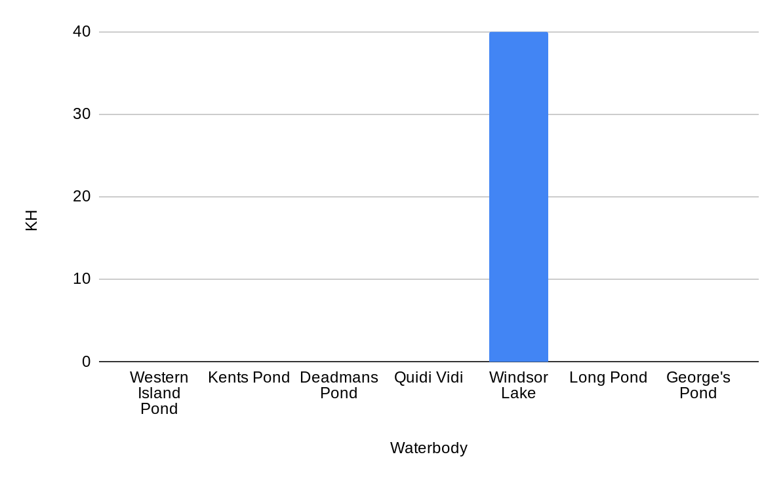
Figure 5: Different Bodies of Water and Their Carbonate Hardness.
Results continued:
Waterbody | KH | Range: | Average: | Median: | Mode: | Standard Deviation:
Western Island Pond | 0 | 0-40 | 5.714285714 | 0 | 0 | 15.11857892
Kent's Pond | 0
Deadman's Pond | 0
Quidi Vidi | 0
Windsor Lake | 40
Long Pond | 0
George's Pond | 0
Table 5: Different Bodies of Water and Their Carbonate Hardness.

Slide 11
Discussion:
The hypothesis for this experiment was correct, however there was little difference of the pH levels of water in the more polluted areas of St. Johns compared to the not as polluted areas.
In the hypothesis it stated that NL’s water will be less acidic (healthier environment), the experiment showed that to be true.

Slide 12
Conclusion:
In conclusion based on the results, Newfoundland’s ponds/lakes prove to be a very healthy environment, according to the results Windsor Lake showed to have the healthiest water.

Slide 13
Sources of Error:
Random Error: It was difficult to measure the pH level of the water because of the high winds shaking the water off the stick.
Parallax Error: It was difficult to view the colors as they were changing. This is because at different eye levels, different colors were visible making it harder to be accurate.
Systematic Error: The error had developed when there was a realization that the pH sticks are not 100% accurate.

Slide 14
Acknowledgments
Our parents
Ms Heidi Kavanagh

Slide 15
References
Kazmeyer, M. (2019, November 22). Water pH & Pollution. Retrieved October 29, 2020, from https://sciencing.com/water-ph-amp-pollution-5850000.html
May 14, 2. (2020, September 02). Water Pollution: Everything You Need to Know. Retrieved October 29, 2020, from https://www.nrdc.org/stories/water-pollution-everything-you-need-know
Lewis, R. C. (2014, May 13). Study is first to examine pollution sources between urban and rural air in the Midwest. https://phys.org/news/2014-05-pollution-sources-urban-rural-air.html.

