Slide 1
Gel Electrophoresis Chamber
By: Arika Rahman and Meghna Saha
School: MacDonald Drive Junior High
Grade: 9

Slide 2
Purpose and Question
Purpose: The purpose of this experiment was to separate charged molecules.
Question: How are particles separated?

Slide 3

Hypothesis
The prediction for this experiment was that the food dye particles will separate.

Slide 4
Variables
Independent Variable: The coloured dyes that were used.
Dependent Variable: How the particles are separated.
Controlled Variable: The gel electrophoresis chamber.

Slide 5
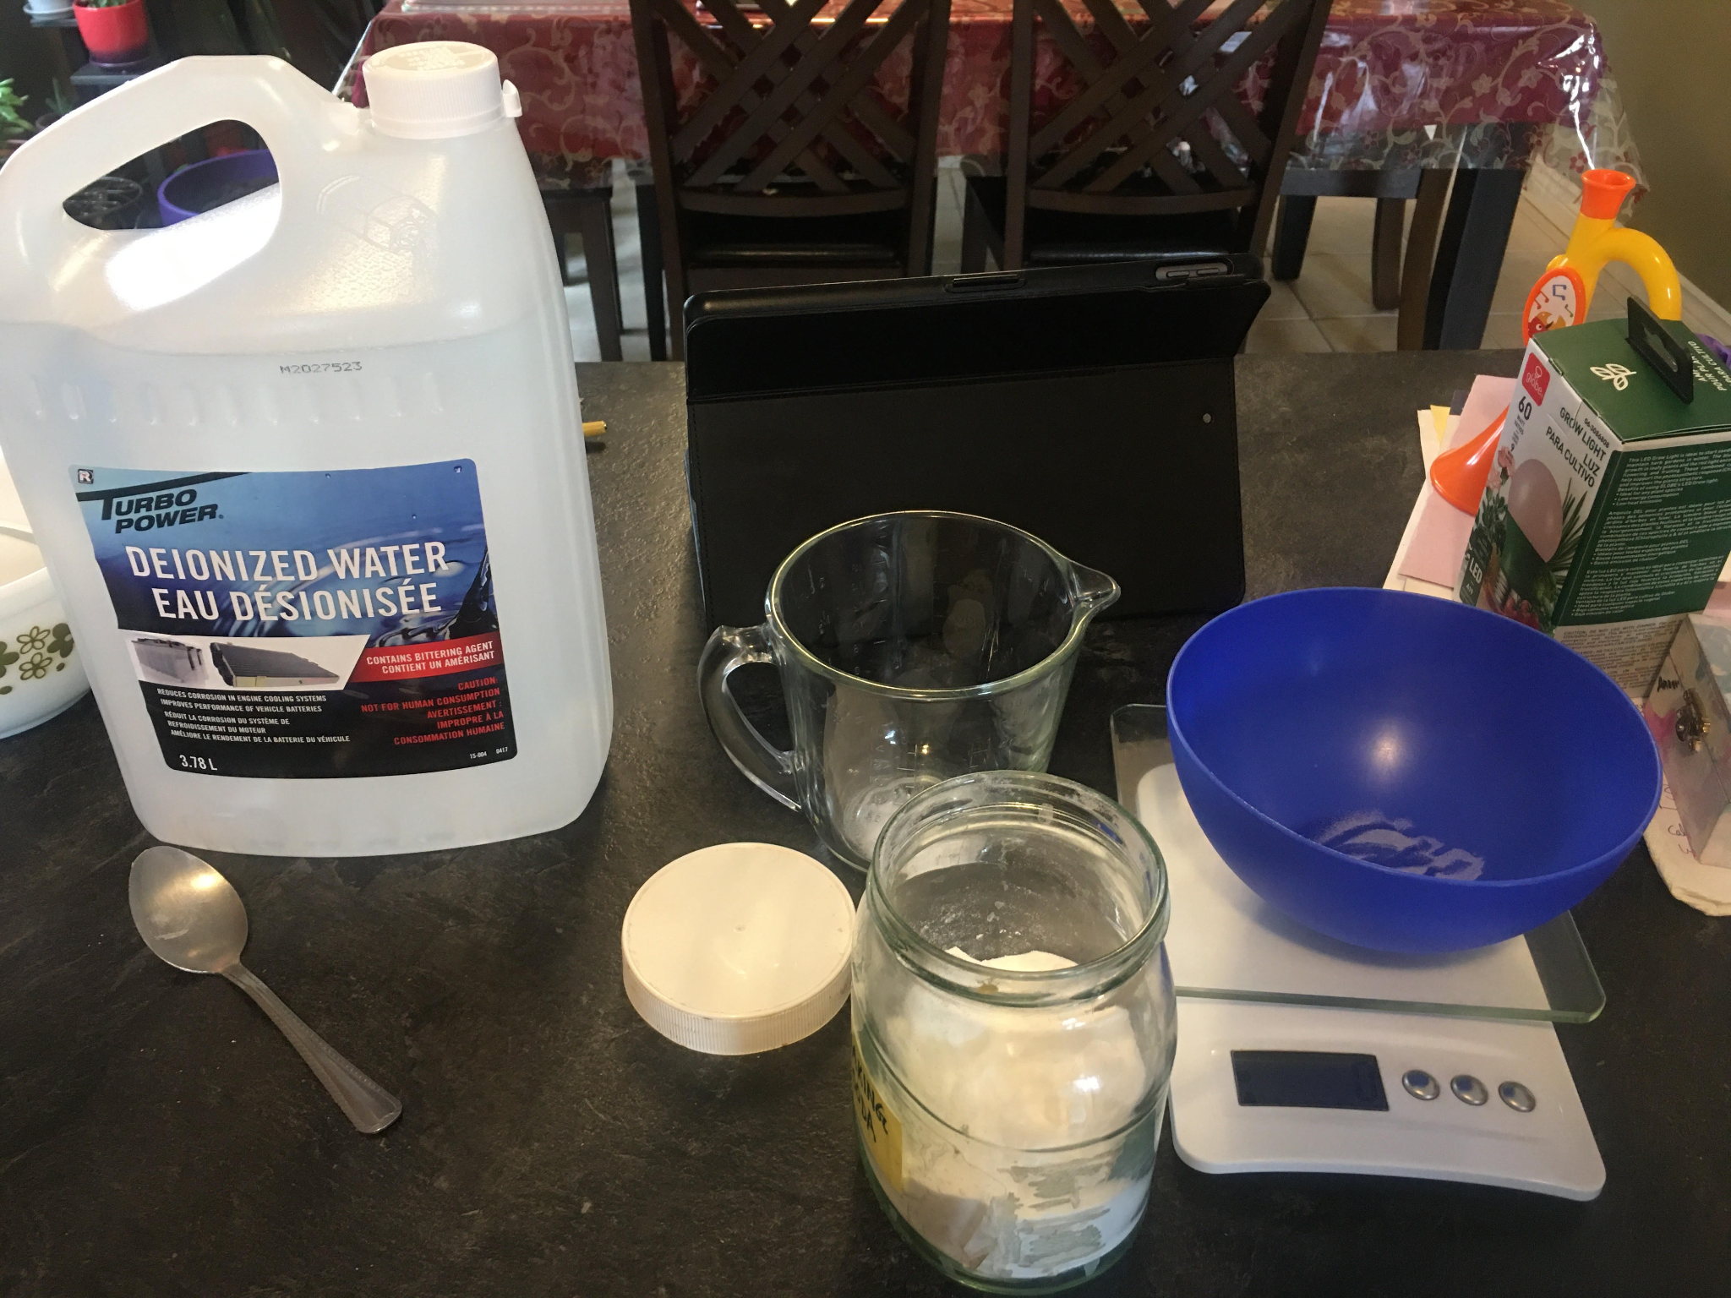
Materials
Small rectangular container
Agar agar powder (1 gram)
Baking soda (2 grams)
Deionized water (200mL)
Food dye/coloring (3 colors)
9 volt batteries (10 batteries)
Medicine droppers
Alligator clips (2)
Cardboard
Chopsticks (1 stick)
Measuring utensils
Microwave safe bowls
Kitchen scale
Butter knife
Scissors
Wire cutters
Microwave

Slide 6
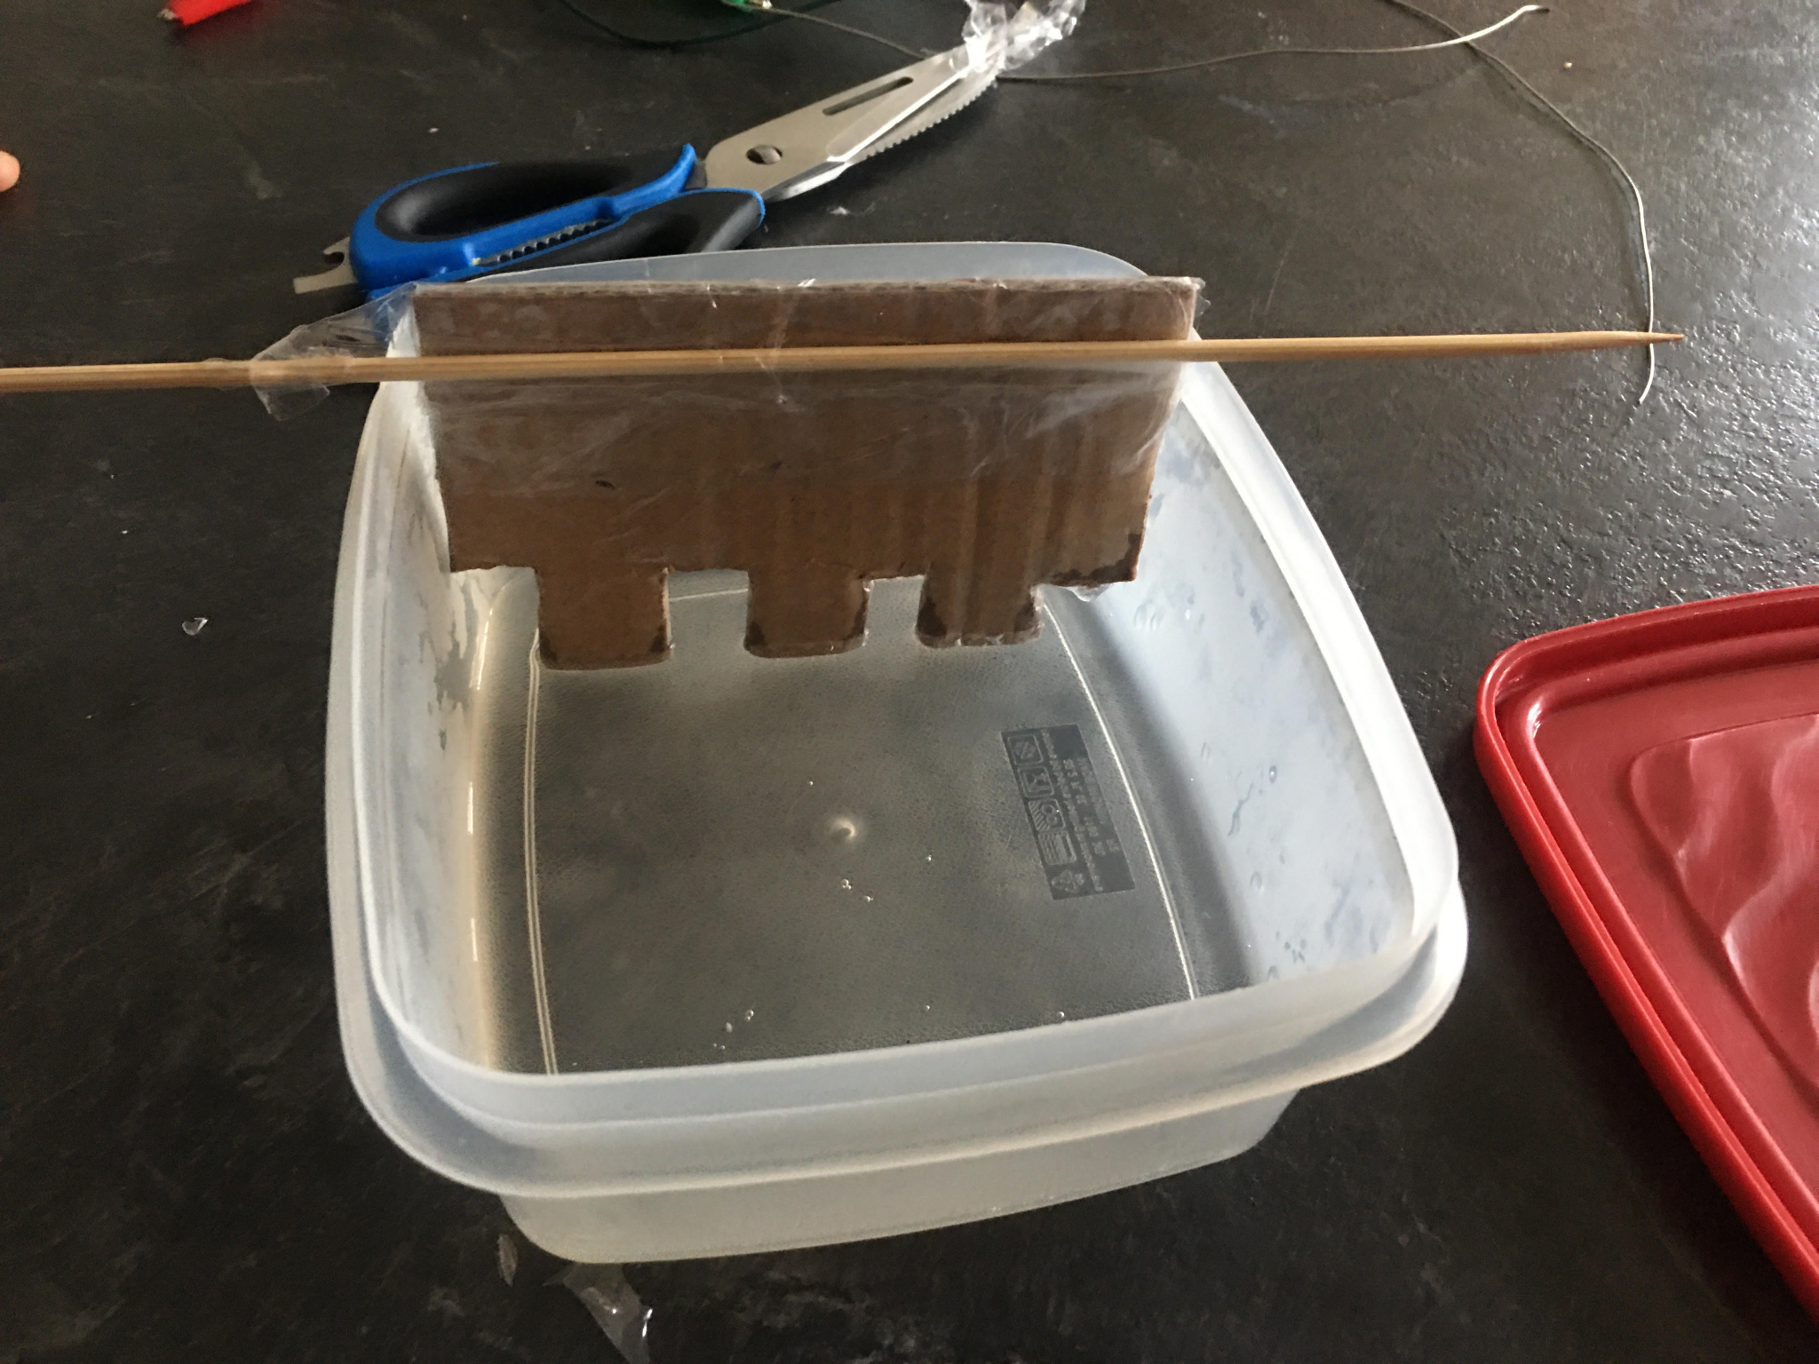
Procedure: Chamber
A container roughly the size of a soap container is used, this is the gel chamber.
Two pieces of wire hook over the side of the box and and run the width of the box, these connect with the battery.
Ten 9 volt batteries are connected, one positive and one negative terminal are left exposed.
An alligator clip is attached to each terminal which will complete the circuit after the gel and agarose gel get added.

Slide 7
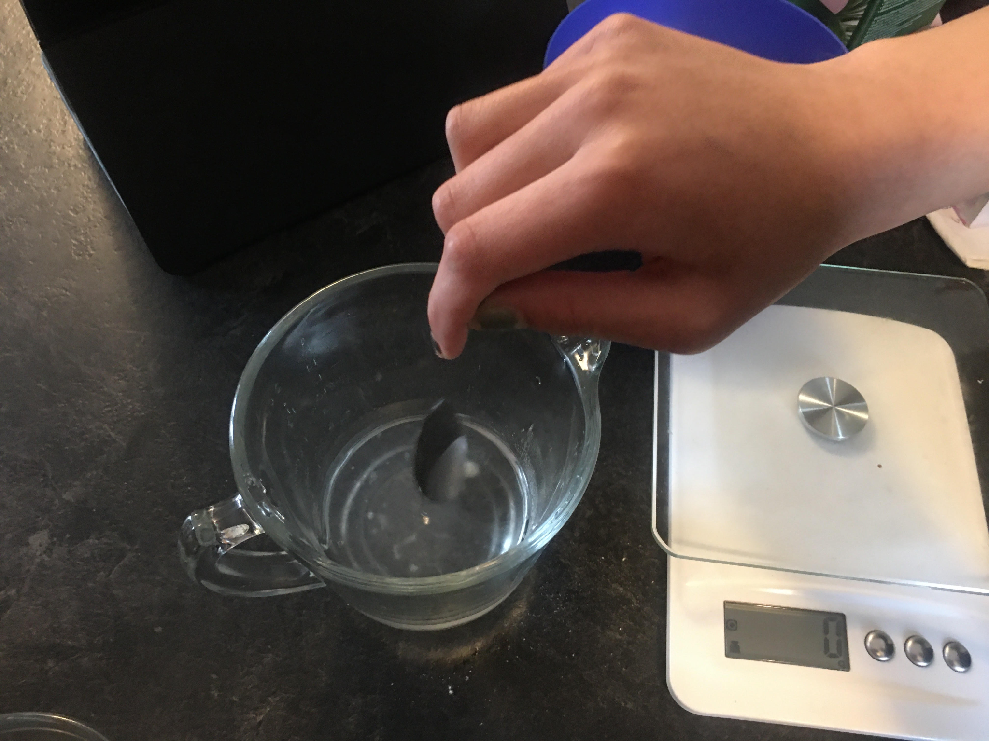
Procedure: Agarose Gel
Baking soda is dissolved in deionized water.
The solution is divided in half.
One half is put aside to be used for the buffer solution.
The other half have agar agar powder dissolved in it while being microwaved.

Slide 8
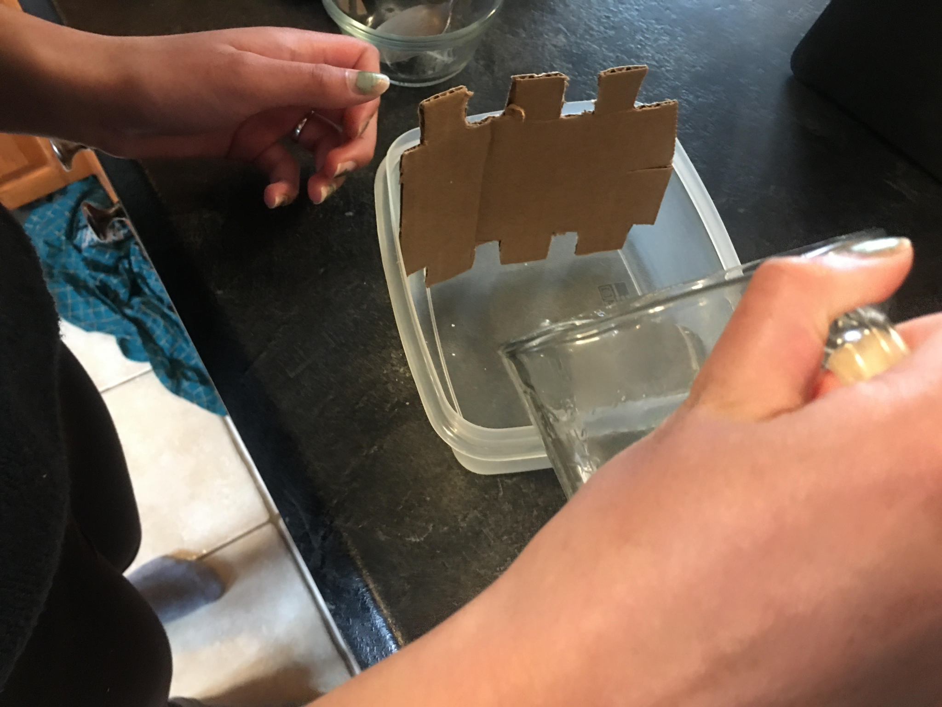
Procedure: Assembling the Experiment
A piece cardboard is cut into a comb-like shape with it being wider on the top so it can rest on the edges of the box. It can’t touch the bottom of the box.
The agarose solution is poured into the box with the comb still in. It takes 30 minutes to harden.
After the gel hardens, the comb is taken out with small wells left behind.
The sides on the width are cut out to make space for the steel wires.
The dye is put into the wells using a dropper after pouring the buffer solution into the box.
The alligator clips are connected to the wires and and the batteries which completes the circuit and starts the process of separating the particle. This will sit for 45 minutes.

Slide 9
Background Information
A gel electrophoresis chamber is used to separate particles with the use of electric charges. When a circuit is complete the charged molecules move towards the steel wires which are the electrodes. Particles that are strongly charged move quicker than charges that have weak charges. Smaller charges are also faster than big particle so they move faster and further. This separates the molecules with different levels of charges and different sizes.

Slide 10
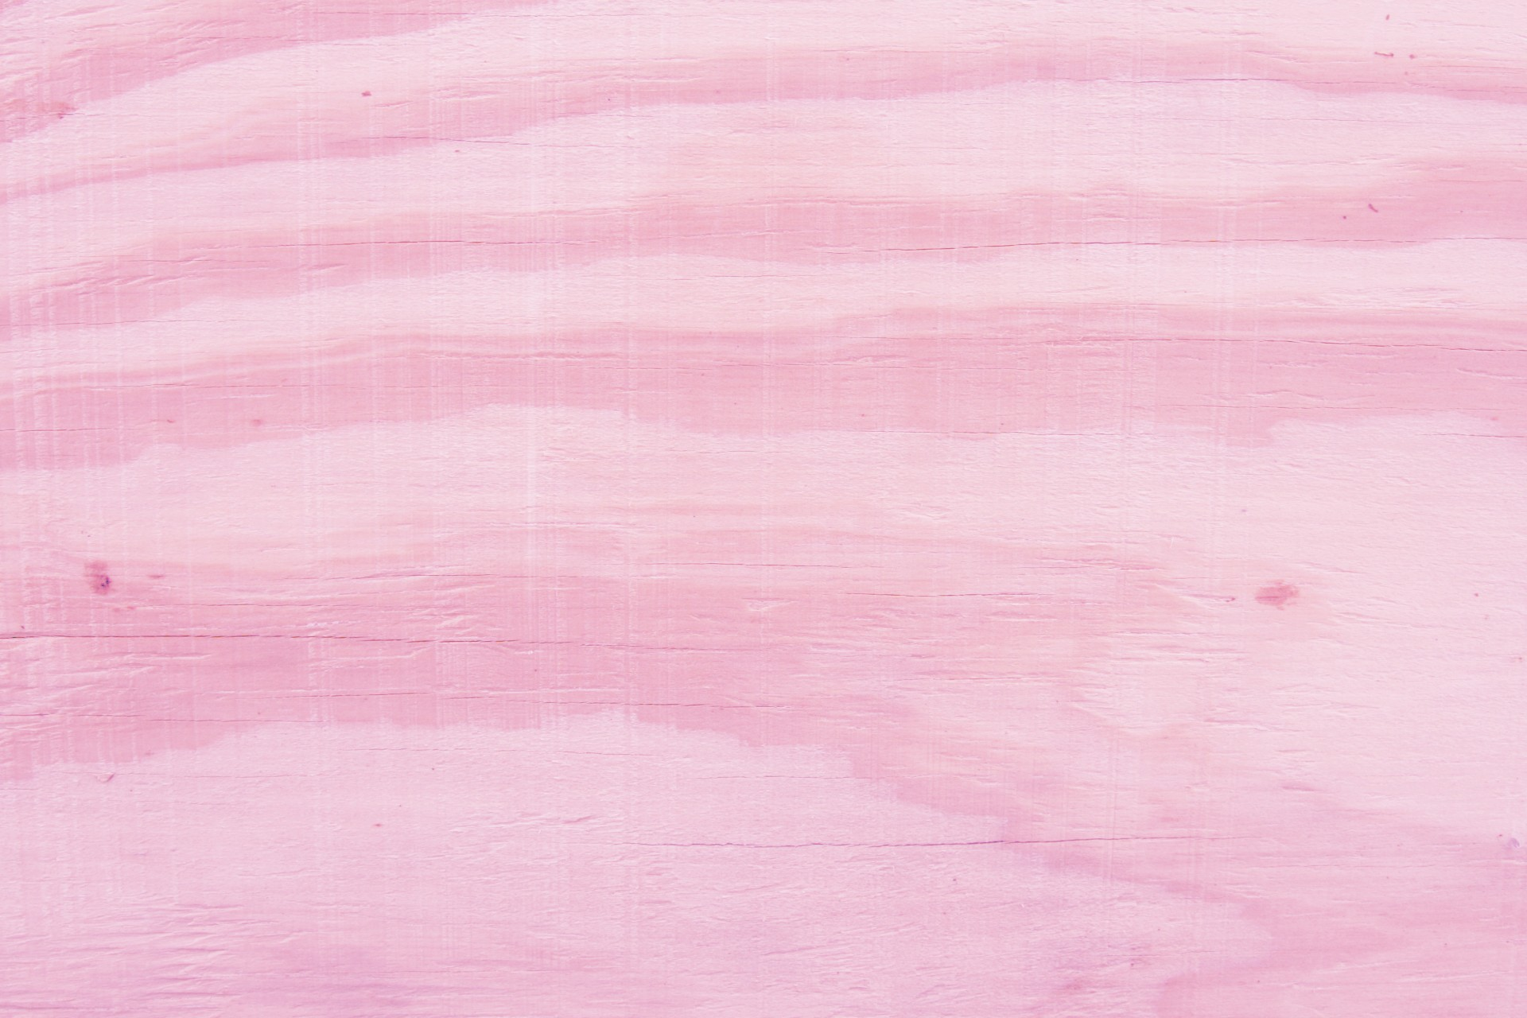
Real Life Applications
A gel electrophoresis chamber can be used for many different things such as:
Biology, the study of life and living organisms
Biochemistry, the study of chemical processes
Medical field
Forensic science, investigating crimes

Slide 11
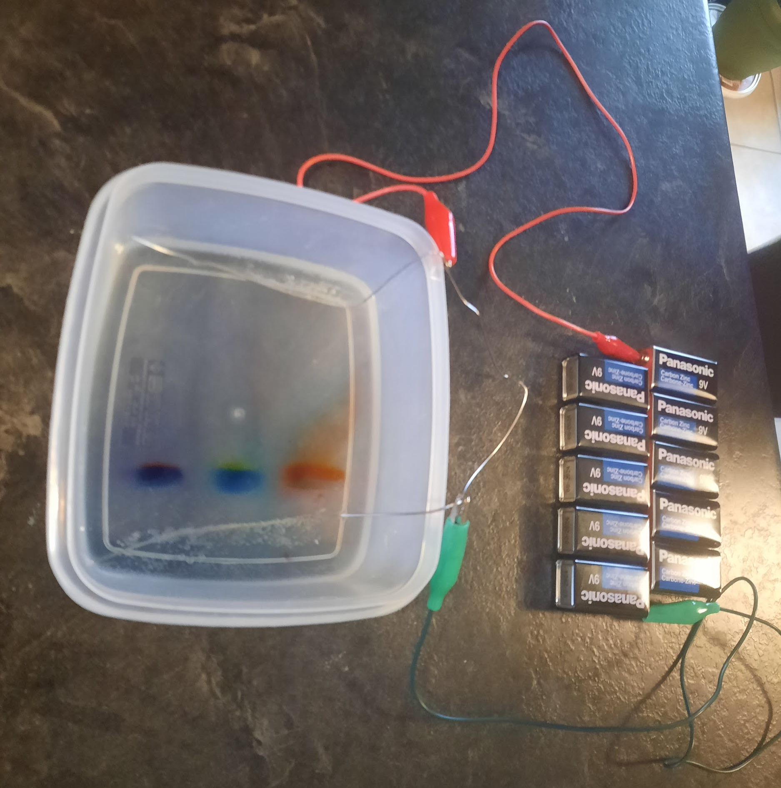
Results
The experiment was done incorrectly three times before it was made without any mistakes. Three colours were used; purple, orange and green. The different colours making up those colours were separated and easily visible. It was seen which particles were smaller and had stronger charges.

Slide 12
Table
Original Dye Color | Separated Colors | Color That Travelled Further
Purple | Red and Blue | Red
Orange | Red and Yellow | Yellow
Green | Yellow and Blue | Yellow

Slide 13
Errors
The procedure had to be done four times to get the expected results. The first time a hole was created when inserting the dye in the agarose gel. The wells went to the bottom of the box which stopped the dye from spreading through the gel. The second time the positive and negative terminals were the wrong way. It was forgotten that electrons move negative to positive the side of the wells was placed on the positive side and there was no space for the colours to separate. This was an extremely ignorant mistake. The third time the agarose gel was made with too much agar agar powder which made it too stiff for the particles to move through the gel. The final trial was done correctly and gave the intended results.

Slide 14
Conclusion
In conclusion, even though there were many mistakes, the gel electrophoresis chamber eventually worked. Many lessons were learned by restarting this process so many times and it was a great learning experience.

Slide 15
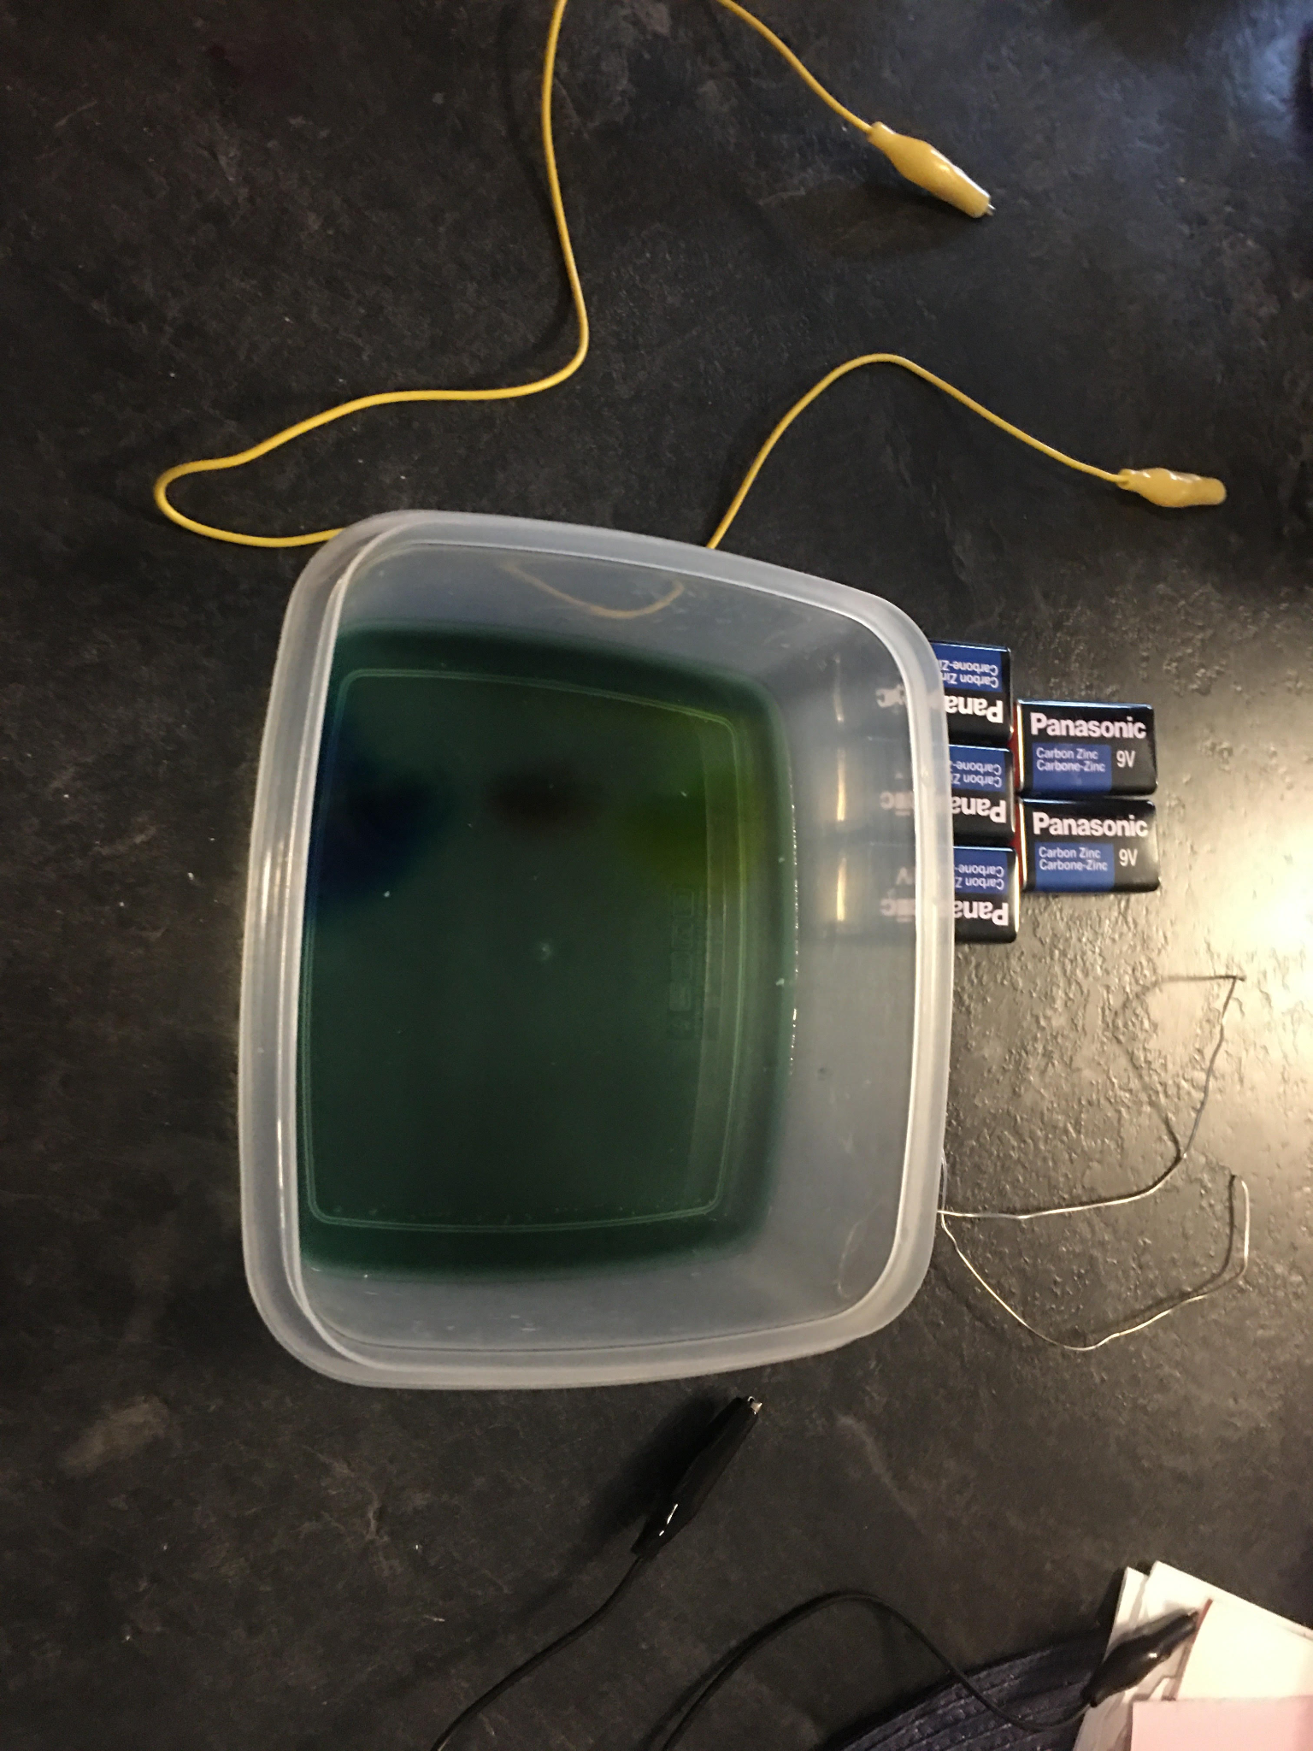
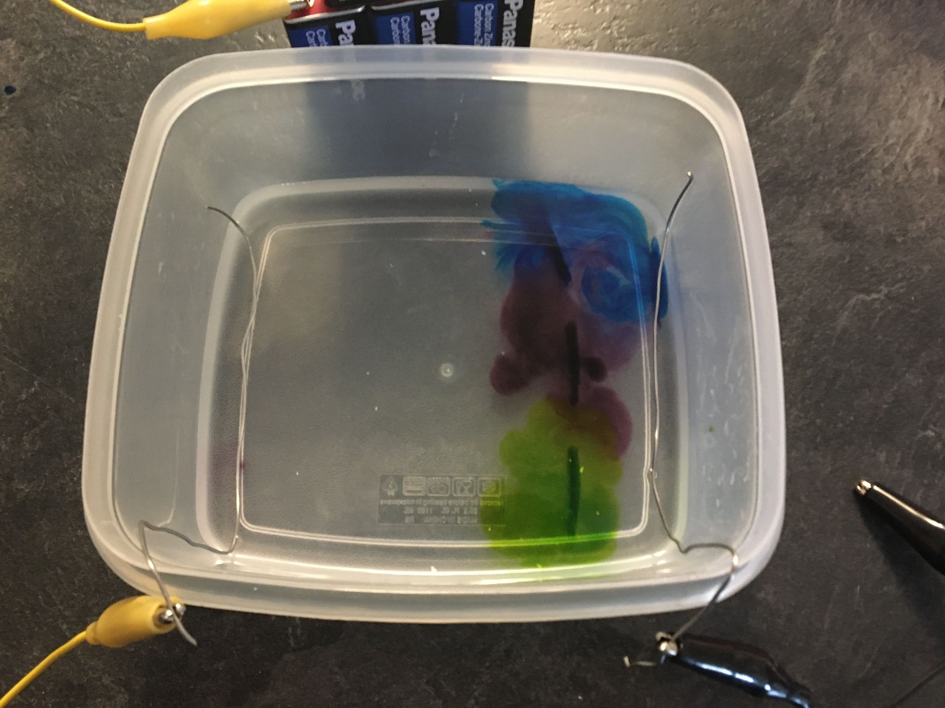
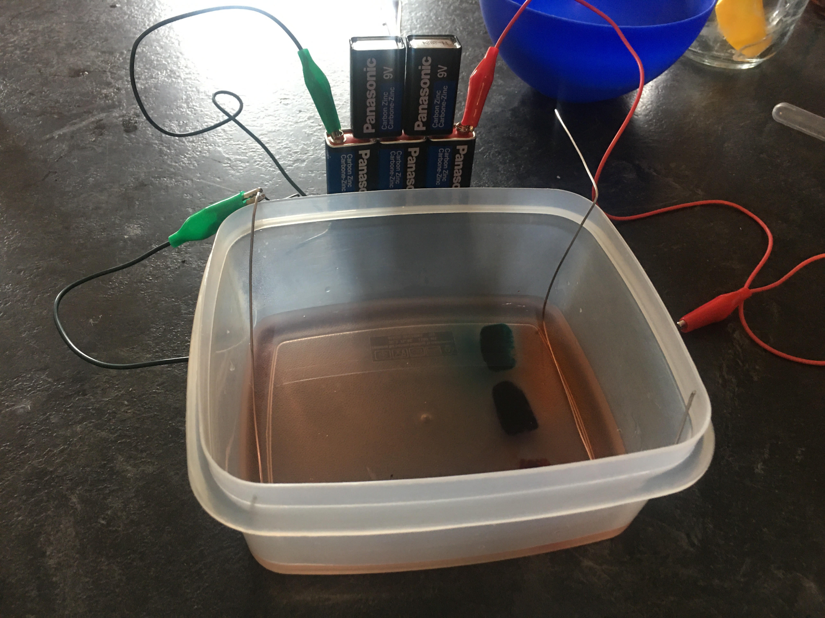
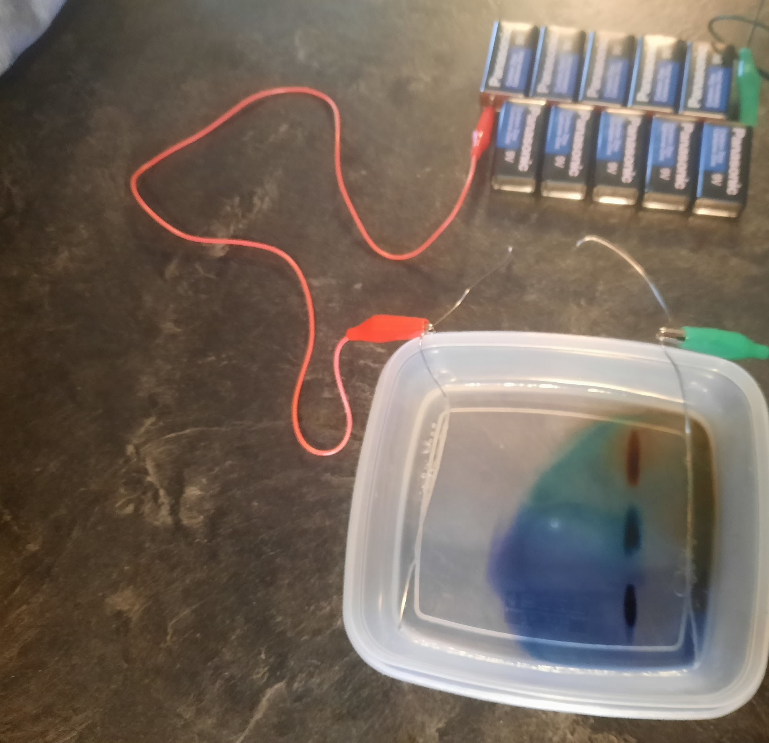
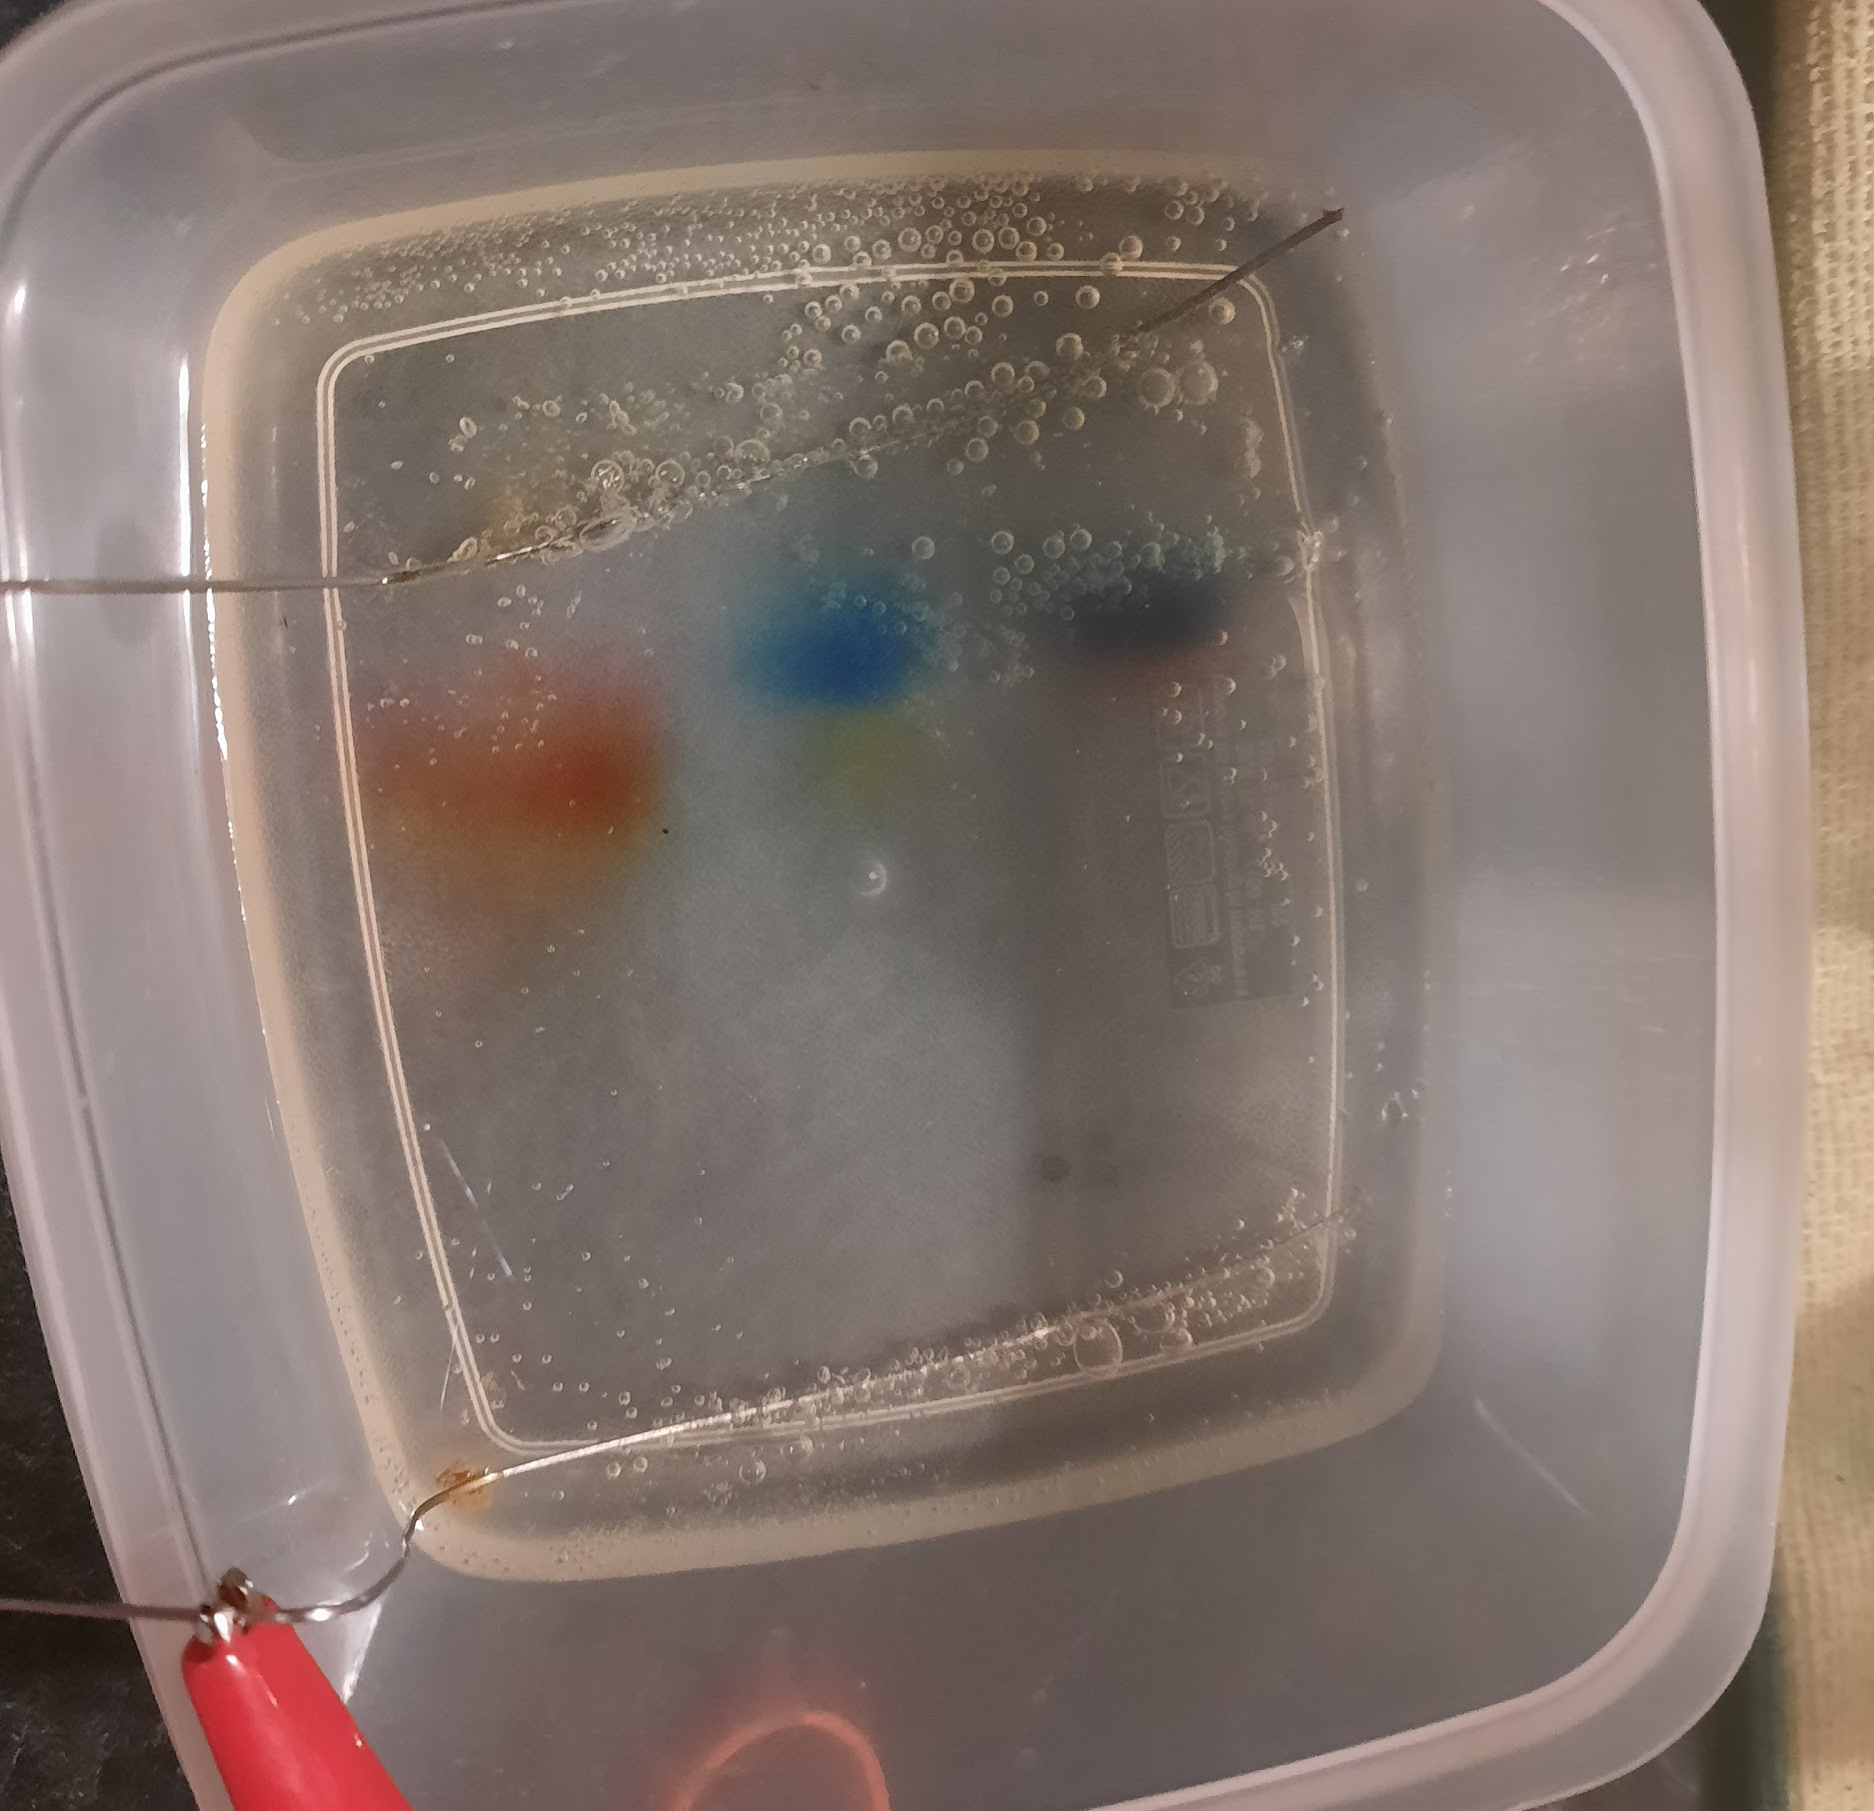
First Attempt
Second Attempt
Third Attempt
Fourth Attempt

Slide 16
Acknowledgments: Help from Parents
Resources:
Science Buddies. (2020, November 20). Forensic Science: Building Your Own Tool for Identifying DNA | Science Project. https://www.sciencebuddies.org/science-fair-projects/project-ideas/BioChem_p028/biotechnology-techniques/forensic-science-building-your-own-tool-for-identifying-dna#background

