Slide 1


Here Comes the Sun:
The Potential of Solar Energy in NL
By Dipayan Dhar
Grade 9, Macdonald Drive Junior High

Slide 2
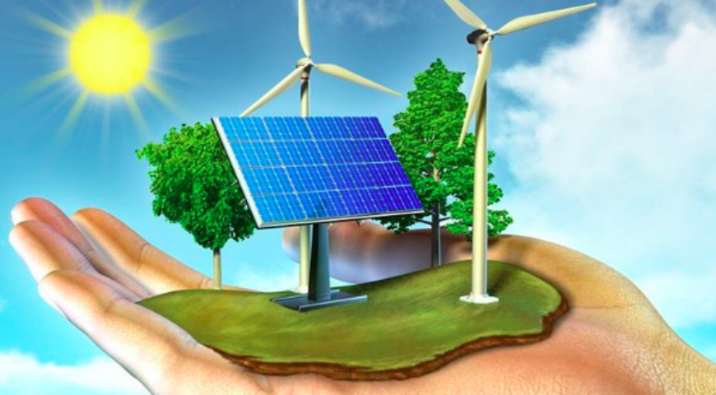
Introduction
The purpose of this project is to find out if solar energy is a viable alternative source of energy for Newfoundland and Labrador.
In the future, renewable energy sources will be needed to rely on. The province of Newfoundland and Labrador is already accustomed to using wind power, and another possible source of renewable energy could be solar energy. Solar energy may be something that would work for our province in the future.

Slide 3
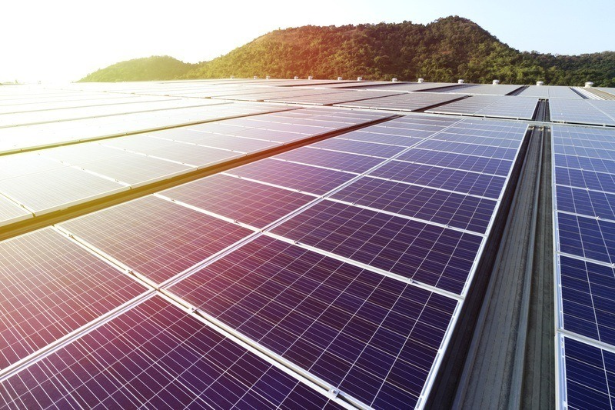
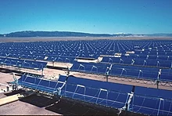
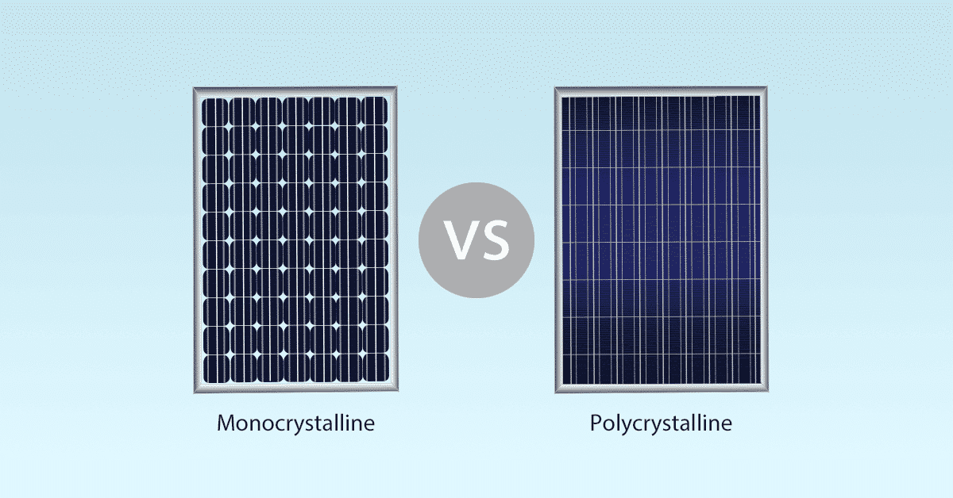
Solar Panels
Photovoltaic
Concentrated Solar Power
There are 2 types of solar panels that are mostly used. They are photovoltaic and concentrated solar power (PV, CSP). The difference between PV and CSP cells is that PV directly converts sunlight into electricity, while CSP uses the sun’s energy instead. PV cells also use both direct and diffuse irradiance, while CSP cells only uses direct.
These cells can be made with many different semiconductor materials. The most used ones are monocrystalline and multicrystalline silicon cells. Monocrystalline solar cells are more efficient, as they are made from a single source of silicon. Monocrystalline/Polycrystalline cells are made from multiple sources of silicon, which make them slightly less efficient.
For this project, a PV monocrystalline cell was used for calculations. The impact of climate change on solar energy output will be discussed throughout the presentation.

Slide 4

Methodology
In this project, an analysis was performed on the effect of temperature on solar output. This was done by obtaining pre-existing data from official online sources and using this information to find and compare solar power outputs from various years. A physical experiment was also conducted to see how climate change affects solar energy outputs. With this information, it is possible to find out if solar energy is a renewable energy source we can use for the future.

Slide 5
Numerical Experiment

Slide 6
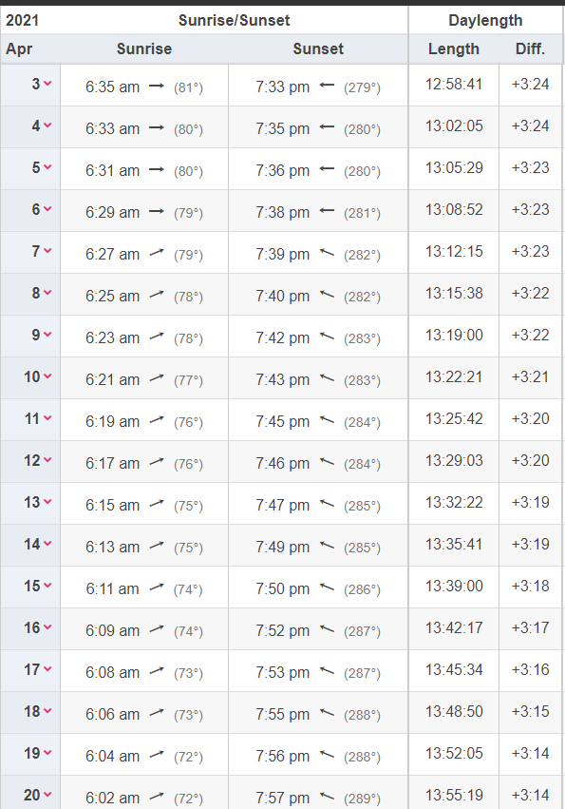
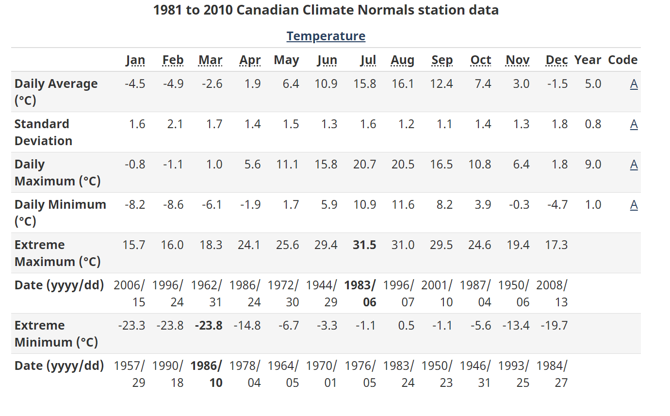
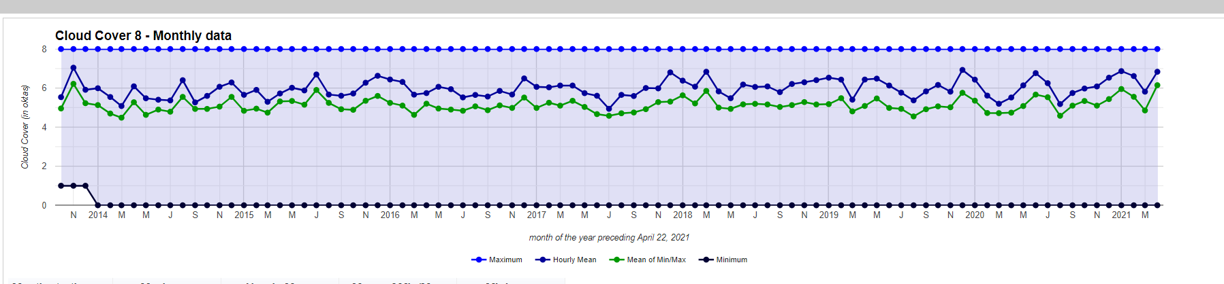
Theoretical Procedure
This procedure is based on the methodology described by Crook et al. (2011). I used a spreadsheet to estimate the solar panel power output.
1. First, I collected climate data for recent climates (1981- 2010). This data was collected from Environment and Climate Change Canada. I obtained the minimum, maximum, and mean temperatures from each month during this time period.
2. Next, I collected monthly cloud cover data from St. John’s Weather Stats, and daylight hours from Time and Date.
Climate data from Environment and Climate Change Canada
Daylight hours, TimeandDate.com
St. John’s Weather Stats, Cloud Cover

Slide 7
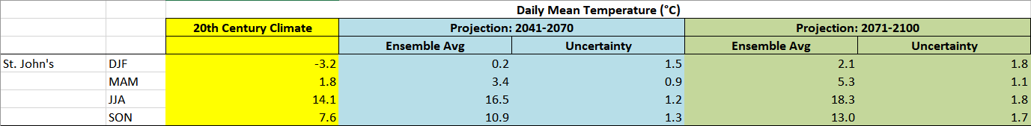

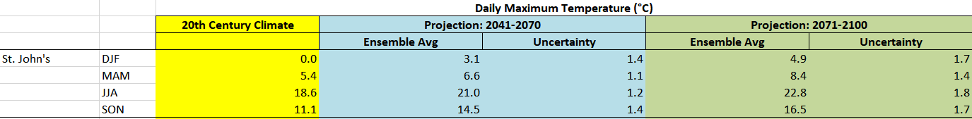
3. After collecting data on the past and present, I went to Department of Environment, Climate Change and Municipalities, NL to get climate projections of the future (2040 - 2100). I obtained the estimated mean, maximum, and minimum temperatures. Since there was no data on the cloud cover or daylight times, I had to keep those parameters the same.

Slide 8
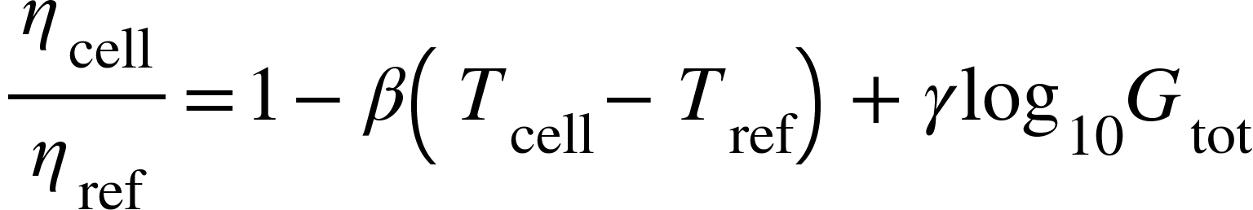

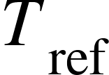
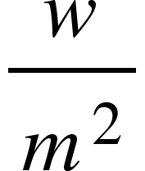




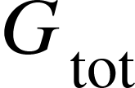
Formula For Solar Panel Efficiency
According to the Crook et al. (2011), the efficiency of a PV cell can be expressed as :
= temperature of the PV cell
= reference temperature
= temperature coefficient
= irradiance coefficient
= efficiency of a PV cell
= reference efficiency (depends on type of solar panel)
= total insulation for cloud cover
4. Using this equation, the average annual energy is obtained when the data is entered into this equation. The unit of measurement for this is in
, which is used for irradiation.
For crystalline silicon cells, β = 0.0045 and γ = 0.1

Slide 9
What is the effect of temperature on solar output?
EXPERIMENT

Slide 10
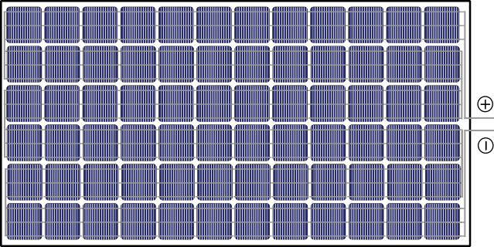
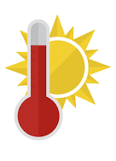
Hypothesis
If the temperature of the solar panels are increased, then the current of the electricity will decrease because when the temperature increases, the resistance will increase as well.

Slide 11
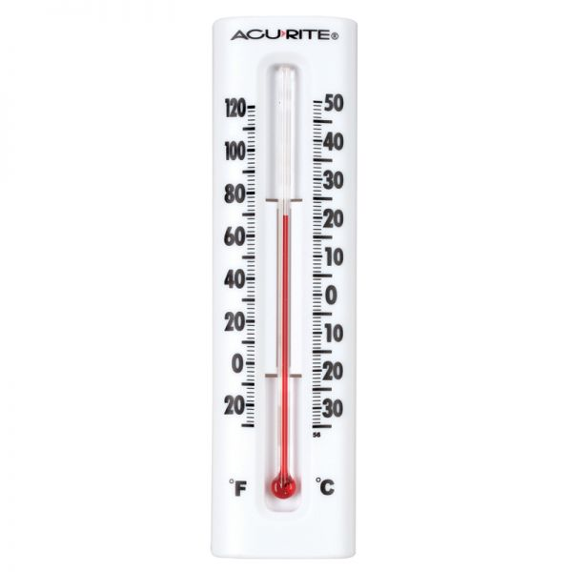
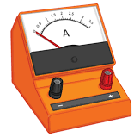
Variables for the Experiment
Control
Type of solar panel
Type of lightbulb
Location
Cloud Cover (attempted)
Length of circuit
Type of wires used
Independent
- Temperature
Dependent
- Solar Panel Output (Current)

Slide 12
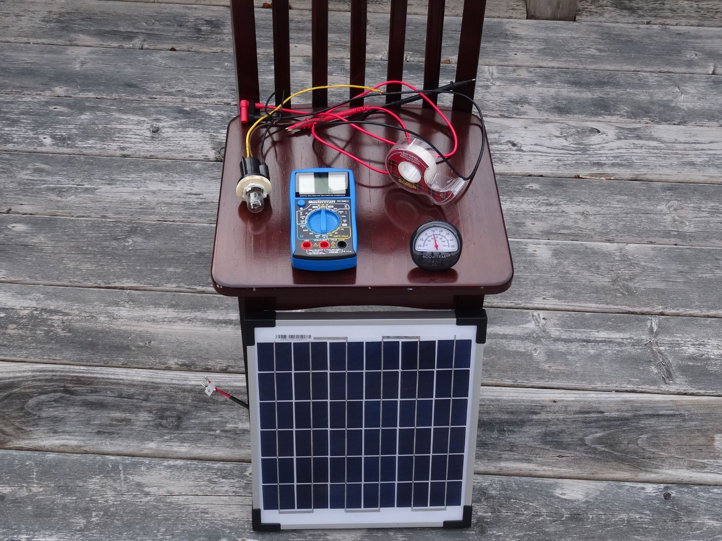
Experiment Materials
12V Monocrystalline silicon PV solar panel
Lightbulb
Tape
Copper wires with plastic coating
Multimeter/Ammeter
Chair (or something else to position the solar panel)
Thermometer
Weather Forecast
Pencil and paper (to record results)

Slide 13
Experimental Procedure

Slide 14
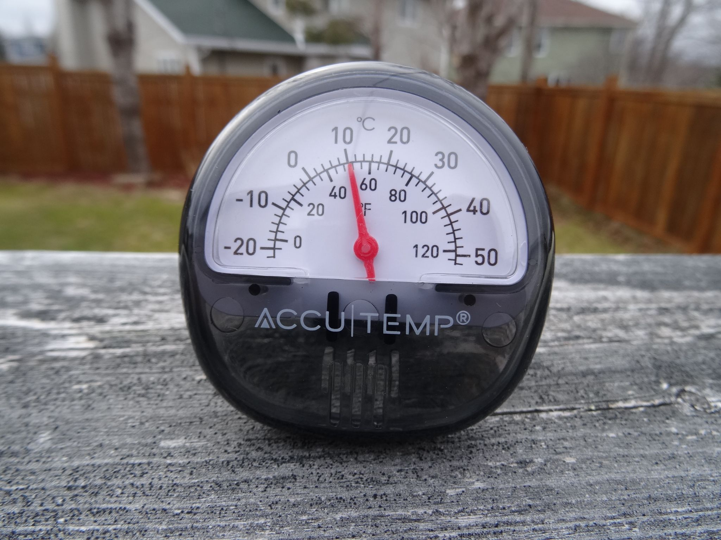
Procedure
1. First, measure the temperature. For my experiment, I used the temperatures 5°C - 12°C. With help from the weather forecast, I was able to find the right times to perform the experiment at. To have some level of consistency, I only recorded data when it was partly cloudy.

Slide 15
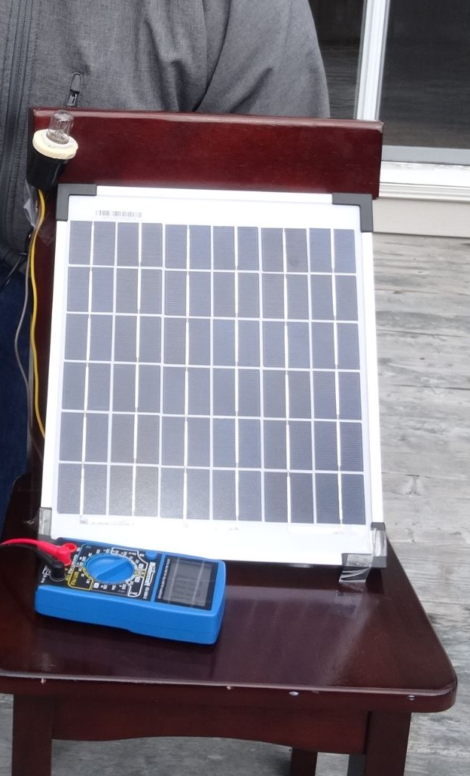
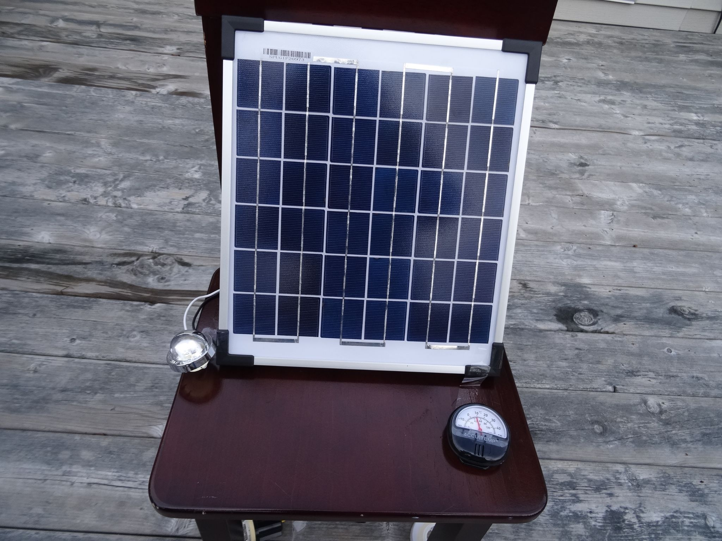
Procedure
2. After checking the temperature, connect the solar panel to the light-bulb. If the bulb lights up, this was done correctly.
3. Position the solar panel to point at the sky/sun. Use tape to secure the light-bulb and wires.

Slide 16
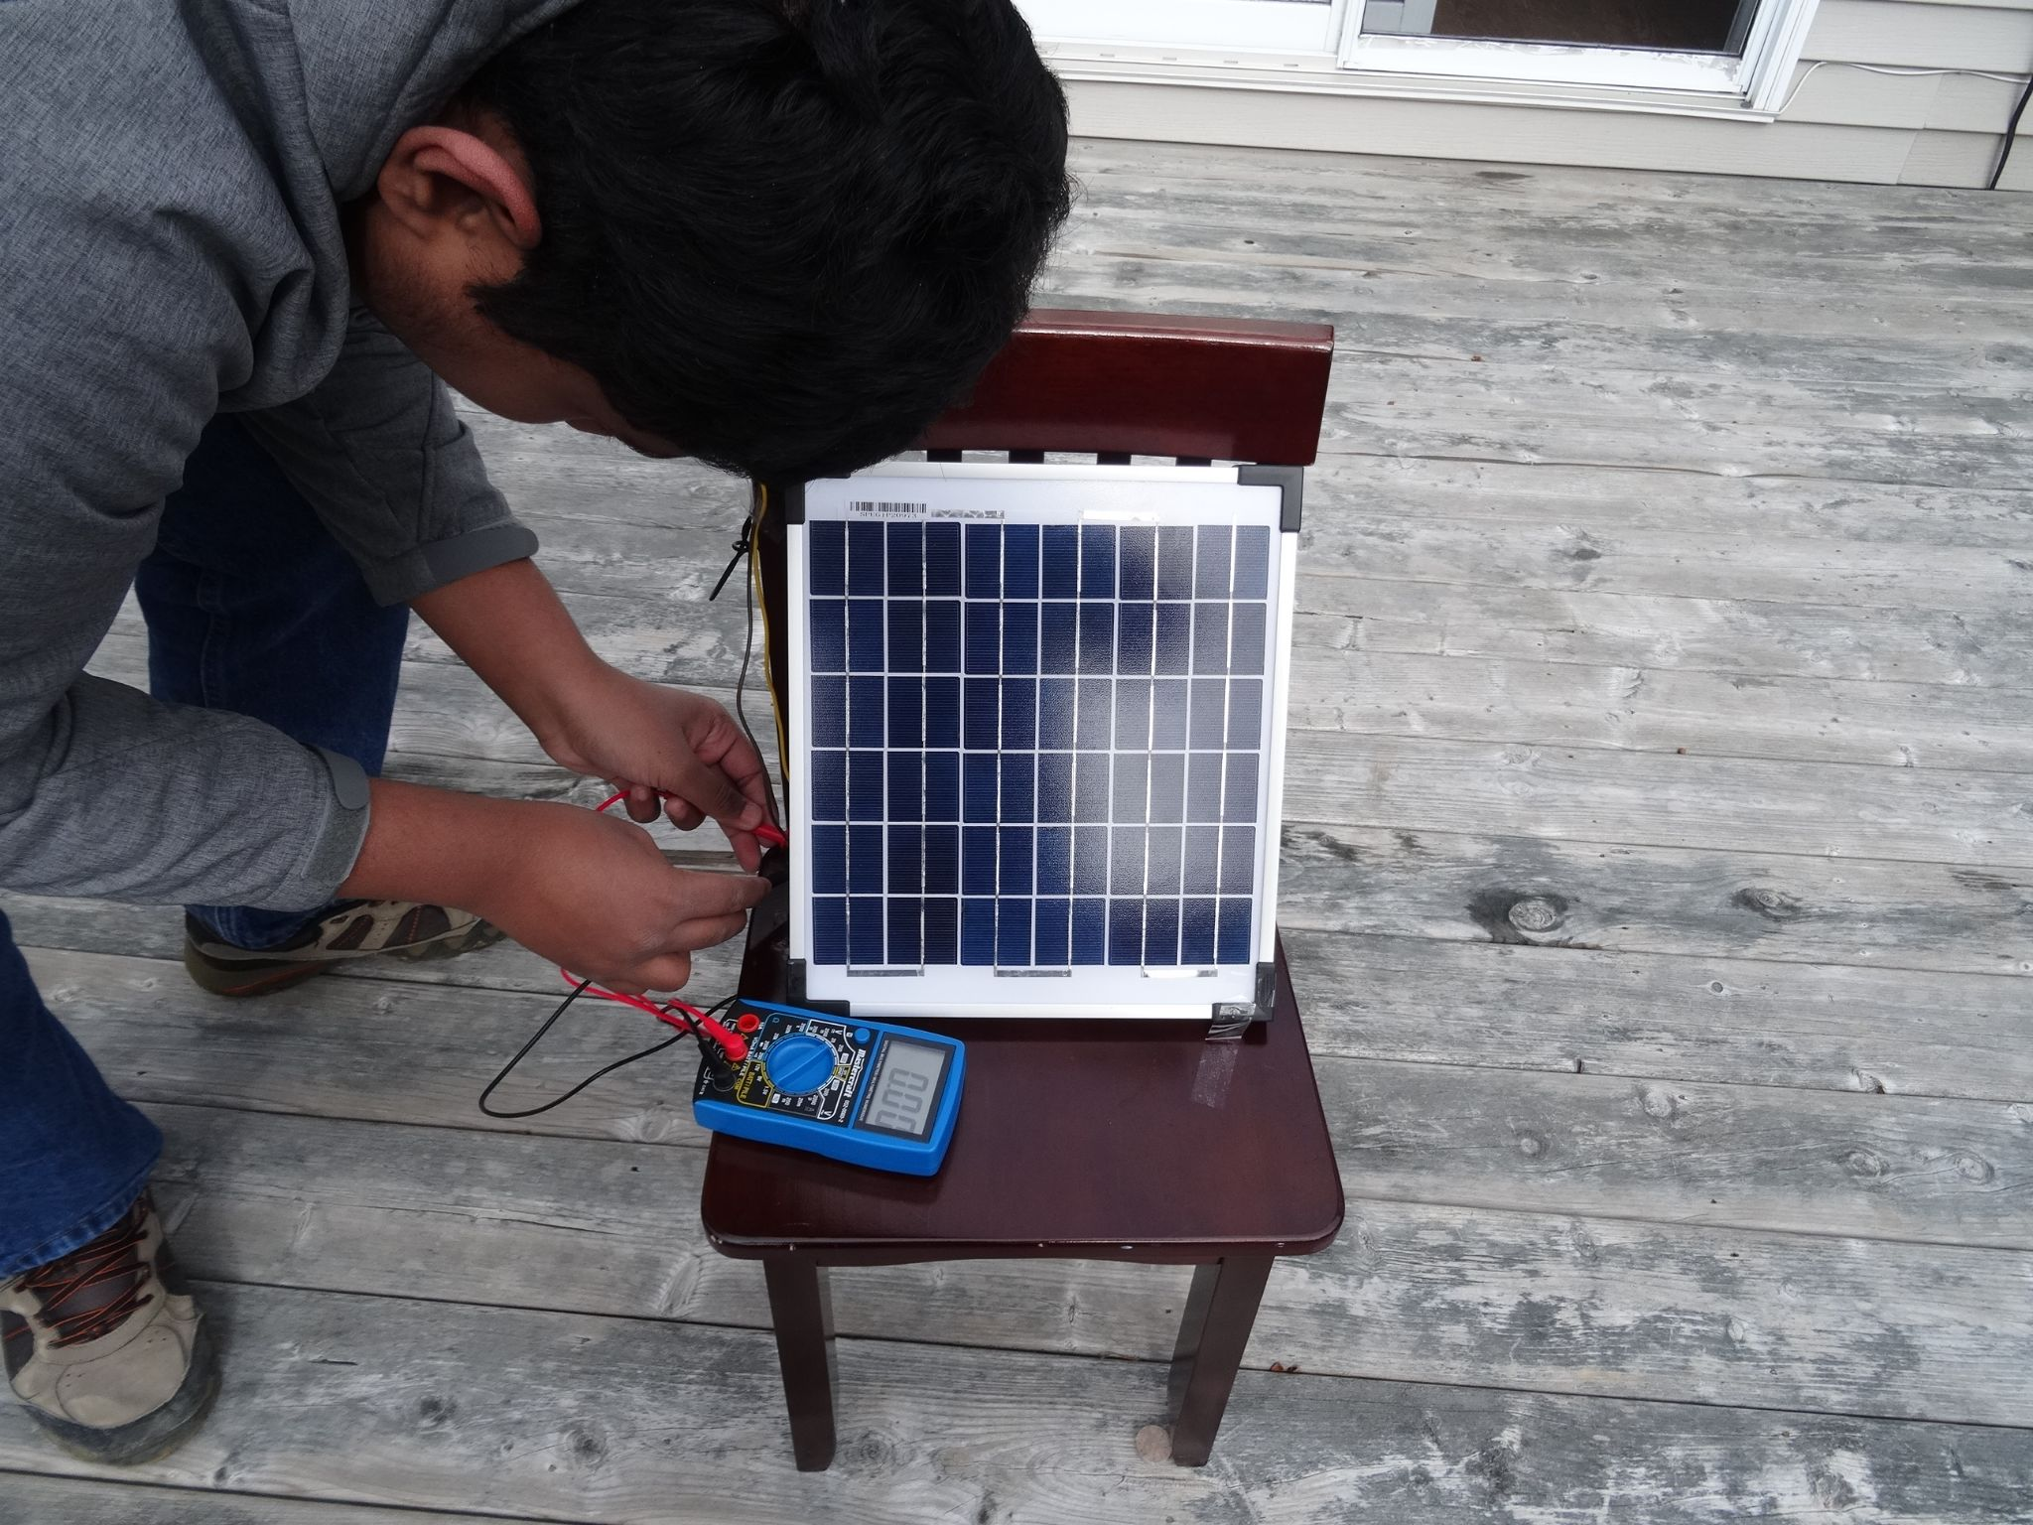
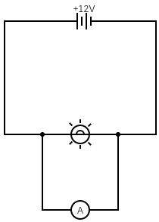
Procedure
4. Set the multimeter to measure amperes (A), to measure the current.
5. Hook it up to the circuit and measure the output.
6. Repeat this process 3 times with each temperature.

Slide 17
Results

Slide 18
Experimental Data

Slide 19
Experimental Data
As you can see, the results of the physical experiment has a negative slope, that is almost linear. This shows that the higher the temperature, the less efficient the solar panels are.
There may have been an error in this experiment, where the output rises. This is likely due to the sunlight not being the exact same the entire time, even if attempted to be in a partly cloudy environment.
To find the resistance, Ohm’s law can be used (V= I/R). In this case, the solar panel used was 12V, so the resistance can be calculated from the current and voltage.
 | Rec. 1 | Rec. 2 | Rec. 3 | Average Current | Resistance (based on average current)
5°C | 0.2 | 0.19 | 0.19 | 0.193 A | 62.176Ω
6°C | 0.18 | 0.19 | 0.17 | 0.18 A | 66.667Ω
7°C | 0.17 | 0.16 | 0.17 | 0.167 A | 71.856Ω
8°C | 0.14 | 0.15 | 0.17 | 0.153 A | 78.431Ω
9°C | 0.15 | 0.15 | 0.16 | 0.153 A | 78.431Ω
10°C | 0.17 | 0.15 | 0.18 | 0.167 A | 71.856Ω
11°C | 0.13 | 0.15 | 0.16 | 0.147 A | 81.633Ω
12°C | 0.11 | 0.14 | 0.13 | 0.127 A | 94.488Ω

Slide 20
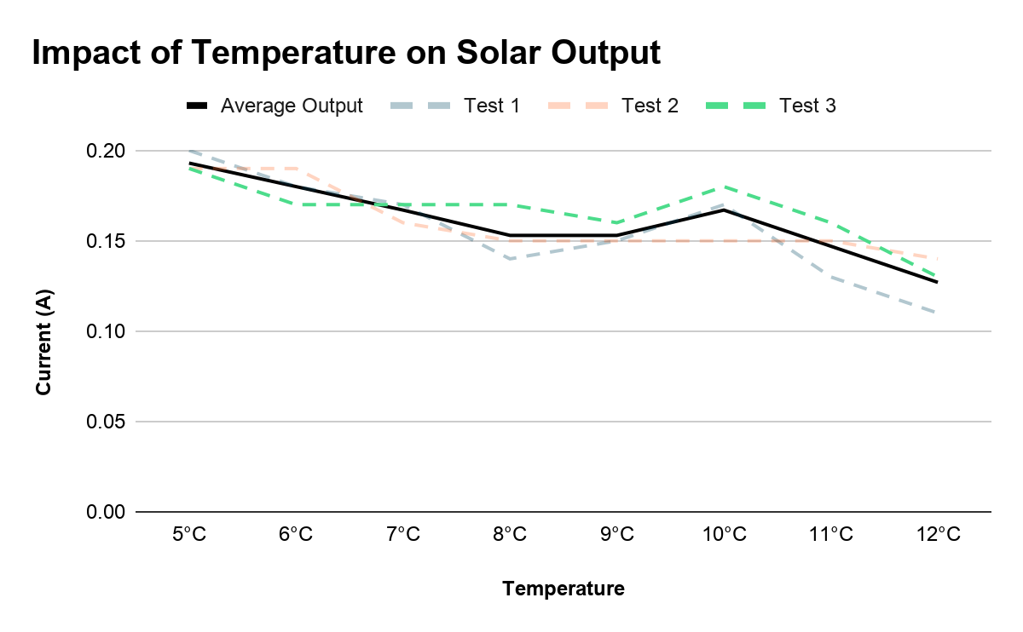
From this graph, it is seen that the temperature of the solar panel reduces solar output in a negative gradient. This supports the hypothesis that the current will decrease with increasing temperature.

Slide 21
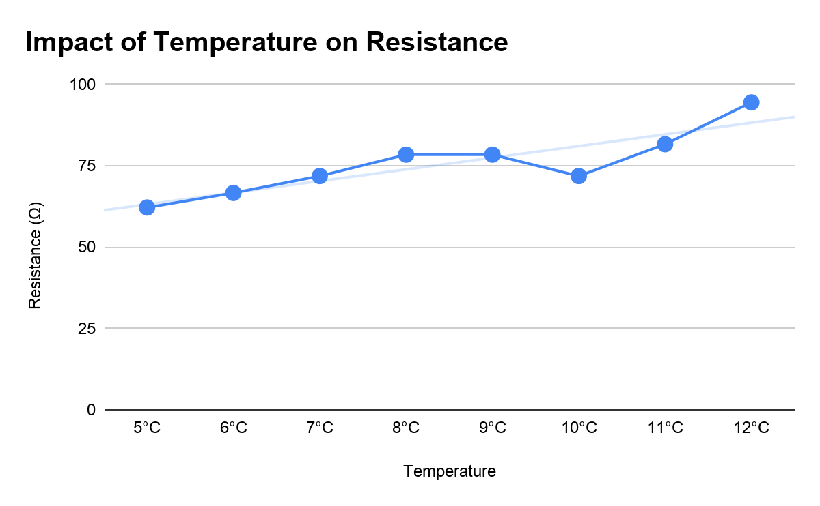
From this graph, it can be seen that the resistance of the current increases with temperature, which supports the hypothesis.
The higher the temperature, the higher resistance there is, which reduces the solar output.

Slide 22
Theoretical Data

Slide 23
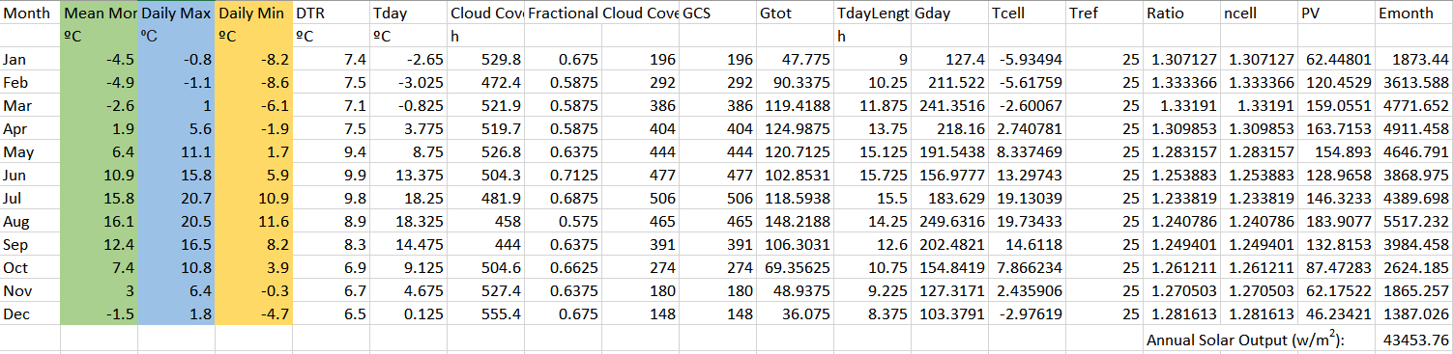
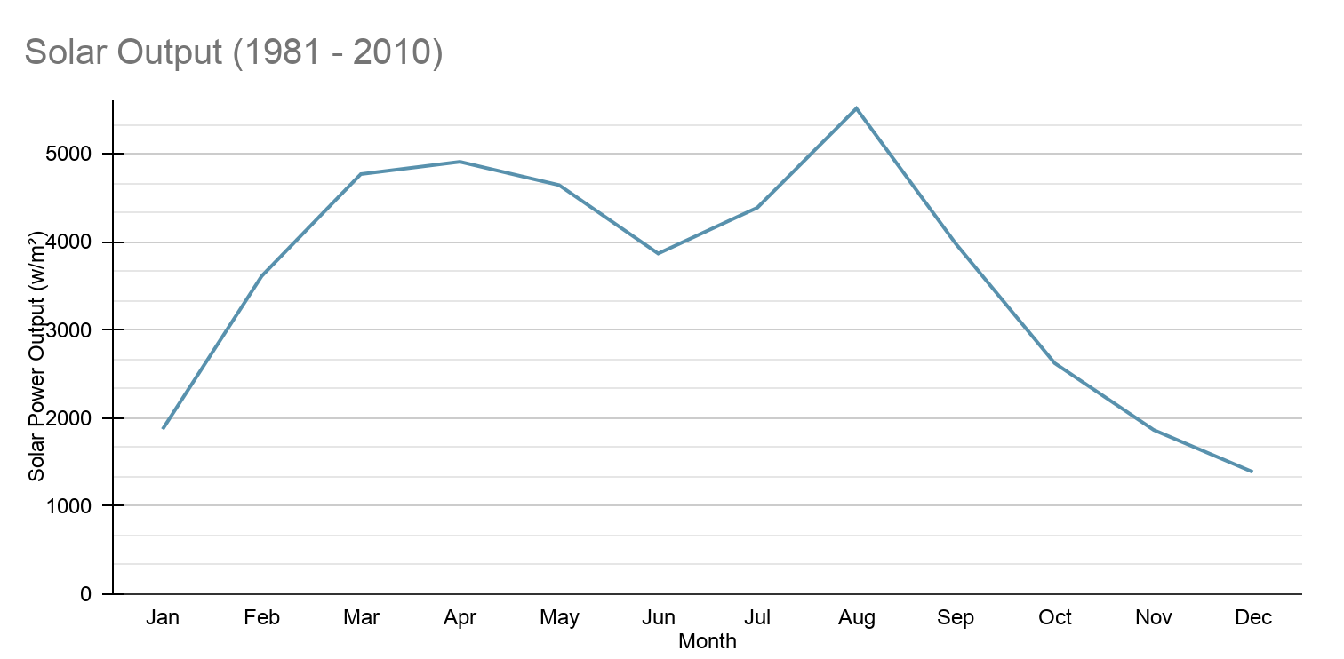
Past Conditions (1981 - 2010)
From this data, you can see that the most energy that would be made by a solar panel annually is during autumn. The least energy that was produced would be in winter. This time period has the highest annual solar output, at 43 453.76 w/m².

Slide 24
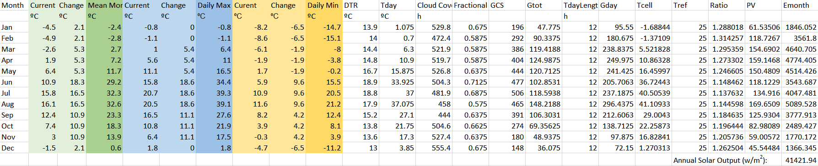
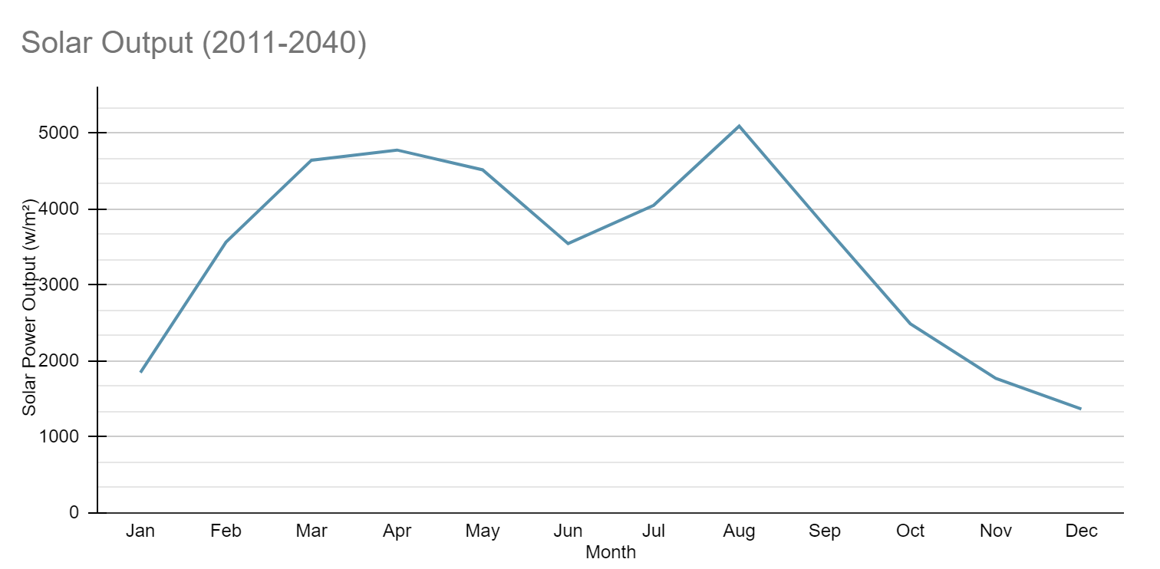
Recent/Future Conditions (2011 - 2040)
In this time period, the data showed a similar curve, also peaking in autumn and falling in winter. The scenario of RCP 8.5 continues, increasing the temperature of NL. This time period was shown to have the least annual solar output out of all of the years collected.

Slide 25
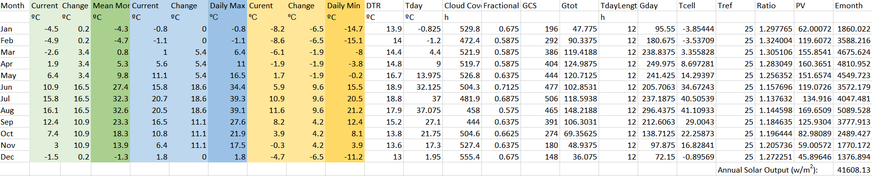
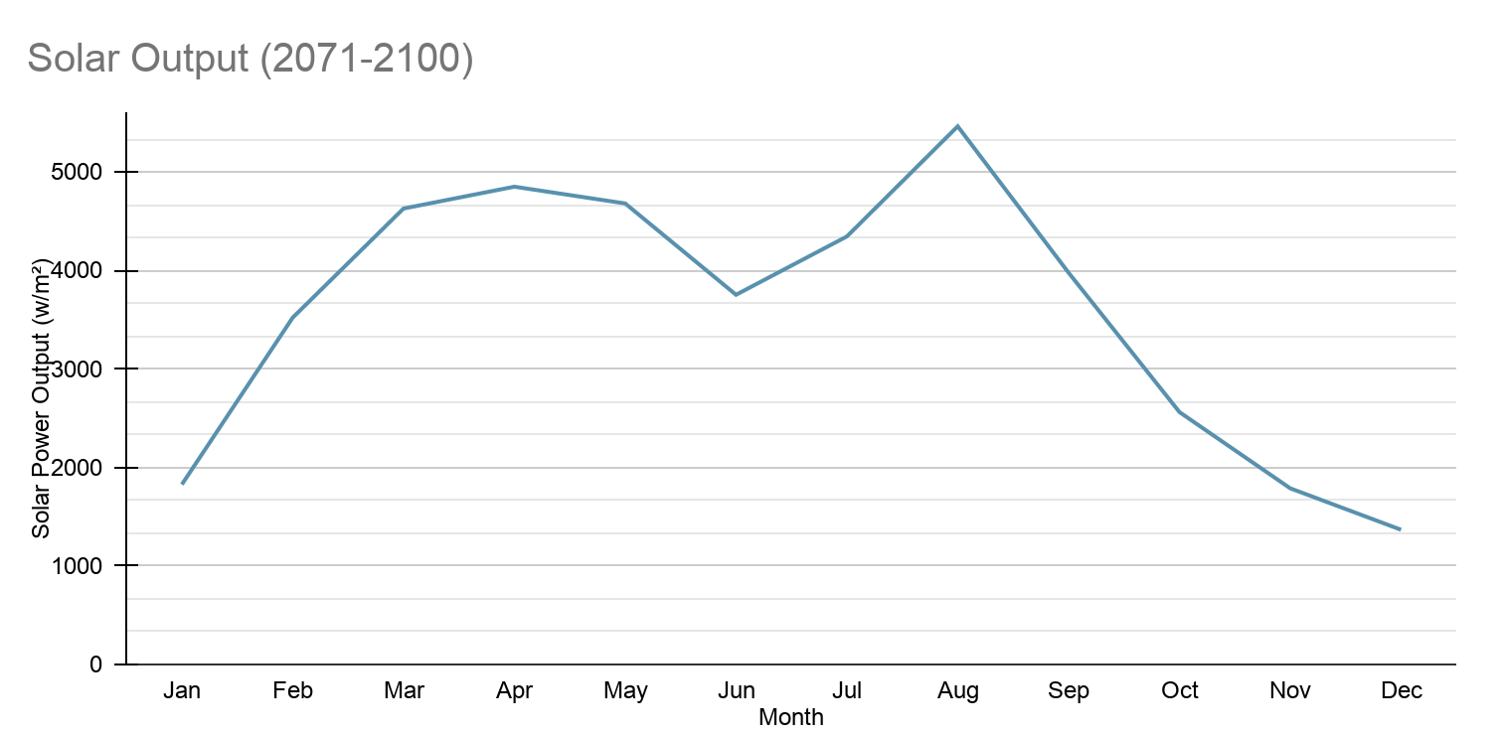
Future Conditions (2041-2070)
A similar curve to the previous years can also be found in this time period.

Slide 26
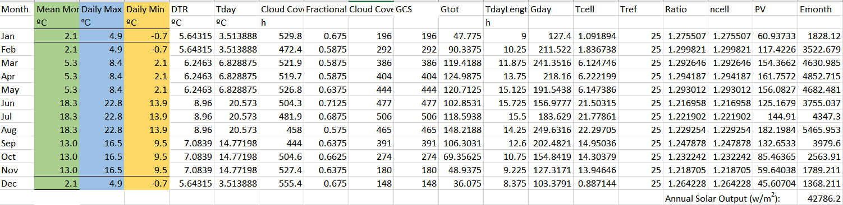
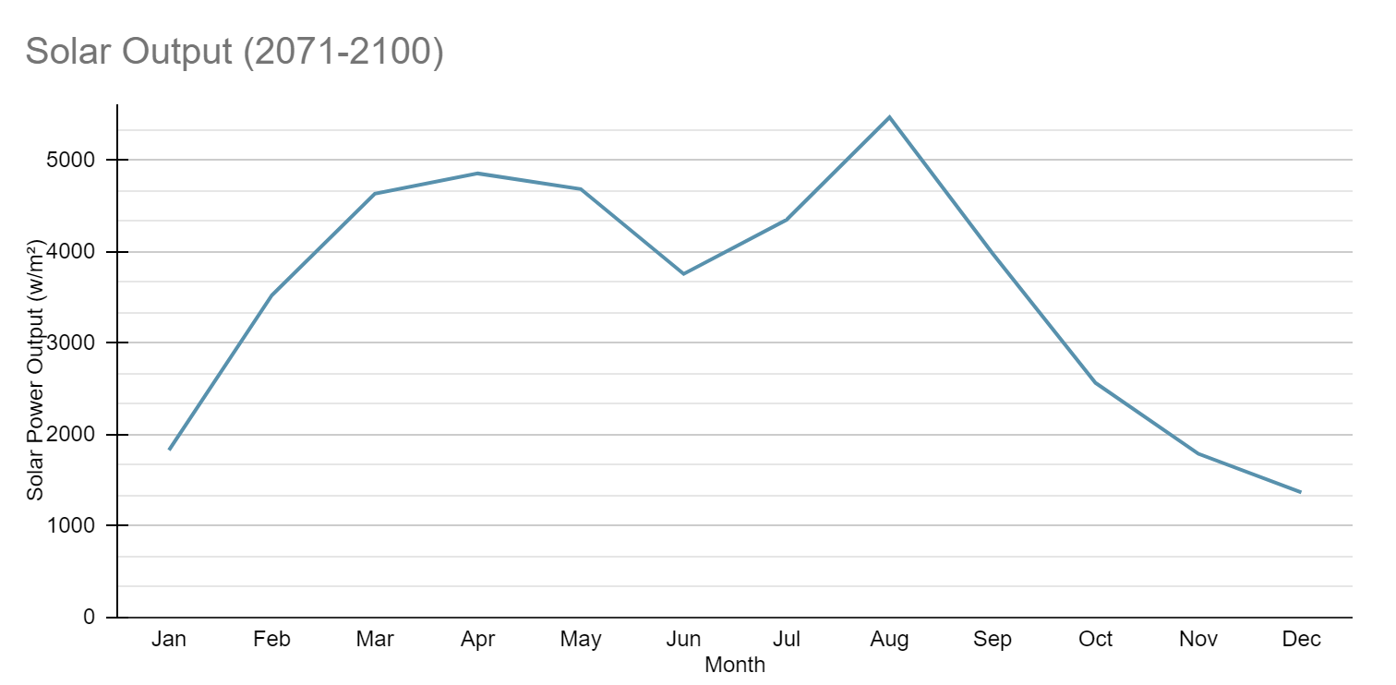
Far Future Conditions (2071 - 2100)
This time period is the one with the highest temperatures, as RCP 8.5 is the scenario where climate change stays at its current rate. While this time period has the highest temperatures, it does not have the least annual solar output.

Slide 27
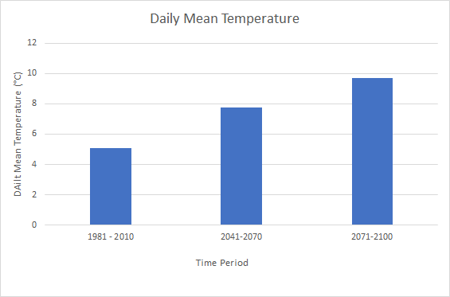
Differences in Daily Mean Temperature
The daily mean temperature increases by 2.6°C in 2041-2070, and increases by 4.6°C by 2071-2100.
This is during RCP 8.5, which is the scenario where the rate of global warming is the same as the current rate.

Slide 28
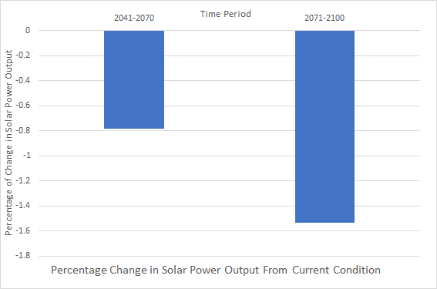
From 2041-2070, solar power output decreased by 0.78%
In 2071 - 2100, solar power output decreased by 1.54%
While this is a decrease in solar output, the amount is not very much.

Slide 29
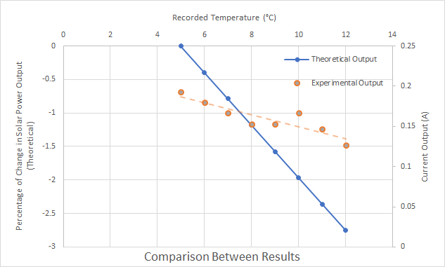
Comparison Between Results
As you can see, with an increase in temperature, solar panel output is decreased. I compared this to the percentage of change in solar power output.
I performed my experiment in April 2021, so I compared my results to the data that was obtained from the same time. The percentage of change in solar output compared to the experimental output is similar. The higher the temperature, the less output there is.

Slide 30
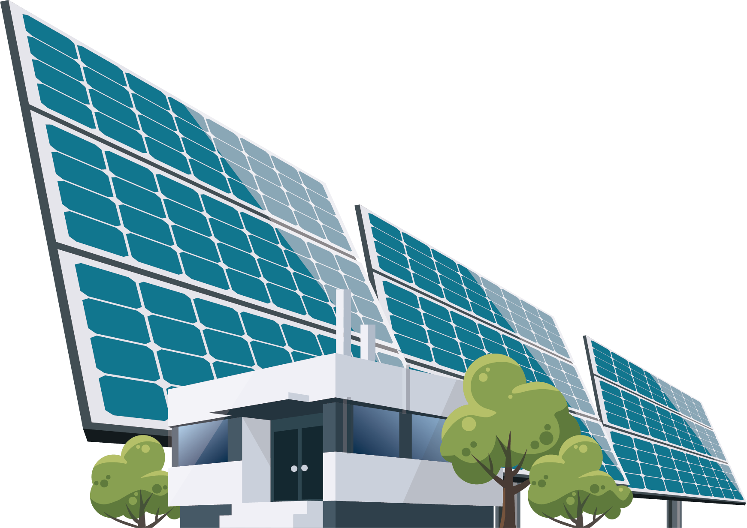

Sources of Error
The monthly average cloud cover condition was used for the theoretical analysis. For the future climate conditions, the same cloud cover and day length was assumed to be the same as the future conditions
The parameters used in the theoretical analysis may be different for the solar panel that was used in the experiment. It varies with each product.
There are uncertainties in the data from the future climate data.
In the experiment, the cloud cover conditions were not completely constant.

Slide 31
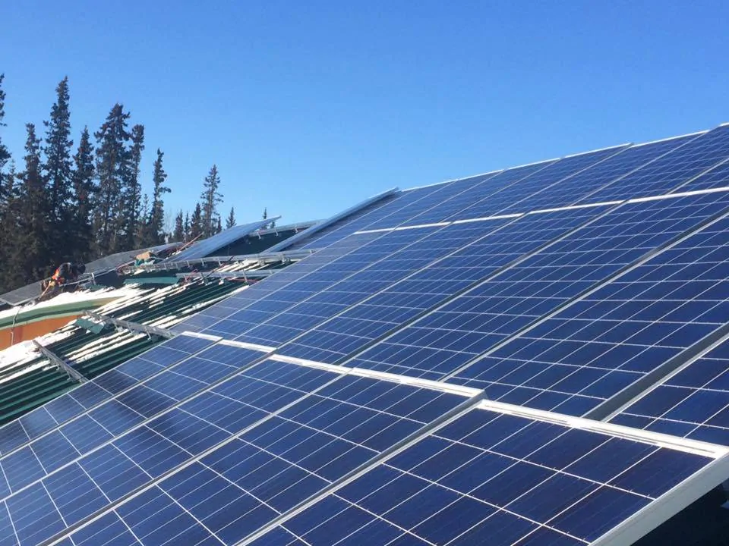
Conclusion
In the end, my hypothesis was proven correct. The output of a solar panel decreases with an increase in temperature. However, in the next 100 years, the output is shown to only be decreasing by 1.5%. This decrease is not very significant, which means that solar panels can be a potential source of energy for Newfoundland in the future.

Slide 32
References
Crook, J.A., Jones, L.A., Forster, P.M. and Crook, R., 2011. Climate change impacts on future photovoltaic and concentrated solar power energy output. Energy & Environmental Science, 4(9), pp.3101-3109.
Environment and Climate Change Canada: https://www.canada.ca/en/environment-climate-change.html
St. John’s Weather Stats: https://stjohns.weatherstats.ca/charts/cloud_cover_8-monthly.html
Department of Environment, Climate Change and Municipalities, NL: https://www.gov.nl.ca/eccm/occ/climate-data/
Monocrystalline vs Polycrystalline Solar Panels: https://solarmagazine.com/solar-panels/monocrystalline-vs-polycrystalline-solar-panels/

Slide 33
Images
http://clipart-library.com/free/sun-png-transparent-background.html
https://www.clipartkey.com/view/bwixoT_newfoundland-and-laborador-atlantic-canada-map-png/
https://www.circuit-diagram.org/
https://www.getsolarmax.com/solar-panels-affect-climate-change/
https://www.pveducation.org/pvcdrom/modules-and-arrays/module-circuit-design
https://line.17qq.com/articles/hehbhfdz.html
https://www.twinkl.ca/illustration/ammeter-electricity-amps-measure-tg-game-science-secondary
https://www.acurite.com/shop-all/weather-instruments/thermometers-and-hygrometers/7-5-thermometer-00338.html
https://pngimg.com/image/80877
https://solarmagazine.com/solar-panels/monocrystalline-vs-polycrystalline-solar-panels/
https://www.rikurenergy.com/things-you-should-know-about-solar-pv-systems/
https://pngio.com/images/png-a1241718.html

