Slide 1
Masks
By: Sydney Vaters G10
HTH
Torbay NL

Slide 2
The purpose of this experiment is to find out what the best materials are for homemade face masks.
Questions:
What is the best materials for face masks?
How protective will they be against the virus?
Hypothesis:
The 100% cotton mask will be the best, due to its thickness and how comfortable and breathable it is, when wearing it you feel more protected, it is also very absorbent and can hold more moisture for a long period of time.

Slide 3
Independent Variable: Mask materials
Dependant Variable: How well the material proforms/ how much water it can hold for a certain amount of time.
Controlled Variable: Type of materials, type of thread, how they are made, how they are washed/ dried, who tests them, water used for droplet test, how droplet test is performed, same amount of water for droplet test, amount of material, size of mask, number of layers on the mask.

Slide 4
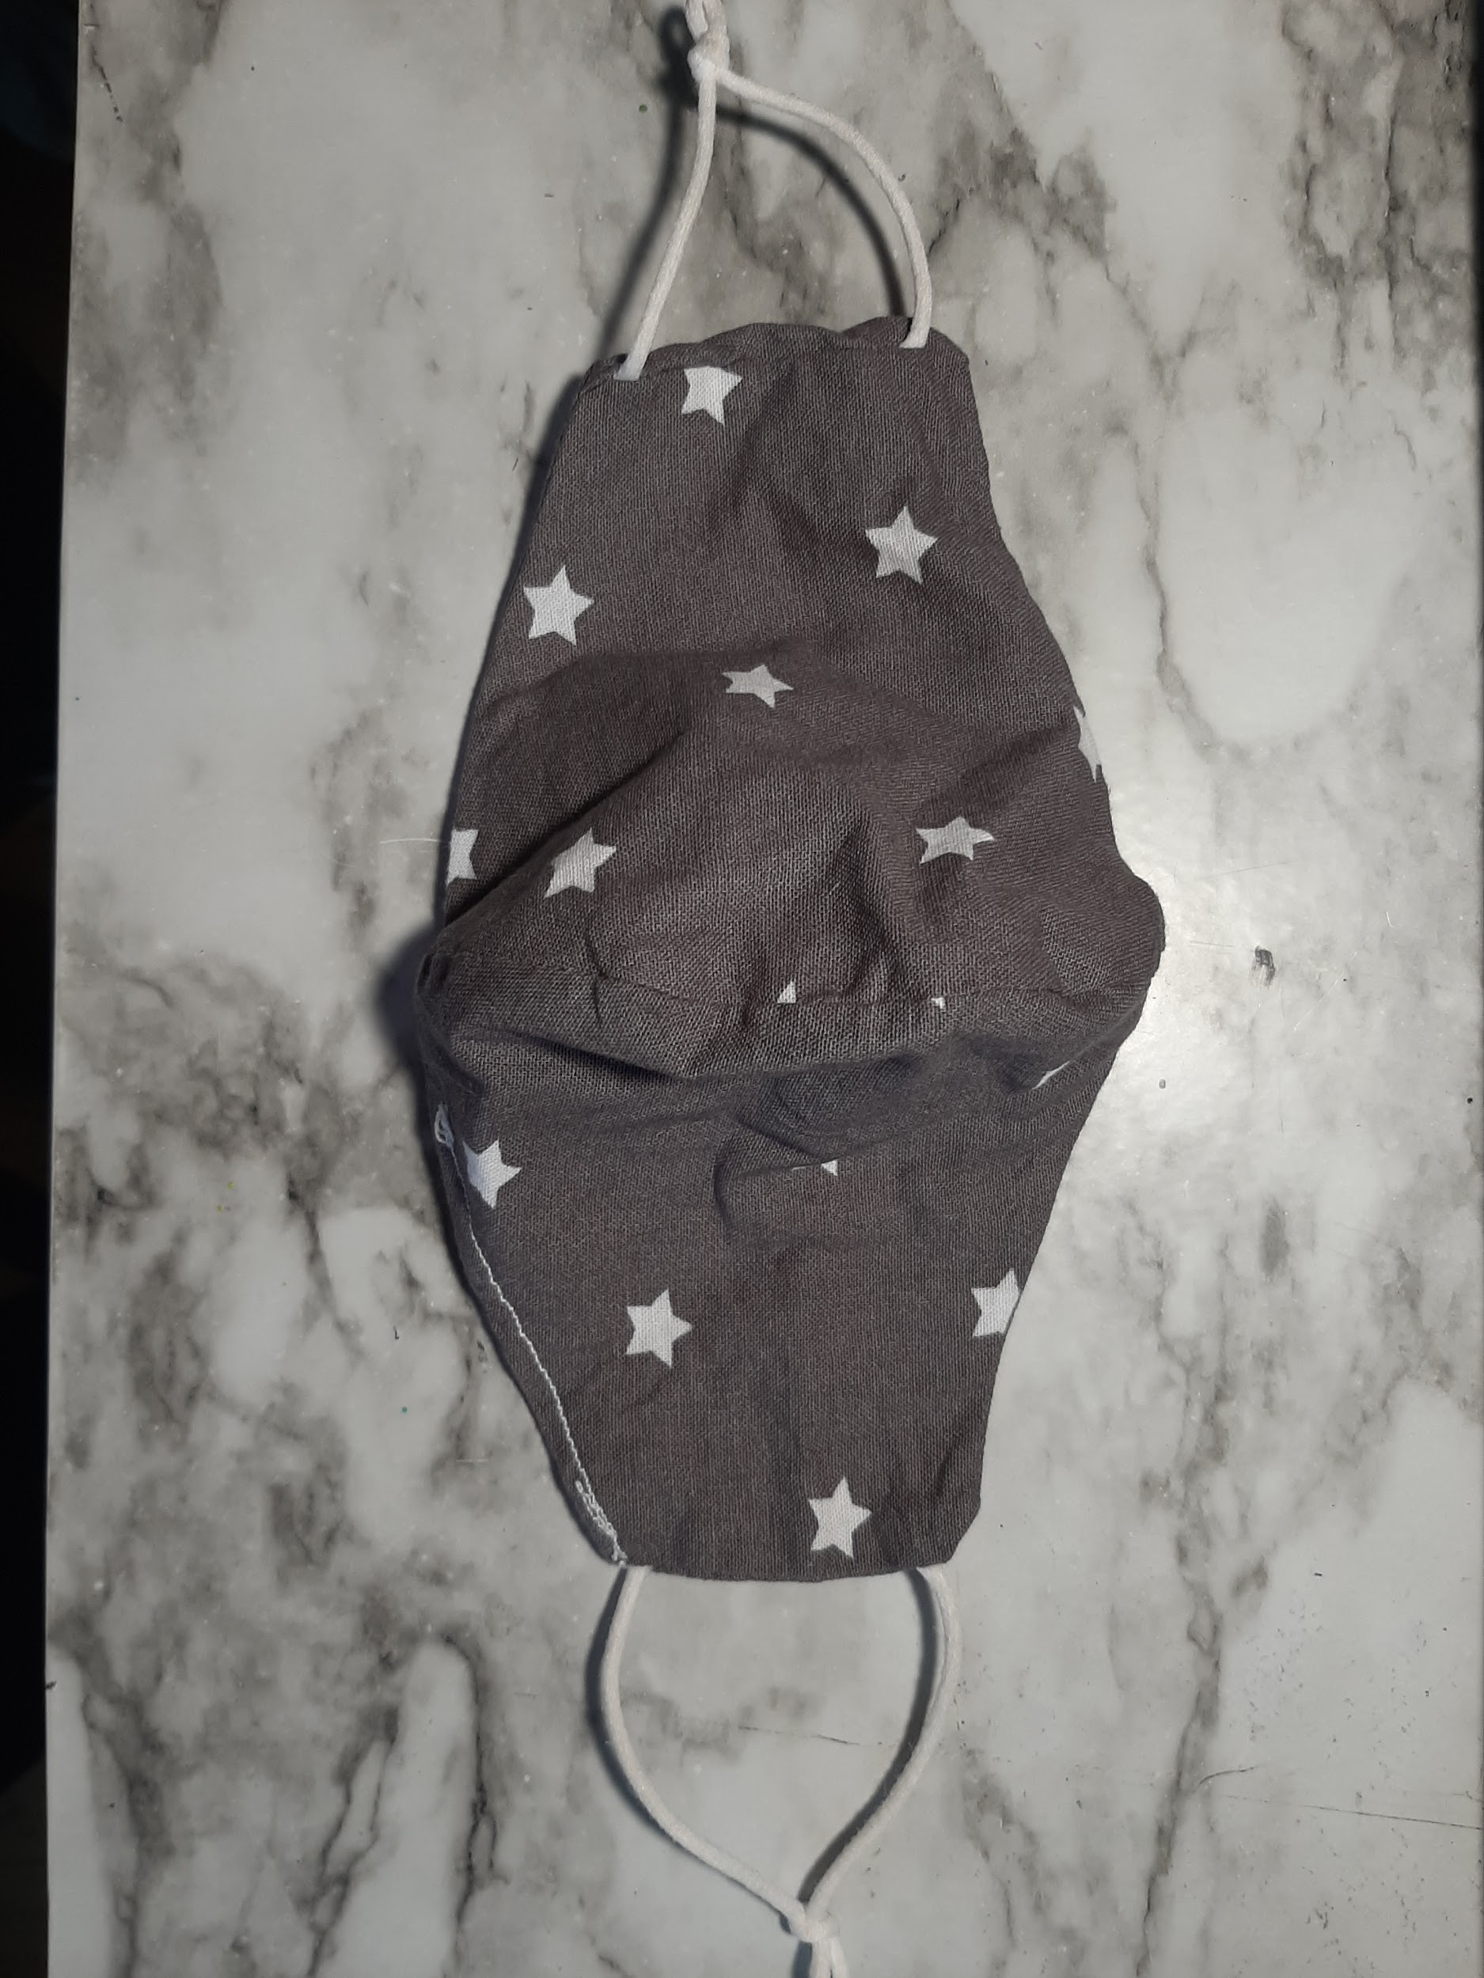
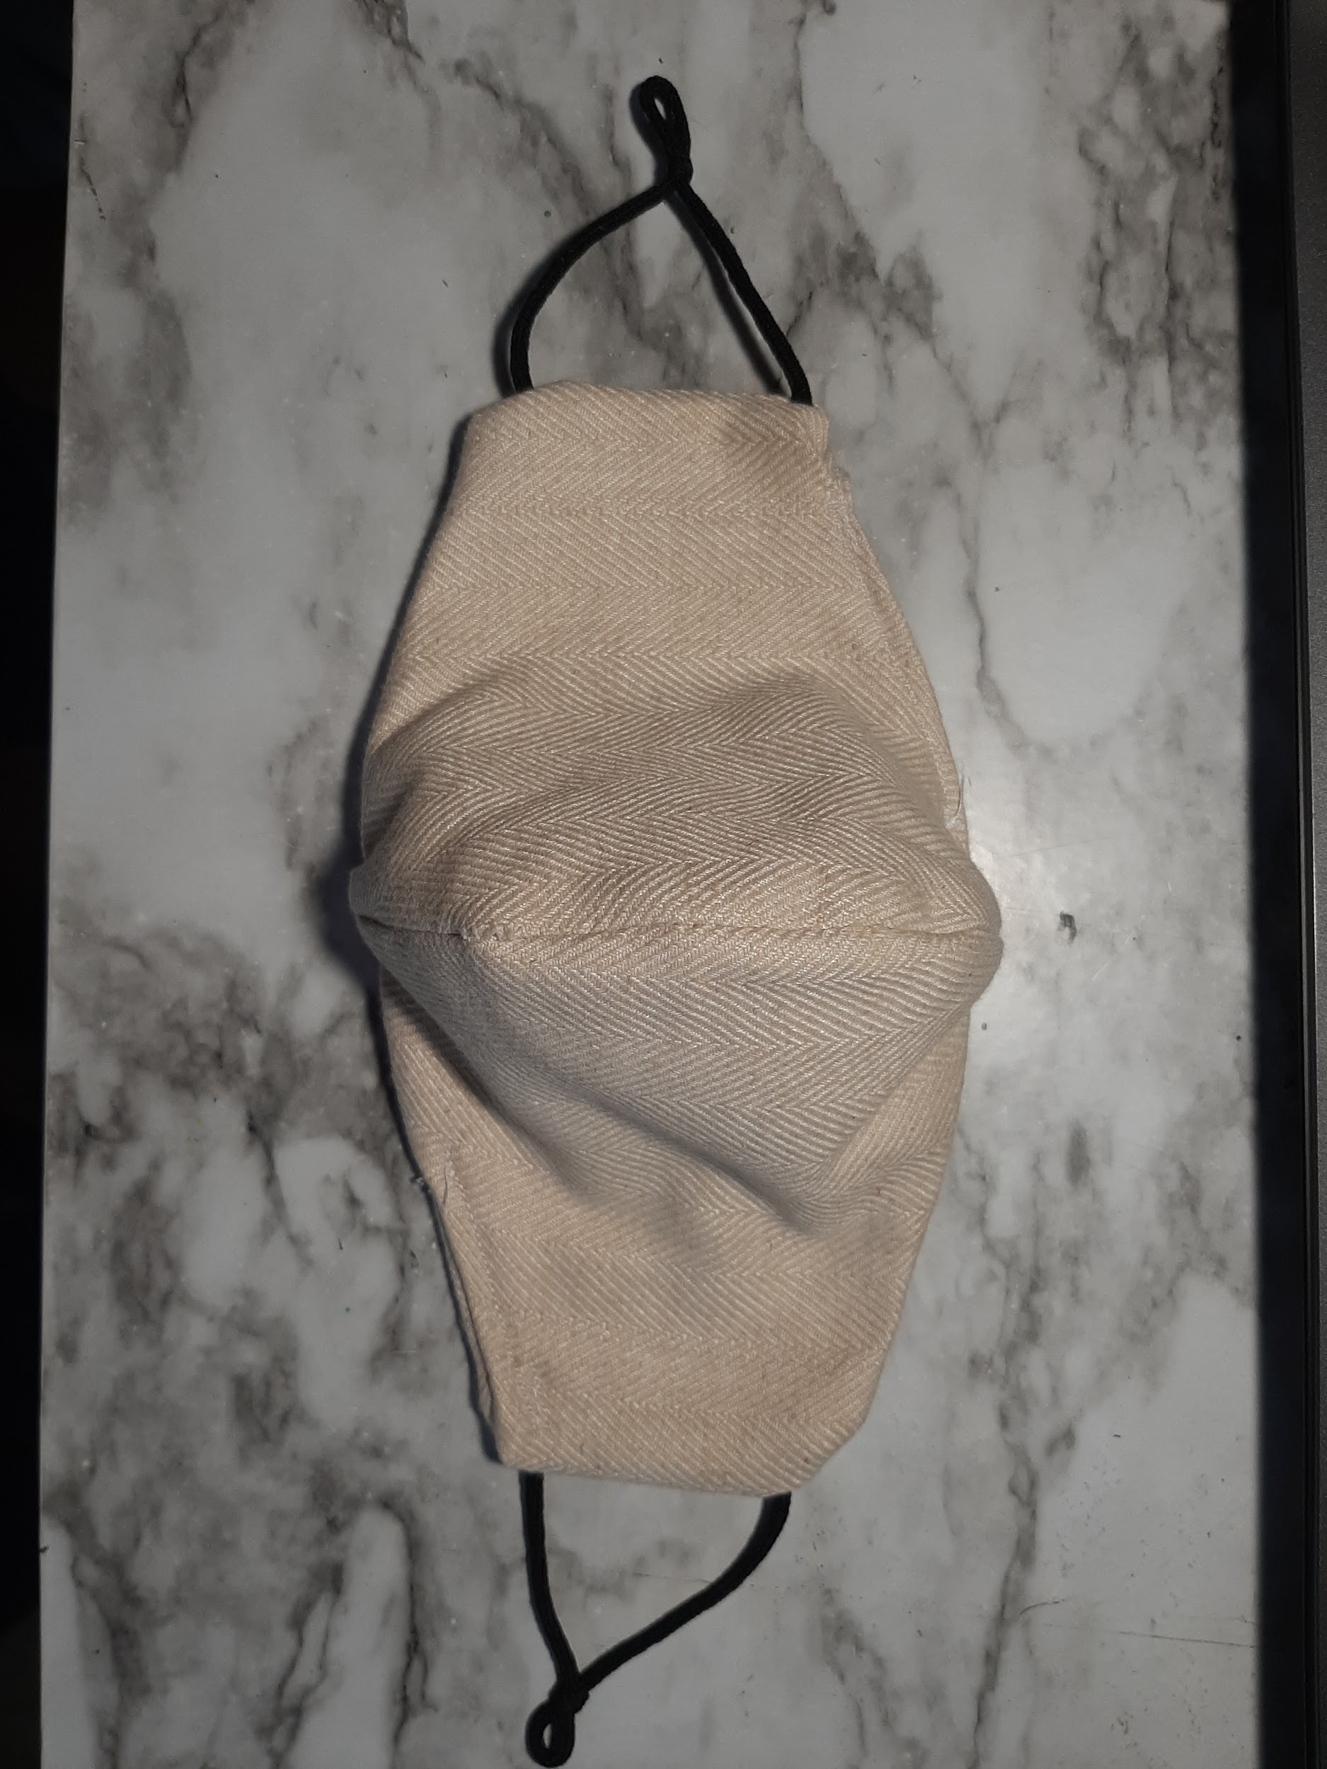
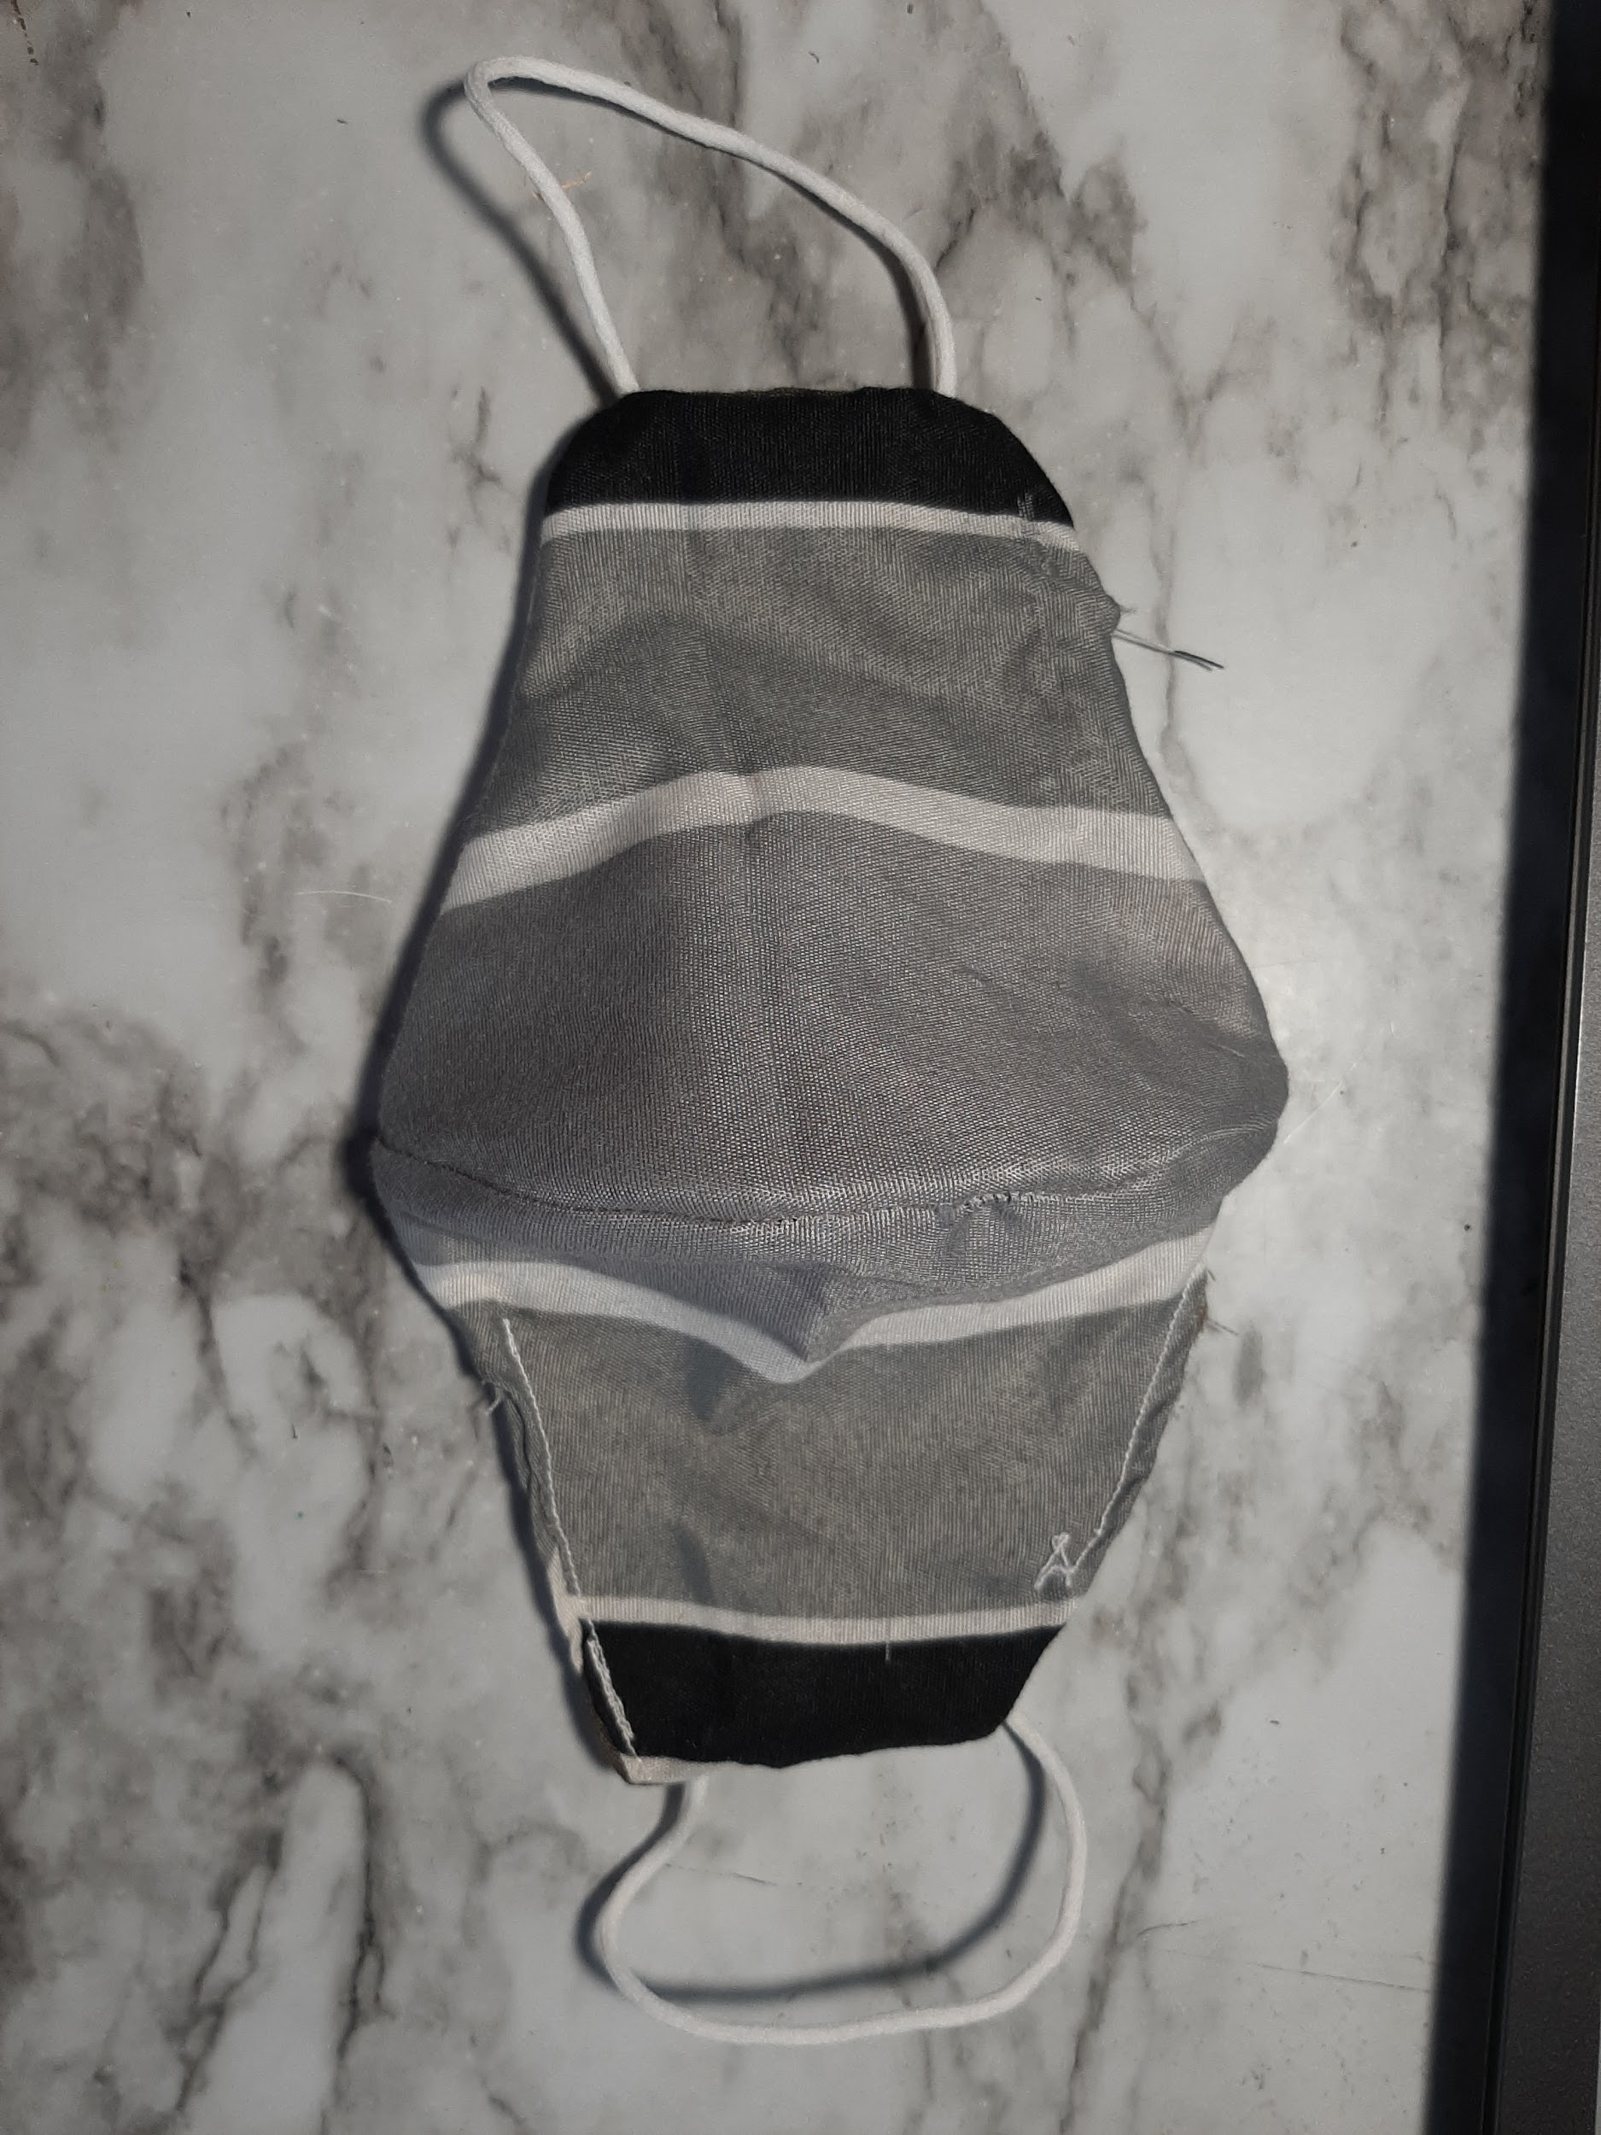
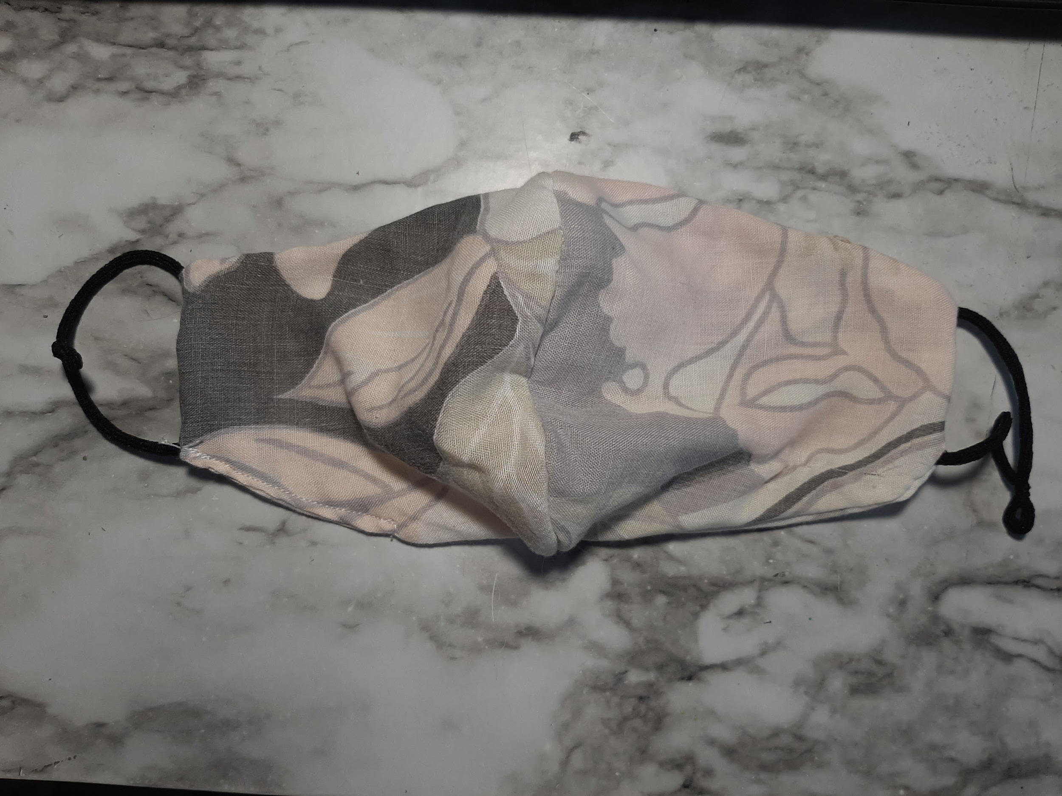
Materials:
100% Cotton
For Making Masks:
Sewing machine
Thread
Mask pattern/stencil
Marker
Scissors
Elastic
100% polyester material/pillowcase
100% cotton material
100% polyester fleece/pj pants (I changed this to 50% Polyester and 50% Cotton)
Polyester, spandex mix shirt ( I also changed this to a mixed material of linen, cotton and polyester)
Linen, cotton and polyester mix
50% cotton, 50% polyester
100% polyester

Slide 5
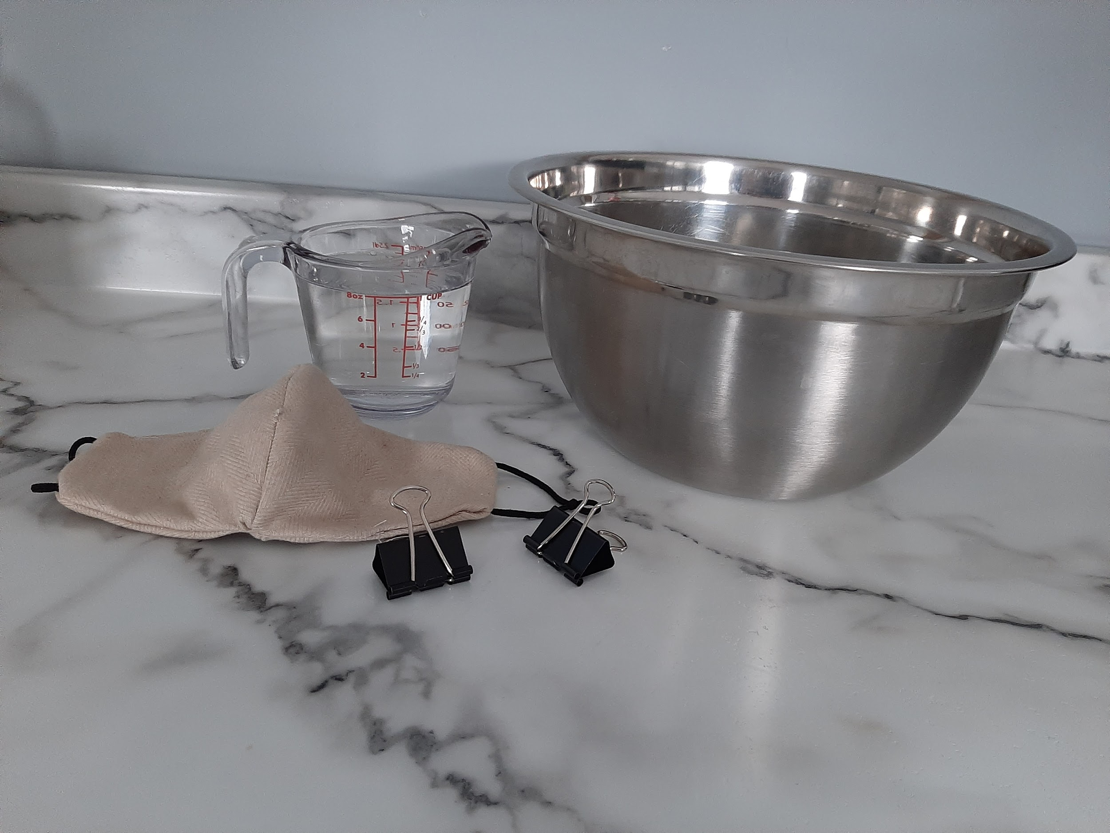
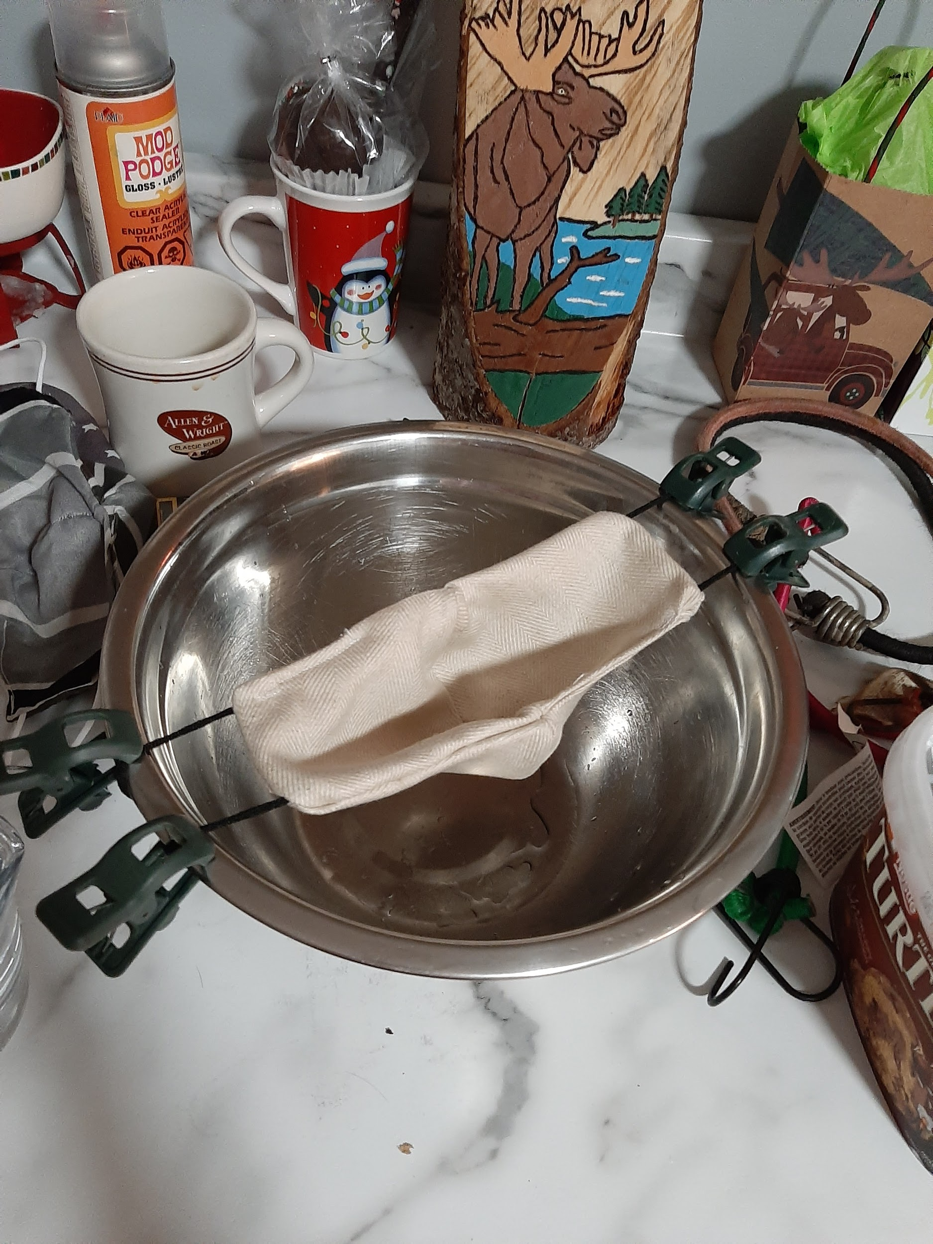
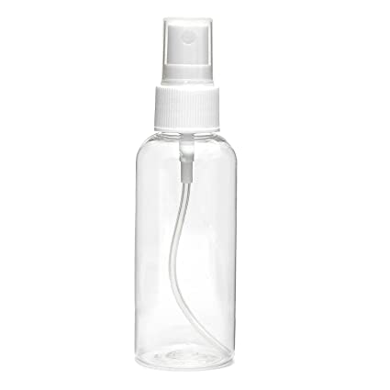

Materials p2:
For procedures:
water
Measuring cup
Bowl
Binder clips
Timer/phone
A face
Spray bottle
And your homemade masks

Slide 6
Procedure:
Wash the materials. This can be done before or after making the masks, you can also do it by hand or in the washing machine.
Make the masks. For this step you can use the materials of your choice, and by using a template of some sort. Pick your thread and begin to sew, a sewing machine is best.
Then you will be testing how comfortable and breathable the masks are, you can do this by rating them from 1-10, 1 being the worst with no breathability and 10 being the best with maximum comfort and breathability.

Slide 7
Procedure p2:
4. Finally you will be doing a droplet test, this will help you to find out how many germs the masks/materials can hold. For this you will be using a cup of water and then measuring how much water passes through it in a certain amount of time.
5. You can also test how well each will do when water is sprayed at them, this will imitate a sneeze or a cough. To measure this you can try and catch as much water as you can that passes through the mask in a bowl or cup and measure it. Or take a slow motion video, this will show you how much water passes through the material.
6.Compare the results of your homemade masks to the results of a disposable mask since they are so far proven to be the most effective. Whatever materials results are closest to those of the disposable masks will be the best material for homemade masks.

Slide 8
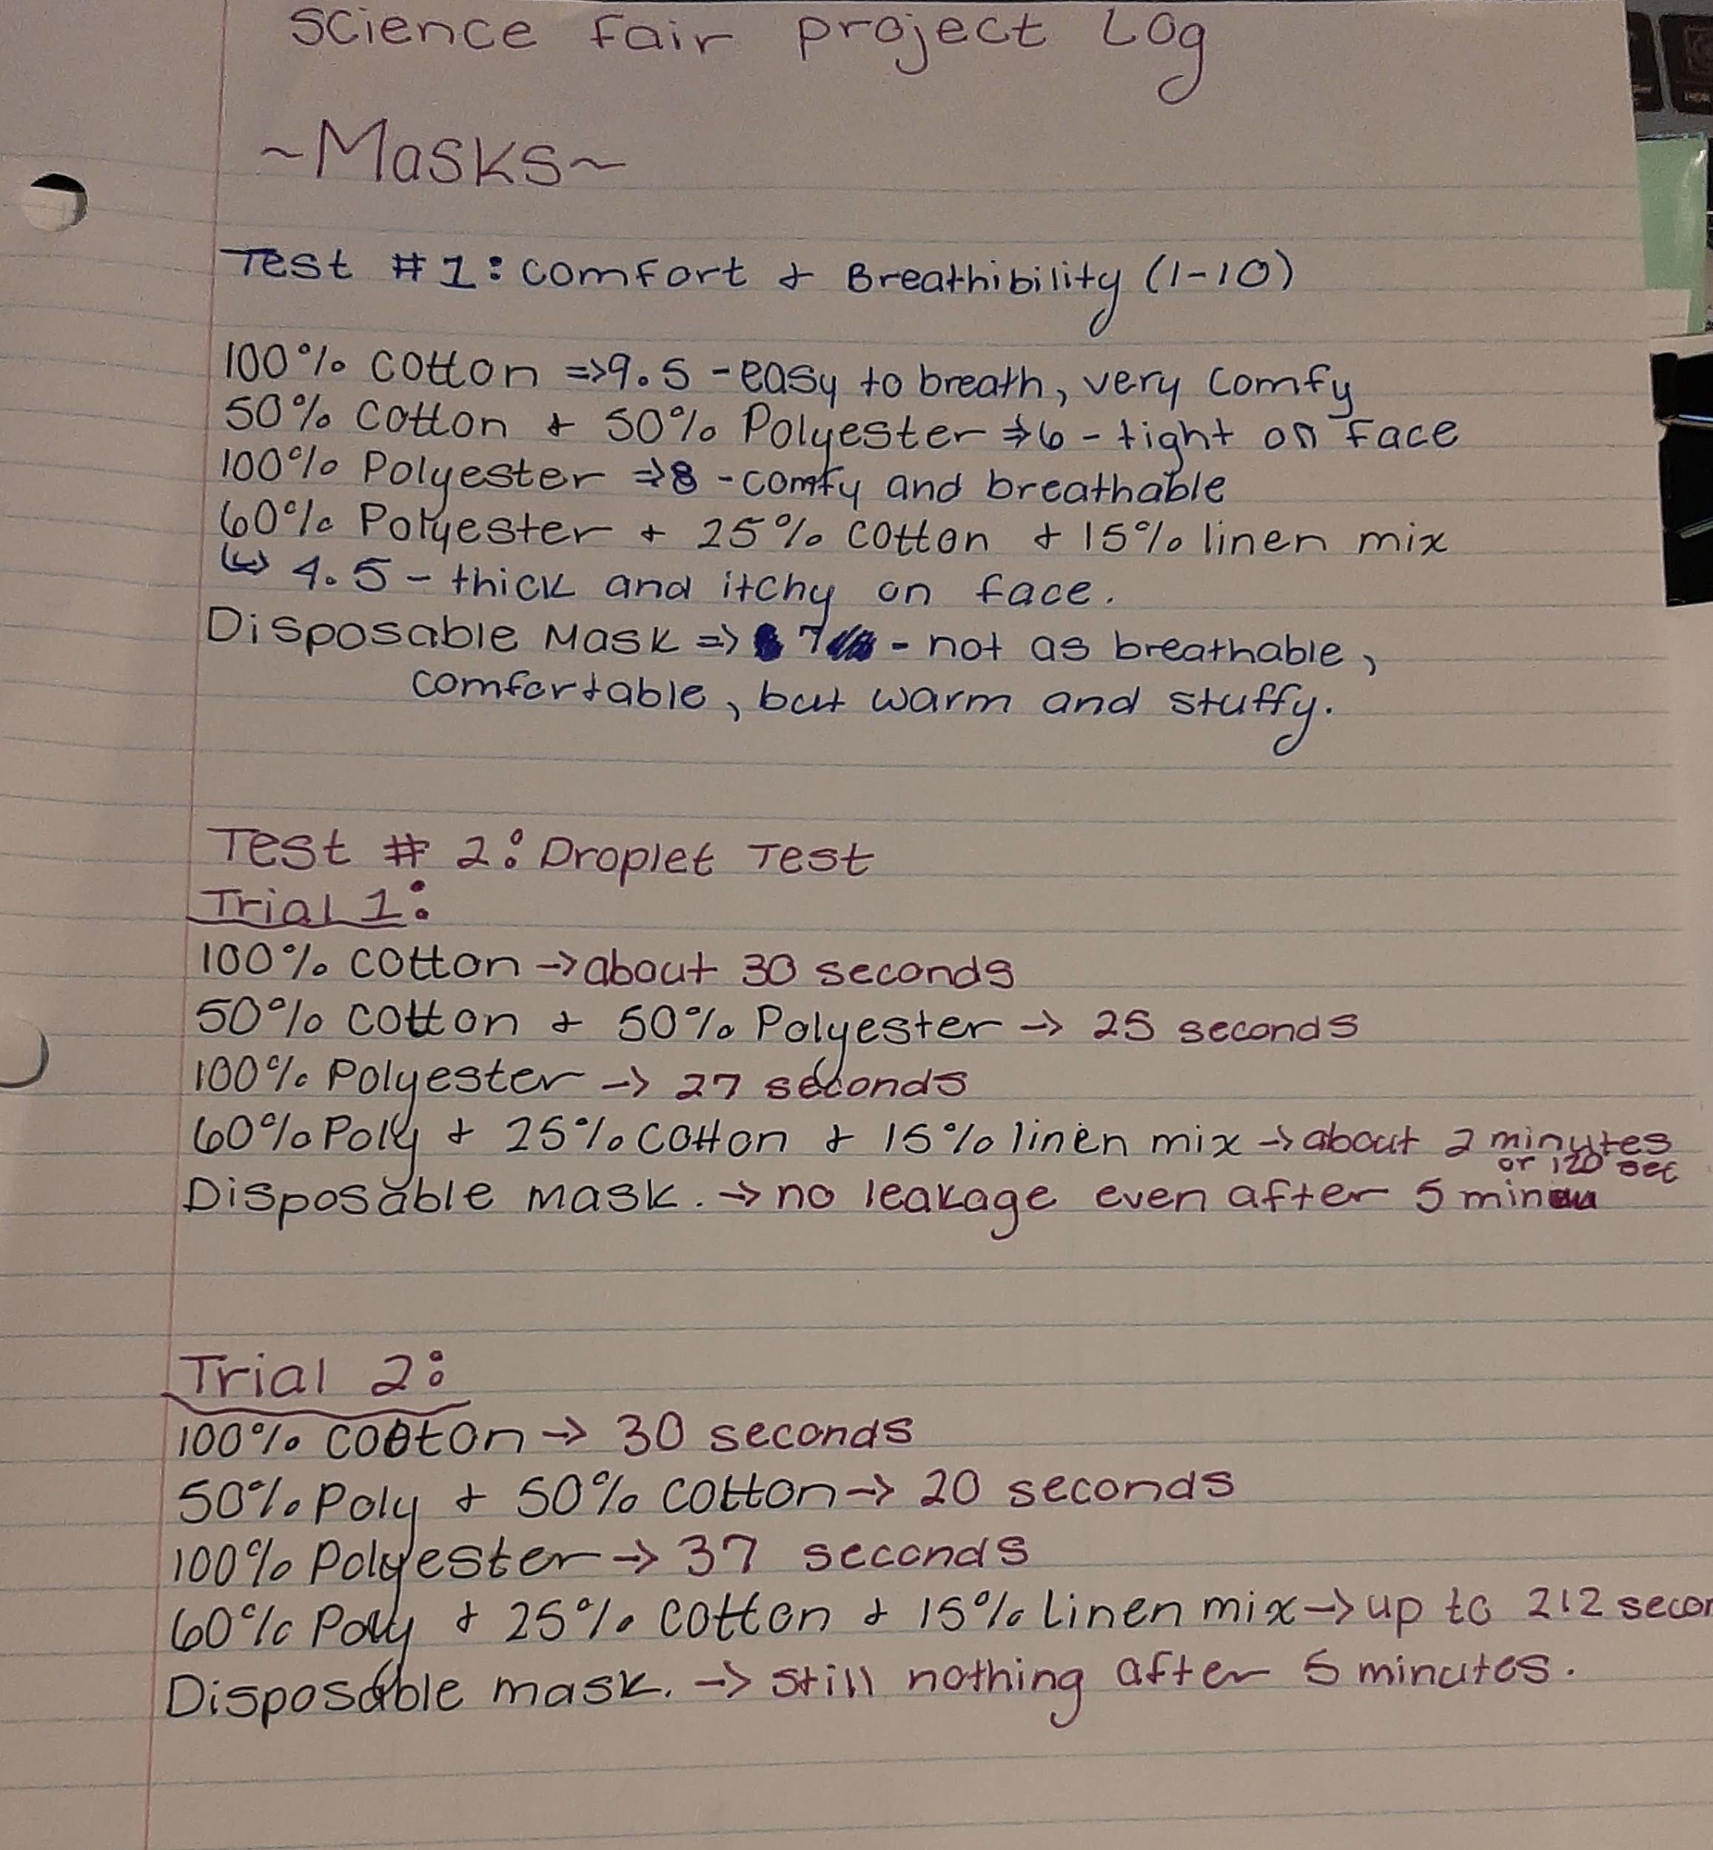
Project Log

Slide 9
Results:
Test #1:
Table 1: Mask Comfort & Breathability
Mask Material | Comfort/Breathability (1-10)
100% Cotton | 9.5- easy to breath in and very comfortable.
100% Polyester | 6- breathable but wasn't very stretchy on the face.
50% Cotton & 50% Polyester | 8- breathable and comfortable.
Mixed Material- 60% Polyester, 25% Cotton & 15% Linen | 4.5- not as breathable, itch on face.
Disposable face mask | 7- not as breathable, comfortable but gets warm and stuffy.

Slide 10
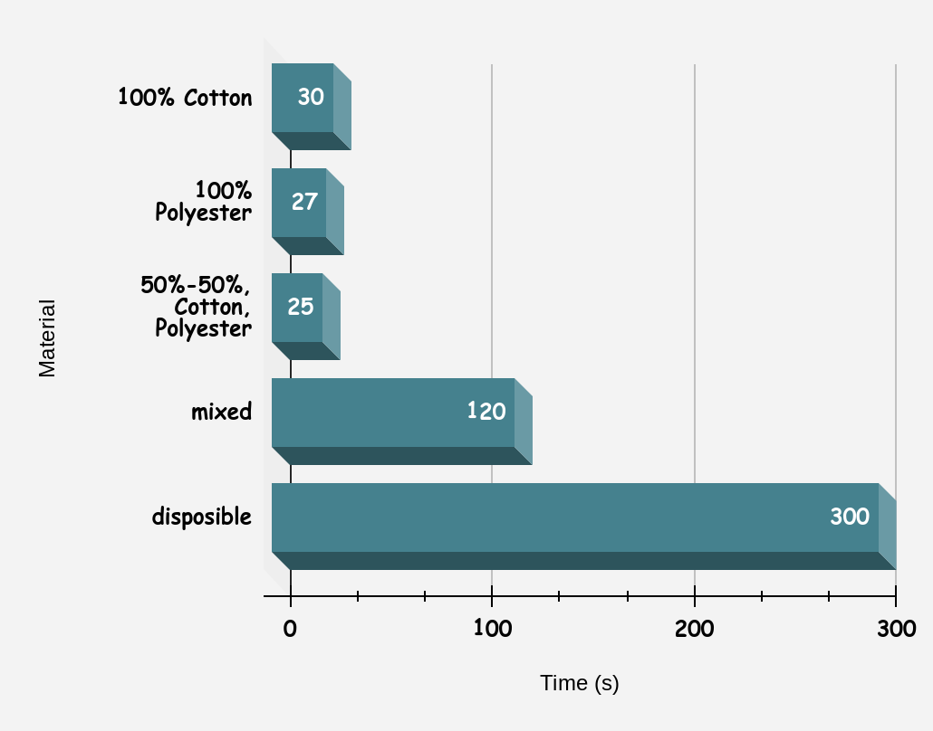
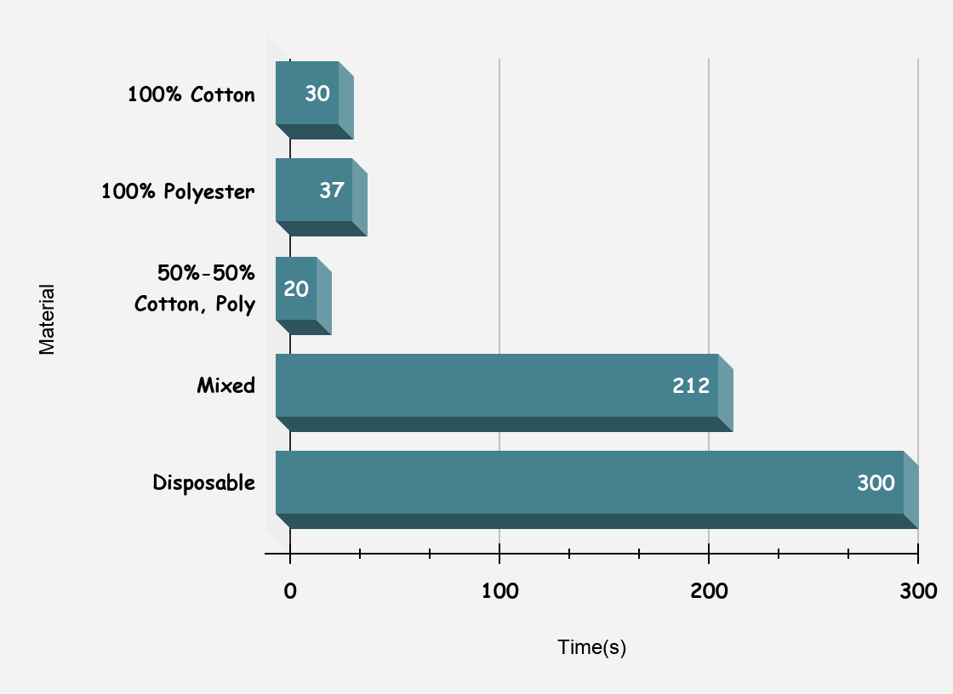
Results p2:
Test #2:
Figure 1: Mask Material vs. How Long It Takes Water To Pass Through.
Figure 2: Mask Material vs. How Long It Takes Water To Pass Through for Trial 2.

Slide 11
Results p3:
Table 2: Statistical Analysis of Data For Figure #1
Material | Time (s) | Average: | Median: | Mode: | Standard Deviation: | Range:
100% Cotton | 30 | 100.4 | 30 | #N/A | 118.5887853 | 25-300
100% Polyester | 27
50%-50%, Cotton, Polyester | 25
Mixed | 120
Disposable | 300

Slide 12
Results p4:
Table 3: Statistical Analysis of Data For Figure # 2
Material | Time(s) | Average | Median | Mode | Standard deviation | Range
100% Cotton | 30 | 119.8 | 37 | #N/A | 128.309002 | 20-300
100% Polyester | 37
50%-50% Cotton, Poly | 20
Mixed | 212
Disposable | 300

Slide 13
Discussion:
As we can conclude from the results collected in the graphs and chart the 100% cotton mask was not the best material although it was the most comfortable. After completing the experiments we have concluded that the mixed material of polyester, cotton and linen was the best against the water test, although not very comfortable on the face. It was the thickest of all the materials and was able to resist absorbing the water as fast for it to leak through.
Surprisingly the 50%-50% cotton and polyester mask was the quickest to absorb and leak out all of the water. As the water was poured into the mask it would immediately pass through the material, the material was unable to withstand any of the water at all. From this we can conclude that compared to the disposable mask and the mixed material with the best results that the 50%-50% mask would not be very helpful in protecting you from Covid-19.

Slide 14
Discussion p2:
Some complications with the experiments where that the first trial was not done completely, instead of stopping the timer after all the water had passed through masks, the time was stopped as it started to leak through, but trail two of the experiment was done correctly.
Another complication was with some of the materials, in part one of the science fair project the original materials included 100% fleece polyester and a spandex shirt, these materials were not used in these experiments because they were very difficult to sew.
The last compilation was with the second experiment where you spray water at the masks. When we tried to complete this experiment none of the water passed through either of the masks, either the spray bottle used was not strong enough or the masks simply absorbed all the water instead of letting it pass through.

Slide 15
Sources of Error:
Each mask could have been stretched differently when doing the water experiment. This would have affected how easy or hard it would have been for the water to pass through, the more the material is stretched the easier it would be for the water to go though.
Some masks were made out of older materials like old pillow cases, this could have affected the durability of the mask, if the materials were really worn out would have made it much easier for the water to go though.
The timer might not have been started the same time water was poured onto the mask, could have been started before or after and if different people started the timer this would have also affected the results.

Slide 16
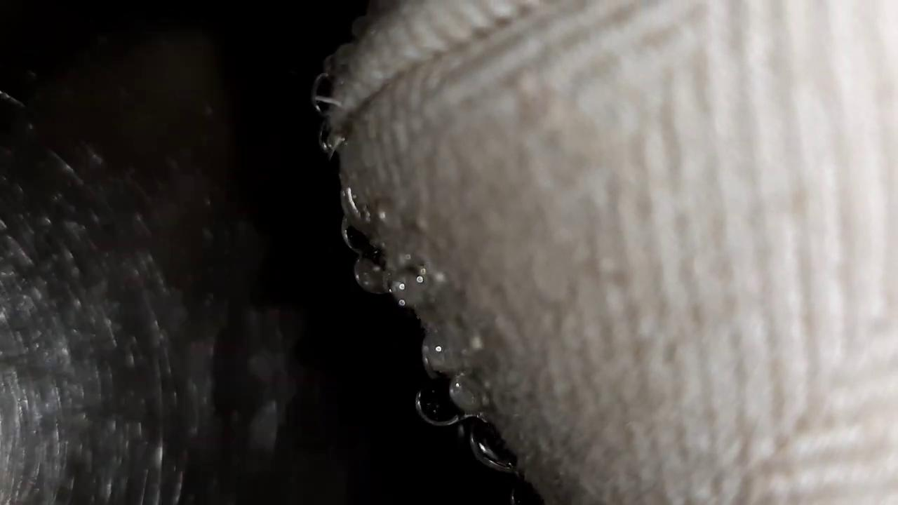
Conclusion:
Our hypothesis about the 100% cotton mask was not correct, the mixed material was the best when it came to the water test and the 50%-50% cotton and polyester mask was the worst when it came to the water test.
This is a short video that I took while completing the experiment. I was fascinated by the droplets going through the mask.

Slide 17

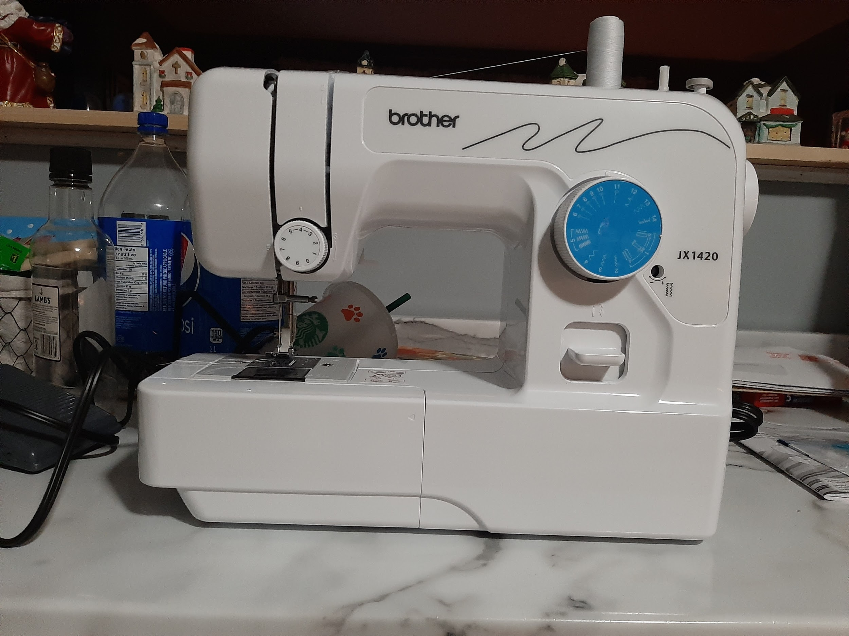
Acknowledgments:
I would like to acknowledge my nan and pop because they bought me a new sewing machine after my old one broke. I wouldn't have been able to complete this experiment without their help.

Slide 18
References:
Medical New Today (2004-2020). Retrieved November 6th, 2020 from: https://www.medicalnewstoday.com/articles/what-material-is-best-for-homemade-masks
Smart Air (2020), written by Paddy Robertson. Retrieved November 6th, 2020 from:
https://smartairfilters.com/en/blog/best-materials-make-diy-masks-virus/
Medical Express (2011-2020). Retrieved November 6th, 2020 from: https://medicalxpress.com/news/2020-05-homemade-covid-mask-fabric-choices.html
One layer T-shirt fabric droplet test- This video was my inspiration for this project

