Slide 1
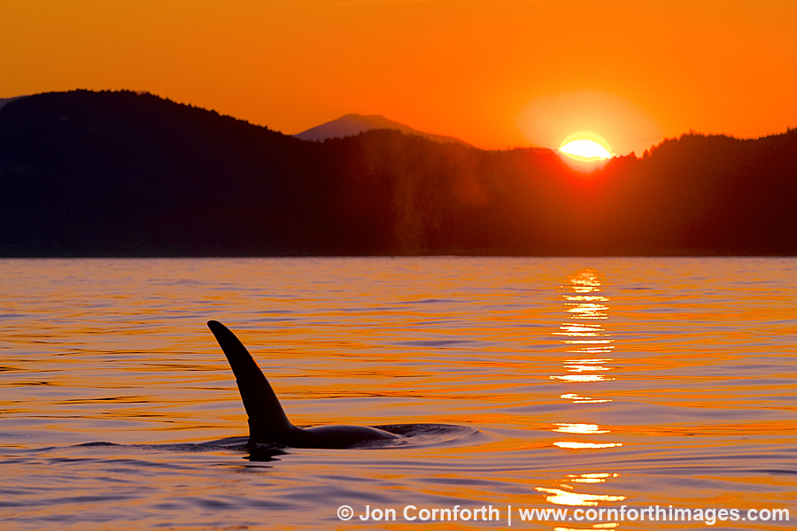
HOW HUMANS HAVE INFLUENCED:
Whale Behavior

Slide 2
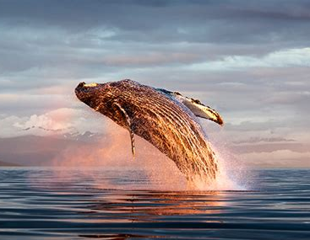
INTRODUCTION
Aim to explore how human activity has impacted the behavior of whales
Human activity has an impact on the ocean ecosystems and creatures
E.g. hunting, sonar disruption, etc

Slide 3
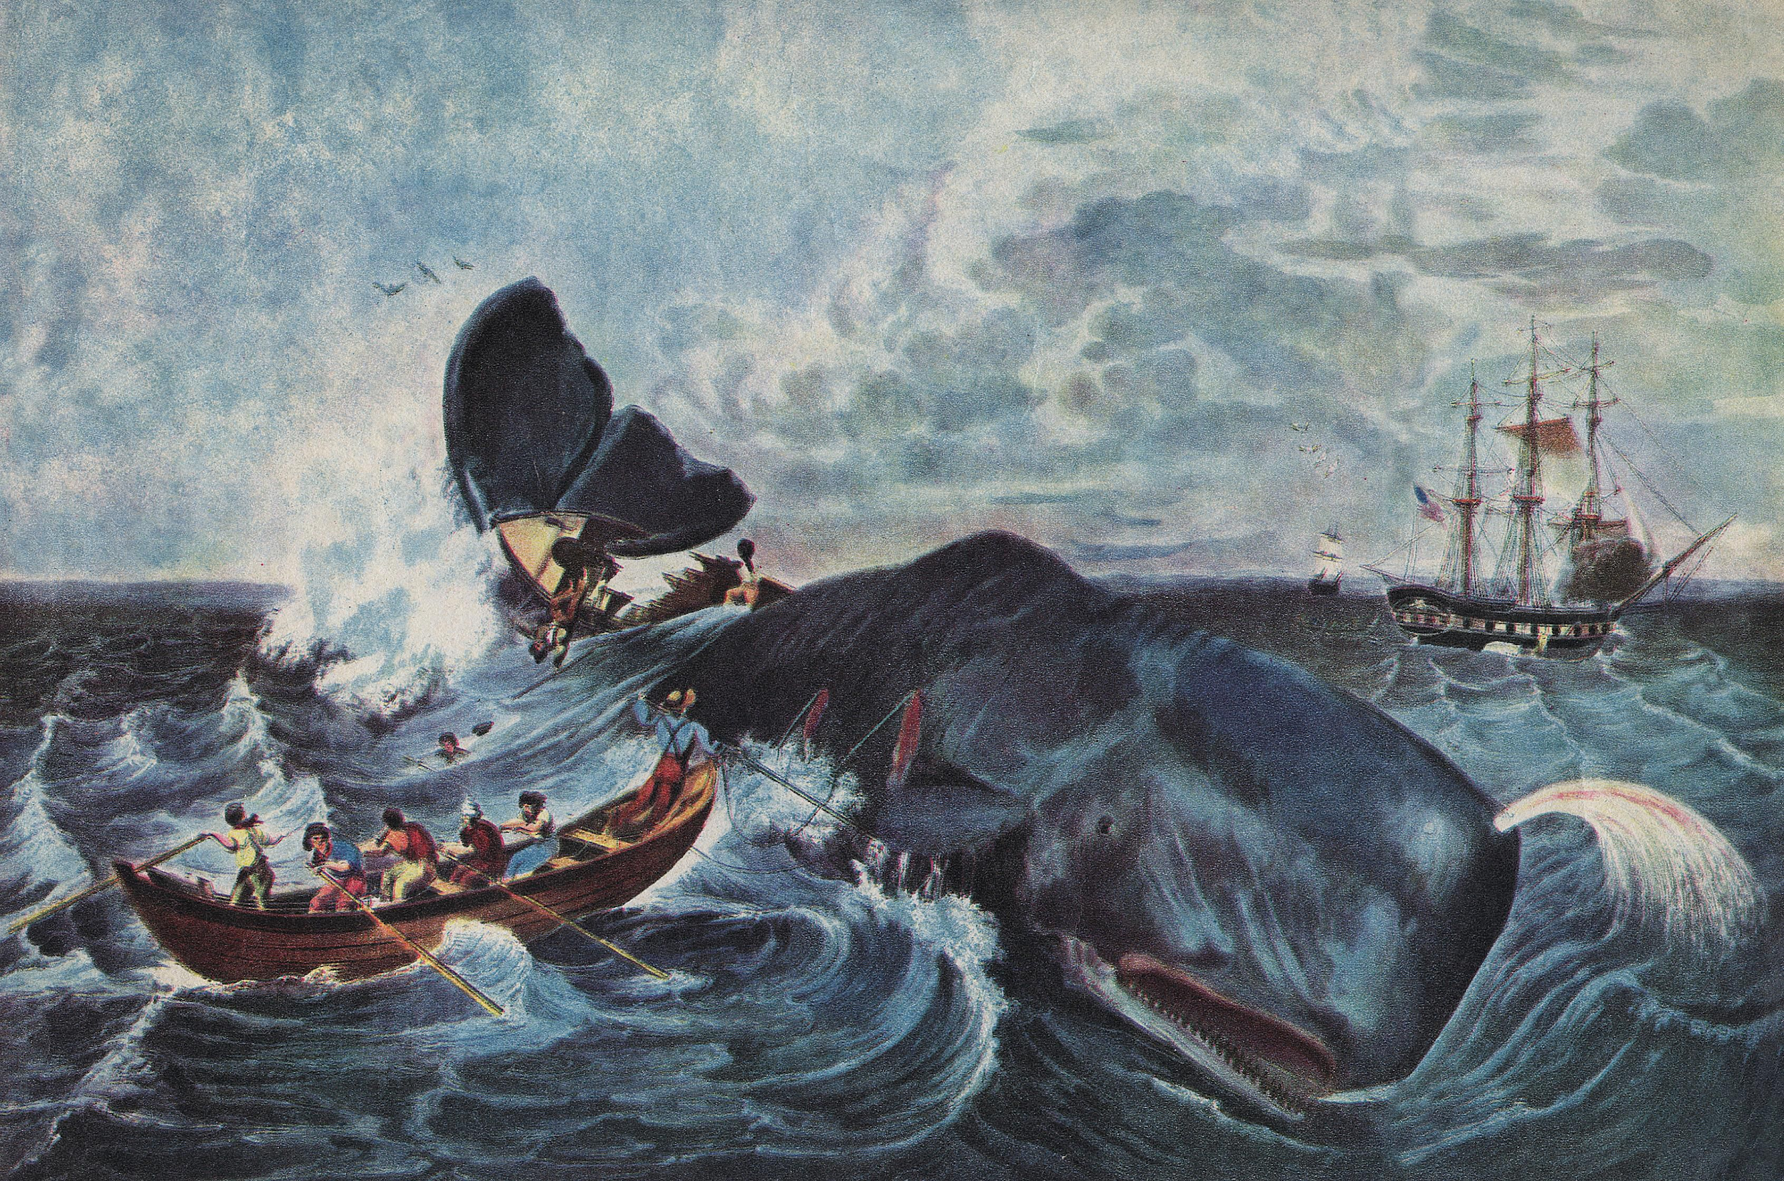
WHALING & ITS EFFECTS
Global phenomenon
Hunted because of products fabricated with their bodies
Destructive and violent
Became industry in 1600s, but dates back to 6000 B.C.E.
Over 300 000 whales killed from 1700s to 1800s
Modernized weapons caused numbers to increase
IWC put in place to help control situation and protect animals

Slide 4
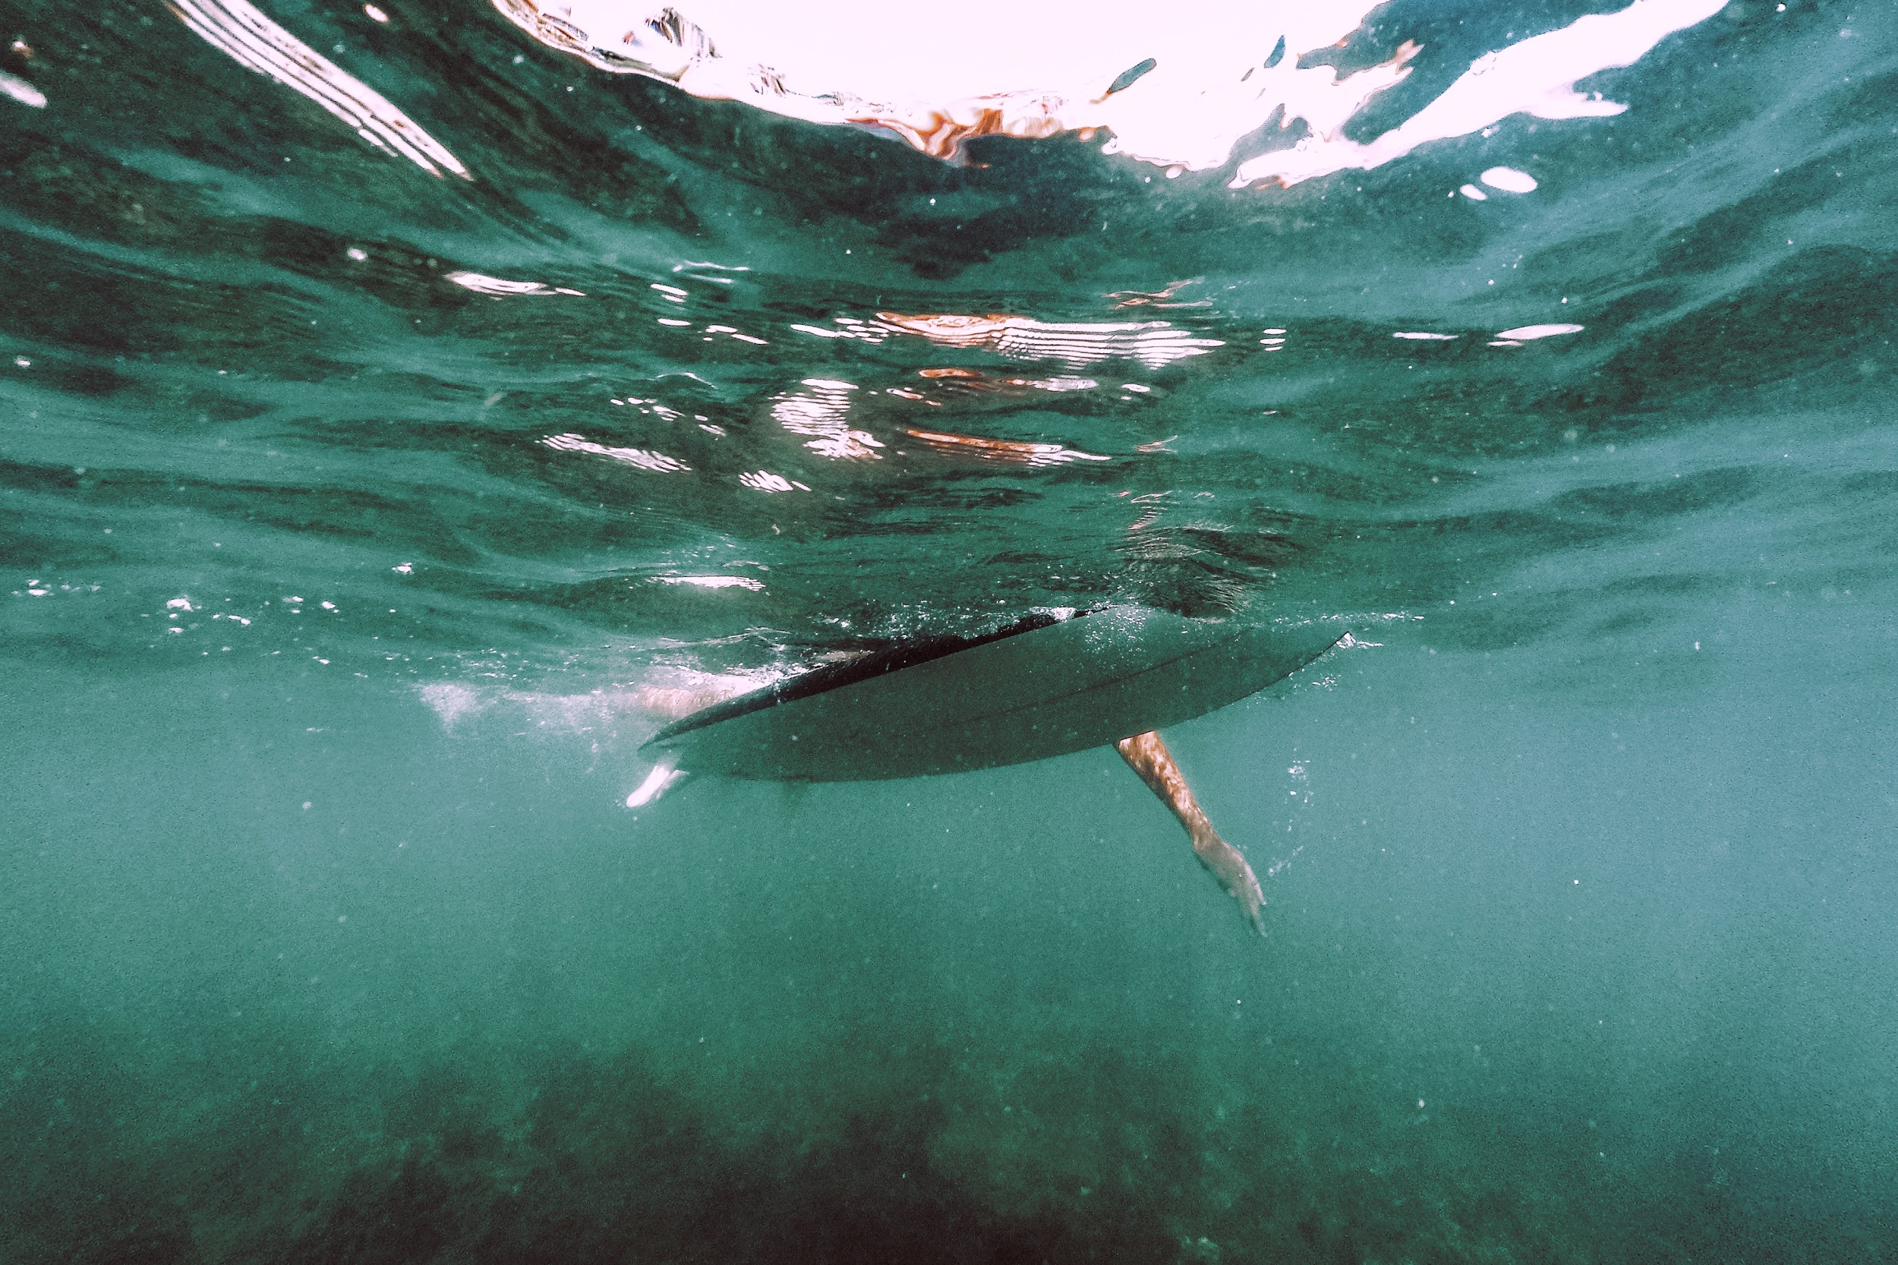
THE CROZET ISLANDS
ILLEGAL FISHING
Scattering of small, uninhabited islands off Antarctic coast
Unaffected by humans for thousands of years
Fisherman discovered location
Orcas discovered they could eat out of the fishing nets/traps
Illegal industry also discovered islands
Orcas formerly associated vessels with easy meals
Fisherman threw explosives into water to ward off animals
Changed the local pod’s perspective on humans/the unknown

Slide 5
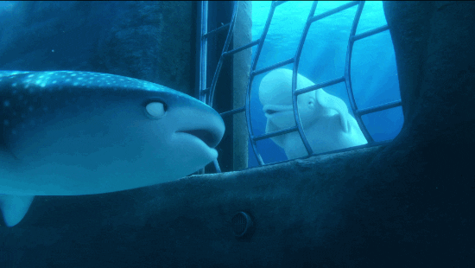
NOISE POLLUTION
Bad visibility underwater therefore whales communicate through echolocation
Each pod has unique ways of communicating (meaning they all have different languages and dialects)
Studies show oceanic noise pollution can cause behavioral changes, hearing damage and even death
Loud noise reduces range of communication (can inhibit activities such as feeding and finding mates and young)
Have to compromise for new noise by singing louder or avoiding habitats
Study conducted shows that manmade sounds (e.g. sonar) caused response that led to mass whale strandings

Slide 6
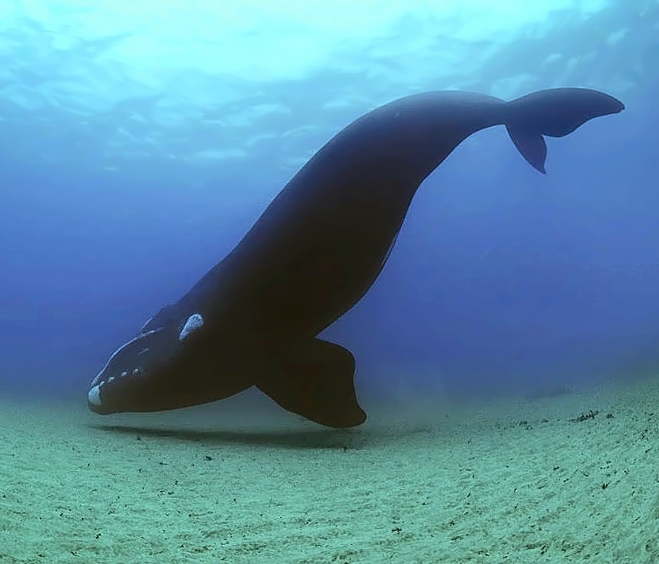
RIGHT WHALES
Fun fact: this type of whale was named because it was the “right” whale to hunt
One of more endangered species of large whale
Only 300-350 individuals left
Populations decimated by over-exploitation
No signs of population recovery since 1930s
Now only found along East coast of North America
2012 study on ship noise shows effect on communication
Communication influences
  Search for food
  Search for mates
  Navigation
  Predator avoidance
  Raising young
Causes of endangerment:
Entanglement
Ship collisions
Shipping traffic

Slide 7

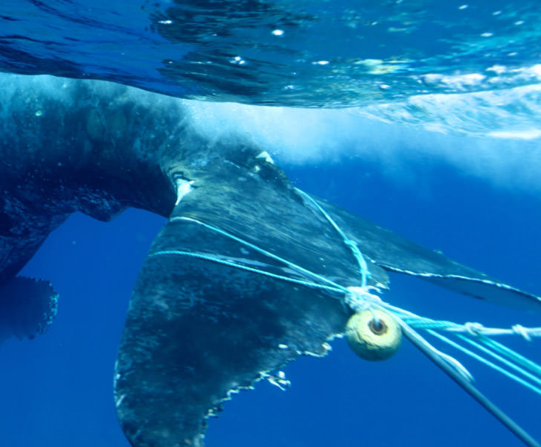
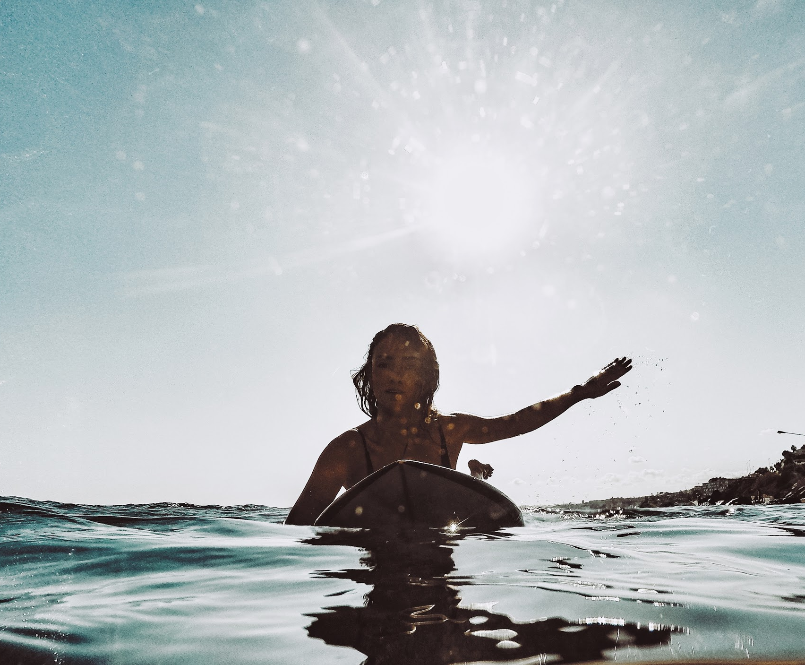
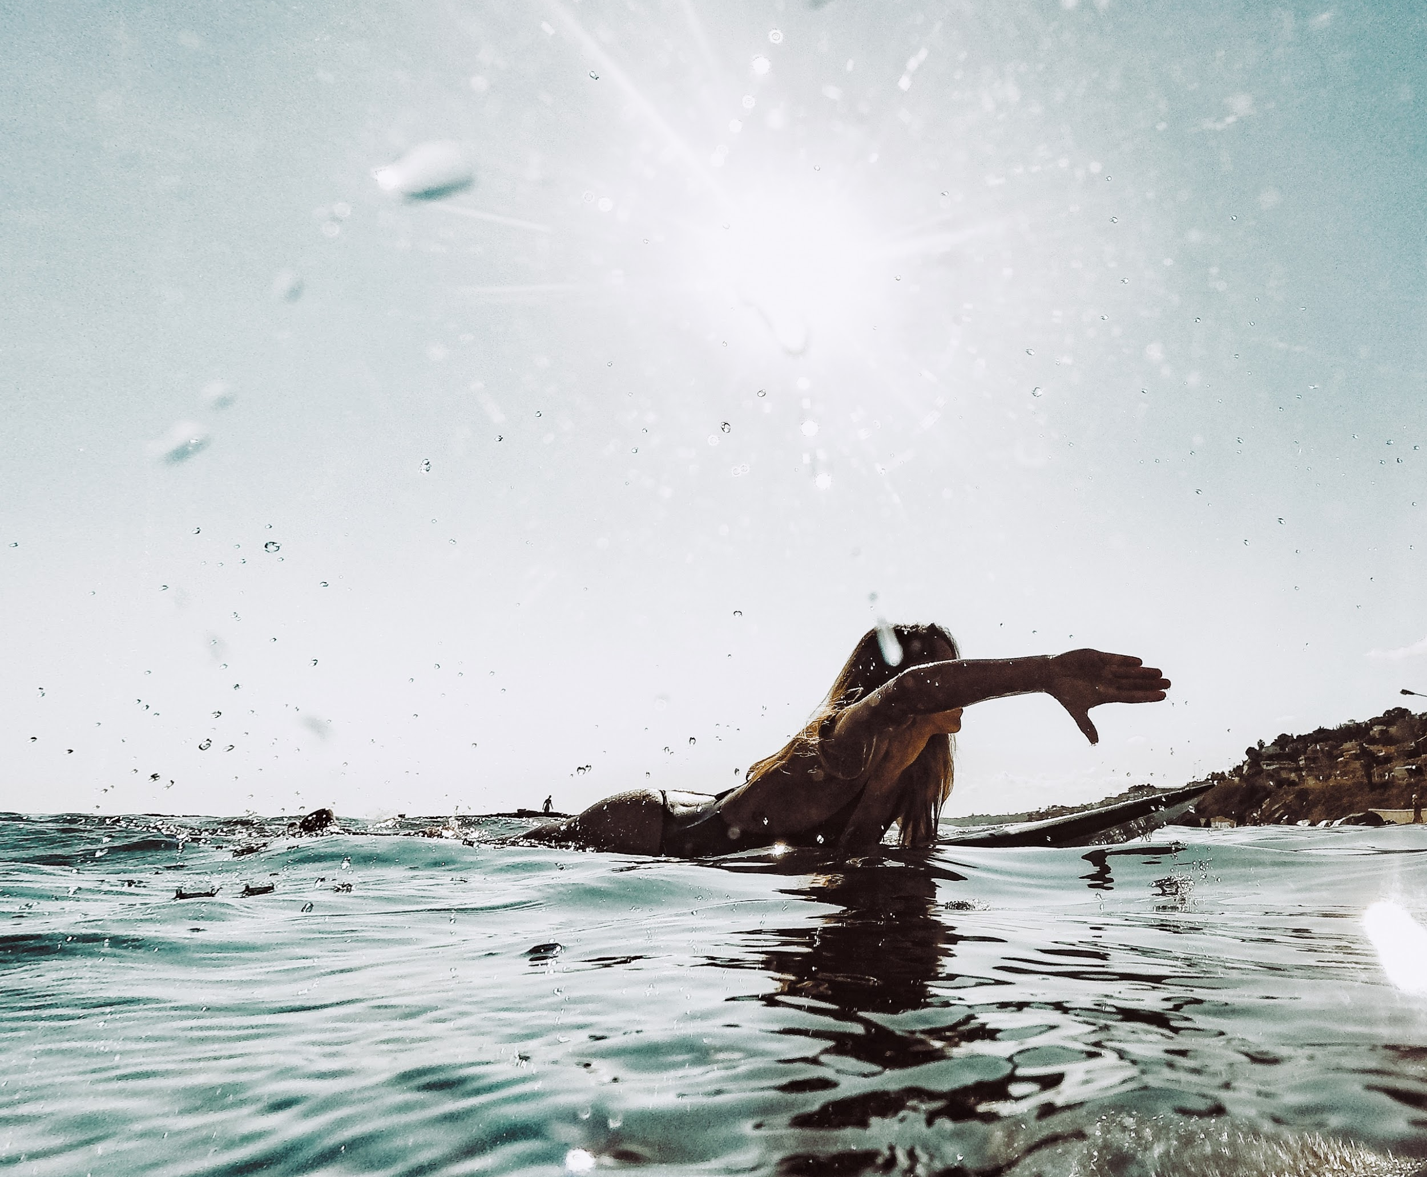
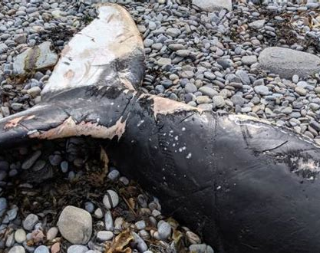
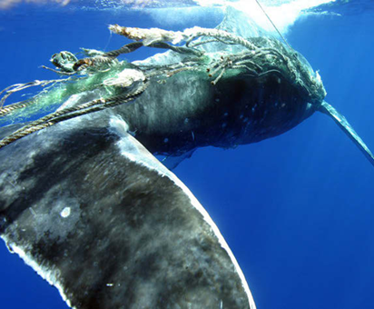
ENTANGLEMENTS (FISHING GEAR)
When whales get caught in fishing gear (typically larger mammals)
Dragging it around causes pain and affects foraging abilities
Can get caught in mouth and affect feeding abilities (prevent consumption of food) or drowning (can’t surface for air)
NEWFOUNDLAND & LABRADOR
Over 1000 humpbacks found entangled around NL
Entanglements occuring farther into open water due to cod moratorium (people now fishing for snow crab)

Slide 8
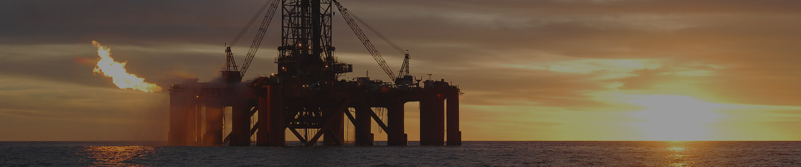
SEISMIC EXPLORATION
SURVEYS
Blasts equivalent to dynamite going off in your home every 10 seconds for days
Can have impacts on hearing
Study shows surveys off Sakhalin (Russia) have kicked grey whales out of primary feeding habitat
In 1992, humpbacks off the coast of NL found with damaged hearing structures because of underwater blasting used for building oil installations
Whales off coast of Alaska also found with hearing damage after seismic testing
Pollutants and toxins from oil related activities pose health risk
Poses 3 main threats to cetaceans:
  Habitat loss
  Hearing loss
  Pollution
Can disturb feeding, resting and breeding

Slide 9
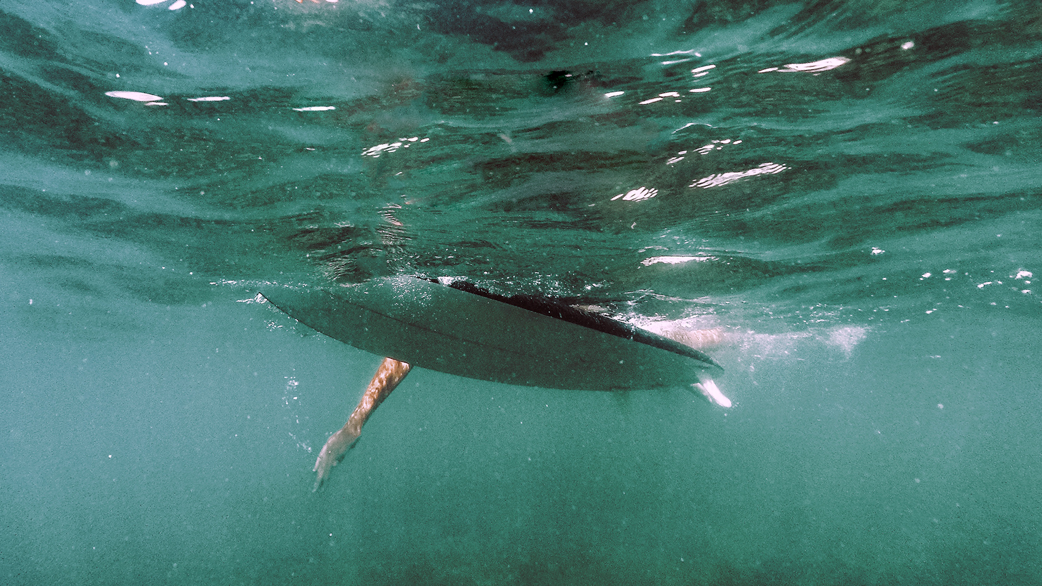
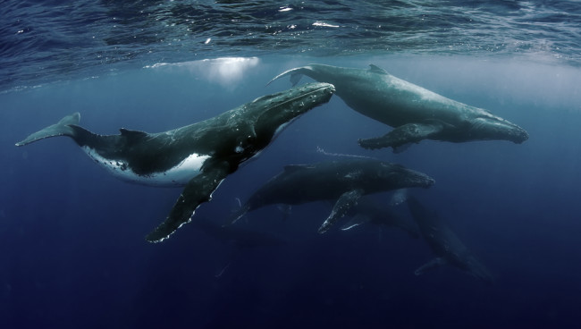
WHALE WATCHING IN NL
GENERAL INFO
RECREATION
RESEARCH
In NL, Humpbacks come to feed for a short season
Any interaction that disrupts feeding will cause avoidance of productive feeding areas (e.g. Witless Bay)
Increased number of recreational boaters bothering whales has led to increased number of collisions
Increased number of jet skiers harassing whales
Even researchers have been known to bother creatures
Trying to get too close for photographs
Taking samples with weapons
Attaching satellites

Slide 10
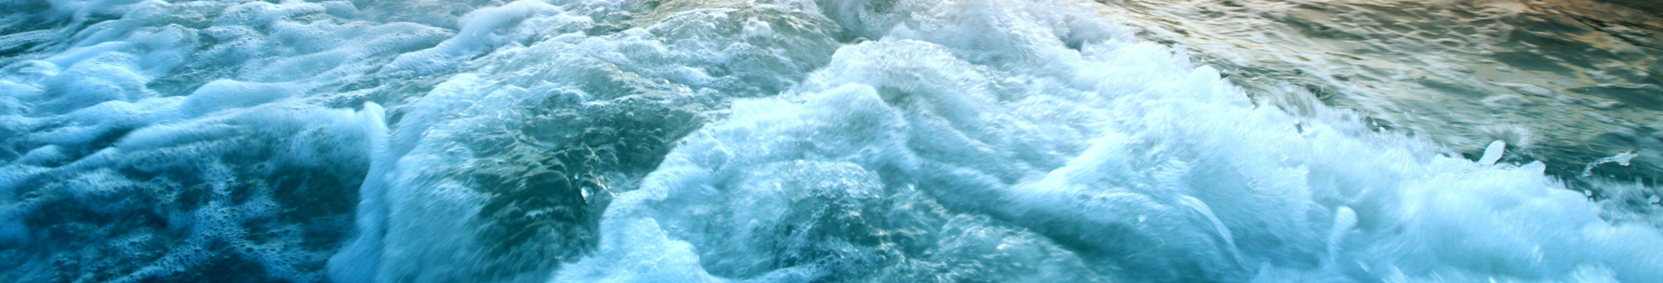
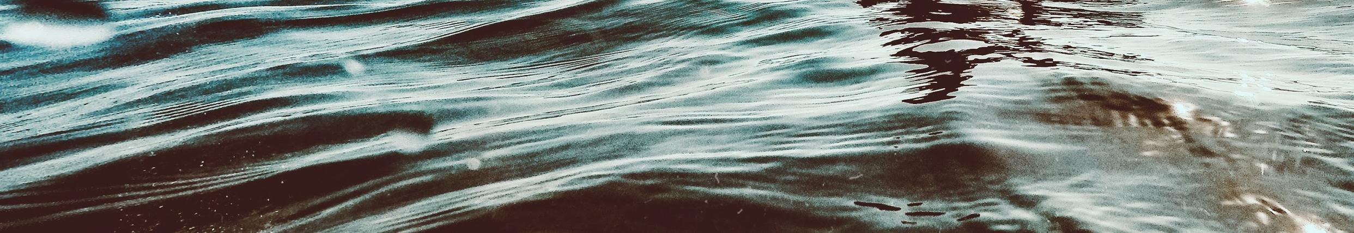
Humans affect ocean much more than just through pollution
Interrupt whale’s ability to live their lives
Have extreme effect on entire collection of oceanic mammals
Humanity has both directly and indirectly impacted entire oceans
Influenced and change both land and sea
Left behind destruction to habitat and inhabitants
CONCLUSION

Slide 11
REFERENCES
Marrero, M. and Thornton, S. (2011, November 1st). Big Fish: A Brief History of Whaling. Retrieved from: https://www.nationalgeographic.org/article/big-fish-history-
Evolution, Behavior and Threats. (Unknown). Retrieved from: https://www.whalefacts.org/history-of-whaling/whaling/
Tyack, P. (2008). How sound from human activities affects marine mammals. Retrieved from: https://acoustics.org/pressroom/httpdocs/155th/tyack.htm
Noise Pollution and Whale Behavior. (Unknown). Retrieved from: http://noaacontent.nroc.org/lesson13/l13la2.html
(n.d.). Encyclopedia Britannica. Britannica. Crozet Island | archipelago, Indian Ocean | Britannica. Retrieved from http://www.britannica.com/place/Crozet-Islands
McNamara, Robert. (2020, August 26). Objects Made From the Whaling Industry. Retrieved from https://www.thoughtco.com/products-produced-from-whales-1774070

Slide 12
REFERENCES
Benjamins, S. (n.d.). THE COST OF CHANGING GEARS: LARGE WHALE ENTANGLEMENTS IN NEWFOUNDLAND AND LABRADOR (CANADA),1979-2008. Retrieved February 25, 2021, from https://static1.squarespace.com/static/554d7c56e4b00bd59f069a1c/t/5589c9d1e4b0ab14a05435f1/1435093457038/Benjamins+et+al+Lg+Whale+bycatch+poster_FINAL.pdf
(n.d.). Impact of oil and gas exploration and extraction on whales. Retrieved February 25, 2021, from https://wwf.panda.org/discover/knowledge_hub/endangered_species/cetaceans/threats/oil_gas/
(n.d.). North Atlantic Right Whale. Retrieved February 25, 2021, from https://www.worldwildlife.org/species/north-atlantic-right-whale
(n.d.). Whale Release & Strandings Newfoundland and Labrador. About Entanglements. Retrieved February 25, 2021, from http://newfoundlandlabradorwhales.net/entanglements
W. Ledwell, personal communication, January 29, 2021

Slide 13

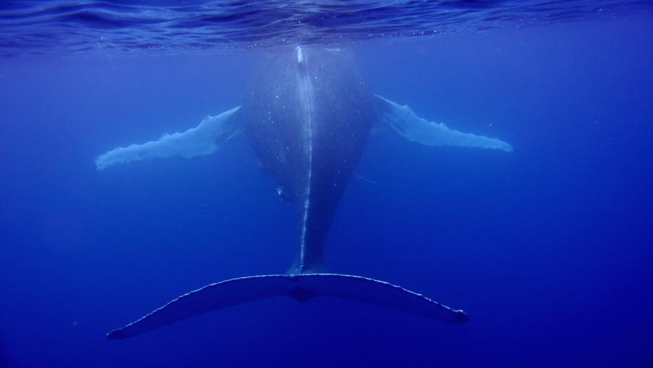
THANK
You

