Slide 1
Germination of grass seeds when exposed to microplastics; Polyethylene versus starch
Science Fair 2020-21
Linnaea Bird

Slide 2
Introduction
Microplastics are small pieces of plastic <5mm and are becoming a global issue. They can come from clothing, packaging, cigarette filters, tires as well as any piece of larger plastic that breaks down. Microplastics are too small to be picked up in standard filtration systems. (Microplastics: What Do We Know about ...)
Soil ecosystems have recently been discovered to be a sink for microplastics due to sewage, wastewater, fertilizer and airbourne plastics. (Microplastics accumulate on pores in ...) The application of sewage sludge, or biosolids, to farmland introduces 44,000–300,000 tons of microplastics to North American soil per year.
Microplastics in soil have also been found to affect the pH of soil, germination, soil biota and plant growth. With the introduction of plastics to soil, aggregates will not form properly affecting soil stability and water percolation. (Microplastics in the soil environment...)

Slide 3
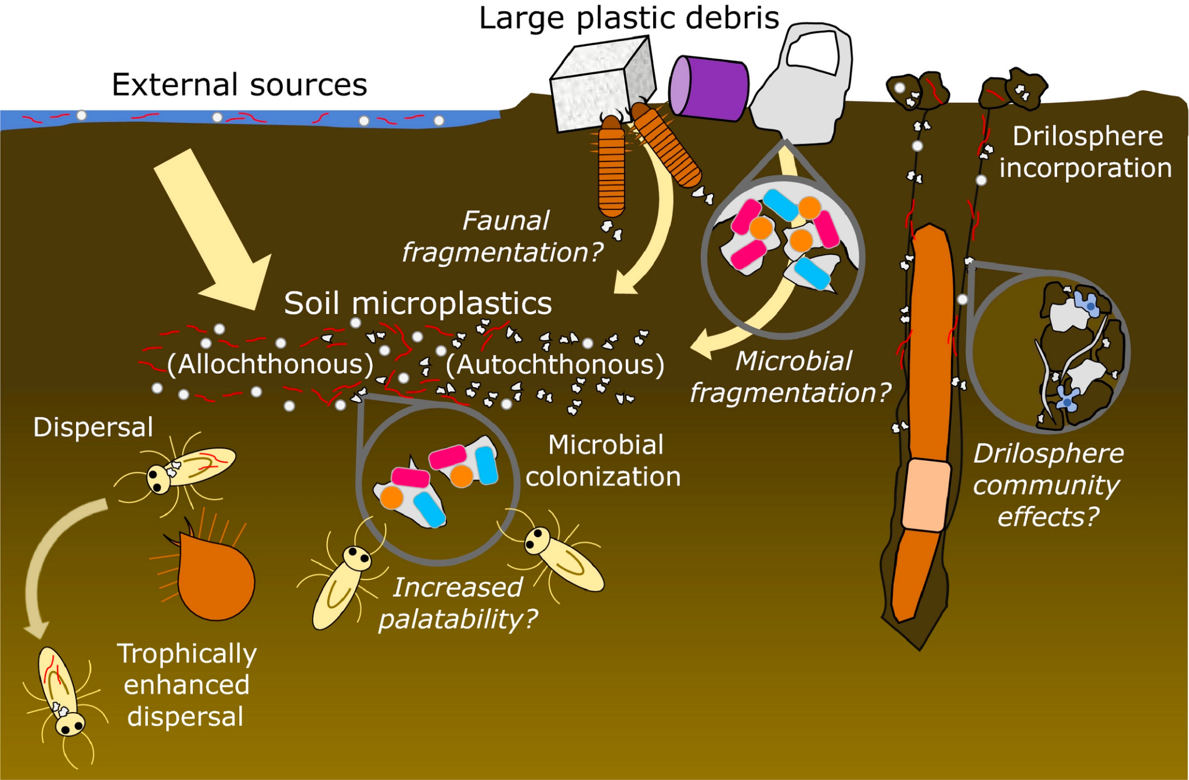
A study by at Leiden University in 2019 found that introducing microplastics to cress seeds before germination significantly reduced both the germination success and the root growth (Microplastics accumulate on pores in ...).
When examined the microplastics were found to be blocking the pores of the cress seeds and accumulating on root hairs leading to low germination success and decreased plant growth. Without the added surface area that root hairs provide, the plant cannot absorb as much nutrients.

Slide 4
In addition, microplastics in terrestrial environments affect the biotic health of bioreactors, such as earthworms.
In a 2019 a study at Anglia Ruskin University introduced high density polyethylene to ryegrass living in a contained environment with earthworms. Compared to the control, not only was the plant less healthy but the worms were also smaller and reproduced less. (Effects of Microplastics in Soil Ecosystems...)

Slide 5
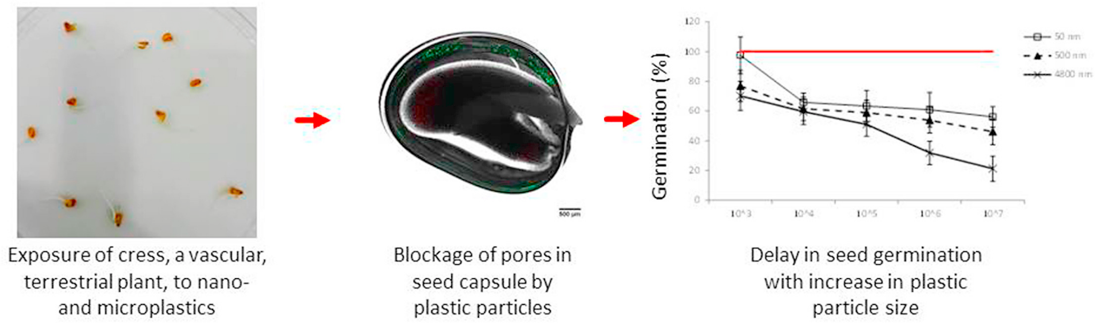
Results of the study by Leiden University

Slide 6
My approach
While these studies show that plastic does affect seed germination in terrestrial environments, I was curious as to whether biodegradable plastic would have a
different effect than other plastics manufactured from oils.
To test this question, I used dog waste bags as an example of plastics that are commonly discarded into the environment. With both polyethylene and starch based plastics, I tested how they affected seeds drawing inspiration from other studies.

Slide 7
Hypothesis;
Grass seeds exposed to starch based plastic will have more successful germination than those exposed to polyethylene.

Slide 8
Procedure;
Materials
Variables
Cardboard seed trays
Grass seeds
Starch based plastic (compostable plastics)
Polyethylene (ordinary plastic bags)
Glass jars x 12
Tweezers
Controlled; Temperature, nutrient input
Dependent: Germination success
Dependent: Germination success

Slide 9
Procedure;
Prepare plastics (polyethylene and vegetable starch) by cutting into pieces <5mm to meet the definition of a microplastic.
Soak the microplastics in a water solution for 24 hours, with one bag to 500ml of cold water. Replicate each solution 4 times in mason jars to prevent experimental error. Mix thoroughly every 8 hours.
After 24 hours, sieve the water of larger microplastics using a large mesh. Rince the sieve between jars to prevent contamination.

Slide 10
cont.;
Distribute 10 grass seeds into their own section of an egg carton with 32 replicates per plastic type. Since grass seed does not have a 100% germination rate, this helps avoid results based on the seed rather than the plastic.
Using a pipette, water each seed with 2 ml of plastic solution when all of the cartons are dry and require it, approx. every 12 until germination. Record which jar is watering which seeds. Rinse the pipette between each jar to prevent contamination.
After 5 days, (the maximum average time for grass seed germination) record actual and percent germination.

Slide 11
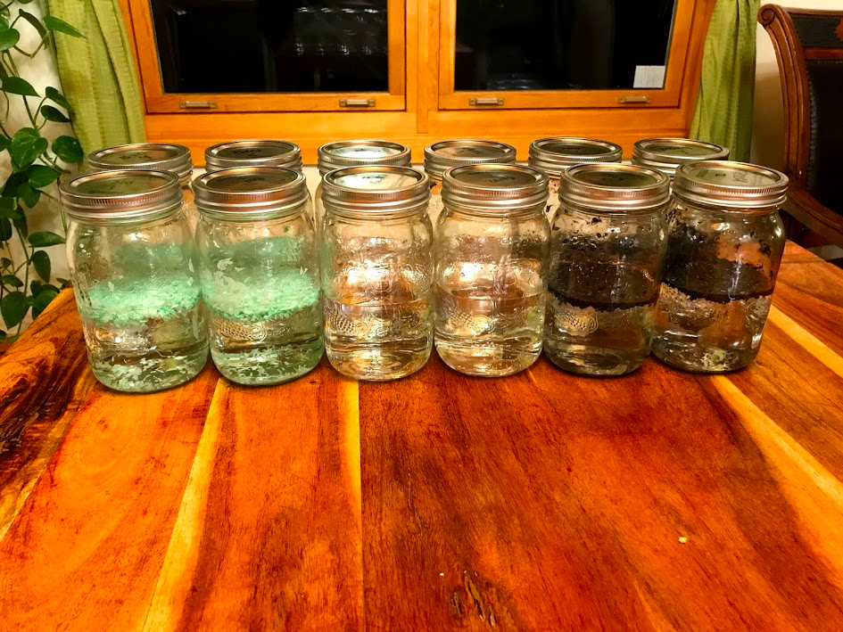
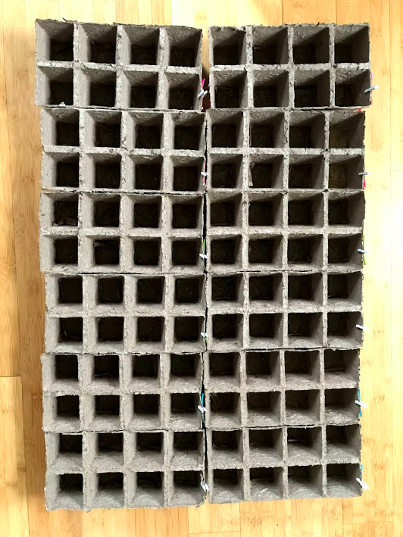
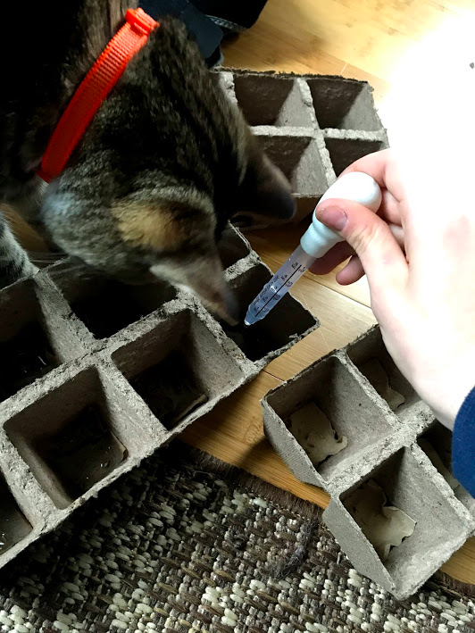

Slide 12
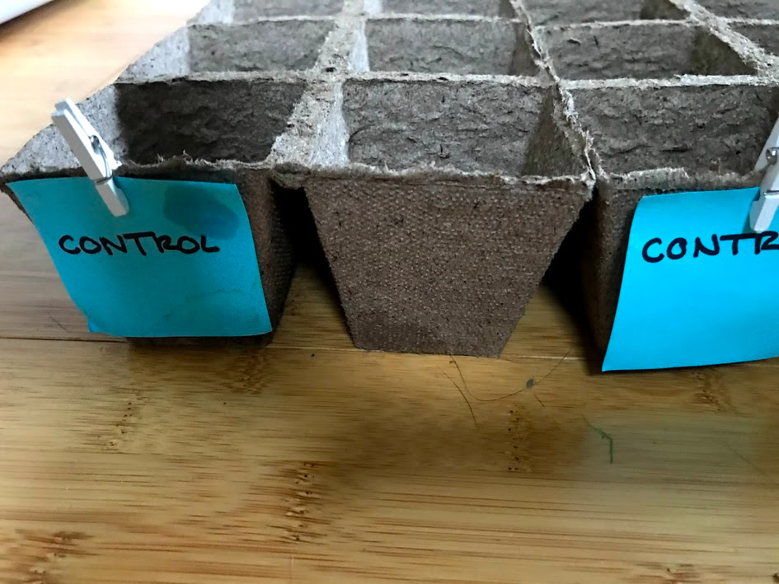
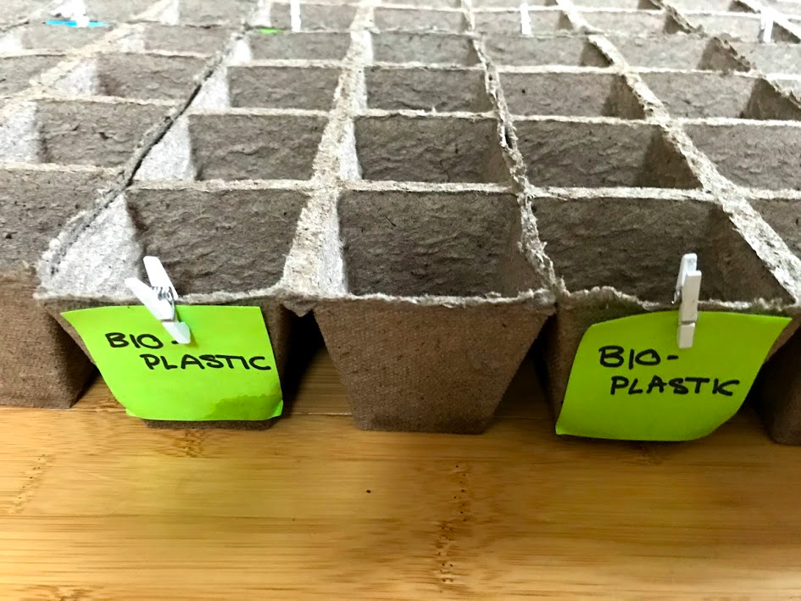
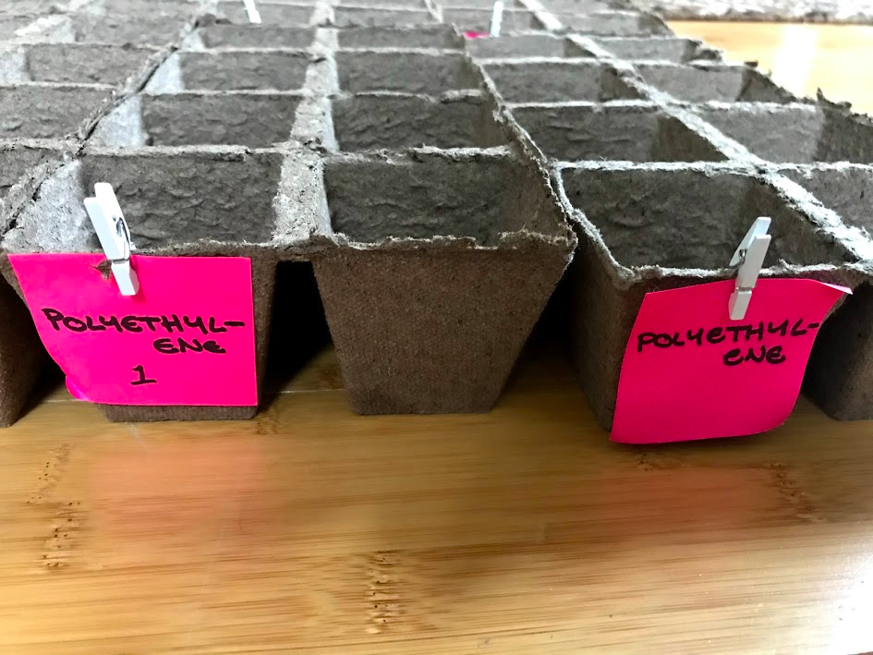

Slide 13
Results
After using the plastic and water solution on the immature grass seeds for five days, there was a trend favouring the control.
The polyethylene samples yielded the least rates of germination, and most germination occurred later in the process than the others. The bioplastic samples had a greater rate of germination success than the polyethylene, but still not as much as the control which contained no added microplastics.
However, the seeds being watered by the bioplastic samples germinated from the third to fifth day in comparison to the delayed germination of the polyethylene, which did not begin to germinate until the fourth and fifth days. The germination rate for low quality grass seed like I used is 60-70%. The germination for the polyethylene was 53%. For the bioplastic it was 61%, and for the control it was 63%.

Slide 14
Table 1 - Overall percent germination
 | Polyethylene | P% | Bioplastic | B% | Control | C%
Germination tray 1 | 44/80 | 55% | 51/80 | 64% | 50/80 | 63%
Germination tray 2 | 43/80 | 54% | 50/80 | 63% | 53/80 | 66%
Germination tray 3 | 38/80 | 48% | 44/80 | 55% | 48/50 | 60%
Germination tray 4 | 44/80 | 55% | 49/80 | 61% | 50/80 | 63%
Notes:
This figure represents the data as percent germination considered per tray (4 per treatment) rather than percent germination per 32 replicates per tray.

Slide 15
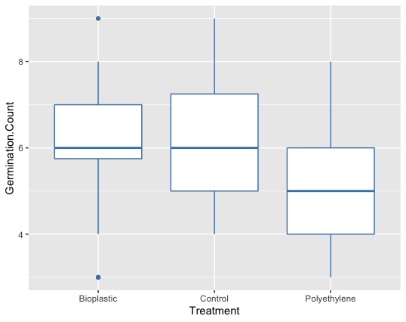
Figure 1

Slide 16
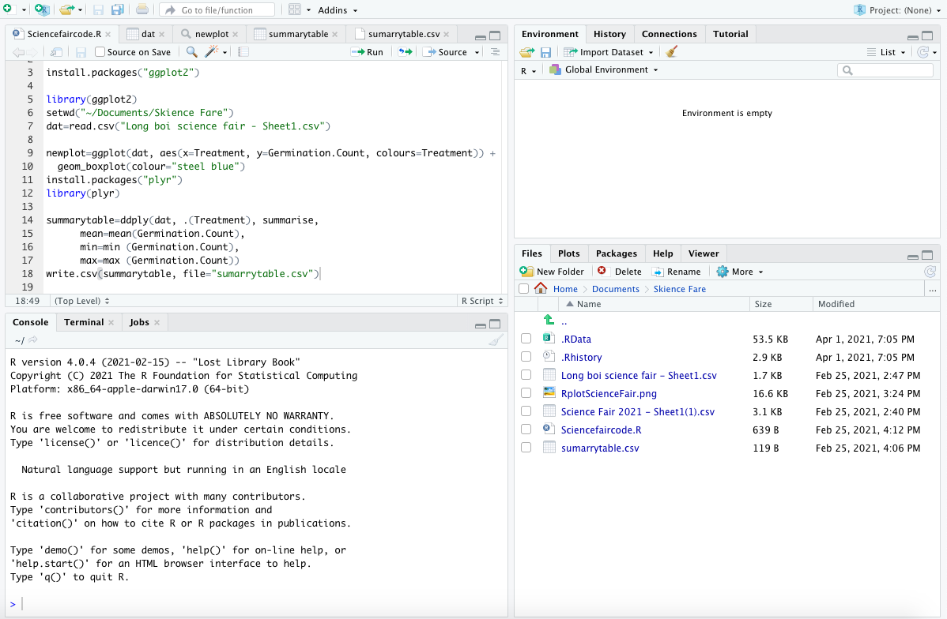
Notes:
This is just a quick look at the coding I did to create the previous graph.

Slide 17
The previous box plot graph shows the data for the experiment taking into account all of the 32 replicates per three plastic varieties.
You can see that the control (CP) germination was very similar to the expected rates, with the average being 6. The bioplastic (BP) was close behind and had a few outlying data points, shown by the blue dots on the bioplastic treatment line.
The average was also 6 for the bioplastic, the same as the control. While the bioplastic was slightly lower than the control, the polyethylene (AP) was significantly lower than the other plastic types. The average was 5.

Slide 18
Table 2 - Comparable data from each treatment
 | Treatment | Mean | Min | Max
1 | Bioplastic | 6.0625 | 3 | 9
2 | Control | 6.28125 | 4 | 9
3 | Polyethylene | 5.28125 | 3 | 8

Slide 19
This figure shows the mean, or the average of the germination counts for each individual treatment as well as the minimum and maximum.
This allows us to see the range of the data, or the min and max number of seeds per ten that germinated for each treatment, which shows the difference between the average and the mean values.
The control had the highest level of germination overall, followed by the bioplastic treatment and then polyethylene.

Slide 20
Results cont.;
The most probable reason that could explain the decrease in growth for the plastic treatments, both starch based and polyethylene, is that the microfibers could have been blocking the root pores.
In another study mentioned in the abstract, cress seeds exposed to microplastics saw a significant decrease in not only germination but in root growth as well. Upon further examination it was found that the microbeads were blocking the natural pores in the seeds, preventing them from extracting nutrients from their environment.
I also completed an analysis of the data and found that there was less than 0.017% chance of this resulting from error or chance. This means that the data was nearly statistically significant as the data almost certainly resulted from the independent variable, the plastic additives.

Slide 21
Discussion
This project was not without experimental error. One of the main risks was the risk of cross contamination between the plastic variants.
I was using the same tools such as a dropper, sieve, scissors, for various tasks that were necessary for all of the plastic variants as well as every single replicate. In addition I had four different plastic solution replicates as another way of reducing random error.
To reduce cross contamination, I rinsed each tool with fresh control water between each replicate as well as each plastic variant. Microplastics are very persistent and can stick to objects or become airborne so it was very important to prevent contamination in all areas possible.

Slide 22
Another way error was reduced in the experiment was by replicating both the plastic solutions and the seed trays.
Each of the shredded plastic bags were placed into a jar with the same volume of water, but I did this four times for each plastic type.
By doing this and then randomising which of the four microplastic solutions the seeds received each time I watered them, it reduced random error which is caused by unknown and unpreventable changes in the environment.

Slide 23
Also to prevent random error, each of the seed pots (32 per treatment, 8 per tray) contained ten seeds.
This totalled to 320 grass seeds per treatment.
This action was taken because poor quality seeds that have been in storage for a long time have a lower germination rate than normal grass seeds, although even fresh seed does not germinate 100%. Therefore, some of the viable seeds were possibly not affected by the microplastics so much as an environmental or genetic issue.
To make a more accurate representation of the effect of the microplastics the number of replicates was increased.

Slide 24
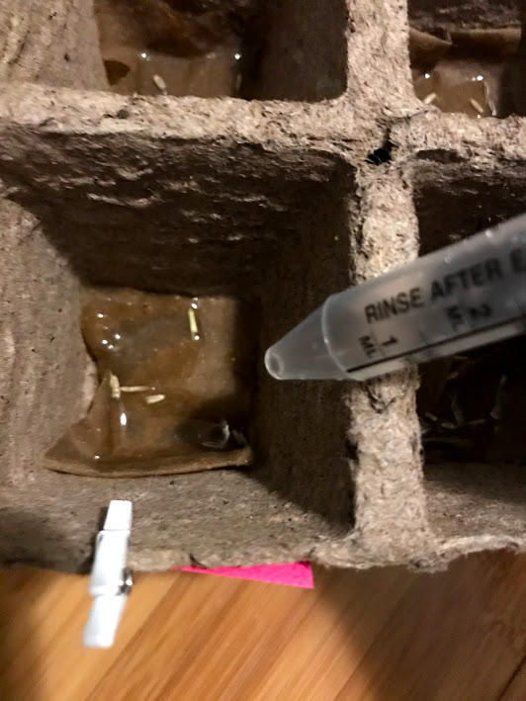

Slide 25
Conclusions
In this experimental science fair project, grass seed was exposed to two different plastic treatments.
The results of this experiment showed that something in the microplastics affect the germination rates. The success of the bioplastic, while lesser than that of the control, was still relatively high; but the polyethylene was at least 7% lower than the biodegradable starch plastic.
Therefore, we can conclude that starch based plastics are better for the environment, especially terrestrial environments.

Slide 26
There are two possible reasons that could be causing the decrease in germination success seen above.
The first reason is the physical blockage from the microplastics of the pores of the seeds. In a previous study fluorescent microbeads were used on cress seeds and under a microscope revealed that when the seed was sucking in water from the environment it was also taking in microplastics which accumulated and blocked the seed from gaining further nutrients. Some microscopic microplastics could have been carried by the water and caused this phenomenon.
The second way the plastic treatments could have affected the seeds is through the release of persistent organic pollutants. These chemicals, when initially exposed to plastic sometime in their life, are absorbed into the plastic. Plastic is very absorbent of POP for many years.

Slide 27
These harmful toxins can then be released into the environment, which may have happened here and shows that polyethylene carries more chemicals than bioplastic.
No matter the reason, this experiment showed that both of these varieties of plastic are harmful to immature, photosynthetic organisms in terrestrial environments.
In addition my previous science fair investigating microplastic prevalence in our local water supplies shows that microplastics are very pervasive and are spreading. If they are in water, they are also on land so this experiment is happening in our soil now.

Slide 28
Microplastics are extremely harmful to so many aspects of nature in a multitude of ways, from their sheer magnitude to their tiny size. As they continue to build in the ocean and in our landfills, we must be mindful of the damage they are doing to the environment.

Slide 29
Bibliography
Boots, B., Russell, C. W., & Green, D. S. (2019). Effects of microplastics in soil ecosystems: above and below ground. Environmental science & technology, 53(19), 11496-11506.
https://pubs.acs.org/doi/abs/10.1021/acs.est.9b03304
Bosker, T., Bouwman, L. J., Brun, N. R., Behrens, P., & Vijver, M. G. (2019). Microplastics accumulate on pores in seed capsules and delay germination and root growth of the terrestrial vascular plant Lepidium sativum. Chemosphere, 226, 774-781.
https://www.sciencedirect.com/science/article/pii/S0045653519306095
Zhang, L., Sintim, H. Y., Bary, A. I., Hayes, D. G., Wadsworth, L. C., Anunciado, M. B., & Flury, M. (2018). Interaction of Lumbricus terrestris with macroscopic polyethylene and biodegradable plastic mulch. Science of The Total Environment, 635, 1600-1608.
https://www.sciencedirect.com/science/article/abs/pii/S0048969718312117

Slide 30
Bibliography
Xu, B., Liu, F., Cryder, Z., Huang, D., Lu, Z., He, Y., ... & Gan, J. (2020). Microplastics in the soil environment: Occurrence, risks, interactions and fate–A review. Critical Reviews in Environmental Science and Technology, 50(21), 2175-2222.
https://www.tandfonline.com/doi/abs/10.1080/10643389.2019.1694822
Microplastics: What Do We Know about Them? (2019). Retrieved on October 15, 2020, from:
https://www.thisisplastics.com/environment/microplastics-what-do-we-know-about-them/
Whitty, J., Berman, A., Guzman, A., Levintova, H., Cohen, M. and Stover, D., 2021. Plastics Suck Up Other Toxins: Double Whammy for Marine Life, Gross for Seafood.
https://www.motherjones.com/politics/2013/01/plastics-and-chemicals-they-absorb-pose-double-threat-marine-life/

