Slide 1
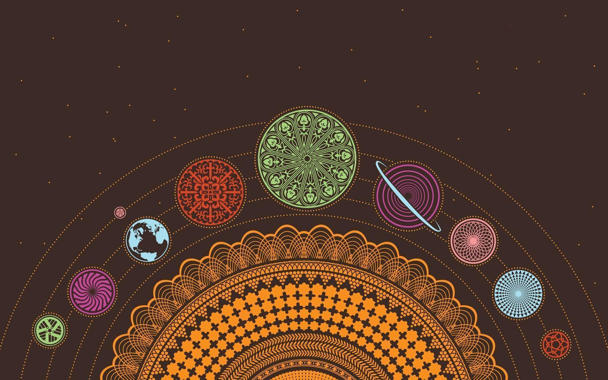
Meditation And Its Effects On The Human Body and Mind
Olivia Bridger - Grade 11
Holy Trinity High School
Torbay, NL

Slide 2

Purpose:
To see if the time people put into meditation is worth it
Question(s):
Does meditation actually make a difference on someone's mental or physical wellbeing?
Hypothesis:
I think that at the end of the week of meditating, there will be an improvement in mental clarity but not much improvement on physical health.

Slide 3
What is Meditation?
Meditation is a practice where someone uses a technique to achieve mental clarity, and a calm mental or emotional state. You can use techniques such as mindfulness, and focusing on a specific thought, object, or activity. The meditation practice goes back as far as 1500 BCE. Meditation originated in India from the Hindu and Buddhist religions, it was described as the “training of the mind”. It is said that it comes from Vedantism, which is one of the Hindu schools of philosophy and one of the earliest paths for Indian spiritual enlightenment. (The history and origin of meditation 2020)
People have been doing research for years on if meditation can have an affect on a persons wellbeing, although some people are still skeptical about it, all of the research done on meditation has shown positive results. Harvard, The US National Library of Medicine, and The American Psychology Association are just a few of the places that have done research on the topic.
Meditation has come a long way since it first originated, we can now access meditation with a click of a button, we don't need professionals or religious leaders to teach and guide us. It's as simple as typing “meditation for beginners” into a search bar and we've got thousands of options in front of us. There's also applications you can download on your phone so you can meditate on the go, such as Headspace, and Calm.
Being someone who uses meditation regularly, I decided to do my own research, having 5 volunteers and myself, all of different age, gender, jobs, and opinions on meditation, meditate for a week straight to see if there would be an improvement. I also felt that this project was the perfect opportunity to get my peers to practice a form of self care during COVID times.

Slide 4
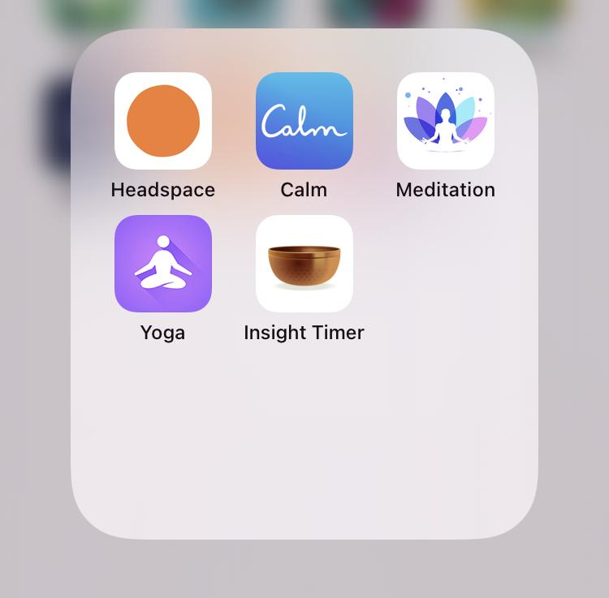
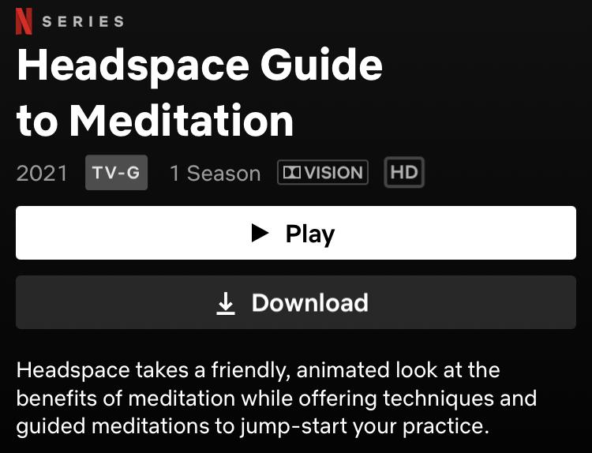
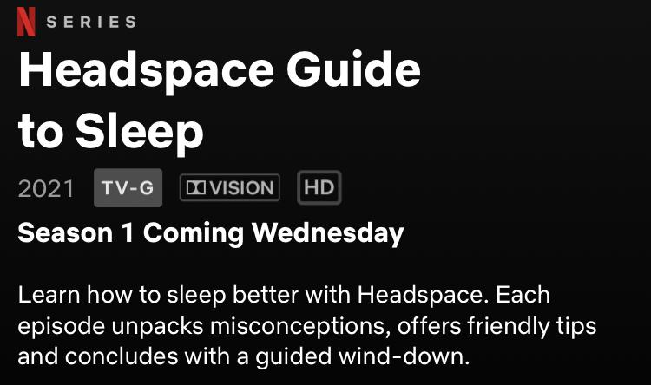
What is meditation? (cont.):

Slide 5
Variables:
Independent variable:
The amount of time each person spends meditating
Dependent variable:
The effects that meditating has on each person
Controlled variables:
Making sure each person spends the same amount of time meditating (5 mins), the same meditation video is used, making sure they’re in a quiet environment, answering the same questions on the google forms

Slide 6
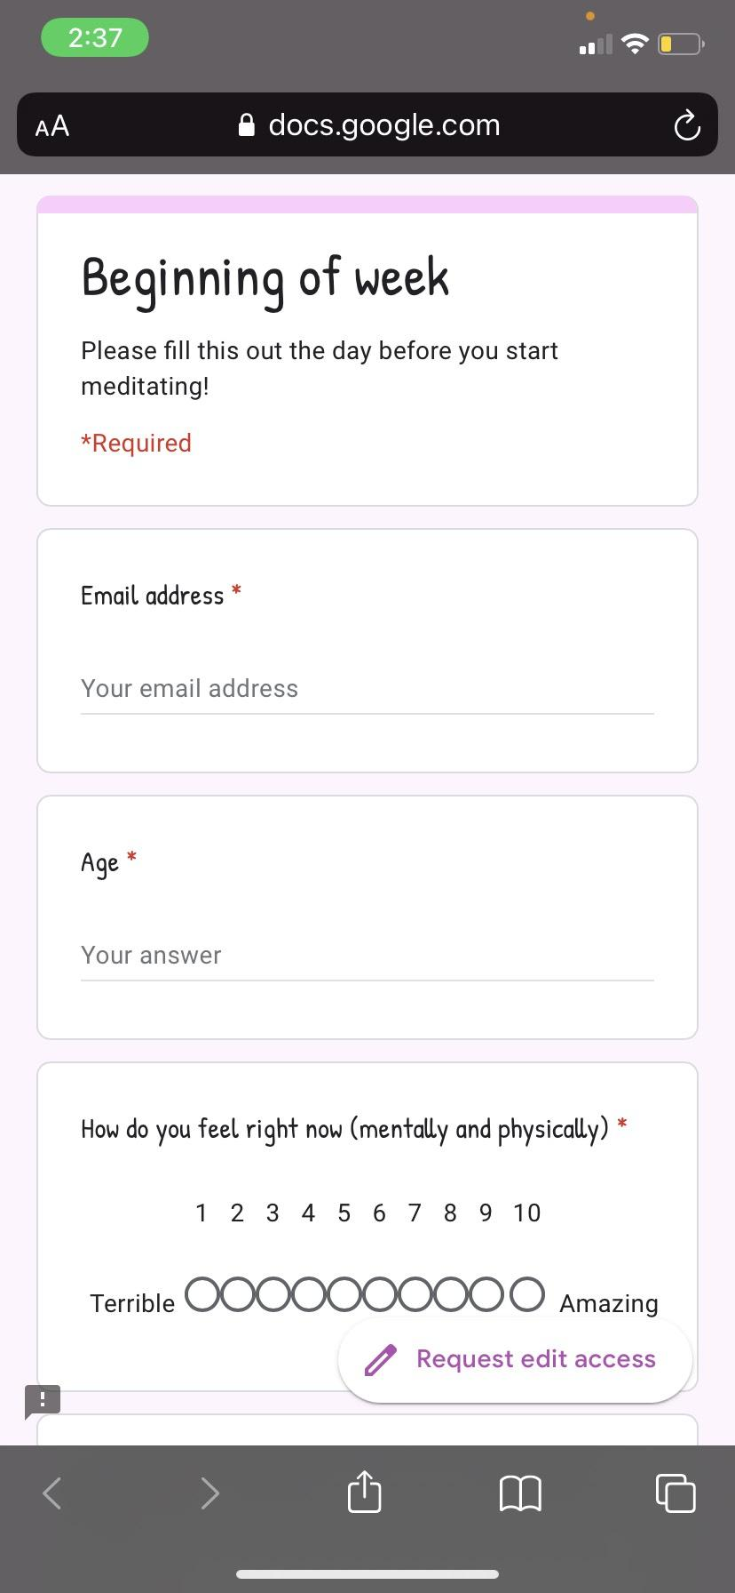
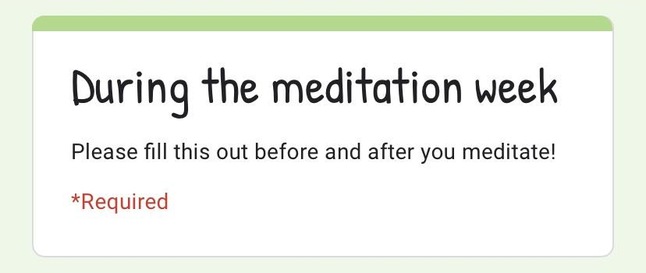
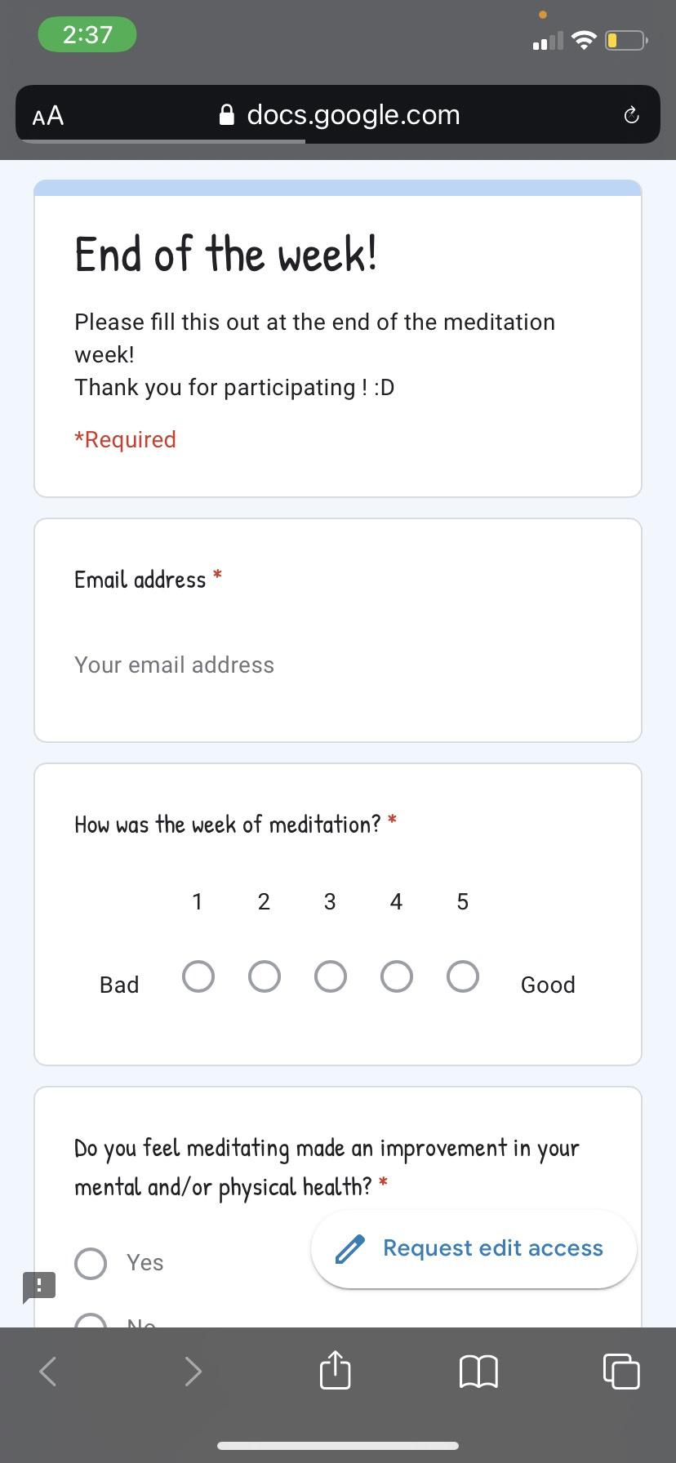
Materials:
Three (3) google forms quizzes, Five (5) minute meditation video from Youtube, Six (6) volunteers

Slide 7
Procedure:
1. Create and send google forms to my volunteers
2. Have them fill out the first one on the day before they start meditating, it will be about how they're feeling, how they think the week will go, and some other questions.
3. Send them the same 5 minute meditation video, have them fill out a `before` form and then follow the videos instructions
4. Then when they've finished the video, have them fill out the `after` form.
5. Continue this for 7 days
6. Have them fill out the End Of Week form and compare all the results.

Slide 8
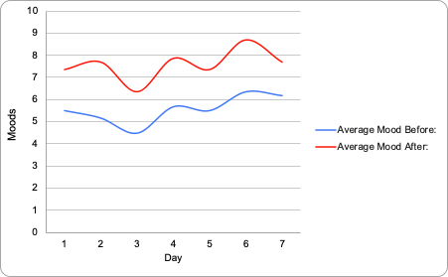
Graph of the results:

Slide 9
Results (continued), statistics:
This is a comparison of the average moods people were feeling before and after meditating during the week
Day
1
2
3
4
5
6
7
Average Mood Before:
5.5
5.1667
4.5
5.667
5.5
6.333
6.1667
Average Mood After:
7.3333
7.6667
6.3333
7.8333
7.3333
8.6667
7.6667

Slide 10
Discussion:
-The hypothesis that meditation will have a positive effect on people’s mental health was proven correct by this experiment, although there were some sources of error.
-It was discovered that meditation does not benefit those who have just started practicing this week the same way it affected long-time practitioners.
-By doing meditation every day, it becomes a routine. If one decided to only meditate on bad days, it is unnatural and the meditation may not be as effective. Consistent meditation for just five minutes every day can greatly improve one’s mood.

Slide 11
Sources of Error:
Some of the inconsistencies that were run into were the Google Form malfunctioning, subjects meditating at different times of the day, and the fact that the 1-10 mood scale is subjective.
-The Google Form malfunctions caused some responses to be doubled, tripled, or sent in hours/days late. It was difficult to discern real data from duplicated results. This is a systematic error with the measuring equipment.
-When subjects meditate at different times of day, they would have had a different amount of time awake. Subject 1 could wake up in a great mood, meditate, and go from an 8 to a 10. Subject 2 could come home from a stressful day at work, meditate, and go from a 4 to a 9. This random error makes it difficult to accurately measure how much one’s mood improves.
-The subjective mood scale means it is hard to measure objectively how good someone is feeling. One person’s 7 could be another’s 4. This random error can incorrectly shift results.
If the experiment were to be redone with one changed factor, there should be a specific time for subjects to meditate, like 6:00 or 9:00 PM. Some subjects were personally involved in meditation before partaking in the experiment, while others weren’t.

Slide 12

Conclusion:
Overall the hypothesis of this experiment, “Meditation will have more of an effect on people’s mental health as opposed to physical health”, is correct as all the evidence given points toward an increase in people’s mental health throughout the week.

Slide 13
Acknowledgments:
This project would have never been complete without the help of my 5 volunteers, Tracy Jensen, Darren Jensen, Claire Jensen, Tina Bridger, and Elvis Bridger. It also wouldn't have been complete without the help of my chemistry teacher, Ms. Heidi Kavanagh.

Slide 14
References:
- The. (2018, March 23). Washington Post. https://www.washingtonpost.com/national/health-science/mindfulness-meditation-is-huge-but-science-isnt-sure-how-or-whether-it-works/2018/03/23/2fa510a6-1e4e-11e8-9de1-147dd2df3829_story.html
Bridger, O. (n.d.-a). Beginning of week. Olivia Bridger. https://docs.google.com/forms/d/1Jm4YPh5kj0V4YbmrBJJirs07dhK0LrSCVuvO-wLk-Ig/viewform?edit_requested=true
Bridger, O. (n.d.-b). During the meditation week. Olivia Bridger. https://docs.google.com/forms/d/1ivqm4rO_Zp5wLtbJpq3arviH0fpR_Dn1Jdw1yhb-K4E/viewform?edit_requested=true
Bridger, O. (n.d.-c). End of the week! Olivia Bridger. https://docs.google.com/forms/d/1u_YJ74mxcWTCt5dHs4omfokDmTgWlj7pkJRd9M4OFBI/viewform?edit_requested=true
Cooper, B. B. (2020, June 30). What is Meditation & How Does It Affects Our Brains? | Buffer. Buffer Resources. https://buffer.com/resources/how-meditation-affects-your-brain/
Meditation: In Depth. (n.d.). NCCIH. https://www.nccih.nih.gov/health/meditation-in-depth
YouTube. (2019, September 4). [Video]. YouTube. https://www.youtube.com/watch?v=inpok4MKVLM&feature=youtu.be

