Slide 1
Bottled Water Comparison
Science Fair Project: Emma Dalley
Grade 11 - Holy Trinity High, Torbay

Slide 2
INTRODUCTION
Purpose:
To determine if there are any differences in the parameters of various brands of bottled water. Some of these parameters include: pH, fluoride, mercury, nitrites, zinc, total chlorine, aluminum, etc..
Question:
What, if any, are the differences between the various brands of bottled water?
Hypothesis:
There will be some variation in the levels of each parameter in bottled water, however; all within safe drinking limits.

Slide 3
VARIABLES
INDEPENDENT
DEPENDENT
CONTROLLED
The brand of bottled water tested.
The level of each parameter in each brand of bottled water.
Water temperature, the brand of test strips, and the time test strips are in water samples.

Slide 4
MATERIALS
LIST OF NEEDED MATERIALS:
Multiple different brands of bottled water
Water testing strips, which include 16 parameters
Thermometer to insure temperature of water
Paper Towel
Test Tube (Plastic or Glass)
Paper to record test results
Pen of pencil

Slide 5
PROCEDURE
Purchase/order water testing strips
Purchase multiple different brands of bottled water, leave out to reach room temperature
Gather all needed materials listed and prepare a clean and organized workspace
Check to insure water is at room temperature by using a thermometer
Pour water sample #1 into a clean and dry test tube
Dip one test strips into test tube, leave for approximately two seconds
Quickly remove and shake test strip to remove all excess water
Lay the test strip on a flat surface and wait 60 seconds before reading test strip results
Record results in a project log
Repeat steps 4-9 for each of the remaining brands of water
*Note: To insure accurate readings for each brand, complete 2-3 tests per brand

Slide 6
RESULTS

Slide 7
RESULTS: PART ONE
Table Figure 1.1 - Results were achieved by using the Complete Water Test Kit by Varify. For the most accurate results each brand of water was tested three times, average results are shown in the table.
 | Parameters of Different Brand of Water Results
Parameter | Fiji | Kirkland | Circle K | Dasani | Eska | Evian
Lead | 2 | 0 | 0 | 0 | 0 | 0
Fluoride | 0.5 | 0.5 | 0.5 | 0.75 | 0.5 | 0.5
Iron | 0.2 | 0 | 0 | 0.2 | 0 | 0
Copper | 0 | 0 | 0 | 0 | 0 | 0
Mercury | 0 | 0 | 0 | 0 | 0 | 0
Total Chlorine | 0 | 1 | 0 | 0 | 0 | 0
Nitrite | 1 | 0 | 0 | 0 | 0 | 0
Nitrate | 10 | 0 | 5 | 0 | 5 | 0
pH | 7.5 | 7.2 | 7.5 | 6.2 | 7.2 | 7.5
Total Alkalinity | 160 | 100 | 120 | 0 | 120 | 150
Hardness | 50 | 450 | 450 | 50 | 25 | 450
Aluminum | 0 | 0 | 0 | 0 | 0 | 0
Sulfate | 100 | 0 | 0 | 0 | 0 | 0
Zinc | 2 | 2 | 2 | 2 | 2 | 2
Free Chlorine | 0 | 0 | 0 | 0 | 0 | 0
Manganese | 0.05 | 0 | 0.05 | 0 | 0 | 0.05

Slide 8
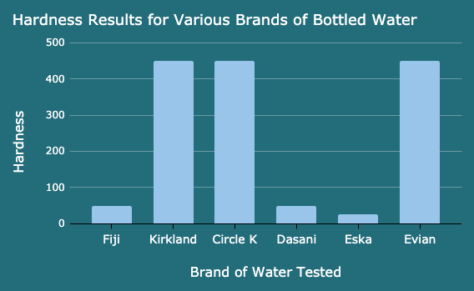
RESULTS: PART TWO
Figure 1.1 - This chart shows the hardness results for the various brands of bottled water. Chart shows a range in hardness from 25ppm-450ppm.

Slide 9
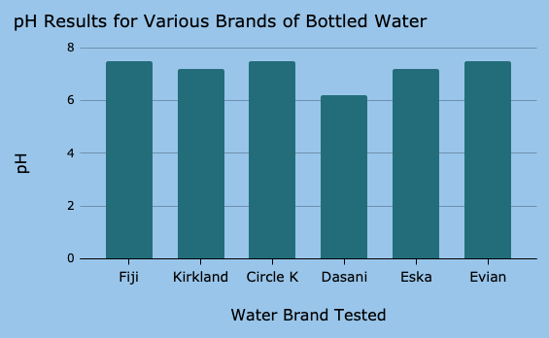
RESULTS: PART THREE
Figure 1.2 - This chart represents the pH results for the various brands of bottled water. The chart shows the range in pH from 6.2-7.5.

Slide 10
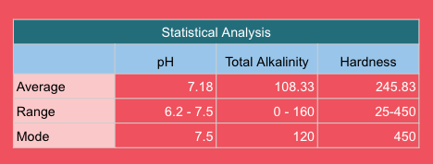
RESULTS: PART FOUR
Table Figure 1.2 - This table gives a statistical analysis of the results for the pH, total alkalinity, and hardness. This statistical analysis includes the average, range and mode.

Slide 11
DISCUSSION

Slide 12
All results were within the safe limits suggested by the test strip kit, as expected. A detailed analysis of results is to follow.
Parameters with no variance:
lead (0.0 ppm)
copper (0.0 ppm)
mercury (0.0 ppm)
aluminum (0.0 ppm)
free chlorine (0.0 ppm)
Zinc (2..0 ppm)
It was expected to have levels of lead, copper, mercury, aluminum and free chlorine at 0.0ppm, as these are parameters that consumers do not want to see in their water for safety reasons and any traces would be removed by the company before they were bottled.
Parameters with slight variances:
Fluoride (0.5ppm-0.75ppm)
Iron (0.0ppm-0.2ppm)
Total Chlorine (0.0ppm-1.0ppm)
Nitrate (0.0ppm-10.0ppm)
Nitrite (0.0ppm-1.0ppm)
Manganese (0.0ppm-0.05ppm)
The parameters above had only slight variances and this may be the result of some of the sources of error (ex, test strips, result reading errors, etc)

Slide 13
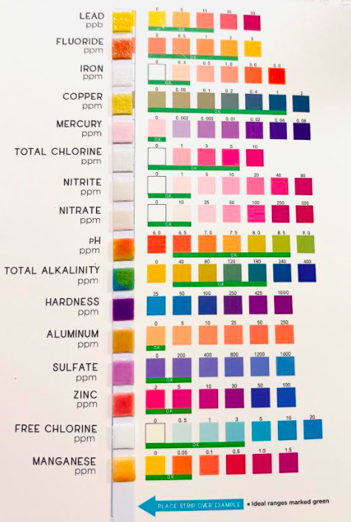
Parameters with large variances:
pH (6.2-7.5)
Total Alkalinity (0-160)
Hardness (25ppm-450ppm)
The variation in pH is explained by the different acidities of soils that these samples came from.
Water described as “hard” is high in dissolved minerals. Hard water does not pose any health risks, however one does not wish for hard water as the minerals will buildup on water fixtures and may result in poor soap/detergent performance.
Figure 1.3 - This is an example of a used test strip

Slide 14
SOURCES OF ERROR
Systematic Error 1:
It is possible that the test strips were inconsistent with each other or possibly faulty, resulting in some data collected being off and/or incorrect.
Systematic Error 2:
Everything in this world has some variation. The specific bottled water purchased may not have been good examples of that brand as a whole. Therefore, results are not specific to the brand, rather the sample purchased.
Human Error:
Results were shown on the test strips as colours, one would have to judge, based on the chart provided, the numerical value associated with that colour. Results may be affected by this.

Slide 15
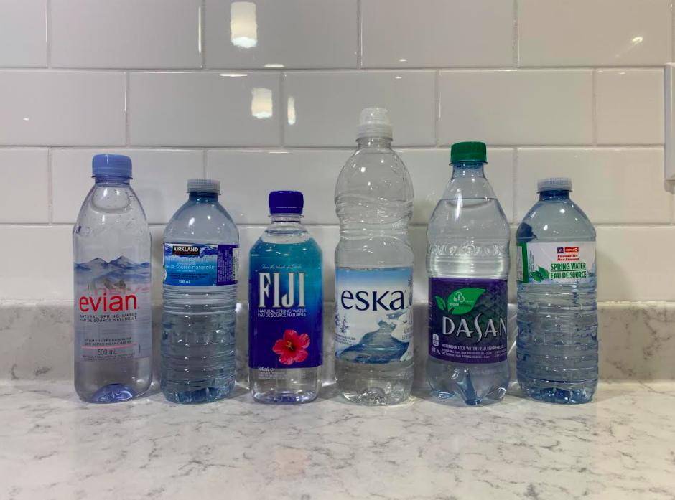
CONCLUSION
Results reveal that there are some variation in the parameters of different brands of bottled water, some larger than others.
Figure 1.4 - An image of the brands of bottled water that were included in the testing.

Slide 16
ACKNOWLEDGEMENTS
I would like the thank the following people:
My Chemistry teacher, Ms. Kavanagh, and my Physics teacher, Ms. O'Reilly, who both provided guidance on this project.
My parents who assisted with the at home aspect of this project, including the experiment.

Slide 17
REFERENCES
Reference 1:
Omer, N.H, October 16th 2019.
Retrieved from: Water Quality Parameters
Reference 2:
Authors name and date of publication is unknown.
Retrieved from information booklet provided with the purchase of water testing kit
Water testing kit: https://varifytest.com
Reference 3:
Ada McVean B.Sc, January 11th 2019.
Retrieved from: McGill - Office for Science and Society

Slide 18
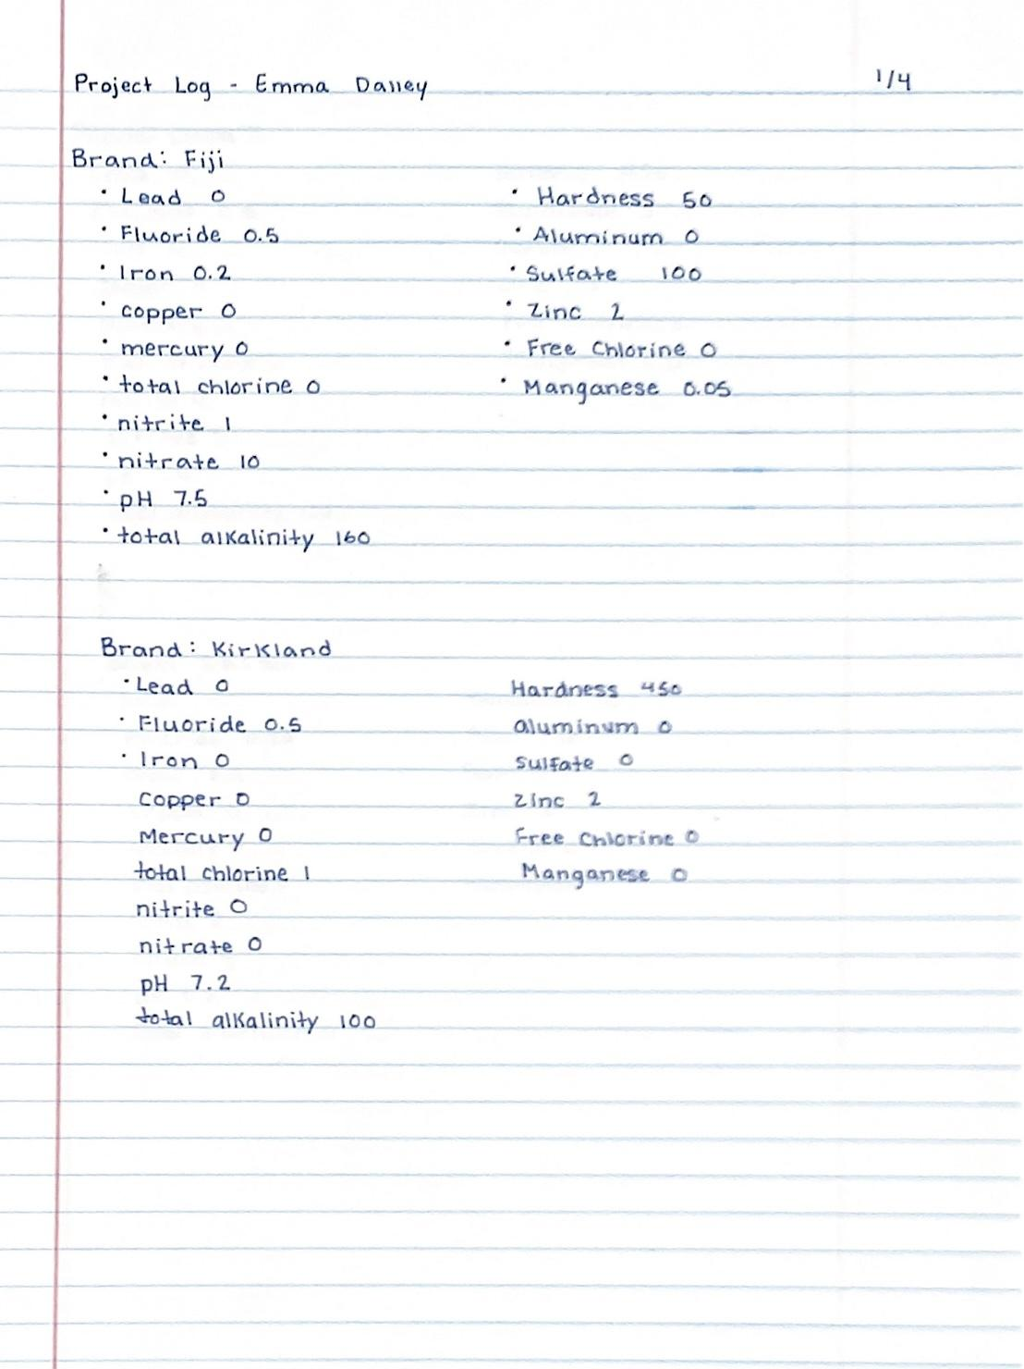
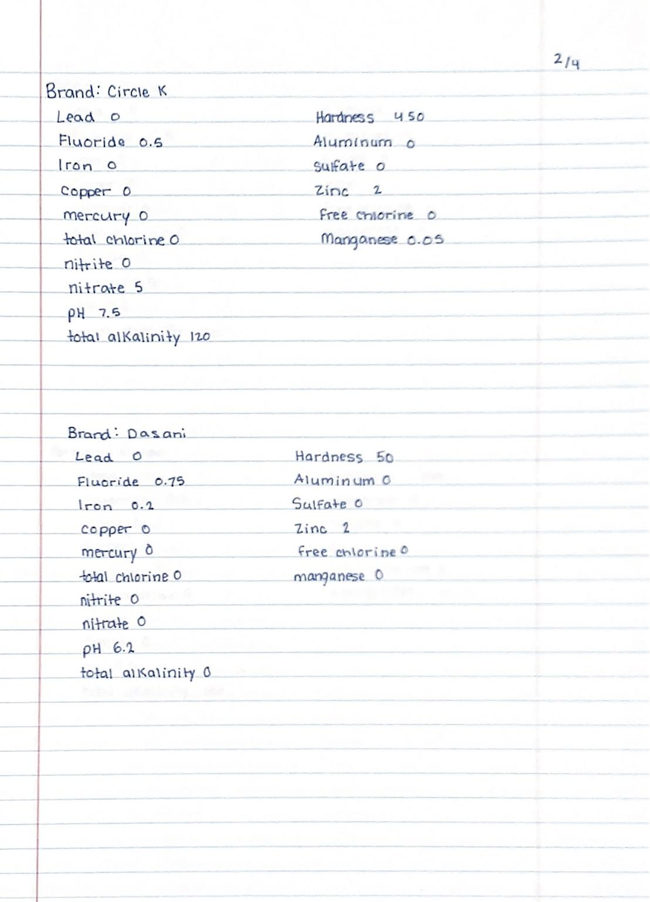
PROJECT LOG: PART 1

Slide 19
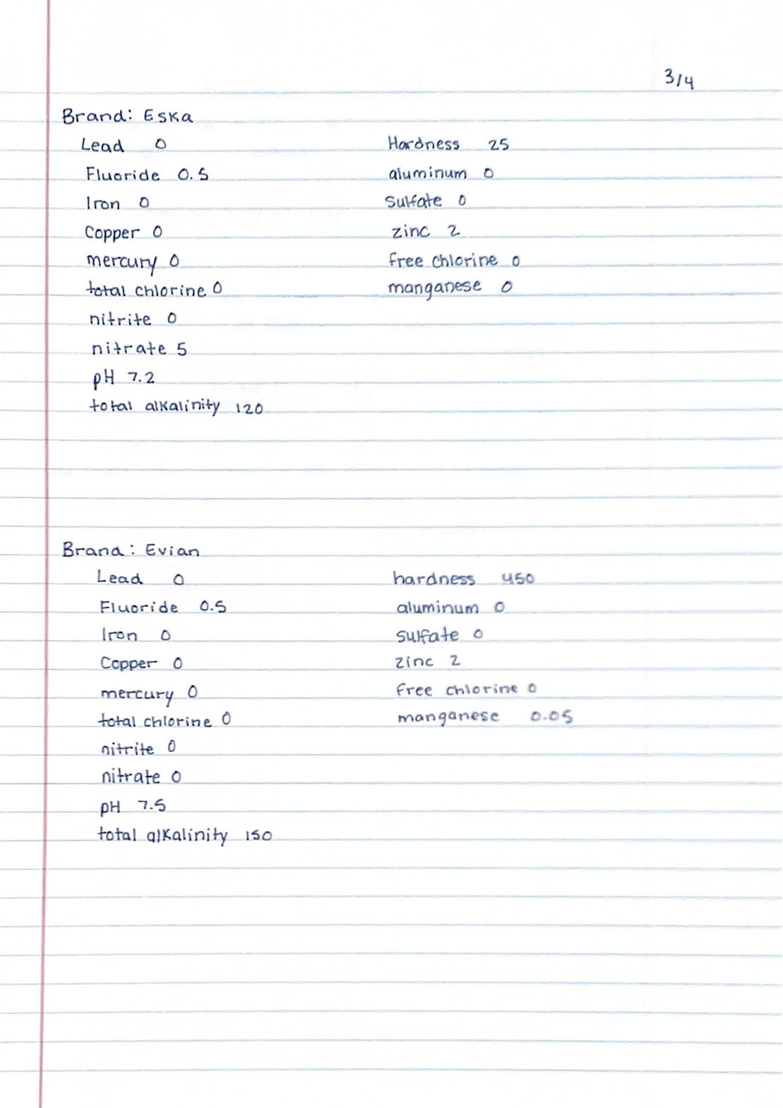
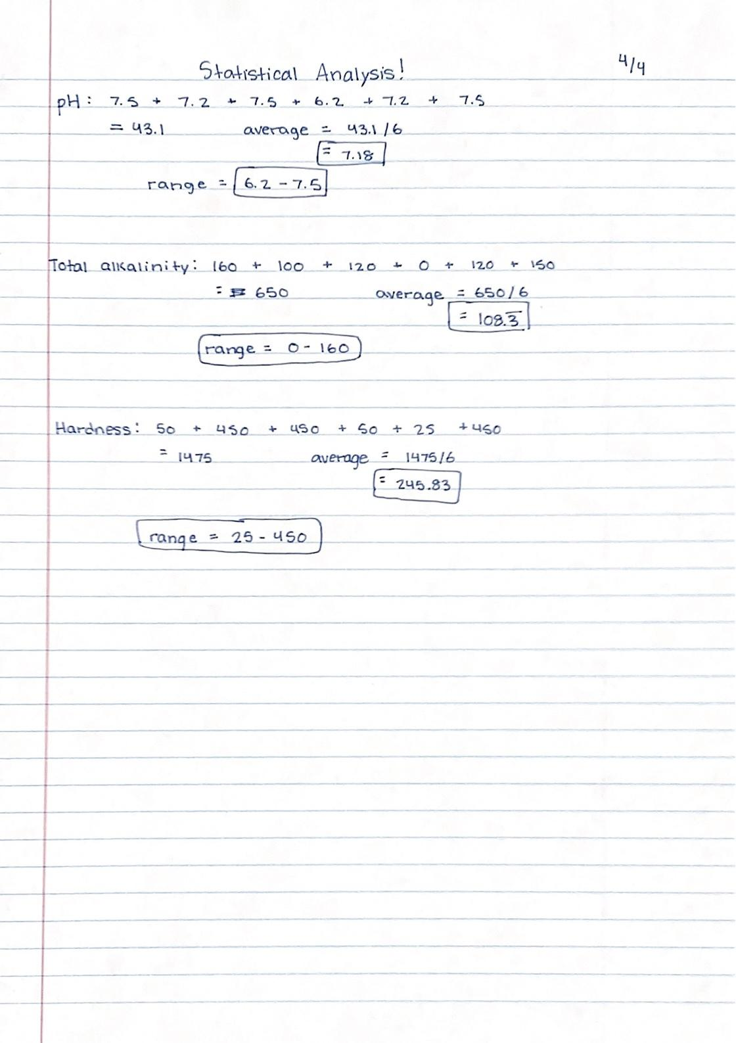
PROJECT LOG: PART 2

Slide 20
THANK YOU

