Slide 1
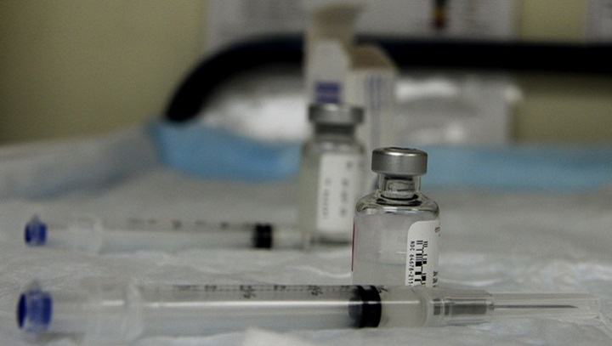
How vaccines stop the spread of deadly diseases
Sara King & Michelle Woodfine
Grade 12
Holy Trinity High
Torbay, Newfoundland

Slide 2
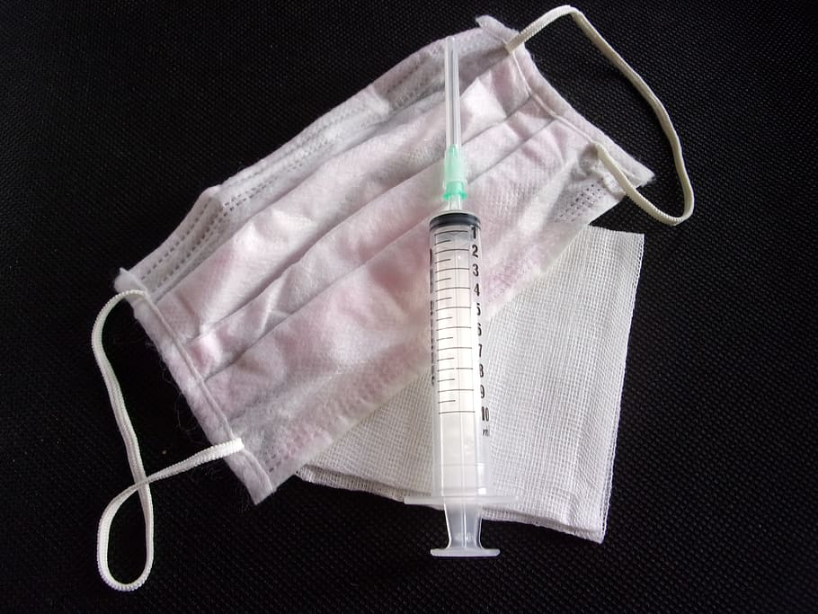
Purpose: To show how vaccines work to prevent viruses and disease.
Question(s): How do vaccines help prevent illnesses?
Hypothesis: Vaccines will help prevent the dangers and spread of dangerous diseases safely.

Slide 3
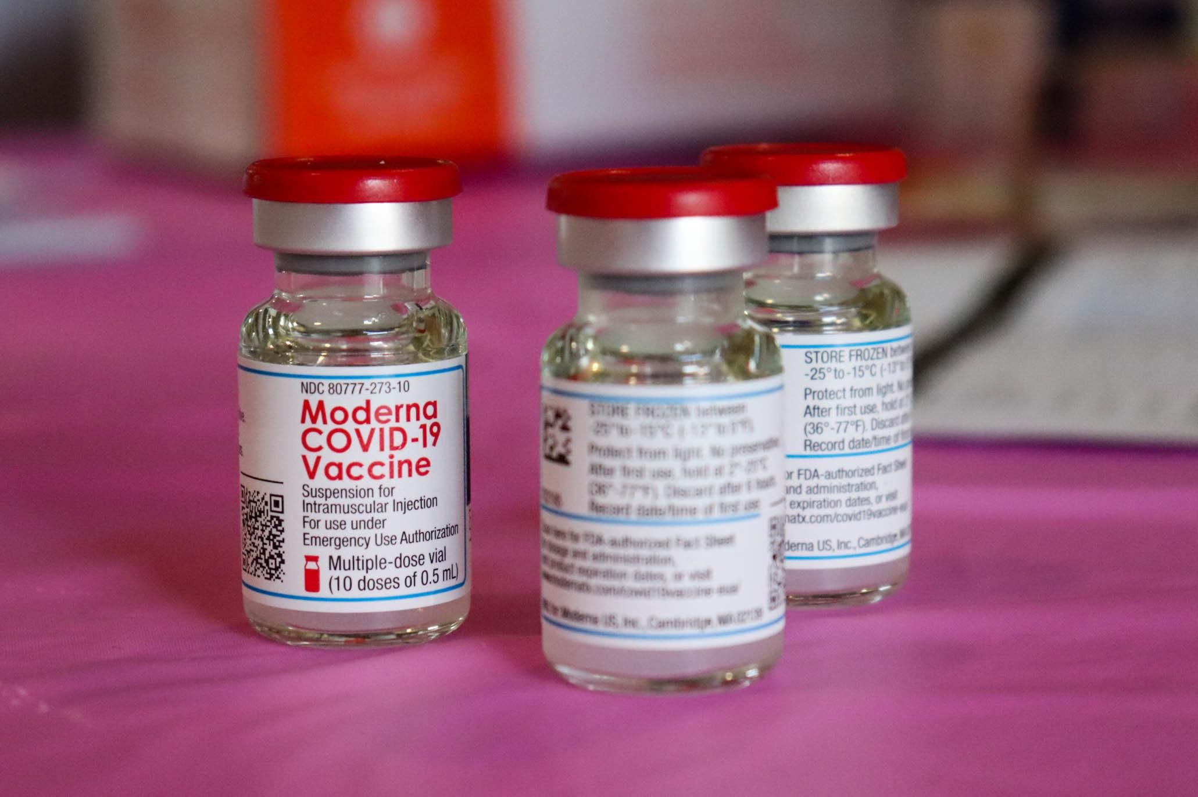
Independent variable: People who are vaccinated, people who are not vaccinated
Dependent variable: Do they get sick?
Controlled variables: Type of vaccines, populations, prior health issues

Slide 4
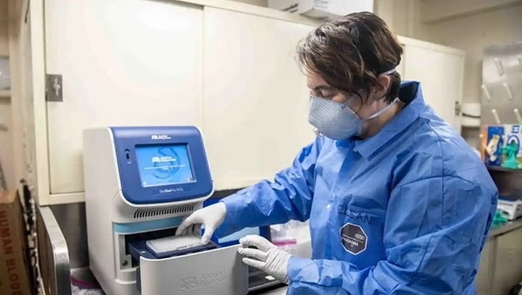
Materials:
VanderSlott, S. (2019 December.) Our World in Data: Vaccines. Retrieved from: https://ourworldindata.org/vaccination
Infographics: Vaccines Work. (2018 April.) Retrieved from: https://www.canada.ca/en/public-health/services/publications/healthy-living/vaccines-work-infographic.html
Benefits of Immunization: Canadian Immunization Guide. (2016 August.) Retrieved from: https://www.canada.ca/en/public-health/services/publications/healthy-living/canadian-immunization-guide-part-1-key-immunization-information/page-3-benefits-immunization.html
Elflein, J. (2020 March 26) Vaccines in Canada. Retrieved from: https://www.statista.com/topics/5216/vaccinations-in-canada/
WHO/UNICEF Immunization (2020 July)
https://data.unicef.org/topic/child-health/immunization/
Centers for Disease Control and Protection (2014 May 4) https://www.cdc.gov/vaccines/basics/test-approve.html

Slide 5
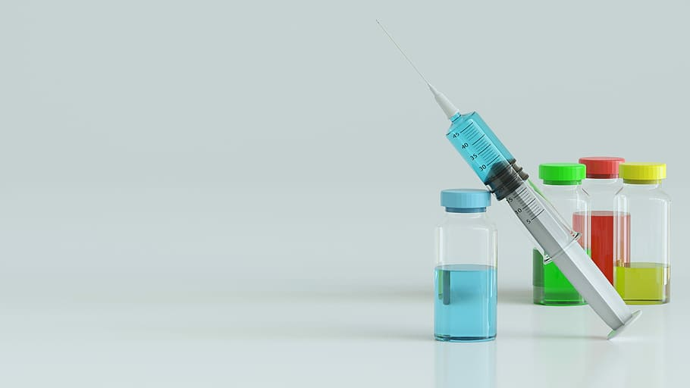
Procedure:
Steps for Vaccination production:
Exploratory Stage
Preclinical Stage
Clinical Development (Phase i- Small groups of people receive the vaccine. Phase ii- the clinical study is expanded and the vaccine is given to people who have characteristics (such as age and physical health) similar to those for whom the new vaccine is intended. Phase iii- the vaccine is given to thousands of people and tested for efficacy and safety.)
Regulatory review and approval
Manufacturing
Quality Control

Slide 6
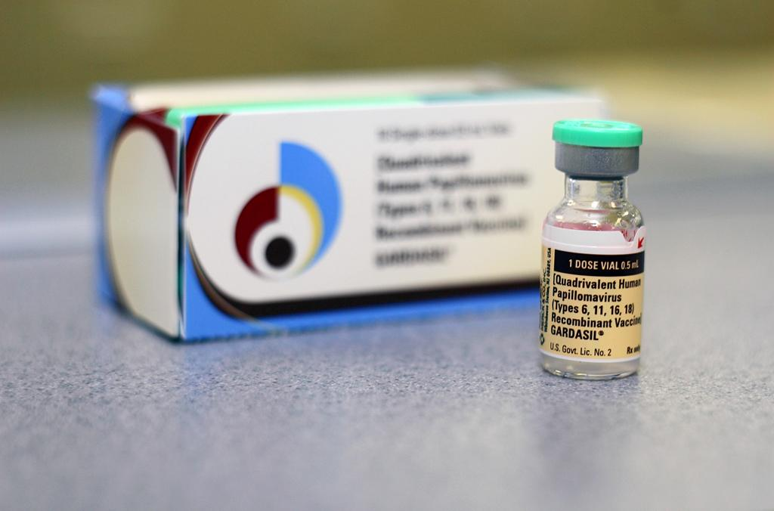
Diseases we studied:
The following vaccines that were researched were for the diseases; polio, tetanus, measles, and rubella. The data taken was from the years: 1987, 1997, 2007, and 2017. This led to the discovery of the following data.
In the beginning of the research, the rates of vaccines went up over the years until around the 2007 or 2017 bar, in which it started heading back down. This shows how the vaccines are effective at stopping the disease from spreading as less and less people vaccinate their children against certain illnesses.

Slide 7
Results:
1 year olds vaccinated against polio |  |  | 1 year olds vaccinated against tetanus |  |  | 1 year olds vaccinated against measles |  |  | 1 year olds vaccinated against rubella
Group A |  |  | Group A |  |  | Group A
1987 | 86% |  | 1987 | 85% |  | 1987 | 70% |  | 1987 | 70%
Group B |  |  | Group B |  |  | Group B
1997 | 88% |  | 1997 | 86% |  | 1997 | 96% |  | 1997 | 96%
Group C |  |  | Group C |  |  | Group C
2007 | 99% |  | 2007 | 94% |  | 2007 | 94% |  | 2007 | 94%
Group D |  |  | Group D |  |  | Group D
2017 | 91% |  | 2017 | 91% |  | 2017 | 90% |  | 2017 | 90%

Slide 8
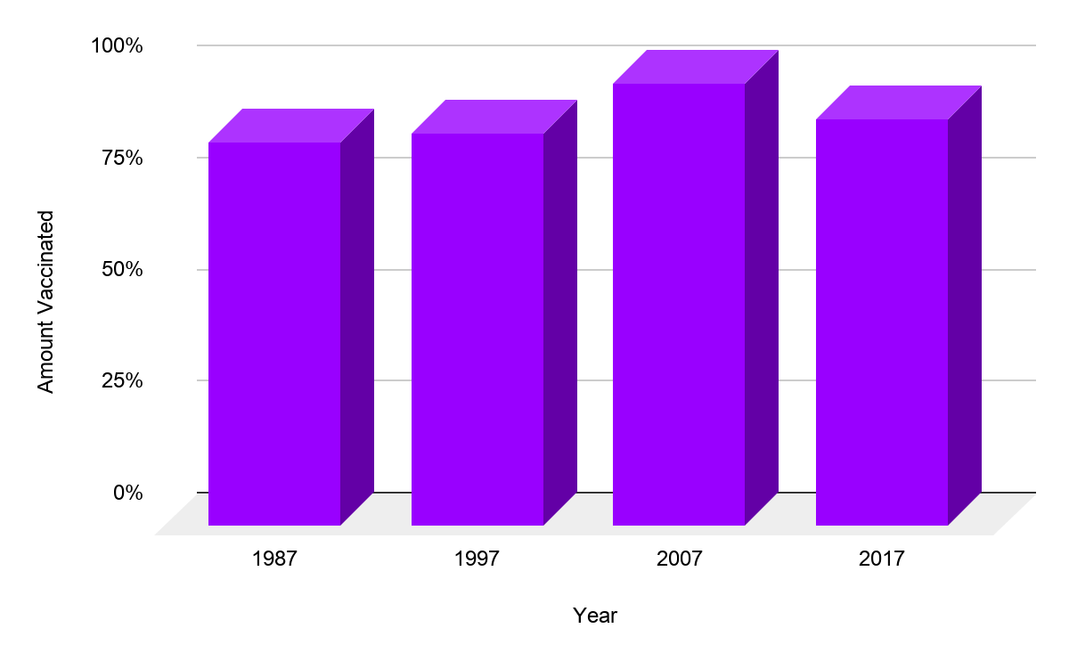
Results Continued:
Table 2: 1 year olds vaccinated against Polio statistics
Table 2 represents the data from figure 1 : One year olds vaccinated against polio
Average | 0.91
Median | 0.895
Range | 0.13
Standard Dev | 0.05715476066
Figure 1: One year olds vaccinated against Polio

Slide 9
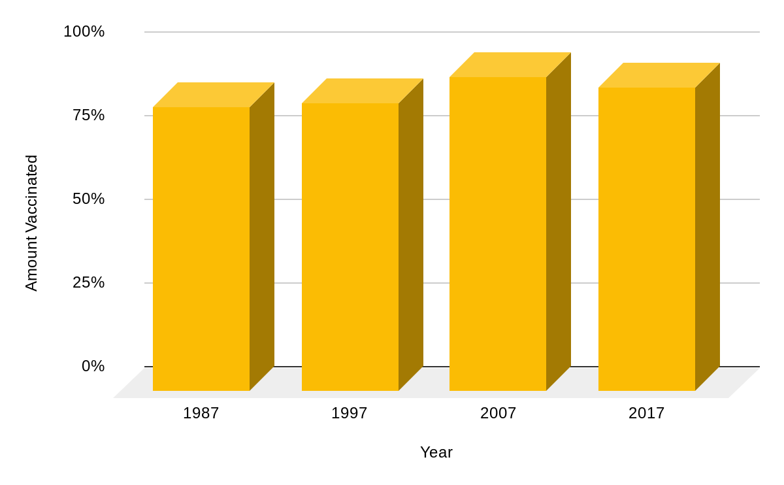
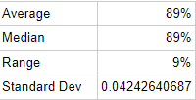
Results Continued:
Table 3: 1 year olds vaccinated against tetanus statistics
Table 3 represents the data from figure 2: one year olds vaccinated against tetanus
Figure 2: One year olds vaccinated against tetanus

Slide 10
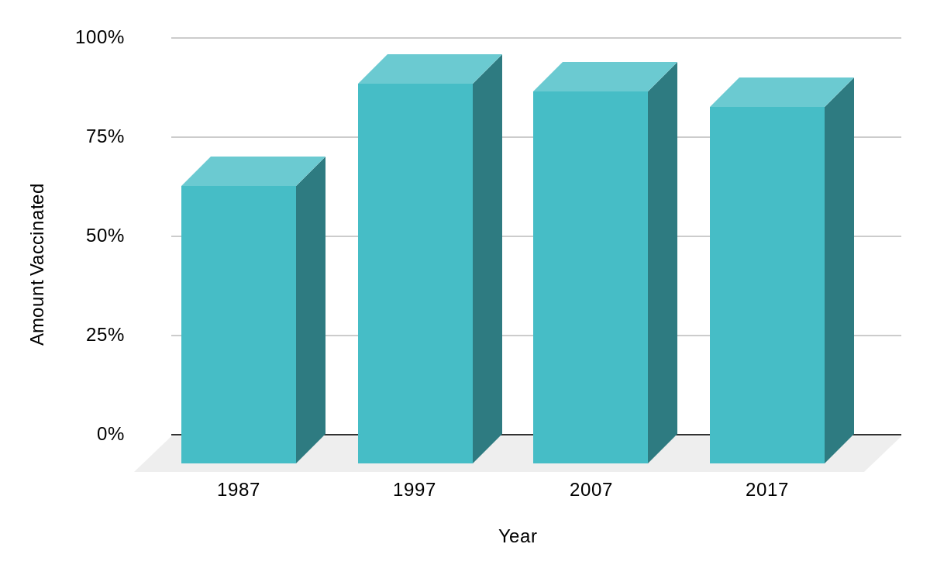
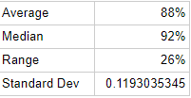
Results Continued:
Table 4: 1 year olds vaccinated against measles statistics
Table 4 represents the data from figure 3: one year olds vaccinated against measles
Figure 3: One year olds vaccinated against measles

Slide 11
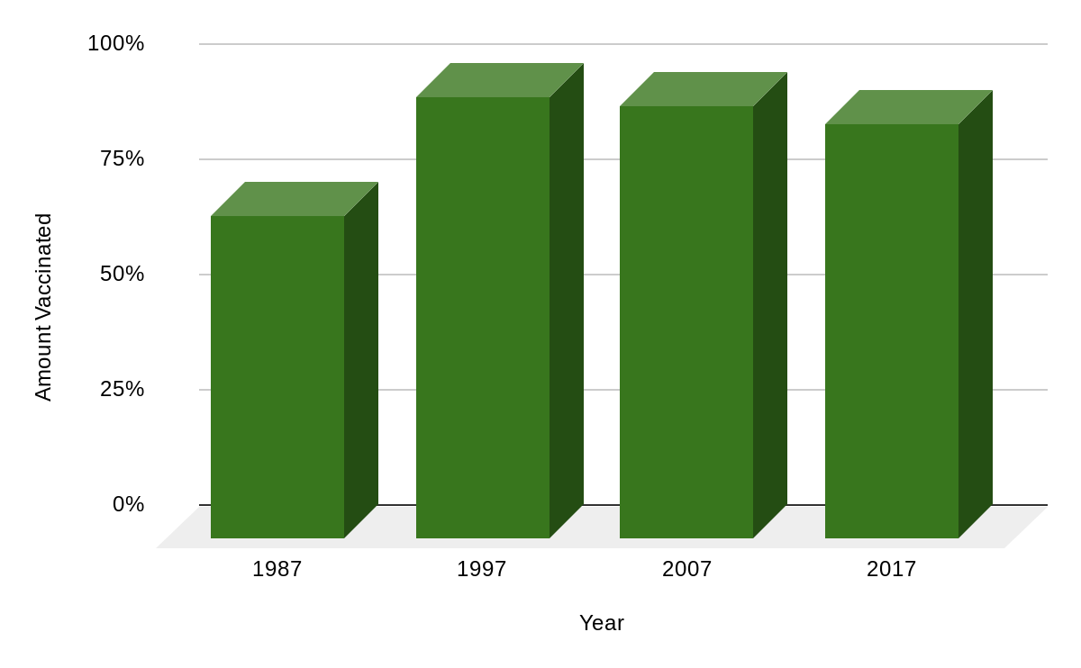

Results Continued:
Table 5: One year olds vaccinated against rubella statistics
Table 5 represents the data from figure 4:One year olds vaccinated against rubella.
Figure 4: One year olds vaccinated against rubella

Slide 12
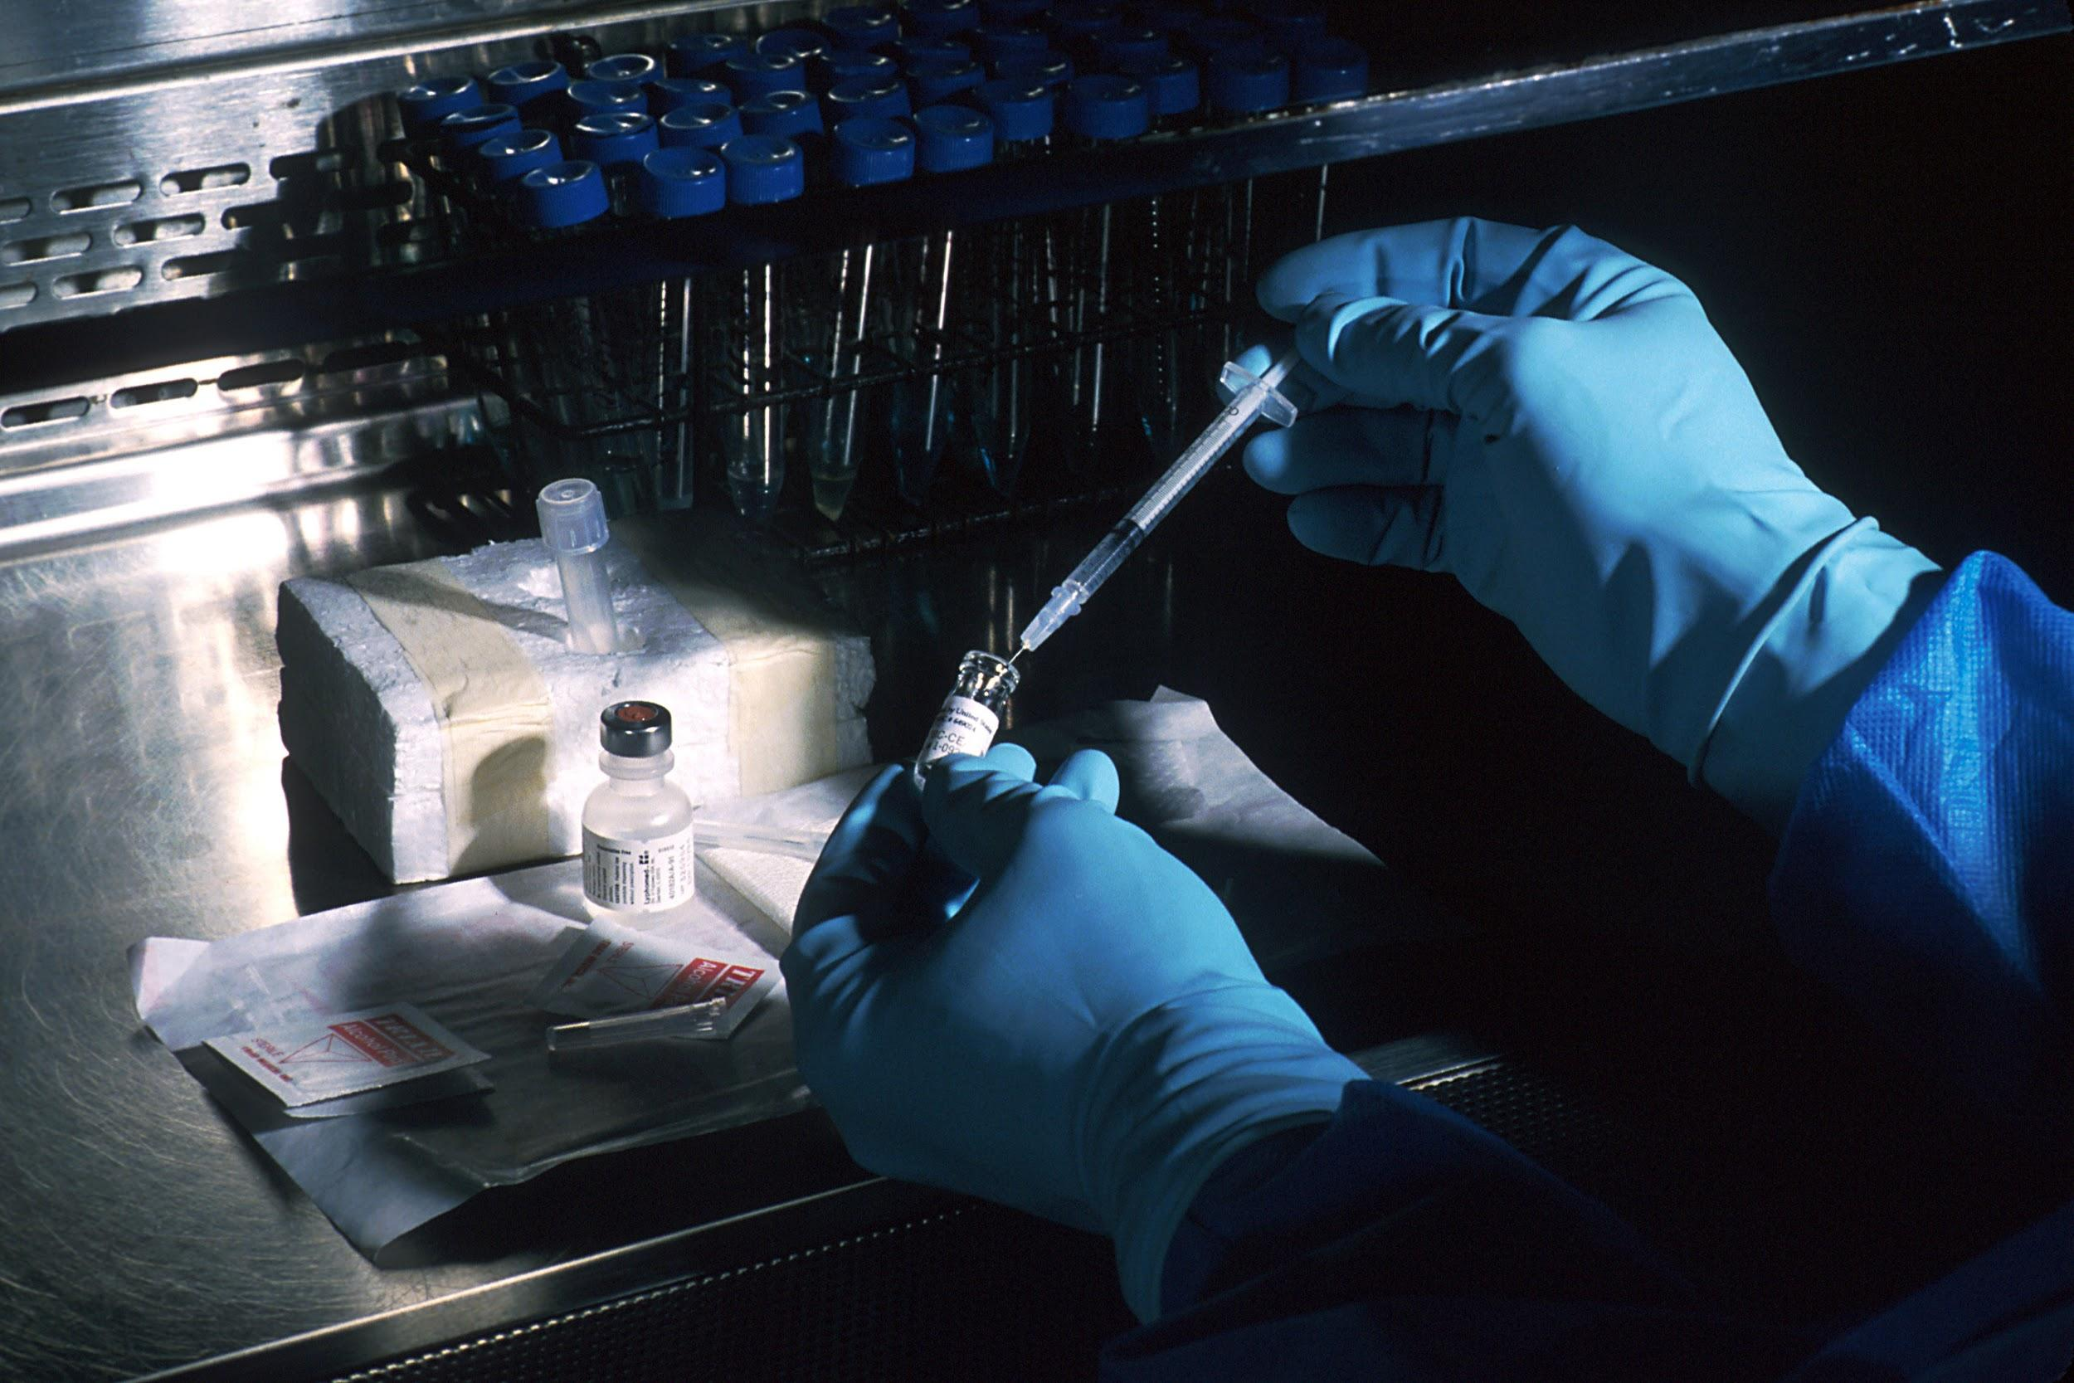
Discussion:
The project was started with the question, ¨How do vaccines help prevent illnesses?¨. This question had opened up the hypothesis that was that vaccines will help prevent the dangers and the spread of dangerous diseases. This hypothesis led into the research project presented.
With all the graphs above, it has been shown that increased vaccines rates and decreased illness rates go hand in hand. This data is due to the vaccine increasing immunity to the said illness. It is also due to the fact that with more people getting the vaccine for said disease, and boosting immunity, those who can’t get the vaccine are now protected by herd immunity. The data that this research has shown also proves that vaccines have a very high success rate in properly protecting the population from said diseases. These trends help answer the original question and support the original hypothesis.
Things that were learned during the research project was that the hypothesis was correct. The project was started with the question, ¨How do vaccines help prevent illnesses?¨. This question had opened up the hypothesis that was that vaccines will help prevent the dangers and the spread of dangerous diseases.

Slide 13
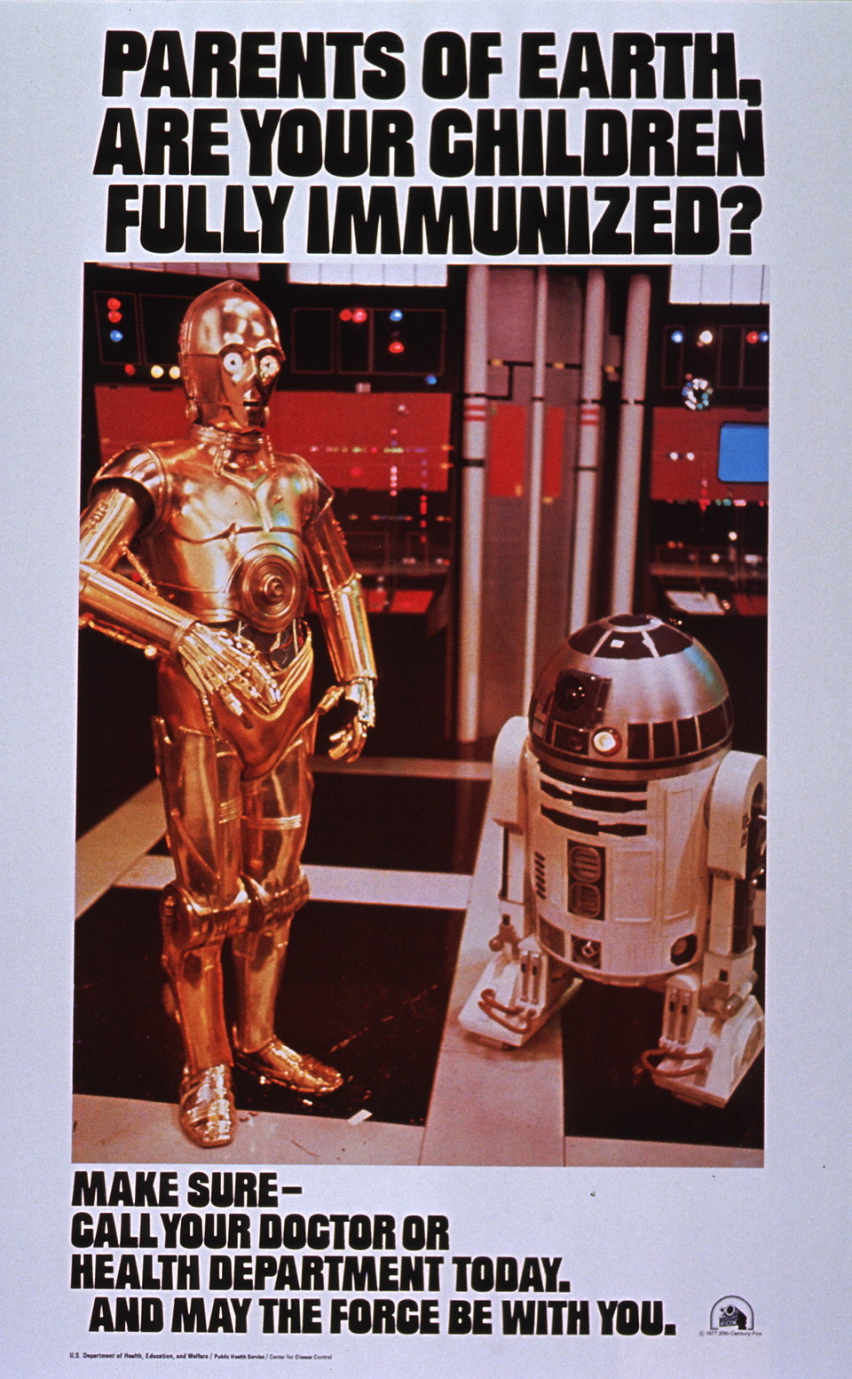
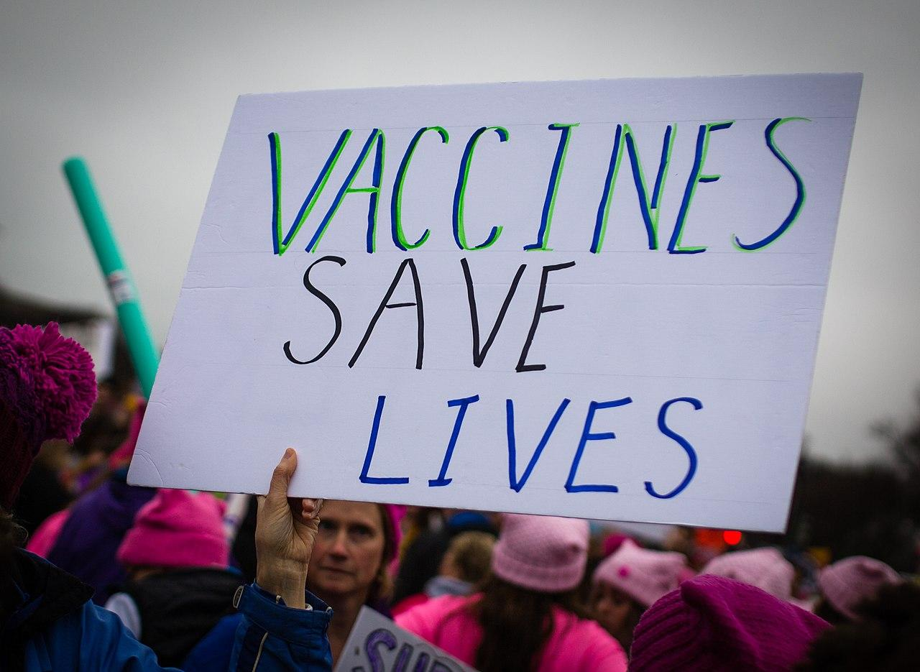
Sources of Error:
Difficulties within this research project would have been collecting realistic and relevant data to explain whether or not the hypothesis is true. With so much controversy about vaccines online and with the medical community, there are questionable findings and research projects. Sifting through non-professional and weak research can be challenging. Incorrect medical research could have been a source of error.

Slide 14
Conclusion:
The data that this experiment and research has collected strongly supports the original hypothesis, being that vaccines will help prevent the dangers and spread of dangerous diseases.

Slide 15
Acknowledgments:
Thanks to Mrs. Kavanagh for helping us stay on track and improving on our science fair.

