Slide 1

The Physics Behind Baseball
Nicholas Smith 2021

Slide 2
Abstract
The Physics behind the game. Every play in every inning of every game there's physics affecting all aspects of baseball. In 2020, technology has advanced to where we collect an average of 7 TB of data from every Major League Baseball “(MLB)” game. In the game of baseball, which has been around since 1839, understanding the physics behind each play allows us to gain an advantage in the ever evolving game. The data collected can give organizations, teams, and players an advantage in both offence and defensive aspects of today’s game.

Slide 3
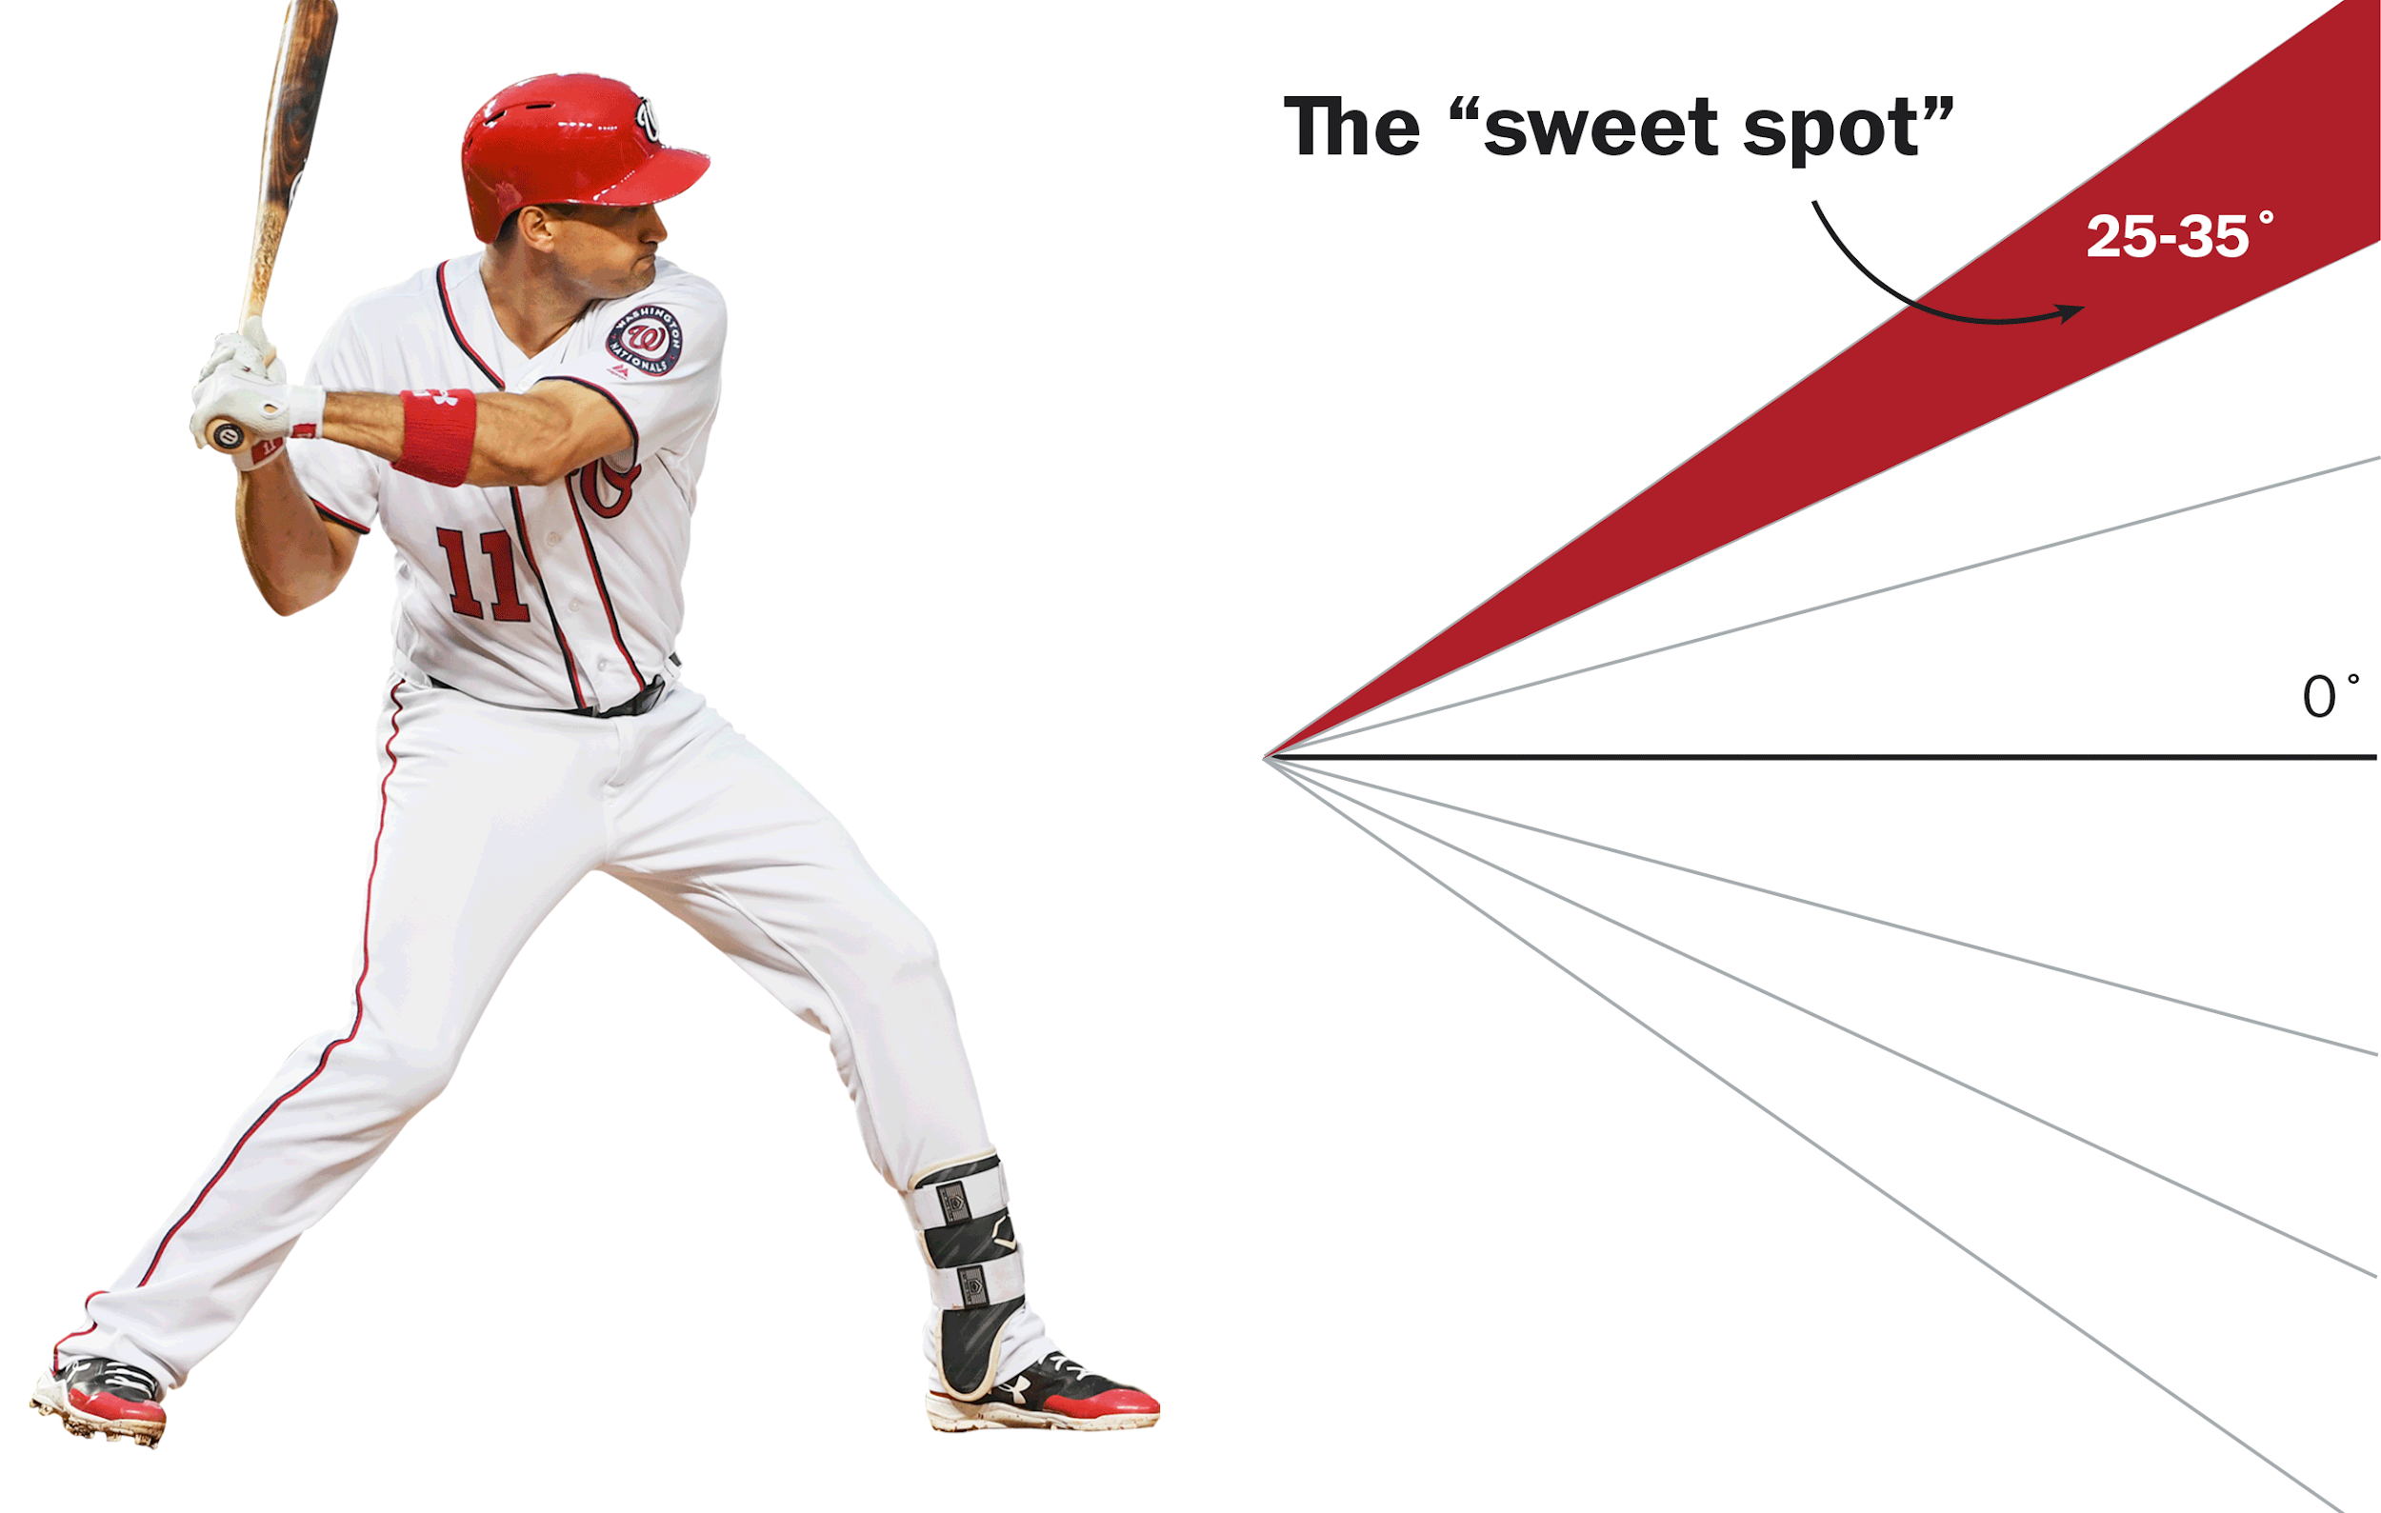
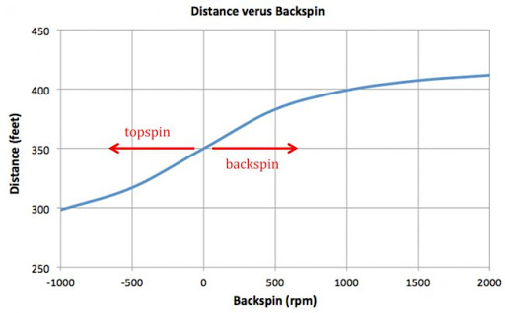
How Does Launch Angle Affect Home Runs?
The optimal launch angle for a home run on a hard hit ball is between 25°and 35°
Hitters attempt to induce backspin on the baseball
Pressure differential created by the backspin,
Low pressure on the top side of the ball and high pressure on the bottom
Resulting in a slight upward force on the ball, example of the magnus effect

Slide 4
The Magnus Effect On The Baseball (Pitching)
The Magnus effect is when a spinning sphere affects the air pressure around it
Every pitch thrown in the game uses the spin of the ball to create a force towards the side which has the lowest pressure
The seams on the baseball create drag, this exaggerates the potential movement of the ball
All pitchers have attempted to manipulate and understand the physics involved in pitching the baseball, which could give their team an advantage while playing the game.

Slide 5
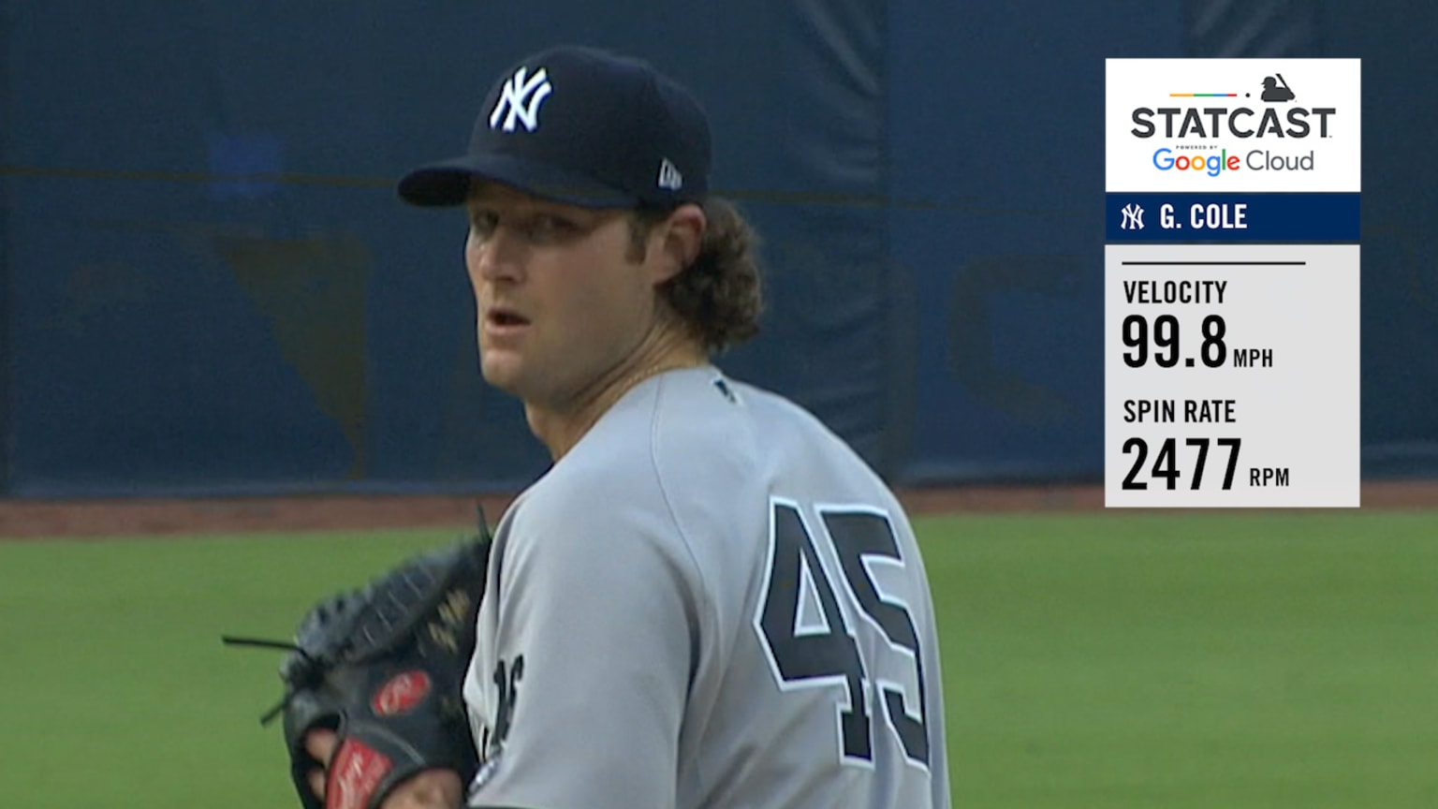

Pitching advantage from knowledge of physics
Pitchers could look into a pitches spin rate to help develop it and make game day decisions on the usage of the pitch in the upcoming game
Knowledge may also help pick up on certain injuries before they get too serious, ie. shoulder and or elbow injuries

Slide 6
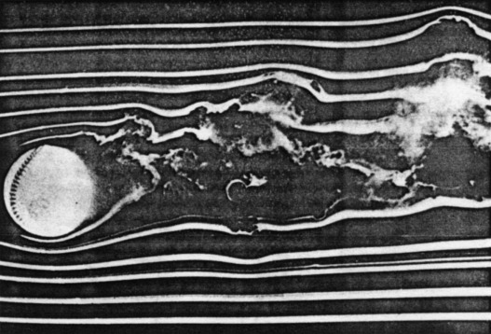

The Unpredictable Flight Path of a Knuckleball
The knuckleball causes a kármán Vortex Street- which is a string of vortices trailing alternating sides of the ball. The effect is the ball wobbles from side to side and its flight becomes impossible to predict.
Baseball With Spin
Baseball Without Spin

Slide 7
How Baseball Related Physics Is Collected In Major League Baseball Games
The system features the use of sensors from Hawk-Eye Innovations and online resources provided by Google Cloud
The Hawk-Eye optical sensors are positioned in 12 locations throughout the ballpark (baseball stadium). Five of the cameras which are designated for pitch tracking, normally operate at 100 frames per second. The other seven cameras are used for tracking batted balls and players; these cameras operate at 50 frames per second.
Replaced the Trackman Chyronhego system

Slide 8
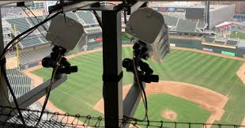
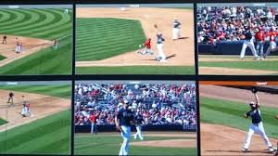
Optical Sensors Throughout The Baseball Stadium
The Hawk-Eye technology collects baseball related data such as: Arm Strength, Base-to-base Time, Distance Covered, Extension, Exit Velocity, Launch Angle, Lead Distance, Pitch Velocity, Pop Time, Spin Rate. Metrics include: Barrels, Catch Probability, Expected Batting Average (xBA), Expected Weighted On-base Average (xwOBA), Outs Above Average (OAA), Sprint Speed

Slide 9
Fun Facts on Hawk-Eye
Hawk-Eye is best known for its use in professional tennis matches since 2006
Hawk-Eye's optical tracking system and vision-processing technology enable live
ball and player tracking to +/- 0.1 inch accuracy with full-field coverage
The tennis system reportedly costs upwards of $60,000, the system used in Major League Baseball most likely costs much more

Slide 10
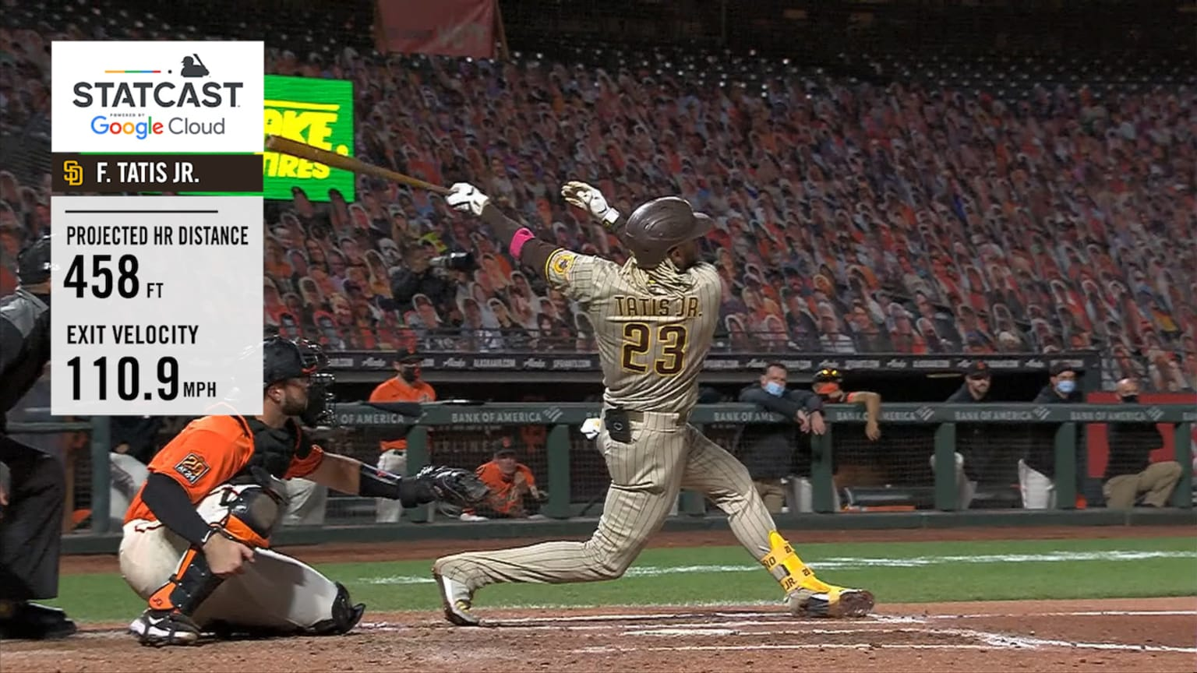
Statcast In Major League Baseball Games
Statcast In Major League Baseball Video Link
Statcast Data

Slide 11

Catching Advantage From Physics Knowledge
This is me in a training session with my catching coach!
Even if they know it or not, catchers have a high knowledge of physics especially projectile motion. We use this knowledge to predict the eventual location of the pitch so we can position ourselves in a better location to help ‘steal strikes’- make a ball look like a strike to the umpire, this helps our team win games one pitch at a time.

Slide 12
References
Baseball. (n.d.). Hawk-Eye. Retrieved January 10, 2021, from https://www.hawkeyeinnovations.com/sports/baseball
Launch Angle (LA). (n.d.). MLB. Retrieved January 10, 2021, from http://m.mlb.com/glossary/statcast/launch-angle#:~:text=Launch%20Angle%20represents%20the%20vertical,by%20all%20Batted%20Ball%20Events
MLB. (2019, July 8). 2019 Home Run Derby [Dataset]. Baseball Savant. https://baseballsavant.mlb.com/hr_derby
Statcast. (n.d.). MLB. Retrieved January 10, 2021, from http://m.mlb.com/glossary/statcast

Slide 13
References
Who Invented Baseball? (2019, March 28). Who Invented Baseball? https://www.google.com/amp/s/www.history.com/.amp/news/who-invented-baseball
Why MLB hitters are suddenly obsessed with launch angles. (n.d.). Retrieved February 04, 2021, from
https://www.washingtonpost.com/graphics/sports/mlb-launch-angles-story/
Hard-hit rate: Glossary. (n.d.). Retrieved February 20, 2021, from
https://www.mlb.com/glossary/statcast/hard-hit-rate#:~:text=Statcast%20defines%20a%20'hard%2Dhit,at%2095%20mph%20or%20more.

Slide 14
References
Panel, A., & Publisher Summary This chapter focuses on a boundary-layer hypothesis and examines its consequences. The equations of fluid motion within the boundary layer can be simplified because of the layer's thinness. (2012, February 29). Boundary layers and related topics. Retrieved March 1, 2021, from
https://www.sciencedirect.com/science/article/pii/B9780123821003100095
(n.d.). Retrieved from
https://commons.wikimedia.org/wiki/File:Karmansche_Wirbelstr_gro%C3%9Fe_Re

Slide 15
References
Baseball savant: Trending MLB Players, Statcast and visualizations. (n.d.). Retrieved March 04, 2021, from
https://baseballsavant.mlb.com/
Baseball video Search: MLB FILM ROOM. (n.d.). Retrieved March 04, 2021, from https://www.mlb.com/video/search
Baseball video Search: MLB FILM ROOM. (n.d.). Retrieved March 04, 2021, from
https://www.mlb.com/video/search

