Slide 1
Determining How Dissolving Chemicals in Water Changes the Freezing Point of a Solution
The purpose of this experiment is to determine how dramatic the freezing point of water will change when mixed with chemicals.
By Kate Gillingham and Joseph Mahon

Slide 2

Will adding more and more chemicals to the same amount of water change the freezing point?

Slide 3
Hypothesis
Background information
It is known that the reason you can make ice cream (because of how cold it needs to be) is because of the ice and salt solution rather than just ice.
The more chemicals used in the mixture will make the liquid crystalize faster causing a lower freezing point.

Slide 4
The Experiment

Slide 5
Variables
Independent | Dependent | Controlled
Salt and sugar | Freezing Point | Amount of product

Slide 6
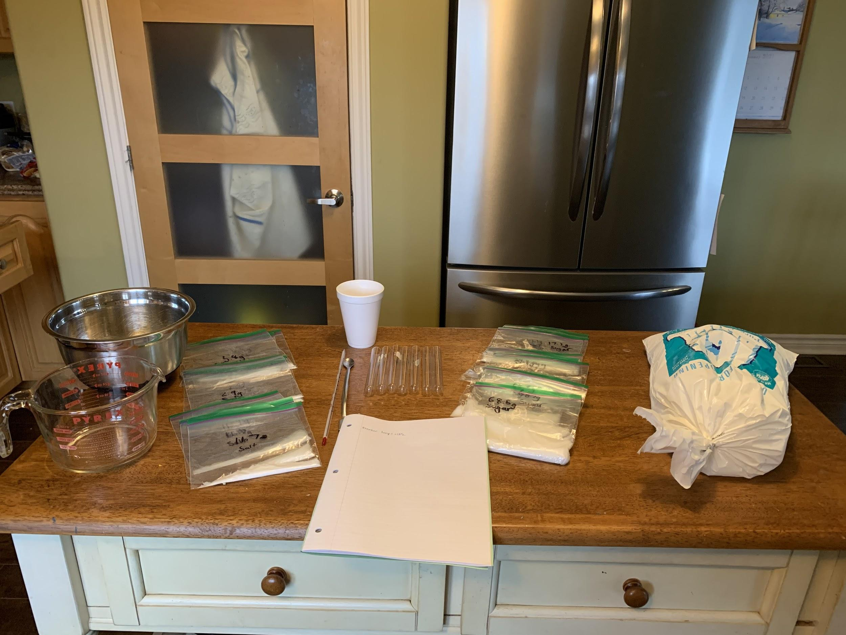
Materials
Water
Ice
Permanent marker
Table or sea salt (sodium chloride, NaCl, 500g or 18oz)
Granulated sugar (sucrose, 360g or 13oz)
Small spoon or scoop
Lab notebook
Test tubes(7)
glasses/cups (6)
1000ml measuring cup
Gram balance, accurate to 0.1 grams (used in the lab)
Thermometer, minimum range −10°C
Stir rods
Large Styrofoam cup (12 ounces)
Large bowl
Syringe
Figure 1: Image of setup

Slide 7
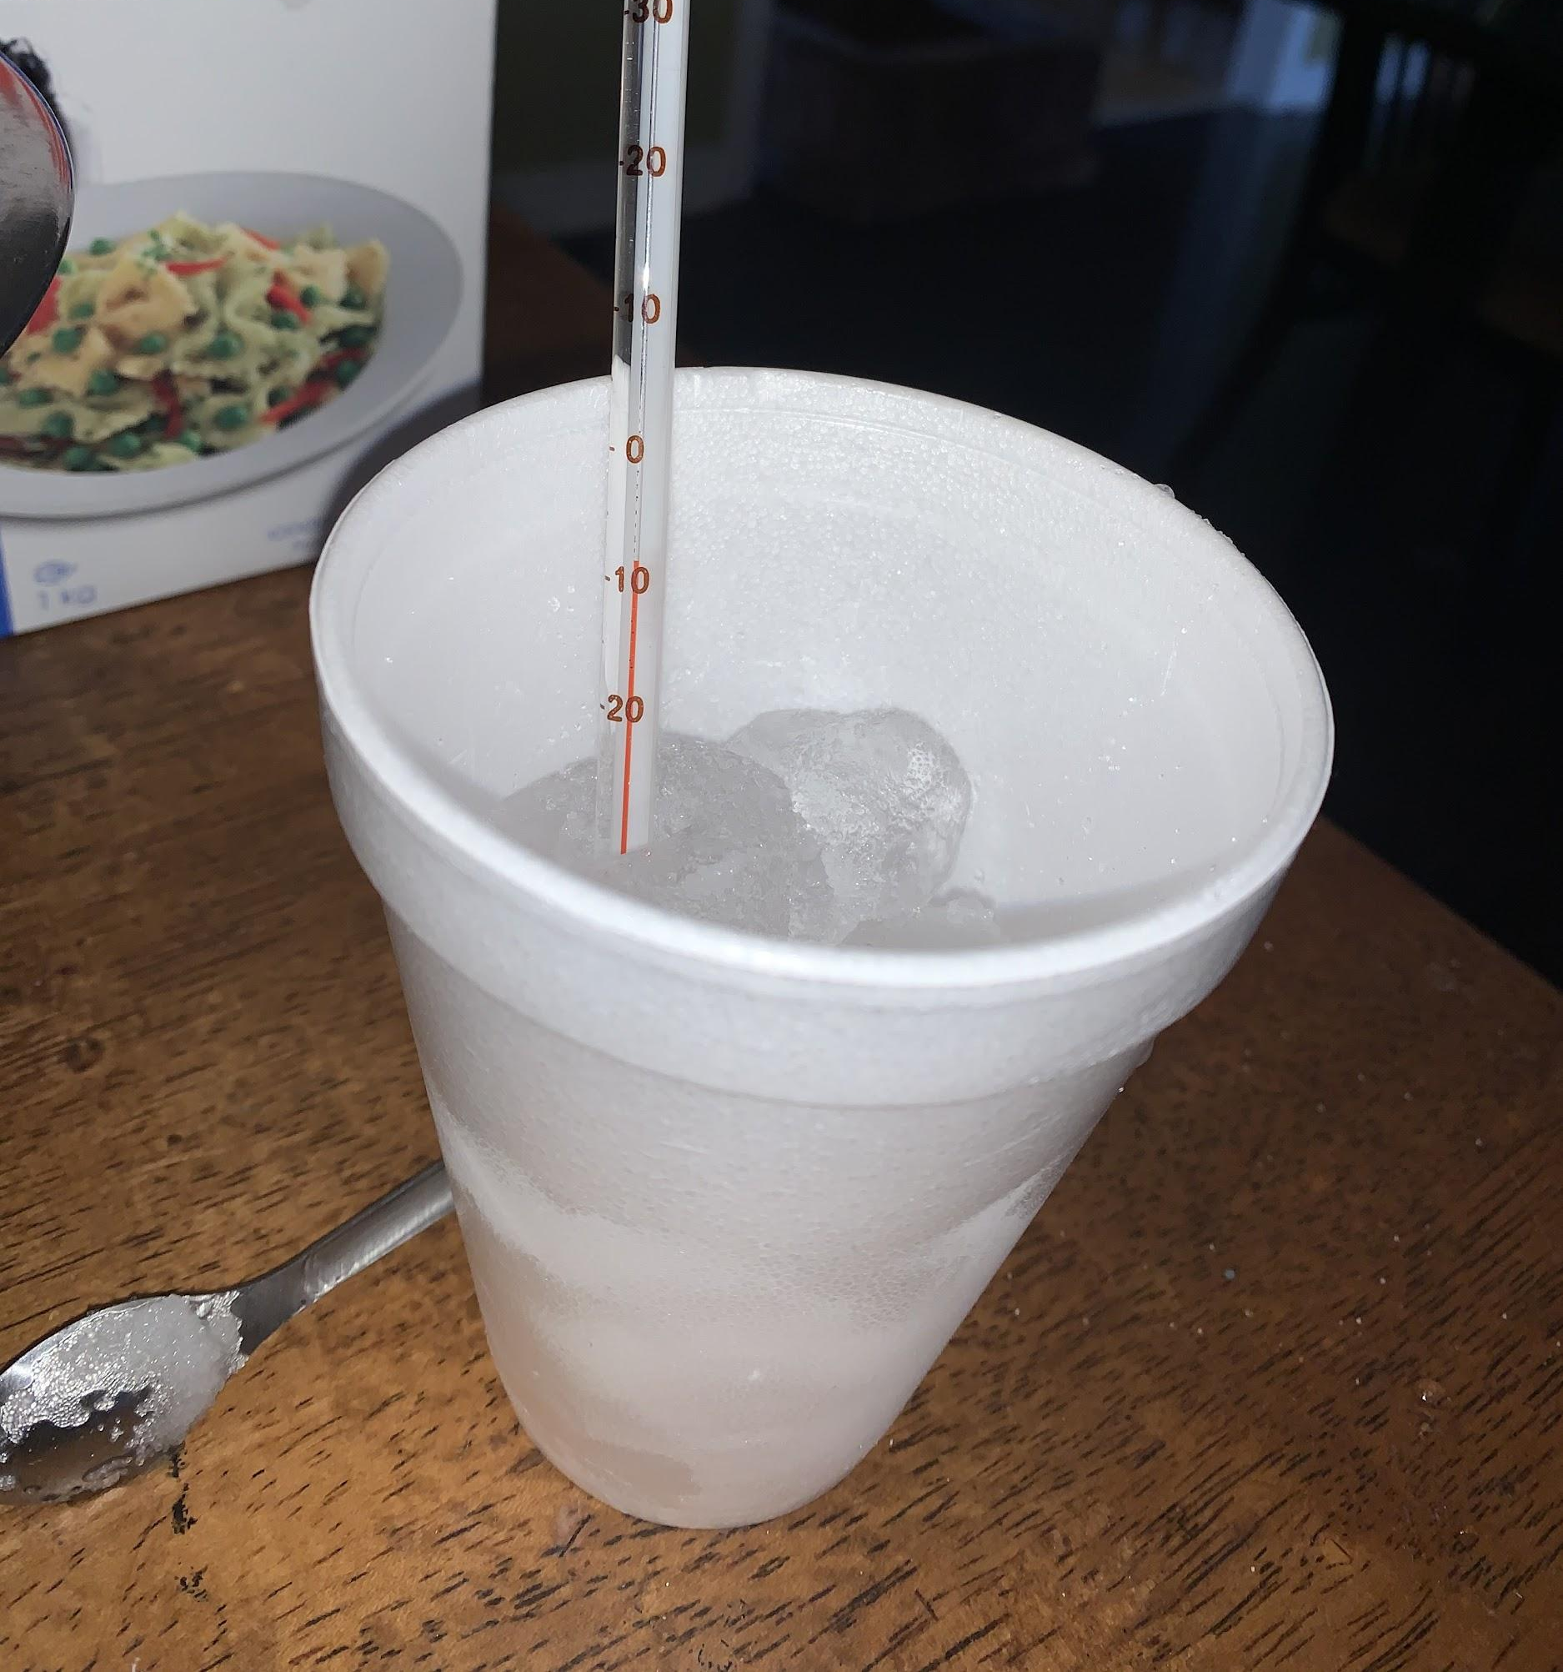
Procedure
Prepare the ice bath
Fill the Styrofoam cup ¾ full with ice and cover the ice with ¼–½ inches of table or sea salt.
Stir this ice-salt mixture with a spoon or stirring rod.
Use the thermometer to check the temperature of the ice-salt mixture. It should be close to −10°C.
Use this ice bath to freeze several test liquids. One may need to add ice and take away the melted ice as the ice bath needs to constantly be at −10°C.
Also---Check the temperature of the ice bath before freezing each of your test liquids.
Always carefully rinse and dry the thermometer before using it to measure the freezing point of your test liquids.
Figure 2: The ice bath

Slide 8
Procedure
Determining the freezing point of the liquids
All together one would be measuring the freezing point of seven different test liquids: three salt solutions, three sucrose (sugar) solutions, and a pure water control. The pure water control is important for determining the freezing point of the water in the experiment, which may or may not be exactly 0°C.

Slide 9
Continued:
Use a permanent marker to label one of the test tubes and one of the 250 mL beakers as "#1". (One may use paper instead and lay the test tubes by their corresponding piece
Prepare your first test liquid in the beaker labeled #1. (One may also use paper and lay their glasses next to their right number)
Use the digital scale to weigh 2.9 g of table or sea salt (NaCl) into the beaker.
Measure 100 mL of water in a graduated cylinder, and pour it into the beaker with the salt. Stir with a stirring rod until all of the crystals are dissolved.
Rinse the stirring rod with water. Do not want to contaminate the other test liquids.
Fill test tube #1 one-third full with test liquid #1. Place the test tube in the Styrofoam cup with the ice and salt.
The liquid in the test tube should be below the level of the ice and salt in the cup.
Do not allow any ice or salt from the cup to get into the test tube.

Slide 10
Continued:
7. Stir the test liquid in the test tube gently with a thermometer while keeping track of the temperature.
8. Check the test tube frequently during the first 5 minutes for appearing crystals, then go on to check every minute after that for at least 45 minutes. When the first ice crystals appear on the inside wall of the test tube, record the temperature in a lab notebook. This is the freezing point of the test liquid.
9. Melt the ice again by rolling the test tube in hands and empty the contents of the test tube down the drain. Next, refill the same test tube with fresh test liquid #1. Repeat steps 4–8 with a fresh sample. Then empty and refill the test tube again, repeating steps 4–8 for a third time. One should have a total of three tests for solution #1, all carried out in the same test tube.
10. Repeat steps a,b and 1-9 for each of the remaining test liquids, making sure to use a different beaker and test tube for each of the test liquids. Do not want the residue from one test liquid to contaminate the other test liquids. Make sure to label the beakers so that you know which test liquid is in which beaker.
11. After everything has been complete, clean up and put together the information one has collected in your lab notebook.

Slide 11
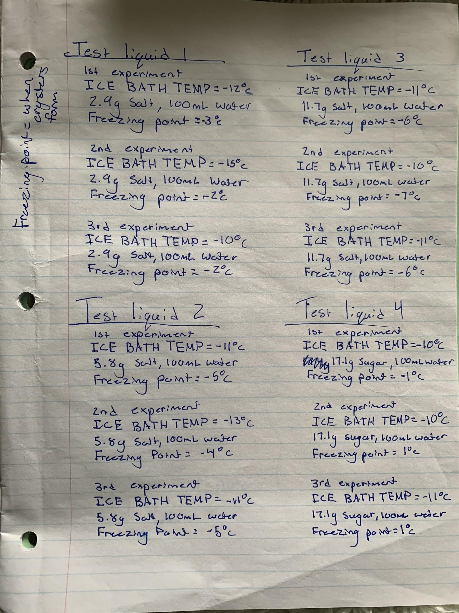
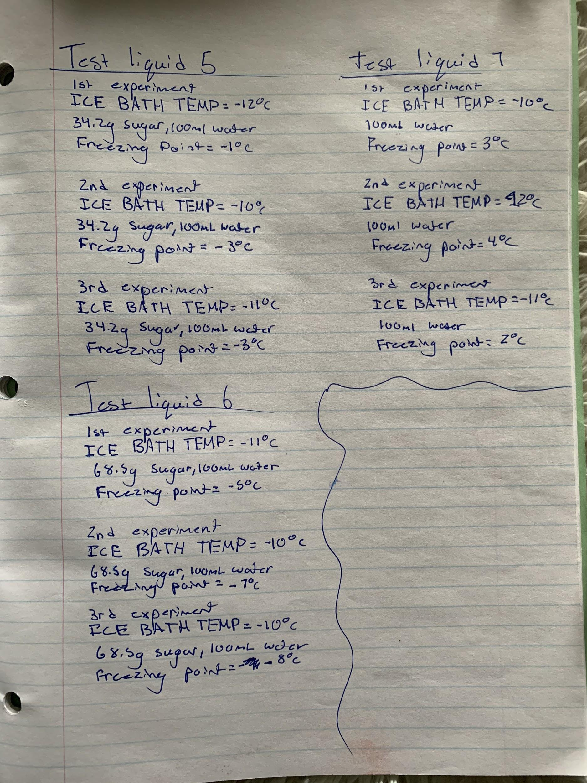
Notes from the lab

Slide 12
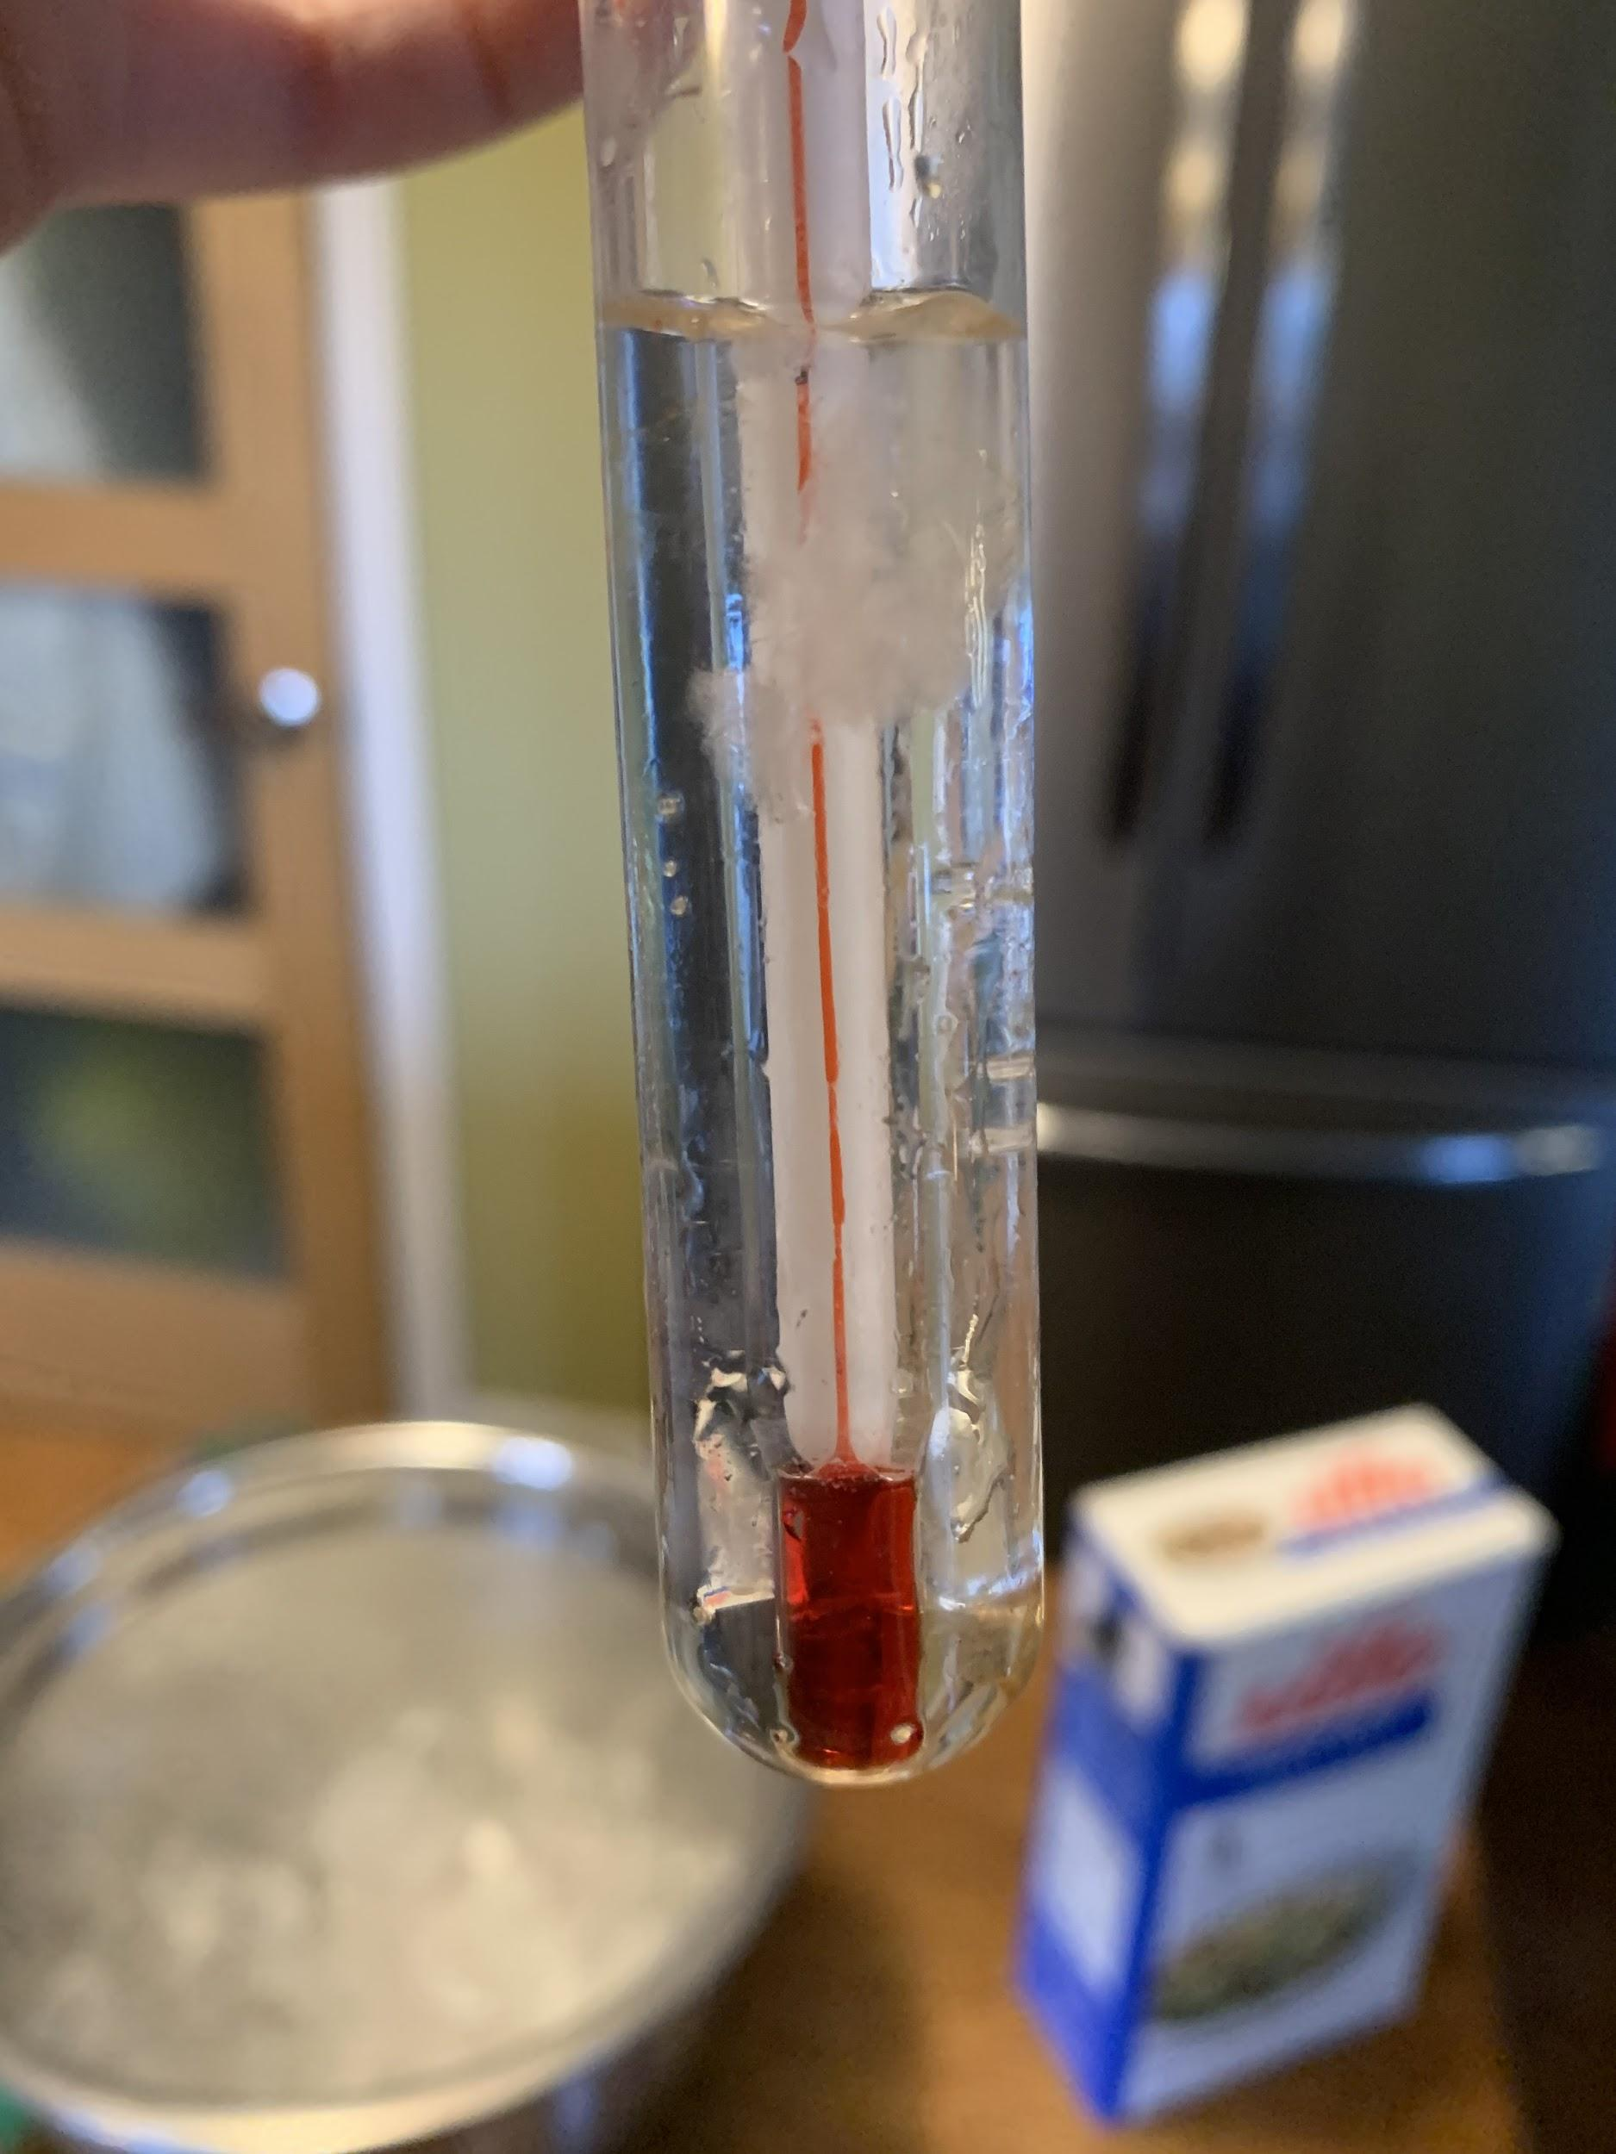
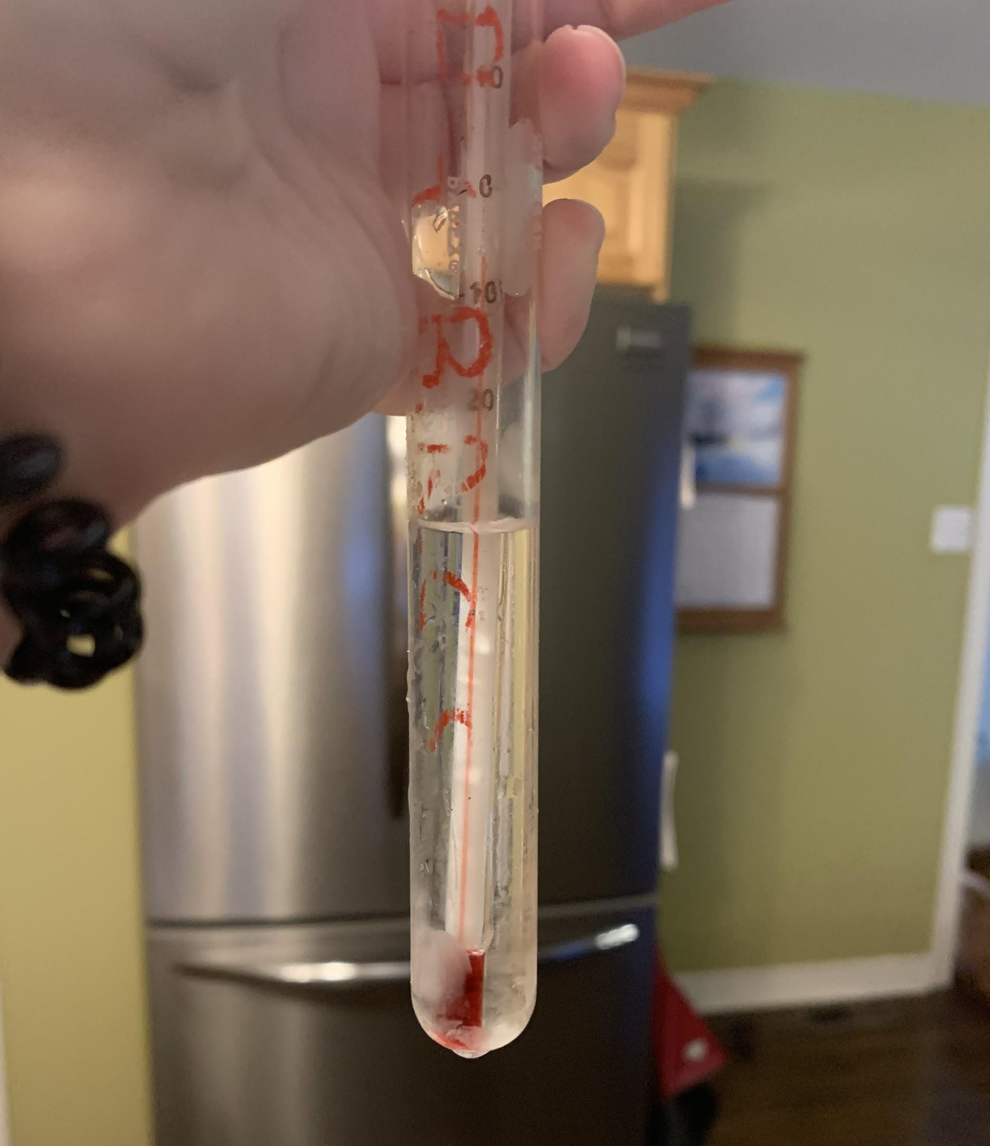
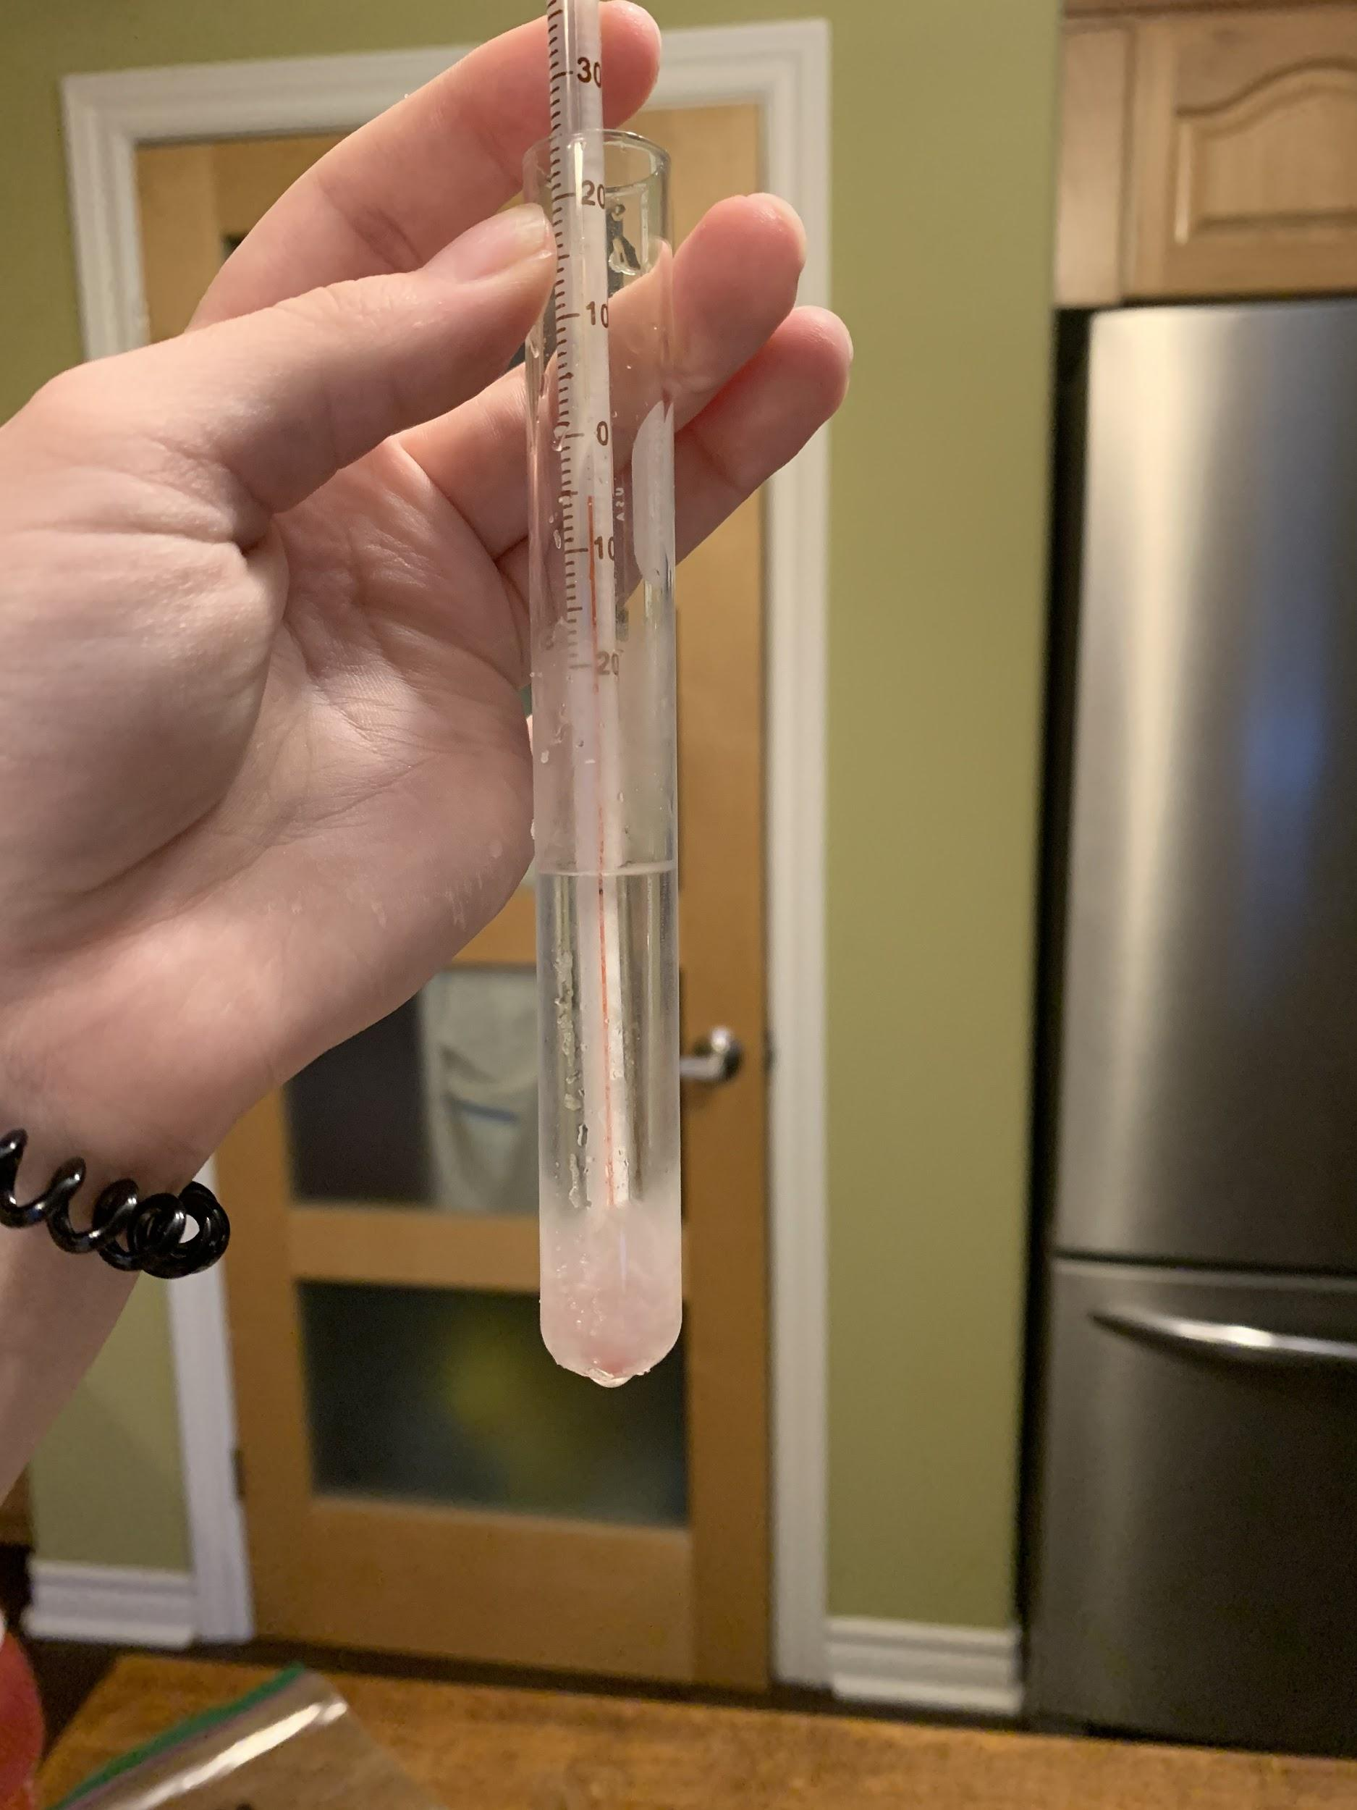
Figure 3: Test liquid 1 at it's freezing point
Figure 5: Test liquid 3 at it's freezing point
Figure 4: Test liquid 2 at it's freezing point
The experiment

Slide 13
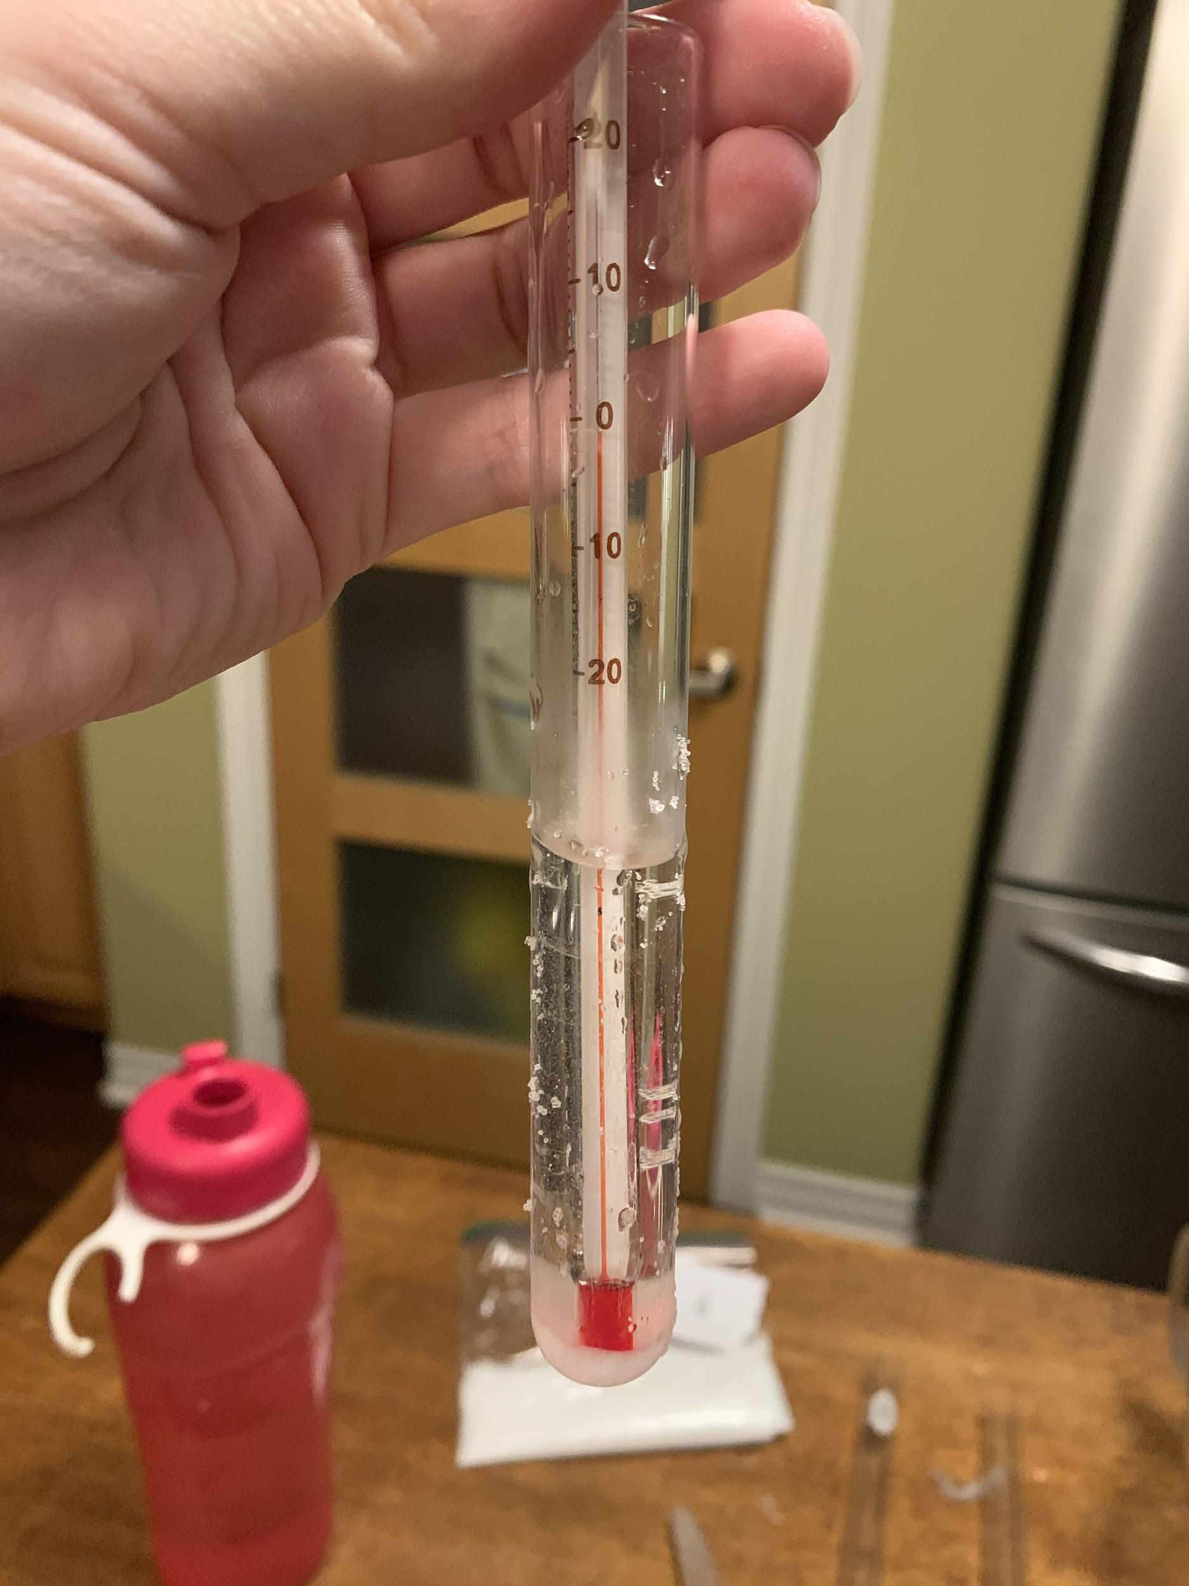
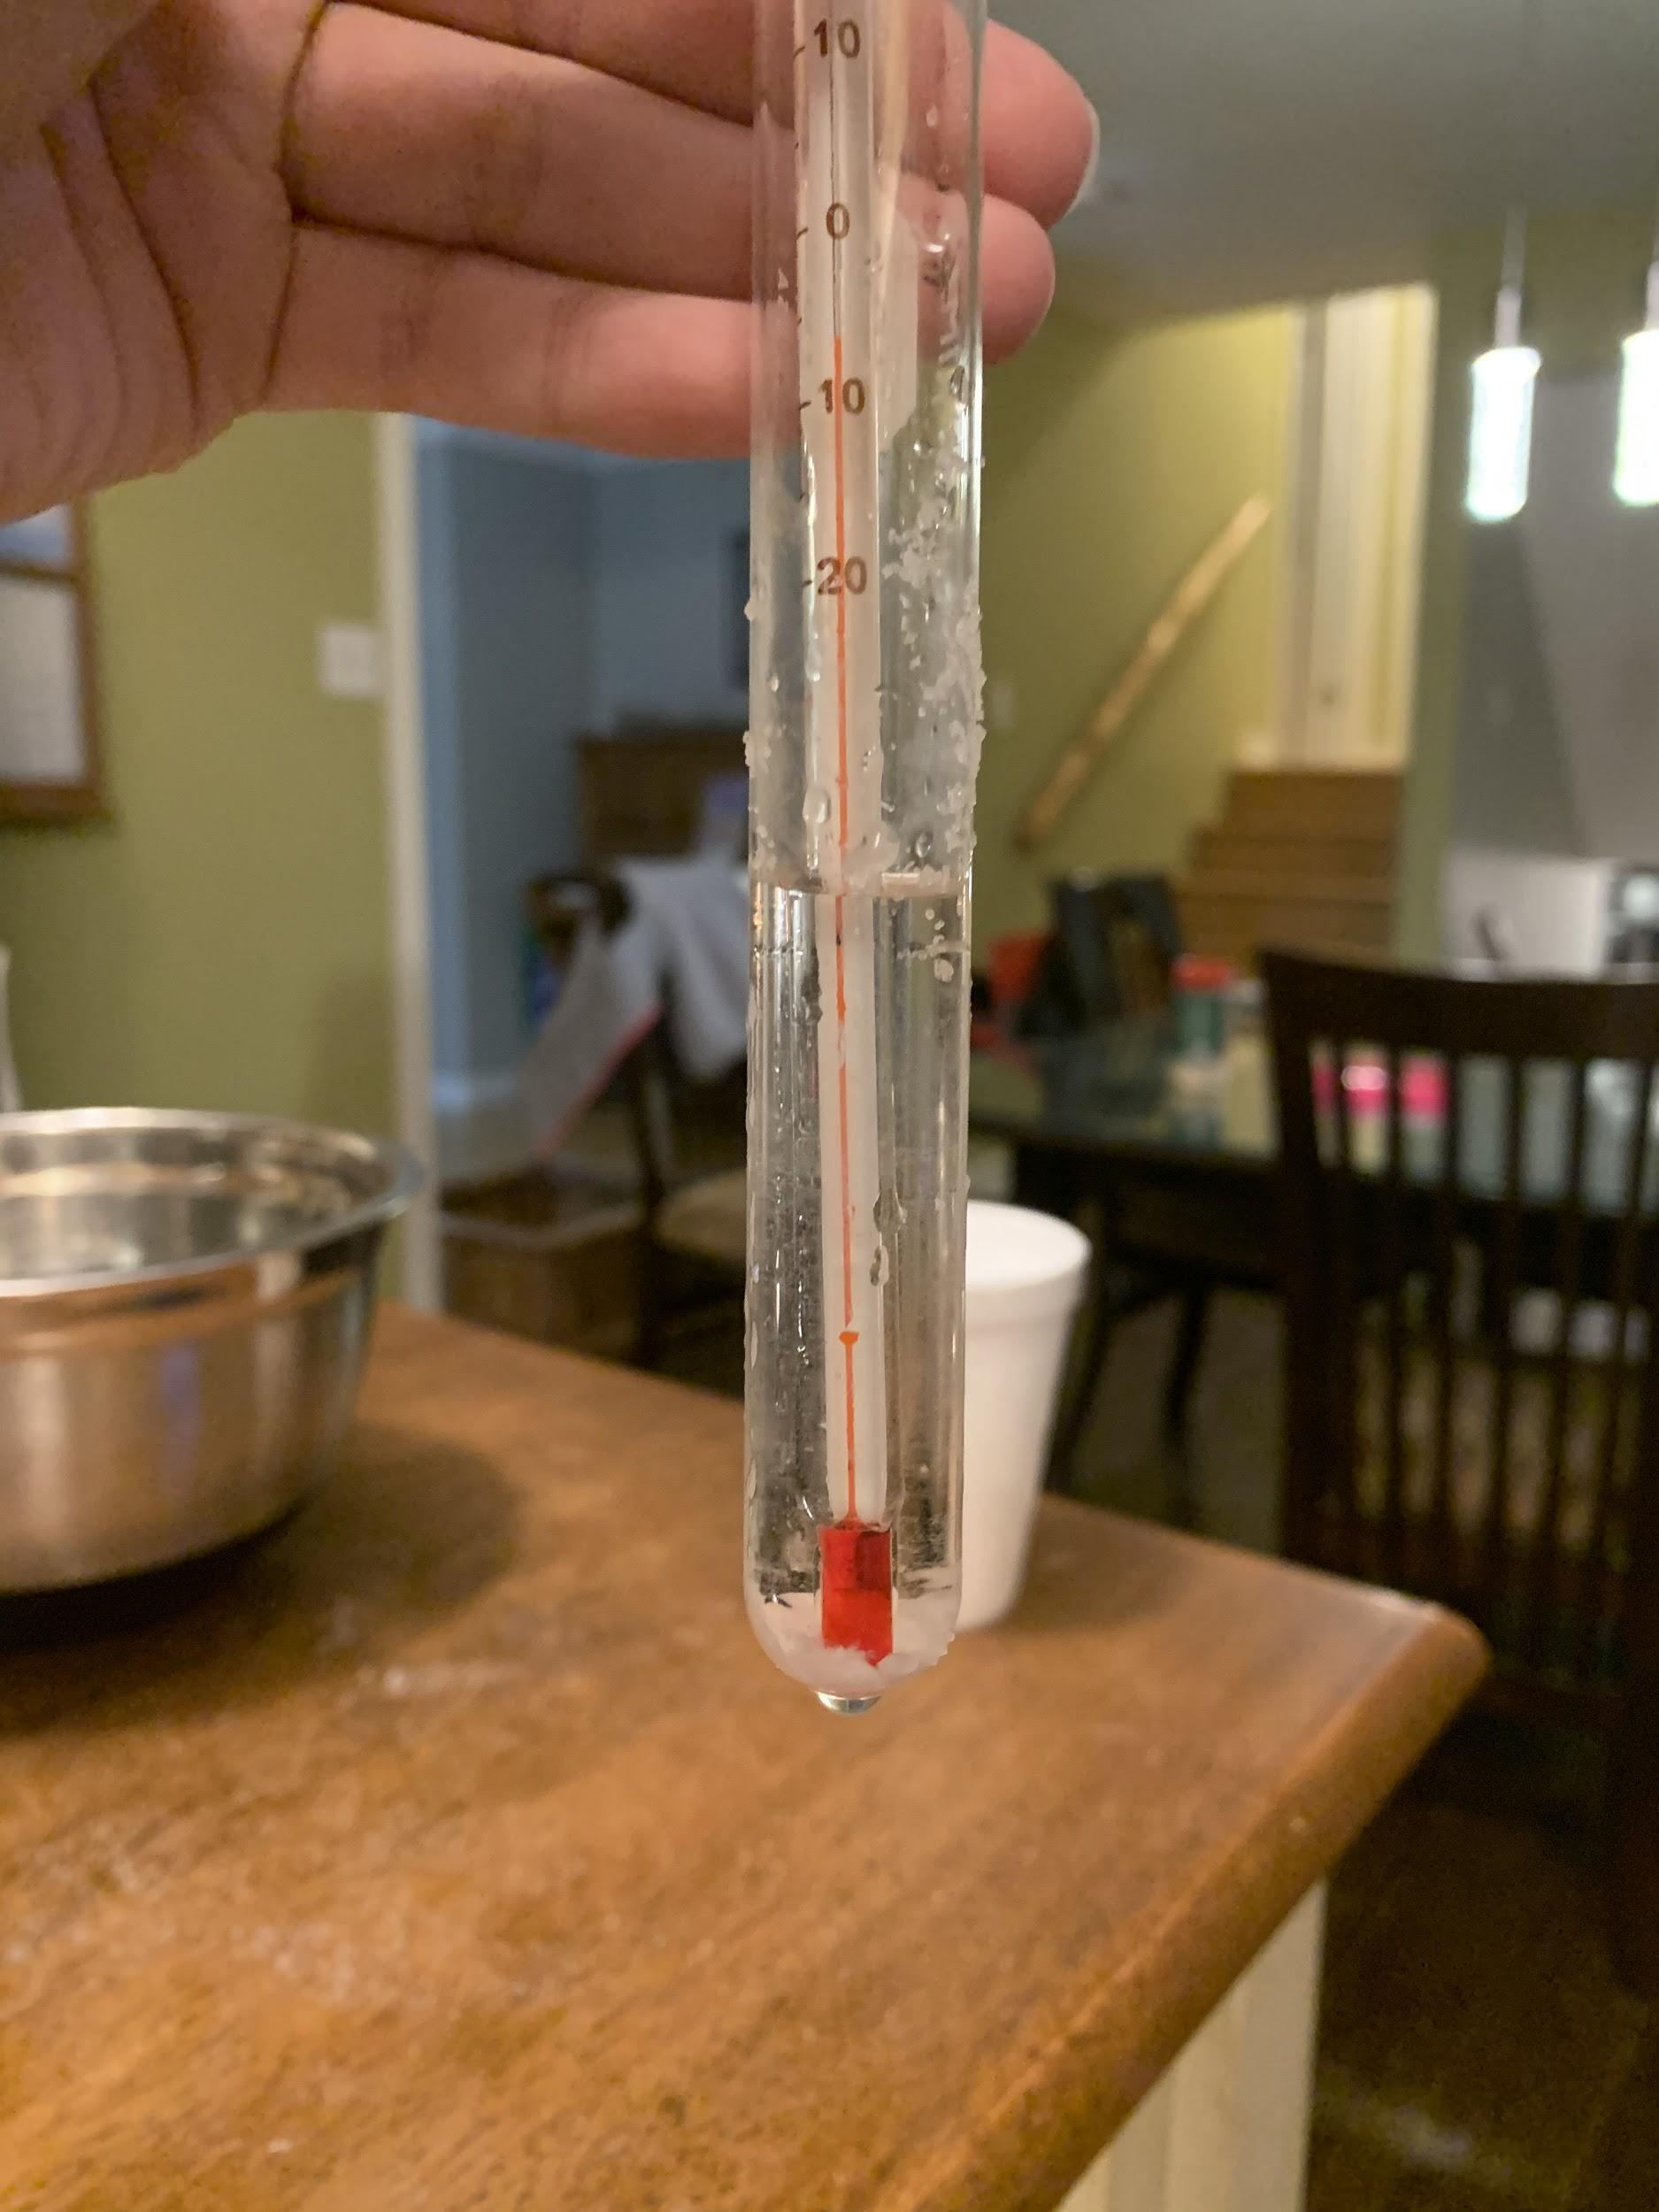
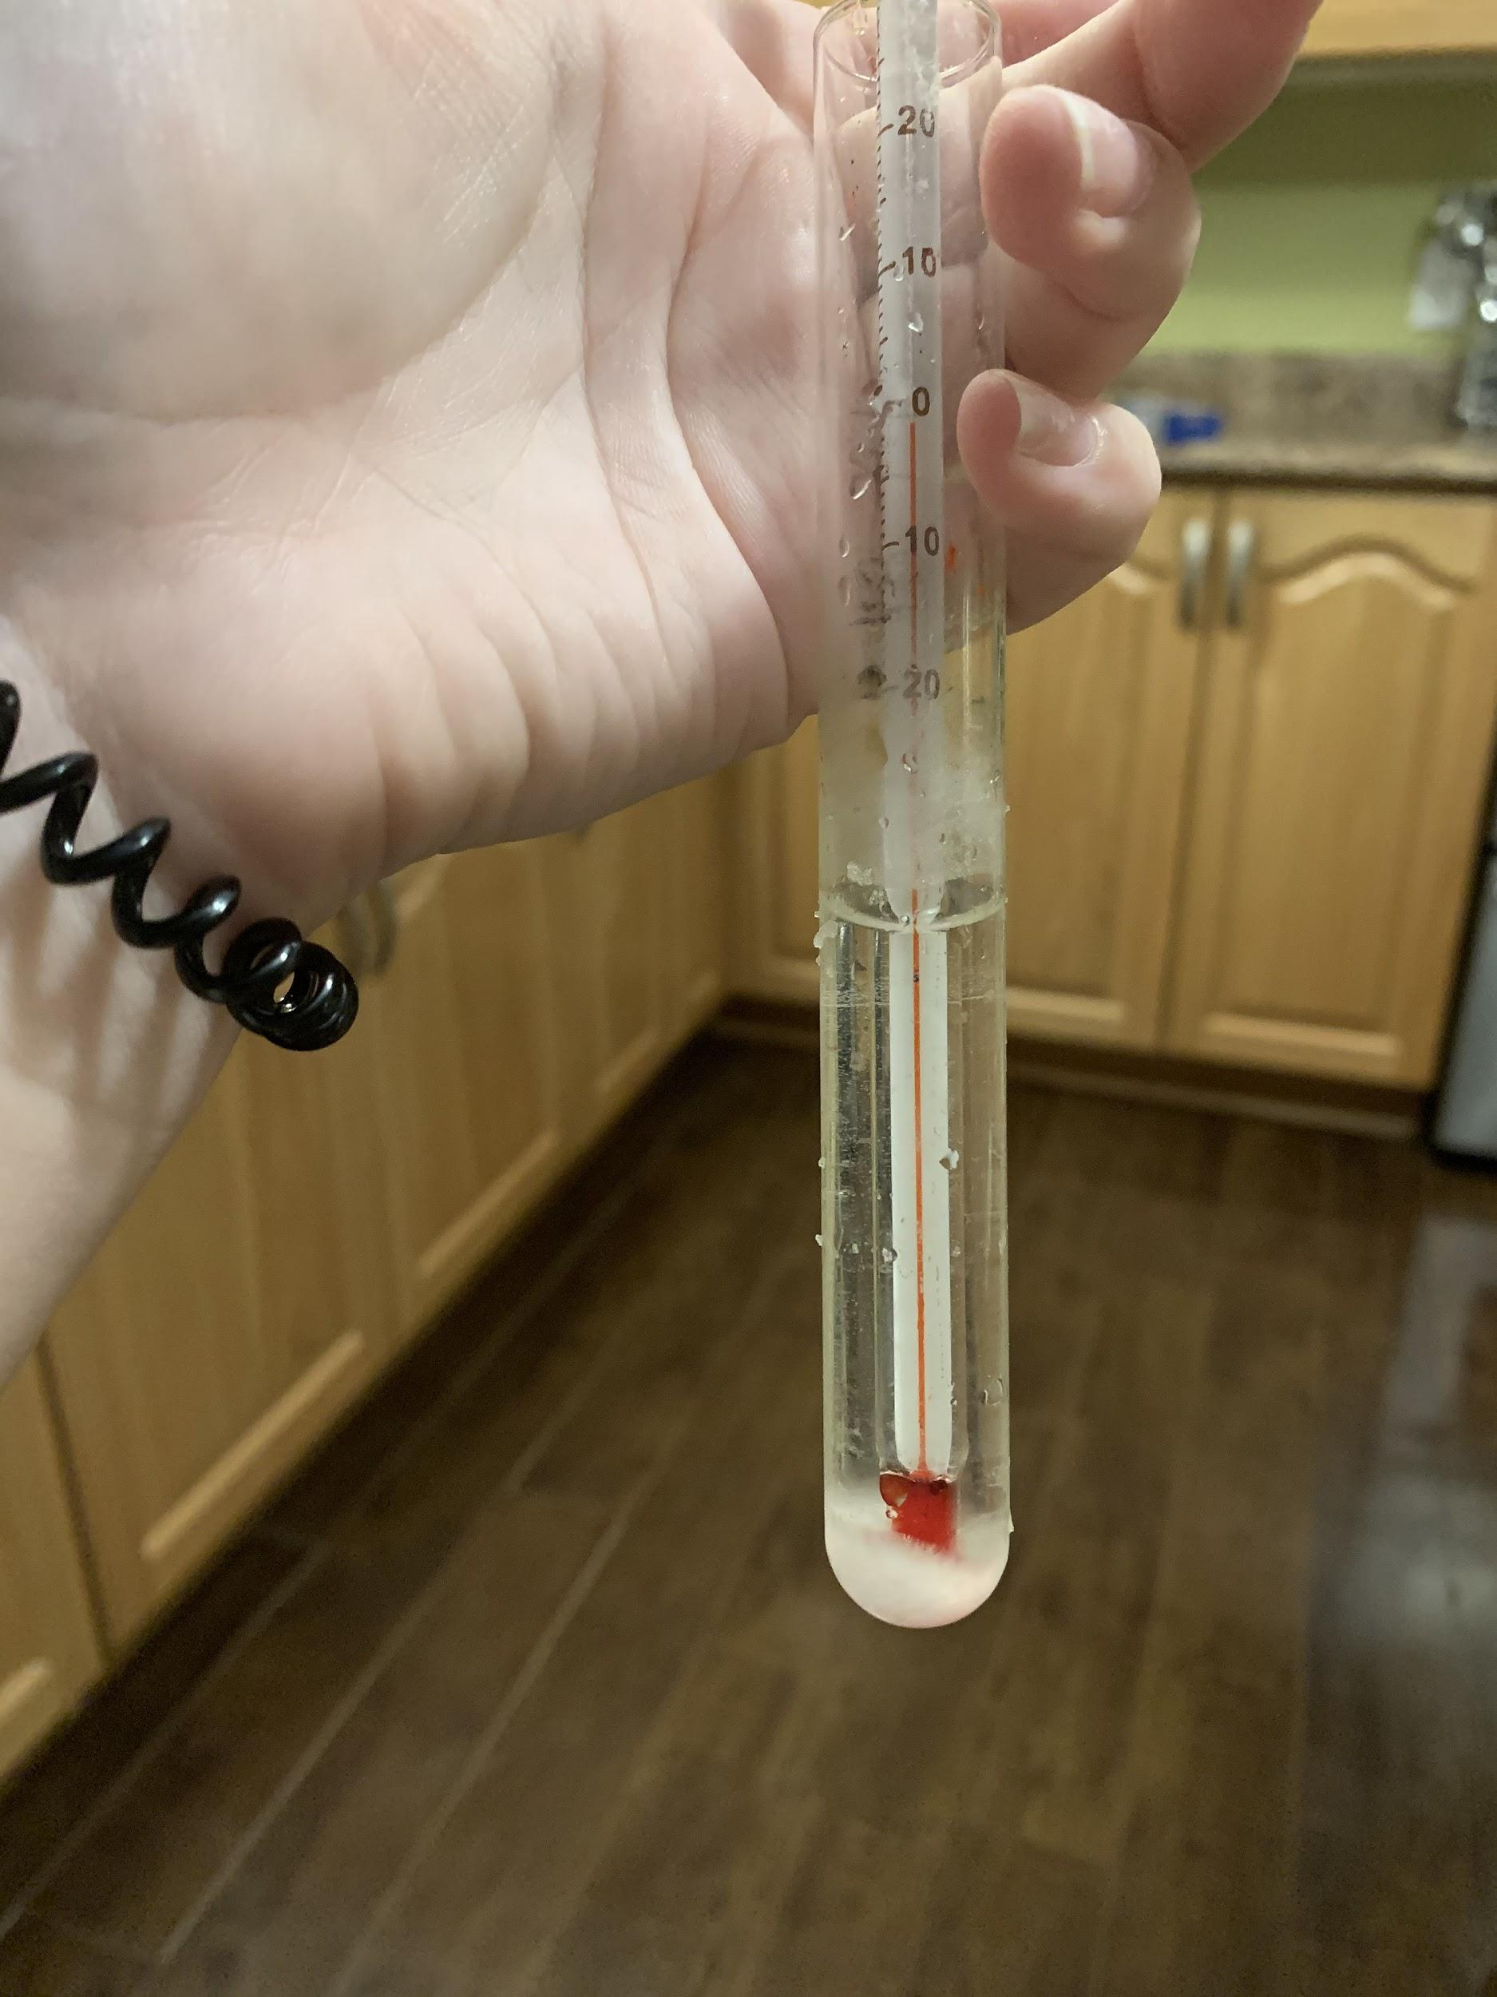
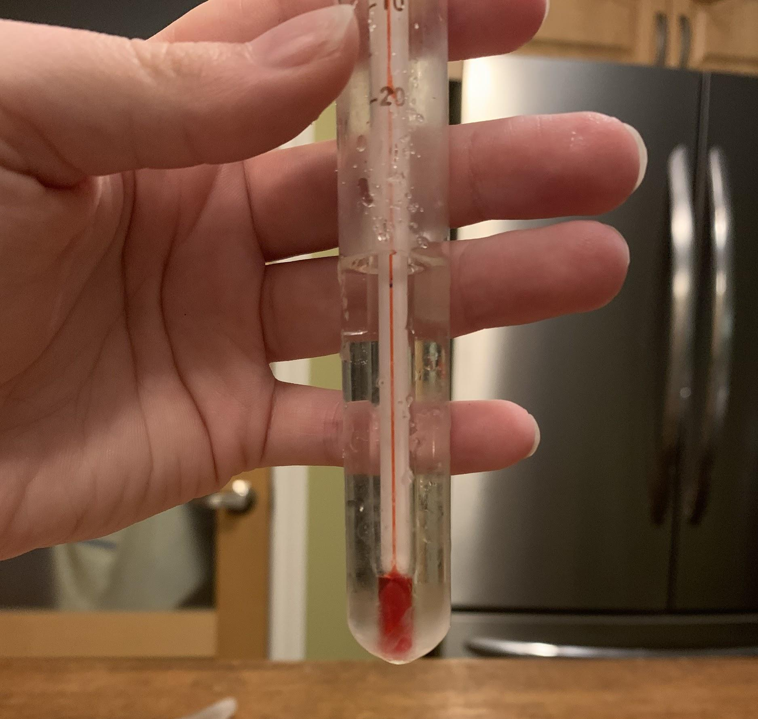
Figure 6: Test liquid 4 at it's freezing point
Figure 9: Test liquid 7 at it's freezing point
Figure 7: Test liquid 5 at it's freezing point
Figure 8: Test liquid 6 at it's freezing point
The experiment

Slide 14
Test liquids and their average freezing point.
Results
Test liquid 1 (2.9g salt, 100ml water) | Test liquid 2 (5.8g salt, 100ml water) | Test liquid 3 (11.7g salt, 100ml water) | Test liquid 4 (17.1g sugar, 100ml water) | Test liquid 5 (34.2g sugar, 100ml water) | Test liquid 6 (68.5g sugar, 100ml water) | Test liquid 7 (100ml water)
1st trial Ice bath:-12 Freezing point:-3 | 1st trial Ice bath:-11 Freezing point:-5 | 1st trial Ice bath:-11 Freezing point:-6 | 1st trial Ice bath:-10 Freezing point:-1 | 1st trial Ice bath:-12 Freezing point:-1 | 1st trial Ice bath:-11 Freezing point:-5 | 1st trial Ice bath:-10 Freezing point:3
2nd trial Ice bath:-15 Freezing point:-2 | 2nd trial Ice bath:-13 Freezing point:-4 | 2nd trial Ice bath:-10 Freezing point:-7 | 2nd trial Ice bath:-10 Freezing point:1 | 2nd trial Ice bath:-10 Freezing point:-3 | 2nd trial Ice bath:-10 Freezing point:-7 | 2nd trial Ice bath:-12 Freezing point:4
3rd trial Ice bath:-10 Freezing point:-2 | 3rd trial Ice bath:-11 Freezing point:-5 | 3rd trial Ice bath:-11 Freezing point:-6 | 3rd trial Ice bath:-11 Freezing point:1 | 3rd trial Ice bath:-11 Freezing point:-3 | 3rd trial Ice bath:-10 Freezing point:-8 | 3rd trial Ice bath:-11 Freezing point:2
Average freezing point: -2 | Average freezing point: -5 | Average freezing point: -6 | Average freezing point: 1 | Average freezing point: -3 | Average freezing point: -7 | Average freezing point: 3
This chart shows the freezing points we received after each trial for each different test liquid. In order to get the average freezing point for each, add all three trials together and divide them by 3.
Figure 10: Result chart

Slide 15
Discussion
As you may know, when making ice cream the mixture needs to get really cold to freeze it quickly. And just the ice cubes alone will not cut it. But if you add chemicals like salt or sugar to the ice cubes that surround the ice cream container the mixture gets cold enough to freeze. This experiment is generally based on the making of ice cream and leads to a greater understanding of the process of how it's made. It is known that it takes a very high temperature to melt salt, and that it works to depress the freezing point of water. This would make using salt and ice cubes more efficient than pure water ice cubes, as the salt mixture would freeze the ice cream faster and better. As one performs this project they will see how the freezing point changes when adding greater amount of salt or sugar to water. Making it noticeable that when adding it to ice you will receive the same results as that is how an ice cream mixture gets cold enough to freeze. Overall, this experiment resulted in no errors or complications.

Slide 16
Conclusion
As seen with the results, the more chemicals added to a certain amount of water will lower the solutions freezing point.

Slide 17
References
Olson, A., Daly, T., & Lohner, S. (2020, June 23). Chemistry of Ice-Cream Making: Lowering the Freezing Point of Water. Retrieved from https://www.sciencebuddies.org/science-fair-projects/project-ideas/FoodSci_p013/cooking-food-science/chemistry-of-ice-cream-making#procedure

