Slide 1

Computational Determination of the Common Vibrational Modes Responsible for Sweetness in 14 Different Sweeteners
Nicholas Qiu
NL Regional Science Fair 2021
April 23, 2021

Slide 2
Introduction and Background
Two proposed mechanisms help to explain how we perceive different smells: lock and key method and the more acceptable vibrational theory of olfaction.
Vibrational theory of olfaction uses IR spectroscopy to predict the odor of molecules and the modes responsible for them.
No literature that determines whether vibrational theory of olfaction can apply to the gustatory senses.
This investigation will test if vibrational modes are responsible for taste.
Morrison, J. Nature News 2014.
Hoehn, R. D.; Nichols, D. E.; Neven, H.; Kais, S. Front. Phys. 2018, 6, 25.

Slide 3
Infrared Spectroscopy
Measurement of the interaction of infrared radiation with matter, either by absorption, emission or reflection.
Used to determine functional groups and different vibrational modes in molecules.
Upon absorbing infrared energy, different groups in the molecules vibrate.
This investigation will determine if sweeteners share a common vibrational mode.
Bluemel, M. IB Chemistry; Oxford Study courses, 2008.

Slide 4
Basis Sets
In computational chemistry, a set of functions used to represent the electronic wave function in the Hartree-Fock method or Density Functional Theory.
Either composed of atomic orbitals or plane waves.
There are several types of atomic orbitals that can be used to allow for efficient implementations of Post Hartree-Fock methods.
Basis Sets. https://gaussian.com/basissets/.

Slide 5
Hartree-Fock
Method of approximation to determine the wave function and the energy of a quantum many-body system in a stationary state.
Hartree-Fock uses iteration to numerically solve for many-electron systems.
Hartree-Fock uses five different approximations.
Accurate method of approximation, but there exist more efficient methods such as Density Functional Theory.
Slater, J. C. Phys. Rev. 1951, 81, 385.
Lykos, P.; Pratt, G. Rev. Mod. Phys. 1963, 35, 496.

Slide 6
Research Question
What is the vibrational mode responsible for the sweet taste in 14 dierent sweeteners: advantame, alitame, aspartame, erythritol, isomalt, lactitol, maltitol, mannitol, neohesperidin, neotame, saccharin, sorbitol, sucralose, and xylitol, using calculations at the Hartree-Fock 6-31G(d) level of theory?

Slide 7
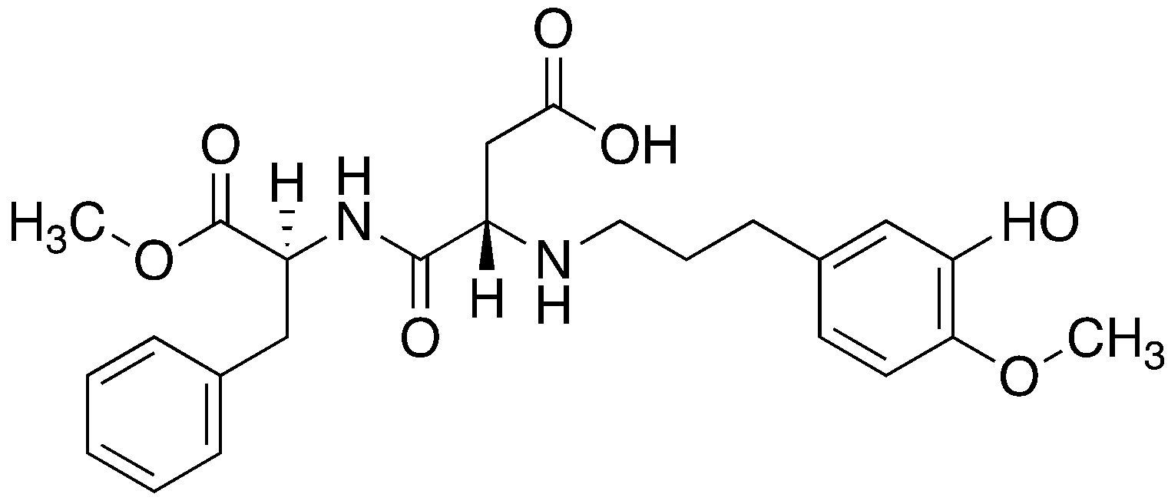
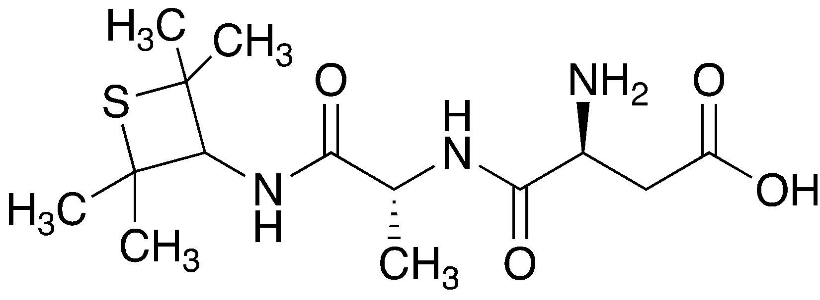
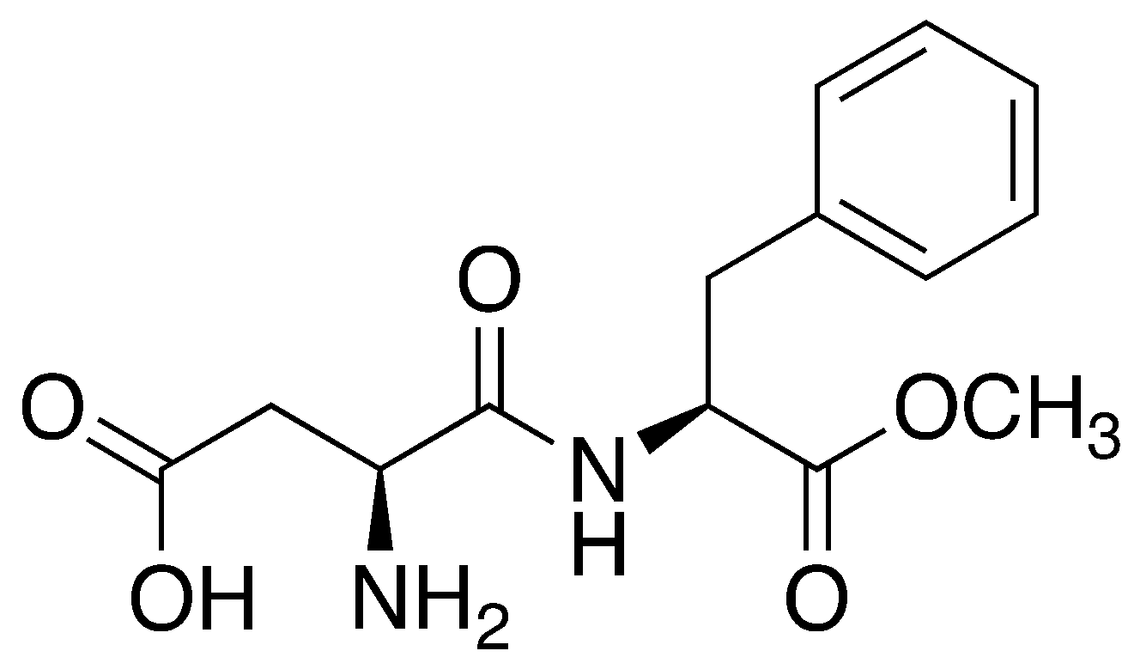
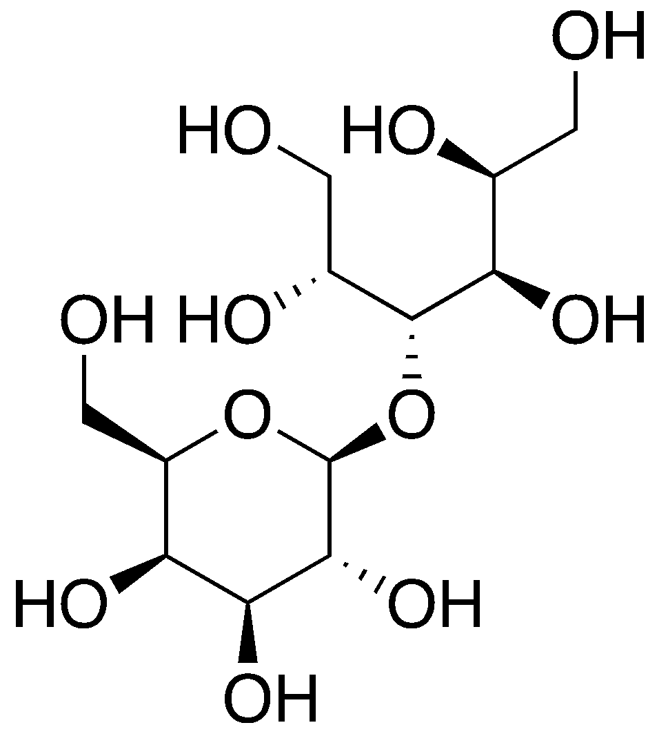
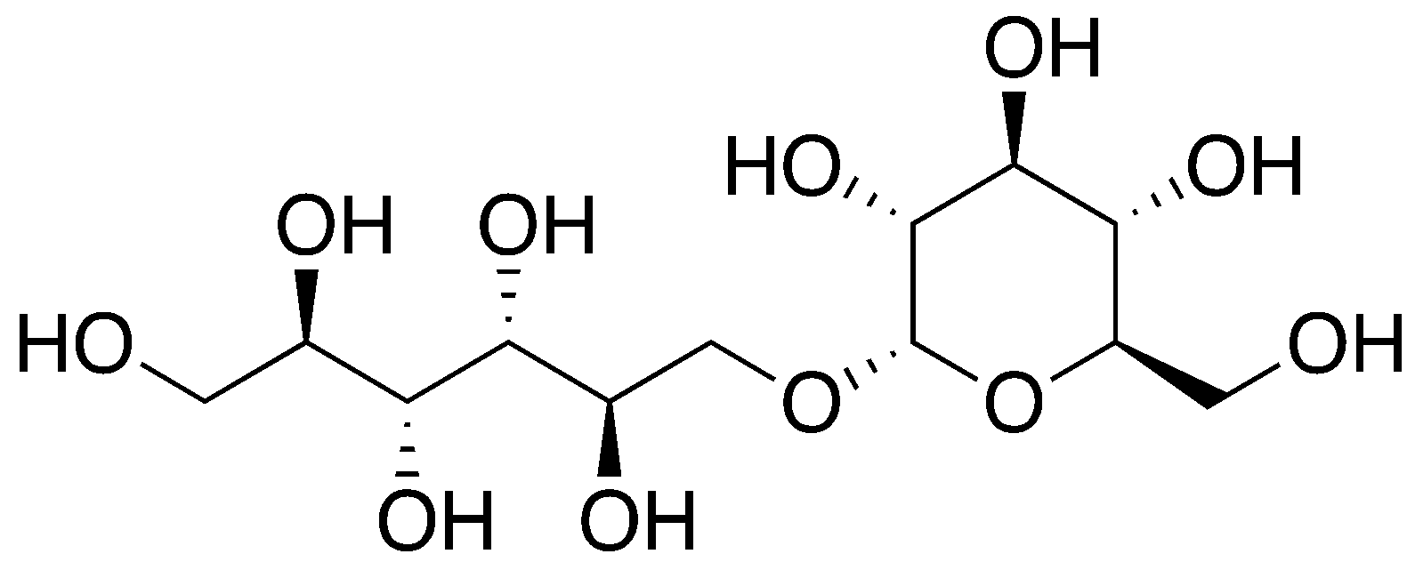
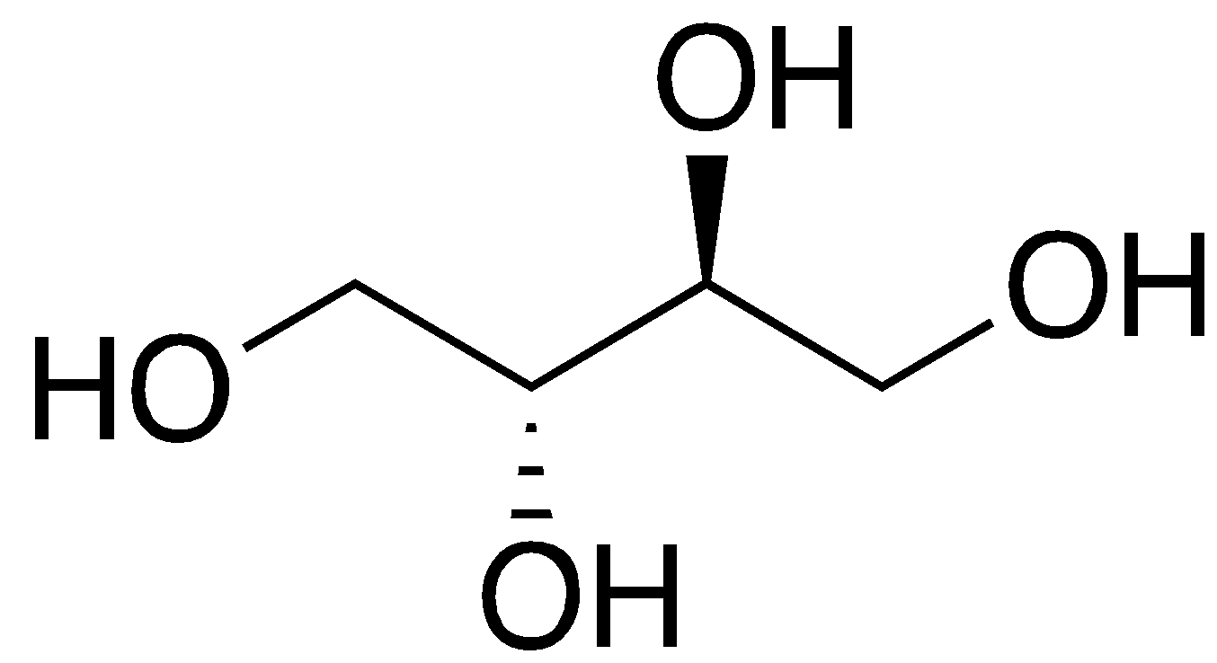
Molecular Structures of all 14 Sweeteners Generated Using ChemDraw 20.0
Advantame
Alitame
Aspartame
Erythritol
Isomalt
Lactitol

Slide 8
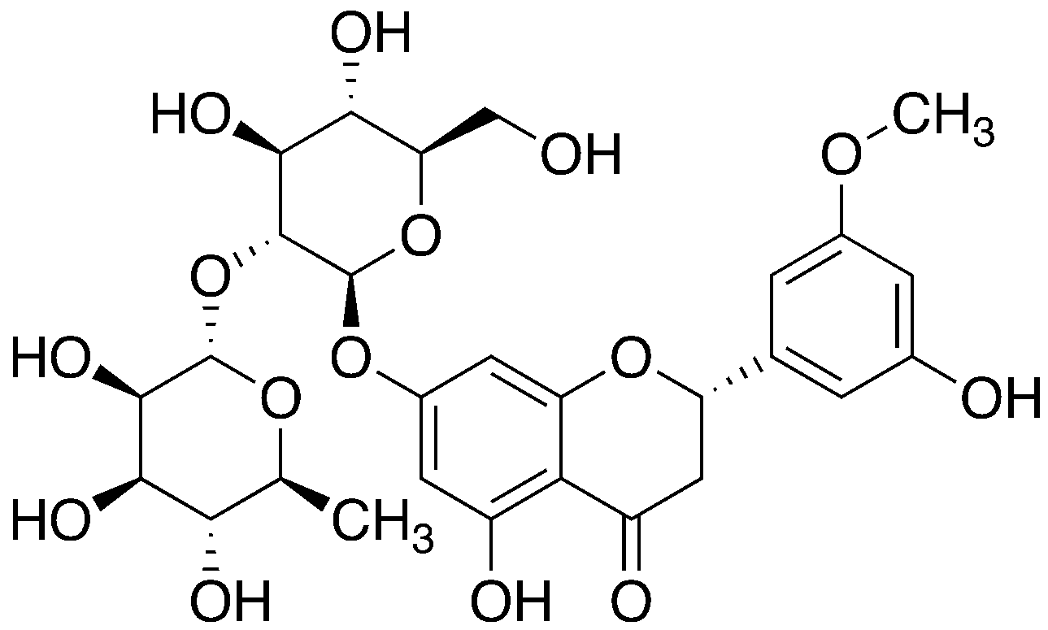
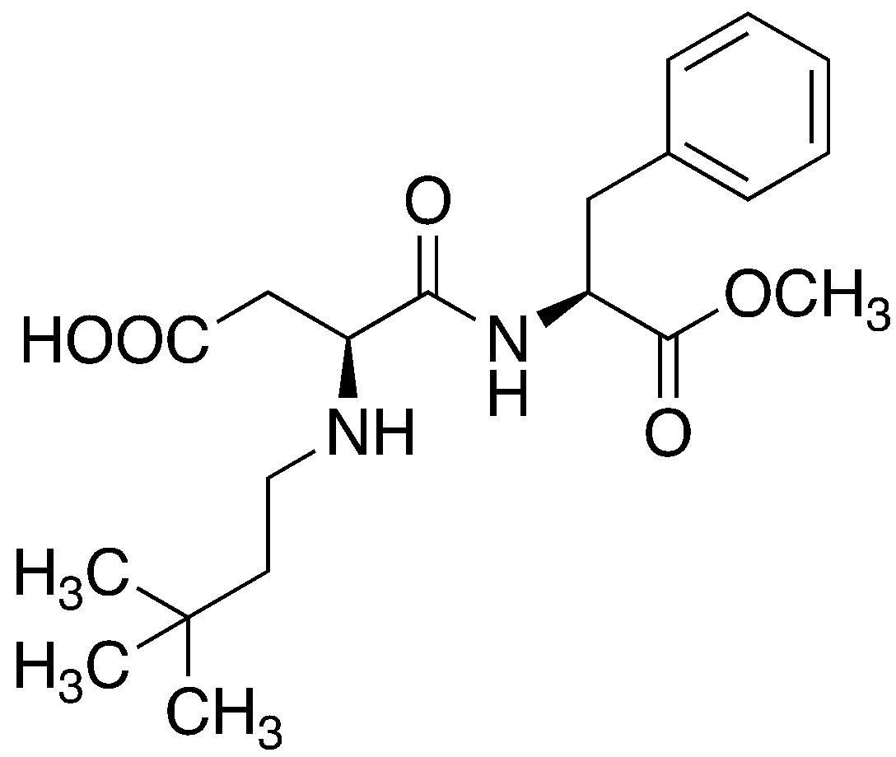
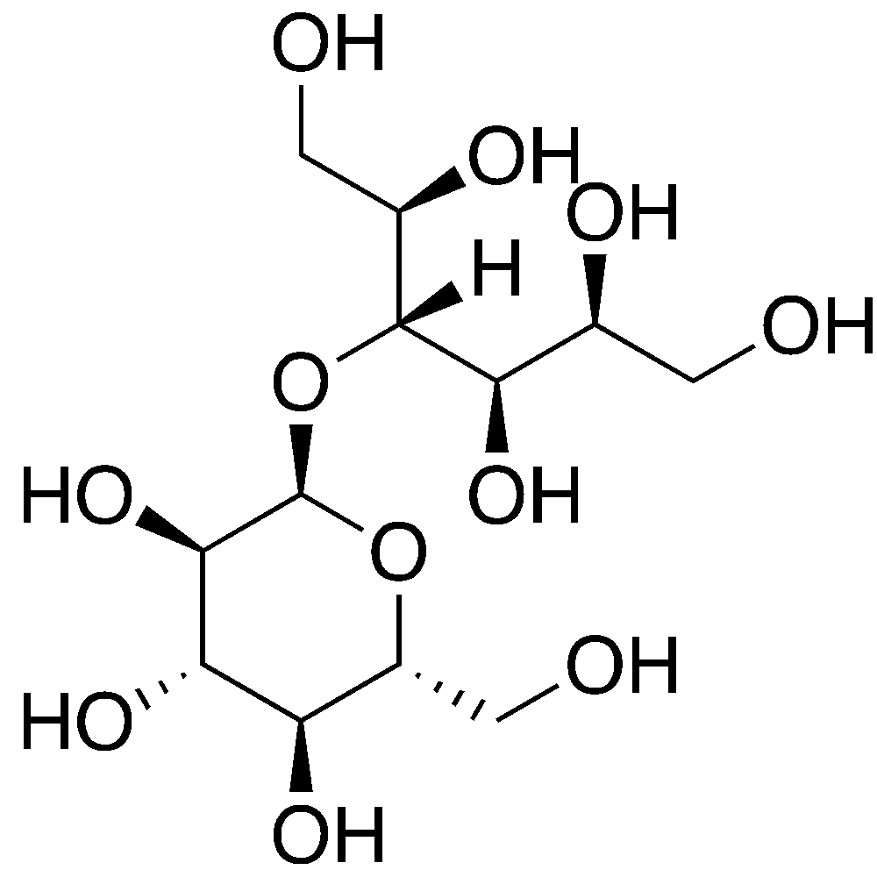
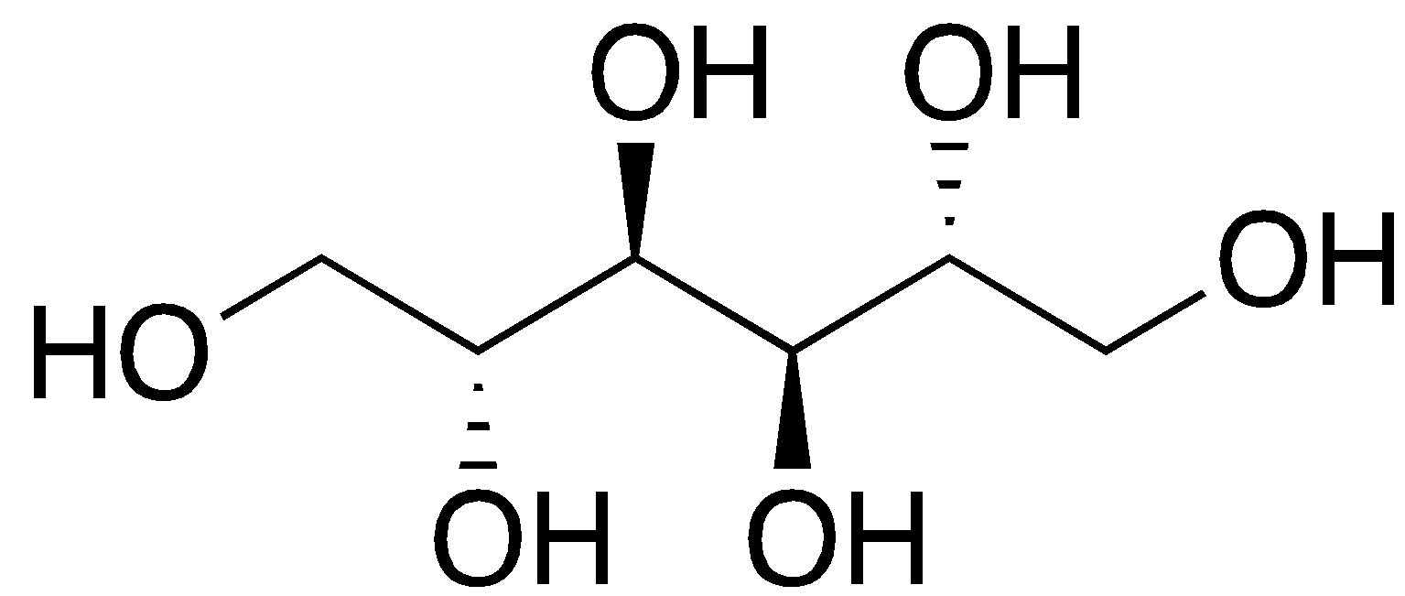
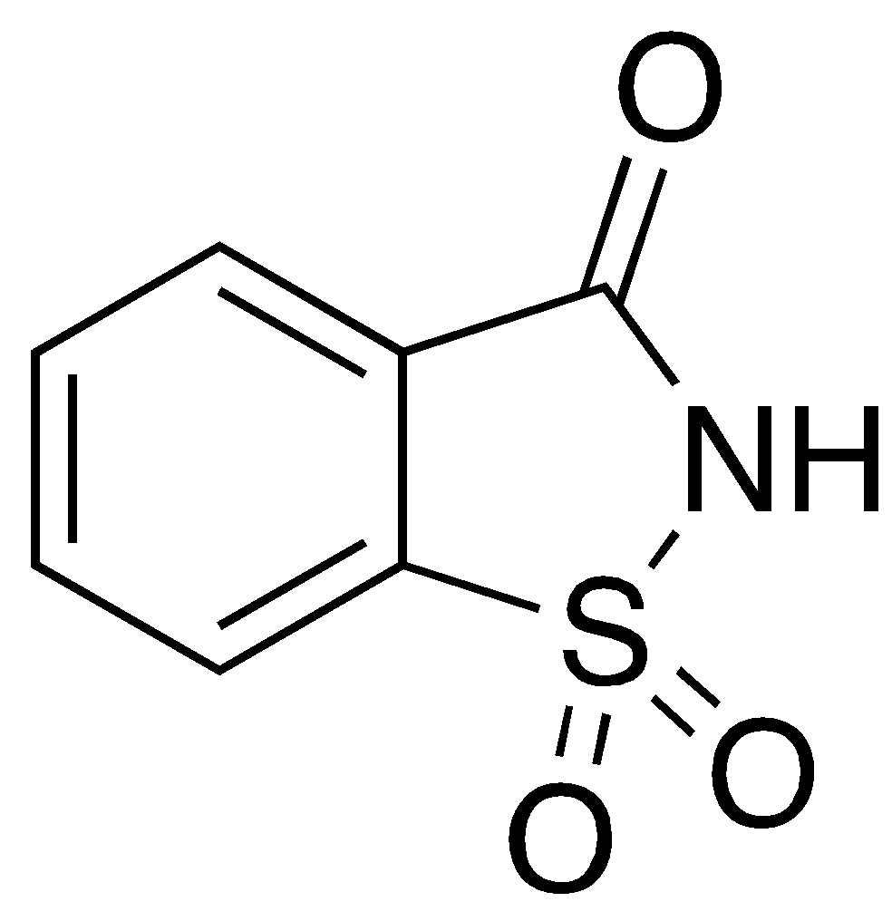
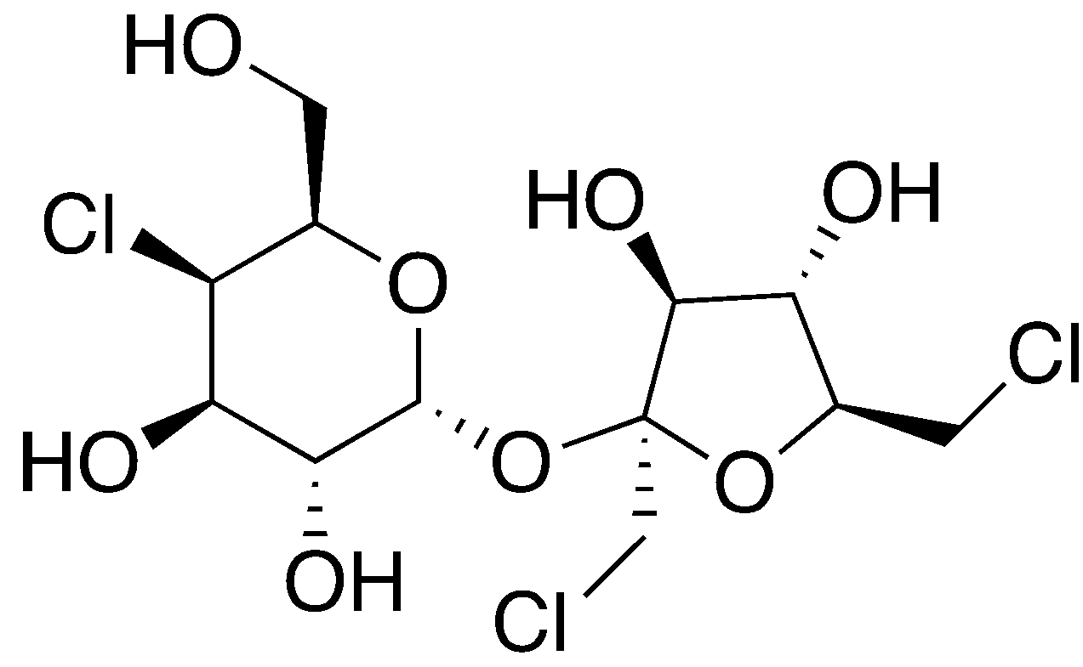
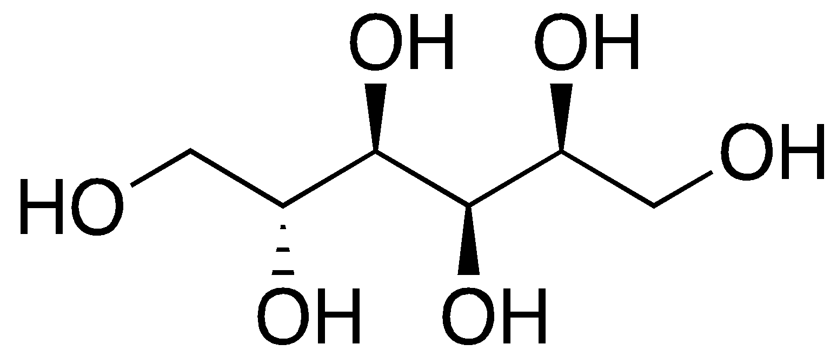
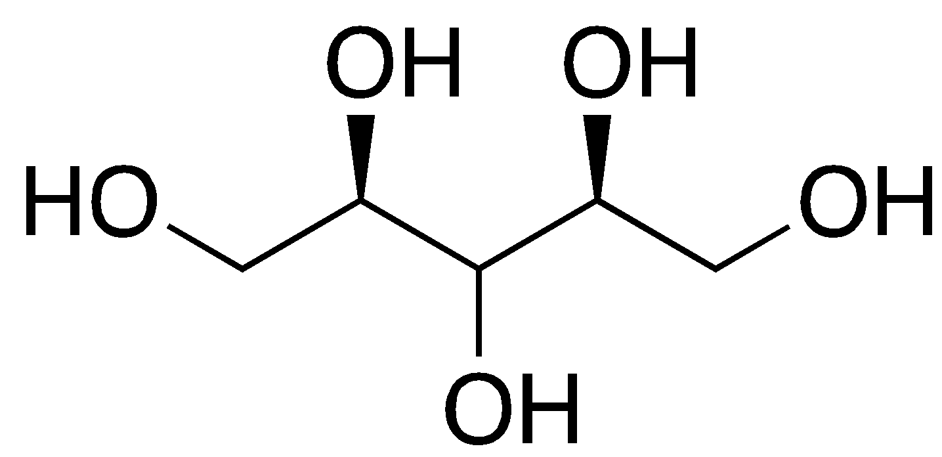
Molecular Structures of all 14 Sweeteners Generated Using ChemDraw 20.0
Maltitol
Mannitol
Neohesperidin
Neotame
Saccharin
Sorbitol
Sucralose
Xylitol

Slide 9
Hypothesis
There is a common vibrational mode that is responsible for the sweet taste in the 14 different sweeteners.

Slide 10
Variables
Independent variable: The different sweeteners.
Dependent variable: The vibrational modes present.
Control variables: Using the same software.

Slide 11

Methodology
All computations were performed using Gaussian09 software package, and under standard conditions.
All structures were optimized, and energies calculated at the HF/6-31G(d) level of theory.
Visualized using GaussView6.
14 different sweeteners were constructed and optimized.
Bond frequencies of each sweetener were calculated and plotted, generating an IR spectrum for each sweetener.
Frisch, M. J. et al. Gaussian 09 Revision A.2. 2009.
Dennington, R.; Keith, T. A.; Millam, J. M. GaussView Version 6. 2019; Semichem Inc. Shawnee Mission KS.
Canada, H. Government of Canada. 2020; https://www.canada.ca/en/health-canada/services/food-nutrition/food-safety/food-additives/lists-permitted/9-sweeteners.html.

Slide 12

Methodology
Spectrums were normalized and averaged, allowing for the identification of significant peaks.
Individual sweetener spectra were compared to the average spectrum.
Common significant peaks/frequencies of each sweetener were viewed to identify all possible vibrational modes.
Most common modes could be responsible for sweet taste in sweeteners.
Turin, L. Chem. Senses 1996, 21, 773-791.

Slide 13
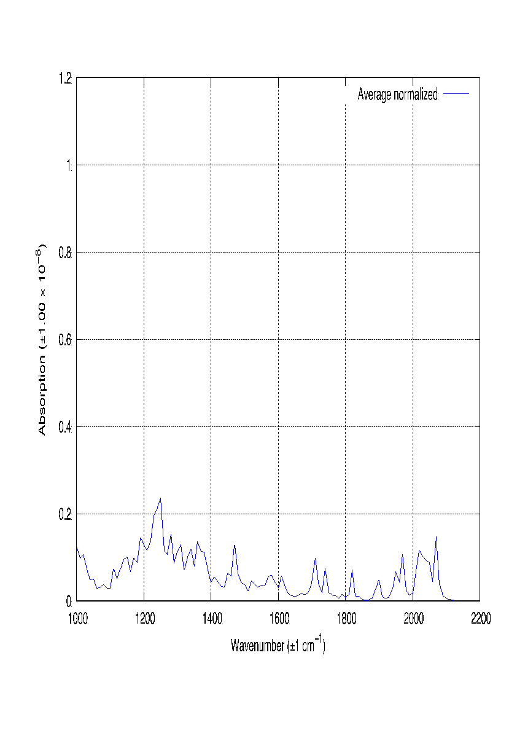
Results and Discussions
Significant average peaks:
1250 cm⁻¹
2070 cm⁻¹
1360 cm⁻¹
1470 cm⁻¹
Figure 1: The average infrared spectrum of all the sweeteners from 1000 cm⁻¹ - 2200 cm⁻¹ in gas phase at standard conditions.

Slide 14
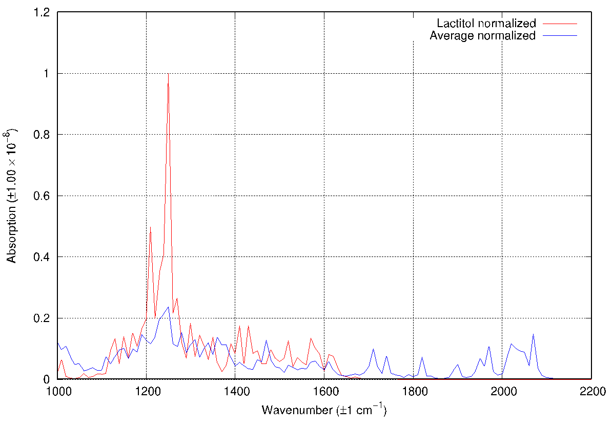
Results and Discussion
The average spectrum allows for direct comparison to the individual sweeteners’ IR spectra.
Two identified significant peaks, 1250 cm⁻¹ and 1210 cm⁻¹ , but only one contributing to the sweet taste.
Figure 2: Infrared spectrum of lactitol and the average infrared spectrum of all the sweeteners from 1000 cm⁻¹ - 2200 cm⁻¹ in gas phase at standard conditions.

Slide 15
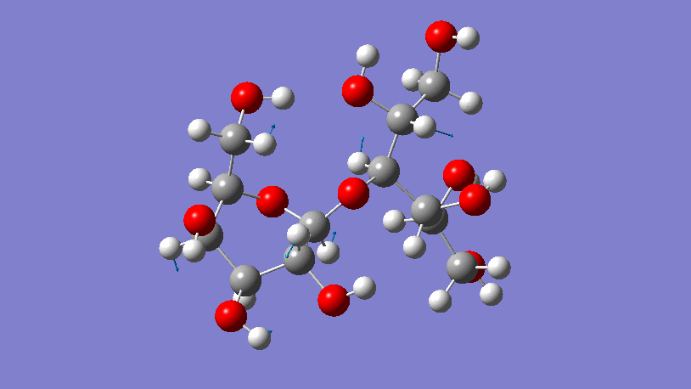
Results and Discussions
Observed lactitol vibrational modes at 1250 cm⁻¹ :
3 x H-C-C scissoring
1 x C-C-C scissoring
1 x C-C-C symmetric stretch
2 x H-C-C symmetric stretch
1 x C-C-C rocking
3 x O-C-C asymmetric stretch
2 x C-O-C asymmetric stretch
1 x O-C-C asymmetric stretch
1 x C-C-C asymmetric stretch
1 x O-C-O asymmetric stretch
Figure 3: Animated bond vibrations of lactitol at 1250 cm⁻¹ generated and viewed using GaussView6.

Slide 16
Results and Discussions
Sweetener | Wavenumber (±1 cm⁻¹) | Identified Mode(s)
Advantame | 2070 | 2x C-C=O asymmetric stretch
 | 1230 | 3x H-C-C scissoring
Alitame | 1360 | 1x H-C-C scissoring
Aspartame | 2070 | 1x H-C-C scissoring
 | 1470 | 1x C-C=O asymmetric stretch
 | 1380 | 1x H-C-C scissoring
Erythritol | 1240 | 6x H-C-C scissoring
Isomalt | 1280 | 1x H-C-C scissoring
 | 1370 | 3x H-C-C scissoring
 | 1460 | 5x H-C-C scissoring
Lactitol | 1250 | 3x H-C-C scissoring
Maltitol | None | N/A
Mannitol | None | N/A
Neohesperidin | 1280 | 6x H-C-C scissoring
 | 1370 | 1x H-C-C scissoring
Neotame | 2020 | 2x H-C-C scissoring 1x C-C=O asymmetric stretch
Saccharin | 2050 | 1x C-C=O asymmetric stretch
Sorbitol | None | N/A
Sucralose | 1250 | 1x H-C-C scissoring
Xylitol | 1260 | 2x H-C-C scissoring
There are no significant peaks in the sorbitol, mannitol and maltitol infrared spectra that contribute to the significant peaks of the average. Thus, the data for these molecules are omitted.
Table 1: Summary of identified modes in all sweeteners

Slide 17
Results and Discussions
Two most frequent vibrational modes were asymmetrical stretching and scissoring. Specifically, H-C-C scissoring and C-C=O asymmetrical stretching.
Sweeteners containing C-C=O asymmetrical stretching, are usually much sweeter than sucrose: neotame, saccharin, aspartame and advantame.
Sweeteners not containing C-C=O asymmetrical stretching, are usually less sweet than sucrose: isomalt, lactitol, erythritol and xylitol.
Exceptions: neohesperidin, sucralose and alitame.
Das, A.; Chakraborty, R. 2016.
Caballero, B. Encyclopedia of human nutrition; Elsevier, 2005. Food Safety, C.; Nutrition, A. Additional Information about High-Intensity Sweeteners. https://www.fda.gov/food/food-additives-petitions/additional-information-about-high-intensity-sweeteners-permitted-use/food-united-states.
15th January 2019 By Editor,; Editor, Lactitol is a member of the family of bulk sweeteners known as polyols (sugar alcohols), used in a range of low-calorie, low-fat and/or sugar-free foods. 2020;https://www.diabetes.co.uk/sweeteners/lactitol.html.

Slide 18
Results and Discussions
The H-C-C scissoring mode appears in all applicable sweeteners except saccharin; thus, it is likely that it contributes to sweetness.
H-C-C scissoring likely effects the magnitude of sweetness less than the C-C=O asymmetrical stretching.
Exceptions to the mechanism: Mannitol, maltitol and sorbitol.
BeMiller, J. N. Carbohydrate chemistry for food scientists; Elsevier, 2018.
Anderson, P. How Sugar Substitutes Stack Up. 2021;https://www.nationalgeographic.com/news/2013/7/130717-sugar-substitutes-nutrasweet-splenda-stevia-baking/.
Chattopadhyay, S.; Raychaudhuri, U. C. Journal of Food Science and Technology 2014, 51, 611.

Slide 19
Limitations
Assumption that the vibrational theory of olfaction mechanism works with the gustatory receptors.
Hartree-Fock uses approximations.
Basis set 6-31G(d) only uses 25 functions for optimization.
Interpretation when identifying modes and significant peaks on the IR spectrums.
Improve investigation by using Density Functional Theory and a larger basis set.

Slide 20
Conclusions
The modes responsible for the sweetness taste in the sweeteners were found to be H-C-C scissoring and C-C=O asymmetrical stretching.
C-C=O asymmetrical stretching has a larger impact on the degree of sweetness than H-C-C scissoring.
Use of Hartree-Fock with the basis set 6-31G(d) indicates accurate results as uncertainty for geometry optimizations and frequency calculations is ±1.00x10⁻⁸.
Use of Density Functional Theory and a larger basis set such as aug-ccpVQZ could result in greater accuracy.

Slide 21


Future Implications
Synthesis of new sweeteners and common molecules with an added sweetness modification (ex. Caffeine).
Benefit consumers and potentially industries.

Slide 22

Acknowledgements
Eastern Newfoundland Science and Technology Fair
Dr. Yuming Zhao
Christopher Qiu
Natasha Janes

Slide 23
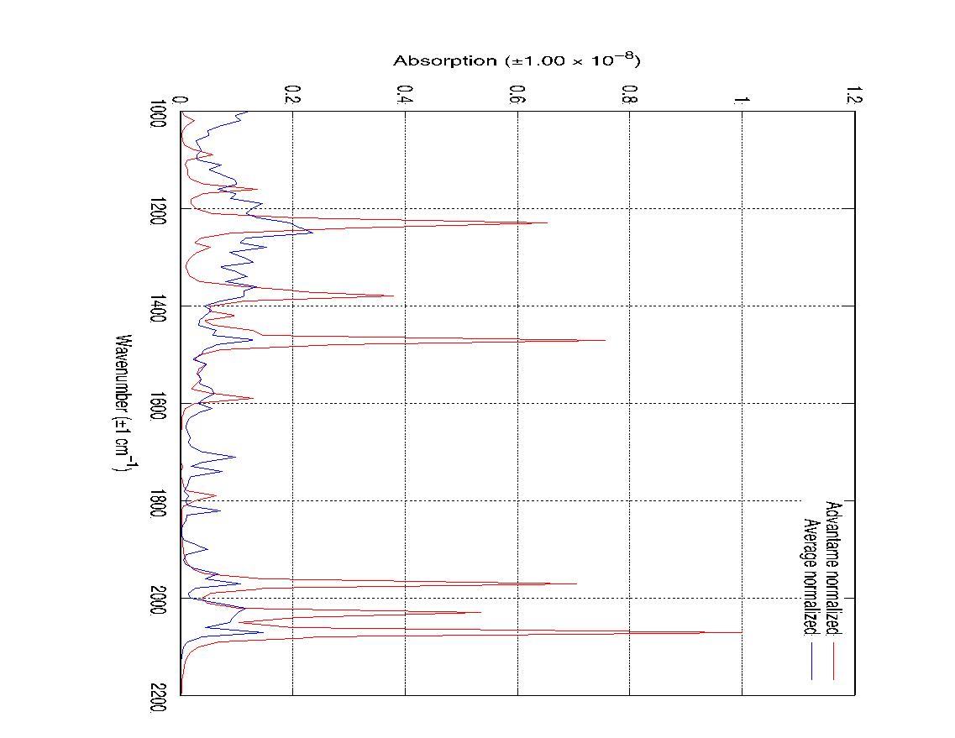
Supplementary Information
Figure S1: Infrared spectrum of advantame and the average infrared spectrum of all the sweeteners from 1000 cm⁻¹ - 2200 cm⁻¹ in gas phase at standard conditions.

Slide 24
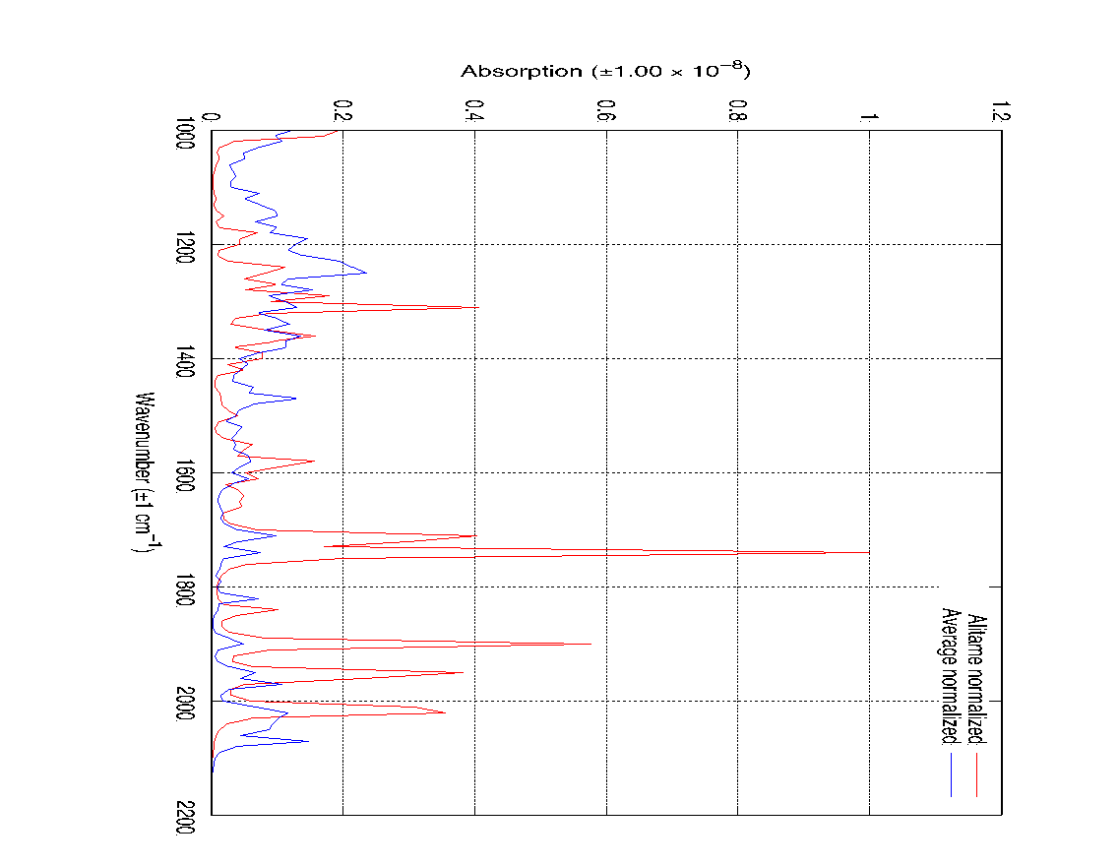
Supplementary Information
Figure S2: Infrared spectrum of alitame and the average infrared spectrum of all the sweeteners from 1000 cm⁻¹ - 2200 cm⁻¹ in gas phase at standard conditions.

Slide 25

Supplementary Information
Figure S3: Infrared spectrum of aspartame and the average infrared spectrum of all the sweeteners from 1000 cm⁻¹ - 2200 cm⁻¹ in gas phase at standard conditions.

Slide 26
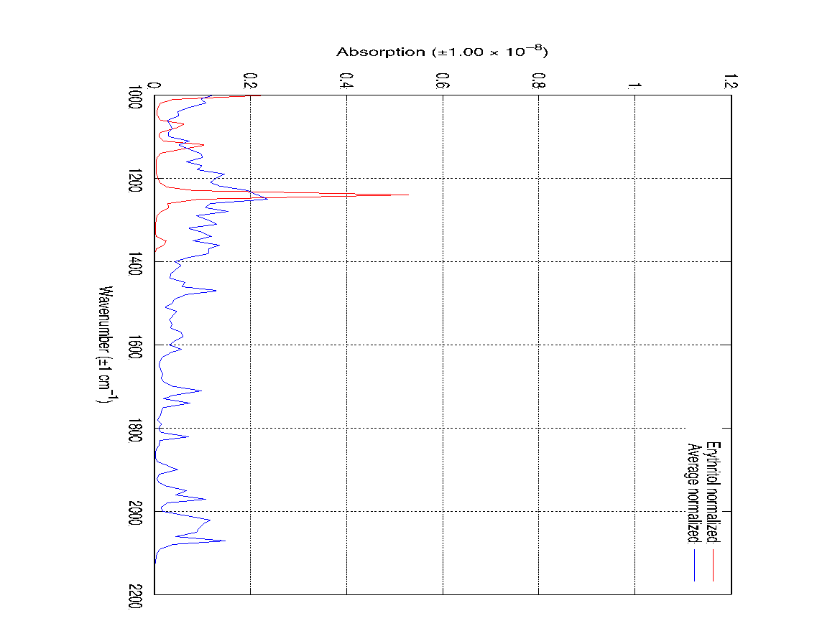
Supplementary Information
Figure S4: Infrared spectrum of erythritol and the average infrared spectrum of all the sweeteners from 1000 cm⁻¹ - 2200 cm⁻¹ in gas phase at standard conditions.

Slide 27
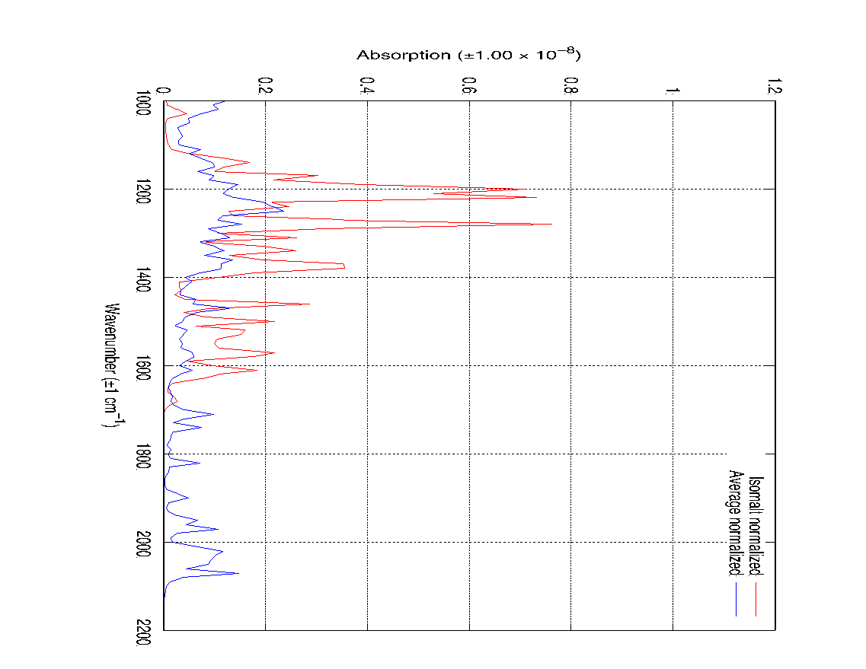
Supplementary Information
Figure S5: Infrared spectrum of isomalt and the average infrared spectrum of all the sweeteners from 1000 cm⁻¹ - 2200 cm⁻¹ in gas phase at standard conditions.

Slide 28
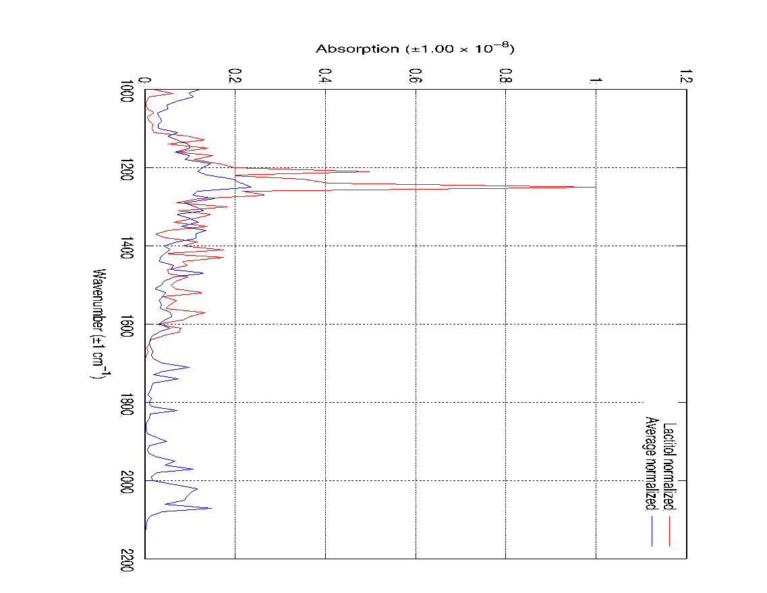
Supplementary Information
Figure S6: Infrared spectrum of lactitol and the average infrared spectrum of all the sweeteners from 1000 cm⁻¹ - 2200 cm⁻¹ in gas phase at standard conditions.

Slide 29
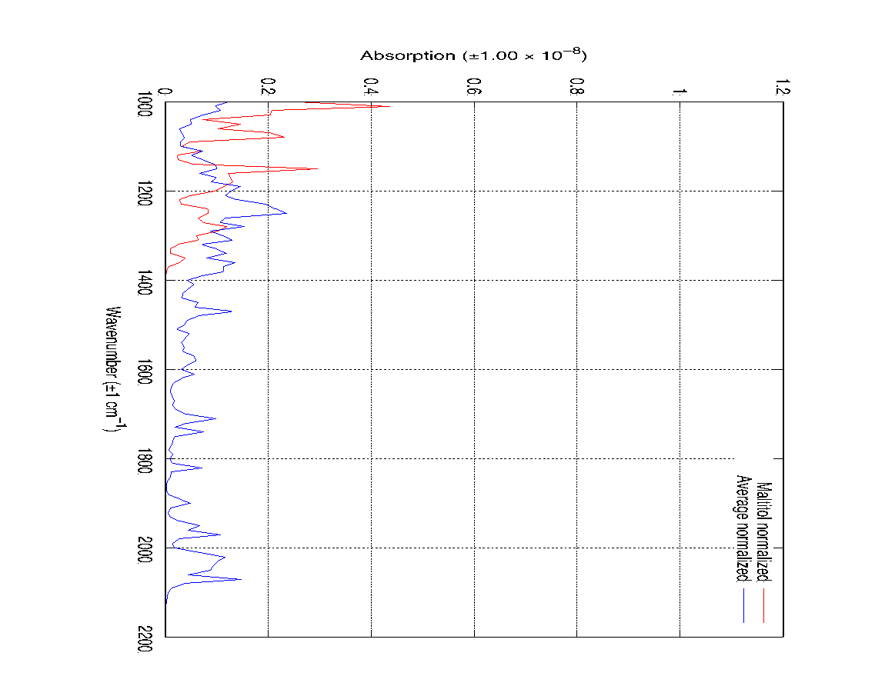
Supplementary Information
Figure S7: Infrared spectrum of maltitol and the average infrared spectrum of all the sweeteners from 1000 cm⁻¹ - 2200 cm⁻¹ in gas phase at standard conditions.

Slide 30
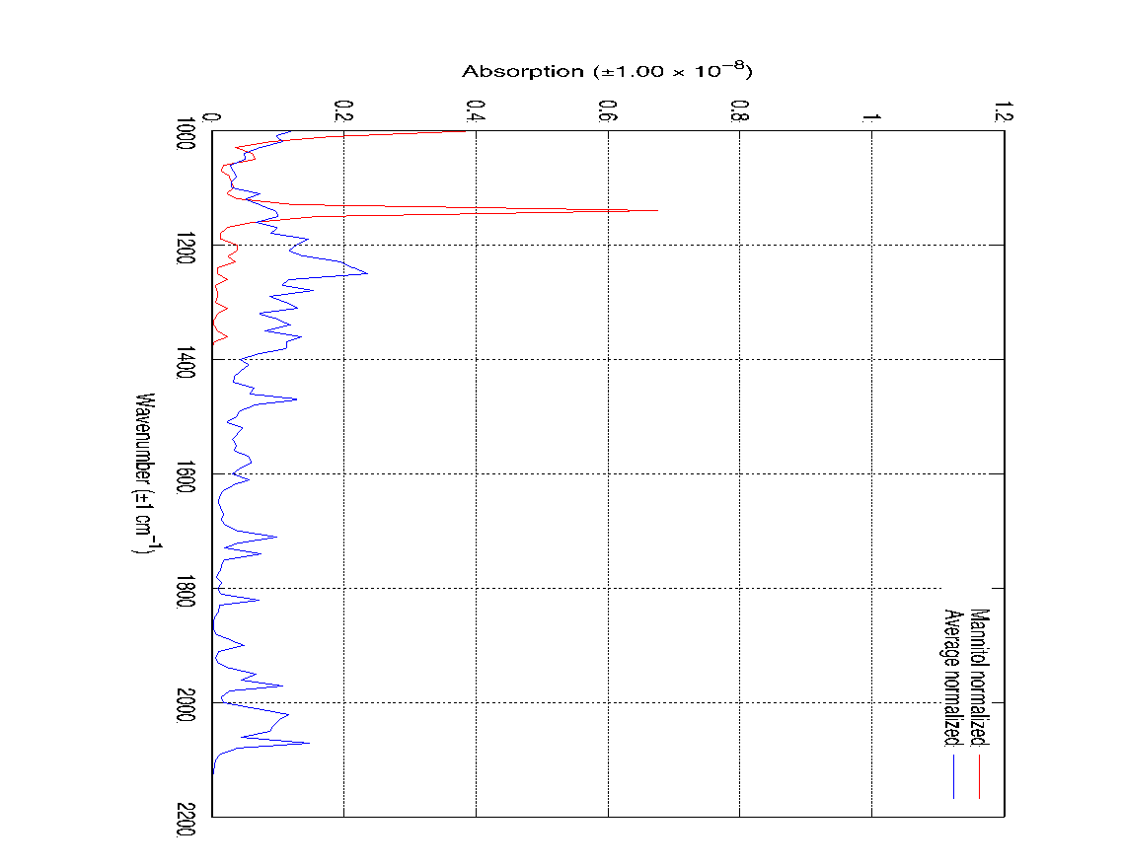
Supplementary Information
Figure S8: Infrared spectrum of mannitol and the average infrared spectrum of all the sweeteners from 1000 cm⁻¹ - 2200 cm⁻¹ in gas phase at standard conditions.

Slide 31
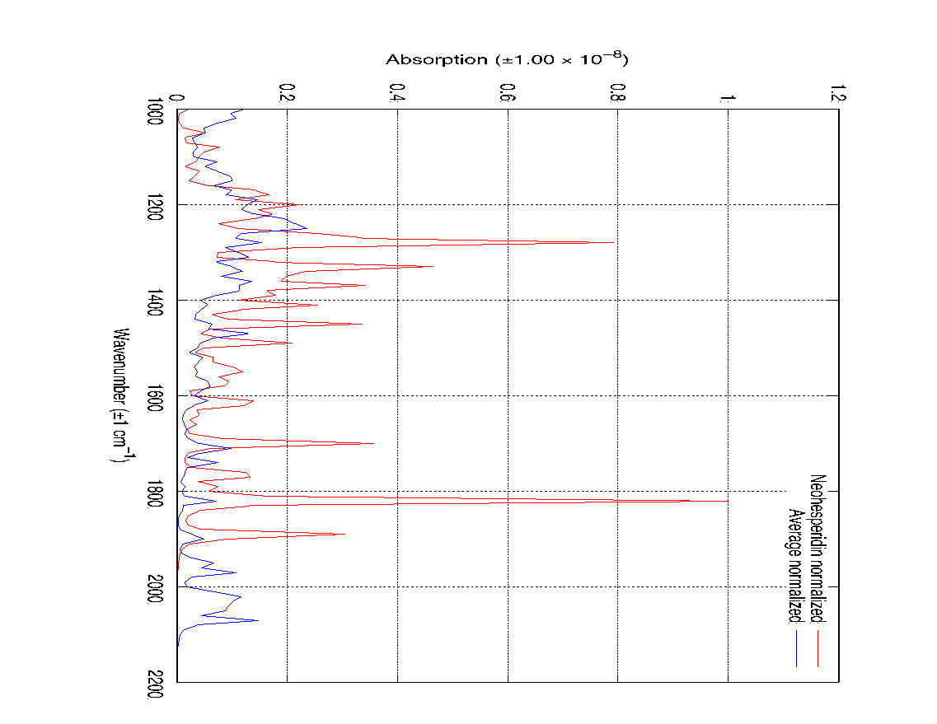
Supplementary Information
Figure S9: Infrared spectrum of neohesperidin and the average infrared spectrum of all the sweeteners from 1000 cm⁻¹ - 2200 cm⁻¹ in gas phase at standard conditions.

Slide 32
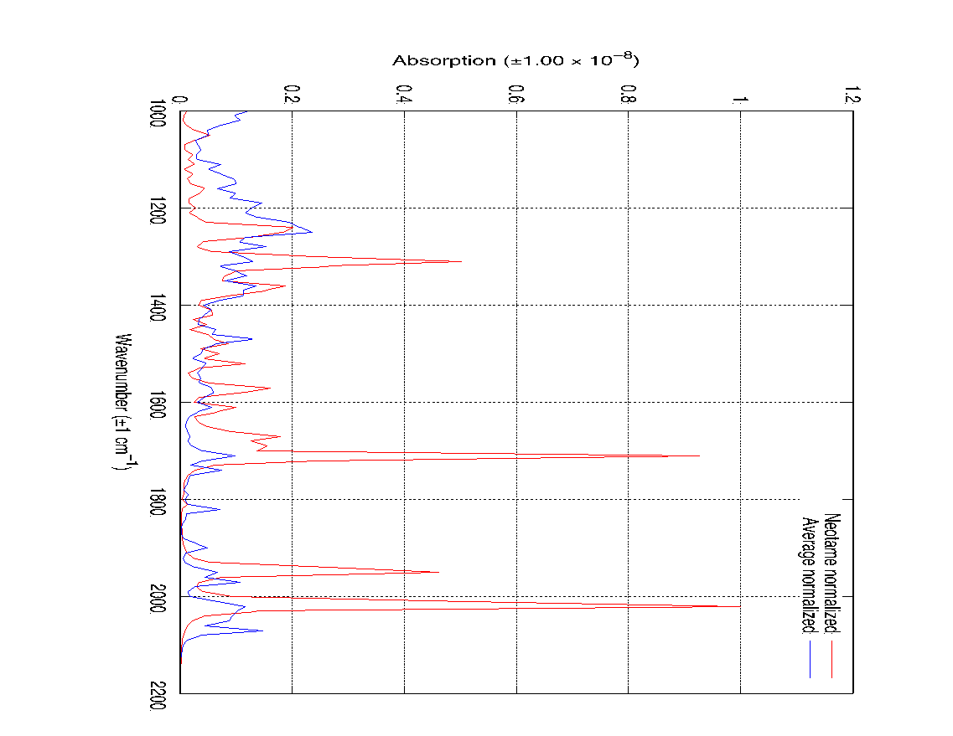
Supplementary Information
Figure S10: Infrared spectrum of neotame and the average infrared spectrum of all the sweeteners from 1000 cm⁻¹ - 2200 cm⁻¹ in gas phase at standard conditions.

Slide 33
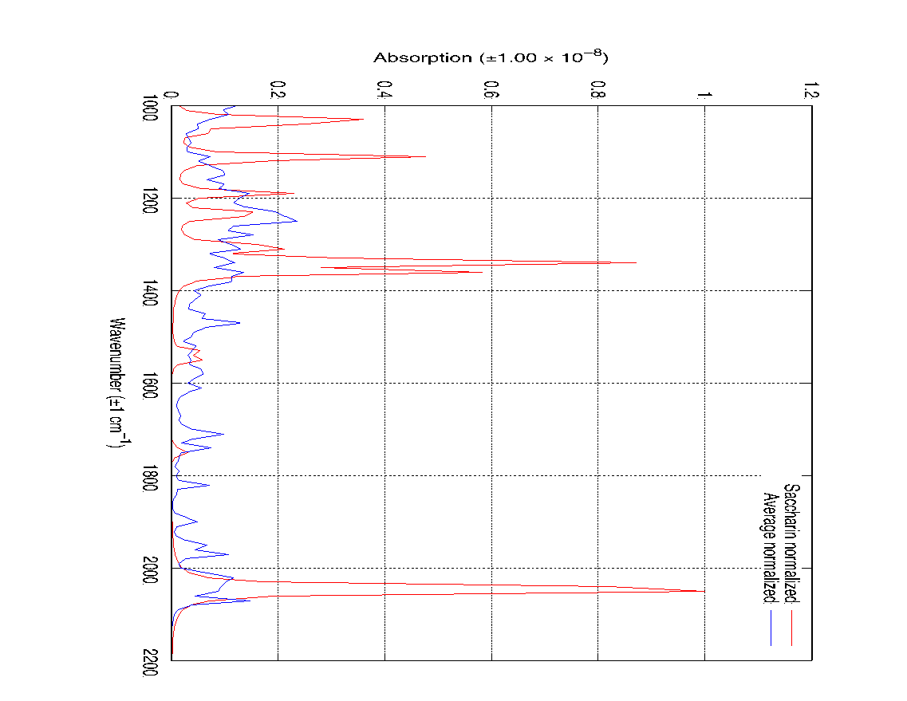
Supplementary Information
Figure S11: Infrared spectrum of saccharin and the average infrared spectrum of all the sweeteners from 1000 cm⁻¹ - 2200 cm⁻¹ in gas phase at standard conditions.

Slide 34
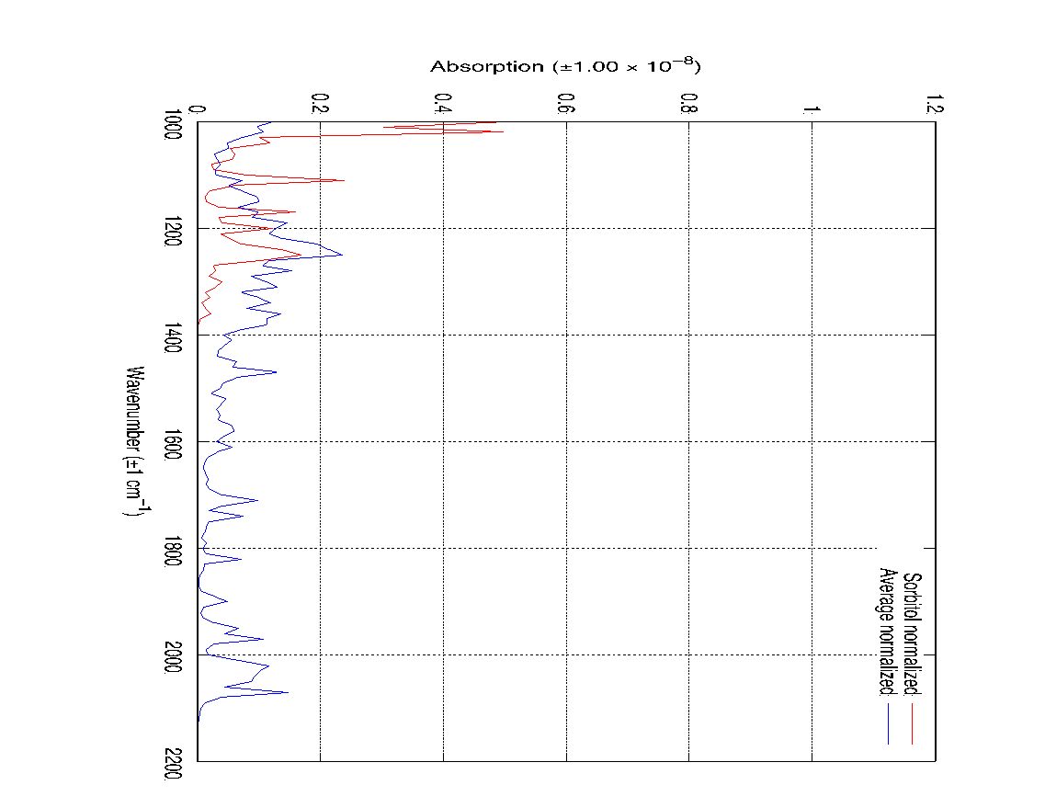
Supplementary Information
Figure S12: Infrared spectrum of sorbitol and the average infrared spectrum of all the sweeteners from 1000 cm⁻¹ - 2200 cm⁻¹ in gas phase at standard conditions.

Slide 35
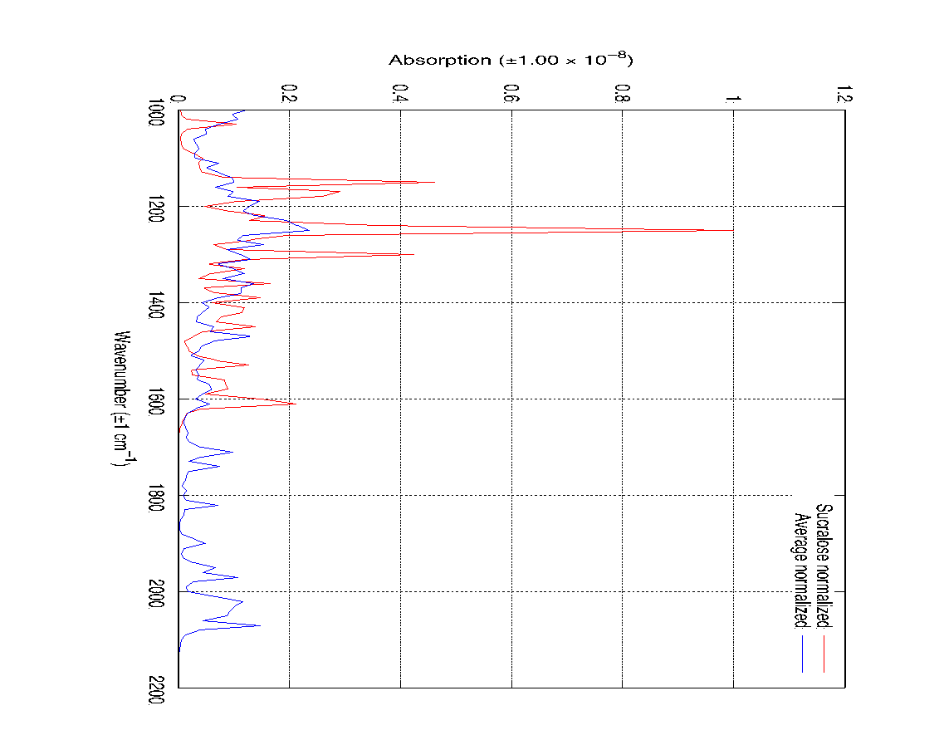
Supplementary Information
Figure S13: Infrared spectrum of sucralose and the average infrared spectrum of all the sweeteners from 1000 cm⁻¹ - 2200 cm⁻¹ in gas phase at standard conditions.

Slide 36
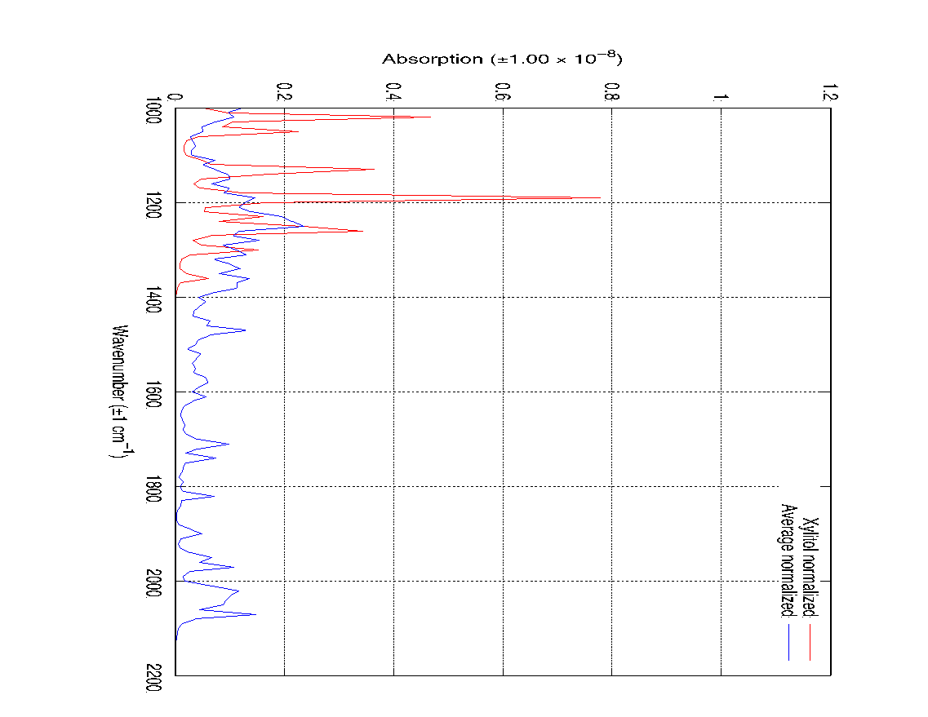
Supplementary Information
Figure S14: Infrared spectrum of xylitol and the average infrared spectrum of all the sweeteners from 1000 cm⁻¹ - 2200 cm⁻¹ in gas phase at standard conditions.

Slide 37
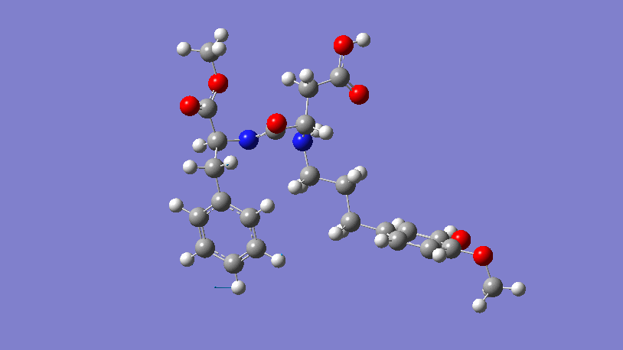
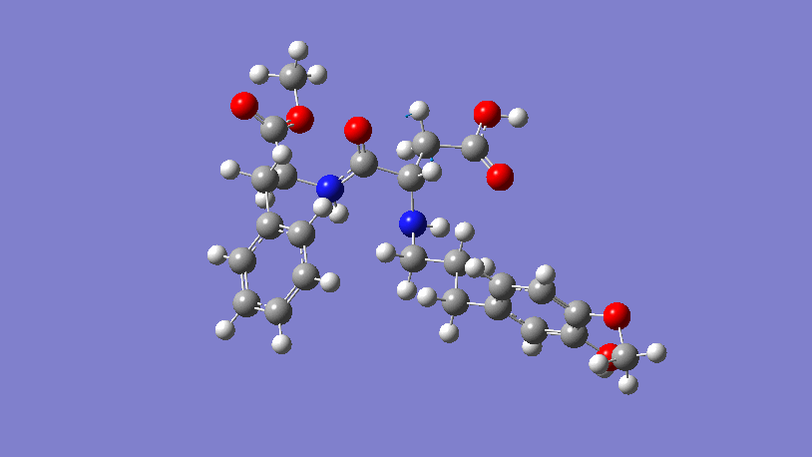
Supplementary Information
Figure S15: Animated bond vibrations of advantame at 1230 cm⁻¹ generated and viewed using GaussView6.
Figure S16: Animated bond vibrations of advantame at 1380 cm⁻¹ generated and viewed using GaussView6.

Slide 38
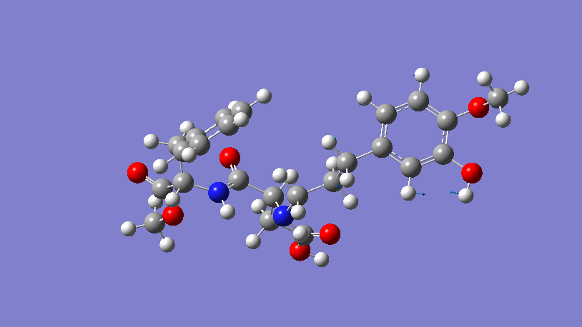
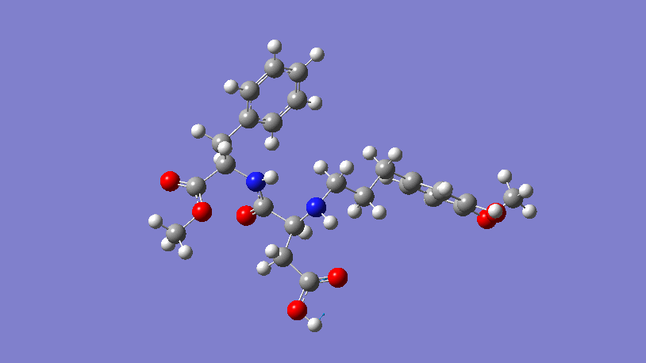
Supplementary Information
Figure S17: Animated bond vibrations of advantame at 1470 cm⁻¹ generated and viewed using GaussView6.
Figure S18: Animated bond vibrations of advantame at 2070 cm⁻¹ generated and viewed using GaussView6.

Slide 39
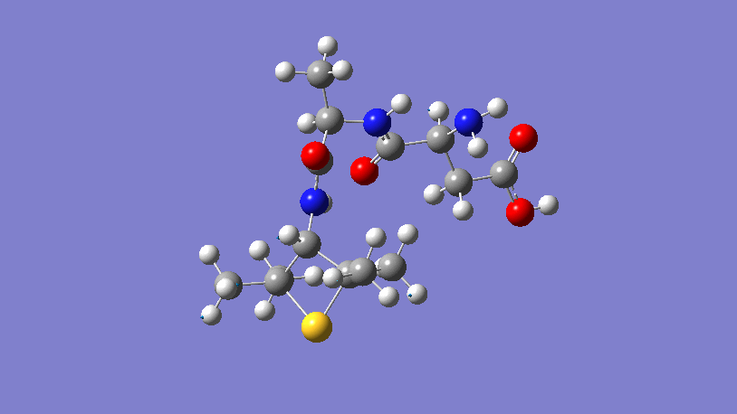
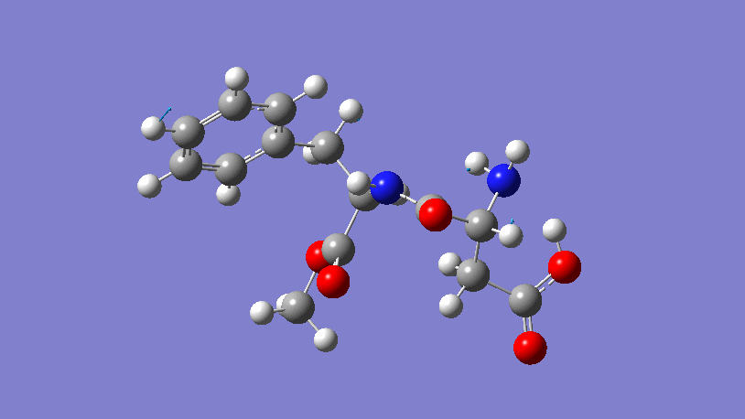
Supplementary Information
Figure S19: Animated bond vibrations of alitame at 1360 cm⁻¹ generated and viewed using GaussView6.
Figure S20: Animated bond vibrations of aspartame at 1230 cm⁻¹ generated and viewed using GaussView6.

Slide 40
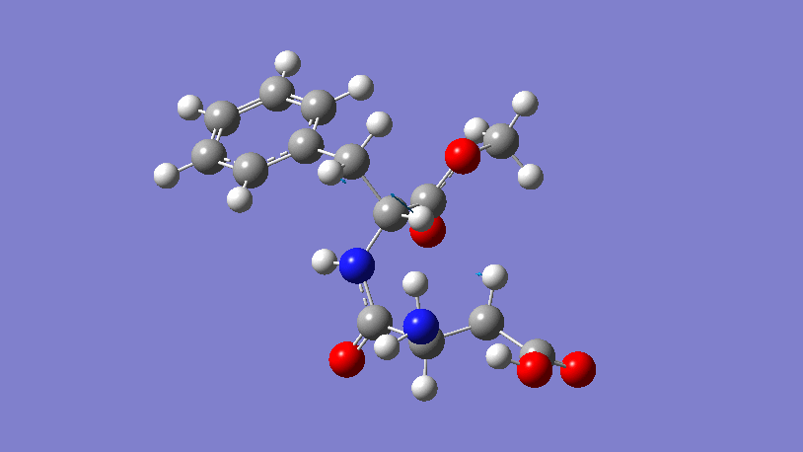
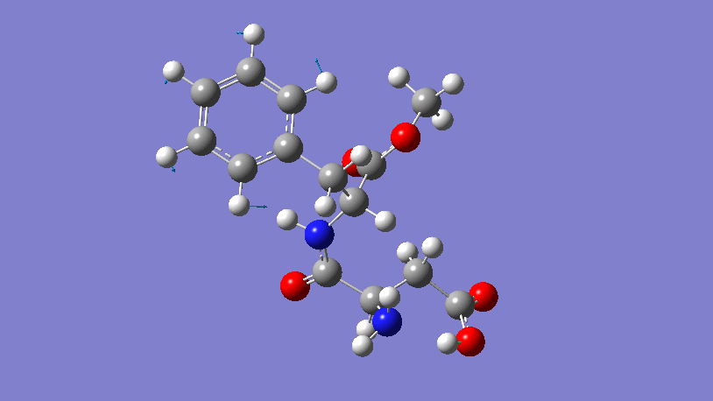
Supplementary Information
Figure S21: Animated bond vibrations of aspartame at 1380 cm⁻¹ generated and viewed using GaussView6.
Figure S22: Animated bond vibrations of aspartame at 1470 cm⁻¹ generated and viewed using GaussView6.

Slide 41
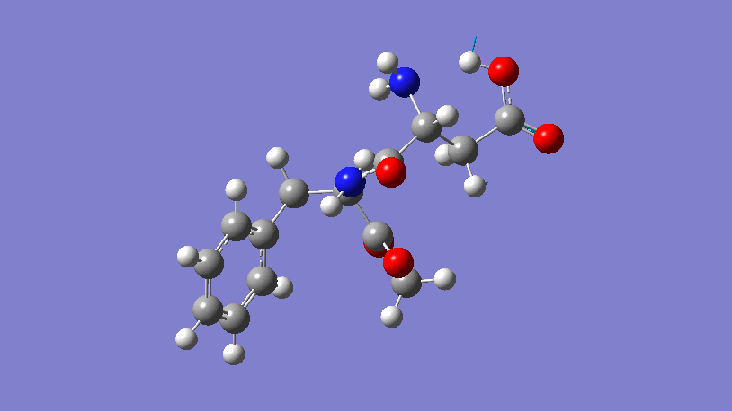
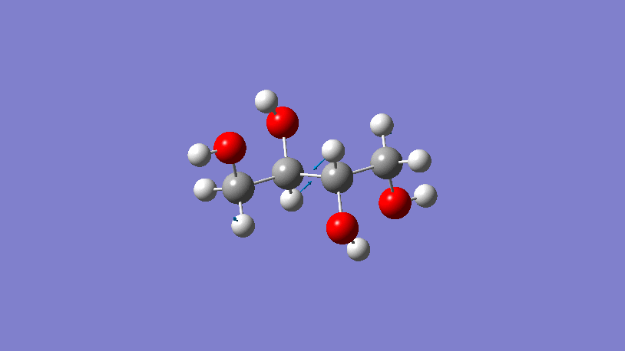
Supplementary Information
Figure S23: Animated bond vibrations of aspartame at 2070 cm⁻¹ generated and viewed using GaussView6.
Figure S24: Animated bond vibrations of erythritol at 1240 cm⁻¹ generated and viewed using GaussView6.

Slide 42
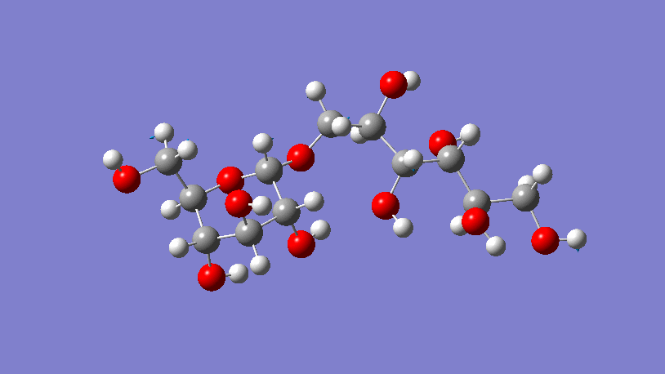
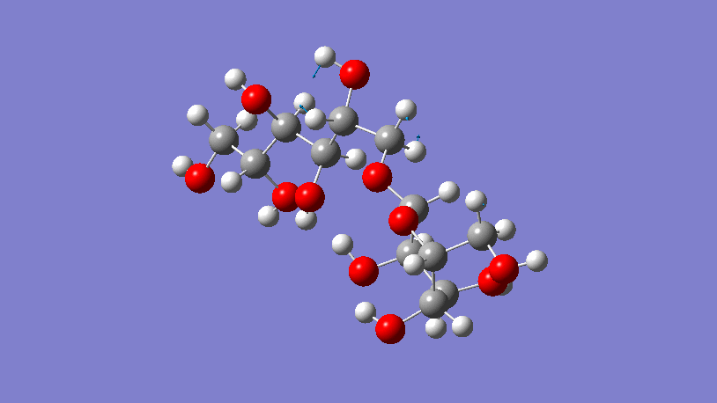
Supplementary Information
Figure S25: Animated bond vibrations of isomalt at 1280 cm⁻¹ generated and viewed using GaussView6.
Figure S26: Animated bond vibrations of isomalt at 1370 cm⁻¹ generated and viewed using GaussView6.

Slide 43
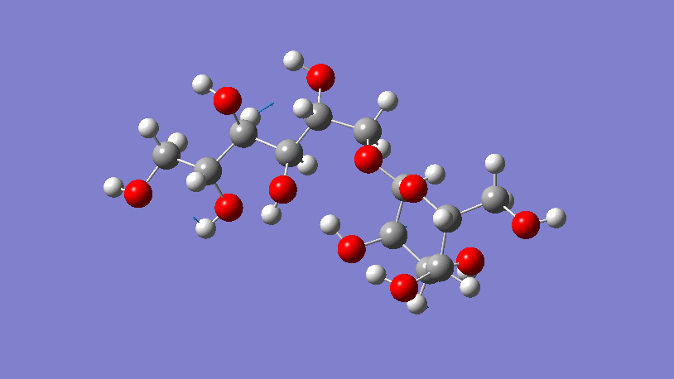
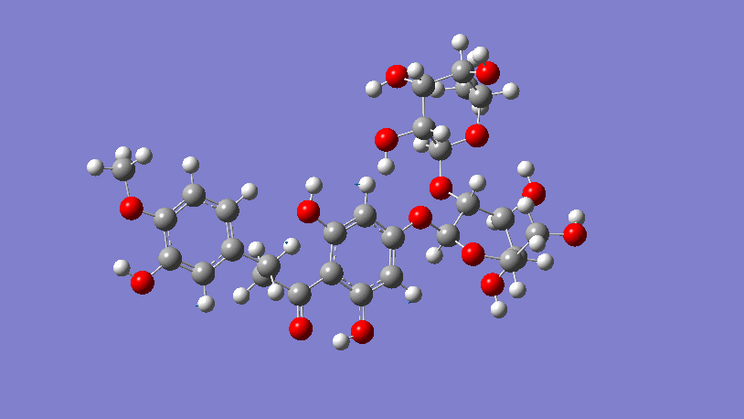
Supplementary Information
Figure S27: Animated bond vibrations of isomalt at 1460 cm⁻¹ generated and viewed using GaussView6.
Figure S28: Animated bond vibrations of neohesperidin at 1280 cm⁻¹ generated and viewed using GaussView6.

Slide 44
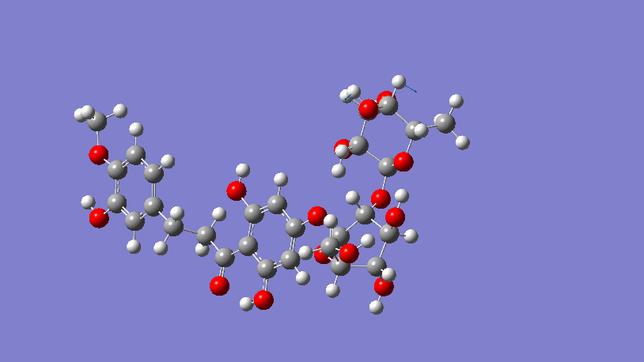
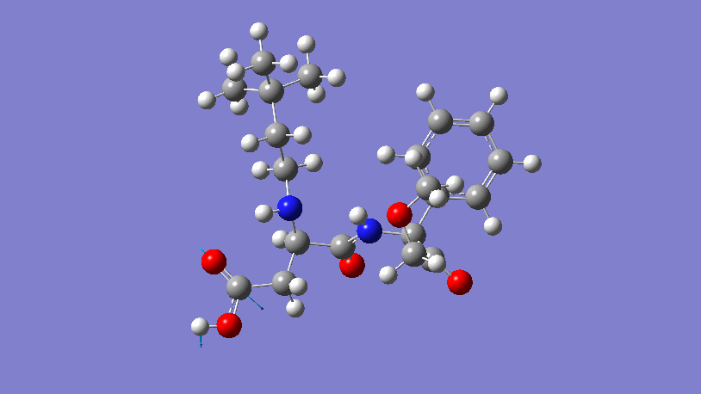
Supplementary Information
Figure S29: Animated bond vibrations of neohesperidin at 1370 cm⁻¹ generated and viewed using GaussView6.
Figure S30: Animated bond vibrations of neotame at 2020 cm⁻¹ generated and viewed using GaussView6.

Slide 45
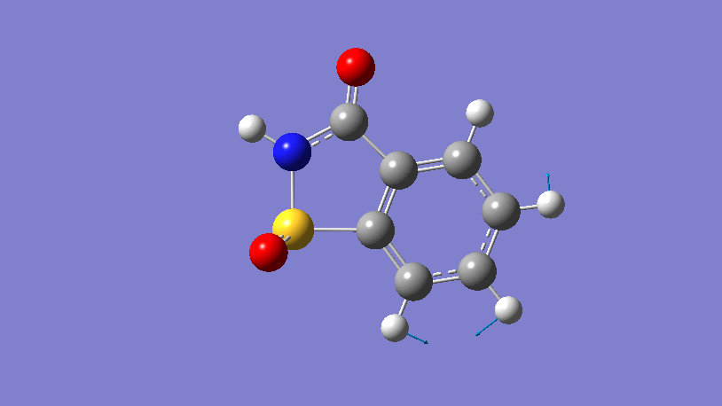

Supplementary Information
Figure S31: Animated bond vibrations of saccharin at 1350 cm⁻¹ generated and viewed using GaussView6.
Figure S32: Animated bond vibrations of saccharin at 2050 cm⁻¹ generated and viewed using GaussView6.

Slide 46
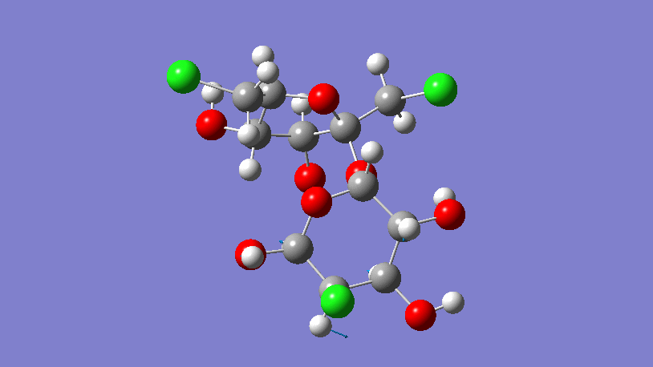
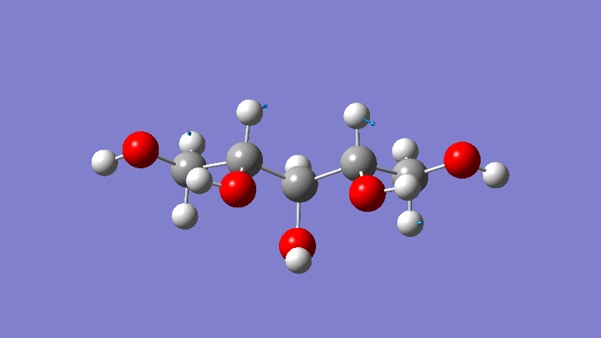
Supplementary Information
Figure S33: Animated bond vibrations of sucralose at 1250 cm⁻¹ generated and viewed using GaussView6.
Figure S34: Animated bond vibrations of xylitol at 1260 cm⁻¹ generated and viewed using GaussView6.

Slide 47
Supplementary Information
 | Identified modes
2070 | 2x C-C=O asymmetrical stretch 1x O-C=O asymmetrical stretch 1x C-O-H scissoring 1x C-C-O scissoring
1470 | 6x H-C-H wagging 2x H-C-H twisting 1x H-O-C scissor
1230 | 3x H-C=C scissor 3x H-C-C scissor 1x C=C-H rocking 3x C-C-H rocking 1x C-C-C asymmetric stretch 1x H-C-H rocking 1x H-N-C rocking
1380 | 7x H-C-H twisting 1x C-N-H rocking 1x C-C-C asymmetric stretch
Table S1: Identified modes for advantame

Slide 48
Supplementary Information
 | Identified modes
1360 | 2x C-C-C scissoring 5x C-C-C asymmetric stretching 1x C-S-C rocking 1x C-N-H scissoring 1x H-C-C scissoring
Table S2: Identified modes for alitame

Slide 49
Supplementary Information
 | Identified modes
2070 | 1x O-C-C scissoring 1x H-O-C scissoring 1x H-C-C scissoring 1x O=C-O asymmetrical stretch 1x C-C=O asymmetrical stretch
1470 | 7x H-C-C scissoring 6x H-C=C scissoring 2x C-C-C scissoring 1x H-C-H twisting
1230 | 2x C=C-H scissoring 2x H-N-C scissoring 1x C-C-N scissoring 1x C-C-C scissoring 2x C=C=C asymmetrical stretch 2x C=C-C asymmetrical stretch 1x C-C-C asymmetrical stretch 1x N-C-C asymmetrical stretch 1x N-C-H symmetrical stretch 1x H-C-H twisting
1380 | 5x H-C-C scissoring 1x C-N-C scissoring 1x O=C-O scissoring 1x N-C-C asymmetrical stretch 1x H-N-H twisting 1x H-C-H wagging
Table S3: Identified modes for aspartame

Slide 50
Supplementary Information
 | Identified modes
1240 | 2x O-C-C scissoring 1x H-O-C scissoring 3x H-C-O scissoring 6x H-C-C scissoring 2x C-C-C asymmetrical stretch 4x O-C-C asymmetrical stretch 2x H-C-C asymmetrical stretch
Table S4: Identified modes for erythritol

Slide 51
Supplementary Information
 | Identified modes
1280 | 3x C-C-C scissoring 3x C-O-H scissoring 2x O-C-C scissoring 1x H-C-C scissoring 2x O-C-C asymmetrical stretch 2x C-O-C asymmetrical stretch 1x O-C-O asymmetrical stretch 2x C-C-H asymmetrical stretch 2x H-C-H twisting 1x C-C-H rocking 1x H-C-H rocking
1370 | 3x H-C-C scissoring 2x H-O-C scissoring 4x H-C-O scissoring 2x H-C-H twisting 1x C-O-C asymmetrical stretch
1460 | 5x H-C-C scissoring 4x H-O-C scissoring 1x H-C-O scissoring 1x H-C-O symmetrical stretch 1x H-C-H twisting 2x H-C-C asymmetrical stretch
Table S5: Identified modes for isomalt

Slide 52
Supplementary Information
 | Identified modes
2020 | 2x H-C-C scissoring 1x O-C-C scissoring 1x H-O-C scissoring 1x O-C=O asymmetrical stretch 1x C-C=O asymmetrical stretch
Table S6: Identified modes for neotame

Slide 53
Supplementary Information
 | Identified modes
1280 | 6x H-C-C scissoring 1x H-O-C scissoring 1x C-C-C scissoring 3x H-C-C rocking 2x H-C=C rocking 1x C-C-C rocking 1x H-C-H twisting 1x C-C-O symmetrical stretch 2x C-O-C asymmetrical stretch 1x O-C-C asymmetrical stretch
1370 | 1x H-C-C scissoring 2x H-O-C scissoring 1x H-C-O scissoring 1x C-C-C scissoring 1x C-C-O scissoring 1x O-C-O symmetrical stretching
Table S7: Identified modes for neohesperidin

Slide 54
Supplementary Information
 | Identified modes
2050 | 1x H-N-C scissoring 1x N-C-C scissoring 1x C-C=O asymmetrical stretch 1x N-C=O asymmetrical stretch
1350 | 2x C=C-H rocking 4x C-C-H rocking 1x C=C=C asymmetrical stretch 2x C=C-C asymmetrical stretch 1x C-C-C asymmetrical stretch 1x N-C-C asymmetrical stretch 1x C-C=C symmetrical stretch
Table S8: Identified modes for saccharin

Slide 55
Supplementary Information
 | Identified modes
1250 | 1x H-C-C scissoring 2x H-C-O scissoring 2x C-C-C scissoring 2x H-C-H twisting 1x H-C-C rocking 1x C-C-C rocking 1x C-C-O asymmetrical stretch 1x O-C-O asymmetrical stretch 1x C-O-C asymmetrical stretch
Table S9: Identified modes for sucralose

Slide 56
Supplementary Information
 | Identified modes
1260 | 2x H-C-C scissoring 6x H-C-O scissoring 2x H-C-H rocking 1x C-C-C symmetrical stretch 1x C-C-C asymmetrical stretch 4x C-C-O asymmetrical stretch
Table S10: Identified modes for xylitol

