Slide 1
Are Masks Really Protecting You
Tori Pike and Cassie Stagg
Grade 12
Holy Trinity High

Slide 2
Purpose: Testing the use or absence of masks at different distances against projectile aerosols.
Question: Which masks, if any, are best at protecting yourself and others from aerosols.
Hypothesis: The cloth masks at a distance of six feet will produce the least amount of bacteria in the petri dish. In comparison, no mask at one foot will produce the most bacteria.

Slide 3
Independent Variable
Dependent Variable
Controls
Type of mask/lack of mask
Bacterial growth
Distance of projectile aerosols
The same type f petri dish
The same location of experiment
The same ventilation in the area
Petri dishes in the same location
Petri dishes receive the same amount of light and constant temperature
The same force of the cough
Same medical and cloth mask for each distance
Observed and recorded at the same time

Slide 4

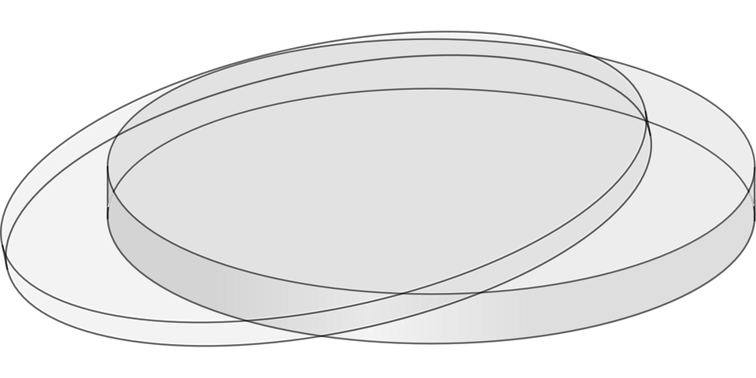
Materials
Petri Dishes (seven)
Medical grade mask
Cloth mask
Sterile gloves
Sanitized area with low ventilation

Slide 5
Procedure
Locate a sanitized area with low ventilation
Put on sterile gloves
Set a petri dish up vertically
Measure one foot away from the dish
Cough directly at the dish with no mask, then repeat with a medical grade mask then a cloth mask
Immediately cover dishes after cough
Repeat these steps measuring 6 feet away from the petri dish
Place all dishes in the incubating area including the control which has not been coughed on
168 hours later open incubator and record findings

Slide 6
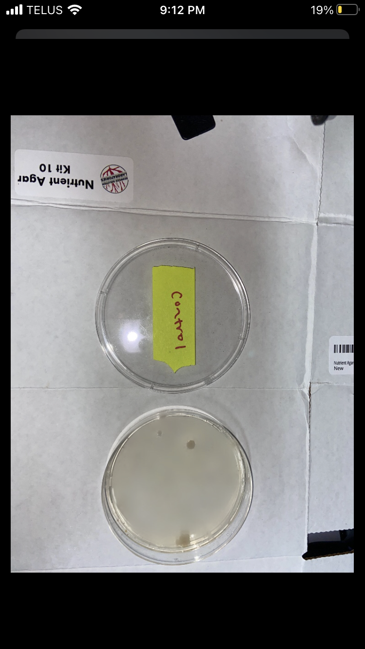
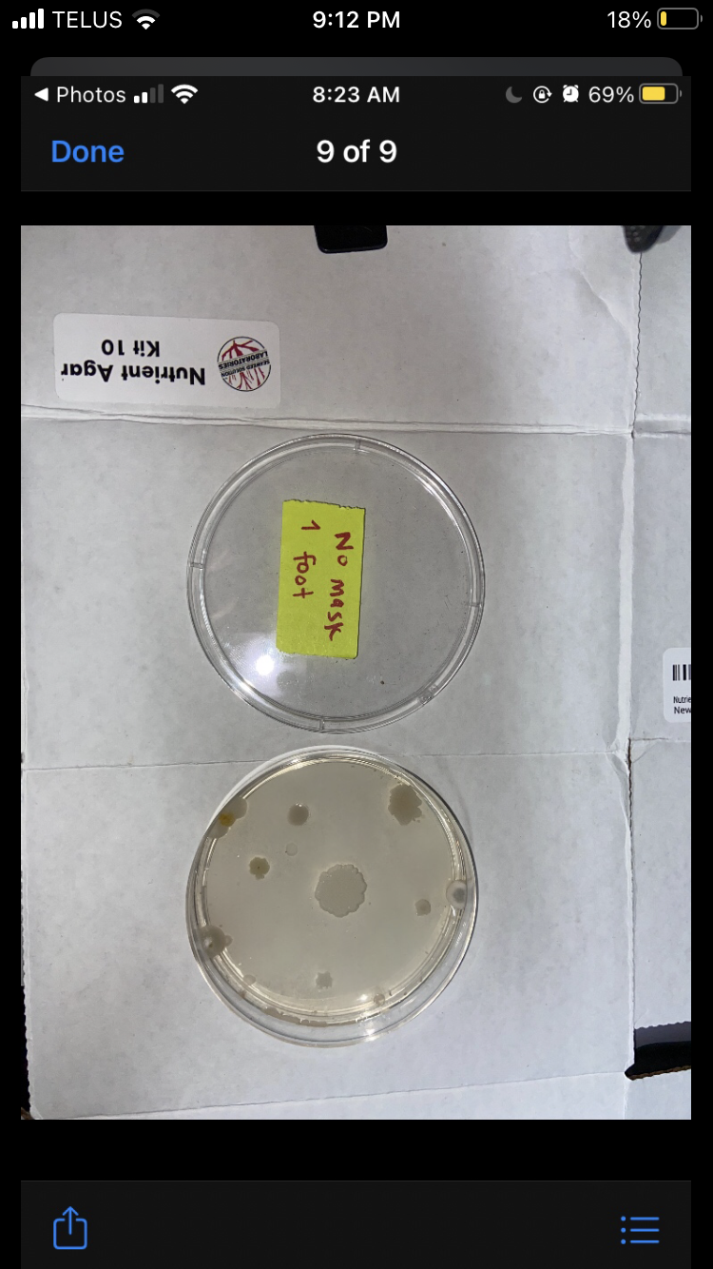
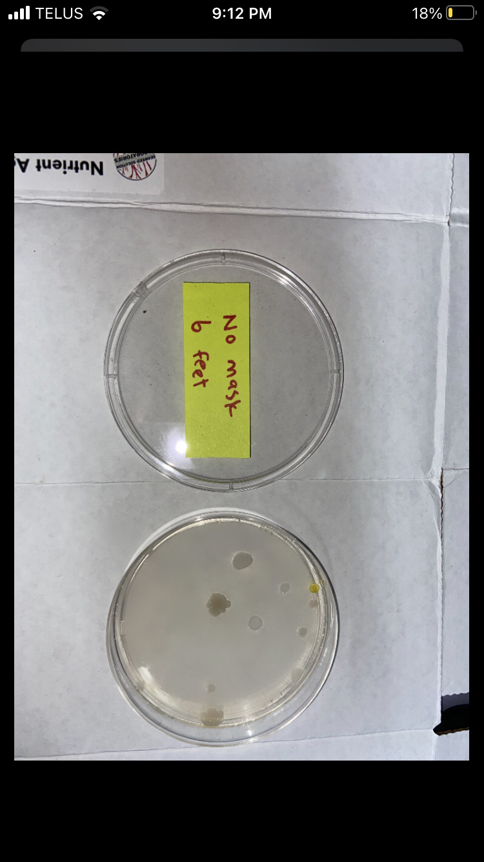
Control
No masks

Slide 7
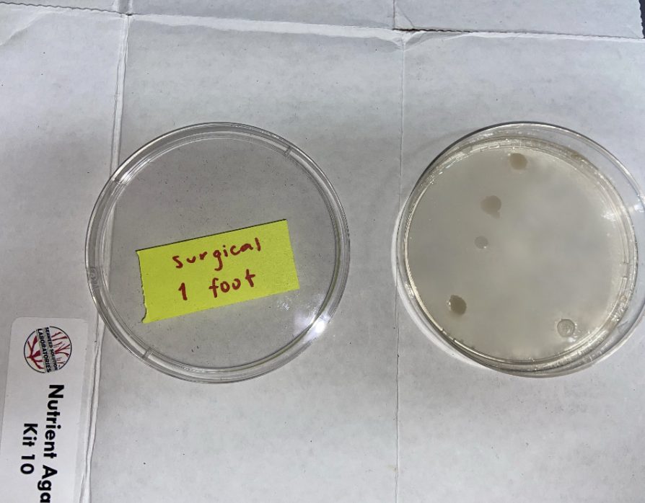
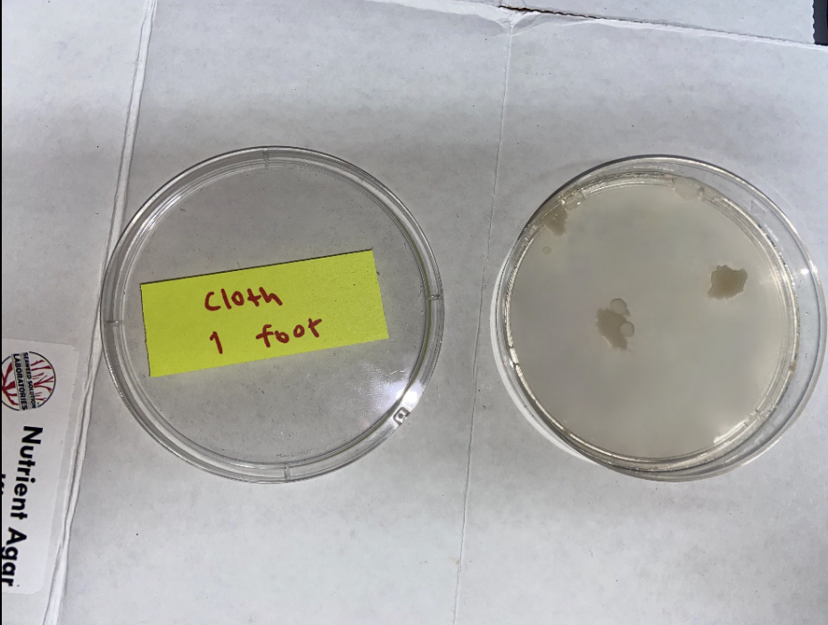
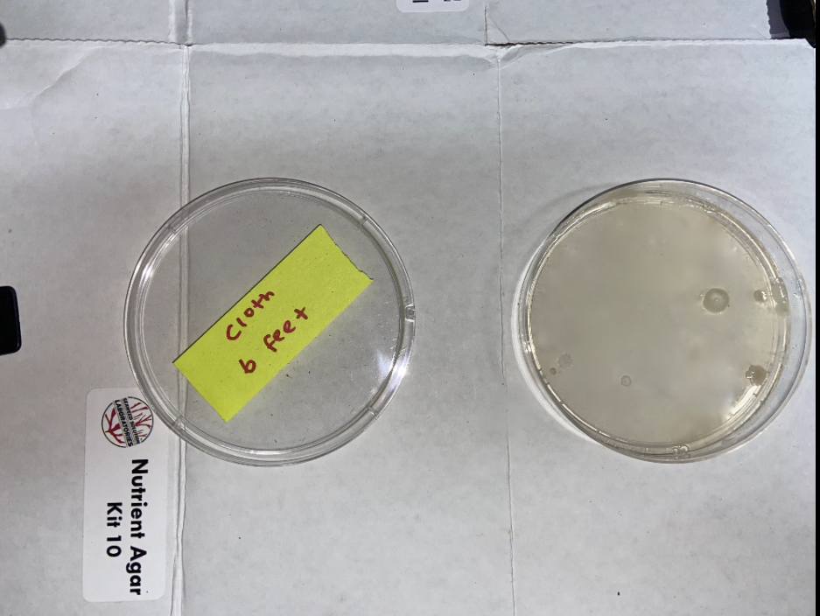
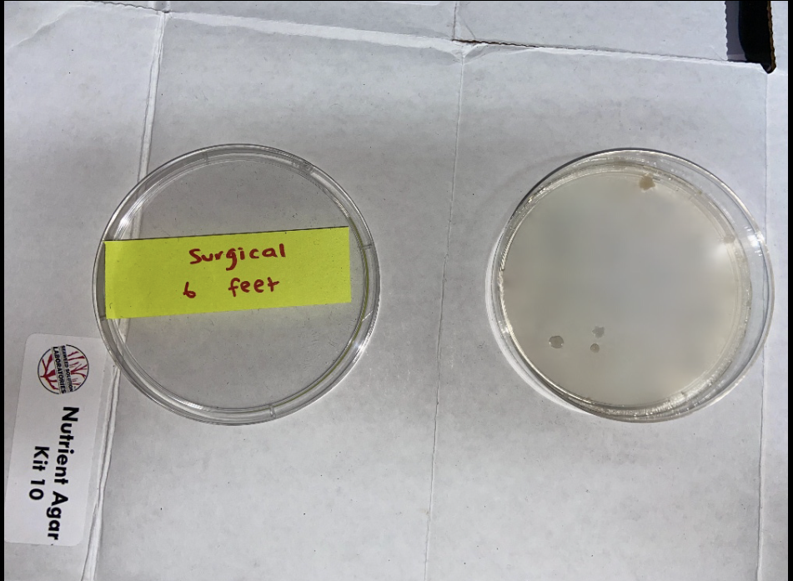
Surgical masks
Cloth masks

Slide 8
Results:
No Mask | Spore Amount | Zeroed out Spore Amount | Average | Standard Deviation
1 foot | 13 | 10 | 8.5 | 2.121320344
6 feet | 10 | 7
Surgical Mask | Spore Amount
1 foot | 6 | 3 | 4.5 | 2.121320344
6 feet | 4 | 1
Cloth Mask | Spore Amount
1 foot | 8 | 5 | 4.5 | 0.7071067812
6 feet | 7 | 4
Control | 3 | 0

Slide 9
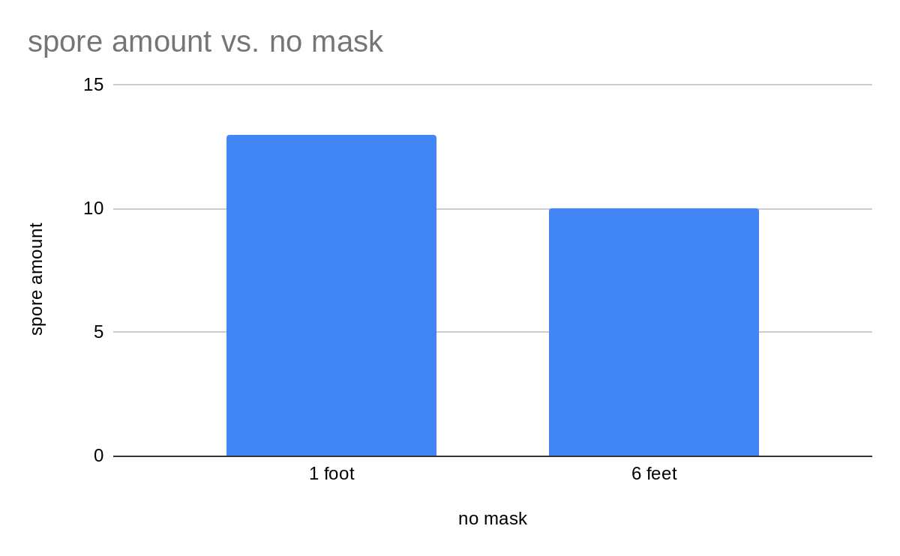
Results (continued) :

Slide 10
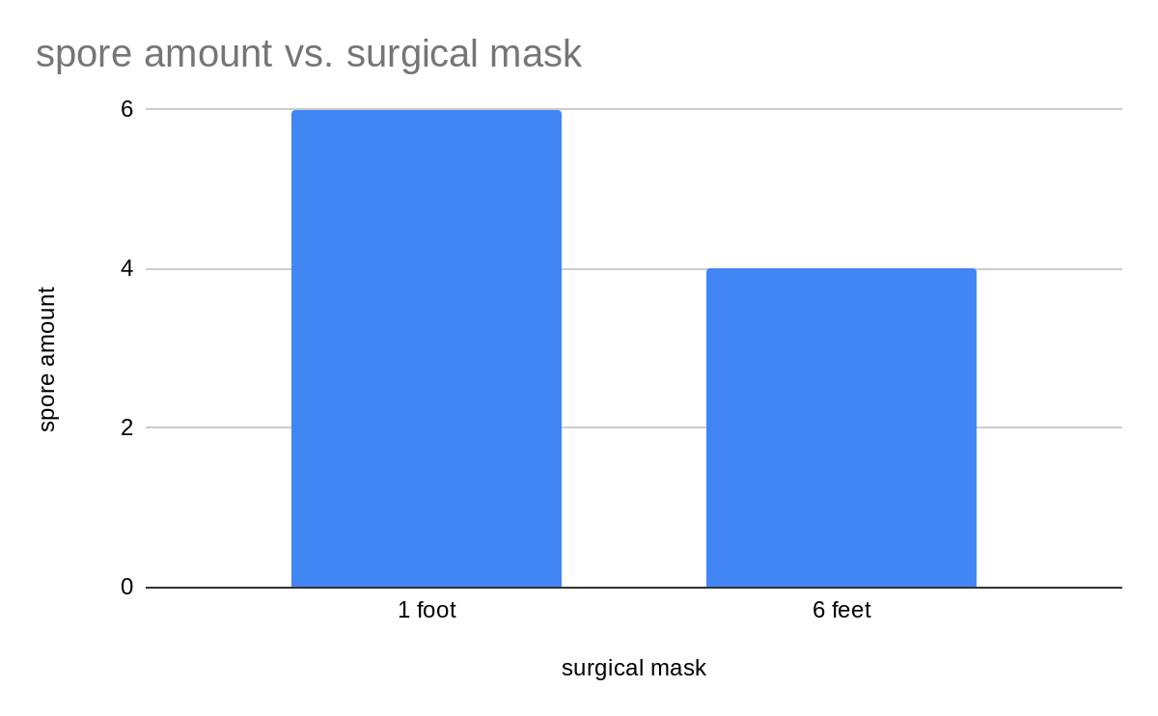
Results (continued) :

Slide 11
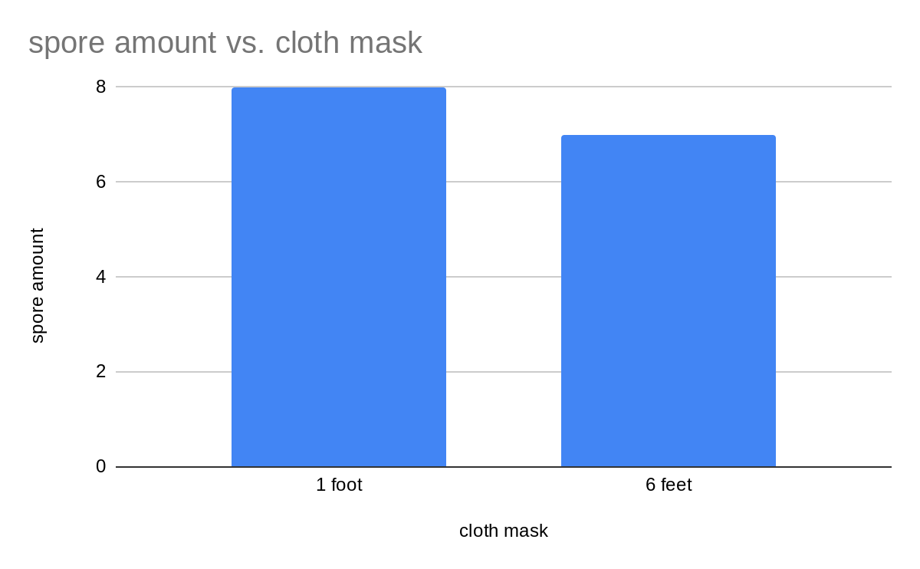
Results (continued) :

Slide 12
Discussion
In each experiment the 6 foot results had less spores than the one foot results, this indicates that standing 6 feet away is effective in decreasing the risk of bacteria spreading between people. Overall the experiments with no mask had more spores than surgical or cloth masks, this proves that masks work in stopping bacteria transferring. Out of the two mask experiments the surgical mask performed better than the cloth masks with a lower spore count than cloth at both 1 and 6 feet. The hypothesis was incorrect in thinking that the cloth masks from 6 feet would produce the least amount of spores. In reality the results show that the surgical masks from 6 feet produced the least spores, only producing 1 while the cloth masks produced 4.

Slide 13
Discussion (continued) :
If the experiment were to be redone there would have to be a more sterile environment and be sure the control had zero spores present to make the other samples more accurate. In order to do experiments using agar and petri dishes it has to be extremely sterile and make sure all surroundings and equipment are completely clean which was not successful in this experiment. Another question that came up during the experiment was if both people were wearing masks would the bacteria amount decrease. The experiment replicated only the person expelling bacteria wearing a mask. Potentially if both people had masks on, the amount of spores would decrease immensely. This question could inspire a whole new experiment to be tested.

Slide 14
Sources of Error :
The results of the experiment were not what was expected. This could be the result of random error, caused by human mistake, as the control was not sterile and had three spores present which could distort the results for the rest of the samples. To combat this the control could be zeroed out by subtracting three from the total spore number in each to get a more accurate result. The petri dishes were not airtight which could have led to other bacteria contaminating the samples over the course of the week the bacteria grew, this is a systematic error that could not be avoided. The frequency or strength of an individual's cough could be inaccurate representing random error.

Slide 15
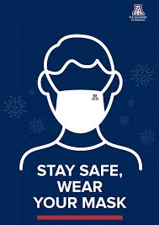
Conclusion
To answer our question, masks work in protecting yourself and others from bacteria in the air. Although our hypothesis was incorrect it still proves that masks work.

Slide 16
Acknowledgements
We would like to thank Ms. Kavanagh for helping us with this project and teaching us how to create charts and graphs using our data.

Slide 17
References
CLOTH MASK VS. SURGICAL MASK: THE SURPRISING COVID-19 WINNER Health News Hub (2020, May 7th) retrieved October 29th 2020 https://healthnewshub.org/cloth-mask-vs-surgical-mask-vs-n95-how-effective-is-each/
Centers for Disease Control and Prevention. CDC twenty four seven. Saving Lives, Protecting People (2020, July 15th) retrieved october 29th 2020
https://www.cdc.gov/coronavirus/2019-ncov/prevent-getting-sick/social-distancing.html

